Slide 1
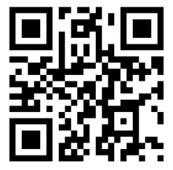



The Next Generation of Library Orientation.
Discussion on the application of
Virtual and Immersive Reality, 360 Degree Movies ,etc.
https://www.slideshare.net/aidemoreto/vr-library
short link: https://tinyurl.com/MNsummit2017
Minnesota eLearning Summit
Normandale Community College
August 2−3, 2017
Bloomington, Minnesota
#mnsummit2017 #vrlib
Dr. Plamen Miltenoff & Dr. Mark Gill

Slide 2
Contact info and take outs from today’s session
Plamen Miltenoff, Ph.D., Professor, pmiltenoff@stcloudstate.edu
Mark Gill, Ph.D., Director Visualization Lab mcgill@stcloudstate.edu
learn about the opportunities offered by each of these technologies: VR reality, Augmented reality and 360 media
learn to operate the various forms of these technologies
contemplate, discuss and propose new applications of these technologies in library and academic settings

Slide 3
Plan
Intro to the idea of VR/360 media and gamification in the library
  VR / Video 360 for library orientation
  Gamification for library instruction
Video 360 Library Orientation – case study
VR / Video 360 – how to
Video 360 Library Orientation – survey results
Gamification for Library Instruction – case study

Slide 4
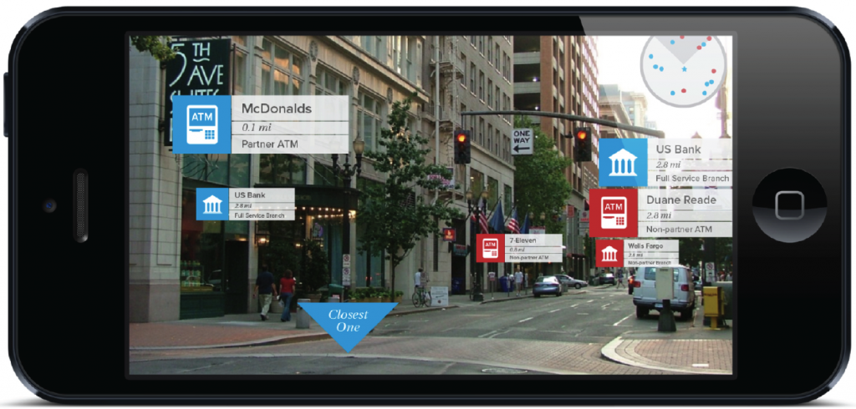
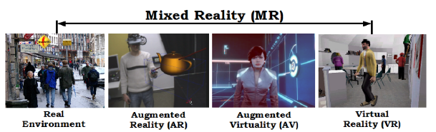
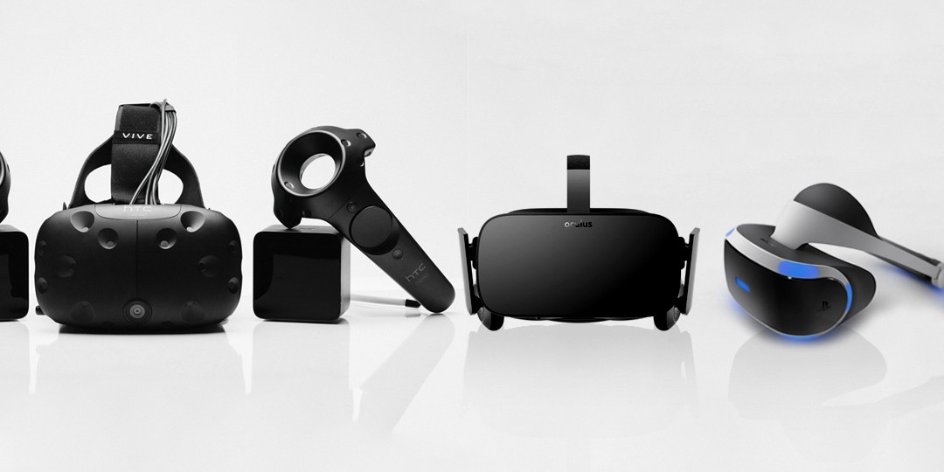
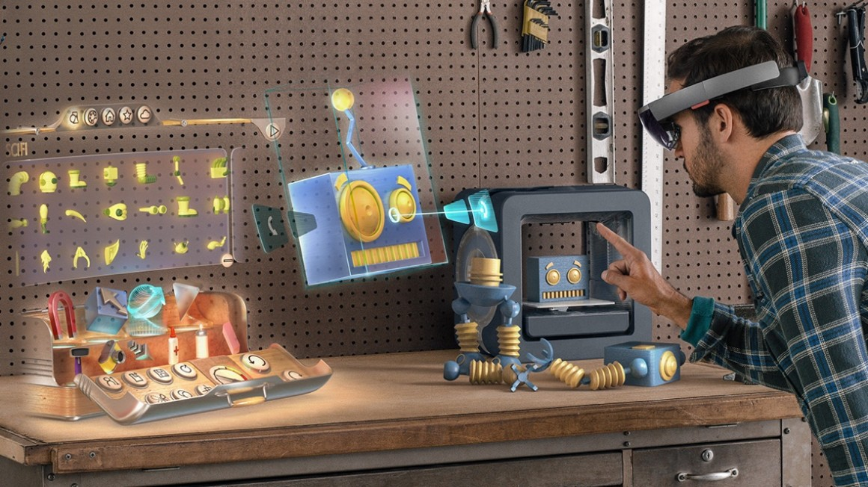
11 Ed Tech Trends to Watch in 2017 http://pdf.101com.com/CampusTech/2017/701921020/CAM_1702DG.pdf
15 Tech Tool Favorites From ISTE 2016 https://ww2.kqed.org/mindshift/2016/07/05/15-tech-tool-favorites-from-iste-2016/
new forms of human-computer interaction (HCI) such as augmented reality (AR),virtual reality (VR) and mixed reality (MR)
Extensive costs for VR design and development drive the need for collaborative efforts.
“Whether using AR for a gamified course or to acclimate new students to campus, the trend will continue into 2017”

Slide 5
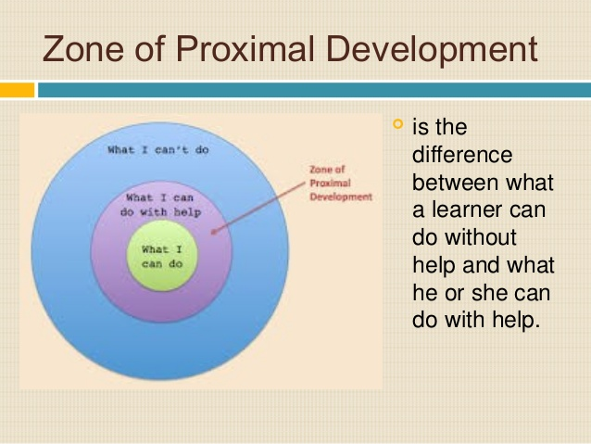
…acclimate new students to campus… http://pdf.101com.com/CampusTech/2017/701921020/CAM_1702DG.pdf
Learn about campus and services
Library Orientation
  Self-paced
  Student-centered
  Project-based
  Peer-supported (Vygotsky)
  Gamified learning

Slide 6
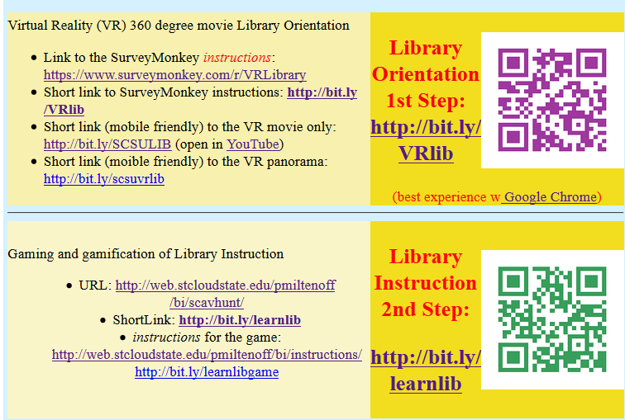
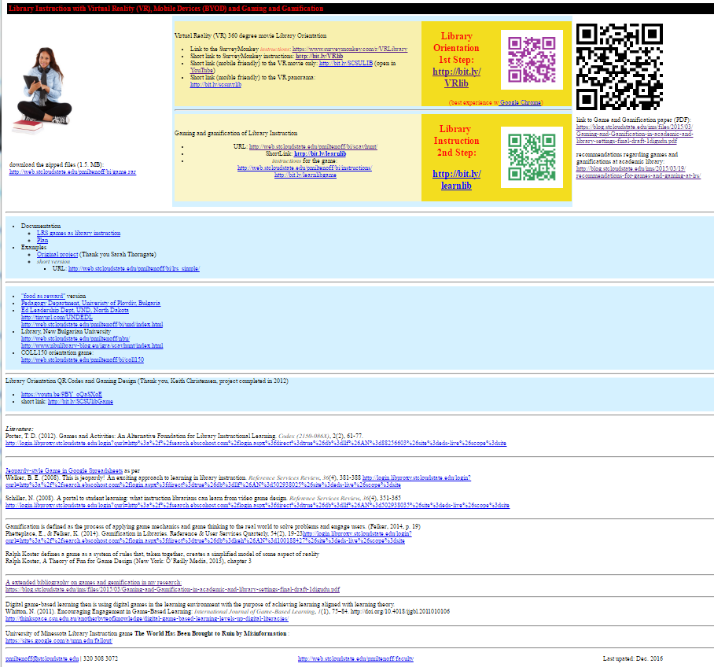
http://web.stcloudstate.edu/pmiltenoff/bi/
http://bit.ly/
VRlib
http://bit.ly/learnlib

Slide 7
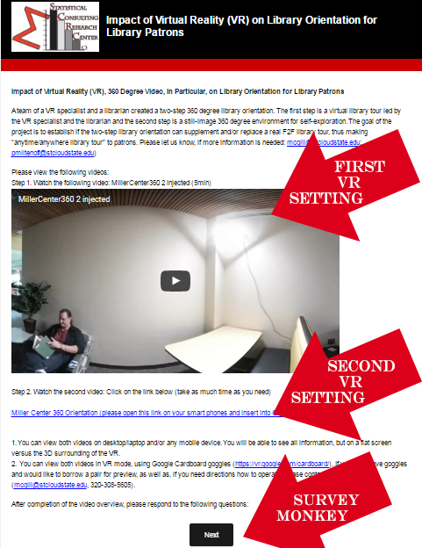
http://bit.ly/VRlib
1st step
two VR settings;
  a movie set (First VR setting)
  and a still-image set (Second VR setting)
Google Cardboard goggles
Large instructor PC’s screen
Students BYODs
SurveyMonkey survey

Slide 8
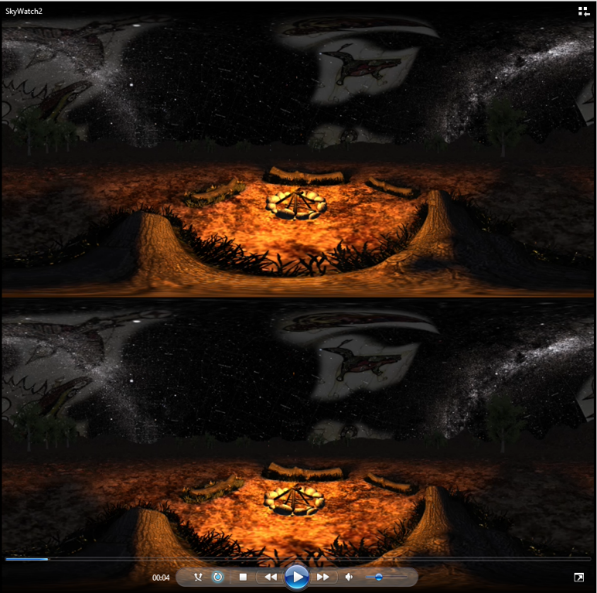
360 Media - Formats
Same file formats as flat media
  (H.264, PNG, JPG)
    Video -- 4K Resolution Limit.
Multiple Cameras capture overlapping spheres
Can then be edited with other tools
  (Photoshop, Premiere, Gimp)
Stereo (3D)
  Rendered with multiple cameras
  Provides a sense of 3D depth
  Each frame is 2 distorted images
  Player splits the frame into separate eyes
  Same resolution limits; lower image quality

Slide 9
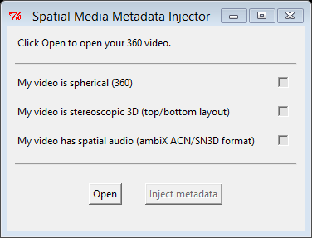
360 Media - Stitching
Images must be corrected to blend hemispheres together
  Samsung Action Director
    Fast, takes up tremendous hard drive space
  On-Camera Processing
    Bluetooth over phone. Samsung phones only.
Metadata in the media informs the player of the frame format
  Some tools (e.g., Adobe)
  will report the frame format
  Tools such as Spatial Media Metadata Injector also will do it.

Slide 10
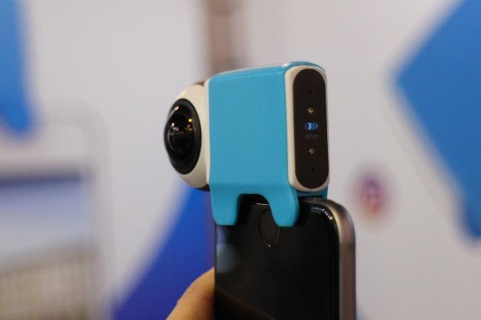
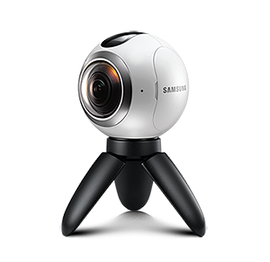
360 Media - Hardware
In the past 6 months a dozen consumer level 360° cameras have come on the market.
Samsung Gear 360 (The one we used)
  Bluetooth control through phone app
  4K Video, 7776x3888 JPG
  Limited use with other phone brands
  Phone app or Action Director used to stitch.
There are many cameras under 1000$
  At this time only the Vuze does Stereo 3D
New Cameras will support one-button posting, and live 360° streaming

Slide 11
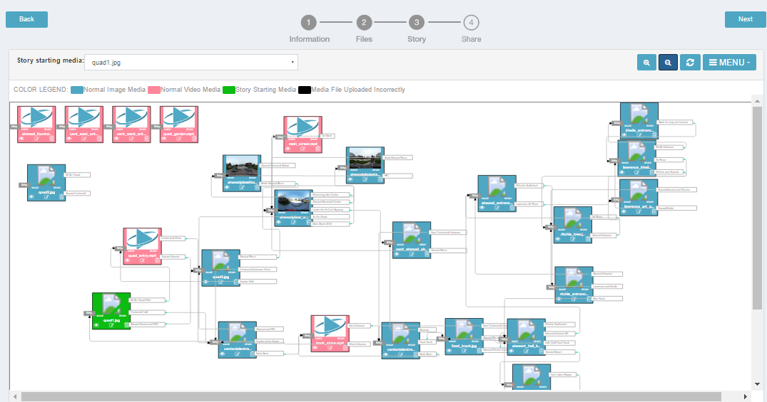
360 Media - Hosting
Youtube, Facebook, Vimeo
  Metadata must be injected into media
  Mono in browser and Stereo in headsets supported
  All provide tools for setup, view analytics.
Viar360.com
  Allows mixed media
  Link different media files into a ‘story’
  Paid subscription service.

Slide 12
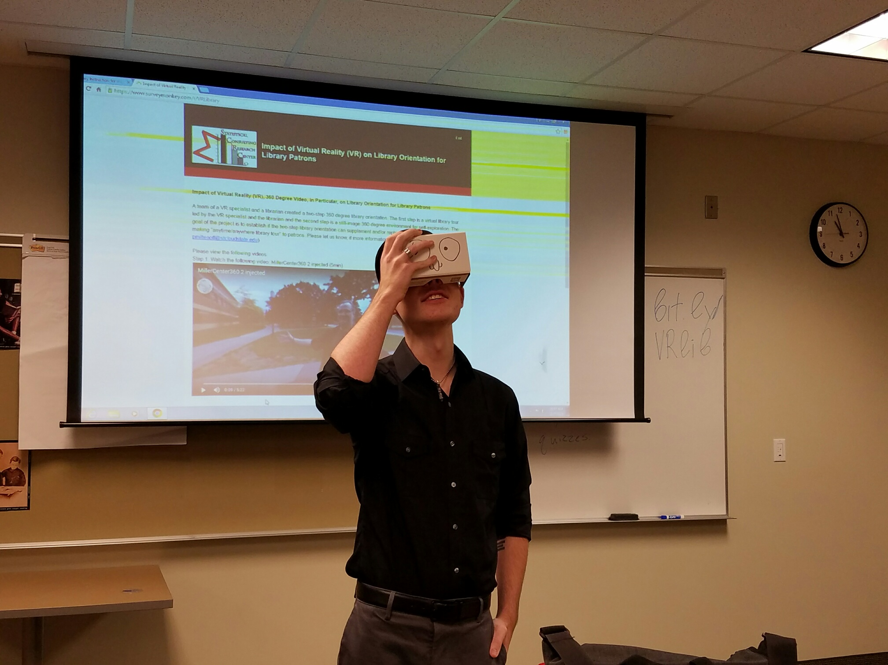
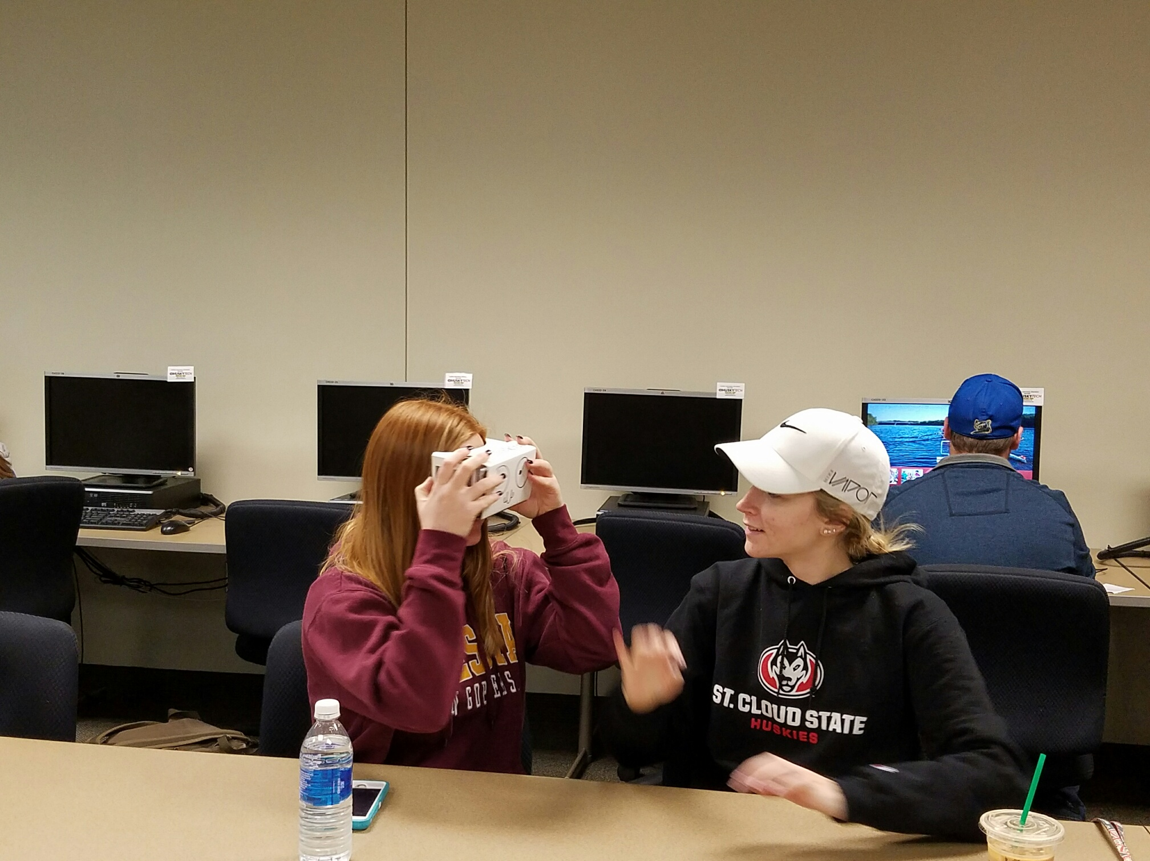
360 Media – Students Survey

Slide 13
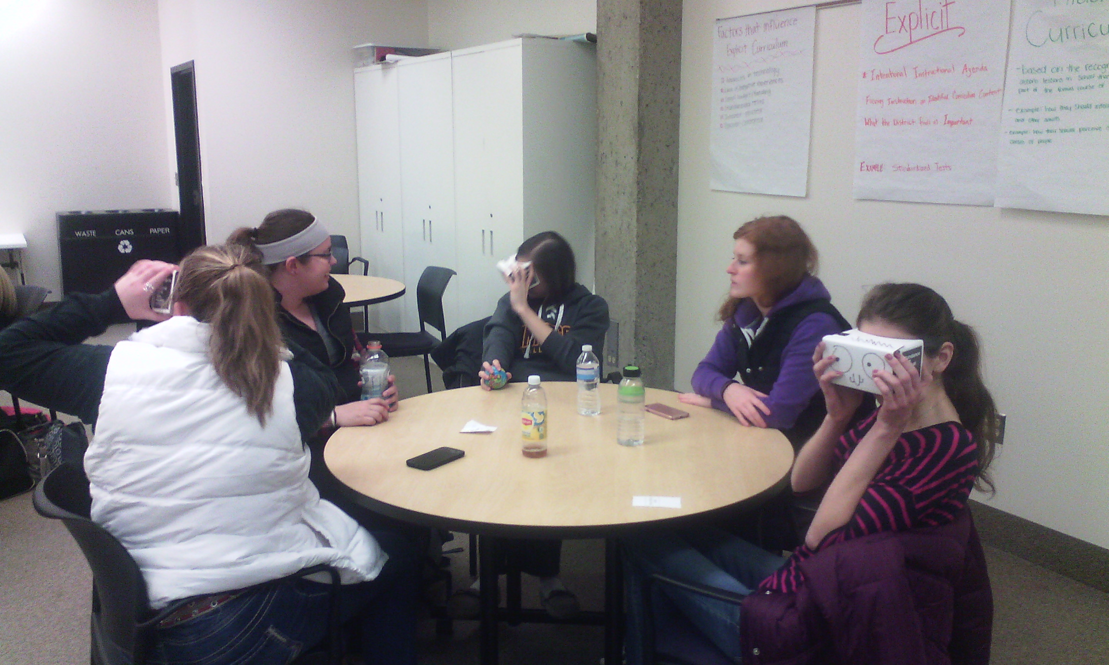
360 Media – Students Survey

Slide 14
Survey goals
to establish if 360 Media, as part of the general VR and AR idea, is a feasible platform for student learning
to find out when using VR, if learning really occurs;
and to seek if there is any dependency between the first two goals and student demographics.

Slide 15
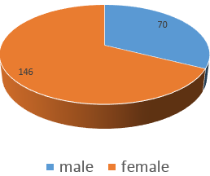
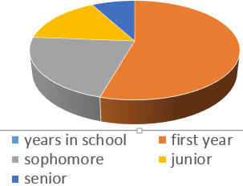
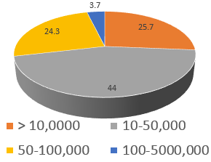
Survey results: demographics
221 student participants,
217 participants considered
Female, 66%, male, 44%
50% are first-year students
43% come from
place of
10-50,000
population

Slide 16
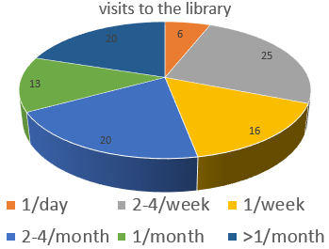
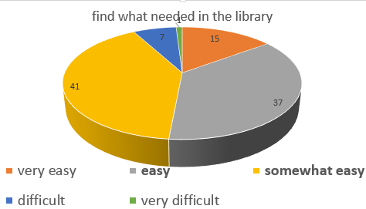
Survey results: library
Most visits 2-4 times a week
Easy to
orient
themselves –
37%

Slide 17
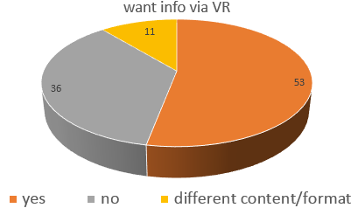
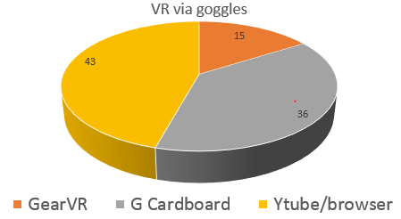
VR, video 360
want info via VR – 53%
Watched w GearVR – 15%
Watched with
Google Cardboard-
37%

Slide 18
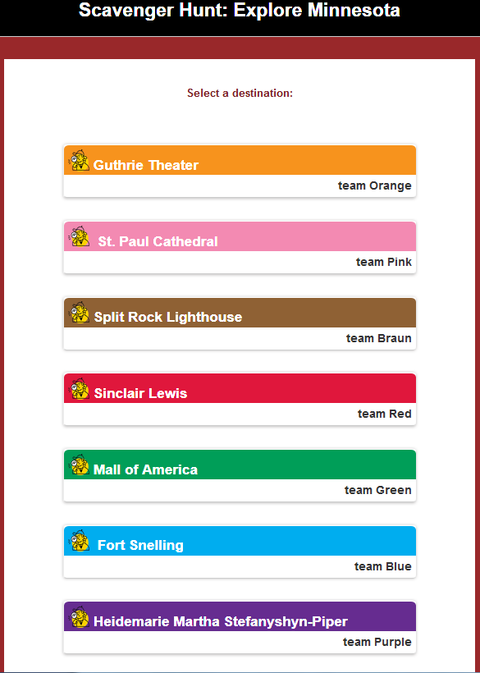
http://bit.ly/learnlib
2nd step
Learn about library services
Gamified scavenger hunt
BYOD
Split in groups: peer support
Project-based
Self-paced, self-directed

Slide 19
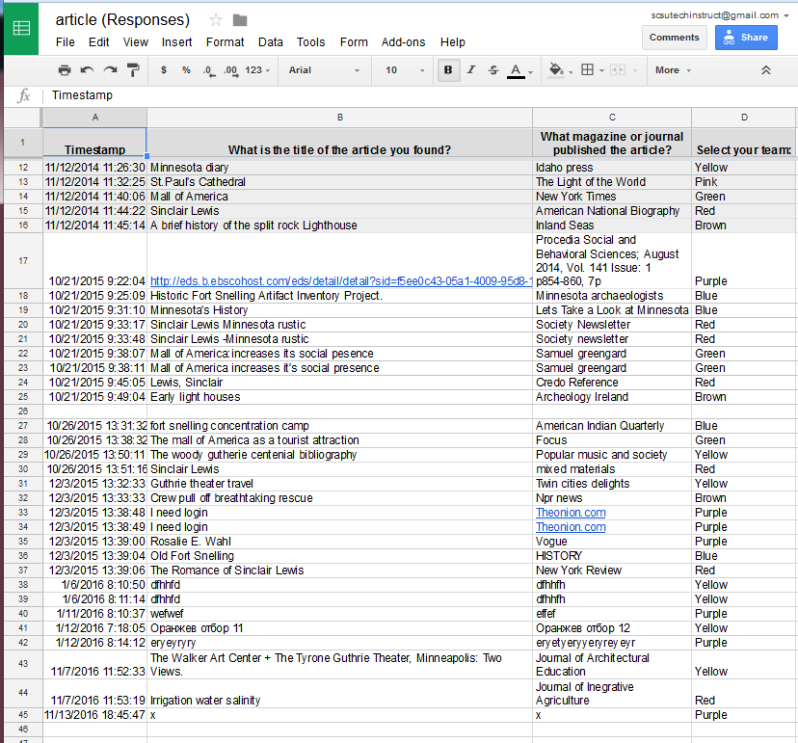
http://bit.ly/learnlib
2nd step
Gamified orientation
Quantifiable assessment
Opportunity for
  Immediate tune up
  Long-term research
E.g.:
https://goo.gl/EywX4M
https://goo.gl/kRpeB3

Slide 20

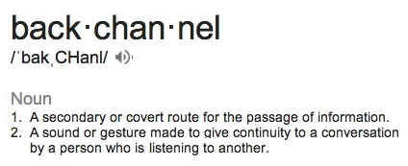
@SCSUtechinstruc #mnsummit2017 #vrlib
https://www.facebook.com/SCSUVizLab
https://www.facebook.com/InforMediaServices/

Slide 21



Contact Info:
https://www.slideshare.net/aidemoreto/vr-library
short link: https://tinyurl.com/MNsummit2017
Plamen Miltenoff, Ph.D. Professor
pmiltenoff@stcloudstate.edu
http://web.stcloudstate.edu/pmiltenoff/faculty/
http://blog.stcloudstate.edu/ims
https://www.facebook.com/InforMediaServices/
Mark Gill, Ph.D., Director Visualization Lab
mcgill@stcloudstate.edu
https://www.facebook.com/SCSUVizLab
@SCSUtechinstruc

