Slide 1
Student Success in the Electronic Era: Why Schools Need Media Specialists Now More Than Ever Kathy B. Enger, Ph.D.
Northern Lights Library Network

Slide 2
Problem: The Diaspora of Media Specialists (School Librarians)
Schools have lost qualified media specialists without understanding the true skills students learn from them.
Students in schools with full-time media specialists do significantly better on standardized than students in schools without media specialists.

Slide 3
Study Using a Grounded Theory Qualitative Approach
This study examined sixty-seven full-text scholarly articles from a search of Academic Search Premier on the terms “Media Specialist” and “School Librarian” from 1997-2016, along with sixty-eight Internet documents, from state education websites and district education websites.
Total of 2,240 pages of documents.
Chamaz (2014) use of documents as a source of qualitative data.
Charmaz, K. (2014). Constructing grounded theory. Los Angeles: Sage Publications.

Slide 4
Three Key Themes Emerged
Information Literacy
Digital Literacy
Library and Information Science Skills
**Throughout the learning process, students are continually reading and writing.**

Slide 5
INFORMATION LITERACY CYCLE
1. A Need to Access Information is Realized.
2. The Information/Knowledge Needed is Located.
3. The Value and Relevance of the Knowledge Located is Determined.
4. The Knowledge Located is Organized.
5. The Knowledge Located is Put to Use.

Slide 6
The Need to Access Information Begins

Slide 7
Needed Information/Knowledge is Located

Slide 8
The Value and Relevance of the Knowledge is Determined

Slide 9
The Knowledge Located is Organized

Slide 10
The Knowledge Located is Put to Use

Slide 11
DIGITAL LITERACY SKILLS
Begins with developing usernames and passwords, keyboarding, using email and websites effectively, practicing digital etiquette, and even manipulating a mouse
TO
Navigating social media sites such as wikis, blogs, manipulating data with spreadsheets, creating multimedia presentations, and using apps. for mobile phones and tablets.

Slide 12
LIBRARY AND INFORMATION SCIENCE SKILLS
Reading
Reading
Reading
Reading
Reading
Reading …

Slide 13
Bronfenbrenner’s (1979) Ecological Systems Theory
The most advanced grounded theory analysis links results back to existing theory, in order to build new theory, much like the function of a literature review in quantitative studies. This study follows a true grounded theory qualitative analysis approach.

Slide 14
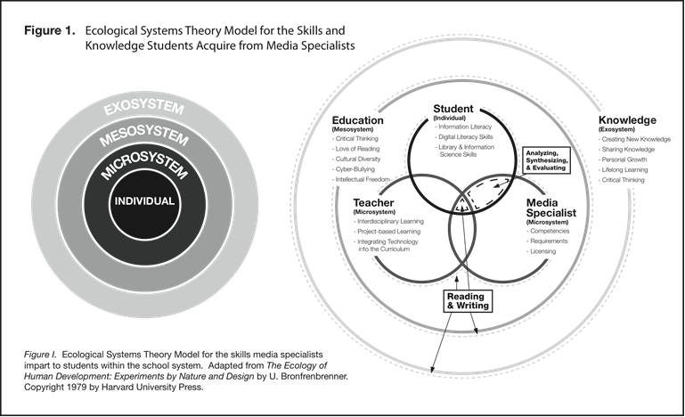

Slide 15
Equity
Literacy levels improves as access to reading material increases.
Children raised in home with many books go on for more education.
There are performance-based disparities between students with Internet access at home and those without it.

Slide 16
Libraries and Democracy
Reading is a universal human right.
The core element of libraries rests solidly in reading.

