Slide 1
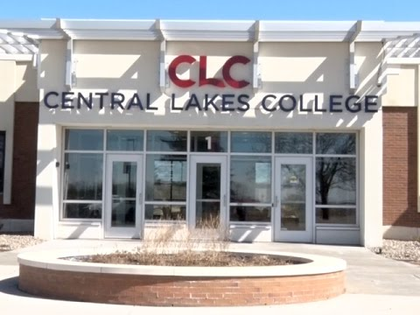
Campuses
in
Brainerd
and
Staples Minnesota

Slide 2
Using a D2L Course Room and Collaborative Learning Circles
to Support Faculty in
OER Review, Adoption, Course Redesign, and Authoring
Karen Pikula PhD.
Psychology Instructor
Central Lakes College Minnesota State OER Coordinator
Educational Innovations, Minnesota State
Paul Preimesberger
Dean Enrollment Management and Student Success
Central Lakes College

Slide 3
Central Lakes College Demographics
Central Lakes College is a comprehensive community and technical college serving about 6,000 students per year who of spend an average of $1,036 per year on books, supplies, and equipment (EMSI, 2010).
Many of our students are living in poverty: 35% of our Full Year Equivalent 2014 entering students were Pell Eligible (MnSCU Accountability Dashboard: Strategic Framework Performance Measures, Central Lakes College).
The College spends about $250,000 annually on textbooks for PSEO students.

Slide 4
Presentation on OER’s to faculty by System Office and OTN members on faculty duty day.
Creation of OER committee.
CLC faculty members participate in system office OER reviews (OTN).
OER committee works with faculty who reviewed an OER.
CLC applies for System Grant and was awarded grant.
Learning Circle Process Implemented.

Slide 5
OER Committee…
Active OER Committee:
Librarian
Faculty members
Bookstore and IT representation
Administration
More recently student representation

Slide 6
Applied for System Grant…
Purpose:
1.) Increase awareness and adoption of open textbooks and other open access materials for:
Both Brainerd and Staples campuses
Postsecondary Enrollment Options (PSEO) students:
Online eCollege program
College in the Schools (CIS)
2.) Increase student success and significant cost savings for our students, the college and our CIS partners.

Slide 7
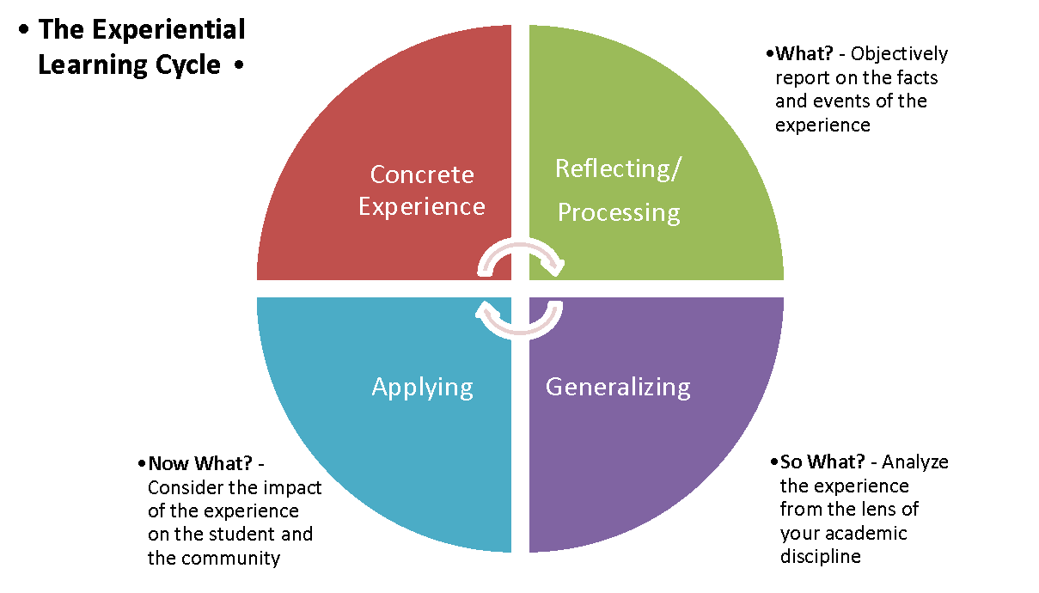
Learning Circle Process
Librarian driven initiative
Increases faculty awareness of OER opportunity
Increases adoption of OER’s
Faculty attend 80% of scheduled Learning Circle meetings.
Faculty create, submit, and update weekly workplans and journals.
Faculty present their final work results to colleagues.
Participants are paid a stipend for their work…
The OER textbook review pathway stipend is between $200.00 - $500.00
Both the course redesign pathway and the authoring pathway recipients receive $1500.00 stipends for their work.

Slide 8
Application Process:
Interested faculty apply to attend Learning Circles…
The OER committee reviews applications, and announces successful applicants.
Scoring criteria:
Courses with high PSEO and CIS enrollment will receive priority.
Course is needed for Z Degree
Course is scheduled to be taught in the next academic year
Course is high enrollment (>50 students per year)
Faculty is new to OER Learning
Circles
Application sustains current OER course
Potential money saved next academic year

Slide 9
Faculty Participation
Spring 2016 10 faculty participated
Summer 2016 7 faculty participated
Spring 2017 4 faculty participated
Summer 2017 5 faculty participated

Slide 10
Collaborative Learning Circles
Interactive support for faculty as they work through each of three pathways…

Slide 11
Three Pathways
OER Review
OER Course Redesign
OER Authoring.

Slide 12
Review Pathway
Faculty on the Review Pathway:
Work in facilitated, cross disciplinary, collaborative, Learning Circles with other faculty members.
Faculty share ideas and support each other through their chosen Learning Circle pathway.
Faculty on the review pathway must attend at minimum 80% of the scheduled Learning Circle meetings.
Faculty on the review pathway will complete a work plan, a textbook comparison template and a review rubric (BC Campus Criteria Checklist).
Faculty share their textbook review results with the other participants at the final scheduled Learning Circle meeting.

Slide 13
Redesign Pathway
Work in facilitated, cross disciplinary, collaborative, Learning Circles with other faculty members.
Faculty share ideas and support each other through their chosen Learning Circle pathway.
Faculty on the review pathway must attend at minimum 80% of the scheduled Learning Circle meetings.
Faculty will create a D2L course shell using their selected OER materials or create a hard copy portfolio of content, objectives, and assessments, for their course.
Faculty share their completed courses with the other participants at the final scheduled Learning Circle meeting.
Faculty license intellectual property( a copy of this one course) to Central Lakes College for department use.
This helps to move OER adoption from the level of the individual faculty member to the level of the department, and make our OER efforts more sustainable.

Slide 14
Authoring Pathway
Faculty are limited to one Authoring Project per session.
Participants in the OER Authoring Project work individually or collaboratively to create open educational resources that will be shared and licensed to CLC. These resources may be an OER textbook or other open resources such as a test bank, portfolios of worksheets, assignments, quizzes, videos, podcasts and/or PowerPoint files.
These resources are housed in a repository for sharing and also have a Creative Commons license.
Faculty on the authoring pathway must attend a minimum of 80% of the scheduled Learning Circles.
Faculty must create a work plan detailing the process they plan to use in the creation of their OER resource/s. This plan will change, so it does not have to be perfect, but is reviewed and approved by the OER committee.
Faculty are asked to download and read the Authoring Guide from BC Campus.
BC Campus Authoring Guide: https://opentextbc.ca/opentextbook/
Faculty share their completed projects at the final Learning Circle.

Slide 15
Brightspace (D2L) Faculty Support Course Room
Structured weekly modules for each of the three pathways
Repository of resources
Universal Design links
QM support and links
Case studies
Organizational structure for faculty work
Opportunity to share and discuss “Pearls” from individual experiences.

Slide 16
Brightspace (D2L) Faculty Support Course Room
Tour of a D2L Learning Circle
support course room
https://clc.ims.mnscu.edu/d2l/home/2337928

Slide 17
Applied for 2nd System Grant… Our current OER work builds on the work we have accomplished as a result of the system level grant our college was awarded in 2016.
Purpose:
1.) Increase awareness and adoption of open textbooks and other open access materials and take us to the next level of OER implementation:
Z-degree with a corresponding low-textbook-cost degree.
Partner with our CIS high schools to promote OER use in our CIS classes.
Refine CLC’s Print on Demand Process
2.) Increase student success and significant cost savings for our students, the college and our CIS partners and bolster NACEP accreditation.

Slide 18
Learning Circles framework applied to OER in concurrent enrollment project
K-12/College instructor collaboration to develop OERs in CIS courses
Learning Circles = Professional Learning Communities (PLC’s)
Four Questions:
What OERs will we research and review?
How will we evaluate them?
What are the gaps?
How will we supplement the gaps?

Slide 19
Learning Circles framework applied to OER in concurrent enrollment project
PLCs met five times over the course of the semester
1
Each meeting was at CLC and lasted 3 hours; lunch provided
2
Time for review, ?s, success sharing and OER work
3
Lead to discussions focused on assessment, outcomes, content and delivery
4

Slide 20
Learning Circles framework applied to OER in concurrent enrollment project
Project culminated with a Findings Summit; principals and superintendents invited
1
Low cost print versions contributed to group’s enthusiasm for OERs; provided opportunity to pilot OERs during project
2
Every course will be utilizing an OER next year
3
Project extended into 17-18 with new and current participants
4

Slide 21
Takeaways
Take-away: Participants will leave with ideas for promoting and supporting the adoption of Open Educational Resources at their learning institutions
Outcome: Understand the value of having a repository of resources and cross disciplinary faculty collaboration as a support system for OER adoption.
Participants will have the opportunity to share questions, answers, ideas, and food for thought about OER’s in a wind -up group discussion.

Slide 22
Questions…

Slide 23
Thank you for attending
our presentation!
Karen and Paul

