Slide 1
Leveraging for Success:
Engagement in an Asynchronous Non-Credit Mandated Course
Ellie McCann, Sharon Powell, & Kate Welshons
Notes:
Ellie, Sharon & Kate intros

Slide 2
This presentation will help you learn more about:
Successfully converting learning materials from a face-to-face format to an online format
Challenges
Strategies to address challenges
Developing evaluation to measure efficacy
Notes:
Ellie

Slide 3
Parents Forever
A coparent education class
Composed of three sections:
Parent well-being
Parent-child relationships
Coparenting
Notes:
Ellie
The face to face course is highly interactive and includes a great deal of input from participants. Discussion is a primary pedagogical tool and we utilize discussion between participants as a way to augment their learning. We also operate from the teaching philosophy that, rather than just depositing lots of information into the participants’ brains, it’s our role as educators to spark their interest and evoke learning within the participants (Teaching is not filling a pail, it is lighting a fire.”- WB Yeats). We feel that the learning sticks much more effectively and participants are much more likely to be motivated to extend their learning.

Slide 4
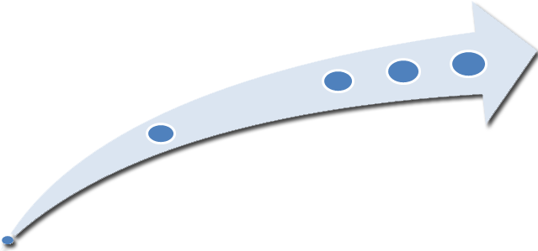
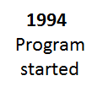
Program Beginnings
Notes:
Ellie
Parents ForeverTM got its start in 1994. At that time a group of local Extension educators in Winona county noticed an increasing need for education for parents experiencing divorce. They drafted a curriculum that would later become Parents ForeverTM and piloted it in the surrounding communities.
In 1996, the Minnesota state legislature requested that the Minnesota Supreme Court form a committee to examine visitation and custody issues. The committee explored these issues and concluded that parent education during the divorce process could help minimize return-to-court appearances regarding issues with visitation and custody. The committee’s recommendations were written into statute. In court cases where custody or parenting time is contested, the parents of minor children are court-ordered to attend a parent education course.
The Minnesota Supreme Court and/or district judges approve these parent education courses and ensure that they meet the 25 minimum standards defined in the policy.
In response to this new mandate, University of Minnesota Extension revised the existing parent education curriculum and launched Parents ForeverTM in the fall of 1998.

Slide 5
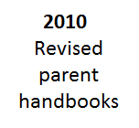
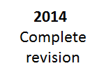
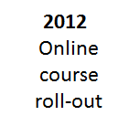
Changes in Recent Years
Notes:
Ellie
Since 1998, we have trained hundreds of professionals across Minnesota and beyond how to start and maintain a Parents ForeverTM program in their county.
In 2010 we revamped all of the parent handbooks.
In 2011 we were approached by the Minnesota Supreme Court to develop an online version of the course to help meet the needs of parents who could not easily attend an in-person course. Our situation was that we had a decades old face to face program which we needed to convert to an online format. The Parents ForeverTM Online Course for Parents was the first online offering approved by the state of Minnesota and was rolled out early 2012.
In 2014, we updated the entire Parents ForeverTM curriculum and related program materials.

Slide 6
Notes:
Ellie
The Parents ForeverTM theory of change is informed by research and the feedback we have received from facilitators and participants over the years. The course has three main areas of content:
Self-care
the parent-child relationship, and
the co-parenting relationship.
While the parent-child relationship and co-parenting components are common across divorce education curricula, the equal focus on self-care is unique to Parents ForeverTM. We firmly believe that promoting parents’ self-care helps to enrich parental health and well-being, and leads to improved outcomes for their children.
As illustrated on the slide, all three components of the model influence one another and ultimately influence outcomes for children. The course evaluations for Parents Forever align with this theory of change.

Slide 7
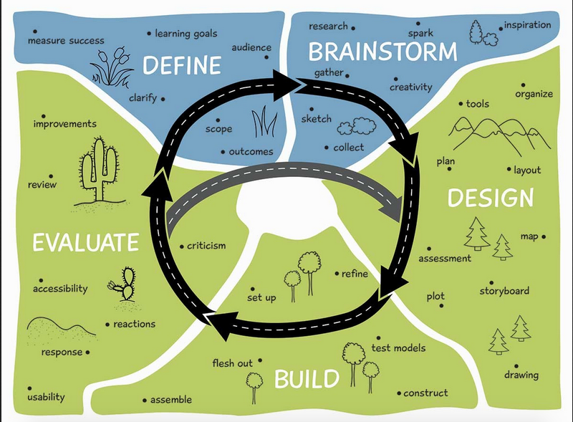
Online Course Developmental Process
Notes:
Kate or Sharon?
We used this template as a guide. Began with the “Define” step, particularly focusing on our learning goals (some of our goals were our own and some goals were the state supreme court’s). Ours: normalize the process for families; help create a strategy for successfully navigating the transition; example of Supreme Court goals: explain the legal process; discuss child support). We returned to our theory of change quite a bit when conceptualizing how the online version would look.
In between “define” and “brainstorm”, we considered each section of our course and what our objectives were in designing activities. Then we brainstormed about, given our parameters, how we could promote similar process and outcomes in our online course (idea of equifinality). Here are some of our objectives:
To Promote:
Self reflection
Analysis of one’s own situation, strengths, challenges
Application of concepts to one’s own life
Learning from others who are experiencing similar transitions but may be at different stages in the process or who have taken a different approach
Development of a sense of agency about their family’s journey from here on out
Helping people see themselves in our examples (inclusivity is really important)
Also considered various learning styles; needed to become more overt by telling people to think about a concept. How do we make text heavy pieces more engaging (interview type style; have kids read sections of text that are about kids)

Slide 8
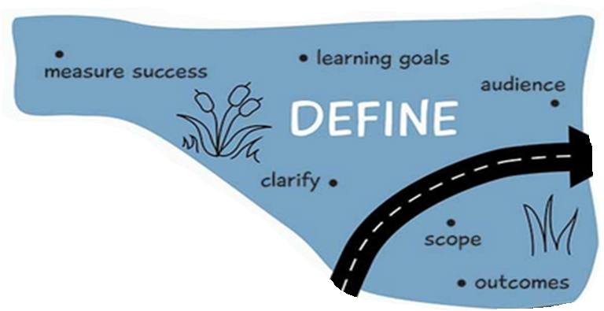
Notes:
Kate or Sharon?
Technology
Staff
External Requirements
Audience

Slide 9
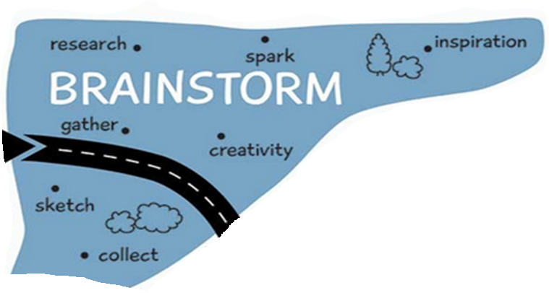
Notes:
Kate or Sharon?

Slide 10
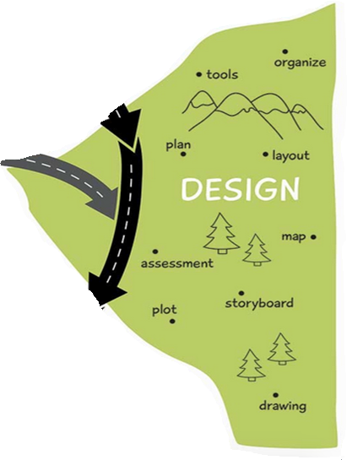
Notes:
Kate

Slide 11
Learning Objective | In Person Learning Activity | Online Learning Activity
Self reflection | Journal entries | Journal entries
Analysis of one’s own situation | Checklists; Onion activity | Checklists; Onion activity
Learning from others in class | Group discussion; group activities | Wordles; interviews
Application of concepts to one’s own life | Case studies; types of support activity | Case studies; types of support activity
Development of a sense of agency about their family’s journey from here on out | Identification of strengths; brainstorming about problem solving
Notes:
Sharon
Dissemination of information is not too difficult in an online format. It’s the synergistic learning that comes from interaction with others that is trickier to duplicate. How do we promote that type of learning given our challenges?
Sharon- Try to reduce text in table!!!

Slide 12
Notes:
Sharon

Slide 13
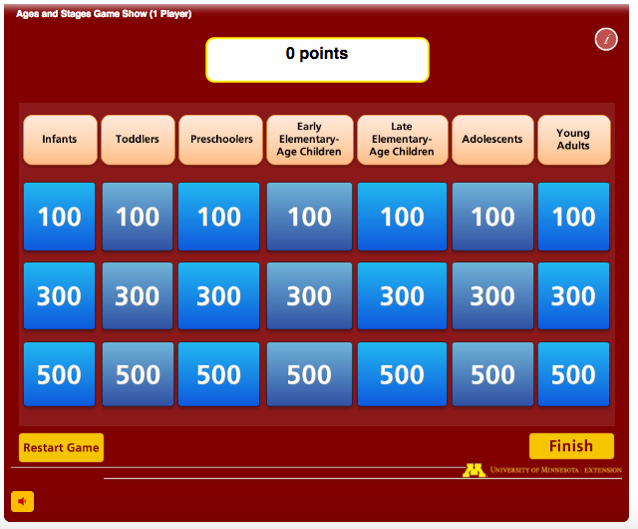
Notes:
Sharon

Slide 14
Notes:
Sharon

Slide 15
Here are some examples of how we approached the challenges…
Types of support
Wordles
Quizzes
Having people read text
Notes:
Sharon

Slide 16
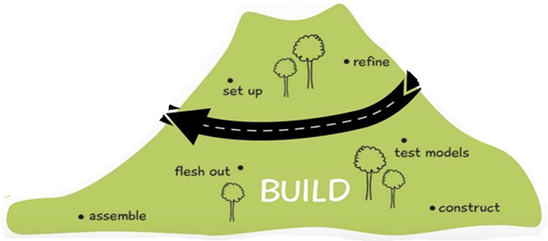
Notes:
Kate
Issues included:
Platform (Moodle vs Articulate)
Limited capacity (not a ton of money to create vids, etc., knowing how to use software)
Confidentiality issues
Not enough capacity to read and respond to comments. If we can’t read, we can’t ask because 1. not nice to ask for work that won’t be reviewed; and 2. given the nature of the subject matter, it’s possible that someone might share info that should be reported. If we never read it, that would be an unethical position to be in. We feel it’s better not to ask if we can’t monitor appropriately.
For the sake of evaluation and to insure that they complete the course, we need to be able to monitor their progress. Moodle and Articulate both have limitations regarding this issue. Also, we’d like to capture some data through their work so we can possibly use it for evaluation.
These limitations have a lot of influence over the way the course is built.
Iterative process where we said what we wanted to do and Dung would tell us what was possible. Then he’d do it and we’d see how it worked.
This is the stage where we had to put all of the pieces together that began in the brainstorming stage.
Consulting with others to make sure instructions are clear.

Slide 17
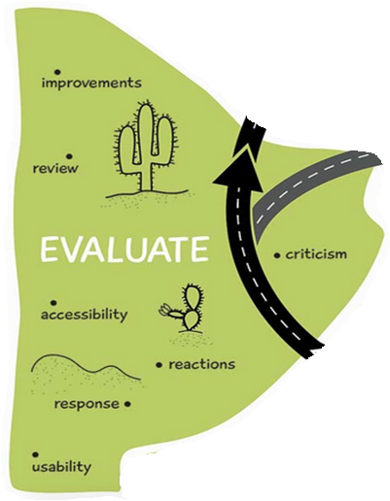
Notes:
Kate
What I mentioned previously about tracking participation; also wanting content to be close enough to face to face so we can compare methods of delivery; different evaluation we did of our project (pilots; going through several times; evaluating after it’s been live for a little while; Bob Hughes students provided external review).Accessibility: transcription and closed captioning. Based upon what we learn though evaluation, we go back to the design stage and make adjustments.

Slide 18
Opportunities
Build capacity & gain experience
Collaboration
Expand reach
Research
Notes:
Kate

Slide 19
How have you dealt with your challenges?
Notes:
Ellie – lead w/ Sharon
Have participants think of a challenge and how they’ve overcome it. Share in pairs and then have a few report back to the whole group.

Slide 20
Questions

Slide 21
Copyright Information
This presentation is part of the Parents ForeverTM educational program.
Visit www.parentsforever.umn.edu for more information on this and other Parents ForeverTM materials and trainings.
© 2016, Regents of the University of Minnesota. All rights reserved. University of Minnesota Extension is an equal opportunity educator and employer. In accordance with the Americans with Disabilities Act, this resource is available in alternative formats upon request. Direct requests to 612-626-6602.

