Slide 1
Authoring Open Textbooks
A Case Study

Slide 2
What is ‘Open’?

Slide 3
CC

Slide 4
free +
Share
Copy
Keep
Mix
Edit
USE

Slide 5
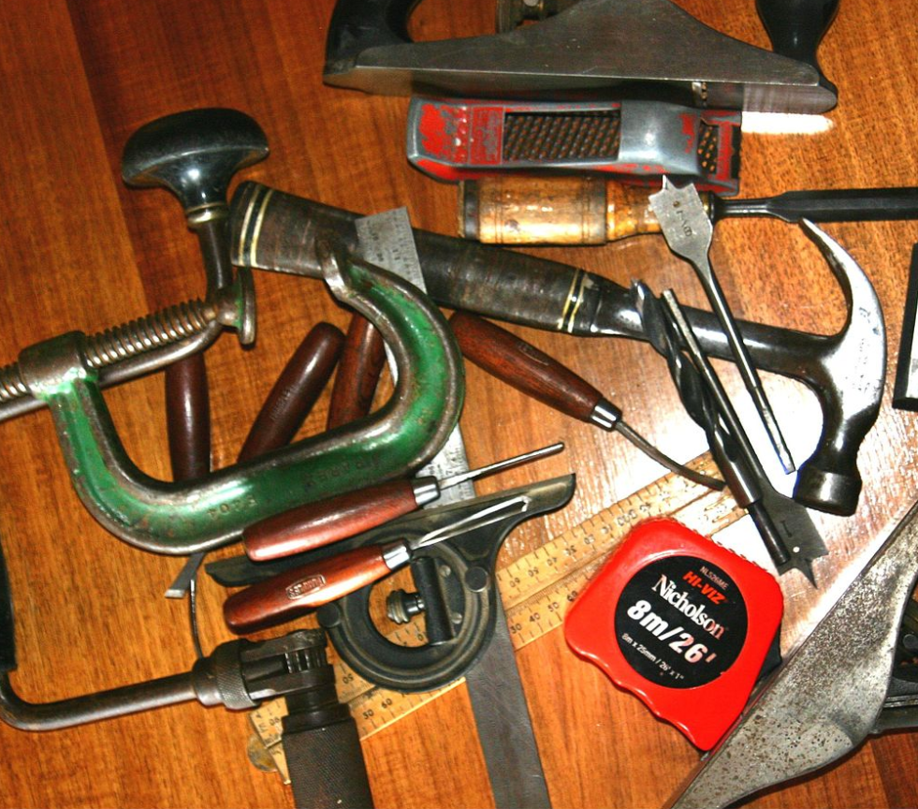
Instructor
USE
Notes:
Assorted Woodworking Tools, Frank Carroll, CC By 3.0 https://commons.wikimedia.org/wiki/File:Woodworking_tools.jpg

Slide 6
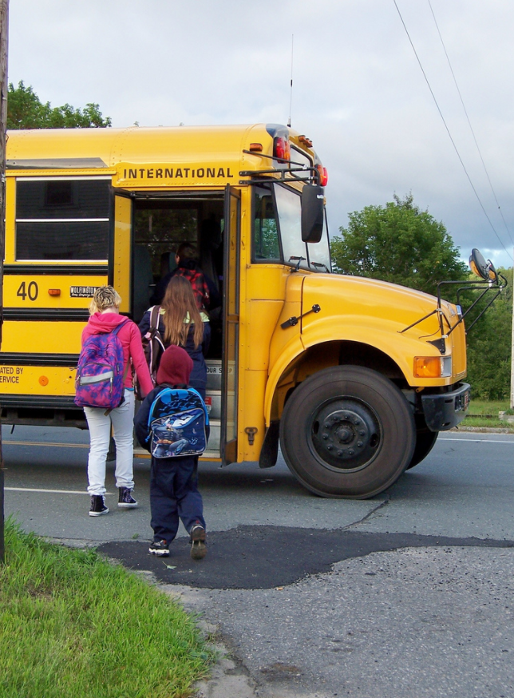
Student
USE
Notes:
Getting on the bus for the first ride in the first grade school season, lorl05871, CC By https://www.flickr.com/photos/mrsmaxspix/3877248167

Slide 7
$

Slide 8
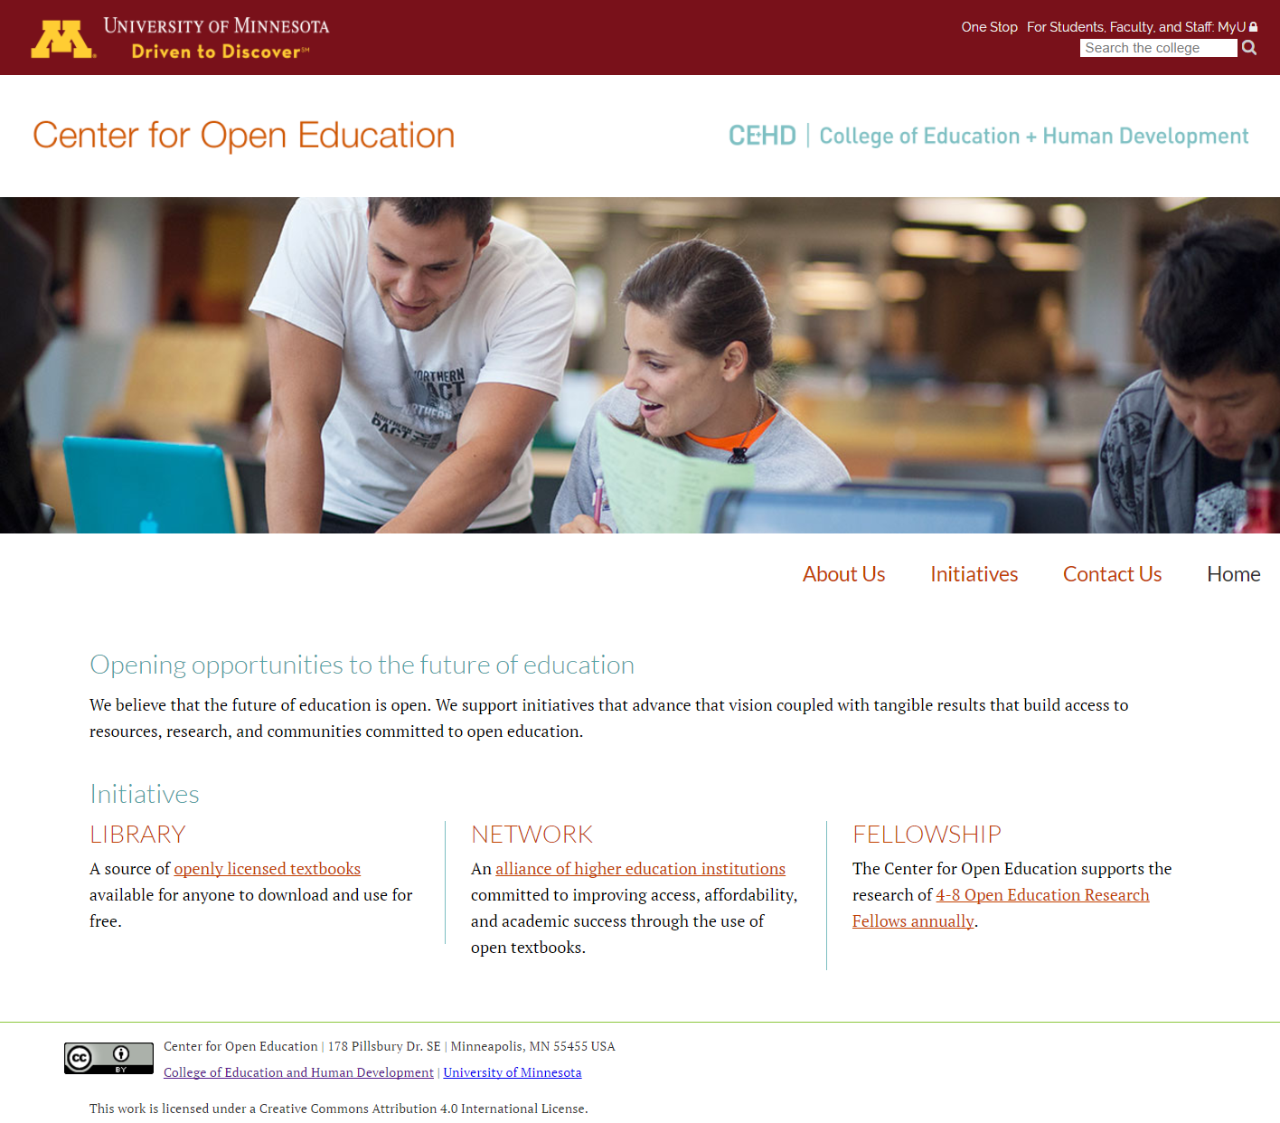
Center for Open Education

Slide 9
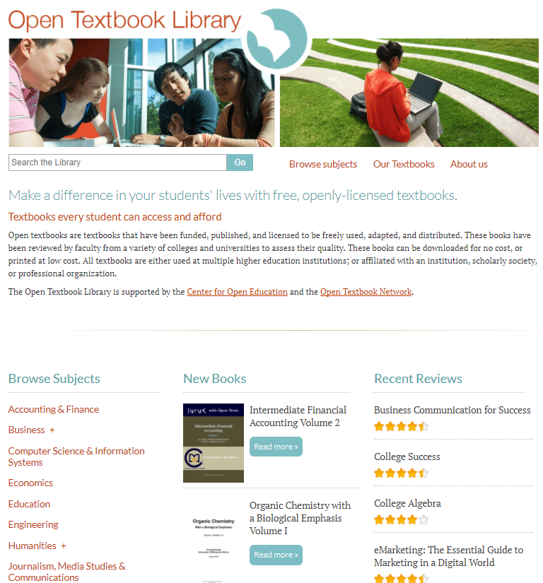
Open Textbook Network
&
Open Textbook Library

Slide 10
The Pilot
Notes:
Workandapix Pixabay public domain license

Slide 11
3
Phases
Pre-Production
Production
Post Production
Notes:
I

Slide 12
Pre-Production
Training
Roles
The textbook re-examined

Slide 13
ADOPT
ADAPT
USE

Slide 14
A Framework
Notes:
Workers Scaffolding Site Scaffold Construction, Public Domain http://maxpixel.freegreatpicture.com/Workers-Scaffolding-Site-Scaffold-Construction-1617969

Slide 15
Structure
Unit
Chapters
Sections
Sub-Sections
Forward
Introduction
Table of Contents
Appendices
Resources
Index

Slide 16
Elements
Learning Objectives
Overview
Key Terms/Vocabulary Terms
Practice Sets
Case Studies
Graphs
Images
Tables
Maps
Key Takeaways
Summary

Slide 17
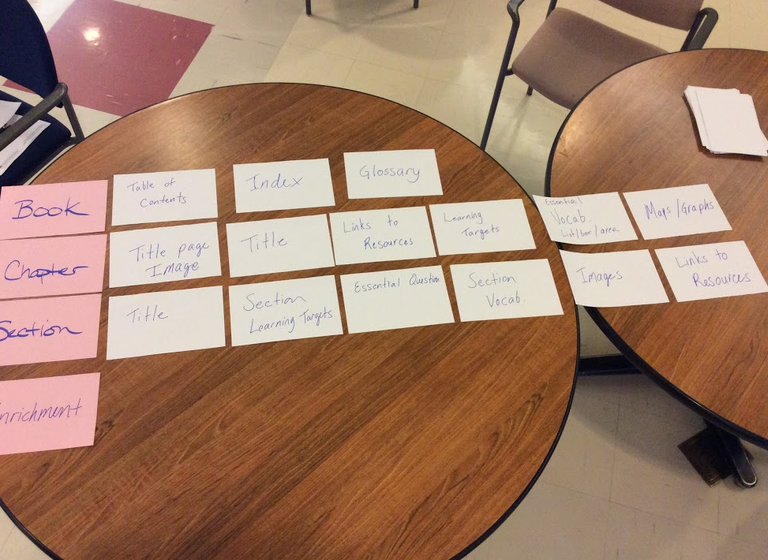

Slide 18
Production
Writing!
4 Days
Divide and Conquer

Slide 19
Authors
Curators
Archivists
Notes:
Trivial Pursuits, Gaetan Lee, CC By https://commons.wikimedia.org/wiki/File:Trivial_pursuits_colors.jpg

Slide 20
Draft In a Flash

Slide 21
Writing is like…
teaching on paper.

Slide 22
Post Production
Copy Editing
Attributions
Accessibility
Print/Publish

Slide 23
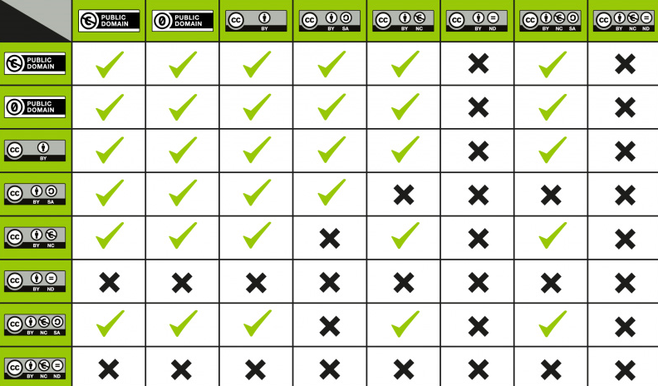

Slide 25
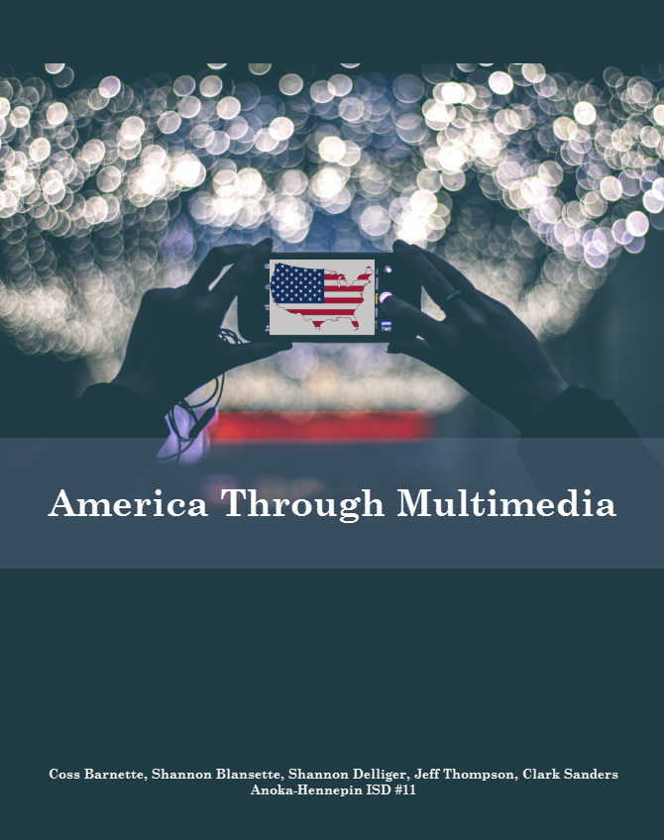

Slide 26
Results

Slide 27
What inspired you in writing an open textbook?
“The chance to design a class with the book exactly the way we wanted it. “
“The chance to choose how it works with your curriculum.”
“The ability to update the course content more frequently than 10 years!”

Slide 28
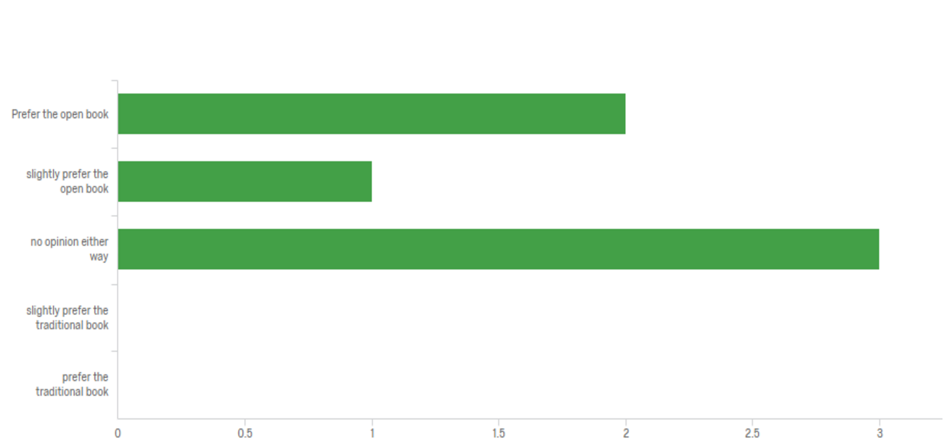
How do you think your students felt about your produced textbook versus tradition?

Slide 29
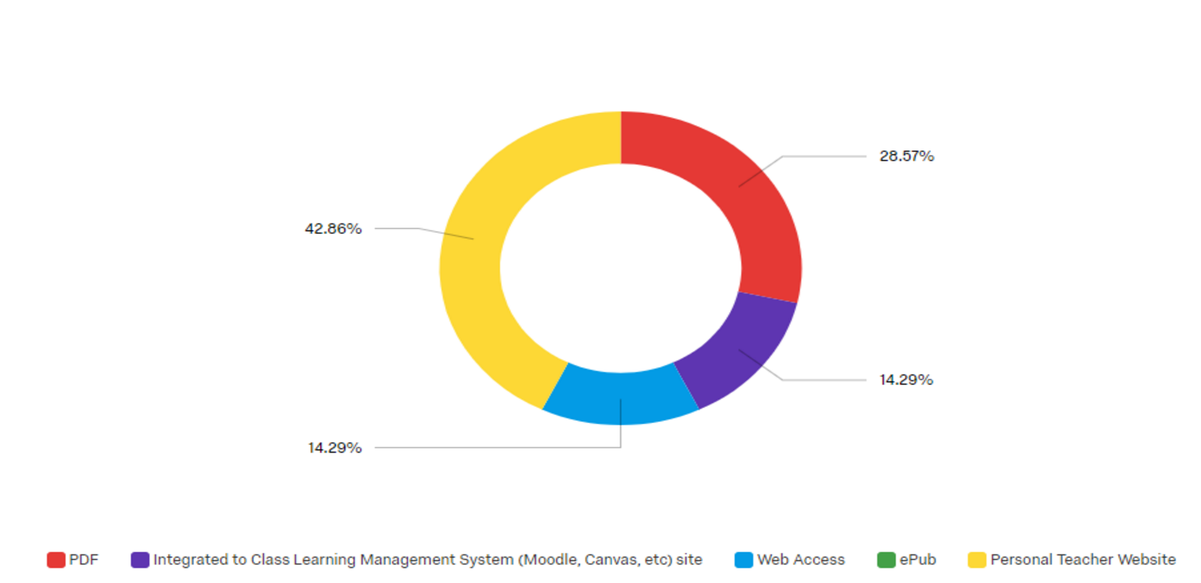
How are you using your book in the classroom?

Slide 30
Would you prefer purchasing a book or creating a book for your classroom after this experience?
“Purchasing, but, only because of the time involved. If the district allows for more time to write, open textbooks are awesome!”
“Depends on the course. For a subject I am passionate about I’d definitely want to create my own”
“Creating! I felt more invested in the all the lessons, not just the book.”

Slide 31
2nd Edition

Slide 32
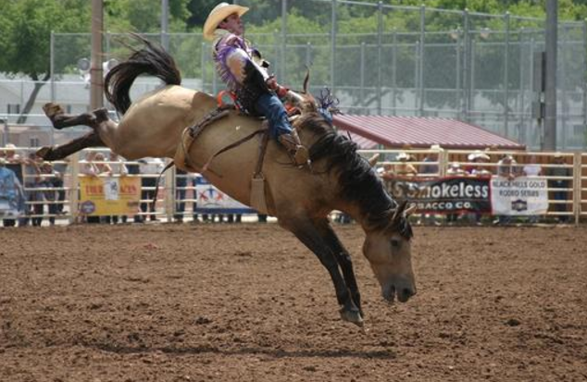
Notes:
S
This image is a work of the Forest Service of the United States Department of Agriculture. As a work of the U.S. federal government, the image is in the public domain.

Slide 34
z.umn.edu/authoropen

Slide 35
Written and compiled by Melissa Falldin and Karen Lauritsen. With contributors:
Karen Bjork, M.A. and MLIS, Head of Digital Initiatives, Portland State University Library.
Caitie Finlayson, PhD. Assistant Professor, Geography Dept., University of Mary Washington.
Dianna Fisher, PhD. Director of Open Oregon State.
Linda Frederiksen, M.L.S. Head of Access Services, Washington State University, Vancouver.
Ralph Morelli, PhD. Professor, Computer Science, Emeritus, Trinity College.
Shane Nackerud, Technology Lead, Library Initiatives, University of Minnesota Libraries.
Deb Quintal, Director of Curriculum Development & Associate Counsel, Center for Computer-Assisted Legal Instruction (CALI).
Anita R. Walz, Open Education, Copyright & Scholarly Communications Librarian, Library Liaison to Economics, Mathematics, and Legal Studies, Virginia Tech.

Slide 36
???

