Slide 1
How Instructional Designers Can Support an Open Movement
Dr. Nathan Lentfer, Adam Minnie, Amy Wegner
Instructional Designers & Technologists | unwsp.edu

Slide 2
Introduction
University of Northwestern-St Paul
Small Christian Liberal Arts College
About 3,500 total enrollment (2014)
Online Learning Office
Notes:
Nathan

Slide 3
Open at UNW
What Are Open Textbooks?
Open Textbook Network (OTN)
Z-Degree
Brief Numbers
Notes:
Nathan

Slide 4
Strategies for Promoting
Promotion among Faculty
Word of Mouth
Platforms (Center for Teaching and Learning)
Student Savings
Video
Institutional Savings
Notes:
Nathan

Slide 5
Support Supplied to Faculty
Open Textbook Consideration in the Development Process
Searching for Open Textbooks
Open Textbook Library (Open.umn.edu)
Global Text Project
Openstax
Lumen Learning
Notes:
Amy

Slide 6
Support Supplied to Faculty
Searching for Supporting Resources
Assessments (MyOpenMath)
Test Banks
Videos
Customization and Formatting (Remixing)
Notes:
Amy

Slide 7
Support Received by OLO
Administration Backing
Departmental Backing for Z-Degree
Stipend for reviewing books
Inviting OTN to present to stakeholders
Notes:
Nathan

Slide 8
Benefits
Customizing your course
Better alignment between content and objectives
Cost-savings for students
Cost-savings for UNW (PSEO)
Sustainability
Notes:
Amy

Slide 9
Obstacles
Open texts sparse or nonexistent for some fields
Questions of Quality
Questions of Academic Freedom
Lack of Supplemental Resources
Impact on Traditional Structures (Campus Store)
Notes:
Adam

Slide 10
Methods for Managing
Integrating Open Textbooks into LMS
Directed links throughout the course
MyOpenMath LTI
Print on Demand
Lulu.com
Notes:
Adam

Slide 11
Tracking Open Adoption
Open Textbook Network
Spreadsheets
Championing and Celebrating
Data Visualization
Notes:
Adam

Slide 12
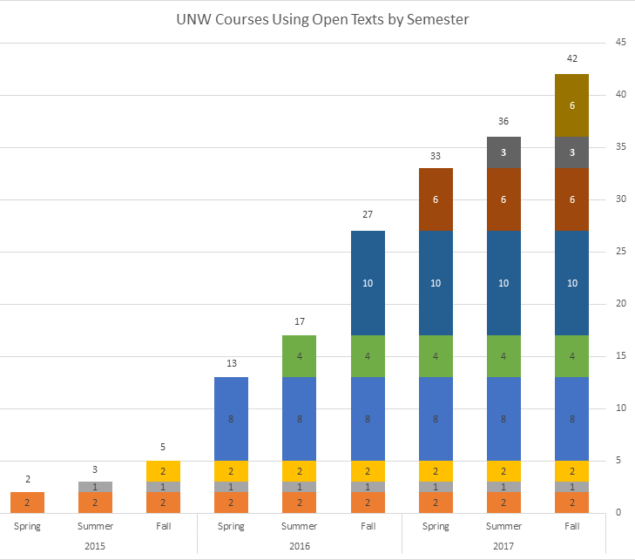
Open-Adopted courses
Total Adoptions
42
Total Enrollments
2591

Slide 13
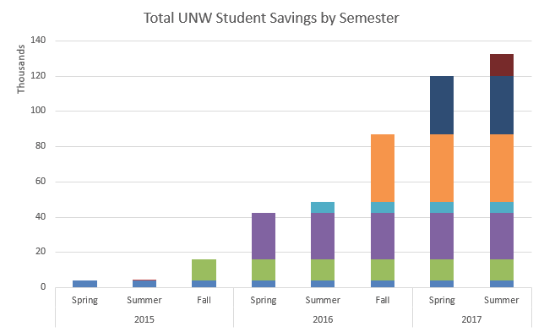
Total Student Savings
~$132,000

Slide 14
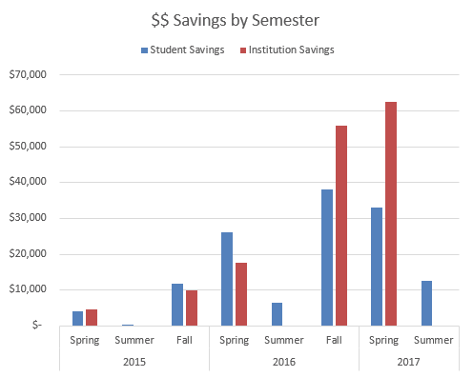
Semester Savings
Students
~$132,000
Institution
~$150,000

Slide 15
Future Goals
Another Z-Degree
Open Textbooks for High Enrollment Courses
Networking
Publication
Notes:
Nathan

Slide 16
Questions?
Contact Information
Dr. Nathan Lentfer, nvlentfer@unwsp.edu
Adam Minnie, atminnie@unwsp.edu
Amy Wegner, alwegner@unwsp.edu

