Slide 1
Applied Learning in the Online Environment
Navigating Degree Completion Options
for Working Adults
and Employers
Notes:
Tom- welcome

Slide 2
Presenters
Dr. Tom Norman
Dean of Extended Education
Dr. Christine Mollenkopf-Pigsley
Assistant Professor-
Applied Organizational Studies
Notes:
Christine- I bet you can tell which one of us is which… Instead of giving you a laundry list of our accomplishments we would rather know who you are. We are going to do this really fast. Let’s go around the room and tell us your name and which college, university or organization you represent. Don’t worry, we’re going to save time at the end to network and share some ideas. In the spirit of practicing what I teach, I am going to ask you to raise your hand or give us a little shout out if you have questions as we go along. In my classes you can expect to get a response from me within 12 hours 7 days a week, you don’t have to wait that long so please ask questions of us.

Slide 3
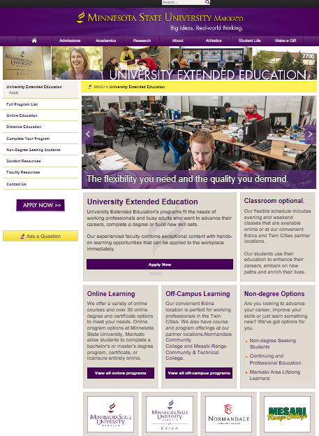
University Extended Education
Notes:
Tom-

Slide 4
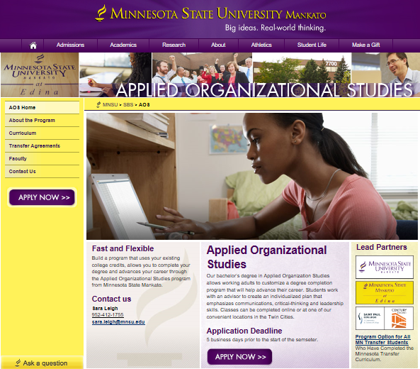
Applied Organizational Studies
Notes:
Tom-

Slide 5
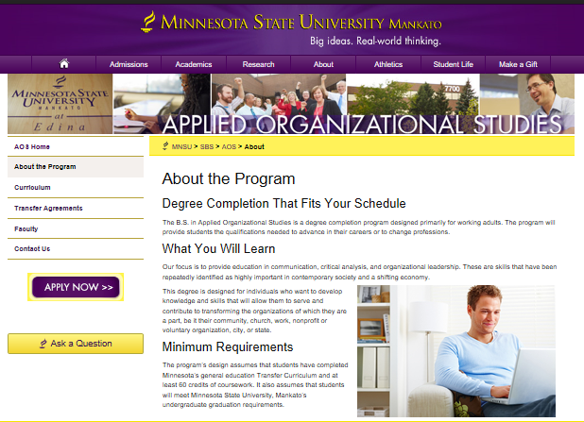
Applied Organizational Studies
Notes:
Tom-

Slide 6
Moving from Margin to Mainstream- AOS
2017 Graduates
GPA- 3.2
2013= 12 students
2 courses
2017= 81 students
7 courses
Online General Education Course Availability
2016 2017 2018
9 of 13 goal areas
11 of 13 goal areas
ALL 13 goal areas
Notes:
Tom- Program statistics-
In 4 years the AOS program has grown from 12 students and 2 courses available to 81 students and 7 courses available.
We found that course availability is key to growing the program. When we started there were only 2 courses in AOS but the addition of 5 more courses helps to meet the demand because we now have more students than we have courses to offer them within the discipline. We also learned as we grew that we didn’t have sufficient general education courses to meet the university requirement online. Instead of turning students away because they needed general education we used the challenge to fuel a move to more general education availability in online format across the university and by Fall of 2018 we will be able to meet all the requirements through online courses.
We also found that our AOS graduates did well academically. The class of Spring 2017, our first graduating class of significant size (12) had an average GPA of 3.2.

Slide 7
This Photo by Unknown Author is licensed under CC BY-SA
This Photo by Unknown Author is licensed under CC BY-NC-SA
Notes:
Christine- Thanks Tom for giving us a great introduction to Applied Organizational Studies. I’d like to take a few minutes to share with you the faculty perspective on the program and what we have learned.
As my students find, I live the applied title on our course and think of our program as a reflection of the life and experiences of our students. Anyone recognize a little program called mythbusters? Well. I feel like we were recruited for the Minnesota version of the show. We heard a lot of things about both online learning and degree completion. Much of what we found was that there are a lot more myths out there than we expected and we entered into this new program with a spirit of innovation and the willingness to try and fail and try again. What our AOS mythbusting has done is have a global institutional impact on the way we teach online and how we build programs. So let’s try a little mythbusting with you.

Slide 8
Online Completion is for “older students”
Notes:
Christine- Talk about who our AOS are demographically and professionally. Remind them of the success statistics- 3.2 GPA

Slide 9
Online Learning is NOT engaging.
Notes:
Christine- introduce that engagement with all learners is important and that technology & geography aren’t the issue- it is the pedagogy
Engage with them in a manner they are familiar with like text messages and video chat.
Everything from the collection of learning styles data. VARK survey- to selection of textbooks that offer e-books and spoken text. It’s about meeting people where they are not forcing them to conform to an alien or antiquated modality.
Everything has to pass the applied test. Can the student use what they learned today or tomorrow at home, at work, as a volunteer? If it’s going into a mental filing cabinet then the learning has to change so it can be used.
The AOS students proved to be so much more attentive and interested in pleasing that often my office hours discussions sound more like professional coaching to get them to trust themselves and to stop trying to get me to tell them what to do and to explore and apply their knowledge.

Slide 10
Knowles, M. (1980)
Notes:
Christine – What his has done is change the dynamic from professing to facilitating- this new relationship between student and faculty can be seen in Knowles’ andragogy. I just want to share 6 points that should ring true with you or at least inspire a new way to reach what I like to call my “new traditional” students.
Adult learning is self-directed/autonomous- minimum instruction maximum autonomy
Adult learning utilizes knowledge & life experiences- use the resource of the diversity of the learners
Adult learning is goal-oriented- many left their program because they didn’t have a direction or goal (motivation)
Adult learning is relevancy-oriented- emphasize the connection to solving the learner’s problems
Adult learning highlights practicality- absorb learning not memorization (applied learning)
Adult learning encourages collaboration- let the learner help design the learning (skin in the game)
Tom- ends this with the point about the extension of this philosophy to the campus framework around online learning and its role in strategy for the university to create

Slide 11
“Non-Traditional Students”
Notes:
Tom- talk about marketing trends and connection to workforce needs and changing college demographics.

Slide 12
Target Market Opportunities
Notes:
Tom-

Slide 13
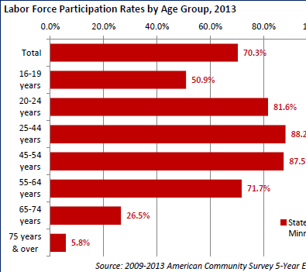
Minnesota’s labor force participation rate is the 3rd Highest in the US
The labor force is dropping for teens and increasing for older Minnesotans
39.4% of MN’s labor force is between 45-64 years of age
Notes:
Tom-

Slide 14
34% of MN Jobs Require Post-Secondary Education
Notes:
Tom-

Slide 15
Notes:
Tom-

Slide 16
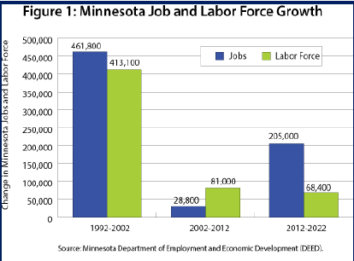
Minnesota is Growing
Minnesota’s labor force projected to grow by 2.3% and gain 68k+ jobs between 2012-2022
Notes:
Tom-

Slide 18
“If You Build it They Will Come”
Notes:
Tom- Focus on the market opportunity for diversified learning and modality
It’s no longer novel, it is expected by the consumer
We’re Not raising cannibals. And Not making rain.

Slide 19
Where Do We Go From Here?
Collaborate in areas where competition isn’t a huge hurdle.
Educate before you collaborate.
Consider each party’s affordable loss.
Solving problems makes you more attractive.
Get out of your office, off campus, and look globally!
This Photo by Unknown Author is licensed under CC BY
Notes:
Christine- Review the meme and the points

Slide 20
Co-Creation Activity
PEDAGOGY
STRATEGY
Share one of your
best practices or a
promising idea .
List an essential
strategy or share a
“what not to do”.
Leave us your name & email to get the results…
Notes:
Christine- In the spirit of innovation we are going to use the power of co-creation to share some more best practices with one another. In this session we have discussed e-learning pedagogy (or andragogy) and we have discussed that colleges and universities have to build e-learning into their strategic plan. Around the room you will see flip chart pages with either pedagogy or strategy. Please take a marker and note one of your ideas on each sheet- post more than one if you like.
When we get done with this we are going to scribe all the ideas into a mindmap and if you leave us your name and email we will share it with you via google docs in the hope we can start a conversation and perhaps new collaborations and opportunities to advance e-learning opportunities for Minnesotans and beyond.

