Slide 1
A website to support faculty with teamwork projects
Christina Petersen, PhD
Mary Jetter, MA
Center for Educational Innovation, UMN

Slide 2
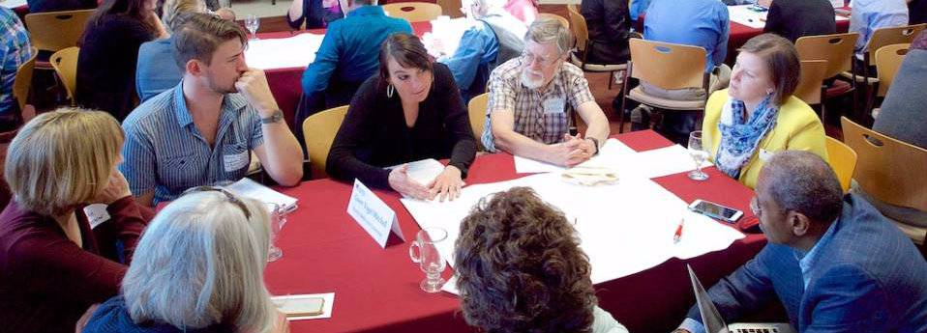
Why is a website needed?
How do I structure a team project?
My students hate team projects. They just aren’t worth the time.
How do I grade team projects?
What do I do about teams that don’t get along?
My students did an amazing job on their projects. Let me show you.

Slide 3
Our process for constructing the site
Survey of faculty & staff
Prototype
Feedback & improvements

Slide 4
Essential qualities of the site
Evidence-Based
Evolving
Stand alone
Concrete
Examples
Not
Overwhelming
NSP-0964-2DA-5N

Slide 5
Let’s have a tour
Insert full banner here

Slide 6
Why use team projects in my teaching?
Effective practice: Create team project to help students learn better, develop useful skills, and engage in more authentic work.
Benefits for students:
Higher-level reasoning skills
Spend more time on task
Persist longer
1
Notes:
Research evidence on benefits and we talk about student resistance (research shows sometimes the projects suck)

Slide 7
What are the characteristics of a successful team project?
Effective practice: Design an authentic task that requires both collaboration as well as distinct contributions.
Other factors to include:
Well-defined & relevant
Individual accountability
Team accountability
2

Slide 8
How do I introduce the project to get student buy-in?
Effective practice: Share with students the purpose and benefits of their team project
Manage student expectations
Tell them why they are doing this
Generate excitement
3

Slide 9
How do I form successful teams?
Effective practice: Create teams that are heterogeneous with respect to knowledge, skills and perspectives
Ways to do this:
Assign randomly
Assign based on relevant strengths
Allow student choice
4

Slide 10
How do I assess team projects?
Effective practice: Assess team output and individual student contributions and understanding
Team quizzes, exams and project
Peer review
Individual quizzes, exams, and report
5

Slide 11
How do I support students with their team projects?
Effective practice: Provide structure, time, and skill development training to your students.
6

Slide 12
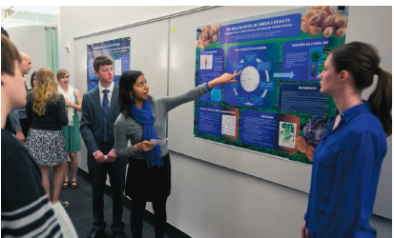
How do I wrap up a team project?
Effective practice: Share final team projects with the class and reflect on the outcomes
7
Image: Science, 2013

Slide 13
What questions or suggestions do you have?

