Slide 1
Upgrade your Teaching Tools 2.0
Dr. Sheri Hutchinson, Minneapolis Community and Technical College
Karen LaPlant, Hennepin Technical College
MN eLearning Summit
August 2-3, 2017

Slide 2
Session Description
Grab your mobile device and join us in this interactive session that will test your digital and computing skills! Learn how to identify the skills students need to successfully complete your class with equal access and flexibility.. Explore the classroom of the future with UDL practices and how to upgrade your knowledge..

Slide 3
Session Description-continued
Discover ways to shorten URL’s, create screenshots, capture whiteboard notes, and use apps in the classroom. Help to better use technology to engage students and improve skills.

Slide 4
Before We Begin
Just to gauge our demographics, please take a moment to raise your hand
What is your role at your institution:
Faculty?
LMS Site Administrator?
LMS Trainer?
Instructional Technologist?
Instructional Designer?
Other?
UDL and Application to Learning
Collaboration and Presentation
Office 365
Twitter, Tiny URL, Snip-it
VR Glasses
Digital Literacy

Slide 5
Before We Begin-continued
Just to gauge our demographics, please take a moment to again raise your hand
What type of institution are you from:
K-12?
2 year college?
4 year university?
Other?

Slide 6
Goals
Upon leaving this session:
demonstrate the use of multiple apps for active learning events of instruction
explain the use of various web and app based tools for teaching purposes

Slide 7
Overview
UDL and Application to Learning
Collaboration and Presentation
Office 365
Tiny URL, Snip-it
VR Glasses
Skills Students Need

Slide 8
No two students learn in the same way

Slide 9
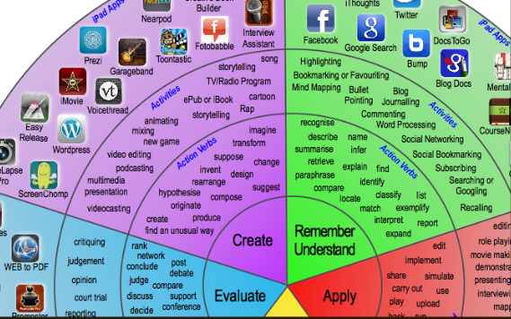
Variety of Engaging Tools for Instruction
Bloom’s Taxonomy Padagogy Wheel
Visit www.unity.net.au/padwheel/padwheelposter.pdf

Slide 10
What is Universal Design?
“The design of products and environments to be usable by all people, to the greatest extent possible, without the need for adaptation or specialized design.”

Slide 11
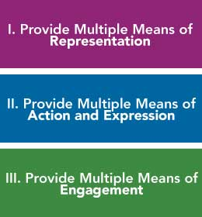
Principles of Universal Design
WHAT For resourceful, knowledgeable learners, present information and content in different ways.
HOW For strategic, goal-directed learners, differentiate the ways that students can express what they know.
WHY For purposeful, motivated learners, stimulate interest and motivation for learning

Slide 12
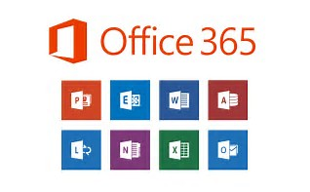
OFFICE 365 Make Life Universal!

Slide 13
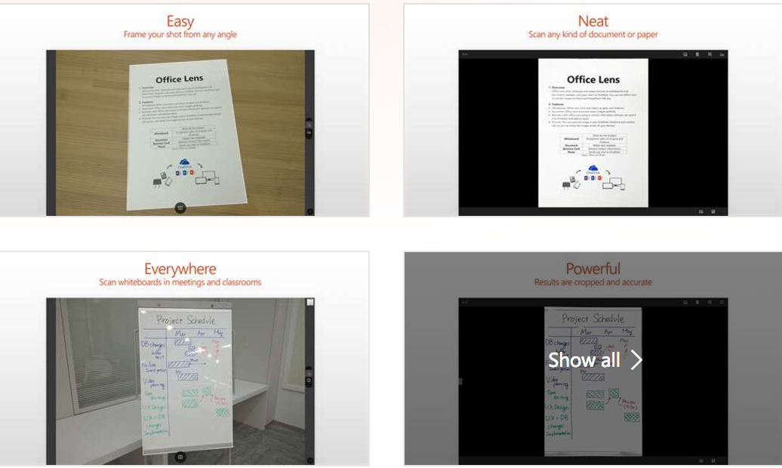
Activity 1: Office365 Getting Organized with Lens and Save to OneNote
Download lens to your smart phone
Must be a device with a camera!
Must have your phone connected with your Office365 through login

Slide 14
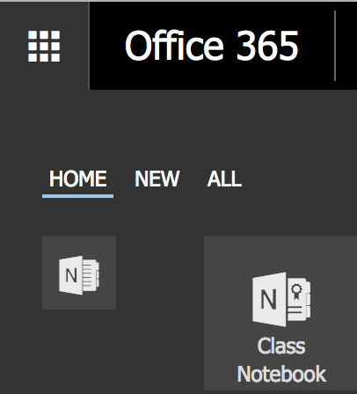
One Note
Add Video
Add Text
Use Whiteboard Lens

Slide 15
Office in Education
Inspire, engage, collaborate, and work wonders in and out of the classroom with Office365

Slide 16
Office365 Education for Students
available for free to students who are enrolled at qualifying school
Install Office on up to 5 PCs or Macs and on other mobile devices, including Android, iPad®, and Windows tablets
Check with your IT Department
Sign up at www.office.com/getOffice365

Slide 17
PowerPoint gets Interactive
Office Mix FREE add-in for PowerPoint2016 is a new way to tell your story with voice, video, inking, screen recording and interactive magic
Upload your lesson to the Microsoft Cloud
Share a link with your students to watch in any browser
https://mix.office.com
Notes:
PowerPoint now has an add in called Office Mix. Not available for Mac, however if you go to the Office Add in’s try WispBook Online Course Materials for quizzes and Youtube videos for Mac!

Slide 18
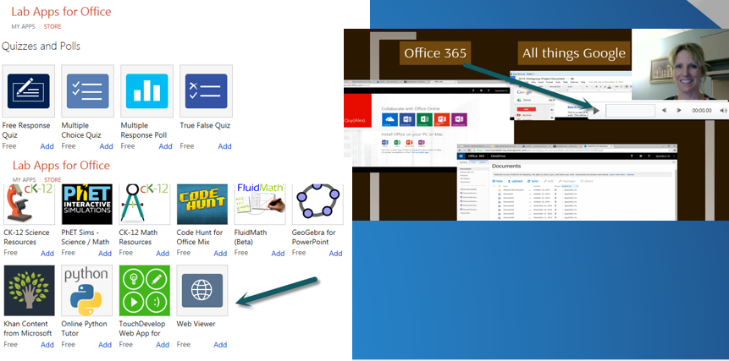
Office Mix eases your “tools” life

Slide 19
What is Sway?
Sway is a new presentation app for expressing your ideas in an entirely new way, across your devices
Drag and drop photos, videos, files from computer, Facebook, YouTube, Twitter, or cloud
Works via a browser or an app for your phone, and the presentation is stored on the web
Microsoft announced Sway in October 2014
Notes:
Sway is available for Mac

Slide 20
Add your content easily
Save time and stop switching between different apps to pull together your content
Sway is seamlessly integrated with OneDrive, your devices, social networks, and the web so you can drag and drop content right to your canvas
Link to introductory Sway

Slide 21
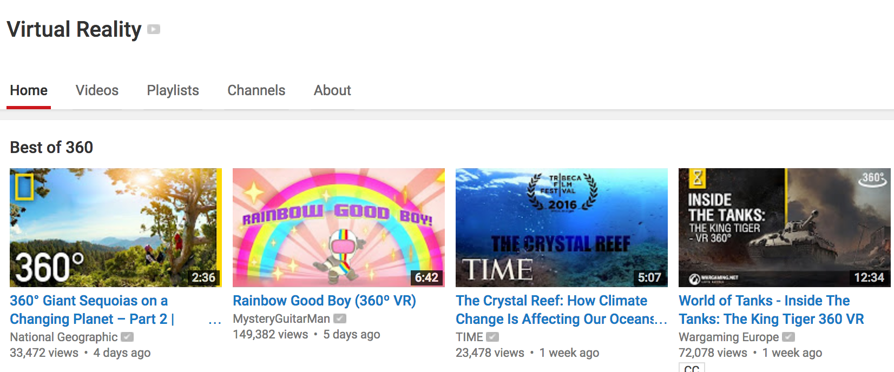
Activity 2
Grab your mobile device and search Youtube for 360 Video National Geographic

Slide 22
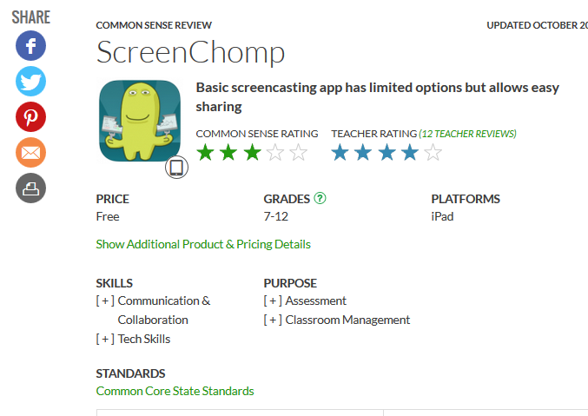
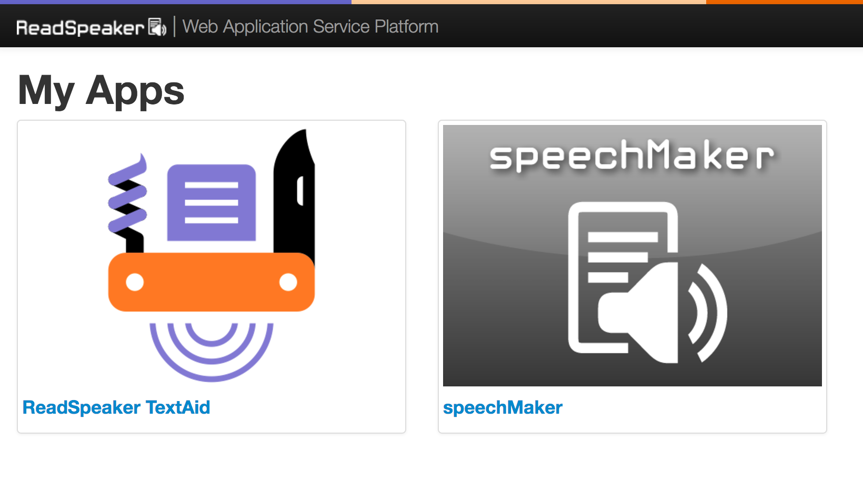
Screencasting and media Snipit(PC Built-in)—SnagIt—Camtasia Tons of Options free and for Purchase Speechmaker ReadSpeaker-Download Audio Files ScreenChomp iPad Video

Slide 23
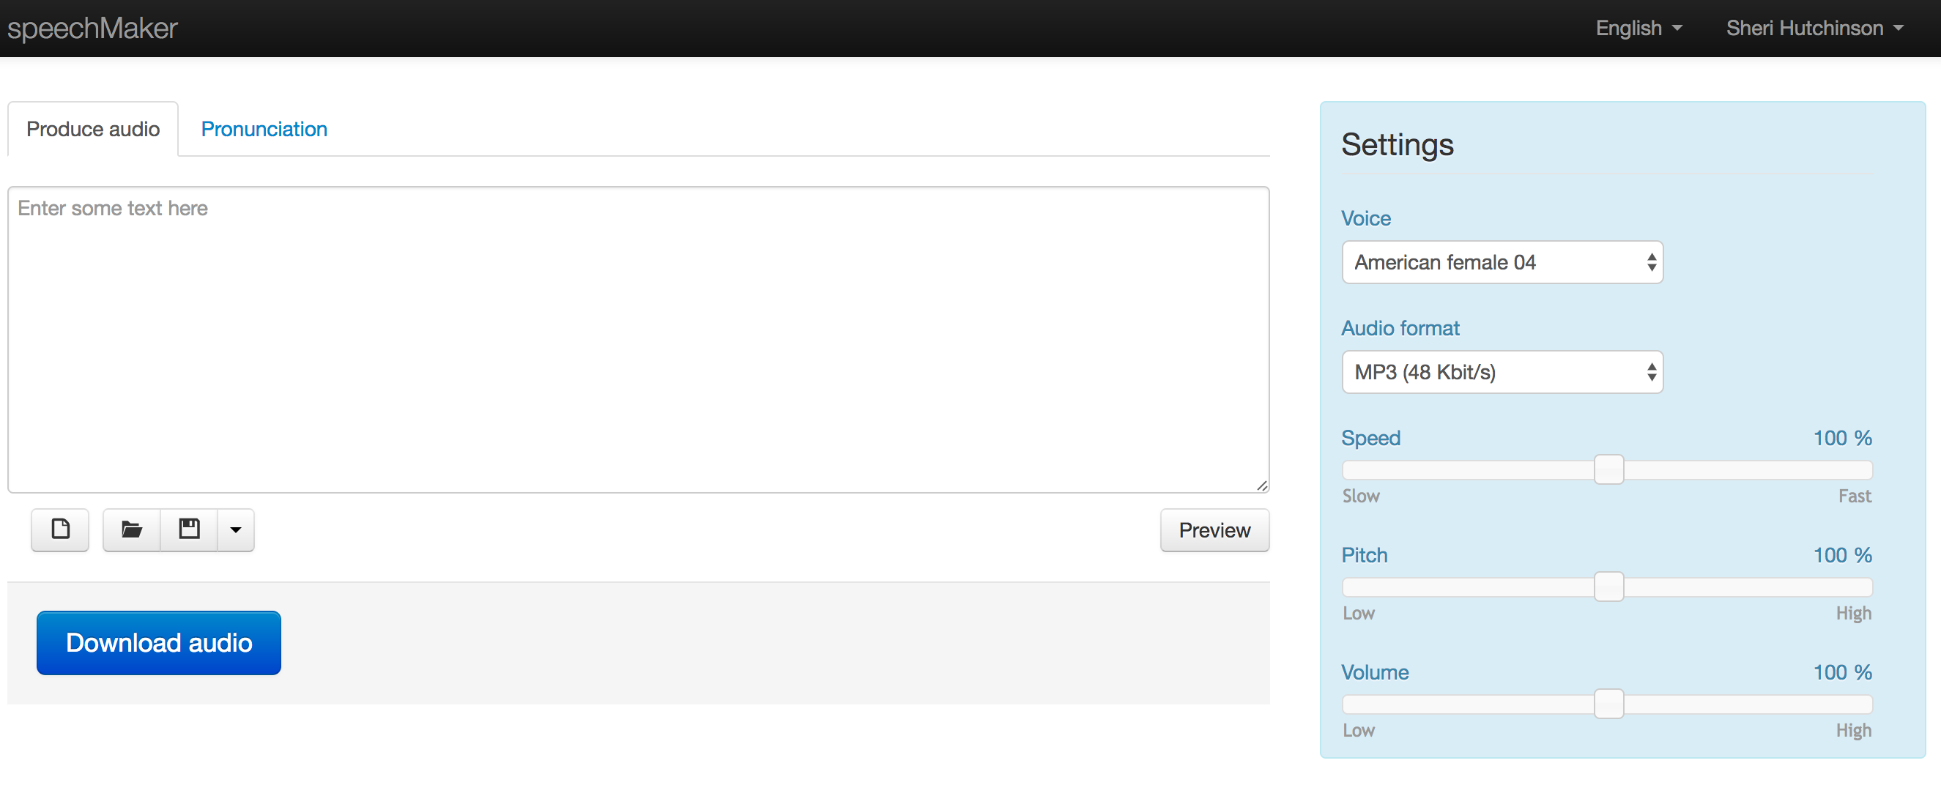
ReadSpeaker SpeechMaker App

Slide 24
Accessible Screen Reading
Key Features to look for
Integrates with LMS
Statistics
Reading and Writing Tools
Discussions and Quizzes

Slide 25
Virtual Reality (VR)
Blippar
Blippar uses image recognition and augmented reality to reach customers and turn mobile devices into engagement and advertising opportunities.
Virtual reality (VR) glasses are also known as augmented reality glasses. They allow an individual to experience game-like features in the real world. Some real world uses could be allowing an individual to access the internet on their glasses or contact lenses.
Youtube VR Channel

Slide 26
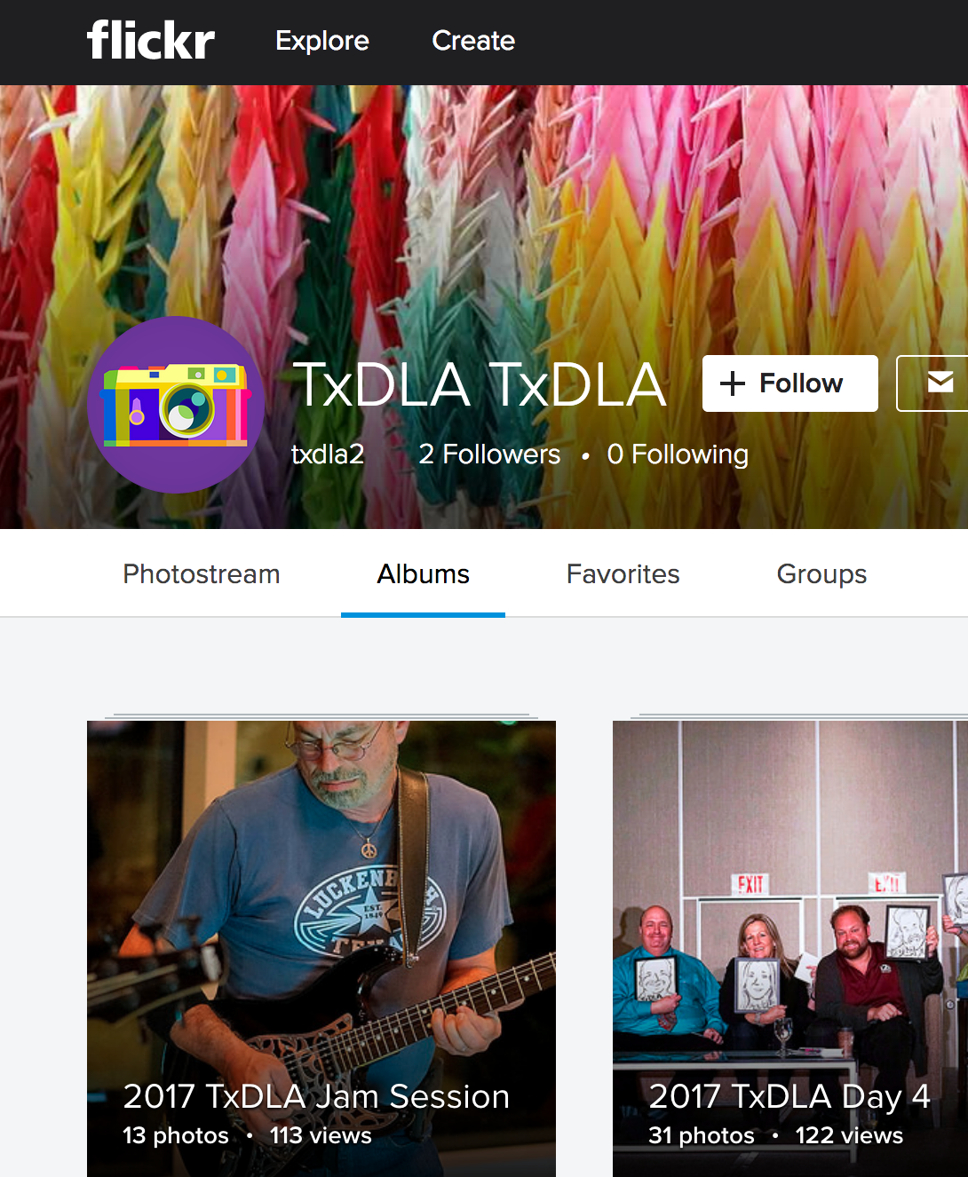
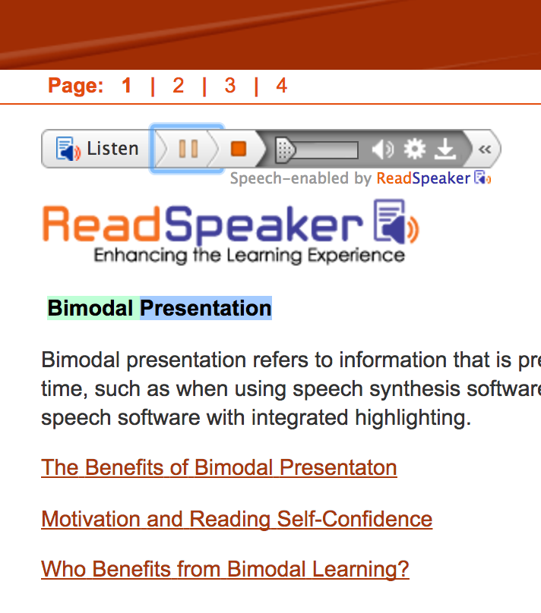
More Multimedia Authoring
Camtasia
Lodestar
Softchalk
Instagram
Flickr-Picassa Creating Albums
(TXDLA 2017)

Slide 27
Take Notes in One Note & Share
Write down two pre-skills that your students or you (please identify which audience you are writing for) will need to be digitally literate in this classroom of the future.
Tiny URL (www.tinyurl.com)Shrinks this : https://docs.google.com/document/d/1NFlze-Bxf2GT2CxeX2GqHpdUHtSQF6y4bGoy3lK4YHU/edit?usp=sharing

Slide 28
Resources
Atomic Learning
Lynda.com (Hennepin County Library, Anoka and Ramsey and LinkedIn)
NorthStar Digital Literacy Assessment

Slide 29
Atomic Learning Resource
Hoonuit Online Learning Framework
LearnIt
DoIt
ShareIt
ProveIt

Slide 30
Resources Galore
Faculty Development Resources: http://www.normandale.edu/current-students/academic-resources/professional-development-center/teaching-tools
@pps for instructors; Learning Activity Library; MNSCU Website; Active Learning; Audio Recordings; Screen Capture, etc
Augmented Reality Resources: http://daqri.com/
NorthStar Digital Literacy Assessment: https://www.digitalliteracyassessment.org/
Atomic Learning: https://www.atomiclearning.com/

Slide 31
THANKS FOR ATTENDING
Dr. Sheri Hutchinson
sheri.hutchinson@minneapolis.edu
Karen LaPlant
Karen.LaPlant@hennepintech.edu

