Slide 1
What does it mean to be Transgender or
Gender Non-Conforming?
A MOOC on Diversity and Inclusion
Rebecca Graetz, EdD
Program in Human Sexuality
Family Medicine and Community Health
University of Minnesota Medical School
rlgraetz@umn.edu

Slide 2
What is a MOOC?
Massive Open Online Course
A MOOC is an open-access online course that allows for unlimited participation.
As of February 2017, Coursera offers 2,000+ courses from 149 university partners with over 180 specializations and 4 Masters Degrees.
Coursera provides universal access to some of the world’s best education, partnering with top universities and organizations to offer courses online.

Slide 3
Education for Social Impact Campaign
The Education for Social Impact Campaign is an opportunity for Coursera Partners to connect learners with high-quality, socially conscious content that equips them with the skills they need to be drivers of social change.

Slide 4
Process for Approval
Subject idea was brought to Dr. Bob Rubinyi, Senior Analyst for Online Learning, at UMN by Rebecca Graetz. This was approved by the Center for Education Innovation to move forward.
Submission to Coursera in December 2016 and approved as part of Coursera’s Education in Social Impact Campaign. A “sandbox” was provided for development to instructional designer to start working in platform.
Split revenues between Coursera, PHS and University of Minnesota Foundation. Coursera provides marketing, enrollment, professional web auditing and digital analytics to PHS.

Slide 5
Audience

Slide 6
What’s in a module in Coursera?
Module
Digital Story
Assessments
News Articles
Media Clips

Slide 7
Module 1: Introduction to Gender Identity
Gender 101
What does it mean to Identify as transgender or Gender Non-Conforming?
Pronouns and Importance of Language
Science and Theory of Gender Development
Dysphoria and Mental Health

Slide 8
Module 2: Digital Stories
Digital Stories
Parenting and Family
Dating and Relationships
Digital Stories

Slide 9
Module 3: Understanding the Process of Gender Affirmation
Gender Affirmation: Children and Youth
Gender Affirmation: Adults
Coming Out

Slide 10
Module 4: History and Culture
Historical Role Models and Events
Artistry
Media and Pop Culture

Slide 11
Module 5: Society and Public Policy in the United States
Transgender Rights Overview
Legal Issues and Discrimination in America
Intersectional Identities
Homelessness
Anti-Transgender Violence
Incarceration
Health Care Disparities
Military Personnel

Slide 12
Module 6: Creating Inclusive Spaces
How to Become an Actionable Ally
Gender Diversity in the Workplace
Creating Gender Affirming Environments
Where do we go from here?

Slide 13
Collecting Content and Cost of MOOC
Email blasts from Program in Human Sexuality (PHS) by Research Intern who is a 3rd year medical student at UMN. This included funders, authors, artists and anyone who has a connection with PHS.
Original video content was recorded with iPad and edited in Movie Maker and Camtasia Studio 9.
Releases were signed for PHS and Coursera.
Some honorariums where paid to organizations who submitted content. Funds were donated to PHS.

Slide 14
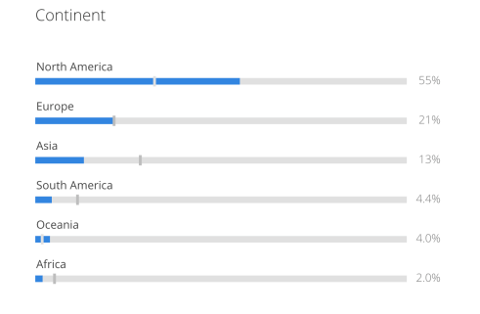
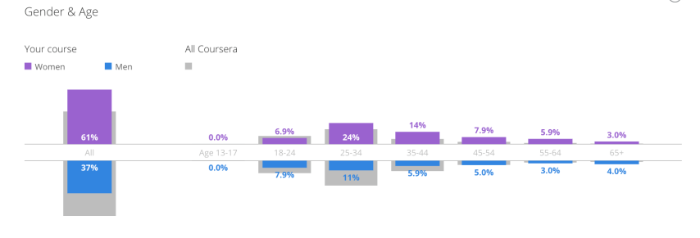
Analytics
As of July 31, 2017
Visitors: 1961
Enrolled in Course: 592
Countries represented: 60
Education for Social Impact Campaign launches August 1, 2017 and course starts again on August 7, 2017.

Slide 15
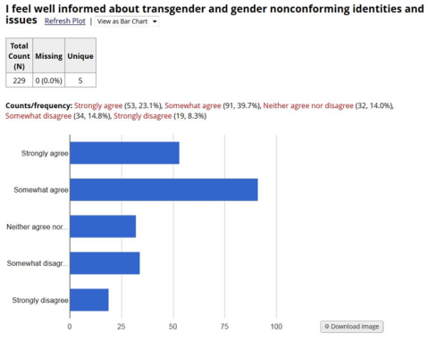
Pre-assessment Data in REDCap
Pre-Assessment in REDCap

Slide 16
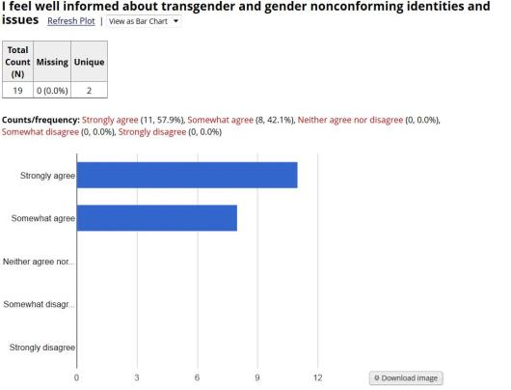
Post-Assessment in REDCap

Slide 17
Community Advisory Board

Slide 18
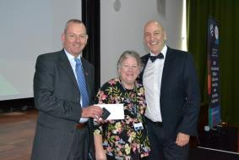
2017 International HETL Poster Award
University of Western Scotland - Paisley Campus
June 28-30, 2017
Creating Inclusion and Diversity in Higher Education
Journal of Applied Research in Higher Education

Slide 19
Contact Information
Dr. Rebecca Graetz
Instructional Designer
Program in Human Sexuality
Family Medicine and Community Health
University of Minnesota Medical School
rlgraetz@umn.edu
Christina Warner
UMN 3rd Year Medical Student
warne015@umn.edu

