Slide 1
Six Pack to the Rescue:
3rd Party Integrations
Karen LaPlant, Hennepin Technical College
Dr. Sheri Hutchinson, Minneapolis Community
and Technical College
MN eLearning Summit
August 2-3, 2017

Slide 2
Session Description
Want to get your online classes ready to show off a marvelous six-pack?
Exercise your choice by joining us to hear how two faculty members have been successful with the implementation of this six-pack of 3rd party LMS Integrations.

Slide 3
Session Description-continued
Improve your student engagement and success rates by one or more of the following 3rd party tools to be presented:
Zoom
Atomic Learning
ReadSpeaker
Cengage (Mindtap)
Pearson (MyIT Lab)
Office365

Slide 4
Session Description-continued
We will demonstrate how we use these products in a variety of blended and online courses at both of our institutions with the result of engaging students with access to rich learning applications.

Slide 5
Before We Begin
Just to gauge our demographics, please take a moment to raise your hand
What is your role at your institution:
Faculty?
LMS Site Administrator?
LMS Trainer?
Instructional Technologist?
Instructional Designer?
Other?

Slide 6
Before We Begin-continued
Just to gauge our demographics, please take a moment to again raise your hand
What type of institution are you from:
K-12?
2 year college?
4 year university?
Other?

Slide 7
Agenda Topics for the Healthy Six-Pack
LTI Integrations and Definitions
Web Conferencing with Zoom
Student Self-Help with Atomic Learning
Publishers LTI: Pearson and Cengage Mindtap
Text to Speech with ReadSpeaker
Office365 Widget in D2L Brightspace

Slide 8

LTI Overview
Get Healthy and integrate 3rd party and publisher content into an online course
Engage students with access to rich learning applications through their familiar LMS interface
Improve student success and retention rates by reaching diverse student populations

Slide 9
What is LTI?
Principal concept of Learning Tools Interoperability (LTI) is to establish a standard way of integrating rich learning applications with platforms like learning management systems (LMS)
LTI enables tool consumers to connect and transfer information to tool providers
Tool providers consist of commercial tools vendors that write and host tools for eLearning
  Examples include wikis, simulations or publisher content

Slide 10
Who is Using LTI?
Many learning management systems, including the most widely used in education across the world, already support LTI
Growing list of application and content vendors
Systems and applications that have achieved official conformance are listed on the IMS website

Slide 11
What is LTI Certification?
A commitment by a supplier to the IMS community for ongoing support for achieving "plug and play" integration
It implies ongoing commitment to resolve problems, revise implementations and retest as need
LTI, as a standard from IMS Global Learning Consortium, allows users to access external learning tools from courses without logging into the tool

Slide 12

Web Conferencing Advantages
Online Office Hours
Online Orientation
Help Sessions
Record and Review Later
Conduct Remote Classes
Easy to Use
Free Demo License to Try-Out
Share screens quickly
No Downloads Required—Just a simple, fast plug-in

Slide 13
ZOOM
This LTI link may be shared to all courses. This allows instructors to use it, but does not automatically place the link within the course.
For basic instructions on how to use the D2L integration, please refer to the Minn State support page about ZOOM LTI Integration as of 3-14-2016:
https://d2l.custhelp.com/app/answers/detail/a_id/1674
Additional Support
Additional support resources for Zoom can be found at: https://support.zoom.us/ https://support.zoom.us.
https://d2l.custhelp.com/app/answers/detail/a_id/1674
https://d2l.custhelp.com/app/answers/detail/a_id/1674

Slide 14
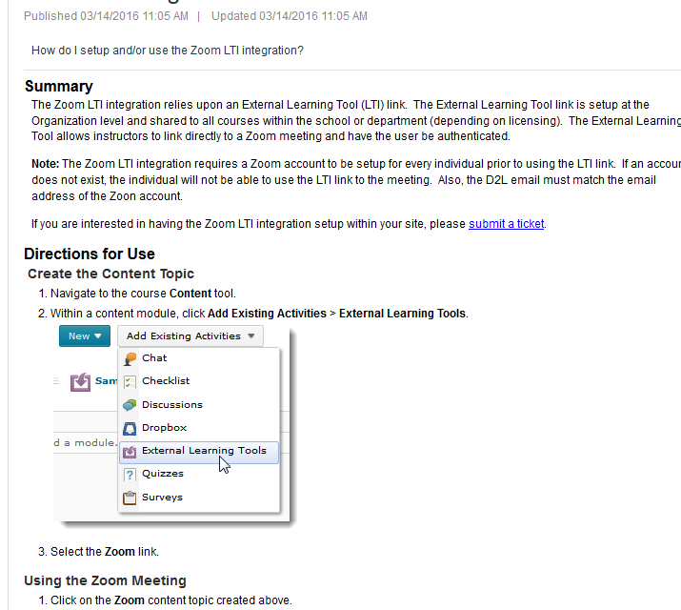
ZOOM

Slide 15
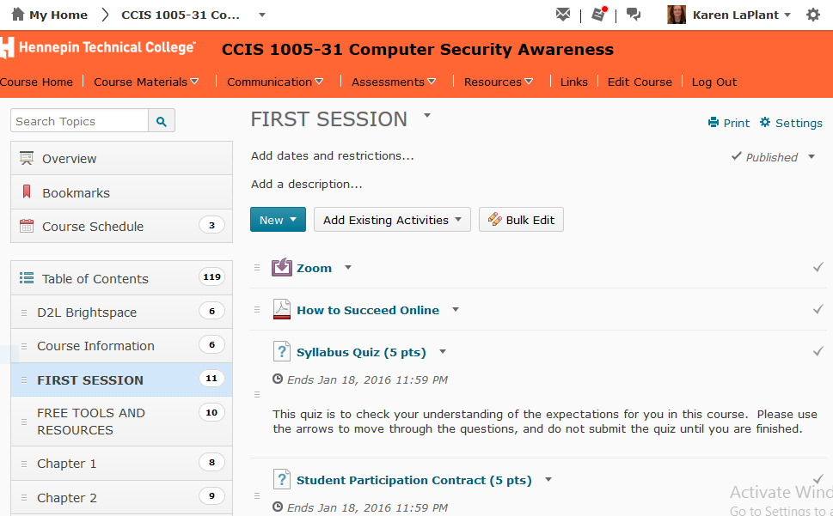
ZOOM Inside D2L

Slide 16
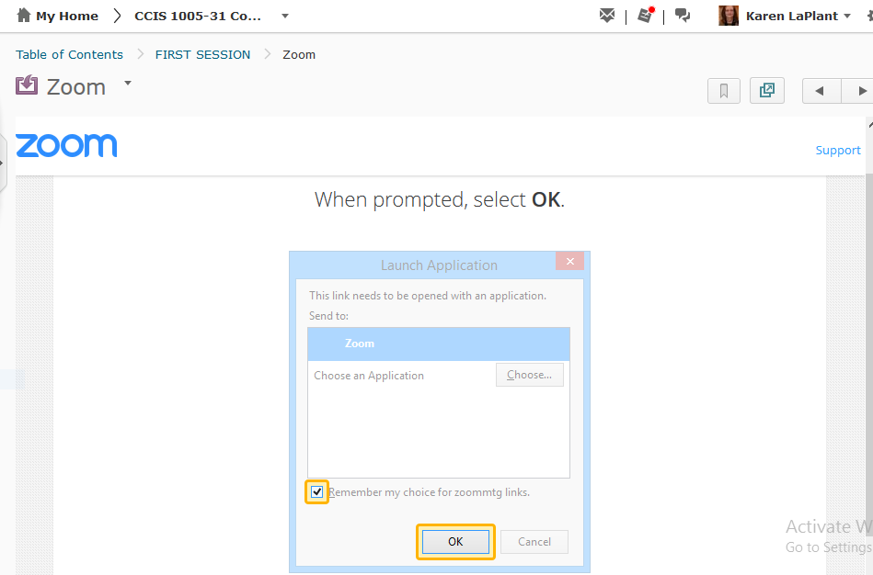
ZOOM

Slide 17

Atomic Learning
    Develop Self-Efficacy Skills
    Via deep links that seamlessly open content directly into LMS-whether tutorials or assessments
    With a subscription to Atomic Learning students automatically open specific Technology Training video content that the instructor has chosen and progress can be tracked unlike external resources
    Self-Help Training and Self-Assessments

Slide 18
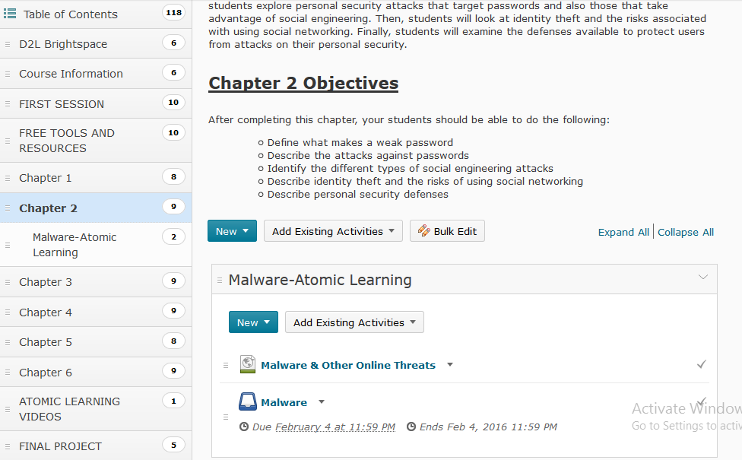
Atomic Learning Inside D2L

Slide 19
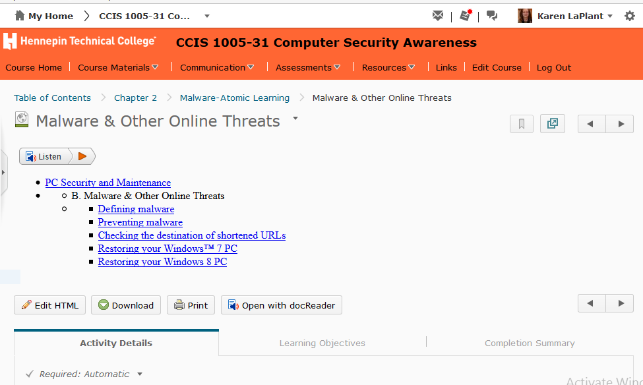
Atomic Learning Inside D2L

Slide 20
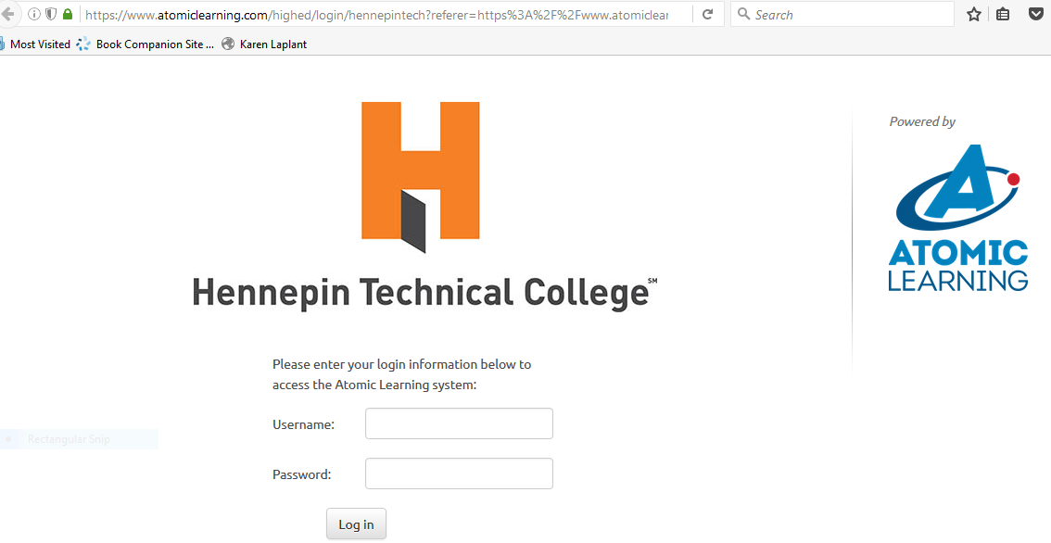
Atomic Learning Inside D2L

Slide 21
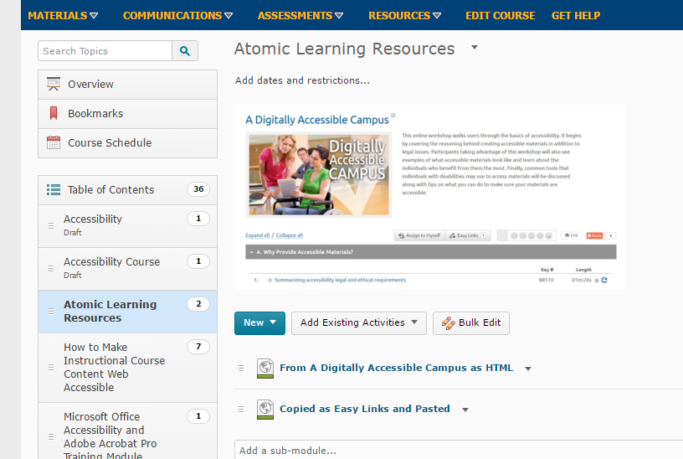
Inside D2L Brightspace: Atomic Learning
Notes:
Search Atomic Learning for things like Accessibility, Technical training, writing skills, career skills and much more. Use Easy Links or use HTML and embed

Slide 22
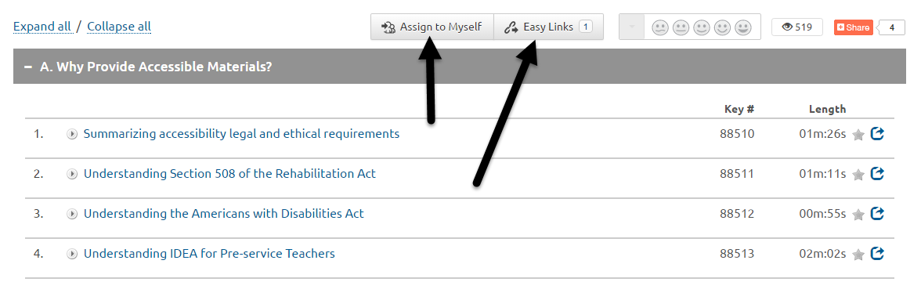
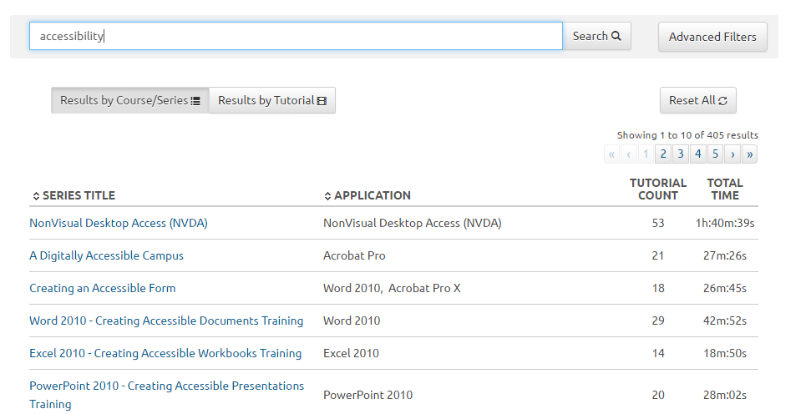
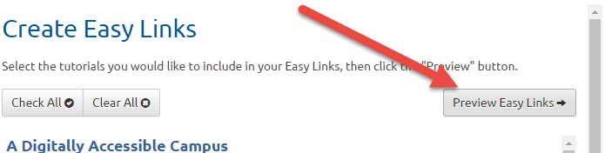
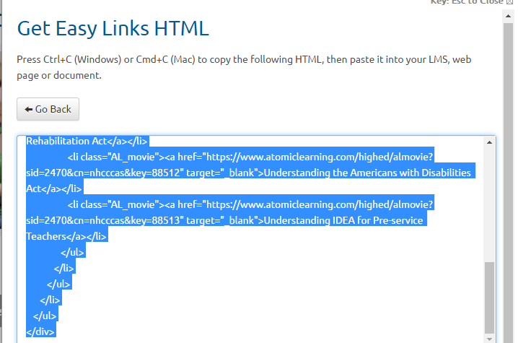
Easy Links and Easy HTML

Slide 23
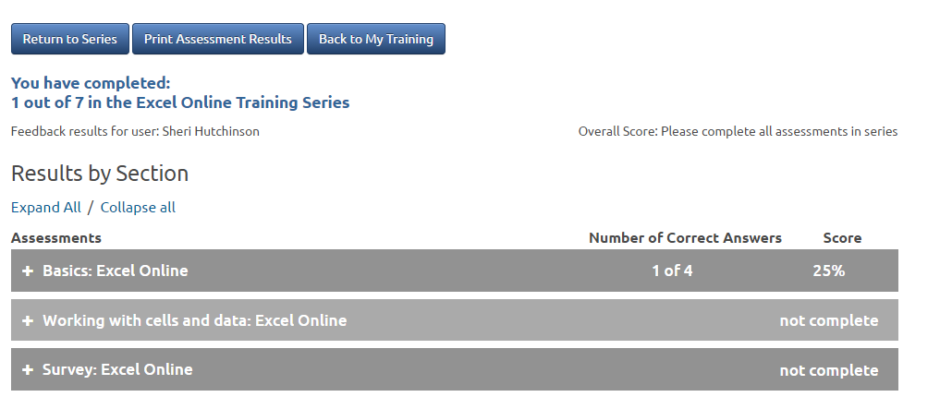
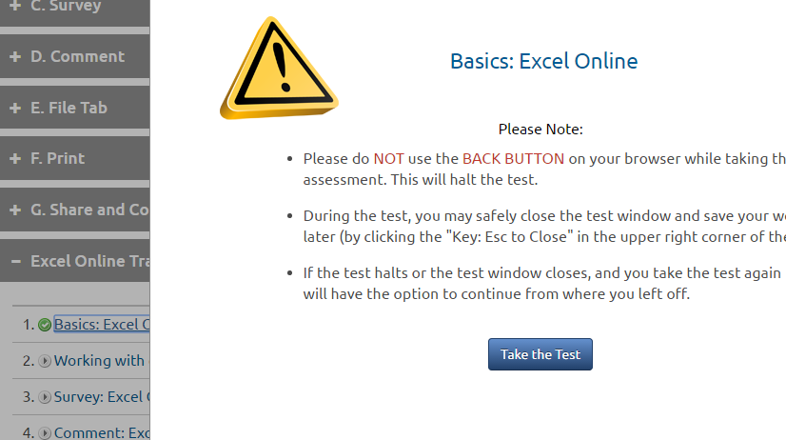
Atomic Learning Assessments

Slide 24
Advantages of Publishers
Without LTI:
  Student must log into eLab or any learning tool separate from their LMS to access resources and assessments
  Instructors must manually transfer scores via Excel or other methods to their LMS
Utilizing the LTI App, students can now access all course content:
  Including videos, assignments, and tests from links within their course in LMS

Slide 25
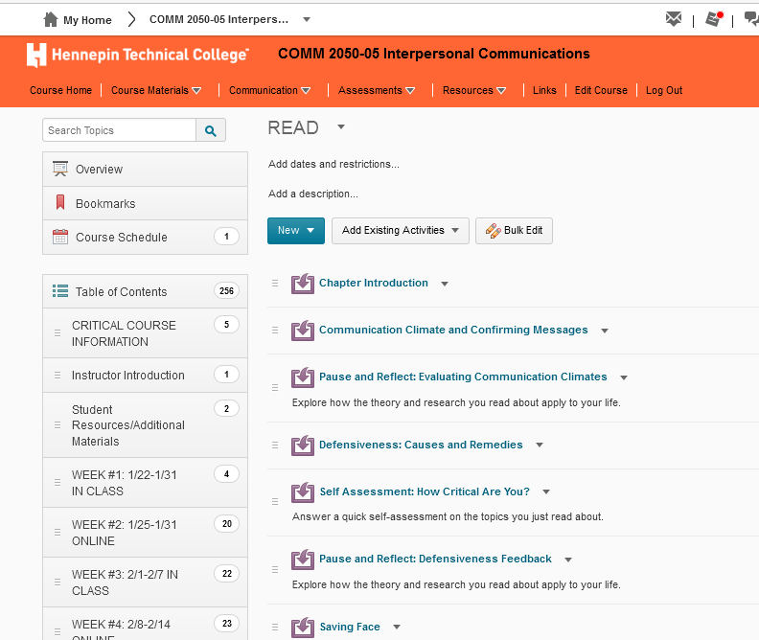
Cengage MindTap

Slide 26
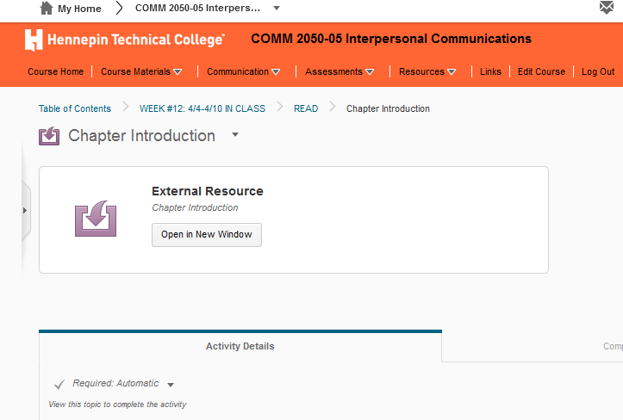
Cengage MindTap

Slide 27
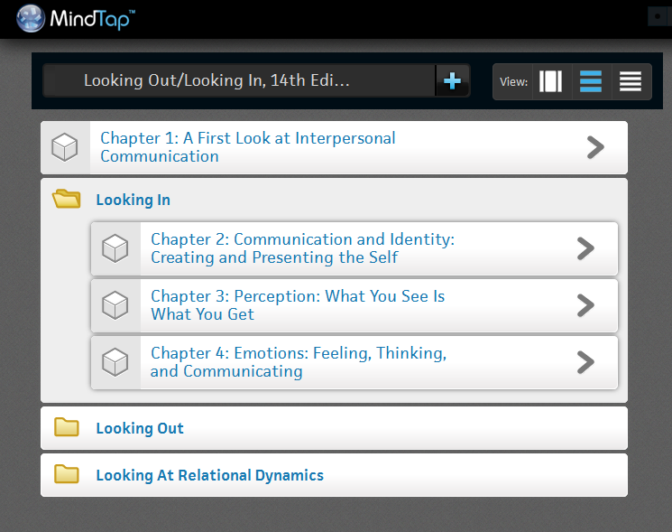
Cengage MindTap

Slide 28
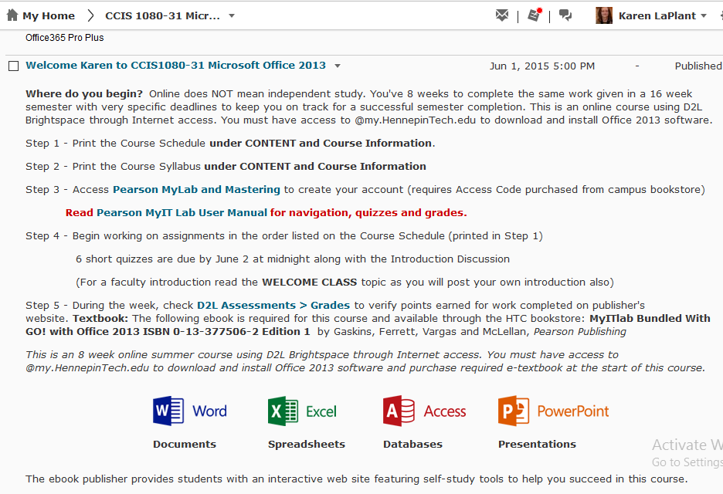
Pearson MyIT Lab

Slide 29
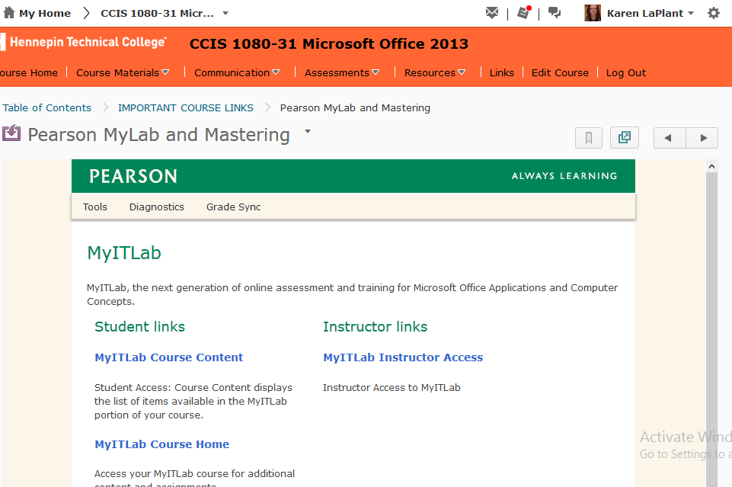
Pearson MyIT Lab

Slide 30

eBook Capabilities
Interactive Capabilities
Bookmark
Highlight
Read Aloud
Notes
Video
Practice Quizzes

Slide 31
Benefits of Publishers LTI 1.1
LTI 1.1 app makes it easy for instructors to integrate into D2L
  Allows you to use publisher content that can’t be uploaded into LMS by seamlessly integrating eLab into LMS and tracking user progress in LMS
  Student can work within LMS familiar platform
  Student can access publisher content without logging in to another platform
  Allows instructor to manage their grades from within LMS without having to import from external platform
  Flexibility around where instructors can add the content for their course.
    For example, course is split into 16 weeks – you can put in access to the videos for that week – the information for what makes sense for your course organization and students.
    Add tests / assignments where you want it or need it by week or by lesson

Slide 32
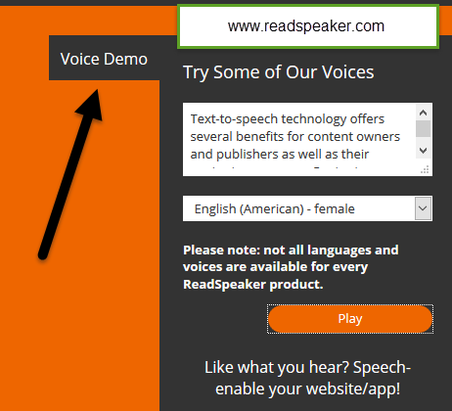

Human Voices with ReadSpeaker
Improve Student Outcomes and Meet Universal Design Needs
Mobile Friendly
Easy to Use
Cost Effective
High Quality Voices
Customizable

Slide 33
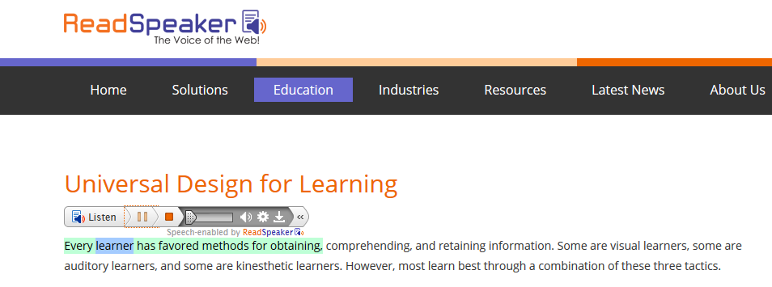


Text to Speech: ReadSpeaker LTI
Change Highlighting and text font colors
Speed up or Slow Down Reading
Increase text visibility

Slide 34
Read Quizzes with LTI
ReadSpeaker LTI Example
Sign up for Free Textaid Account—but must be LTI to read Discussions and Quizzes!

Slide 35
Who Benefits from Text to Speech
Low Illiteracy
Dyslexia
Low Vision or No Vision
Multi-taskers
Returning Adults
Mobile Users
Cognitive or other Disabilities
ELL-English Language Learners

Slide 36
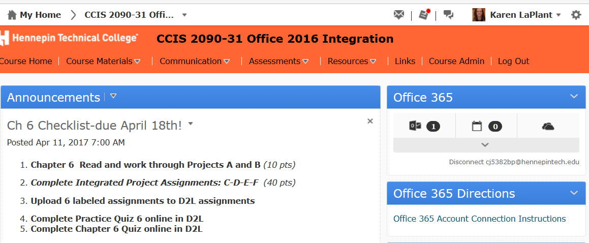
Office 365

Slide 37
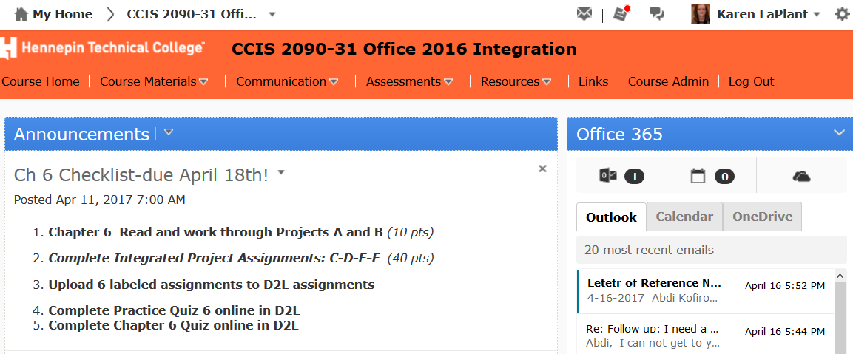
Office 365

Slide 38
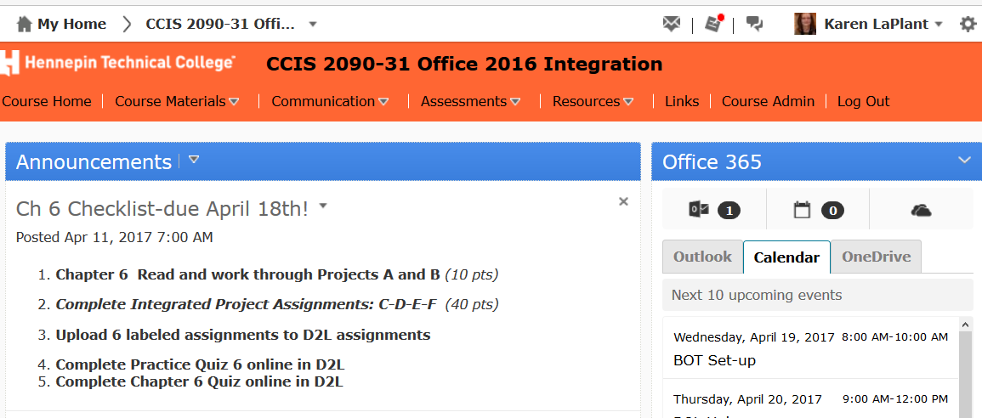
Office 365

Slide 39
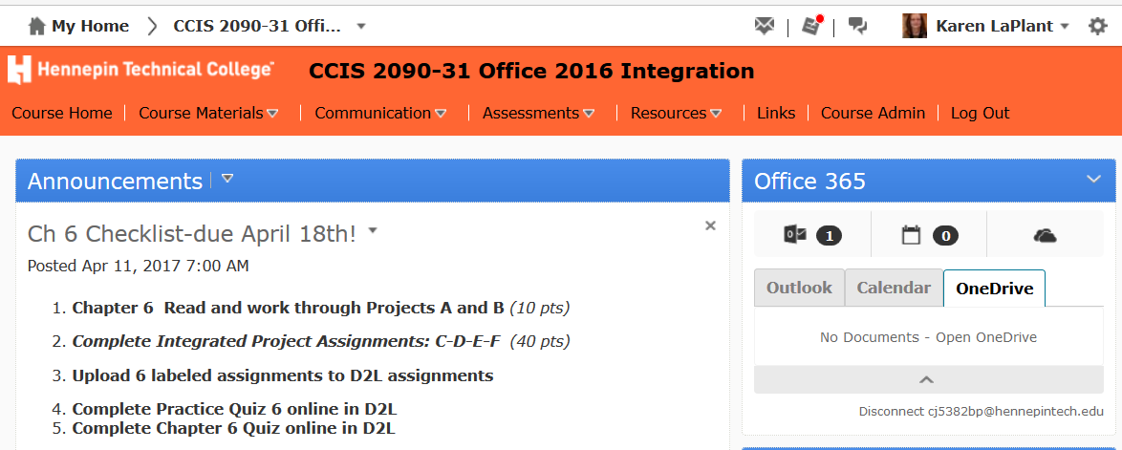
Office 365

Slide 40

Questions & Answers ???
List of MinnState 3rd party integrations within D2L Brightspace:
https://d2l.custhelp.com/app/answers/detail/a_id/1519/kw/lti%20list
https://mnscu.sharepoint.com/sites/d2lintegrations/SitePages/Home.aspx

Slide 41
LTI Benefit Summary
Single signon (students stay within course)
Gradebook Synch with Publishers
Straightforward integrations with third party tools, or tools you build in-house
Employs a standards based approach to allow for a more user friendly process
Compatible with a continually growing, large list of teaching and learning tools in the market

Slide 42
Thank you for attending!
Karen LaPlant, Faculty
Hennepin Technical College karen.laplant@hennepintech.edu
Dr. Sheri Hutchinson, Minneapolis Community and Technical College sheri.hutchinson@minneapolis.edu

