Slide 1
Discussing Discussions: How to Write Discussion Questions to Drive Engagement in the Online Classroom
Renée Cedarberg
Metropolitan State University
August 3, 2017

Slide 2
Agenda
Introductions
Why discussions?
How to write great discussion questions
Techniques to drive discussions, not just postings
Tips and tricks for grading discussions

Slide 3
It’s a discussion board, not a posting board!

Slide 4
How to Manage
Writing Questions
Setting Expectations
Facilitating
Grading
Discussion Roadmap

Slide 5
What makes a great discussion? It starts with a good question…
What is the goal of the discussion? How does it relate to the content in the module?
What types of other media do you want to use to accomplish the learning objectives of the module? Can you tie them together?
Textbook
Articles
Movies / YouTube clips
Podcast
Training module
Case study
Complete a part of a project
Develop research skills
Reflection
Giving Feedback
How to Manage
Writing Questions
Setting Expectations
Facilitating
Grading
Discussion Roadmap

Slide 6
How to write great discussion questions
A discussion can be part of a group or individual project – the discussion answer can get a project started
Ground questions in a case study that is used that week or throughout the semester
Link to a movie / online video and ask students to react
Link to an online survey or assessment and get reactions
Ground questions in current articles – consider compare / contrast of 2 articles
Be sure students practice key skills
Using outside resources
Writing in a specific style
How to Manage
Writing Questions
Setting Expectations
Facilitating
Grading
Discussion Roadmap

Slide 7
Individual / Small Group Activity
Take 10 minutes to review the Sample Discussion Questions document in D2L
Write a new discussion question for your course
In your small group, share questions and offer suggestions and recommendations
How to Manage
Writing Questions
Setting Expectations
Facilitating
Grading
Discussion Roadmap

Slide 8
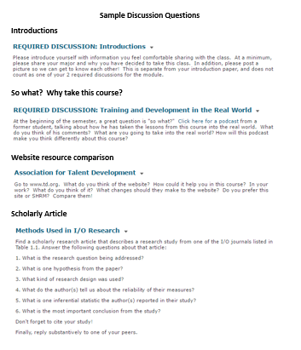
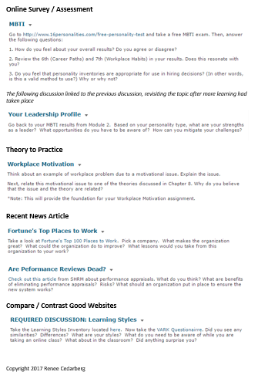
Individual / Small Group Activity
How to Manage
Writing Questions
Setting Expectations
Facilitating
Grading
Discussion Roadmap

Slide 9
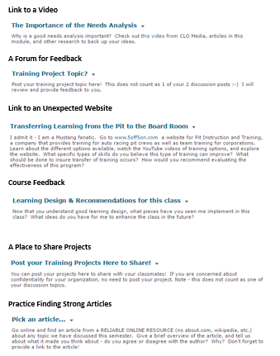
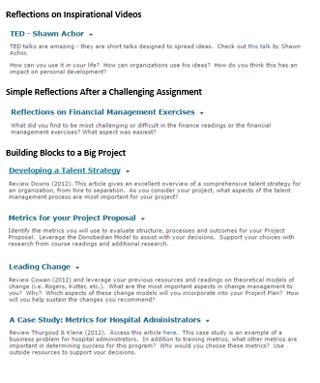
Individual / Small Group Activity
How to Manage
Writing Questions
Setting Expectations
Facilitating
Grading
Discussion Roadmap

Slide 10
Discussion Expectations Must Haves
What is a good post?
When do you need to post? Respond?
What is an “A” grade for discussions?
What are the minim number of initial posts?
What are the minimum number of responses?
Outside resource expectations
Nettiquette expectations (can just be in the syllabus)
How to Manage
Writing Questions
Setting Expectations
Facilitating
Grading
Discussion Roadmap

Slide 11
Techniques to Facilitate Discussions
Be present
Respond to every single person’s introduction post
Have a dedicated place for questions, and check it regularly
Be purposeful with your schedule
Consider bi-weekly modules
Choose when to read and respond to discussions
Pick your voice – and adjust it as needed
Use Full-Spectrum Questioning
Ask students good questions to get them thinking
Encourage debate by starting it yourself and supporting those who disagree
Grade responses
Commend great threads in the discussion thread, and tell students to keep it up!
Jump in and participate – share your thoughts, ideas and experiences
How to Manage
Writing Questions
Setting Expectations
Facilitating
Grading
Discussion Roadmap

Slide 12
Grading Discussions…keep it simple
Provide clear expectations – consider a rubric
Be purposeful with your time
Model what you want to grade
Acknowledge great posts
Track information
Give full-class feedback, but give options for individual feedback
How to Manage
Writing Questions
Setting Expectations
Facilitating
Grading
Discussion Roadmap

Slide 13
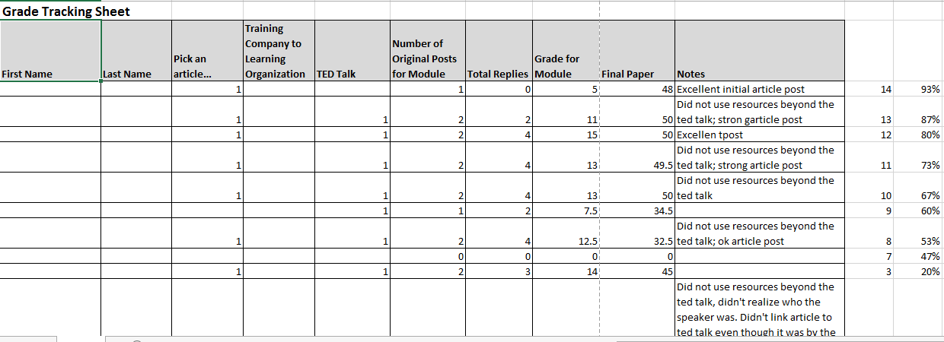
Sample Discussion & Grade Tracking Sheet
How to Manage
Writing Questions
Setting Expectations
Facilitating
Grading
Discussion Roadmap

Slide 14
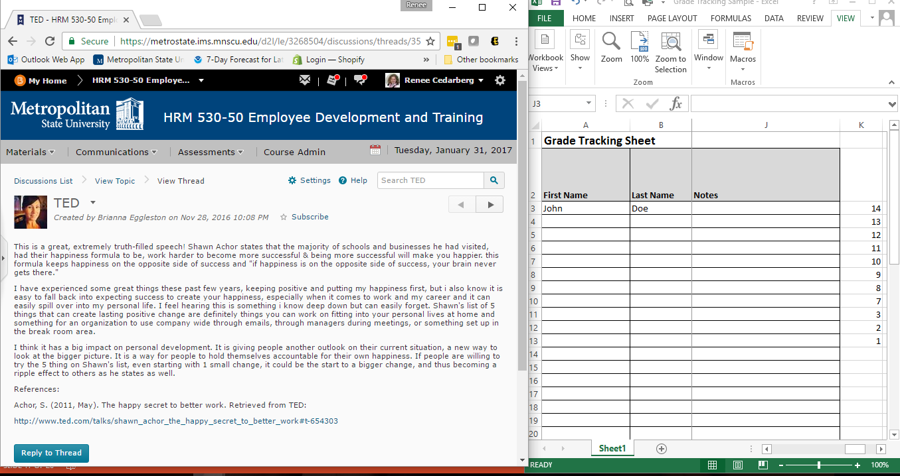
How to Manage
Writing Questions
Setting Expectations
Facilitating
Grading
Discussion Roadmap

Slide 15
Questions?

