Slide 1
The Instructor Is STILL In: Sustaining Presence in the Online Environment
Carol Lacey
Renee Cedarberg
Metropolitan State University
August, 2017

Slide 2

What do students need?
Notes:
Elicit discussion on this –how do we do all this
How do we let our students know we are there and we do care—without being there 24/7? (ex1/2)
Start up: Introduce yourself and share one way you’re “there” for your online students – whole room
Renee and Carol to introduce ourselves first

Slide 3
Agenda
Set the stage
Keep it relevant
Create connections
Convey more than information—why the subject/course matters to you
Give feedback, not just grades
Notes:
Renee – ask everyone which area they are most interested in, and then we can jump to it

Slide 4
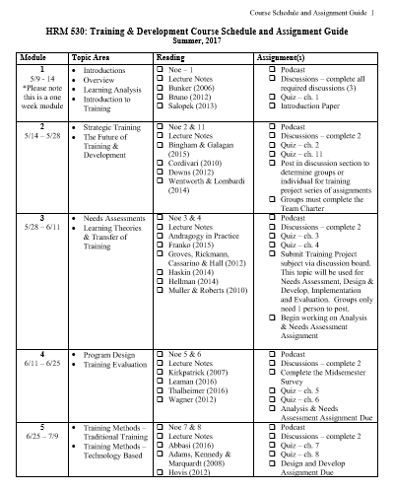
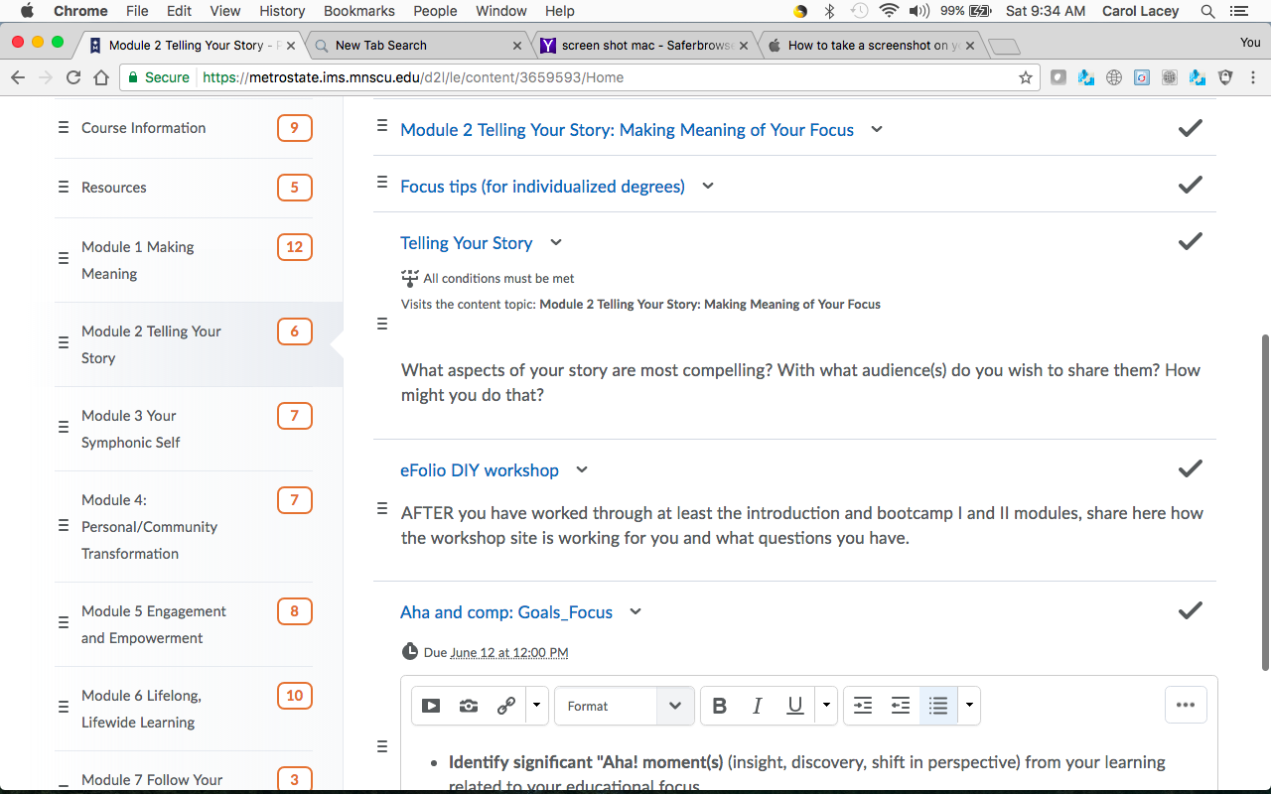
Set the stage: Organize
Notes:
Carol Primary – Renee Secondary
2 Options depending on your student style:
Carol to review how she lays out her Content section based on the above screen shot
Renee to review how students need a printable copy of information – so this is Course Schedule and Assignment Guide is how everything is organized
Combine the 2 options so they are better – I do both for every module.

Slide 5
Set the stage: Introductions
How do you introduce yourself in the traditional classroom? (Chat group)
How do you introduce yourself online? (Chat group)
Notes:
Carol to lead and start by talking about Virtual Tours, and then break into chat groups then go to the next slide

Slide 6
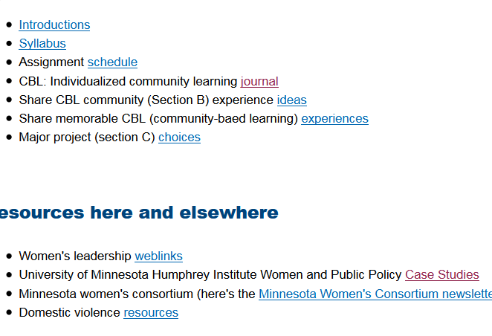
Set the stage: Introductions
Virtual Tour
What did you hear?
What new options did you discover or think about to introduce yourself online?
Notes:
Carol to lead the What did you hear discussion – and I will jump in and talk about how Carol taught me about the virtual tour
Use these questions afterwards
Feedback from groups (what did you hear?)
What new options did you discover or think about to introduce yourself online?
Ideas to elicit:
-Create a video or audio of yourself (personal info can go here)
-Create a virtual Course Tour showing people how to navigate the course (this is SOP for all my courses)
I also have audio intros to each module (both of us do, I think!)
-Leverage a podcast (you’ll have to do this-I haven’t gotten to that!)
-Be sure to include personal information about yourself, just like you would in a traditional classroom.

Slide 7
Building a Virtual Tour
Students arrive in your virtual classroom with widely varying prior experience, both with technology and with IMS/online delivery formats.
Goals:
  Get students into the site beyond the cover and first module.
  Help students easily find key information (syllabus, schedule, etc.)
  Connect to starting assignments, such as introductions on discussion forum.
  Pique interest by connecting them to particularly interesting resources, webpages, assignments. If possible, include a link to something current of relevance to the class.

Slide 8
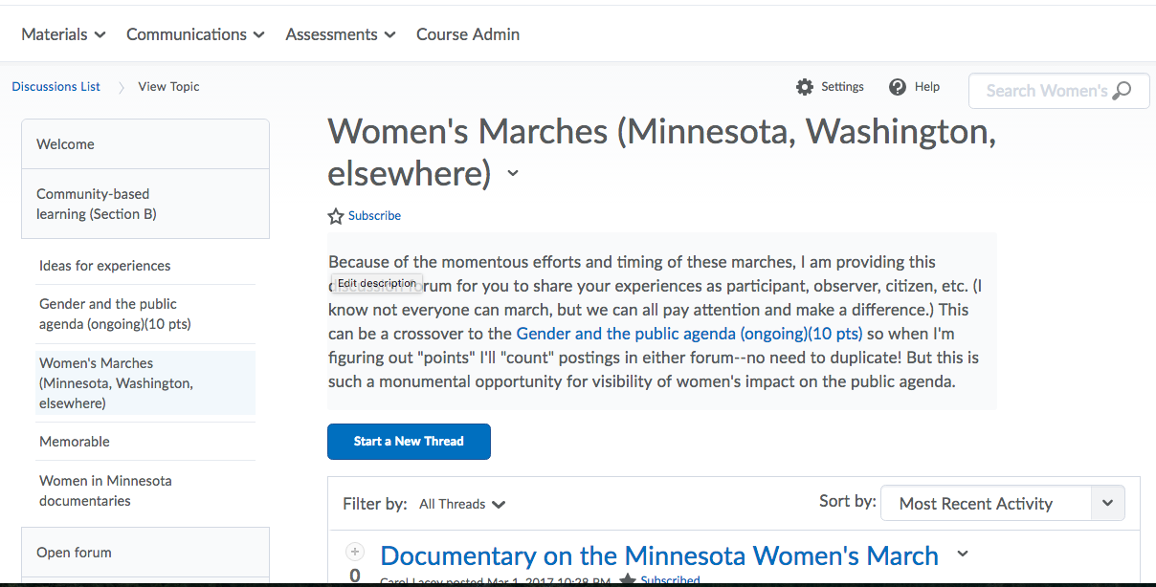
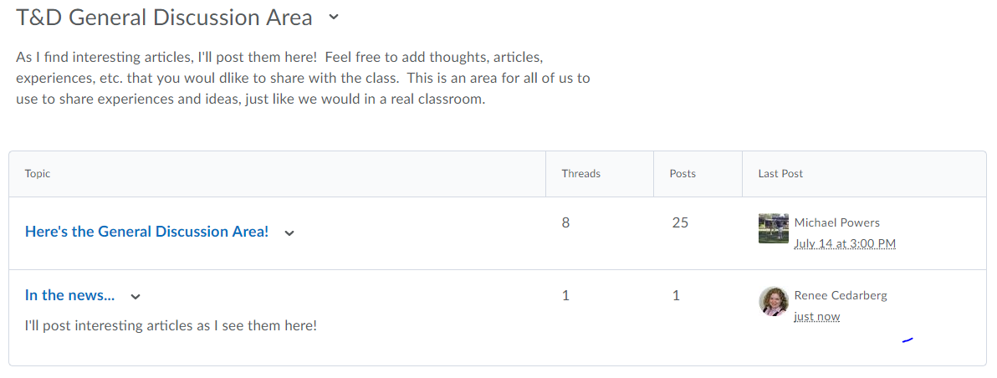
Keep it relevant
How do you bring world events into the traditional classroom?
How do students do this?
How do—or could you you bring world events into the online classroom?
How do you or might you engage students to do this?
Notes:
Renee to lead this slide
Do a brainstorm here with the audience. Encourage them to think about the different types of D2L tools they could use, as well as other options. Examples include:
Posting videos of current events
Linking to news articles
Create a news item about an idea or thought you had relating to the course
Create a “café” section in the discussion area to post ideas and thoughts – encourage students to use it, too!
Chat rooms so students have a “place” to go

Slide 9
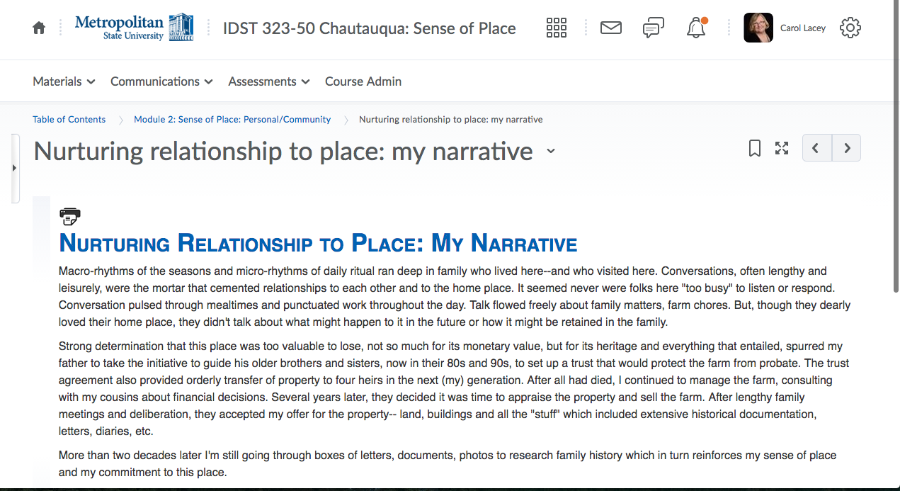
Create Connections
Participate in discussions
Use emoticons to help translate tone
Online area in discussions just for questions about the course
Podcasts ((and pose a question in the podcast, asking for students to respond in the thread)
Convey not just knowledge (what you know), but why you care
Build discussions based on previous discussion to scaffold learning
Notes:
Carol lead – Renee to jump in as needed

Slide 10
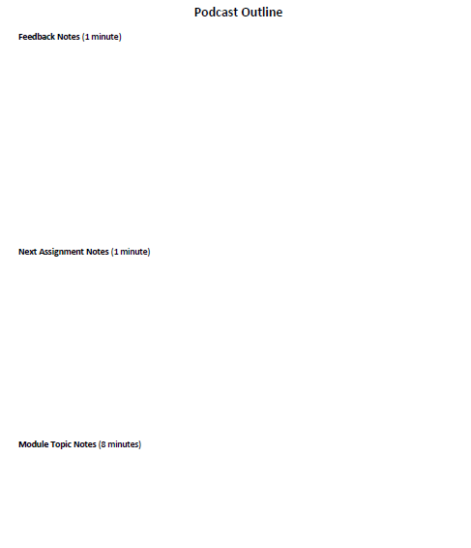
Create Connections: Podcasts
Use the Sound Recorder on your PC or Mac
Click “Record”
Record for up to 10 to 12 minutes
  Feedback
  Overview of assignments
  Preview of content / personal experiences
Save
Post to Course Content and link to a Discussion Posting
Be sure to partner with the appropriate accessibility groups at your institution as needed.
Notes:
Renee to lead slide

Slide 11
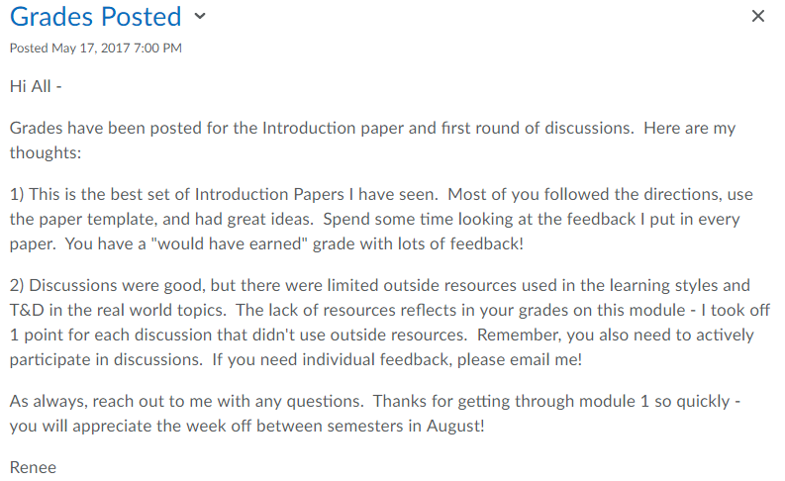
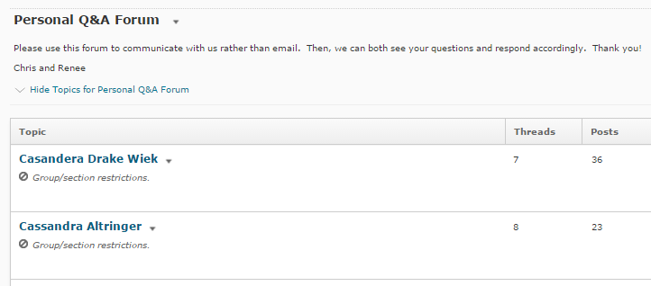
Give feedback…not just grades
Notes:
Renee to lead this section – carol to jump in as needed
Start with news section

Slide 12
Questions?

