Slide 1
Let Adult Learners Show What They Know
Brooks Doherty
Assistant Vice President, Academic Innovation

Slide 2
Notes:
This is a presentation about building space and not barriers for adult learners, typically defined in literature as being 25 or older. Adult learners at colleges or universities differ from “young adult learners” (18-24 years old) in the following ways, according to Knowles. Knowles, M. S., Holton, E. F., & Swanson, R. A. (2005). The adult learner: The definitive classic in adult education and human resource development. Amsterdam: Elsevier.

Slide 3
“Prior experiences of the learner provide a rich resource for learning.”
–Malcolm Knowles’ Andragogical Principle #3
Notes:
In essence, they have experience that younger learners don’t have. The question is, what do we as educators do with that experience? Knowles, M. S., Holton, E. F., & Swanson, R. A. (2005). The adult learner: The definitive classic in adult education and human resource development. Amsterdam: Elsevier.

Slide 4
Notes:
The sun is a resource. It is the essence of life. It can also burn you up.

Slide 5
“Prior experience may be a barrier to learning because they [adult learners] have not been successful learners in traditional education.”
Notes:
So this is where the whole “building space, not barriers” thing comes in. Knowles, M. S., Holton, E. F., & Swanson, R. A. (2005). The adult learner: The definitive classic in adult education and human resource development. Amsterdam: Elsevier.

Slide 6
Build Space, Not Barriers
How can we let adult learners show what they know through non-traditional methods of learning and assessment which build confidence and not remind them of prior struggles?
Notes:
WE CAN BUILD SPACES THAT PROVIDE RESOURCES, INTERACTION, AND COLLABORATION; BUT ALSO RESPECT THE KNOWLEDGE STUDENTS BRING TO CLASSROOM. THAT’S THE KEY WORK TO AVOID RESURRECTING THOSE OLD STRUGGLES – RESPECT. HERE ARE A COUPLE EXAMPLES FROM RASMUSSEN COLLEGE THAT SHOW RESPECT WHILE ALWAYS MAKING SURE KNOWLEDGE IS BEING ASSESSED IN VALID AND RELIABLE WAYS.

Slide 7
Short Bursts of Remediation

Slide 8
Notes:
WE CAN RESPECT ADULT LEARNERS’ KNOWLEDGE BY PROVIDING SHORT BURSTS OF REMEDIATION PRIOR TO ENTRANCE PLACEMENT TESTS. What if adult learners – especially those who can’t afford extravagant test prep or tutoring – were given both free of charge before taking high stakes entrance placement tests? Not too much content. Not teaching to the test. But just enough to wipe the cobwebs away. How many fewer students – especially adult learners who haven’t seen a math problem or dissected a paragraph in a few years – would avoid remediation? How many more would graduate? How many student loan dollars would be saved? This is our model at Rasmussen College through our entrance placement exam called “Rasmussen Ready”

Slide 9
Show What You Know As Soon As You Know It

Slide 10
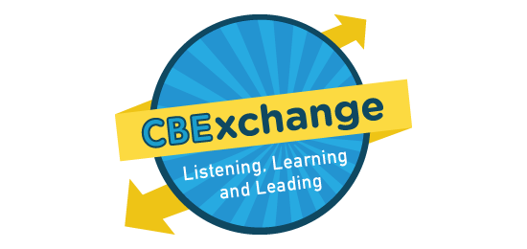
Competency-Based Education
Notes:
WE CAN RESPECT ADULT LEARNERS’ KNOWLEDGE BY ALLOWING THEM TO SHOW WHAT THEY KNOW AS SOON AS THEY KNOW IT. That’s the spirit of Competency-Based Education. There are many different models of CBE right now – including direct assessment, whose programs forgo terms and courses to focus simply on the demonstration of individual competencies; and course- and credit-based CBE programs (Rasmussen College’s Flex Choice programs) which allow students the ability to learn and demonstrate competencies within terms and courses. Irrespective of the differences in CBE models, CBE allows students to demonstrate competence, usually through a project-based assessment, as soon as they are ready. Not when a calendar says the project is due. This not only has the ability to build confidence in adult students, but also potentially saving them time and money.

Slide 11
Build Space, Not Barriers
Design & deliver learning that respects our adult learners’ life and workplace experiences, leading to confidence and not more learning barriers.
Notes:
Every institution’s mission is different. For Rasmussen College, these two characteristics – Short bursts of remediation and CBE’s “show what you know as soon as you know it” approach – have been very successful for our students, whose average age is approximately 28. What may work for your institution? What space will you build?

