Slide 1
Taking the Temperature on OER: Minnesota State Students' Attitudes Towards Open Resources
Carrie Miller, Ph.D.
Instructional Designer, IT Solutions
Minnesota State University, Mankato
Notes:
Image Attribution: OpenClipart-Vectors/ 27452 images
https://pixabay.com/en/clinical-thermometer-fever-153666/

Slide 2
What are Open Educational Resources?
Open Educational Resources (OER) are academic materials that are available to use, adapt and share under a Creative Commons license or other open copyright. OER materials are generally low or no cost and can be used as supplemental or primary course resources.

Slide 3
Open Education Team
Kim Lynch, Senior System Director, Educational Innovations
Kim Johnson, Director of Faculty and Instructional Development
Karen Pikula, Faculty, Central Lakes College – OER Faculty Development
Stephen Kelly, Century College – OER Grants Management

Slide 4
Open Educational Resource Grants
Intent
To encourage the creation and adoption of OERs on Minnesota State campuses
The Actors
Grant Provider – Educational Innovations (SO)
Grantees – 14 Minnesota State Institutions (4 universities / 10 two-year colleges)
Background
In second year of funding
Provide grants of up to $25,000
Projects must be focused on the creation and adoption of OERs to decrease textbook costs
What does the future hold?
Build more momentum, create community spaces, empower evangelists

Slide 5
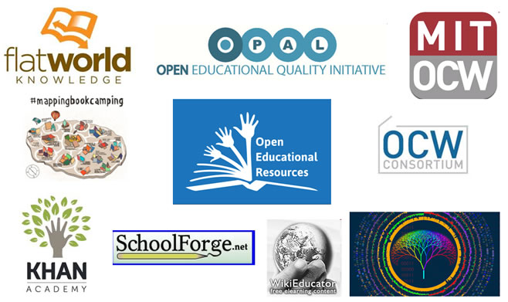
Examples of OER
● MathAS: http://www.imathas.com/
● Khan Academy: https://www.khanacademy.org/
● OpenStax: http://cnx.org/
● Merlotx: http://www.merlotx.org/find/textbooks.html
● Principles of Science: http://www.nature.com/principles

Slide 6
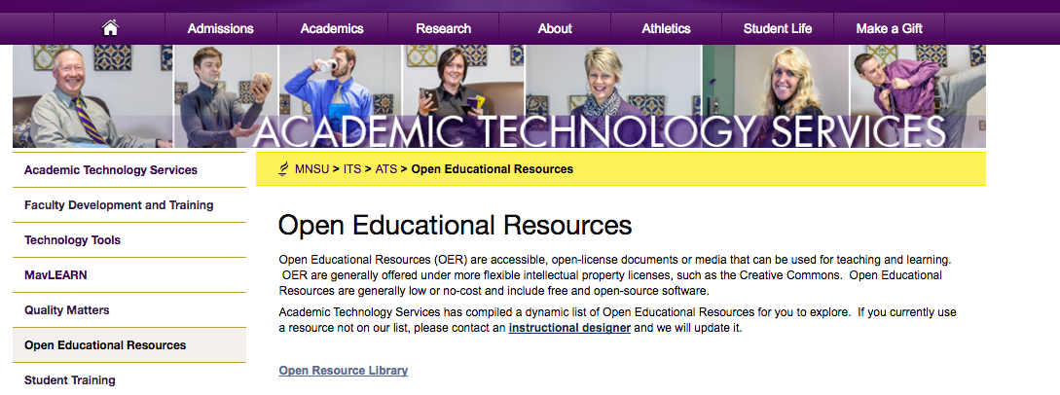
Where can I find OER?

Slide 7
Why doesn't everyone use OER?
Notes:
●75% of faculty who have adopted OER state that the materials are as good or better than traditional materials
●37.6% of educators and 55.7% of formal learners say that using OER improves
student satisfaction
●27.5% of educators and 31.9% of formal learners agree that OER use results in better test scores

Slide 8
Examples of Successful OER Adoption
● Houston Community College
● Virginia State University
● Scottsdale Community College
● Project Kaleidoscope
Notes:
Mercy College, MyOpenMath: ●By switching all sections of basic math to OER, Mercy College saved its students $125,000 in one year and changed their pass rate from 48 to 69 percent - a 44% improvement.
●Popular commercial offering: 48.4% students passing / $180 textbook and online system cost per student = 0.27% students passing per required textbook dollar
●OER offering: 68.9% students passing / $5 textbook and online system cost per student = 13.78% students passing per required textbook dollar
Tidewater College Z Degree: ●Tens of thousands in textbook cost savings: In the first semester alone, students saved more than $60,000.
●Significantly lower cost-of-degree: Students are expected to save around $1,200 per year, approximately a quarter of the total cost-of-degree at TCC.
●Improved persistence: On average, drop rates decrease by 6% in OER-based “Z courses.”
●100% access on day 1: Students enjoy free digital access to all course materials from the first day of class.
●First-mover advantage: TCC introduced the nation’s first zero textbook cost associate degree in fall 2013.
http://www.slideshare.net/OCWConsortium/the-maturing-open-educational-resources-oer-ecosystem-partners-expansion-and-critical-questions

Slide 9
The Study
Participants:
Part 1: 593 students from MNSU as part of a Master’s thesis research project
Part 2: 209 students that identified as being a student at least one Minnesota State College and University institution

Slide 10
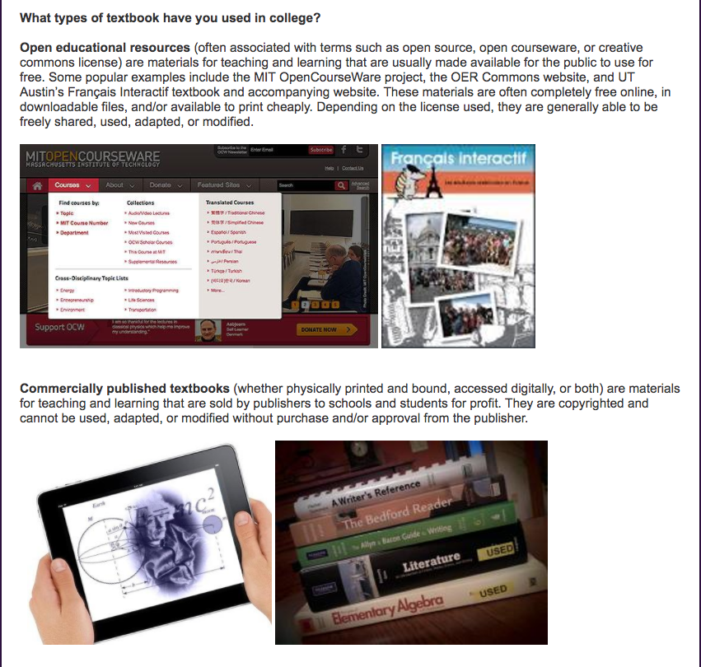
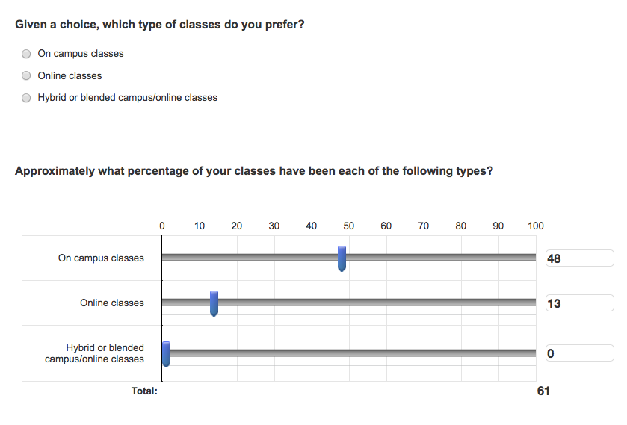
The Study
Questionnaire:

Slide 11
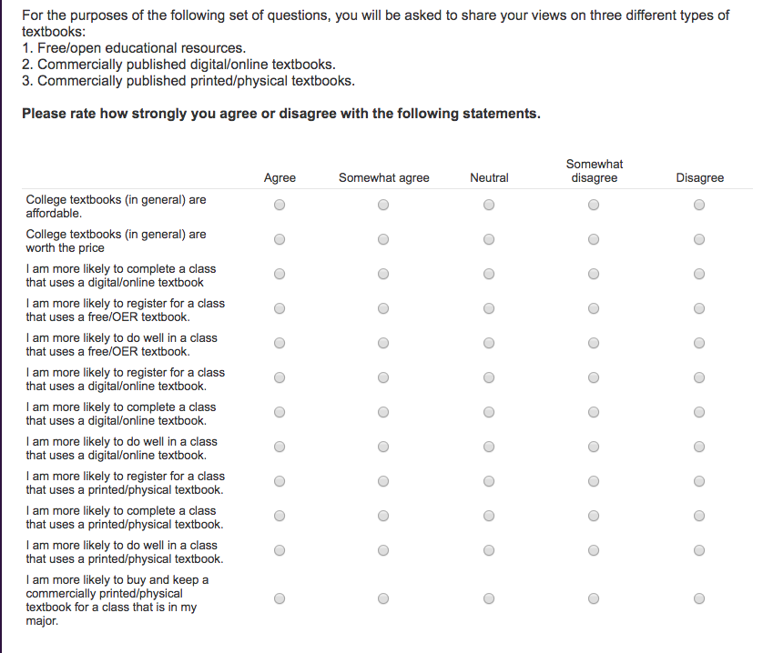
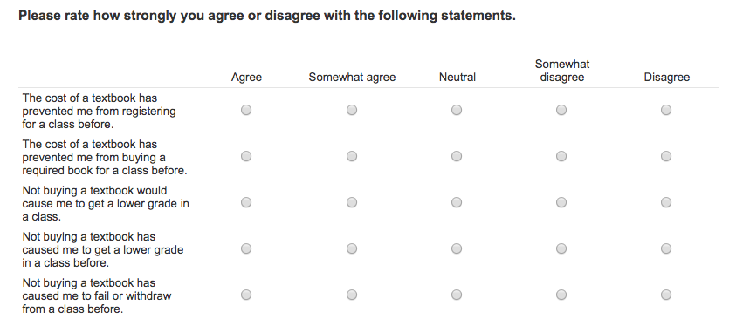
The Study
Questionnaire:

Slide 12
The Study
MinnState Institutions | N
Community Colleges
Fond du Lac Tribal Community College | 2
Lake Superior College | 62
Minnesota State Community and Technical College | 1
Minnesota West Community and Technical College | 1
Pine Technician Community College | 1
Northland Community and Technical College | 18
Total | 85
Universities
Metropolitan State University | 1
Minnesota State University, Moorehead | 1
Minnesota State University, Mankato* | 593
St. Cloud State University | 1
University
Total | 596
Results:
Participating MinnState institutions

Slide 13
The Study
Results:
Textbook Type | Yes | No
OER (digital/online) | 204 | 560
OER (printed/physical) | 176 | 588
Commercially published (digital/online) | 296 | 395
Commercially published (printed/physical) | 581 | 180
Textbook-type use

Slide 14
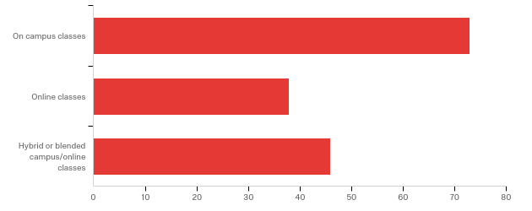
The Study
Results:
Class Type Preference
Notes:
on-campus classes (n = 407; 53.3%)
hybrid or blended classes (n = 160; 20.9%)
online classes (n = 115; 15.1%)

Slide 15
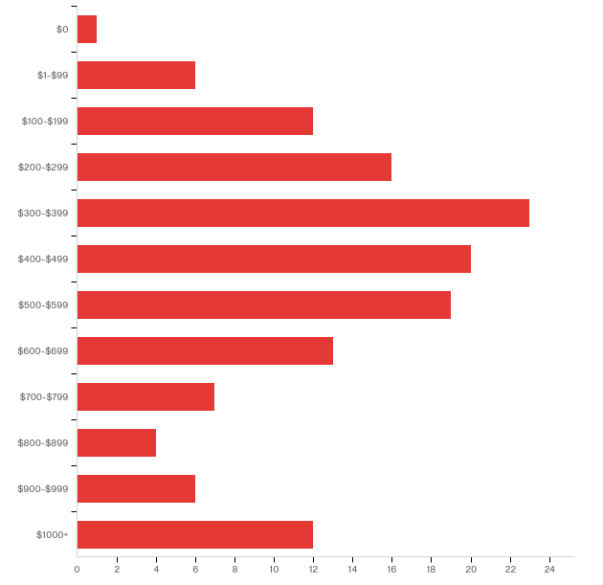
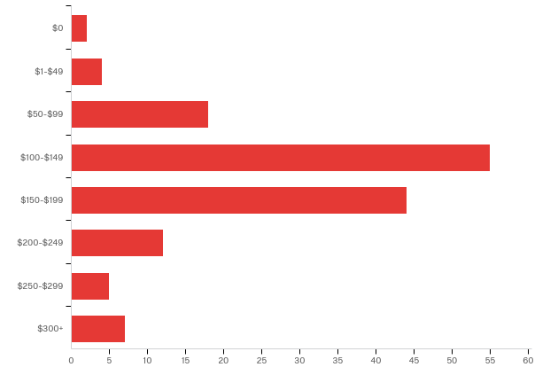
The Study
Results:
Average Cost of Textbooks Per Semester
Notes:
One Book:
$100-$150(n =235; 30.7%)
$50-$99 (n =170; 22.3%)
Total:
$200-$299 (n =120; 15.7%)
$300-$399 (n =112; 14.7%)

Slide 16
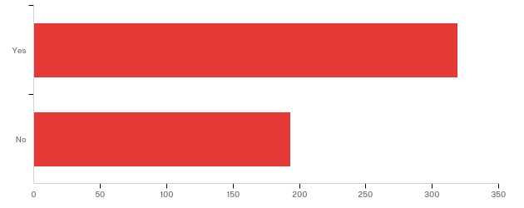
The Study
Results:
Yes! (N=386; 58.6%)
Have You Ever Avoided Purchasing a Required Textbook?
Notes:
Why:
1) 256 were able to complete their assignments without the textbook;
2) 34 felt that the price of the textbook was too high

Slide 17
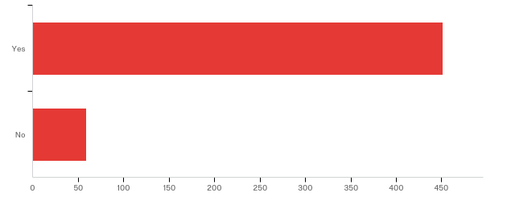
The Study
Results:
Yes! (N=559; 85%)
Purchased a required textbook that they never had to use?
Notes:
Why:
413 were able to complete their assignments without the text book;
313 indicated that their instructor never assigned them to use the textbook

Slide 18
The Study
Results:
There was a strong consensus of disagreement (M= 1.70, SD= .91) among those who responded (n= 608) regarding textbooks being affordable. Similarly, participants expressed disagreement (M= 2.14, SD= 1.04) with the notion that college textbooks are, in general, worth the price.
However: Yet, contrary to these data, of the that participants that reported that they would do well in a class that uses commercially printed/physical textbooks-which tend to be more costly than the freely available OER textbook- they agreed (M=3.82, SD=1.18) that their class grade would suffer from not purchasing a printed textbook.
Student attitudes towards textbooks

Slide 19
The Study
Results:
Textbook prices were placed on an 8-point scale (1= $0 and 8= +$300). The analysis was significant, t (628)= 4.23, p < .001, suggesting that a singular textbook at community colleges costs more (M=4.56; SD= 1.37; approximately $149-$199) compared to university textbook prices (M=3.98, SD= 1.32; approximately $99-$150). In addition, a significant difference was found, t (606)= 5.97, p < .001, between the amount of money community college students spent (M=7.53, SD= 2.83, approximately $599-$650) for all of their textbooks during their most recent semester, compared to university students (M=5.95, SD= 2.43, approximately $399-$450).
However: university students were more likely to purchase a required textbook and not use it, compared to community college students.
Difference in Cost of Textbooks – Community College vs University

Slide 20
The Study
Results:
What are the biggest problems with OER?
Notes:
Cost
Heavy to Carry
Internet connection
Like to use printed material / notetaking strategies

Slide 21
The Study
Results:
What are the biggest problems with commercially printed textbooks?

Slide 22
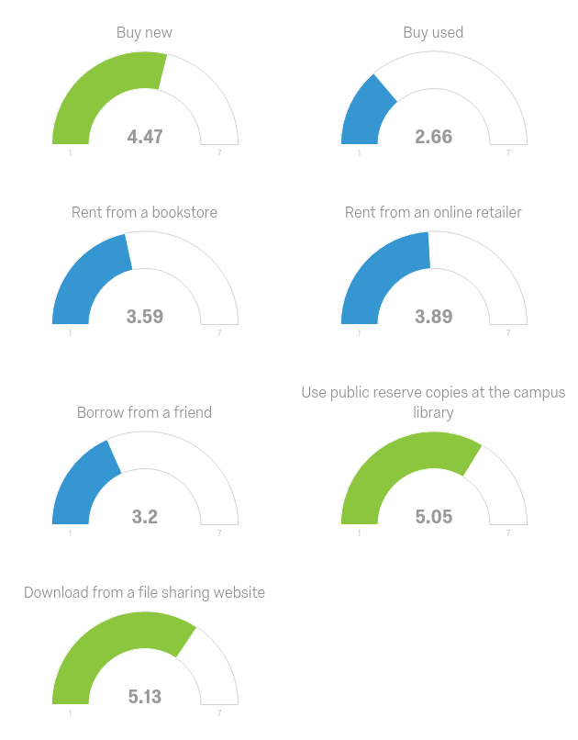
The Study
Results:
How do you prefer to acquire your textbooks?

Slide 23
The Study
Implications:
Majority of respondents were unaware of OER
Students are spending an average of $200-299 on textbooks per semester
Over half the respondents said they had avoided purchasing a required textbook
85% of respondents purchased a textbook that they never had to use
559 x $125 (average cost of one textbook) = $69,875 per semester that didn’t need to be spent!
Majority of respondents indicated they do not feel college textbooks are worth the price
Most respondents feel that their grade would suffer from not purchasing a printed textbook
It is clear that there is no real understanding of the difference between OER and traditional textbooks despite explanations

Slide 24
What can we do?
Create your own material
Assign students to collaboratively write an open-source course textbook
Look for a slightly cheaper option (559 x $10 = $5590 per book)
Investigate OER materials
Lynda.com
TED
Research Journals
Library materials
Critically evaluate whether the textbook is needed
Talk to your preferred publisher
Use the textbooks you require your students to purchase
Learn more about creating OER with Designers for Learning
Review OER textbooks through the UMN Open Textbook Library
Notes:
ABE OER MOOC: http://studio.designersforlearning.org/

Slide 25
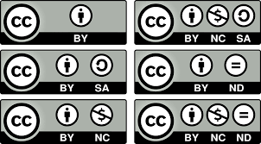
Getting Started Using OER
● Look for resources with a Creative Commons License
● Start small - adopt one or two resources for a course and grow from there
● Keep in mind that Free ≠ Open and vice versa
● Supplement OER resources with current journal articles from the Library
● Check your current publisher for open resources

Slide 26
Contribute to the conversation
#openeducationwk
How can you help?
● Research available OER materials for your discipline
○ Open Resource Library
○ Google
● Advocate for OER in your department or College
● Become an OER developer
● Join an OER network
● Conduct SOTL research on OER materials

Slide 27
Successes?

Slide 28
Challenges?

Slide 29
Thank you!
Carrie Miller, Ph.D.
Carrie.Miller@mnsu.edu
507-389-1531
https://www.mnsu.edu/its/academic/open_ed/

