Slide 1

An Alternative Pathway of Learning Math
Taskin Haque,
Metropolitan State University

Slide 2


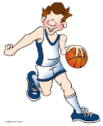
CAN You??
Calculate the sum of 56+27 In 5 seconds?
9 Times Table by just using your fingers?
Basketball and counting at the same time?

Slide 3

Mental Math Techniques
Active Associations
Interest Generation
Developing Number Sense
Fast
Fun????????

Slide 4
Current Learning Process
Learn
Report
Practice

Slide 5



Learning
Pictures: www.google.com

Slide 6
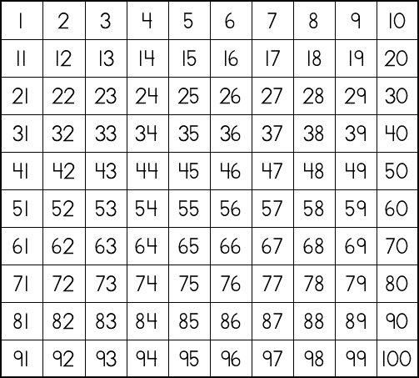
= 83
56 + 27
Source: https://www.youtube.com/watch?v=OsWzVyCWfz0

Slide 7
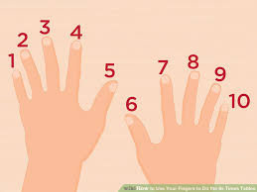
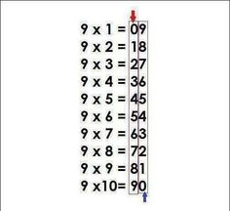
Times Table: Multiply by 9
Source: https://www.pinterest.com/starz0123/times-table/

Slide 8
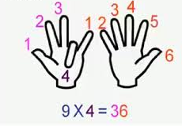
The Finger Trick
Source: http://en.penanglang.my/wp-content/uploads/2014/11/math3.jpg

Slide 9
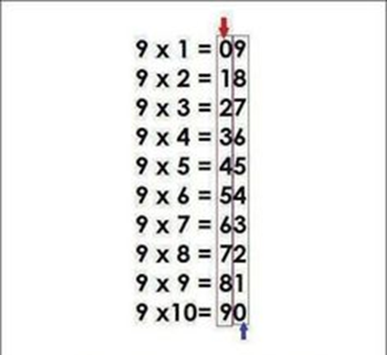
Table Trick

Slide 10
Practice
Motivating
Fun
Interest Generation
Games
Pictures
Songs
Videos

Slide 11
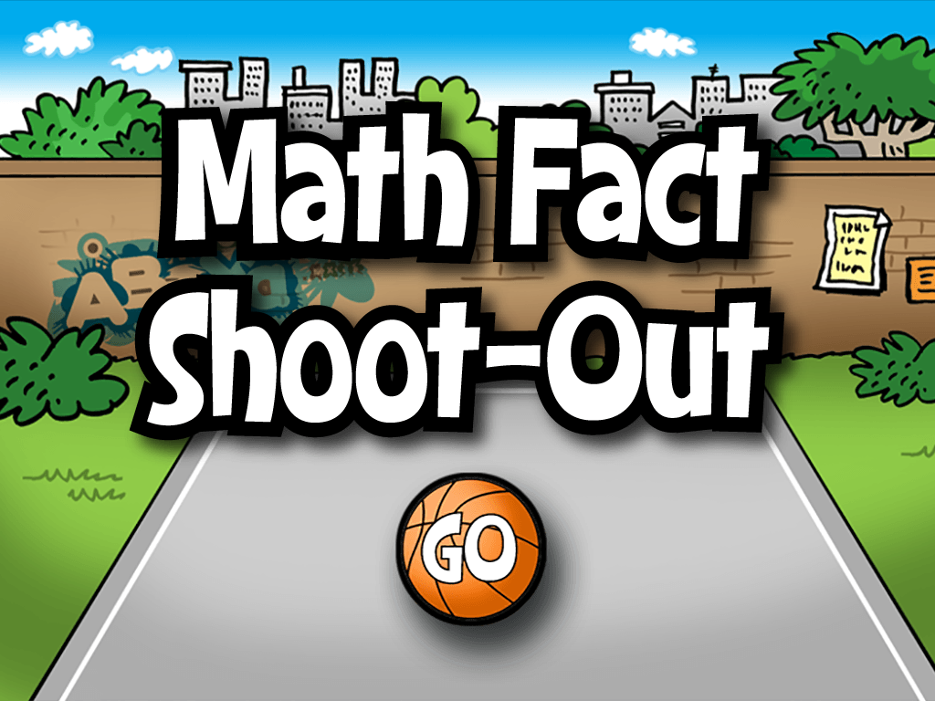
Math Fact Shoot-Out
Source: http://www.abcya.com/math_facts_game.htm

Slide 12




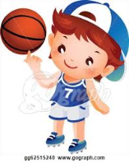
Math Fact Shoot-Out
Select an Avatar
Select a Level
Select an exercise
Correct answers in a ROW and try Shoot-Out
Be a CHAMP

Slide 13






Popular Math Game Sites
http://mycreativeschool1.blogspot.com/2016/02/fun-with-math.html

Slide 14

REPORT

Slide 15
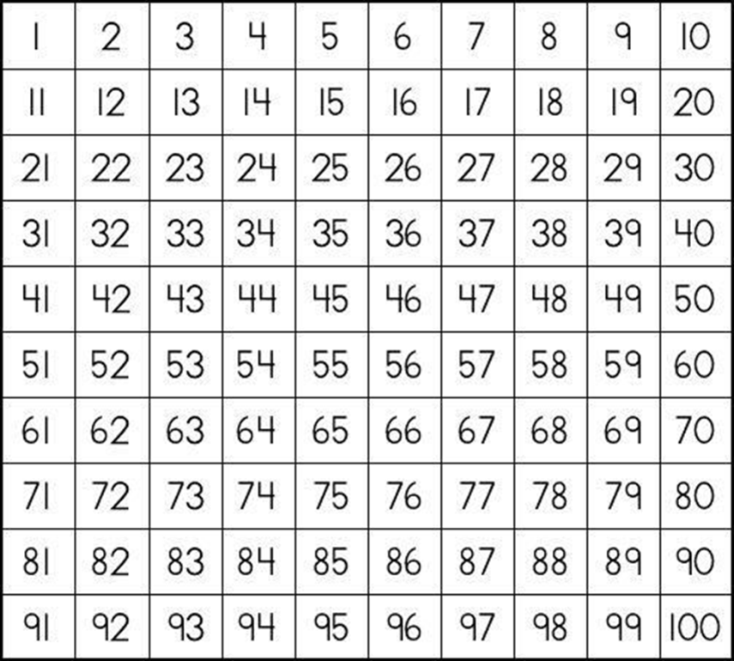
QUIZ TIME:
?
57 + 36 =
93
5..
4..
3..
2..
1..

Slide 16
QUESTION(s)?

Slide 17

Thank You !

