Slide 1
How Can Quality Matters Help Me?
Tips for Instructors to Streamline Online Courses, Engage Online Learners, and Enhance Quality Matters Applications

Slide 2
First, the Basics
In 2010, WSU’s Center of Excellence was asked to develop a baccalaureate completion degree for working professionals in a wide range of allied health professions.
Core competencies for this program are financial, statistical, business, policy and leadership knowledge.
The interdisciplinary program brought together business, nursing, math/statistics, communication studies, education, and exercise science faculty.

Slide 3
First, the Basics
The Healthcare Leadership Administration (HLA) program committed to submitting our online curriculum to the Quality Matters certification process.
If you do not know what that involves, you might start with an overview from the Quality Matters website at https://www.qualitymatters.org/rubric
Today’s presentation focuses on how we have
utilized the QM standards and rubric to
enhance program instruction/delivery.

Slide 4
QM Standard One: Course Overview & Introduction
Technology Requirements
Technology Resources sub-module content (Download to software & training videos)
Technical Skills
Technology Resources sub-module
List of technologies in HTML document and a link to the institution’s site for downloading software
List of technical skills included in HTML document (D2L, email, Word, and PowerPoint)
Notes:
WSU involvement in QM/ items developed for professional development program. Used in my course and HLA program
Advantages to templates/ consistency / updated information
Syllabus/ wiki pages/ D2L content/ widgets/ resources tab
1.5 minimum technology
What technology will be used and how to obtain them and use them
1.7 tech skills
Using lms
Using word
PowerPoint

Slide 5
QM Standard Seven: Learner Support
Technical Support
Technical Support contact information provided in HTML
Institution’s Accessibility Policies
Accessibility policy linked within wiki
Institution’s Academic Support Services
Link to Academic Support Services in custom widget on homepage
Institution’s Student Services
Links, contact information, and description provided in wiki
Technical Support contact information provided in wiki
HTML D2L resources document. Video tutorials & written instructions
Contact information provided in wiki
Explanation of disability service provided in syllabus
Links, contact information, description provided in wiki
Specific services highlighted in syllabus (referencing specific assignments)
“Resources” tab (direct links to websites)
Notes:
7.3 Library & writing center for research paper

Slide 6
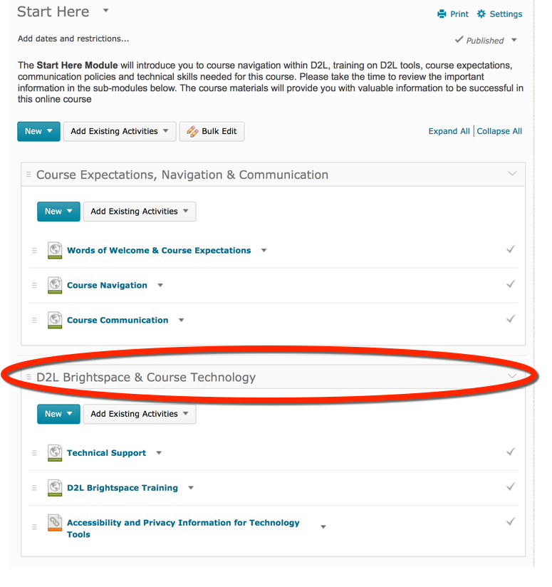
Start Here Module Content
Notes:
Start Here Module

Slide 7
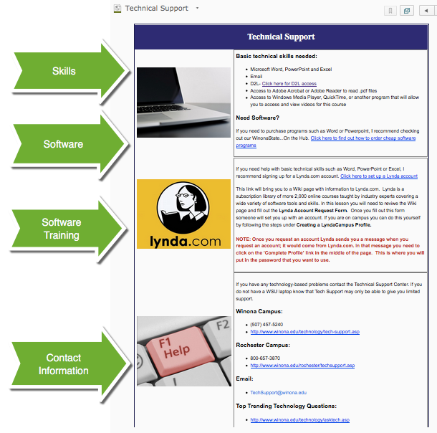
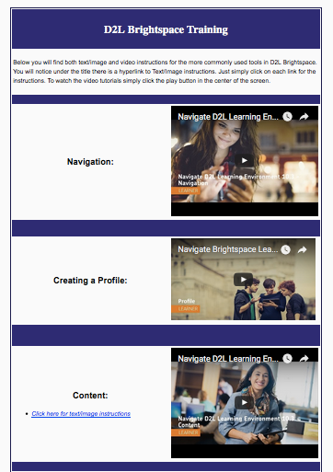
Technical Support & Resources

Slide 8
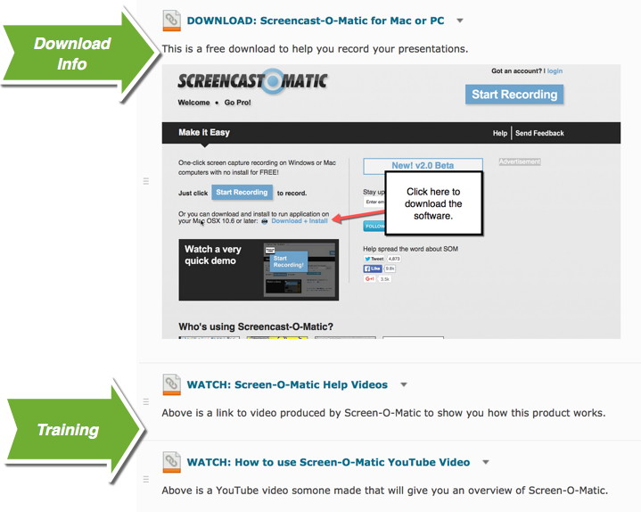
Training & Resources

Slide 9
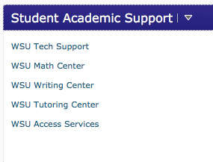
Student Services

Slide 10
QM Standard Five: Course Activities & Learner Interaction
Learning activities help students achieve SLOs
Proposing presentation topics to whole class via Discussion Board
Learning activities provide interactions for active learning (learner-learner, learner-content, learner-instructor)
Students meet virtually with instructor and other class members in Adobe Connect
Instructor has a clear plan for response and feedback that is communicated to students
Responses to emails received no later than 24 hours after message
Expectations for learner interaction are clearly stated
Discussion Board rubric is posted and used regularly to set expectations for learner-learner interaction
Submitting draft outlines and bibliographies
Giving presentations in Adobe Connect, using PowerPoint
Numerous communications-related case studies
Students interact via Discussion Boards
Students receive peer and instructor evaluations
General ‘comments/questions/concerns’ Discussion Board checked daily with responses posted daily as appropriate
Syllabus specifies response time on assignments/presentations
Extensive personal feedback in addition to rubric comments
Peer feedback rubrics are provided as well as examples
Notes:
“Course activities facilitate and support learner interaction and engagement. Course components that promote active learning contribute to the learning process and to learner persistence.”

Slide 11
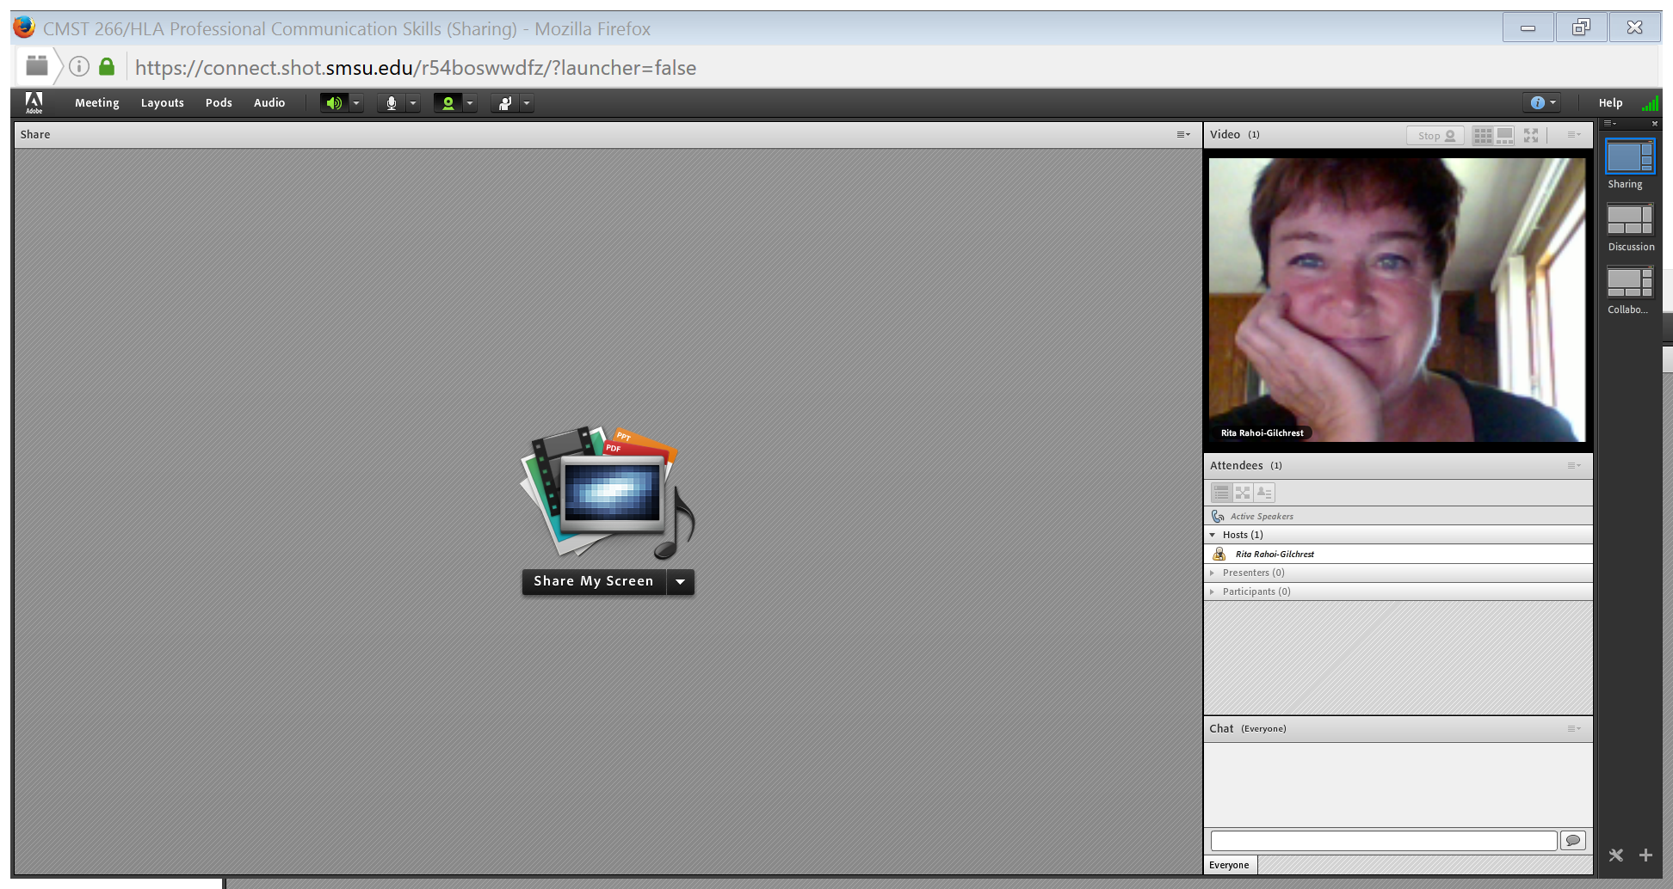
Let’s Take a Look!
Desire to Learn LMS
Adobe Connect login

Slide 12
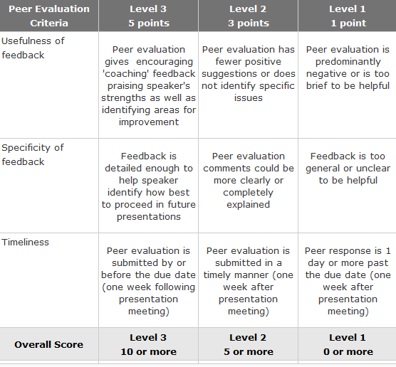
Peer Evaluation Rubric

Slide 13
Discussion Board Rubric

Slide 14
What is working well
Having a “General announcements/ questions/concerns” discussion board (limits emails, students provide input for each other)
Having students submit drafts in Word with extensive feedback within the document improves final submissions
Clear rubrics for peer evaluations also improve quality of learner-learner interaction
Adobe Connect enhances learner-learner/learner-instructor interaction

Slide 15
What Will Change Going Forward
Make some of the assignments two-tiered
Wide range of student abilities and expertise
Example, resume/portfolio module
Add a few more mini-presentations on solving interpersonal communication issues in the workplace
These have been addressed as discussion boards, but perhaps making them optional
online mini-presentations would improve skills even more effectively

Slide 16
Insights From Students
I greatly appreciated the individual feedback on all of my submitted assignments/presentations. I have never had a course where the instructor provided so much detailed feedback. I also admire how calm and personable the instructor was in our online presentations.
I thought the course was very helpful in the online presentations and getting me to open up and do things I wasn't comfortable with. Great layout of the course as far as the syllabus goes. I've been doing online courses for years and have seen several fails at this. You had it laid out perfectly as to what was due, and when it was due.
I liked how you used both peer and instructor feedback on the presentation. Always helps to have more feedback when it comes to presentations

Slide 17
Final Thoughts
The QM review/certification process focuses our attention as instructors on the learner end of the online course.
The focus Standard 5 provides on learner-learner, learner-content, and learner-instructor interaction is a valuable reminder.
Mapping course content/activities to your course learning outcomes is essential!
General education courses might have other outcomes to consider (MnTC).

Slide 18
QM certified Health Policy Course: Lessons Learned
This course is a writing intensive at the 400 level.
Writing is evaluated and feedback given in
8 discussion boards
Letter to a legislator
Reflection paper on MNSURE system
Scholarly paper on a policy issue
Elevator speech (written and recorded)

Slide 19
Examples of topics from this summer
Medical marijuana legislative changes
Clean water legislation
Mental health care access legislation
Wolf protection legislation
Addiction legislation and supports
Close captioning for the hearing impaired in hospitals
Changing the ban on blood donations from gay men.
Compassionate Care Act, and other current legislation.

Slide 20
What is working well
Adult non traditional learners choose a policy issue that matters to them. This can be from their personal or professional experiences.
This topic interest becomes the focus for their course assignments. Students appreciate choice of topic.
He discussion board for questions was a great way to address issues, and they chimed in to help one another sometimes!

Slide 21
More aspects that worked…
Choosing contemporary policy issues to surround as a exemplar (the Affordable Care Act and the Road Map to a Healthier MN) allowed the students to critically analyze a contemporary policy and the implications this has on health of individuals and communities.
Notes:
The ACA is one of many policy issues that could be chosen, in Minnesota we have a State Mental Health Work Plan (2015) and this is another great choice.

Slide 22
A thought on incorporating diversity
MnSURE reflection exercise is intended to have the students go to the MnSURE or healthcare.gov site and experience the process of funding insurance for themselves and their families.
They apply the lessons learned (cost, ease of use, navigation) to their own life but also are asked to reflect on how a non-native English person or non-computer savvy person might experience this system.
Notes:
This is so important in our teaching! Threading in access for all into a health care leadership course is essential as we prepare future (or in some cases current ) leaders. The results here were interesting as some of the students are actual recipients of subsidized insurance or ELL, while many have their employer paid insurance. Hearing from one another on the challenges, costs and how they would incorporate this into their family budget was commented on as being a new learning for them. This summer a ELL Somali woman and a Chinese student shared their experience and how they appreciated incorporating thinking about access into this assignment. The employer based health care students shared how expensive benefits are and that even as a full time employee in healthcare, if they had to buy their own insurance it would be hundreds of dollars per month and not affordable.

Slide 23
Tools for Connecting
Voice Thread for speeches.
https://voicethread.com
https://voicethread.com/myvoice/#thread/7835143/42826428/43700059
ZOOM for individual meetings with faculty or small group connections. https://zoom.us

Slide 24
What I will want to change in Health Policy going forward.
Tweak the rubrics in D2L Brightspace.
The rubrics tended to be divided into large deductions which made mathematical sense, but seemed more severe than I intended when I actually used them.
Lengthen the course to a full term.
Some of the students commented that it was fast as a 5 week course, more time would allow them to dig deeper in things they care about.

Slide 25
Qualitative data from the learners
“I think one of my favorite assignments within the course was the elevator speech. I think speeches like the elevator speech are quick and effective. It was great to be able to speak and talk about something that we are all passionate about in the healthcare policy field.” (HLA student, summer 2016)
Notes:
A final course reflection paper asks students to write about their greatest learning and how they will use the knowledge they have learned going forward. Here are a few of the many great statements from the class in the summer 2016.

Slide 26
Comment, HLA student summer 2016
“To stay engaged with health policy and quality healthcare moving forward requires me to add my voice to the arena of those issues/policies that I am passionate about that either involve me personally or on a professional level. It will require me to utilize my research skills in a manner that will help to foster knowledge to speak on those areas/topics of health care.”

Slide 27
When passion matters…
I have to be honest, this topic [health policy] is not very interesting to me...When I was searching through the different types of bills that were being passed...I came to the topic of animals and read about the bill regarding what to do with animals that are involved in research. That was a topic of interest to me because I am really into dog rescue and am part of a group that rescues the Brittany breed. I went on to look through more of the bills and I came across bill number HF3746 about …how electronically monitored cameras would be allowed in the [nursing home] rooms… It really hit me hard reading that bill because it brought back some personal memories for me as I had written in my letter to my legislator paper, with my grandma. I really would have loved for this to have been an option for her when she was alive so that I knew she was really being taken care of properly. This will definitely be a bill I will be watching. (HLA student, summer 2016)
Notes:
I love the students who are honest about not wanting to take this course! It actually is a significant number each time I teach this content in its various forms. ☺ Our greatest opportunity as educators is to spark curiosity amidst doubt and preconceived ideas. To open a leaner is the joy of this work, and opening adult non traditional leaners with real life behind them and who are doing the work in real time is a bonus of this group of students.

Slide 28
A final insight from a HLA student…
“…this class was a surprise for me because I was really dreading it at the onset. However, it actually became really fun to investigate the different bills and develop the arguments or ways to express my opinion on the issues we addressed. Although the class was short, it did indeed pack a lot of information in that short amount of time and I look forward to learning more as our program progresses. Each class we take gives me more skills for my working “tool box” to help me to pass along information that is important for our everyday working lives.”

Slide 29
In summary
I am committed to stay focused on what interests the learners as a way to spark engagement in health policy. For that passion, they can learn the skills of political processes and analysis.
QM was a great deal of work up front, but the steps of the process ensure a smoother course delivery

Slide 30
Questions?
Jane Foote, EdD, MSN, RN
Associate Professor, Graduate Nursing
Winona State University
Jfoote@winona.edu
Rita L. Rahoi-Gilchrest, PhD
Associate Dean, Liberal Arts/Professor, Communication Studies
Master/Peer Reviewer/Workshop Facilitator, Quality Matters
Winona State University
rrgilchrest@winona.edu
Mary Bohman, MS
Instructional Design Specialist, Teaching Learning & Technology Services
Quality Matters Campus Coordinator (QMC)
Winona State University
Mbohman@winona.edu

