Slide 1
Conquering the Forum
Creative Approaches to Prompts and Responses
MN E-Learning Summit 2016
Kimi Johnson, PhD & Kim Ballard, PhD
UMN CCE Online & Educational Services

Slide 2
Agenda
Icebreaker
Why Forums?
Different Types of Forums
Communicating Expectations
(Some) Uses of Forums
Forums and Bloom’s
Writing Good Forum Questions
Forums in High-Enrollment Courses
Forum Writing Workshop
Instructor Participation

Slide 3
Forums: Friend, or Foe?
What do you LOVE about Forums?
What do you HATE about forums?

Slide 4
Why Forums?
Facsimile of F2F Discussion Online
Test for Comprehension
Expand Comprehension of a Concept or Sub-topic
Promote Interaction
Correct Misunderstanding
Wrestle with Grey Areas
See the Views of Different Stakeholders
Improves Student Writing
Course Investment

Slide 5
Other Uses of Forums
Notes:
Solicit answers from the audience

Slide 6
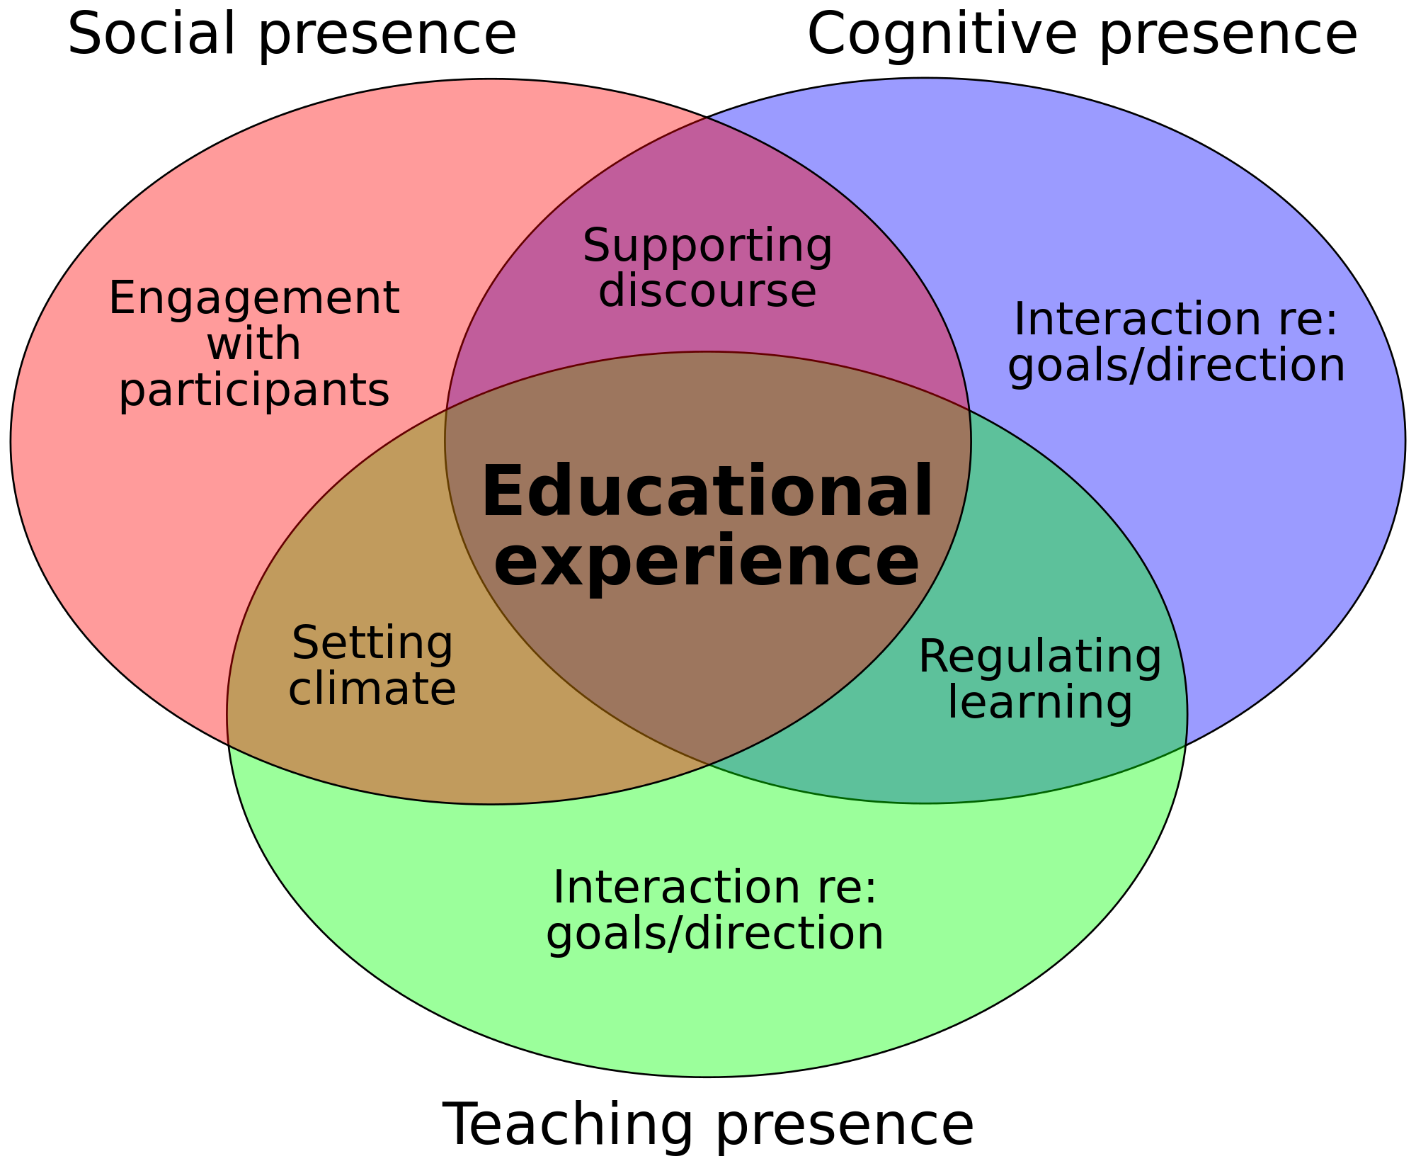
Community of Inquiry

Slide 7
Community of Inquiry
Elements | Categories | Indicator Examples
Cognitive Presence | Triggering Event | Dissonance
 | Exploration | Information Seeking
 | Integration | Connecting Ideas
 | Resolution | Applying New Ideas
Social Presence | Emotional Expression | Tone, Emoticons
 | Open Communication | Risk-free expression
 | Group Cohesion | Encourage Collaboration
Instructor Presence | Management | Defining, Initiating Topics
 | Building Understanding | Sharing Personal Meaning
 | Direct Instruction | Focusing Discussion

Slide 8
Forums in Learning Theory
Pedagogical implications of forums are:
Constructivist
Reflective
Engaging
Promote satisfaction
Promote higher order learning skills
Notes:
Constructivist: Students adjust their understanding by analyzing, interpreting, predicting, synthesizing
Forums allow students to reflect on readings and refine knowledge
Present their points of view
Support their ideas
Write in public--research shows that students writing improves in public spaces
Reflective: Asynchronous discussion allows students to reflect and construct their point of view
Engaging: Ill structured problems without a single solution give students a chance to argue from the stance of different stakeholders
Satisfaction: Asynchronous allows students to discuss and ask questions as they are studying rather than waiting until class time
Higher order learning skills
Effective communication - development of writing skills
Presenting points of view
Presenting facts and opinions clearly
Interpreting, evaluating, and critiquing other students’ points of vie
Sharing information
Group knowledge building

Slide 9
Forum Formats
Question and Answer
Open Forum (Threaded Discussion)
Blog
Moderated Forum

Slide 10
Communicating Expectations
Netiquette
FERPA
Timeliness
Length of Response
Depth of Response
Instructor Participation
Self-Moderation (critique vs. flaming)
Notes:
Thing to note: Students come in with social media experience and the forum is antiquated comparatively, so expectations are a MUST
“Yes, and.”

Slide 11
(Some) Uses of Forums
Roleplay
Devil’s Advocate
Search and Post
Text / Image / Video Analysis
Debate
Public Postings of Student Work
Brainstorming
Collaborative Group Work
Come to a Consensus
Reflection

Slide 12
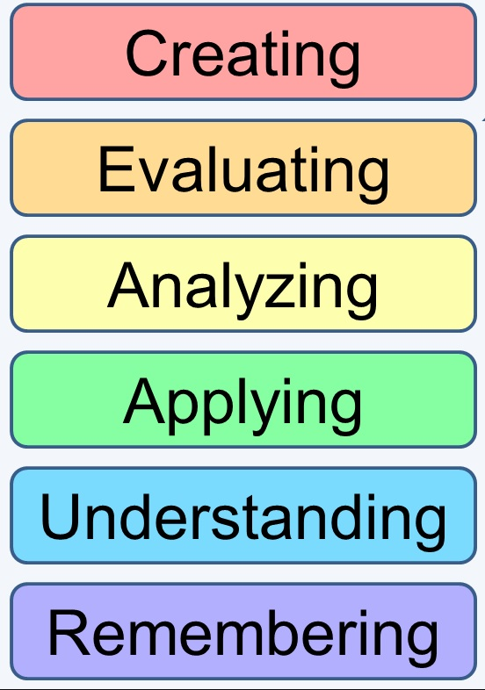
Forums and Bloom’s Taxonomy
Collaborative Group Work, Brainstorming, Consensus
Role play, Devil’s Advocate, Reflection, Consensus
Text / Image / Video Analysis, Debate, Public Posting, Search & Post

Slide 13
Writing Good Forum Questions
What kind of answer do you want to receive?
Your prompt needs a destination!
Avoid Yes/No Questions
Multi-layered Questions
Ask for Citation
What are the Stakes?
Ask Students to think Differently
Make it a Game
Switch Modes
Notes:
Make it a Game: Three Truths and a Lie

Slide 14
Example: Switch Modes
Week 1
Week 2

Slide 15
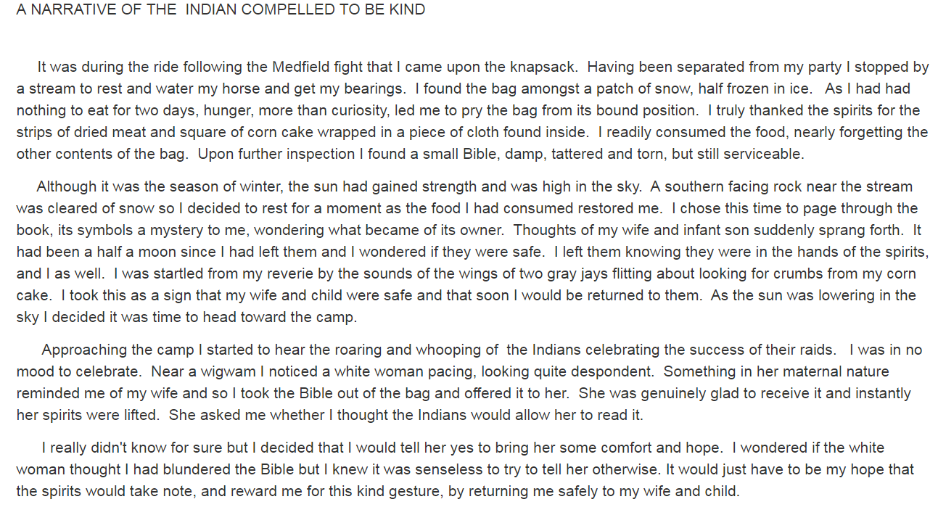
Example: Switch Mode Responses

Slide 16
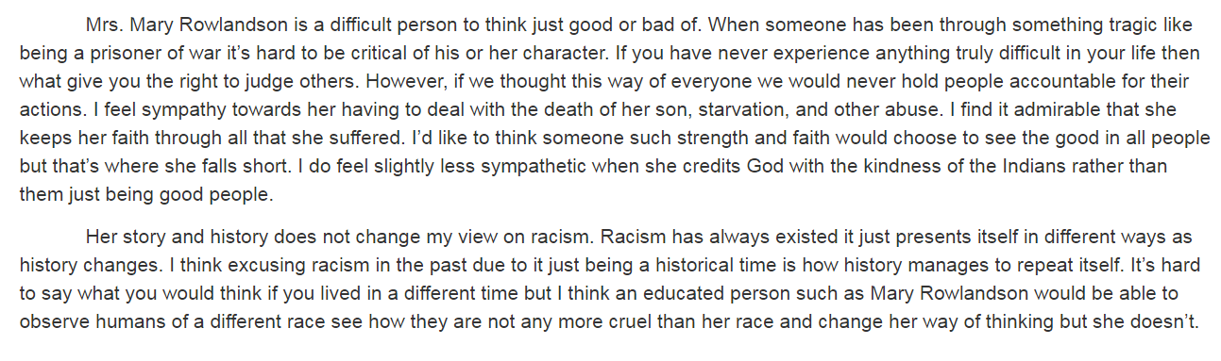
Example: Switch Mode Responses

Slide 17
Example: Questions with Direction
The music we examined in this module is characterized as "art rock." Whatever its virtues, all of it expresses a pretty negative worldview. Some would argue that this type of criticism is an essential component of "serious art," at least art with narrative (that is, verbal) content.
Do you agree? Why or why not? If you disagree, please offer an example from the music we've heretofore studied or another song by one of the same artists that offers a positive worldview. Explain briefly why you think it's serious art.

Slide 18
Example: Student Response
Response 1:
“Serious art” definitely is, through music, a negative worldview. The negative lyrics should not always be judged or create controversy, because I believe they bring up many problems people or the world face, including the artist who writes about them. Many lyrics can address the issues with words many people are not brave enough to say out loud. I also believe that serious songs are more likely to get criticism because not many people would shame a song that was written and sang to make people happy and dance along to it.

Slide 19
Example: Student Response
Response 2:
I would agree with the idea that holding a negative perspective of the world is, in fact, an essential component of "serious art". This is especially the case with musical forms of art like "art rock". I believe this is the case, mainly because the artist usually wants to get his point across to their audience. In most situations, the easiest way to connect with an audience in a serious manner is to identify all of the problems or negativity surrounding a certain issue. In my opinion, this can be the most influential way an artist and their art can resonate with their audience.

Slide 20
Instructor Participation
Check in frequently!
Not every post needs a response...
...but you should provide a summative response at the end of the assignment.
Let your students know you’re reading!
Try to respond to each individual at least once over the course of the semester
Hold yourself to the same response standard
Let students know you’ll be checking in regularly
Redirect or cut-off harmful comments and/or flame wars
Notes:
Use the summative response to redirect, expand, or point out something they might have missed
Better if you can tell the students you check in at least twice a week

Slide 21
Example: Instructor Response
This has been a very thoughtful discussion. A few thoughts:
1) "Art rock" does overwhelmingly express a negative point of view, but it does not have a monopoly on artistic qualities.
2) There's a strong tendency here to consider lyrics over anything else and, as I've said repeatedly, lyrics are less important than you might think. If listeners were really so focused on lyrics, there would also be a substantial audience for traditional poetry and there isn't. Music is the main attraction.
3) In artistic media where technique is overtly valued, like classical music and museum-quality painting and sculpture, the subject of the work, positive or negative, is far less a consideration of artfulness than in rock, which is all over the map technically.

Slide 22
Forums in High-Enrollment Courses
Some Tips:
Groups, Groups, Groups
Base Groups
Leadership Roles
Rotating Responses
Student Moderation
Jigsaws Online
Four Corners Online
Choice Topics
Use Forums as a Peer Feedback Tool

Slide 23
Forum Writing Workshop
Questions to ask as you write a forum prompt...
What is the topic of your forum?
What outcome do you expect your students to achieve by responding to the forum?
How in depth should their response be?
How do you want the students to interact in the forum?
How much time should they spend formulating their response? (Or: Word length.)
What type of knowledge are you assessing? (What level of Bloom’s are you aiming for?)
Notes:
Problems with choosing word length?

Slide 24
Workshop Takeaways
Notes:
Solicit answers on takeaways from partner exchange.

