Slide 1
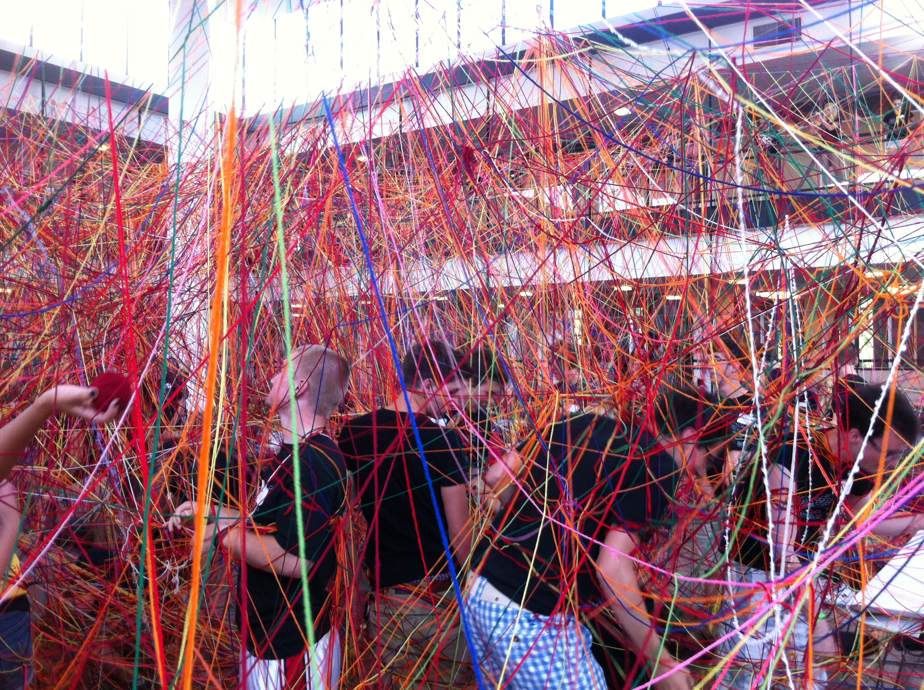
Purple Ribbon Selfies:
An in-person method for increasing social engagement in an online, on-campus course.
Brad Hokanson, Robin Carufel, Xinji Wang
July 28, 2016
Notes:
How do conversations start?
Part of the value of a campus-based education is the interaction and direct personal engagement with peers and faculty. Students that are not on campus challenged by this lack of connection; both commuters and fully online students miss out on important aspects of a college education.

Slide 2
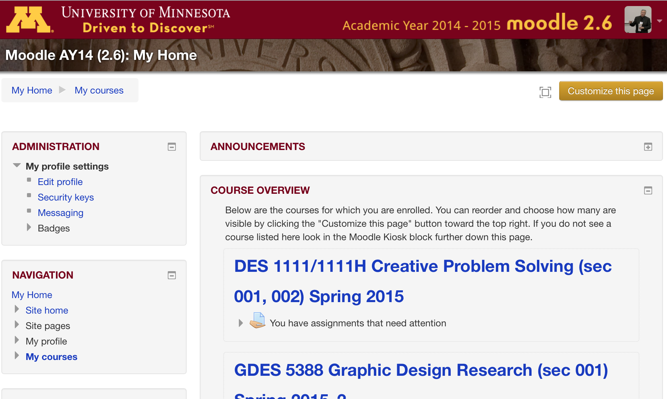
Purple Ribbon Selfies
July 28, 2016
Notes:
Online courses have mushroomed over the past decade and are common. Much of the research and development focus of online learning has concentrated on developing the social connection to support learning by students. Engagement and developing a social presence through electronic media is seen as an important part of the learning experience. Text-based discussions are a standard part of many online classes, and participation is often required as part of the course work, with the hope of developing a virtual connection between students.

Slide 3
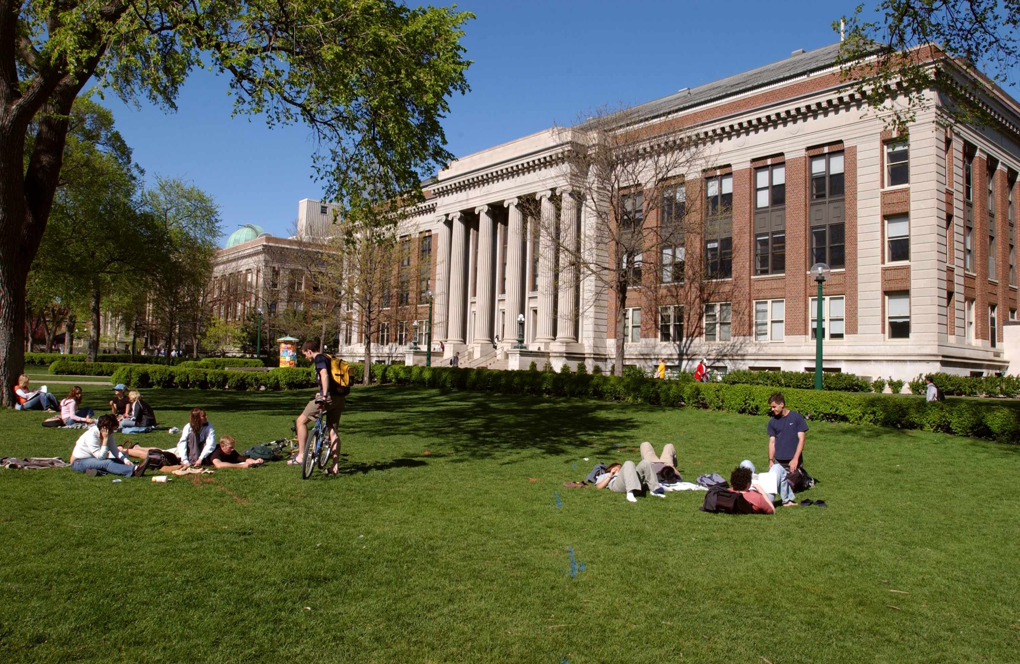
Purple Ribbon Selfies
July 28, 2016
Notes:
While much of the focus of educational technology and online learning has been on distant learners, many of the students in online courses are on campus and taking online courses for convenience and flexibility. More than 45% of all campus-based students take at least one course online and that number continues to grow.

Slide 4
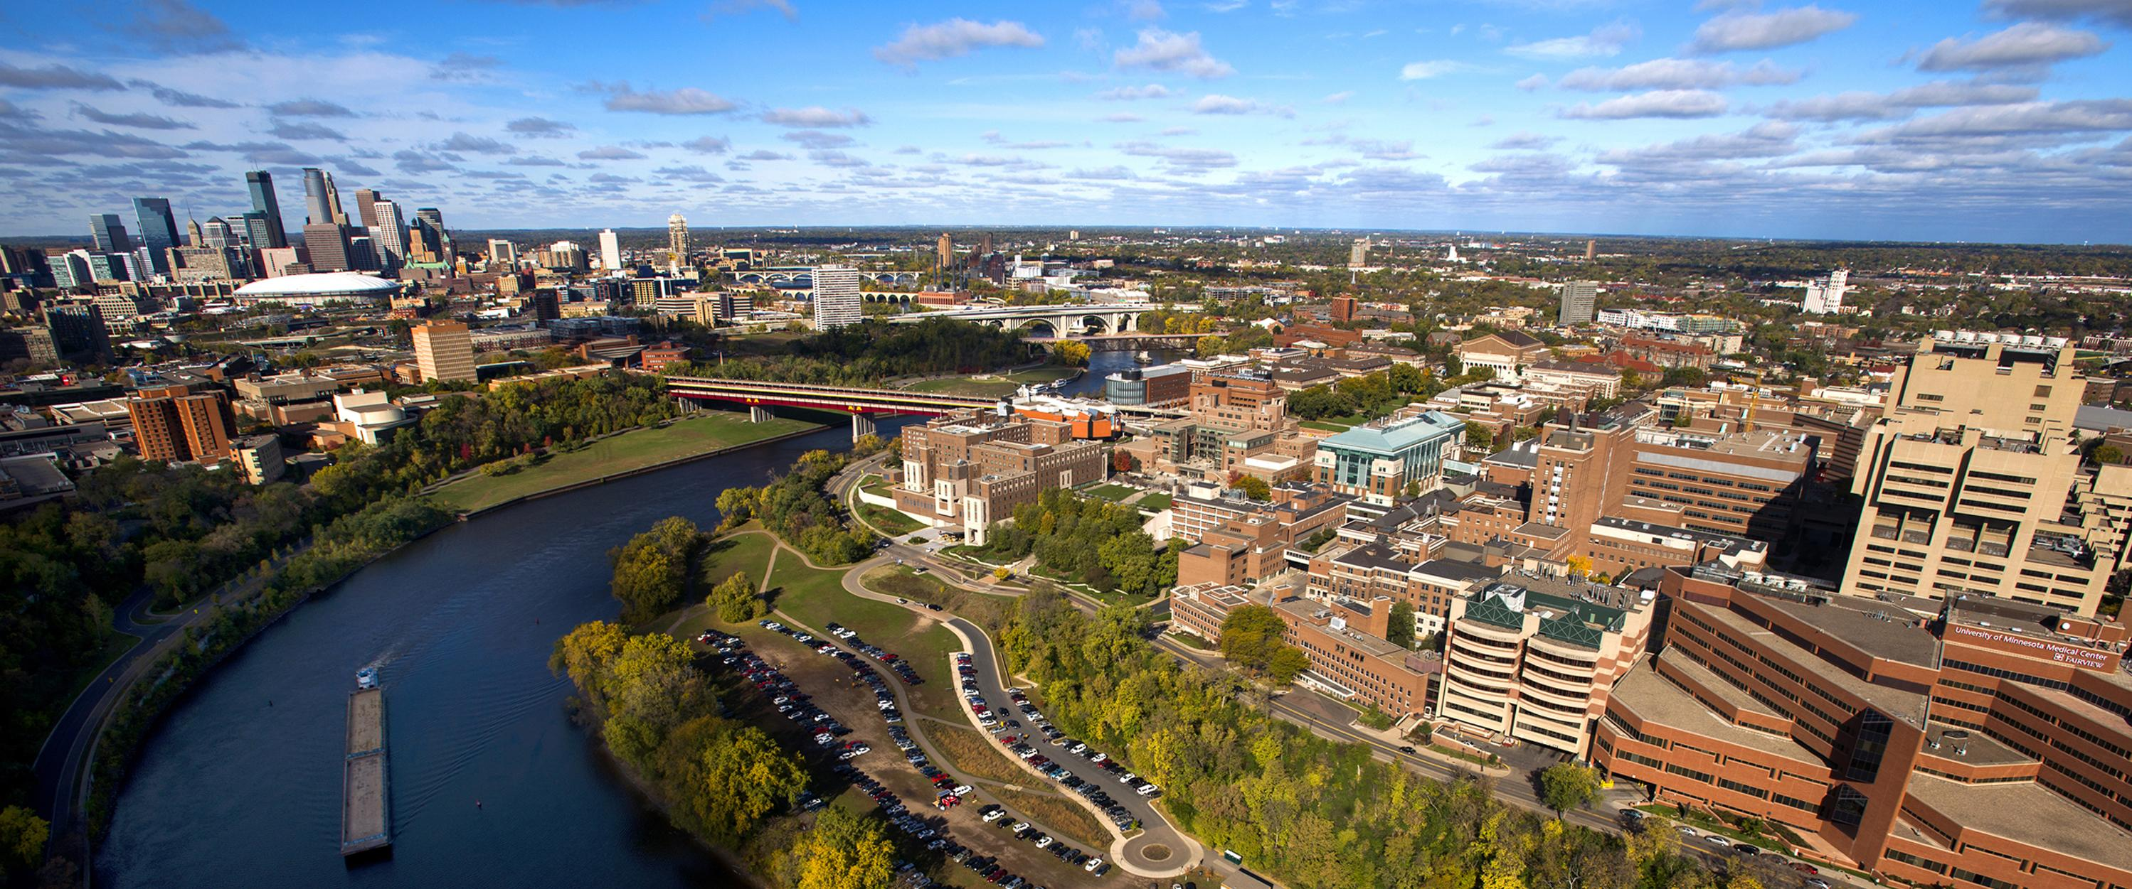
Purple Ribbon Selfies
July 28, 2016
Notes:
Encouraged by university administrations, online courses on campus have many benefits for university and students alike. These include flexibility of scheduling, no need for classrooms or parking facilities, scalability, and the ability to easily reproduce a course with limited effort.

Slide 5
Purple Ribbon Selfies
July 28, 2016
Notes:
In contrast, one value of coming to campus for an education is the opportunity to meet other students, in person, and in class. The incidental meetings and interactions that spring from being in the same physical location have historically lead to dates, discussions over coffee, study groups, and long term relationships.

Slide 6
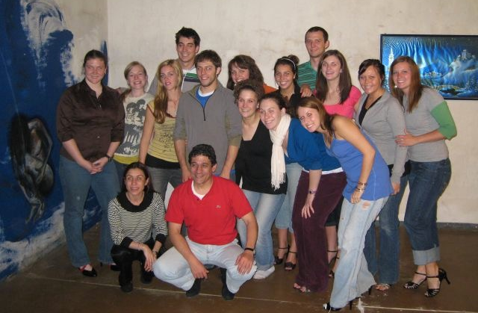
Purple Ribbon Selfies
July 28, 2016
Notes:
Like the value of browsing the library and finding unusual books on your topic, this direct personal interaction is richer and more complex than in the typical online classroom.

Slide 7
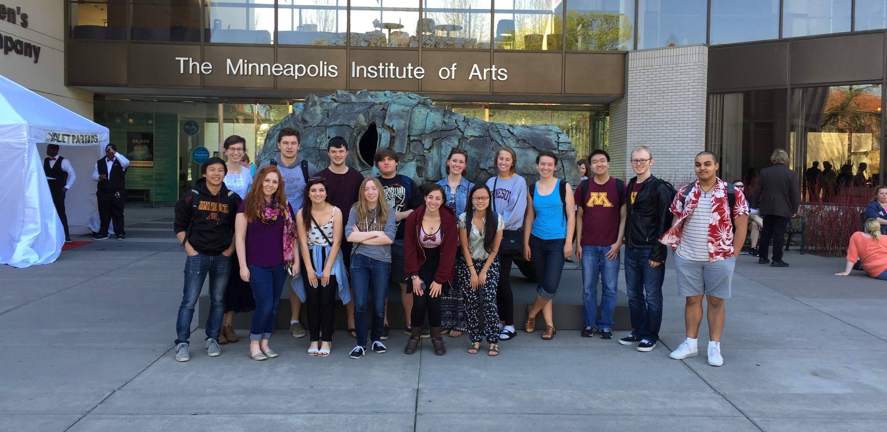
Purple Ribbon Selfies
July 28, 2016
Notes:
The incidental interactions and introductions that occur even in the biggest lecture hall are a valuable part of the higher education experience. With the increase in online courses taken by on-campus students, some of the group identification through shared classes is less present for today's college students.
How do on-campus students meet their peers as part of campus life? That's the genesis of the Ribbon Project.

Slide 8
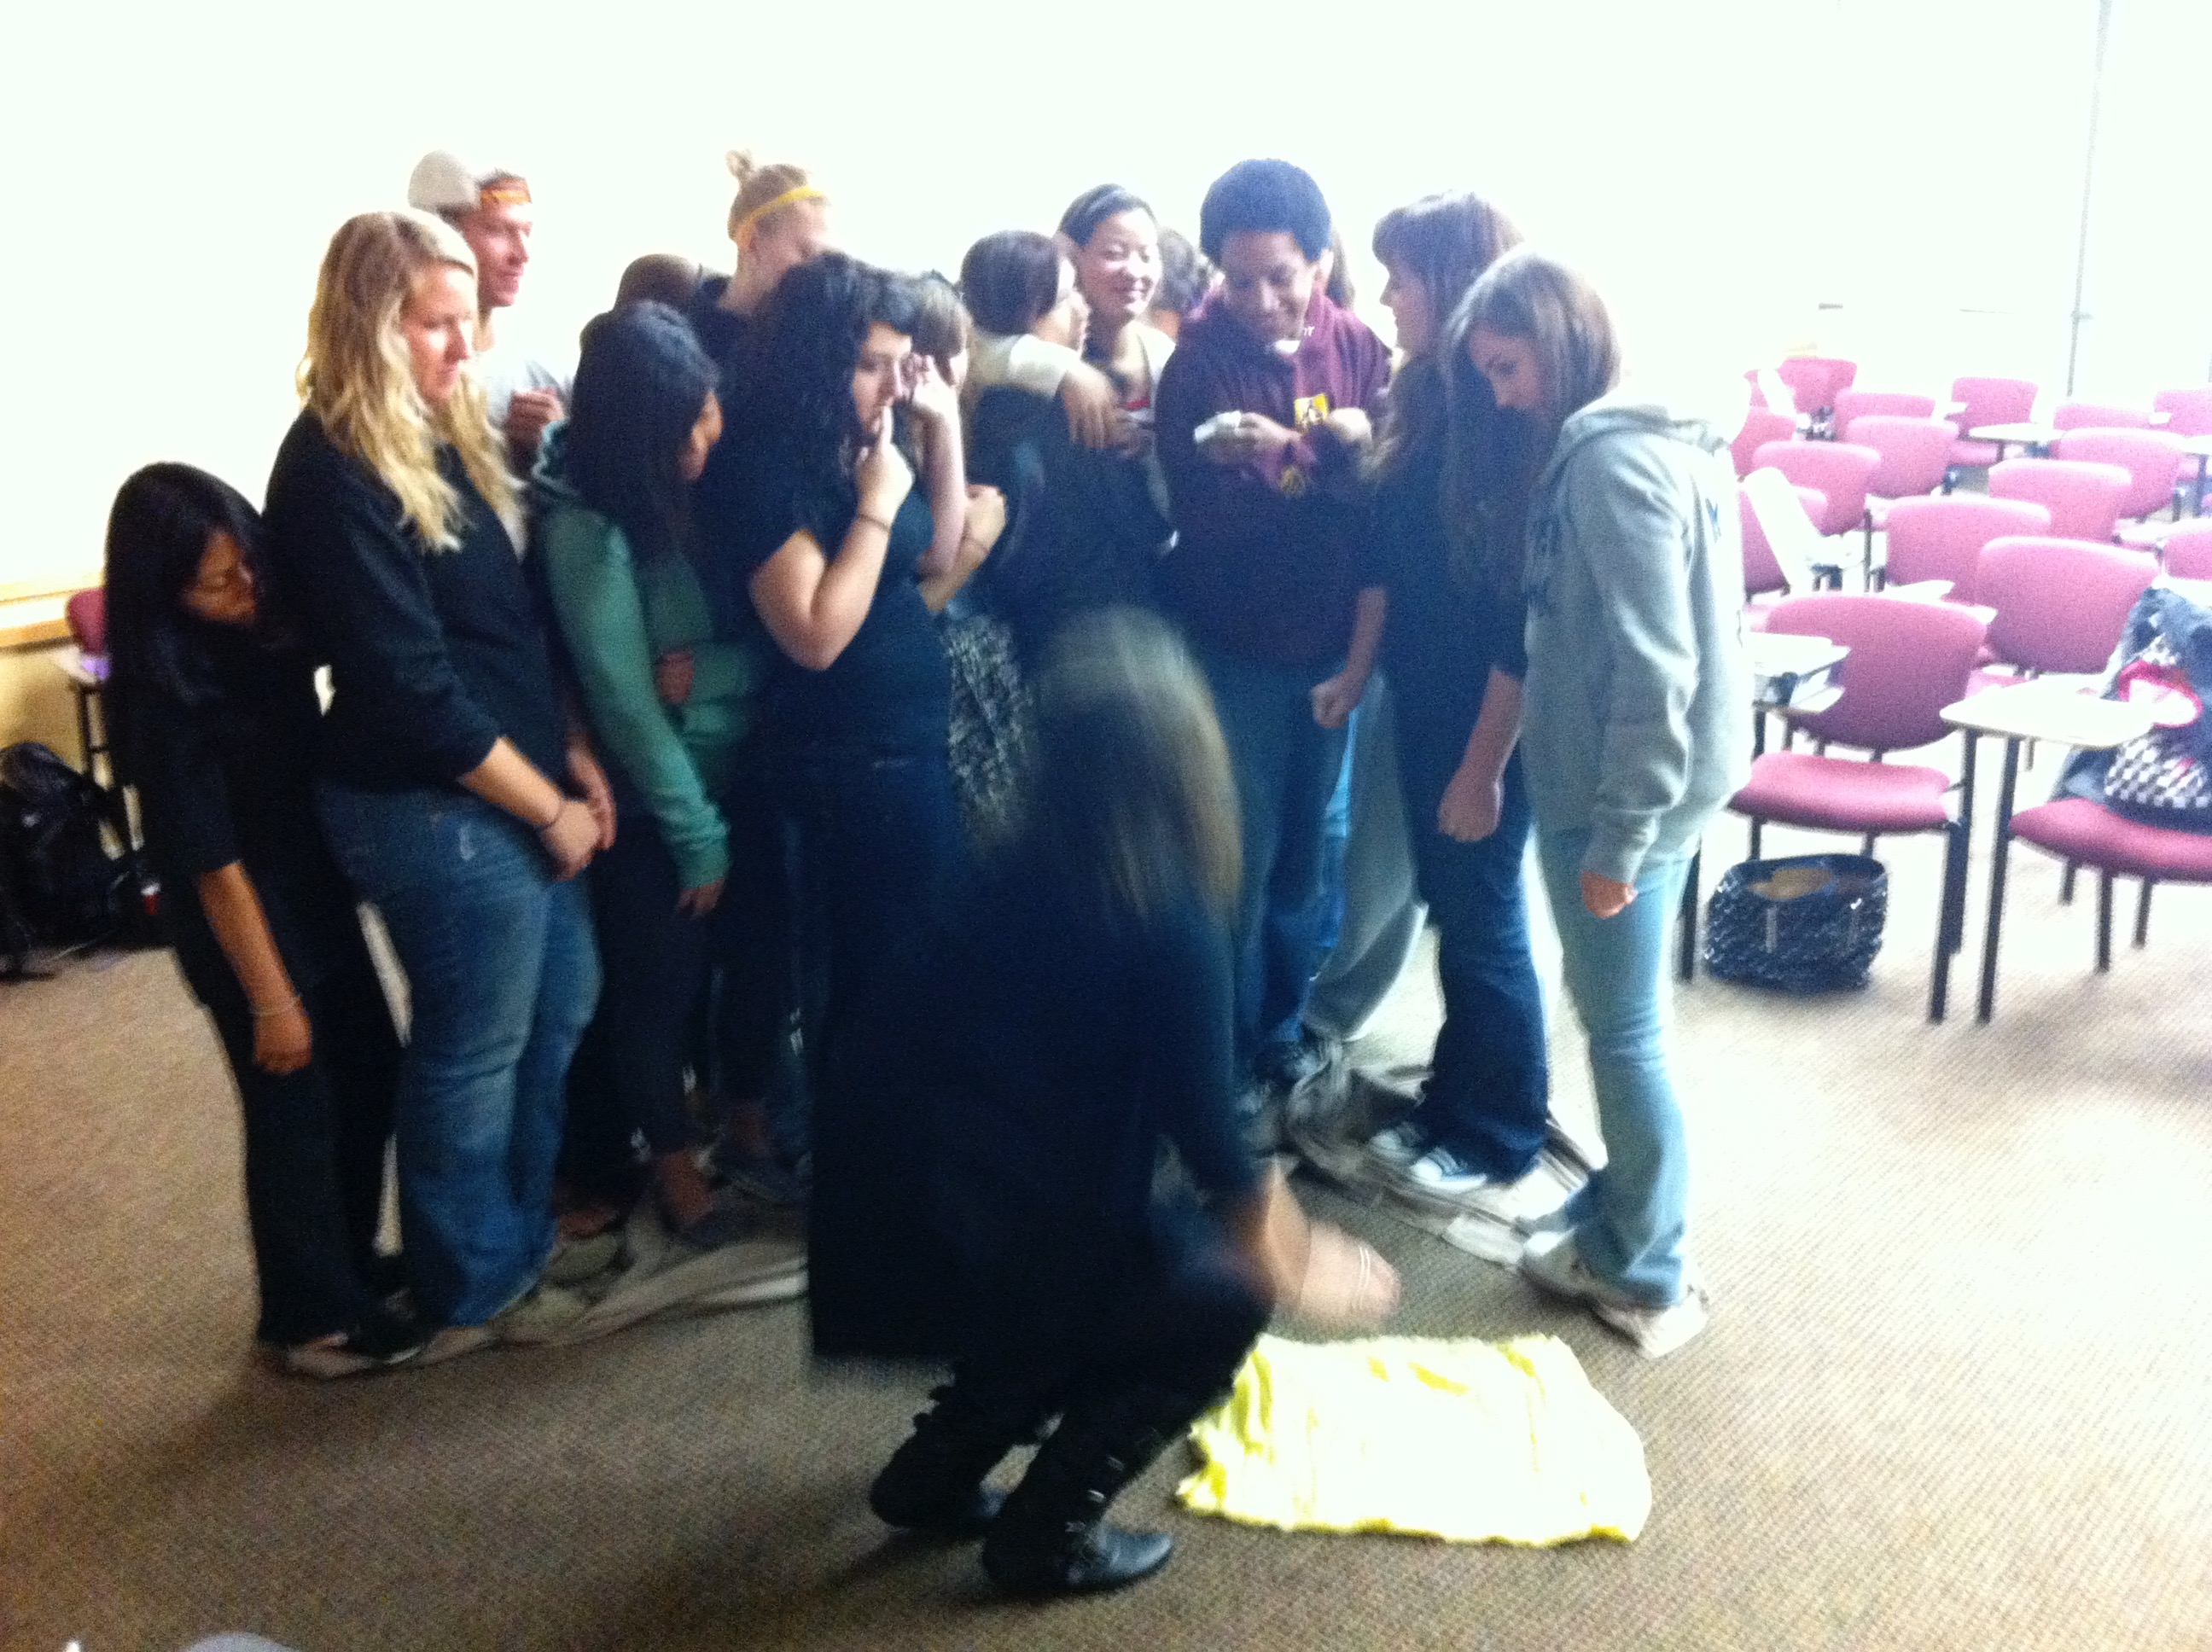
Purple Ribbon Selfies
July 28, 2016
Notes:
The incidental interactions and introductions that occur even in the biggest lecture hall are a valuable part of the higher education experience. With the increase in online courses taken by on-campus students, some of the group identification through shared classes is less present for today's college students.
How do on-campus students meet their peers as part of campus life? That's the genesis of the Ribbon Project.

Slide 9
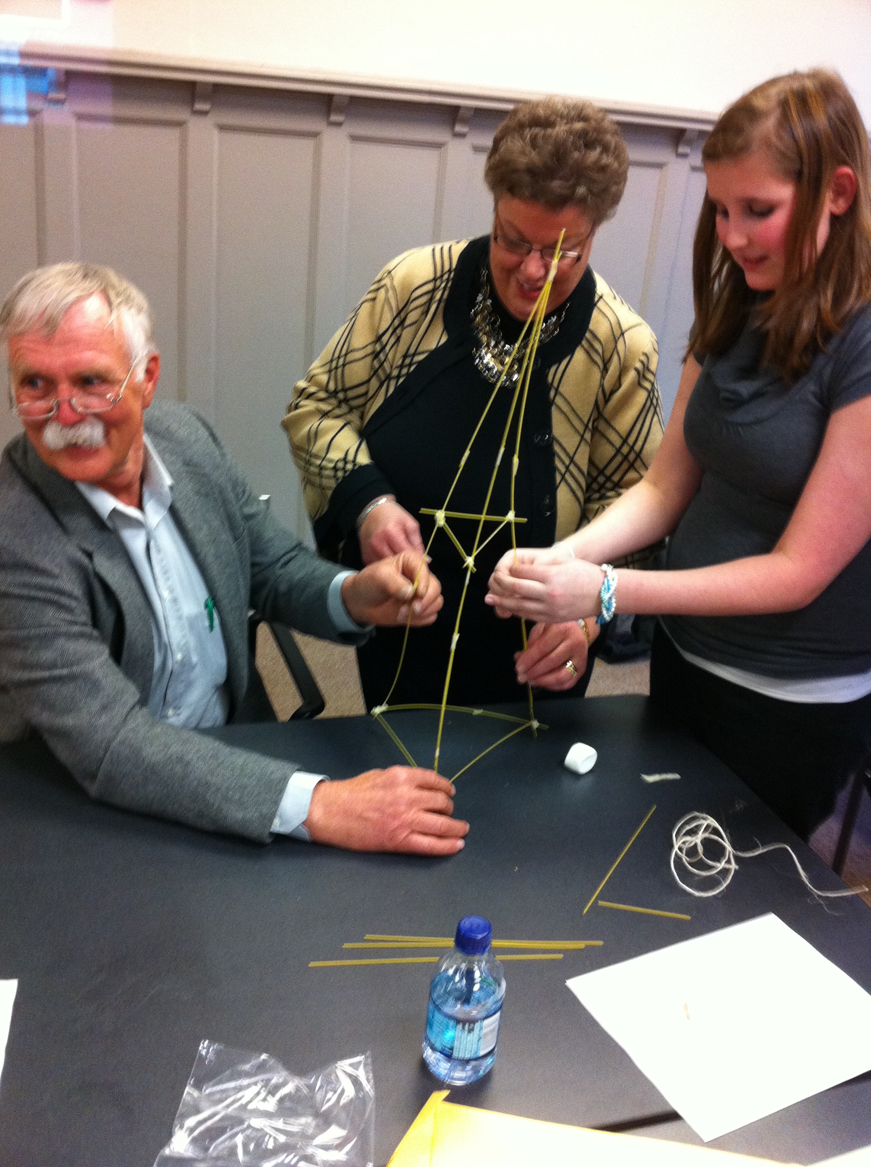
Purple Ribbon Selfies
July 28, 2016
Notes:
The incidental interactions and introductions that occur even in the biggest lecture hall are a valuable part of the higher education experience. With the increase in online courses taken by on-campus students, some of the group identification through shared classes is less present for today's college students.
How do on-campus students meet their peers as part of campus life? That's the genesis of the Ribbon Project.

Slide 10
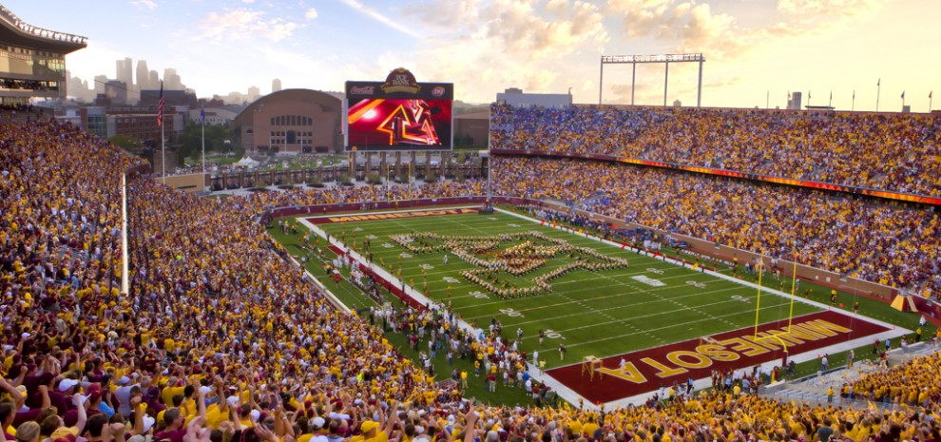
Purple Ribbon Selfies
July 28, 2016
Notes:
The incidental interactions and introductions that occur even in the biggest lecture hall are a valuable part of the higher education experience. With the increase in online courses taken by on-campus students, some of the group identification through shared classes is less present for today's college students.
How do on-campus students meet their peers as part of campus life? That's the genesis of the Ribbon Project.

Slide 11
Creative Problem Solving
• Freshman seminar [2000]
• Large scale class [2007]
• Online course [2014]
• Massive course [2014]
Purple Ribbon Selfies
July 28, 2016

Slide 12
 | F2009 | F2010 | S2011 | F2011 | S2012 | S2015
Index pre-test | 101.76 | 115.56 | 107.17 | 110.69 | 111.65 | 112.4
pre-percentile | 53.51% | 78.17% | 64.00% | 70.35% | 71.99% | 73.24%
index post-test | 129.35 | 129.67 | 129.25 | 128.01 | 130.05 | 132.8
post-percentile | 92.89% | 93.10% | 92.82% | 91.93% | 93.35% | 96
N | 50 | 33 | 36 | 80 | 41 | 46
Purple Ribbon Selfies
July 28, 2016

Slide 13
Class focus
The development of creativity in students through a series of active exercises and projects.
Building a habit of variance through a series of challenges.
Challenging assumptions as well as personal limitations.
Developing a sense of capability, courage
Purple Ribbon Selfies
July 28, 2016

Slide 14
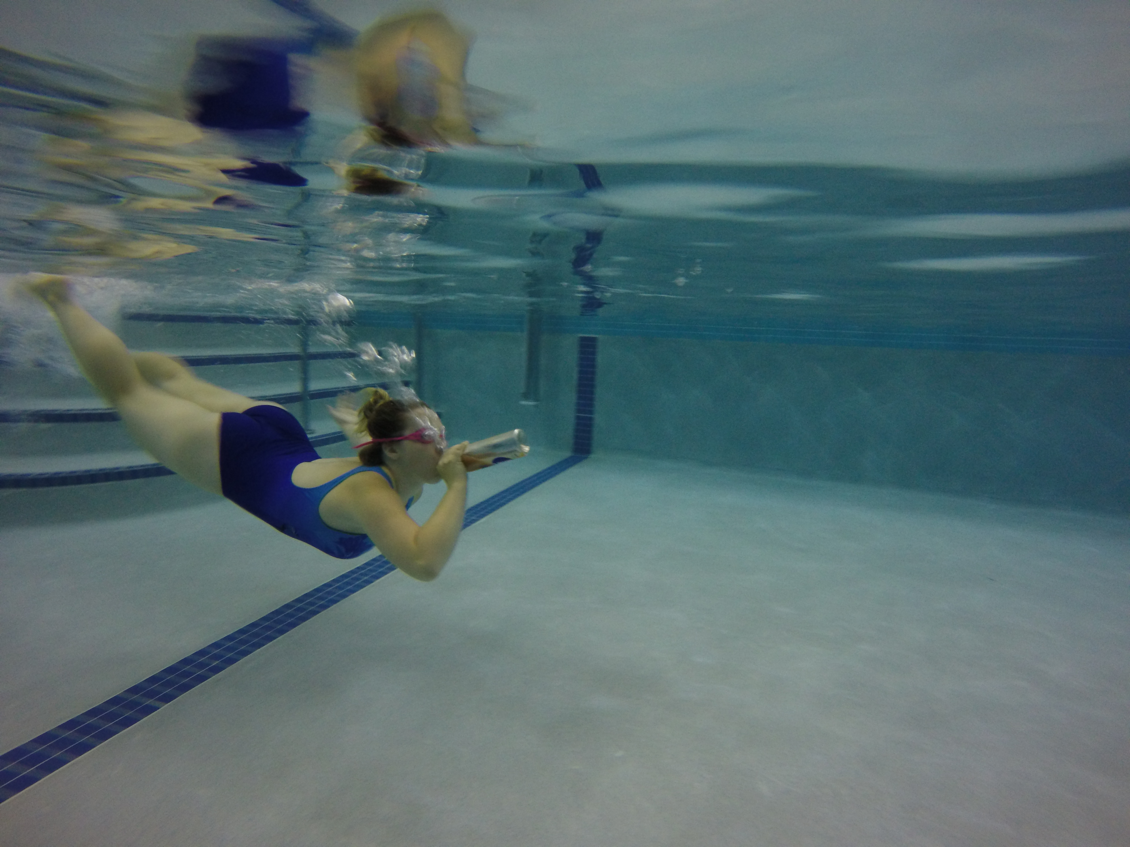
Purple Ribbon Selfies
July 28, 2016

Slide 15
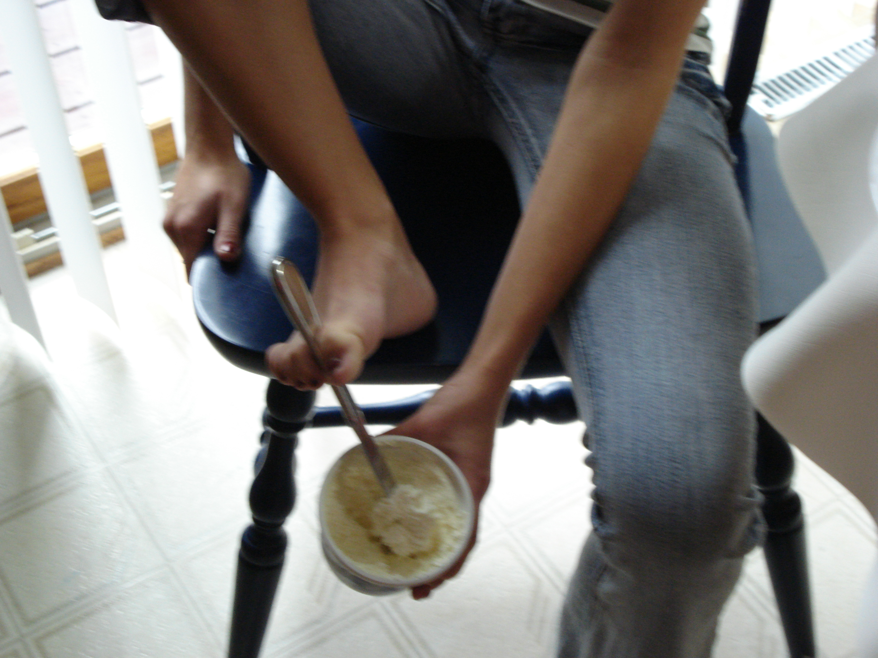
History of the class
Purple Ribbon Selfies
July 28, 2016

Slide 16
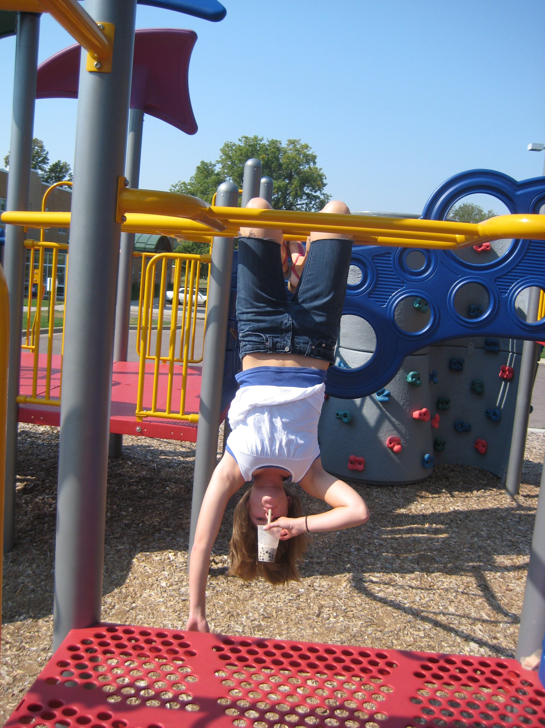
History of the class
Purple Ribbon Selfies
July 28, 2016

Slide 17
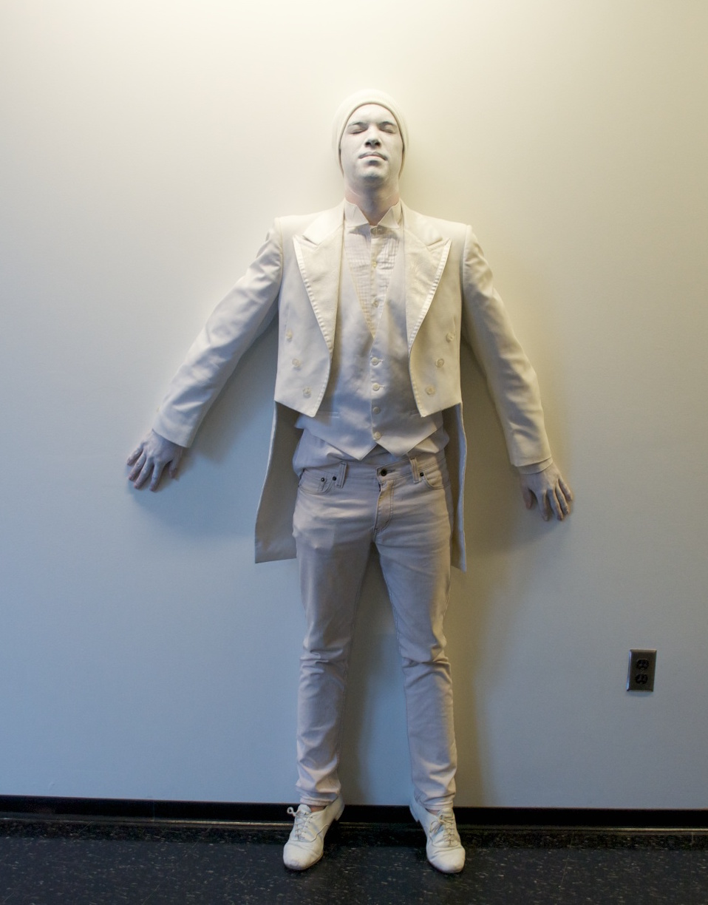
Purple Ribbon Selfies
July 28, 2016

Slide 18
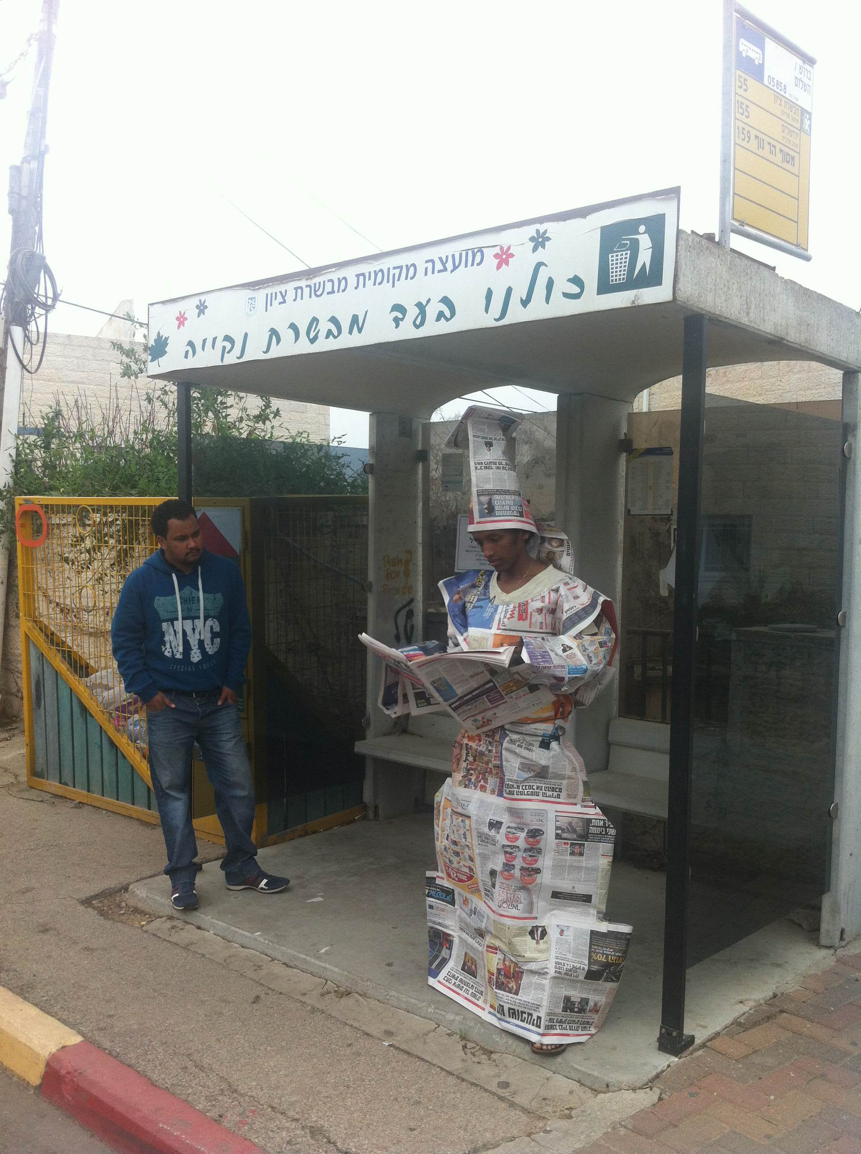
Purple Ribbon Selfies
July 28, 2016

Slide 19
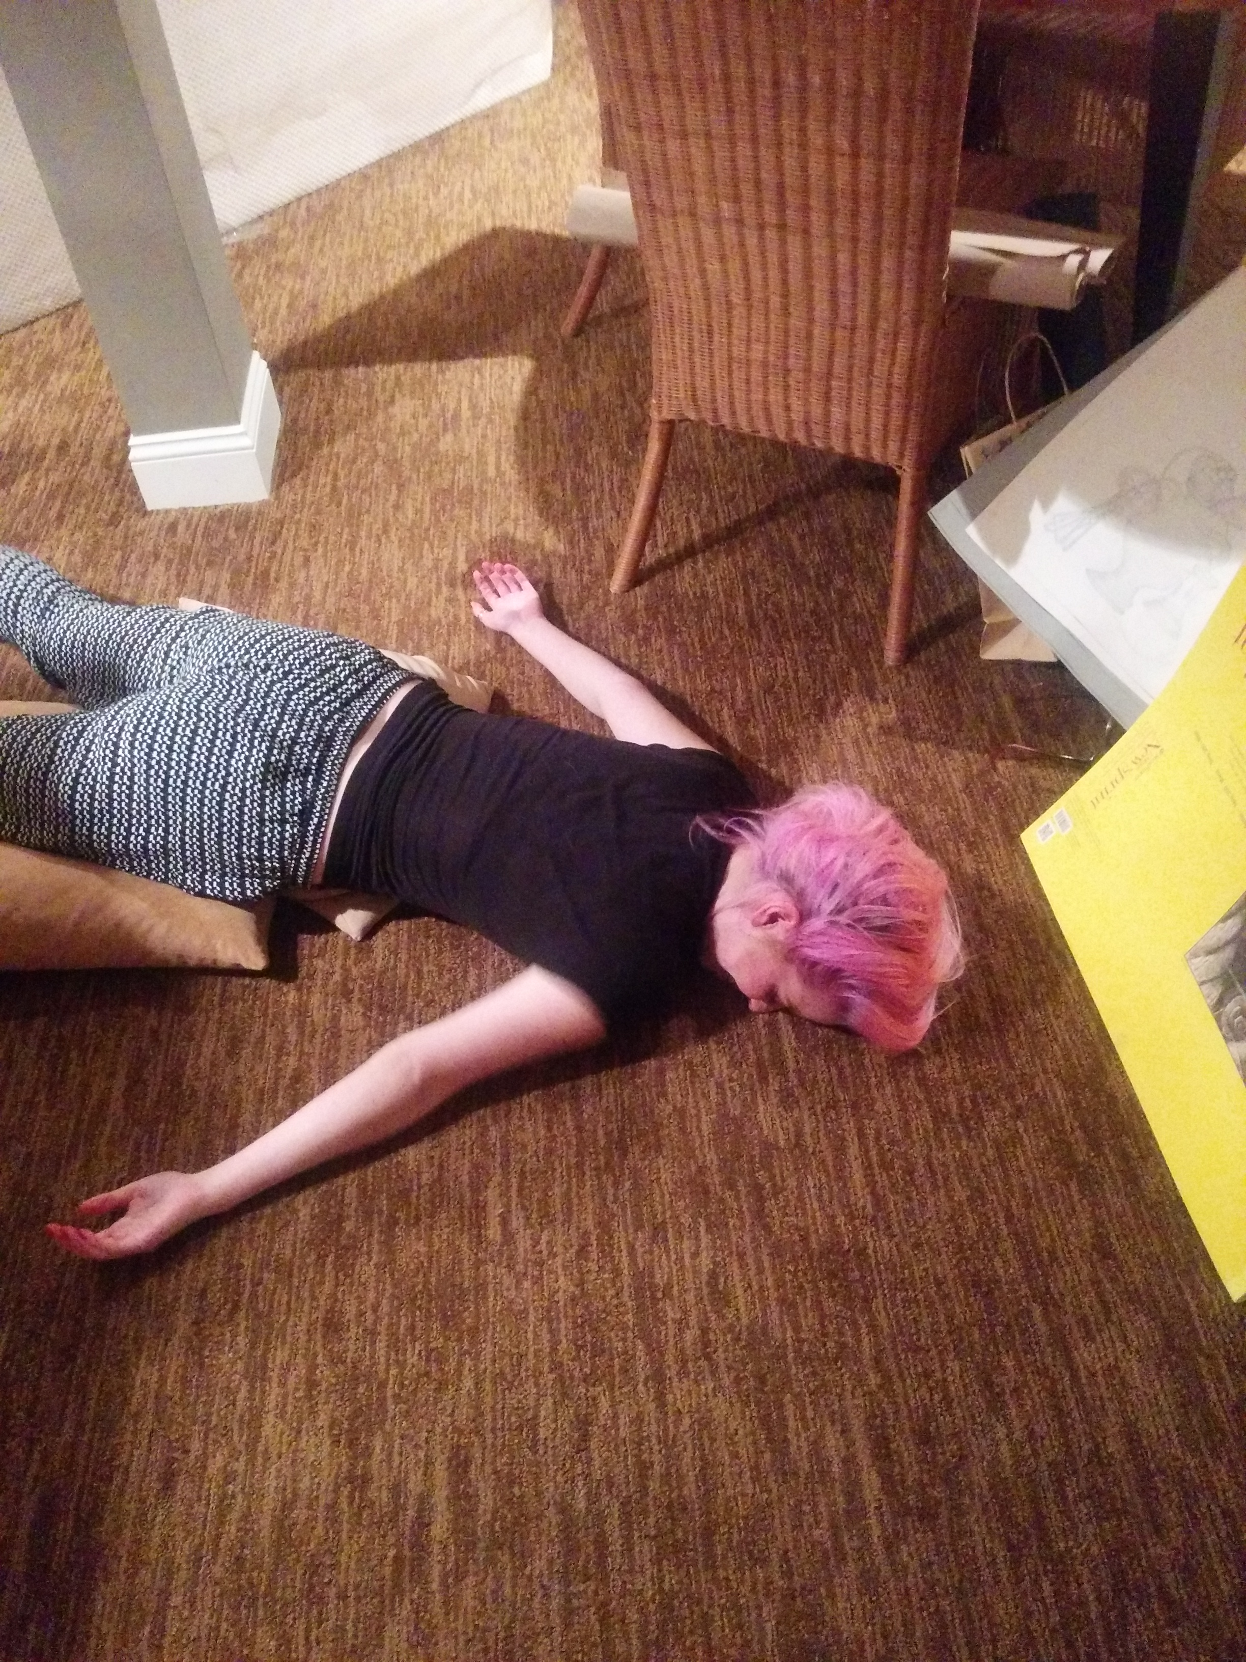
Purple Ribbon Selfies
July 28, 2016

Slide 20
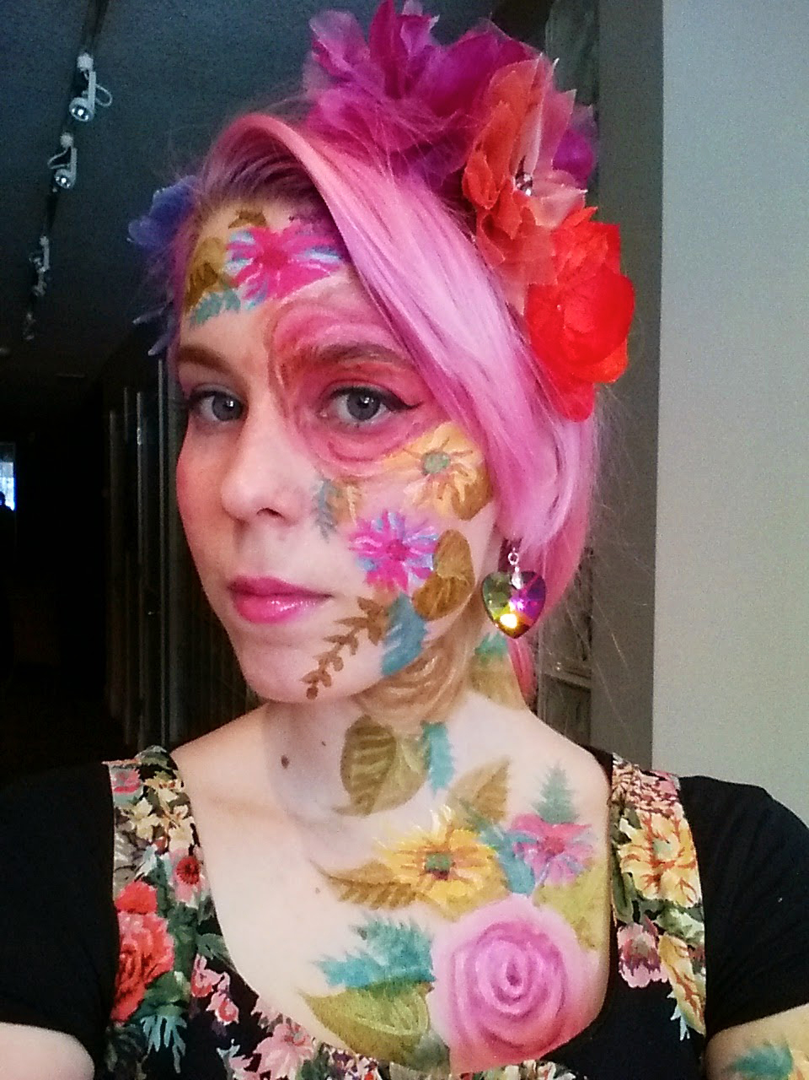
Purple Ribbon Selfies
July 28, 2016

Slide 21
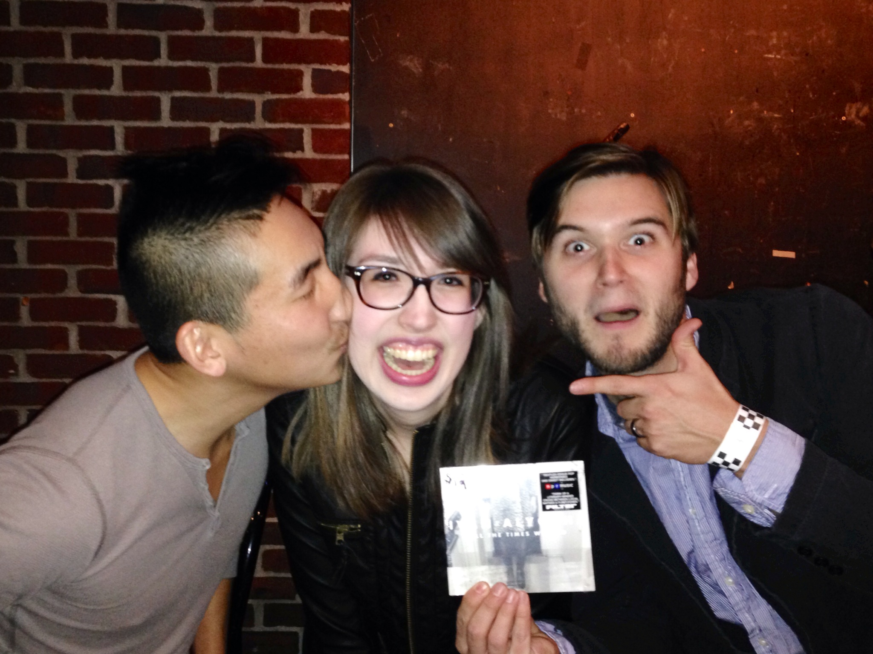
Purple Ribbon Selfies
July 28, 2016

Slide 22
New Friends
"I met two people, Amanda and Andres, who I discovered I have a total of four classes with me, so I see them often and we first met because of our ribbons."
Purple Ribbon Selfies
July 28, 2016

Slide 23
The Ribbon Assignment
"Yet the fact that the course is online inevitably created a somewhat separated environment, which could feel lonely and individualized at times. Meeting classmates through this assignment allowed a better sense of belonging to a group and helped make the class feel more tangible."
Purple Ribbon Selfies
July 28, 2016

Slide 24
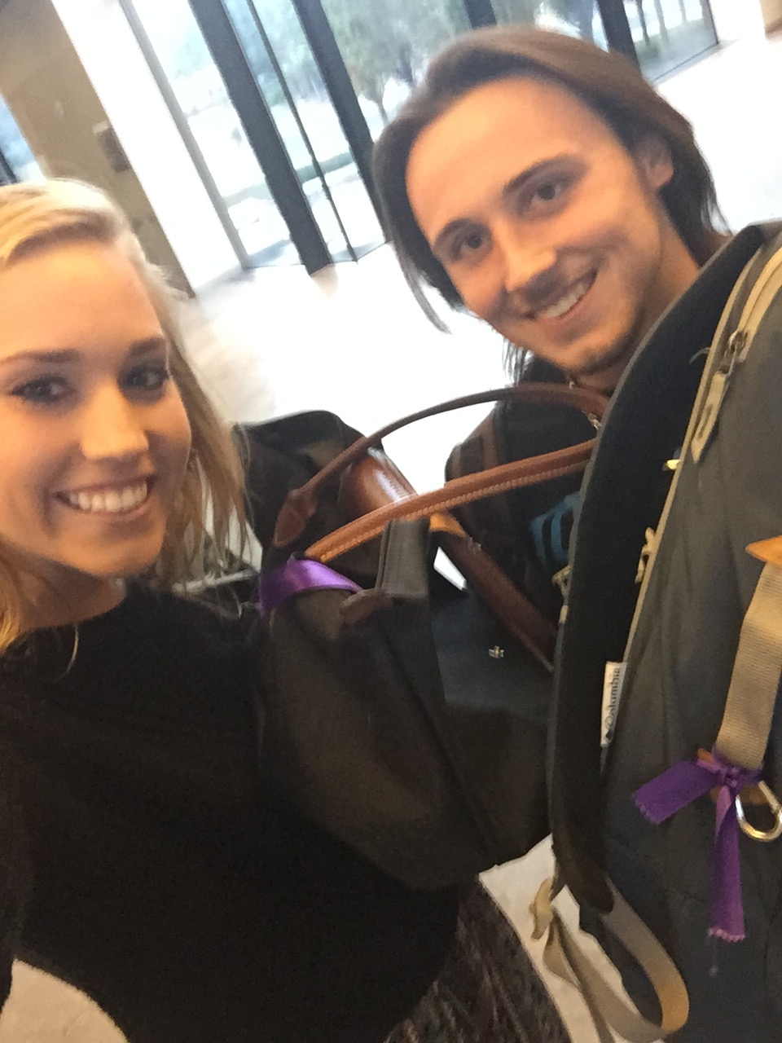
Purple Ribbon Selfies
July 28, 2016

Slide 25
New Friends
“It’s cool how this class creates friendships! I’ve never had an assignment quite like this one before. It was creative and I liked this way of seeing our classmates around campus. Pictures numbers three and five are with two girls I met through this class who have quickly become my closest friends at the U.”
Purple Ribbon Selfies
July 28, 2016

Slide 26
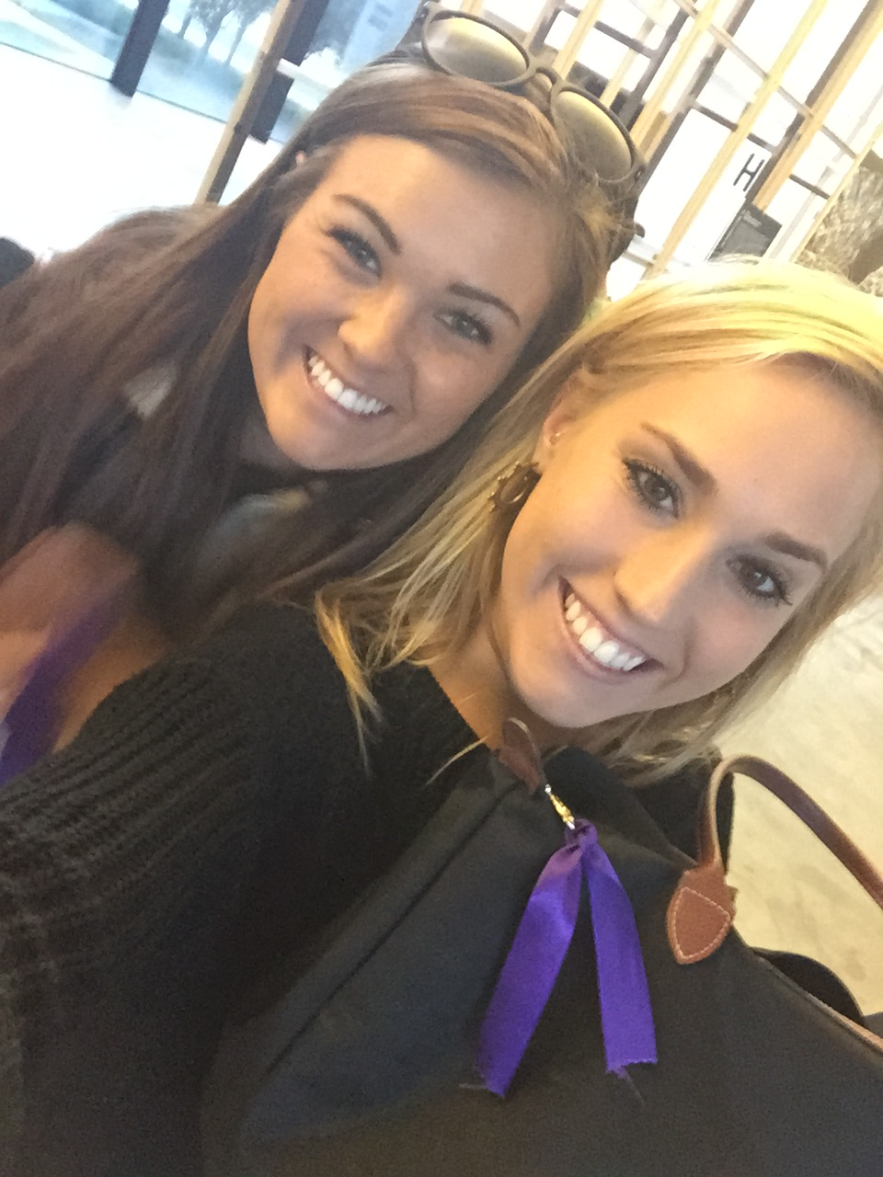
Purple Ribbon Selfies
July 28, 2016

Slide 27
Study groups, friends
“A group of us were able to take pictures and even studied for the Midterm together which was extremely beneficial. Finally, a third connection I made was with three girls that I now eat lunch with every Tuesday and Thursday in between our two classes. Overall, this assignment seemed a little odd at first but in the end, I was able to make friends and form a few study groups which helps me out a lot!”
Purple Ribbon Selfies
July 28, 2016

Slide 28
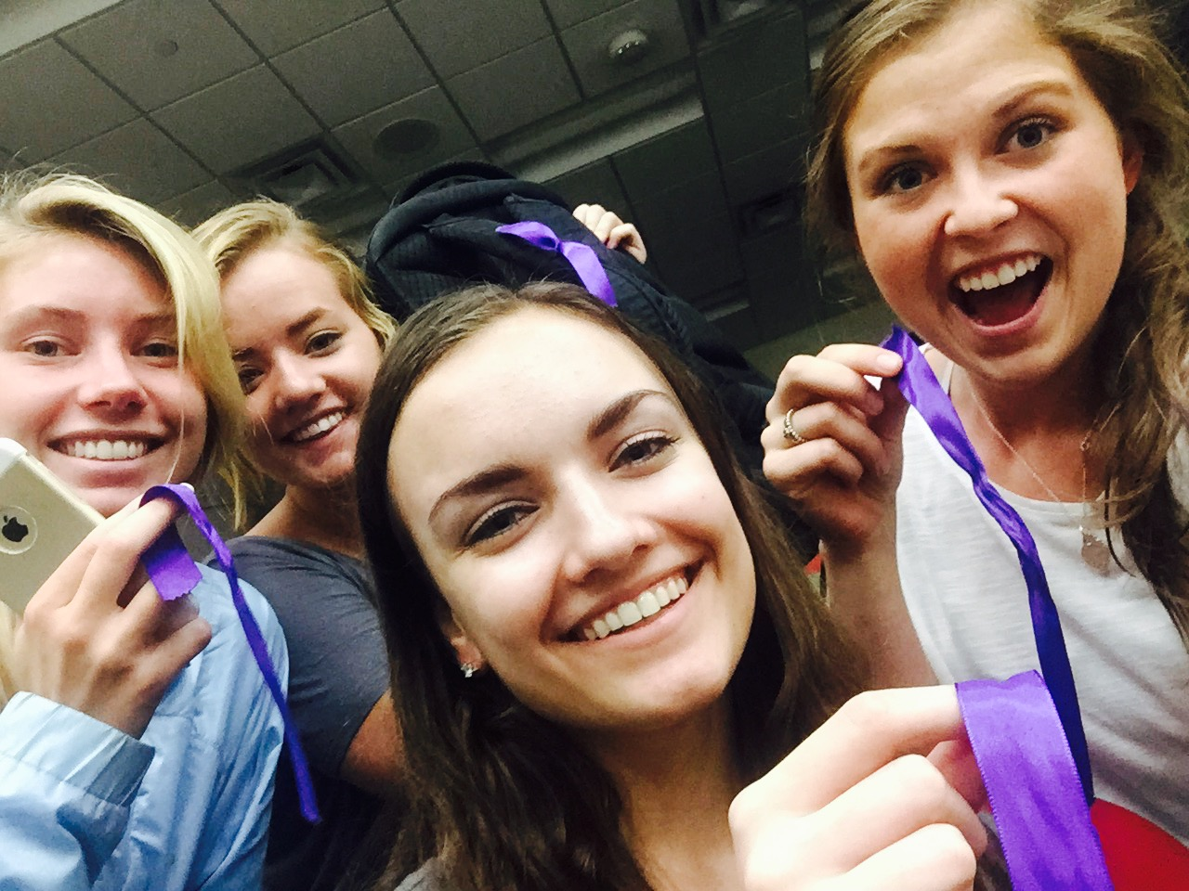
Purple Ribbon Selfies
July 28, 2016

Slide 29
Away from campus
I work full time, I am a mother, I don't live near campus, and all my classes are online. I don't have the time to come all the way to campus to try and find someone with the same ribbon, just to take a "selfie". So after thinking, I decided I would take "selfies" with people of different ethnicities. So I figured this idea would be very diverse and have the same concept.
Purple Ribbon Selfies
July 28, 2016

Slide 30
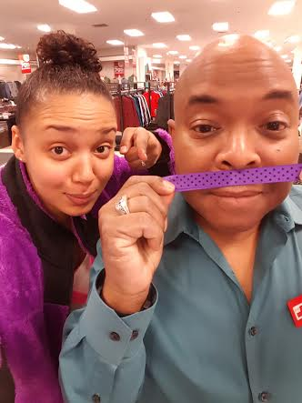
Purple Ribbon Selfies
July 28, 2016

Slide 31
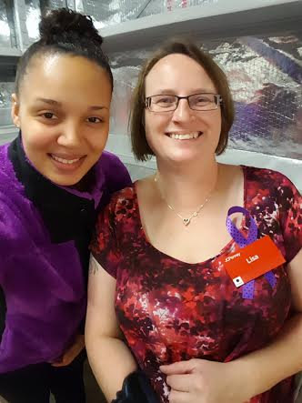
Purple Ribbon Selfies
July 28, 2016

Slide 32
Meetups
“I actually had difficulty with my assignment. It was really difficult to find people to take selfies with. But thanks to the meetup, I managed to get some selfies with a bunch of cool people. We mostly discussed about this class (how funny are some of the things we had to do) and got to know a little bit about everyone. This assignment has definitely cultivated my courage to go up and introduce myself to people.”
Purple Ribbon Selfies
July 28, 2016

Slide 33
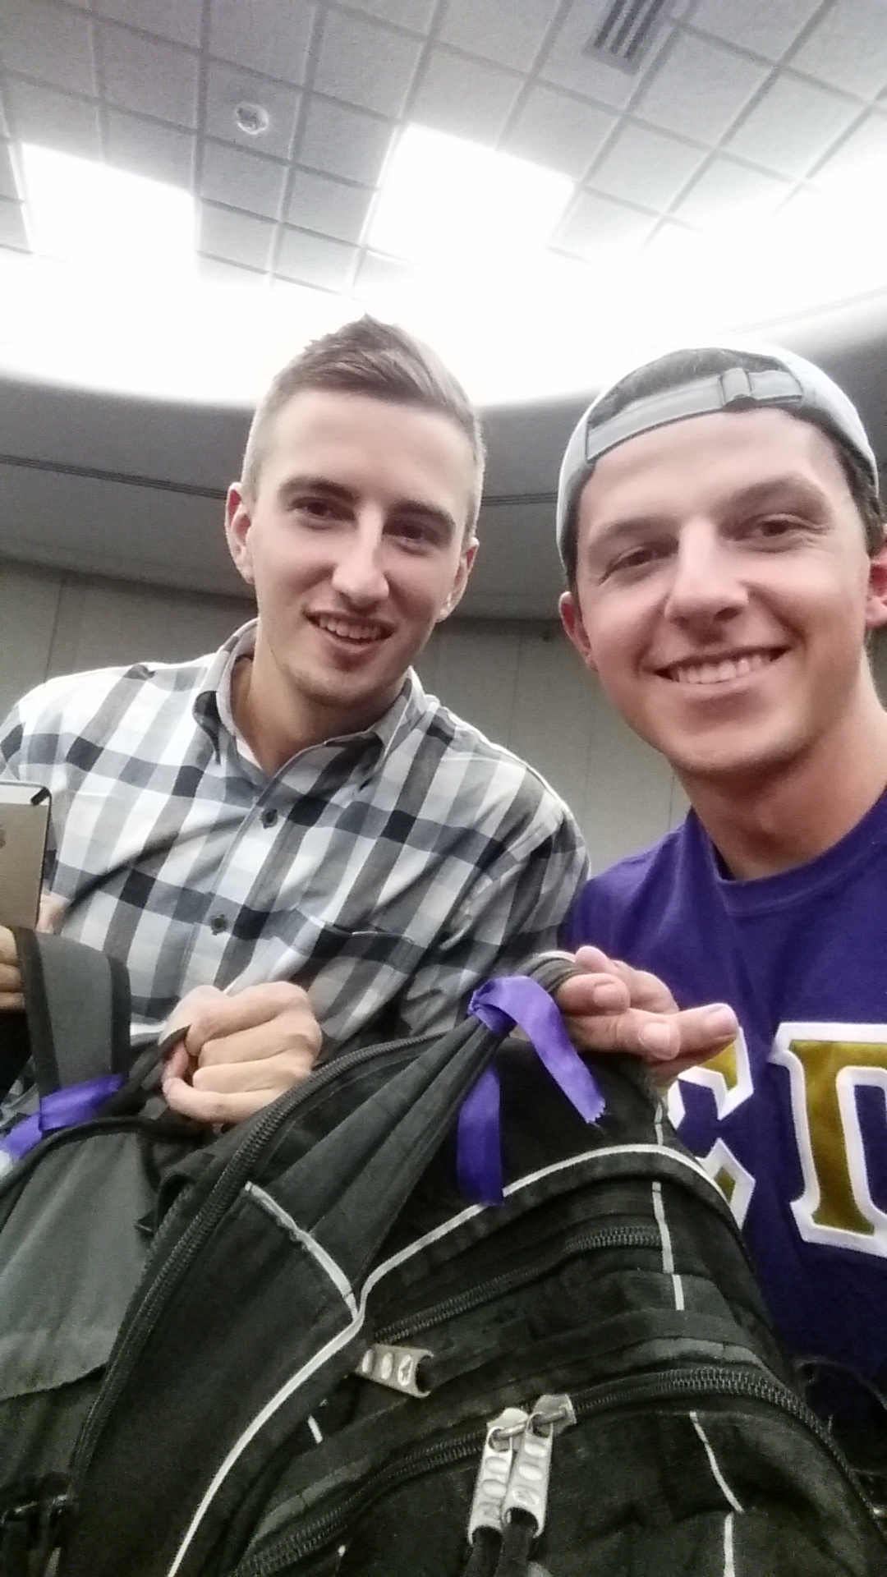
Purple Ribbon Selfies
July 28, 2016

Slide 34
Meetups
"I was thankful for the designated meetup spots to find people with ribbons. Once a group us arrived, it was interesting because though we did not see each other at all, I still felt connected to them as if we had class together 3 times per week.”
Purple Ribbon Selfies
July 28, 2016

Slide 35
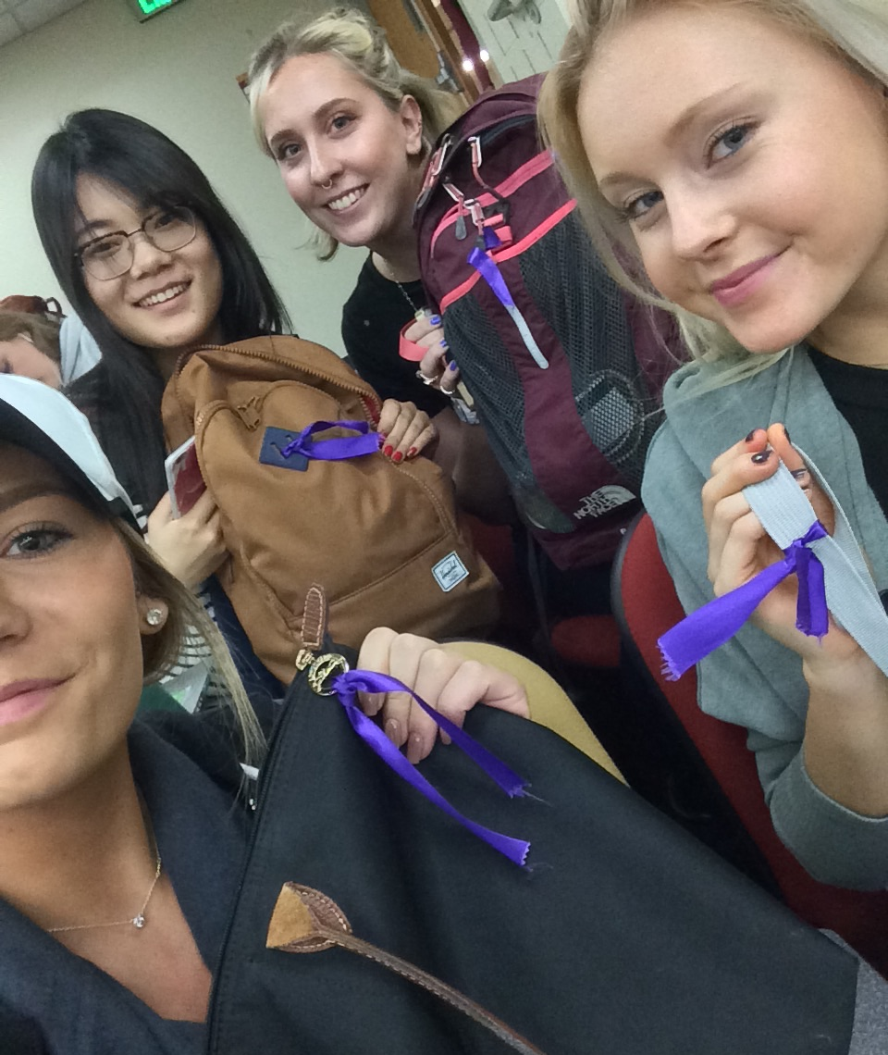
Purple Ribbon Selfies
July 28, 2016

Slide 36
Event
"For the next ribbon I didn't even have to try. As I was walking to class a car pulled up next to me and a guy shouted "can I take a picture with you?! Stay right where you are". So I sat there for two minutes and low and behold a classmate with a ribbon came [back to take a picture]."
Purple Ribbon Selfies
July 28, 2016

Slide 37
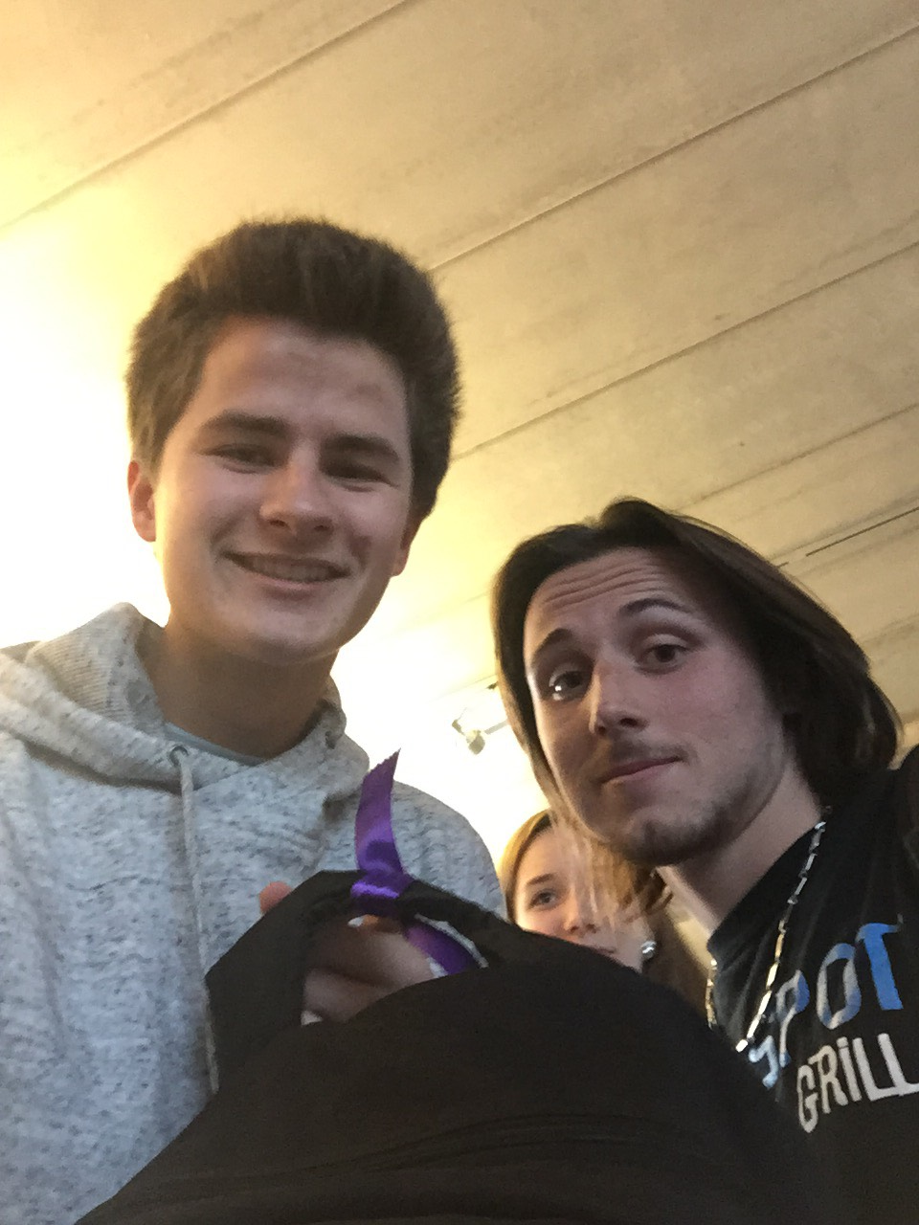
Purple Ribbon Selfies
July 28, 2016

Slide 38
Tagging
“ I was happy that I got to meet and interact with different people around campus due to the commonality that we wore a purple ribbon. Something so small really did make a big difference in my interaction with my classmates. And these interactions were fabricated from creativity.“
Purple Ribbon Selfies
July 28, 2016

Slide 39
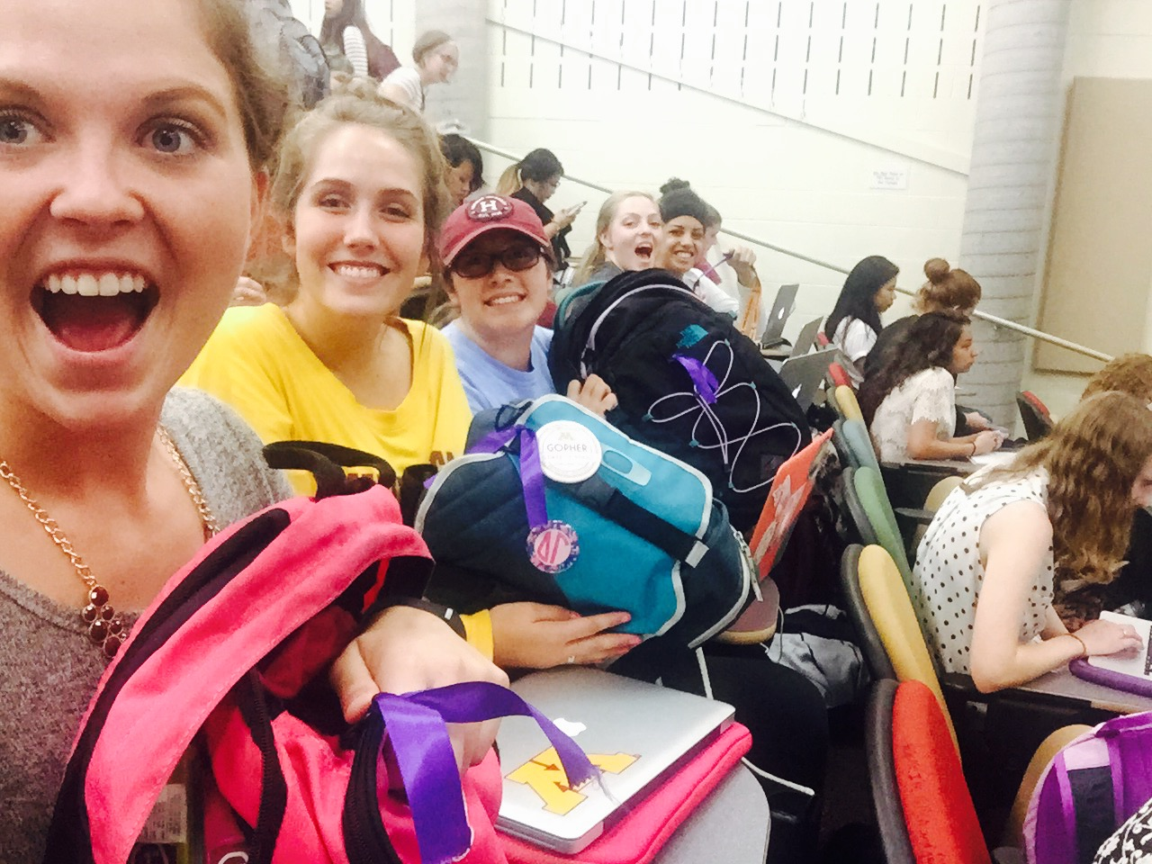
Purple Ribbon Selfies
July 28, 2016

Slide 40
Tagging
“ Having everyone in the course wear a distinctive ribbon was a creative way to recognize people from my class. I enjoyed the subtle secrecy of this assignment as well. While I could see people around campus who are in my class, others could not because the ribbon meant nothing to them.”
Purple Ribbon Selfies
July 28, 2016

Slide 41
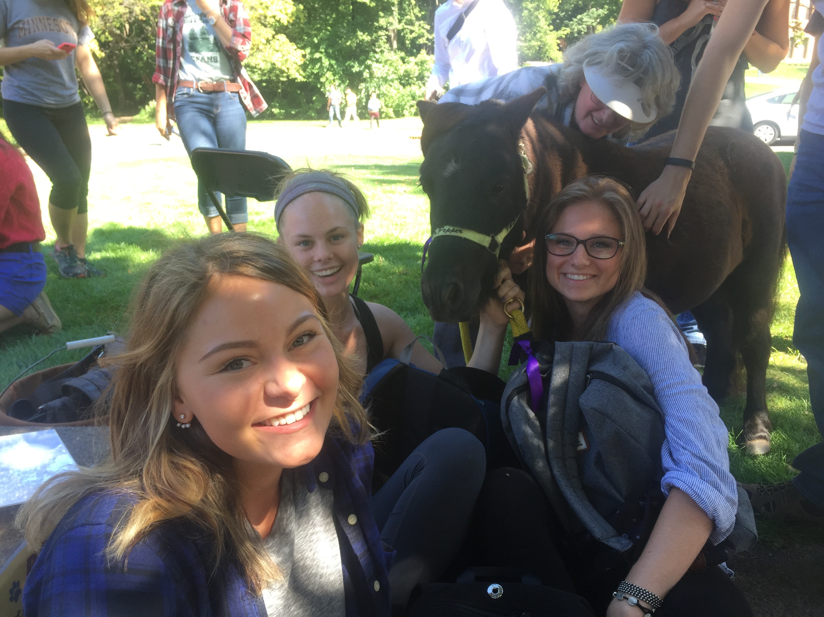
Purple Ribbon Selfies
July 28, 2016

Slide 42
Tagging
"I was happy that I got to meet and interact with different people around campus due to the commonality that we wore a purple ribbon. Something so small really did make a big difference in my interaction with my classmates. And these interactions were fabricated from creativity."
Purple Ribbon Selfies
July 28, 2016

Slide 43
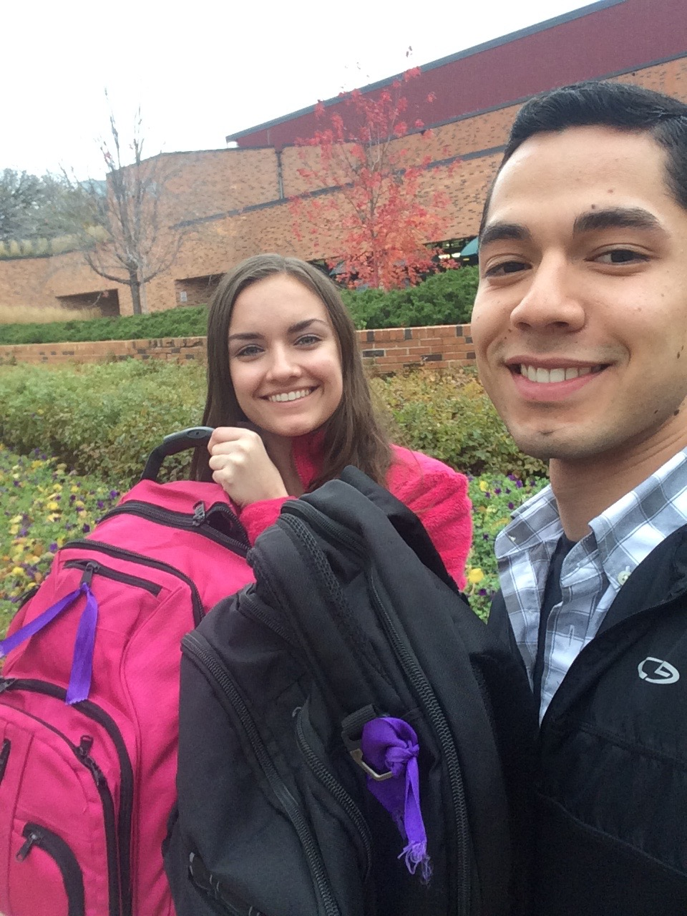
Purple Ribbon Selfies
July 28, 2016

Slide 44
Meetups
"I was thankful for the designated meetup spots to find people with ribbons. Once a group us arrived, it was interesting because though we did not see each other at all, I still felt connected to them as if we had class together 3 times per week."
Purple Ribbon Selfies
July 28, 2016

Slide 45
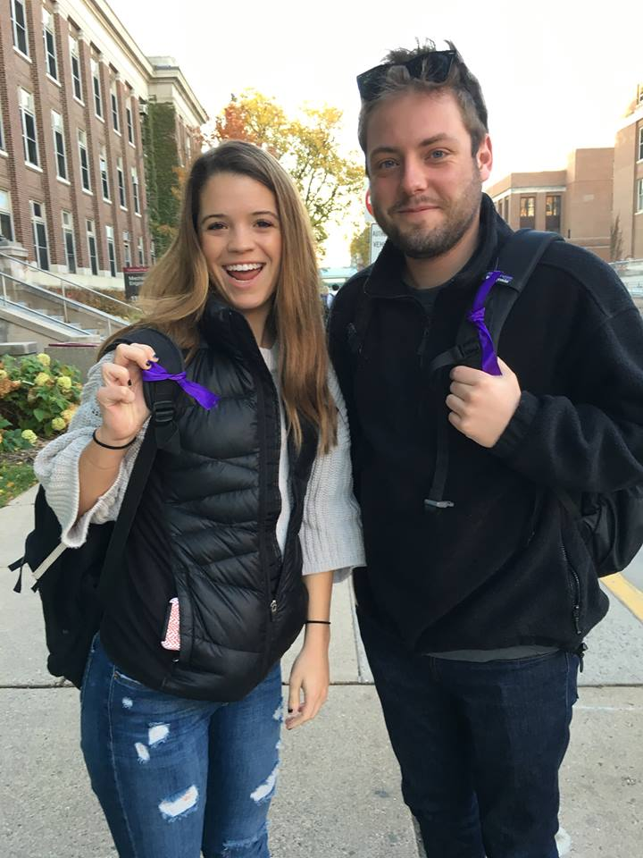
Purple Ribbon Selfies
July 28, 2016

Slide 46
Tagging
"I actually had difficulty with my assignment. It was really difficult to find people to take selfies with. But thanks to the meetup, I managed to get some selfies with a bunch of cool people. We mostly discussed about this class (how funny are some of the things we had to do) and got to know a little bit about everyone. This assignment has definitely cultivated my courage to go up and introduce myself to people."
Purple Ribbon Selfies
July 28, 2016

Slide 47
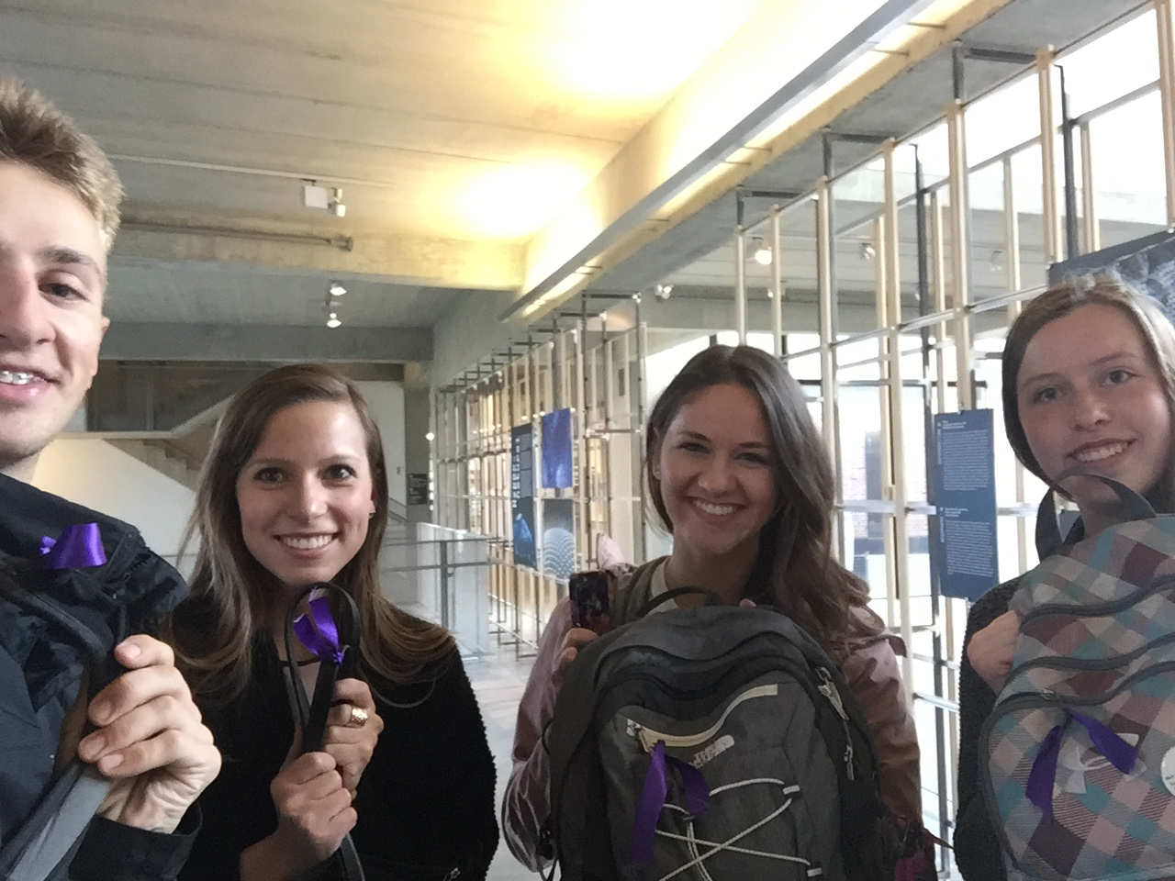
Purple Ribbon Selfies
July 28, 2016

Slide 48
Application
• Location controls
• Spare ribbons
• Scheduling meetups
• Connecting with Domestic Violence effort
• What models do you use to connect students?
Purple Ribbon Selfies
July 28, 2016

Slide 49
Purple Ribbon Selfies:
An in-person method for increasing social engagement in an online, on-campus course.
brad@umn.edu
July 28, 2016

