Slide 1
Trying to Get a Square Peg into a Round Hole? The Path from F2F to Hybrid Format
Verena Van Fleet, PhD
eLearning Summit 2016

Slide 2
What exactly is ‘Hybrid’?
"Hybrid" or "Blended" are names commonly used to describe courses in which some traditional face-to-face "seat time" has been replaced by online learning activities. The purpose of a hybrid course is to take advantage of the best features of both face-to-face and online learning. http://www4.uwm.edu/ltc/hybrid/about_hybrid/
eLearning Summit 2016

Slide 3
Face-to-Face vs Hybrid vs Online
Proposed definitions at NWHSU:
Type of Course | In Class | Online
Face to Face | 80-100% | 0-20%
Hybrid | 20-80% | 20-80%
Online | 0-20% | 80-100%
eLearning Summit 2016

Slide 4
Why Hybrid?
Less fixed seat time
More active learning
Flipped classroom
More interactive learning
More effective learning
The curriculum committee, the dean, … decided
…
eLearning Summit 2016

Slide 5
Definition: Flipped Classroom
The flipped classroom is a pedagogical model in which the typical lecture and homework elements of a course are reversed. Short video lectures are viewed by students at home before the class session, while in-class time is devoted to exercises, projects, or discussions. https://net.educause.edu/ir/library/pdf/eli7081.pdf
Jose Bowen: Teaching Naked: How Moving Technology out of your College Classroom will Improve Learning (2012)
eLearning Summit 2016

Slide 6
Things to think about …
Consider the impact on
The students
The curriculum
Your workload
A switch from F2F will likely need
Approval by curriculum committee and/or supervisor(s)
A change in the course catalog and on the school website
Availability of tech and design support
eLearning Summit 2016

Slide 7
Square Peg Fitting into Round Hole
eLearning Summit 2016

Slide 8
What I did First: Sequencing and Bundling of Topics
eLearning Summit 2016

Slide 9
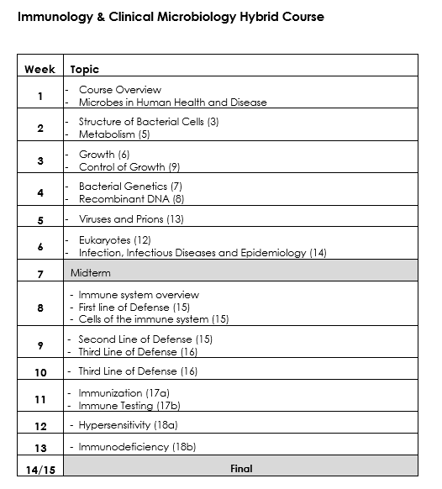
What I did First: Sequencing and Bundling of Topics
eLearning Summit 2016

Slide 10
Working with Educational Technologist
Dr. Glori Hinck wanted from me:
Learning Objectives for each module
Resources, chunked lectures, animations
Activities, assessments
Image(s)
eLearning Summit 2016

Slide 11
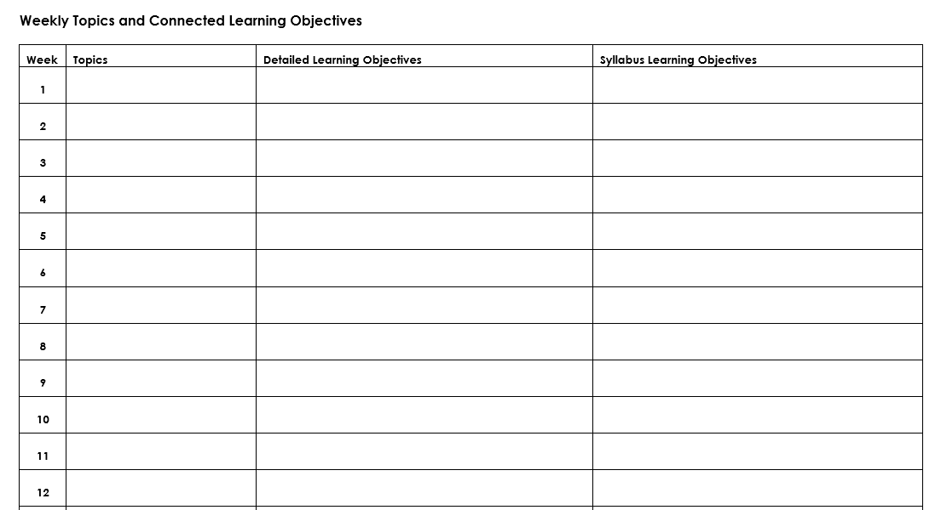
Learning Objectives - Template
eLearning Summit 2016

Slide 12
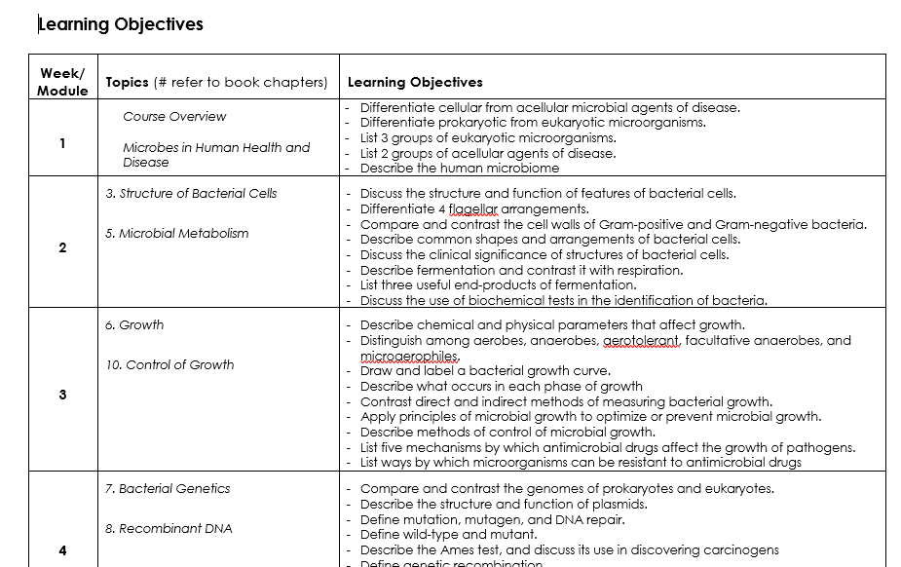
Learning Objectives - Example
eLearning Summit 2016

Slide 13
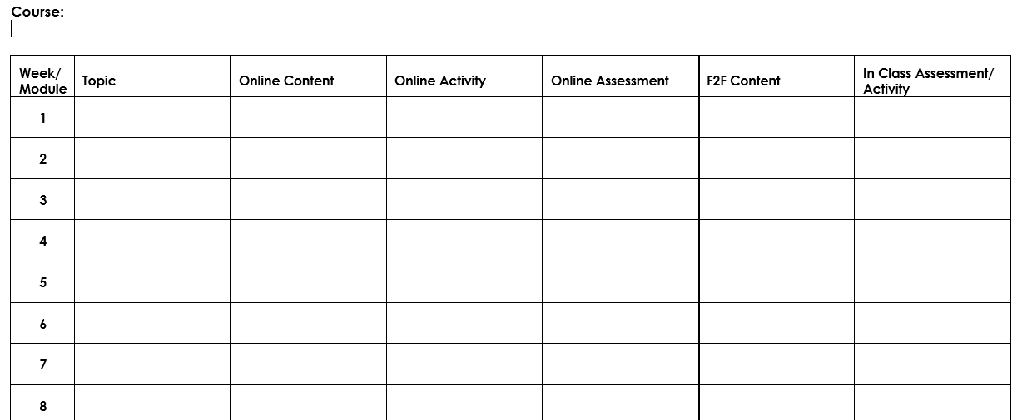
Term Planning - Template
eLearning Summit 2016

Slide 14
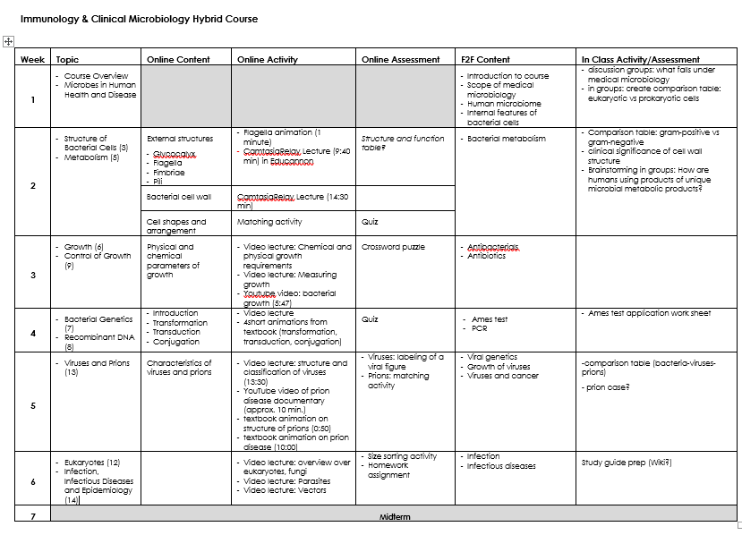
Term Plan – Example
eLearning Summit 2016

Slide 15
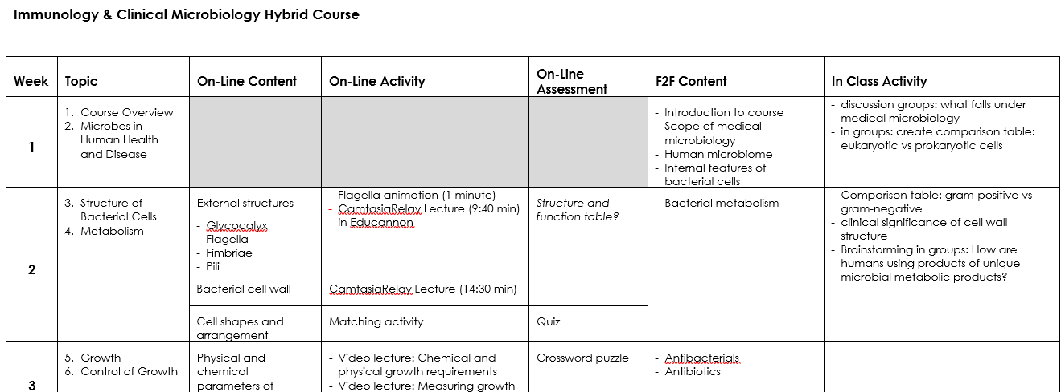
Term Plan – Example (F2F on Thu)
eLearning Summit 2016

Slide 16
Dr. Glori Hinck Provided
eLearning Summit 2016

Slide 17
Definition: Scrambled Classroom
The scrambled classroom enables a variety of approaches for the face-to-face environment as well. Class meetings in this model could include short lectures which introduce new concepts or address misconceptions that were revealed by online assessment. Direct instruction can then be mixed with active engagement, giving students the opportunity to practice new skills like applying, evaluating or synthesizing course concepts. From: Let’s Scramble, not Flip, the Classroom by Pamela E. Barnett https://www.insidehighered.com/views/2014/02/14/flipping-classroom-isnt-answer-lets-scramble-it-essay
Kashif Ahmad: Do I Flip or Should I Scramble? eLearning Summit 2016
eLearning Summit 2016

Slide 18
Some Survey Results
Students enrolled: 118
Students completing survey: 70%
Respondents with very limited experience in online learning: 7%
Devices used:
iPad 38%
PC laptop 29%
Apple laptop 17%
PC desktop 9%
Apple desktop 2%
Surface 2 4%
eLearning Summit 2016

Slide 19
Survey Results: Attitude towards Online
 | Experience with Previous Online Courses | Online Experience in I&CM
Love it | 16% | 5%
Don't mind it | 46% | 30%
Could do w/o it | 27% | 32%
Hate it | 11% | 33%
Blanks | 0% | 0%
eLearning Summit 2016

Slide 20
Survey Results: Technical Difficulties
Students reporting technical difficulties: 40%
63% Problems accessing videos
63% Issues with quizzes, drag and drop, matching activities
50% of those with issues were iPad users
No significant difference between students who had significant to extensive experience with online education and students with limited or very little online experience
eLearning Summit 2016

Slide 21
Survey Results: Technical Difficulties Affecting Attitude
eLearning Summit 2016

Slide 22
Course Evaluations: Overall Average
F2F
eLearning Summit 2016

Slide 23
Things to keep in mind…
Day of the week of the F2F meeting
Number of F2F meetings
Sequencing of F2F and hybrid content
Term course is offered
Number of F2F meetings
Changes in
Technology
Support personal
Types of accessory tools or apps
The first time is not going to be perfect!
eLearning Summit 2016

