Slide 1
Big Idea: Student Technology Resource Center
Presenters:
Carrie Miller, Ph.D. Instructional Designer
John Bayerl, Instructional Technologist

Slide 2
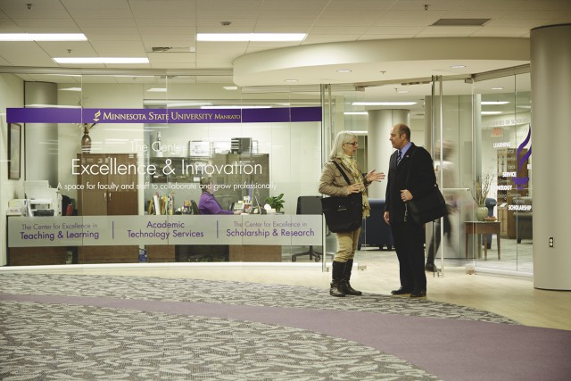
Center for Excellence and Innovation in…
Teaching and Learning
Research and Sponsored Programs
Scholarly Research
Academic Technology
Assessment
Writing Across the Curriculum

Slide 3
Past Technology Initiatives
Student Technology Guides
Visiting all First Year Experience Classes
Partnered with the library

Slide 4
Phase 1 – Identifying the challenge
Faculty vs Technology
Students vs Technology
This all culminated in a big idea!
What if the faculty could send the students somewhere to get training on technology?

Slide 5
Phase 2 – The Ideas
Create a place that offers technology training for our students.
Make it simple for faculty to integrate technology
Create technology literacy tracks
Get students learning about technology and options before they get to campus.
Use as many existing resources as possible.

Slide 6
Phase 3 – The Setup
Get the faculty buy-in
Get the student buy-in
Get the administration buy-in
Find Partners (Library, CETL, Administration)
Align it within IT goals
Get it woven into the fabric of our Academic Master Plan
Research business and alumni experience

Slide 7
Phase 4 – The Creation of the Center
Find funding to get one grad student working on this
Work to create a template and a communication path
Develop the development courses for both online and face-to-face students
Use our existing Solution Center and Academic Computer Center employees for training and support

Slide 8
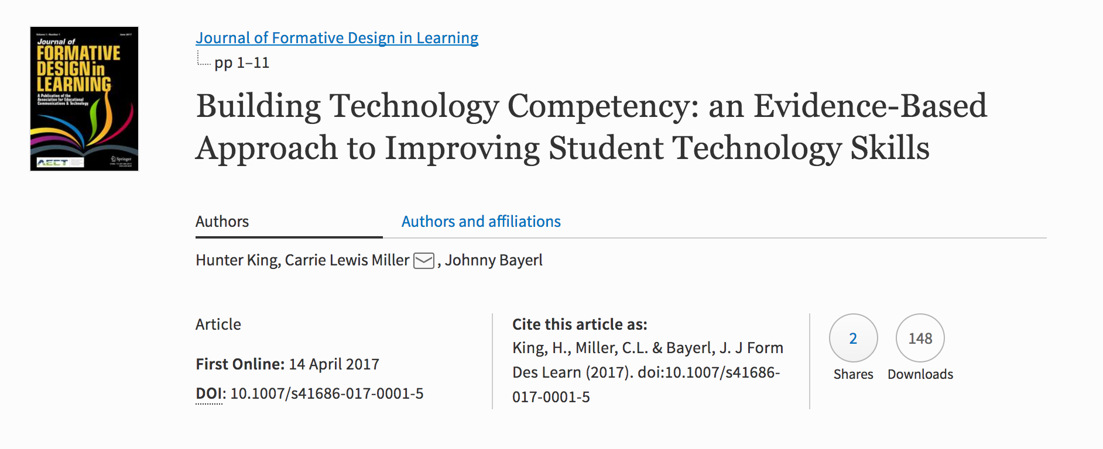
Researching Student Technology
Identify current technology requirements on campus
Identify current usage of supported technology
Perform usage study
King, H., Miller, C.L. & Bayerl, J. J Form Des Learn (2017). doi:10.1007/s41686- 017-0001-5

Slide 9
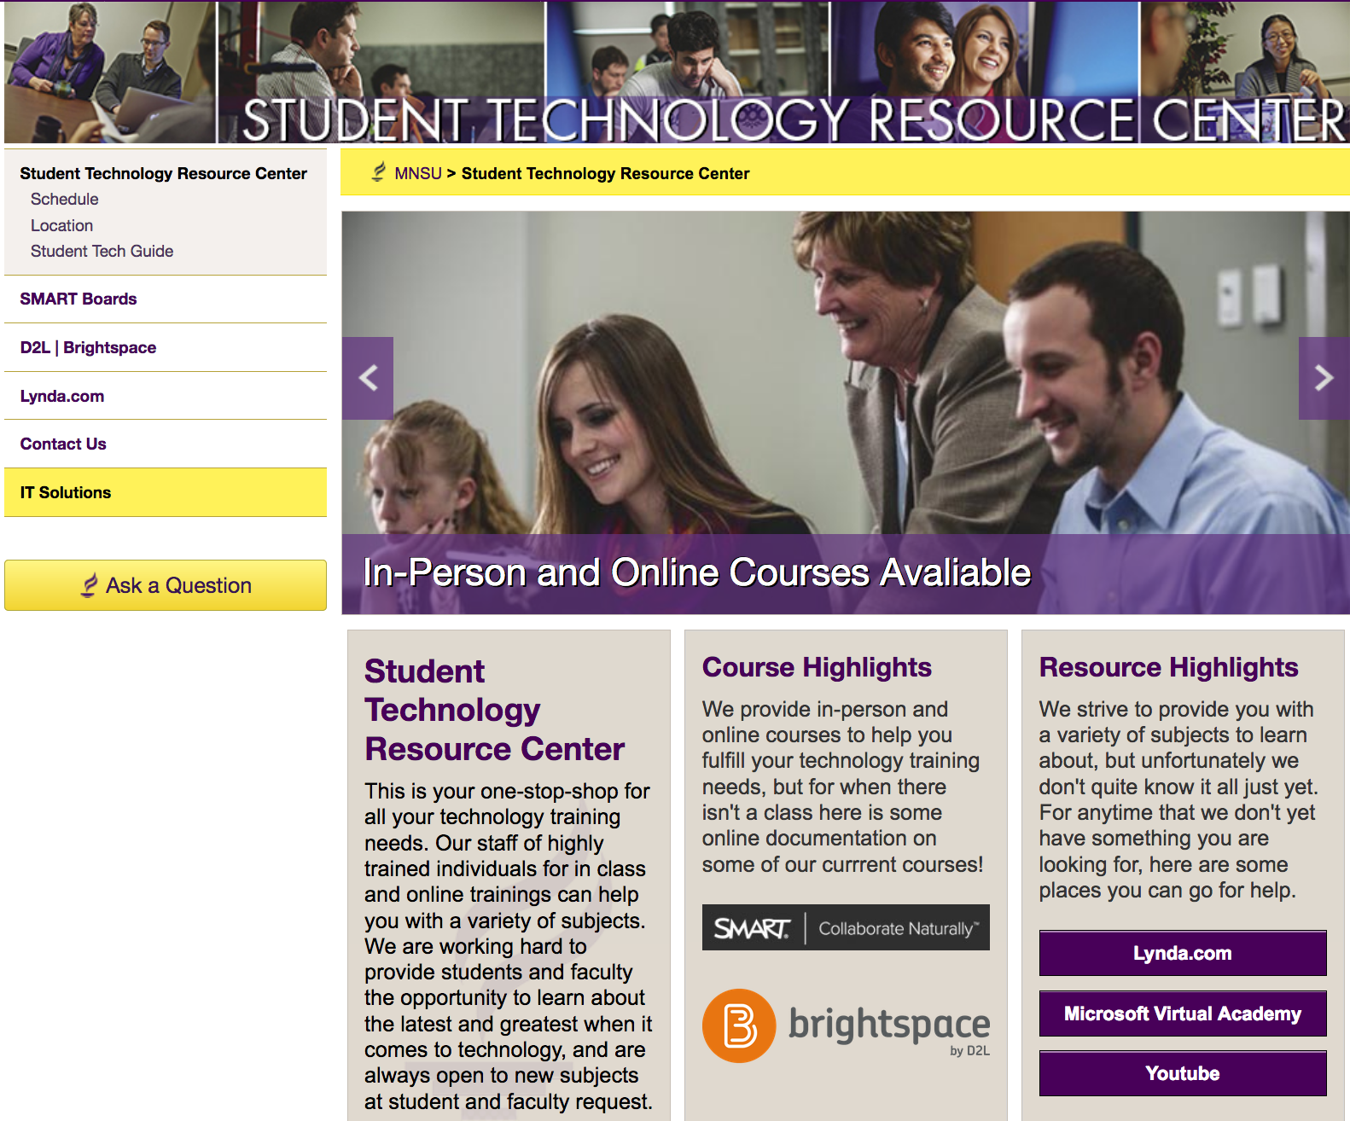
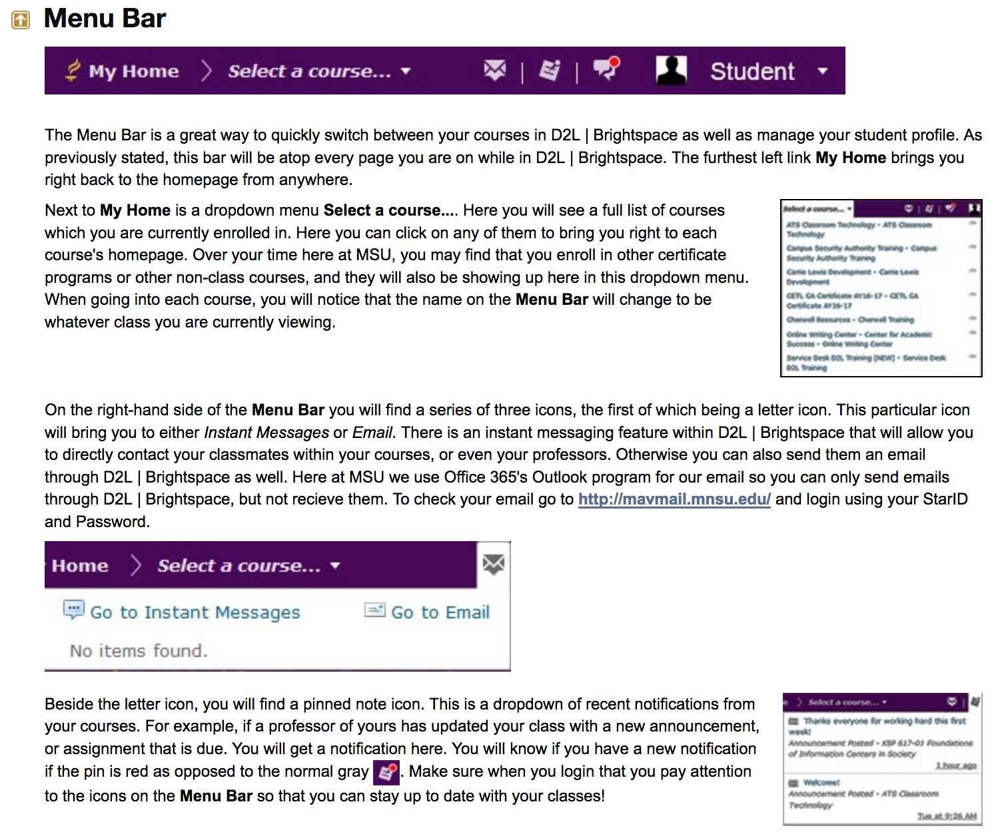
Creating Resources
Mantras: Usability, Accessibility, Comprehensive, and Concise
Began with Web Resources – www.mnsu.edu/stc/

Slide 10
Student Technology Resource Center
In Person Classes
Online Resources
Online Courses
30 min – 1 hour sessions
Focus on Specific topic or tool
Scheduled, or upon request
On-demand support
Focused on specific tools
Information added by request
MOOC-based
Self-paced, open to all students
Technical certification

Slide 11
Questions?
Link to the paper - https://link.mnsu.edu/strc

