Slide 1
Online Financial Educator Program:
Building Capacity and Meeting the Needs of Limited Income Families
Lori Hendrickson, Dung Mao and Mary Jo Katras
University of Minnesota Extension
Center for Family Development

Slide 2
Impetus for FEC
Increased need for financial education
Federal and state initiatives
Staff not trained in content or delivery
Entrepreneurial efforts
Lack of funding for F2F training
Quality assurance
Ability to update knowledge
Recognition of expertise in local agency
Notes:
Increased Need: 1996 – shift in welfare policy environment; shift to asset development approach; 2008 and prior - Financial crisis increased awareness of need
Federal and state initiatives: ACF integration of financial education; Ladder out of Poverty
Staff not trained in content or delivery: Teacher confidence and knowledge: Wisconsin study results; Also staff turnover resulted in on-going training need
Entrepreneurial efforts: U of Maryland SSW, Financial Social Work, Financial Institute, etc.
Lack of Funding: McKnight shift in priorities; challenge in bringing people from across the state together - expensive
Environmental scan: different types of certifications
Quality assurance: one time training without assessment of skills and knowledge
On-going updates: no continuing education systematically offered and documented
Recognition of new staff expertise: Specifically FAIM coordinators

Slide 3
Overall Goal of FEC
To develop a quality, affordable, scalable,
and self-sustaining financial educator
certification program in Minnesota

Slide 4
Two-level Capacity Building
Organization: Enhances ability to teach financial education and improve program and delivery quality
Individual: Increases knowledge and builds confidence to manage own finances and work with others to become financial secure

Slide 5
Community-University Partnership
Greater Twin Cities United Way
University of Minnesota (Family Social Science and Extension)
Community-based advisory group
Community-based professionals
Notes:
GTCUW Funding
FSoS and Extension (content and Delivery)
Advisory: Representatives from the MN Department of Human Services-Office of Economic Opportunity; Minnesota Community Action Partnership; Lutheran Social Services; Family Means; Greater Twin Cities United Way
Community-based professionals: (Lessons from the field)

Slide 6
Why Online Learning
Reduces time and expense
Extended time (9-month study vs. one-off training) enhances learning
Asynchronous schedule allows flexibility for working professionals
Learners trust the U as information source to provide unbiased and non-proprietary financial education
On-going community of learners
Notes:
Non-profit staff training in face to face mode was expensive for agencies. Model was for 1-2 day training in central location (TC or St. Cloud); required three days of work for those at a distance plus 2-3 nights’ hotel and food costs. Current cost of $250 for 9-month program is probably less for some.
Opportunity to absorb content over time; activities for application both hypothetically and with clients over course of program
Ongoing community of learners: could learn from each other – could bring real-world situations to the group for brainstorming and garnering others’ ideas from their practice.

Slide 7
Course Structure and Content
Cohort model September - May
$250
Ten 2-3 week Moodle-based modules covering:
A. U.S. Department of Treasury’s core competencies (earning, spending, saving, borrowing, consumer protection);
B. financial behavior theory;
C. financial education delivery models;
D. evaluation
Notes:
1. Influences on Money 2. Financial Planning Process 3. Understanding Credit 4. Managing Debt 5. Savings and Asset Development 6. Investing 7. Asset Preservation and Protection 8. Delivery Methods for Effective Financial Education (including ethics, not included in most training programs)
9. Evaluation
10. Capstone Project

Slide 8
Learning activities
Learn
Narrated PowerPoint presentations readings, websites
Financial Planning Process Example
Apply
‘Lessons from the Field’ videos, case studies, worksheets, discussion forums, and chats
Denise on Asset Building
Assess
Capstone project
Notes:
Core content: Narrated PPT
Application: Talk a bit about videos
Assessment: create a case study of a ‘typical client’ with whom you work, analyze the situation, and make recommendations for your client (share an example?)

Slide 9
Learner Profile
Age range: 21 – mid-50s
Most college educated; ½ had 4 year degree
Full-time employees
Most worked in agencies that served limited-resource individuals and families; some worked in financial sector
Notes:
Community Action
Goodwill/Easter Seals
Northside Achievement Zone
Way to Grow
Project for Pride in Living
Emerge
Credit Union
Financial Planner

Slide 10
Outcomes for Organization/Client
Increased confidence in working with clients
Increased commitment to help families build wealth
Educated co-workers about need for financial education
Influenced organization to offer more culturally appropriate programs

Slide 11
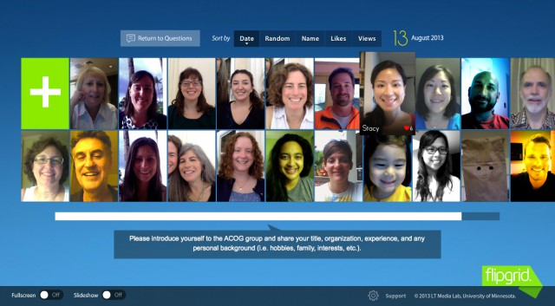
The right tools for the job
Flipgrid - video response
General Moodle Forum
Newer tool
Allow video & audio response to questions
Older tool
Allow for text response
Which tool was preferred?

Slide 12
The right tools for the job
Flipgrid - video response
Most learners were hesitant about using flipgrid
The technology is too new

Slide 13
The right tools for the job
General Moodle Forum
Learners preferred to write posts
Learners preferred to reply to posts via text

Slide 14
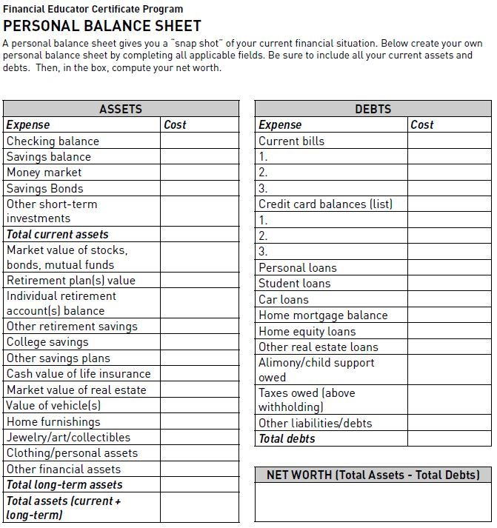
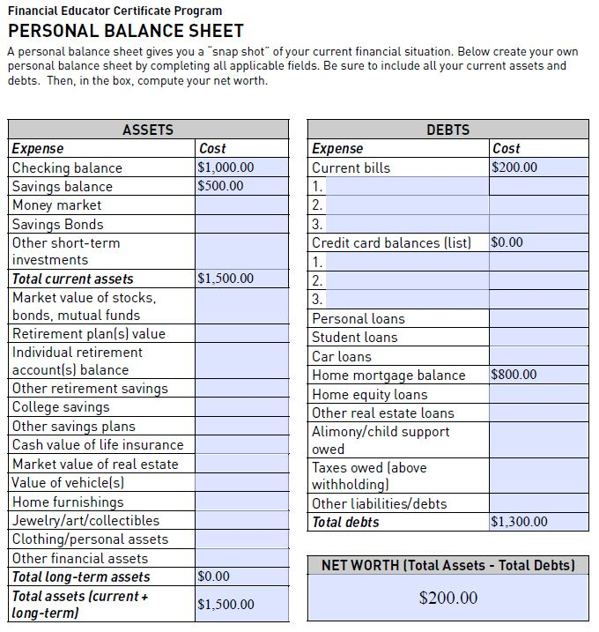
The right tools for the job
Non-interactive Worksheet
Interactive Worksheet
Require learners to print out and fill it in by hand
Automatic calculations
Can be fill in using the computer
Which tool was preferred?

Slide 15
The right tools for the job
Interactive Worksheet
Most learners have trouble with the interactive worksheet

Slide 16
The right tools for the job
Non-interactive Worksheet
Learners preferred the low tech, non-interactive worksheet

Slide 17
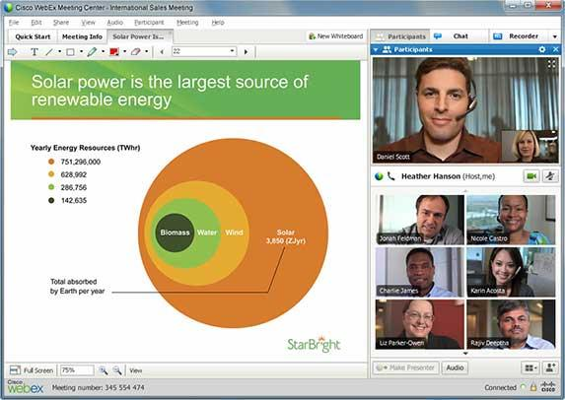
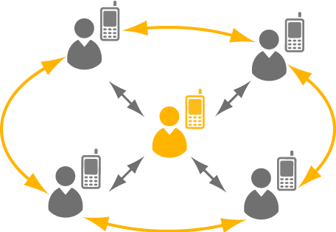
The right tools for the job
WebEx - Video Conference
Phone conference
Newer tool
Allow video & audio conference
And more.
Older tool
Allow audio conference
Which tool was preferred?

Slide 18
The right tools for the job
WebEx - Video Conference
Most learners have trouble getting WebEx to work on their computer

Slide 19
The right tools for the job
Phone Conference
Learners preferred the good ‘ol telephone conference to conduct synchronous chat

Slide 20
Capstone Project
Described client family; education, work and career, transportation, housing, savings and assets, expenses, and goals.
Analyzed family’s financial situation
1) personal balance sheet, 2) cash flow statements, 3) liquidity, debt, and savings ratios, 4) SMART goals, and 5) spending plan.

Slide 21
Capstone Project
Reflected on their financial education/coaching work with families.
Demonstrated their learning by applying financial concepts and tools to a family situation.
Notes:
Mary Jo spoke of the Capstone Project as a method for us to assess student learning, but there is an additional component that helps us as course designers and instructors. That is to see if there are changing audience needs with the clients they are serving on the ground.

Slide 22
FEC Study Purpose
To analyze case studies created by learners, FEC students to understand the realities of low-income families who seek support
To use findings to improve FEC’s relevancy and effectiveness to train financial educators.

Slide 23
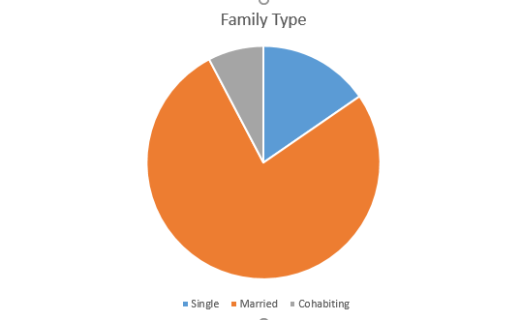
Case study demographics

Slide 24
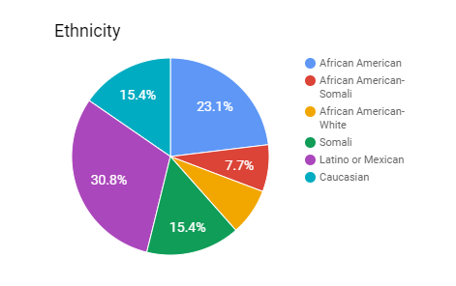
Case study demographics
Notes:
Six families identified as immigrants

Slide 25
Findings-Education
Education used to increase income &
future possibilities
Immigrant families utilized English classes to secure higher paying jobs
Family goals included savings for education-self and children

Slide 26
Findings- Balance
Couples juggled employment to meet child care needs
Families worked several jobs, alternated shifts, became self-employed, took odd jobs to make ends meet

Slide 27
Findings-Transportation
Saving for transportation was a goal for many
7 families used public transportation, 4 owned cars

Slide 28
Findings-Housing
Housing was identified as one of the largest expenditures by families
10 rented; 1 owned
4 lived with others temporarily
Affordability was a concern

Slide 29
Findings-Debt Constraints
Debt constraints were a concern for most
Those with higher income had higher debt levels
Notes:
6 families had credit card debt that ranged from $800-5,000
6 families had student loan debt ranging from 5,000- 95,000

Slide 30
Findings- Inadequate Safety Net
Few families had liquid assets to cover a month or more of expenses
Families understood the importance of saving to deal with unexpected expenses
Savings to build cash reserve was #1 goal

Slide 31
Implications for FEC course
Use identified findings related to family financial concerns to provide enhancements to course
Identify methods/strategies for financial education professionals to assist families

Slide 32
Summary
Today we have shared:
Overview of the FEC course
Learning activities
Course design and adaptations for
Study regarding student capstone project
Implications for future course design

