Slide 1
Presented by:
Randy LaFoy
Notes:
Michele and Shelli

Slide 2
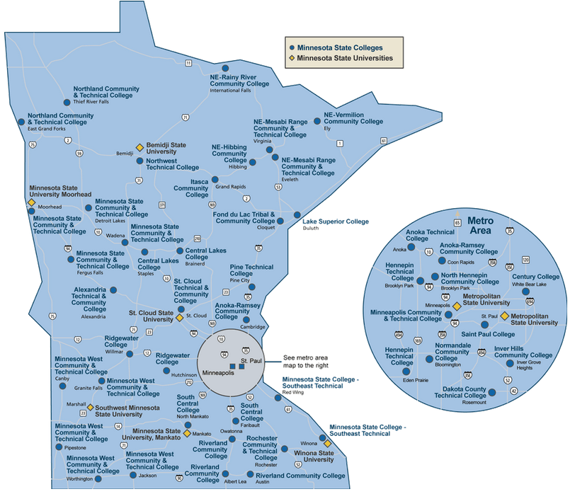
MNSCU Campuses that use GPS

Slide 3
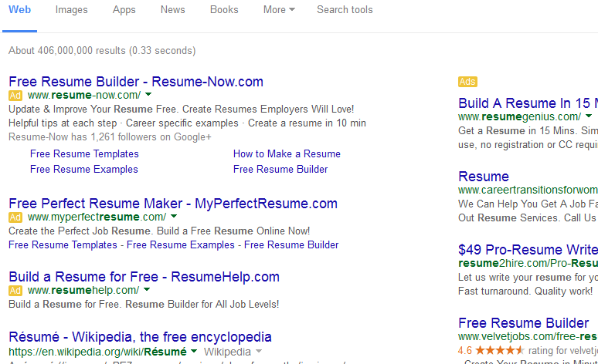
In one slide, what the GPS LifePlan can do
How many hits will one get if
you type in “resume” in Google?
About 585,000,000 results (0.62 seconds)

Slide 4
Appoint >>>>>>>>>> as your agent with full power to enter into any document and/or do any act >>>>>>>>>> may consider appropriate to confirm the grant and assignment, consent and waiver set out above;
We may use the public content to develop products, make connections with potential employers, personalize site views, market products or identify or feature popular members.

Slide 5
So, why if this is so great, why is it free?

Slide 6
Shared economy type of product
Free
No login or password to surf or use toolkit.
Login for saving assessments.
Anyone can use, anytime – including people you don’t see (but are supporting your client/student – like parents or family)
A committee that regularly meets to vet additions to the site
Primarily using .edu, .gov and .org sites (no ads)
Help is available 7-9 M-F and they have military specialists
Interest in creating a Creative Commons First Year book?

Slide 7
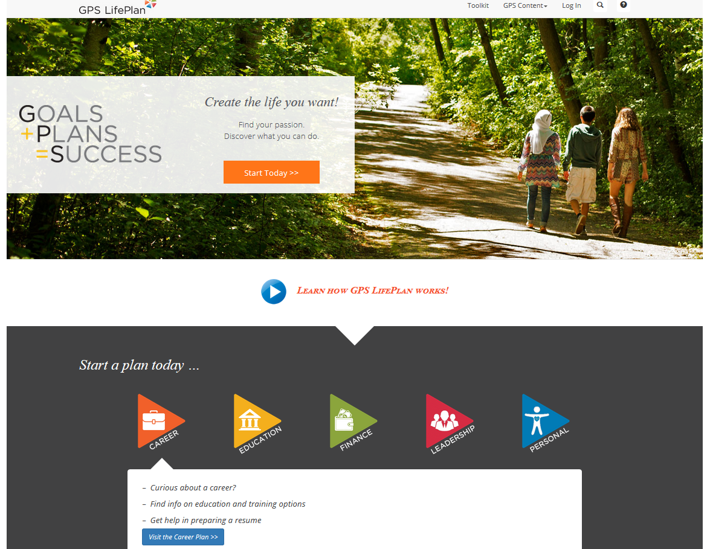
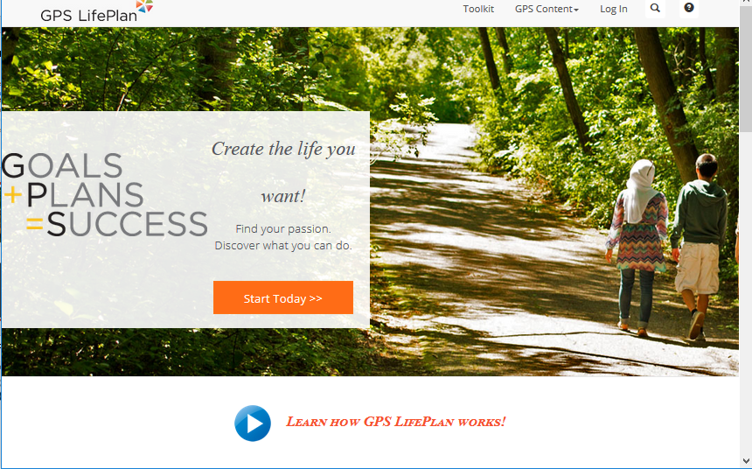
Device Friendly

Slide 8
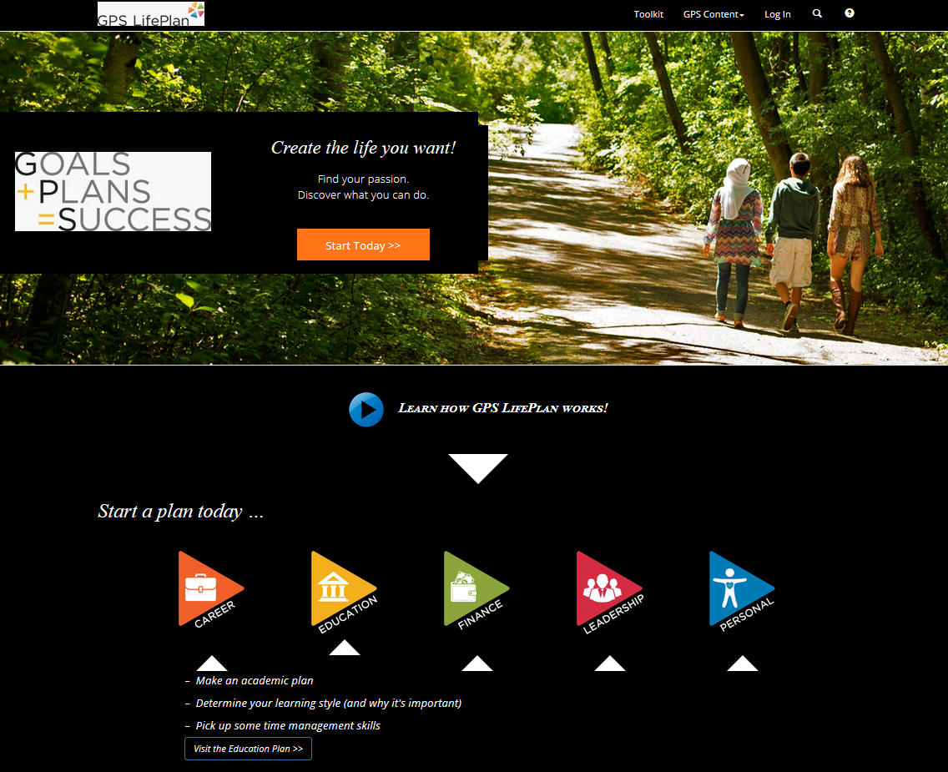

Slide 9
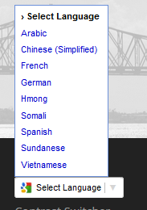
Alternate Languages

Slide 10
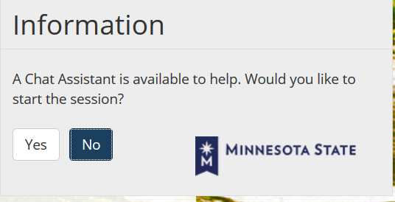
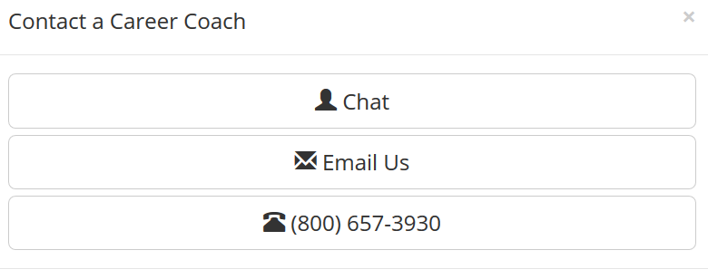
Help is available via chat, email or phone
Hours: 7am-9pm M-F
They have military specialists.

Slide 11
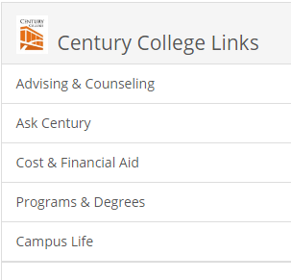
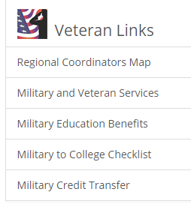
Another advantage of signing up - personalization

Slide 12
Five (5) topic areas, and each topic has many subsections
Career
Education
Finance
Leadership
Personal
700+ links

Slide 13
Career
Learn About Yourself
Explore Careers
Seek Training and Technology Skills
Find a Job
Set Career Goals

Slide 14
Find a Job

Slide 16
Education

Slide 17
Finance
Create Your Budget
Finance Your Education
Understand Credit and Debt Management
Avoid Getting Ripped Off
Save for the Future
Review Tax Information
Set Finance Goals

Slide 18
Leadership
Learn About Leadership Styles
Explore Leadership Resources
Take Action: School and Community Involvement
Develop Global Competency
Set Leadership Goals

Slide 19
Personal
Stay Healthy
Maintain Positive Relationships
Seek Help and Support When Needed
Set Personal Goals

Slide 20
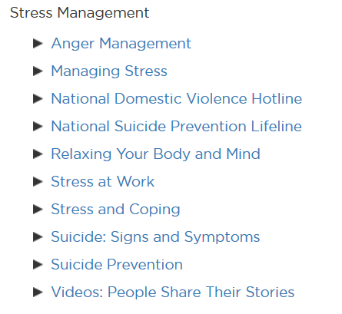
Mental Health and Wellness

Slide 21
The GPS LifePlan Toolkit

Slide 22
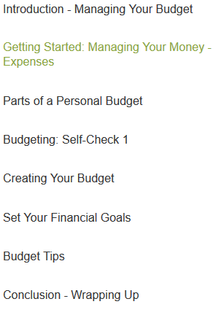
Managing Your Budget

Slide 23
GPS Priorities Assessment
Interest Assessment
GPS LifePlan SMART Goal Setting
Financial Calculator
Goal Setting Worksheets
Preparing Your Resume
Career Interests and Exploration
Managing Your Budget
Paying for College
Explore Education and Training
Plan Your Education
Stress Management
Financial Literacy
Coming soon: Mental Health, Leadership Tools, Procrastination, GPA Calculator, and more
In GPS now

Slide 24
Get Started!

Slide 25
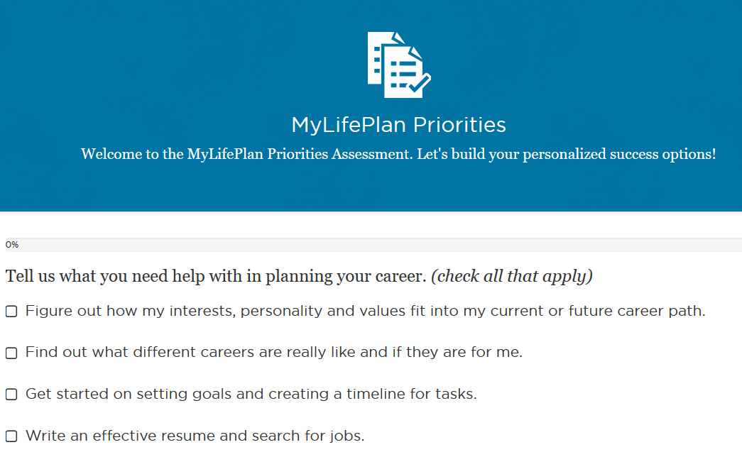

Slide 26
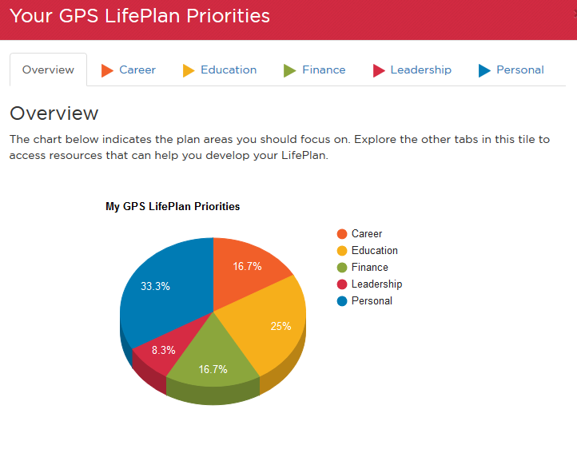
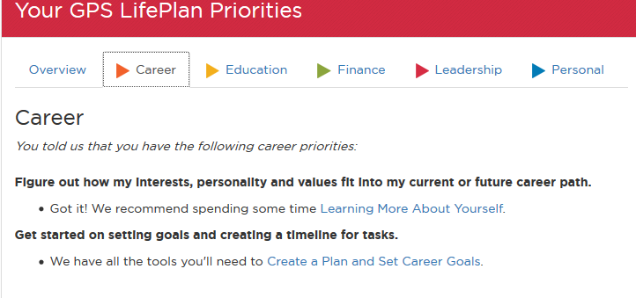

Slide 27
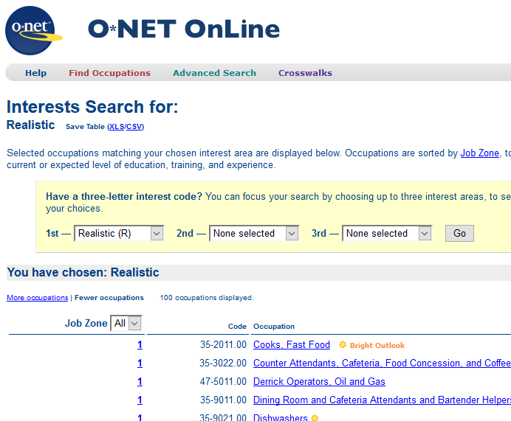
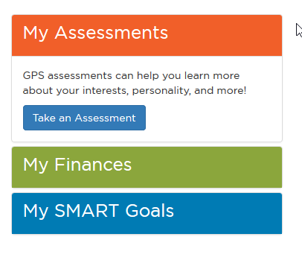
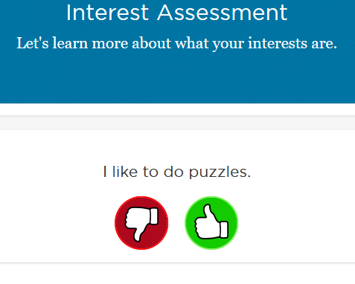

Slide 28
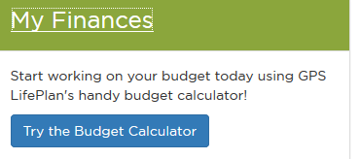

Slide 29
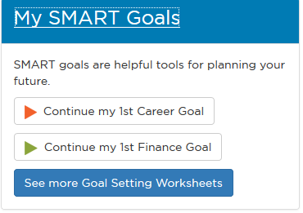

Slide 30
Thank you for your participation!
Want to learn more? Contact: Randy LaFoy
651.779-3363
Randy.lafoy@century.edu

Slide 31
GPS LifePlan Posters

