Slide 1


Slide 2

Personalized Learning Journey at
CICS Irving Park
Claire Nolan
Meaghan Rohan
Aggie Sparrow

Slide 3

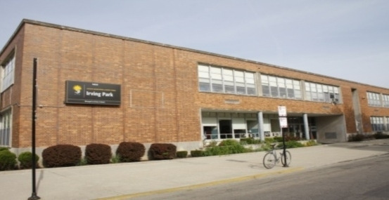
CICS Irving Park
Serving 555 Students in Kindergarten through 8th Grade
56.7% Economically Disadvantaged
11% Diverse Learners
15% EL Population
Notes:
Aggie

Slide 4

4 Years Ago...
Distinctive Schools took over CICS Irving Park as the new management organization. What we saw on paper was vastly different from what we saw in classrooms.
On paper, CICS Irving Park was one of the highest performing schools in the City of Chicago. High test scores and high levels of teacher and parent satisfaction were reported.
What we saw in classrooms was students in rows doing worksheets, teachers in front of the room lecturing.
Students were compliant, but not engaged in learning.
We partnered with the Chicago Public Education Fund & LEAP Innovations in Chicago as we started our journey toward personalized learning.
Notes:
Aggie

Slide 5

Recognizing This,
We Asked the Question:
“How do you ask a successful school community to significantly reimagine the learning experience for all it’s students and stakeholders, when the school is already getting strong results on standardized tests that are widely publicized?”
The bottom line was that while this “old school” model was working for some students, it wasn’t working for all students.
Notes:
Aggie

Slide 6
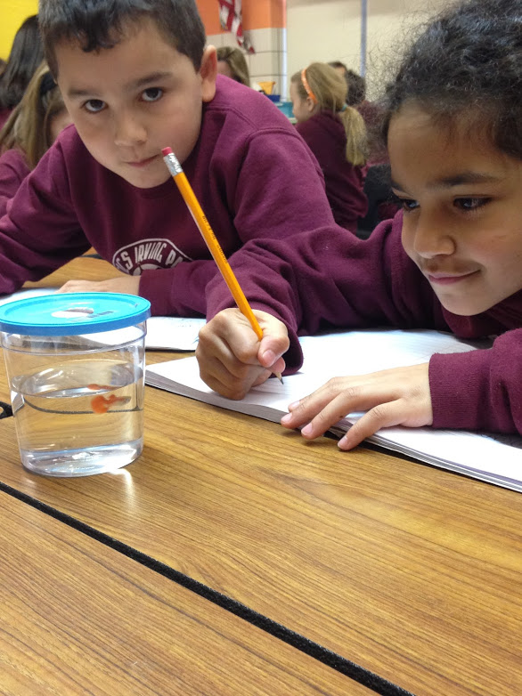
Pilot with 3rd & 4th Grade Students
Two lowest grade levels in academic attainment and in year-to-year growth
Huge range of academic needs
Third grade represented over 50% of behavior referrals and suspensions in the building
Notes:
Meg
2 years ago
Three classrooms (2 third grade, 1 fourth)

Slide 7


Our Traditional School Model
Was Failing These Students
We decided to change the way that school works for these students
We worked on empathy activities with students - what did they want school to look like, feel like and what did they need to feel excited about learning?
We redesigned their entire classroom experience
We focused on blending high quality instruction with technology based programs & projects
Notes:
Meg

Slide 8
In The New Model,
We Started By Listening To Students
Identifying student wants & needs =
More Movement
Technology
Hands-on-activities
Collaboration with peers
Programs & activities that met students at their level
Notes:
Meg

Slide 9

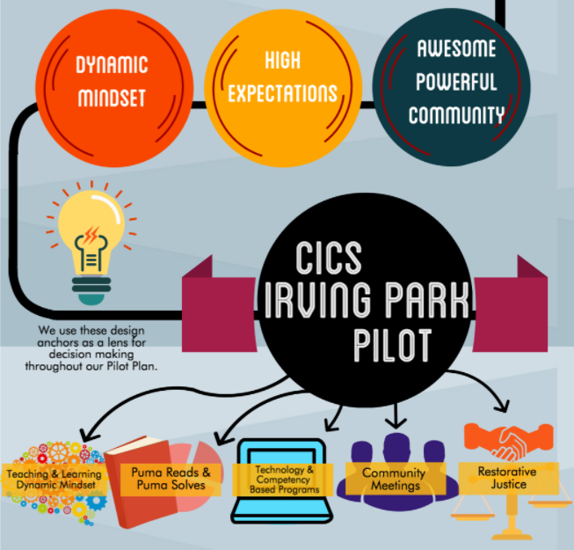
Notes:
Claire
Dynamic Mindset: We knew we had to teach them Growth Mindset, that mistakes are opportunities for improvement and that when things get hard, you can ask for help or try it a new way, but you haven’t failed unless you’ve stopped trying.
High Expectations- We also knew that we had to hold ourselves and our students to high academic and social standards.
Awesome Powerful Community- We began regular community meetings in each of their classrooms and among grade levels to help build the level of collaboration and communication skills among the students.

Slide 10
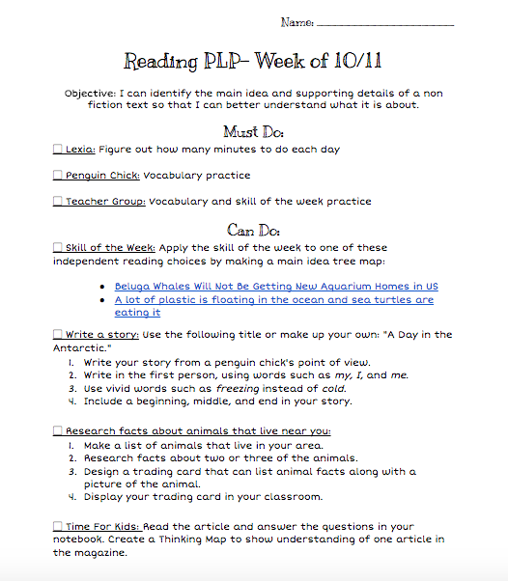
Technology &
Competency Based Programs
During grade-level instruction, students are presented with a weekly menu of options of learning activities that they “must do” and “can do,” including online competency-based progression programs such as Lexia or ST Math, offline independent activities, and instructional tools that mix online and offline learning.
Notes:
Claire
Menus are our starting point, way to organize for the teacher and the student what needs to be accomplished. Highly differentiated, moving towards project enhanced learning.
Allows students to take ownership of their time management.

Slide 11
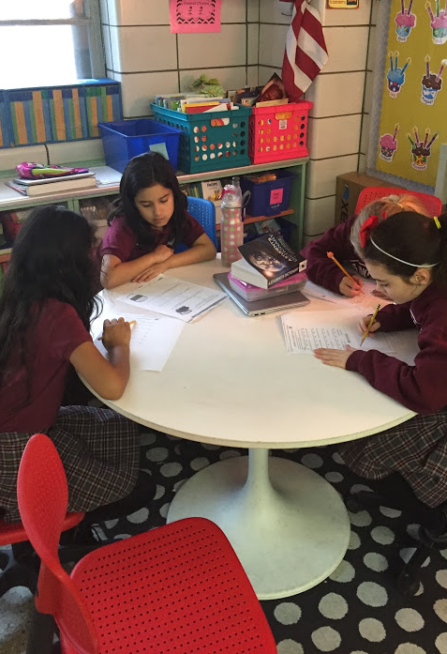
Puma Reads & Puma Solves
Daily scheduled time in addition to grade level content time that addresses students’ academic needs and allows to move on to different skills once they’ve shown mastery.
NWEA Skills Navigator helps to group students based on their areas of need or enrichment and track their progress towards mastery.
Grouping was very fluid - students were able to move among groups based on standards and groups changed regularly.
Notes:
Claire

Slide 12

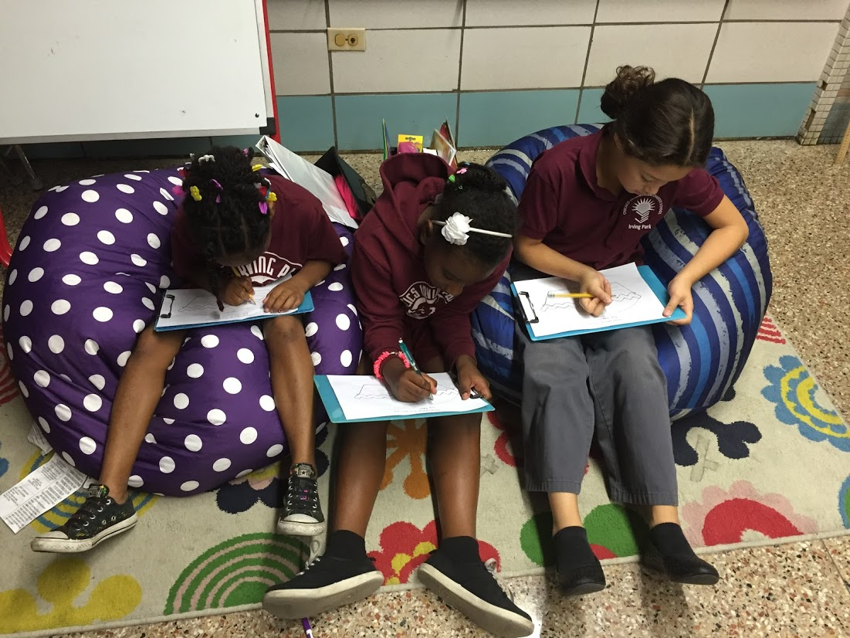
Here Are Some Specific Differences
Old Way
Whole Group Instruction
Desks in Rows
Teach to the Average
Limited Technology
Little Collaboration
New Way
Small Group & Individual Instruction
Student Choice in where they learn best
Teach to the Individual
1:1 Technology
Collaboration among ALL Stakeholders
Daily Classroom Community Meetings - building community within the classroom and school.
Notes:
Aggie
Environment reflects student needs for movement and collaboration. Talk about Furniture
Allows teachers to scaffold instruction to meet all students’ needs.
Gives teachers the opportunity to work with the students individually and in small groups.

Slide 13
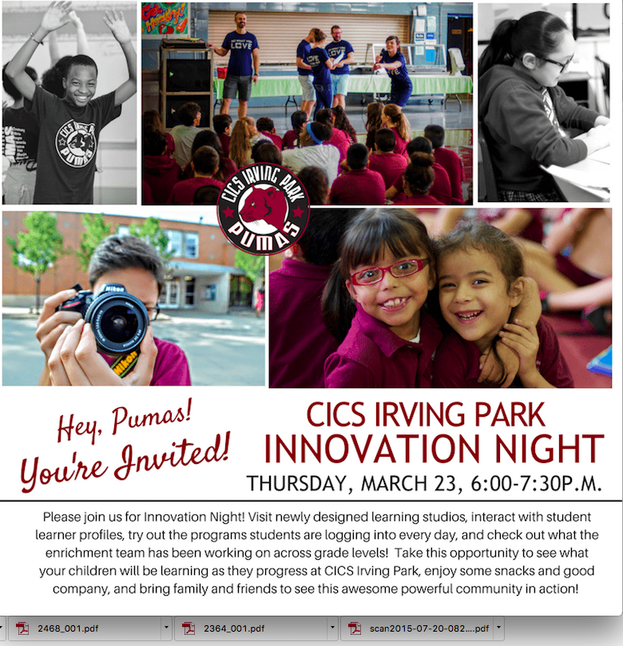
Changes For Students, Parents, and Teachers
Have the shared goal that students understand themselves as learners and people so that they can succeed in any environment.
Hosted Innovation nights so parents can experience learning the way their students do.
Notes:
Meg
Learning takes place everywhere
Explain innovation nights

Slide 14
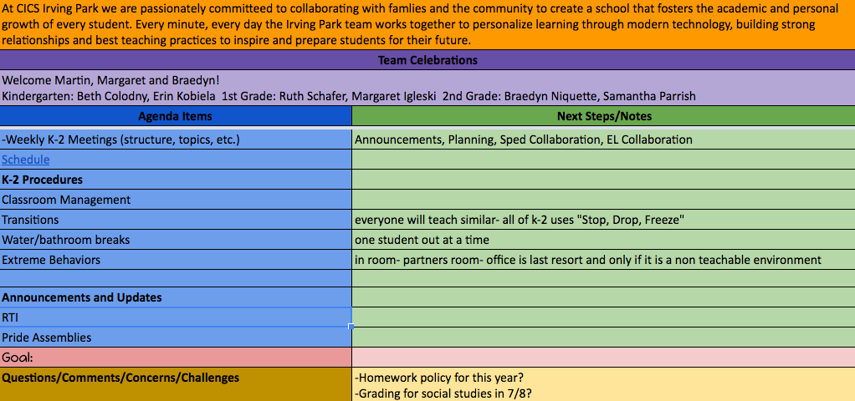
Changes For Students, Parents, and Teachers
Set weekly meetings for grade level teams to meet, reflect, set goals, and collaborate in order to hold each other accountable.
Notes:
Meg
Weekly Meetings

Slide 15
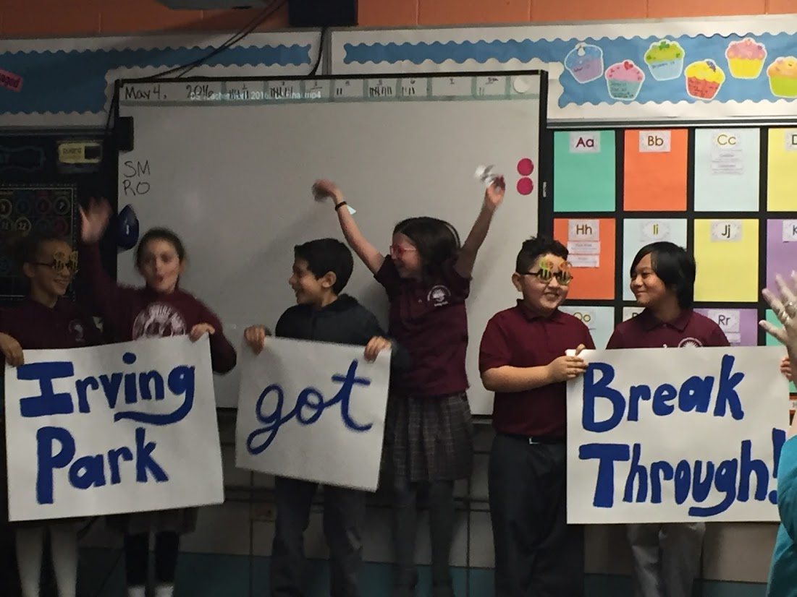
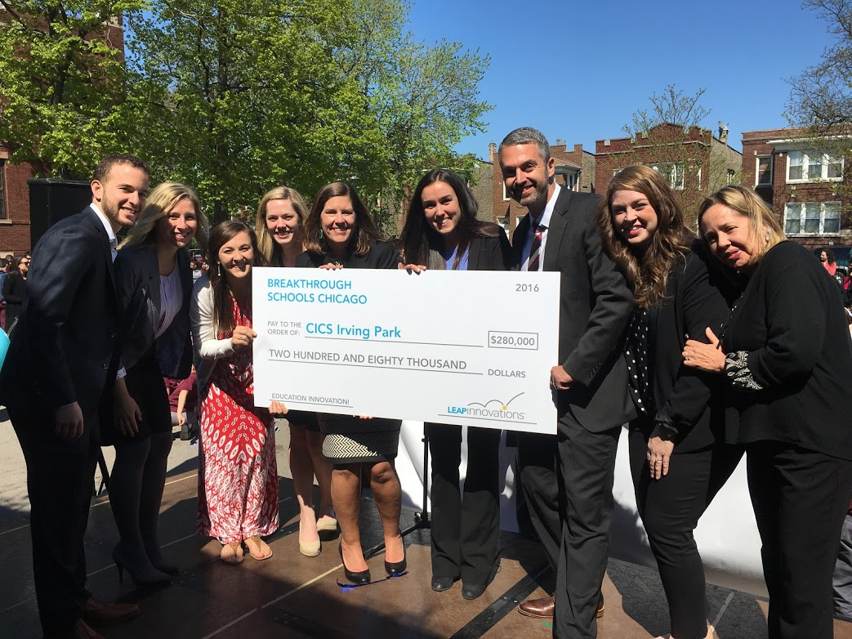
In Spring 2016, Irving Park was the recipient of a $280,000 Breakthrough Schools Grant
What other results have we seen?
Notes:
Aggie

Slide 16
Decrease in Behavior Referrals
Decrease in the number of suspensions by 43%
Decrease in office referrals by
20%
Notes:
Claire

Slide 17
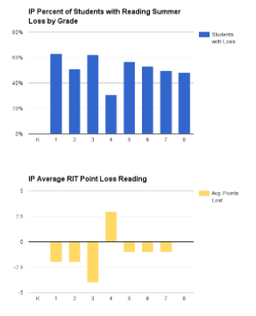
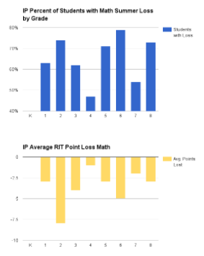
Minimization of Summer Loss
Notes:
Claire
Looking at the pilot group of 3rd graders, only 30% of students experienced summer loss in Reading and the average RIT score actually increased from Spring- Fall.
That same group of students 45% experienced summer loss with an average of only about 1 point loss.
This shows us that students are experience deeper learning and able to retain the information learned better than other students.

Slide 18
Reading Outcomes (Spring to Spring)
3rd Grade
Students made 95% of a year’s growth on average
60% more students made at least a year’s growth compared to last year
75% more students made at least a year and a third’s worth of growth compared to last year
4th Grade
Students made 111% of a year’s growth on average
Over doubled the number of students making at least a year’s growth compared to last year
Tripled the number of students making at least a year and a third’s worth of growth compared to last year
Notes:
Aggie
Check the wording on this before you present!!!

Slide 19
Math Outcomes
3rd Grade and 4th Grades
Math growth (Spring to Spring) was not as robust. However students experienced on average, a zero RIT point loss between Spring and Fall NWEA testing. This indicates that while we might not have seen the growth that we wanted, the learning that happened was deep and retained.
Winter scores show an increase from year-to-year in growth.
Notes:
Meg
As a school, our focus has been on literacy, which could be a potential factor to higher outcomes in reading than math. We are working to balance our model.

Slide 20
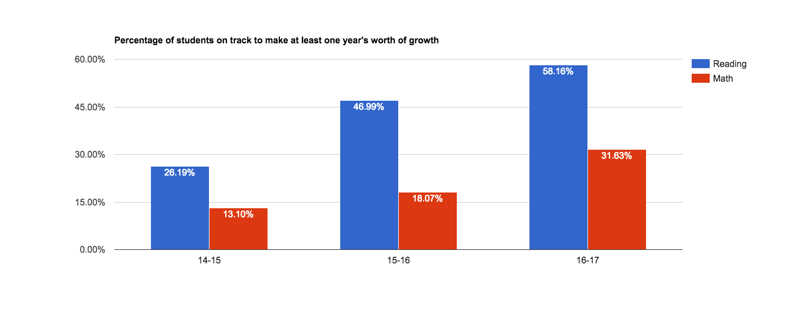
Winter Scores 3 Year Comparison
Notes:
Claire
This graph looks at the percentage of students on track to make at least one year’s worth of growth across the past 3 school years. The blue bar is Reading- which has seen steady growth. The red bar is Math - which has seen steady growth, not quite as significant, but again they’re experiencing less sumer loss which means the learning is deeper.

Slide 21
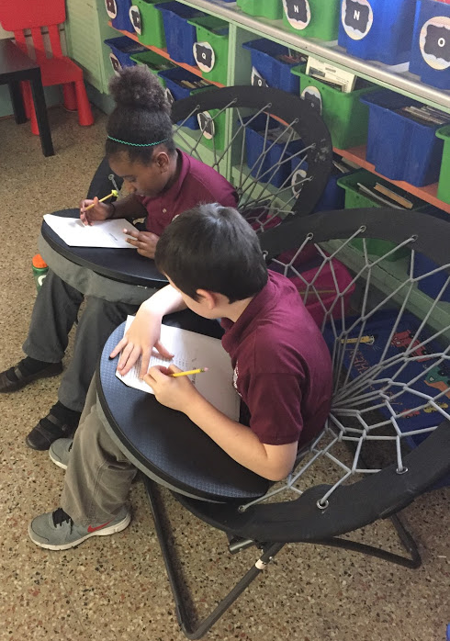
2016-2017 School Year
We implemented our model school-wide in all classrooms K-8
Puma Reads & Puma Solves in grades K-5
Began using Summit Learning Platform in grades 6-8
Piloted Learner Profile using Thrively in grades 3-4
School-wide Innovation Nights
Hosted multiple school visits to showcase our model
Notes:
Claire

Slide 22
Questions?
Notes:
Claire

