Slide 1
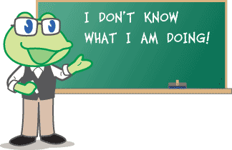
Learning from Mistakes: Share Your Experience!
Minnesota eLearning Summit 2016
Image Credit: soyouthinkyoucanteachesl.com

Slide 2
Personal Examples
Minnesota eLearning Summit 2016
Pedagogy Mistake: 45-minute lecture videos (instead of 4-6)
Structure Mistake: non-clickable assignment checklist
Interaction Mistake: students needed more feedback
Image Credit: edweek.org
http://facultyecommons.com/why-video-length-matters/

Slide 3
Share Your Experience!
Minnesota eLearning Summit 2016
Image Credit: quotepixel.com

Slide 4
Examples from Other Educators
Minnesota eLearning Summit 2016
Pedagogy Mistakes: try too many things/not enough things, reusing F2F course
Course Design Mistakes: not enough planning time, limited by fear, inconsistency
Interaction Mistakes: lack of rubrics
Personal Mistakes: forgetting the joy of teaching
Image Credit: unknown
http://facultyecommons.com/online-course-design/
http://www.edweek.org/tm/articles/2015/08/04/9-mistakes-new-teachers-make.html

Slide 5
Summary
Minnesota eLearning Summit 2016
Recognizing and improving mistakes is a great place for positive change.
Thanks for sharing your experience!
Image Credit: Unknown

Slide 6
References
Minnesota eLearning Summit 2016
Academic Partnerships. (2013, July 22). 5 Common Mistakes to Avoid During Online Course Design. Retrieved July 27, 2016, from http://facultyecommons.com/ online-course-design/
Academic Partnerships. (2012, November 1). Why Video Length Matters - Faculty eCommons. Retrieved July 27, 2016, from http://facultyecommons.com/ why-video-length-matters/
Watson, C. (2015, August 4). 9 Mistakes New Teachers Make. Retrieved July 27, 2016, from http://www.edweek.org/tm/articles/2015/08/04/9-mistakes- new-teachers-make.html

