Slide 1
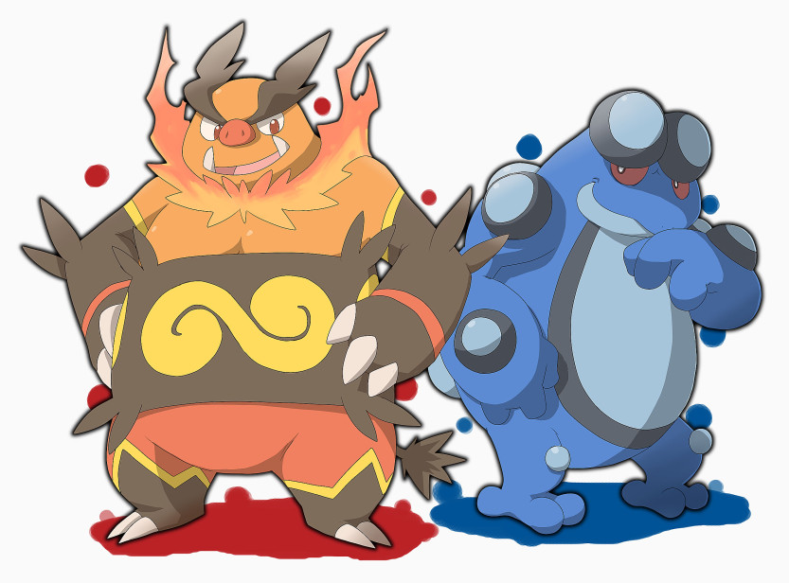
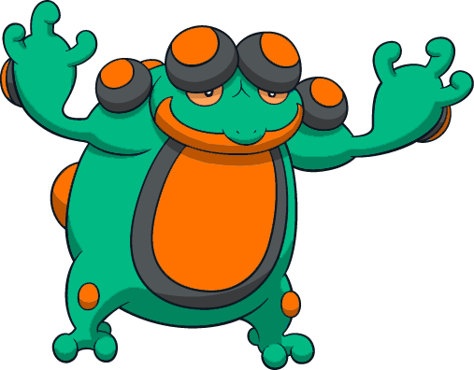
Being OPEN-ly Sexy and ADAPT-ably Beautiful:
An Open Educational Resource (OER) Look at Attractive, Sustainable Course Design!
By: Michael Wiechmann

Slide 2
Questions to Guide Our Talk:
How much do you focus on the DESIGN part of being an Instructional Designer?
How do some of the great artists’ designs compare to current online educational materials?
Why does someone climb a mountain?
What are 5 easy steps to improving your course design?
How do OER materials change the equation?

Slide 3
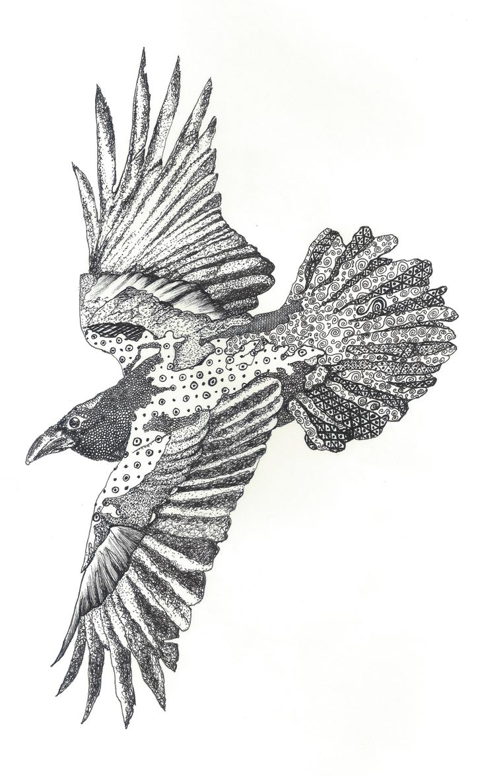
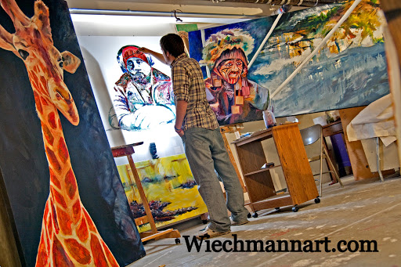
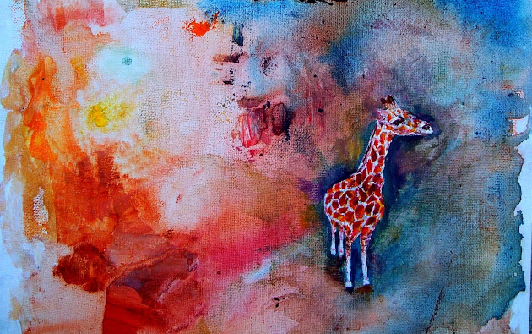
HELLO!
I am Michael Wiechmann
Studio Art Major - Masters of Arts in Teaching - K- 12 Certified Art Teacher
You can find me at @mwiechmannTEACH

Slide 4
Uncomfortable

Slide 5
How much do you focus on the DESIGN part of being an Instructional Designer?
1

Slide 6
Instruction isn’t the issue in this context!

Slide 7
How do some of the great artists’ designs compare to current online educational materials?
2

Slide 8
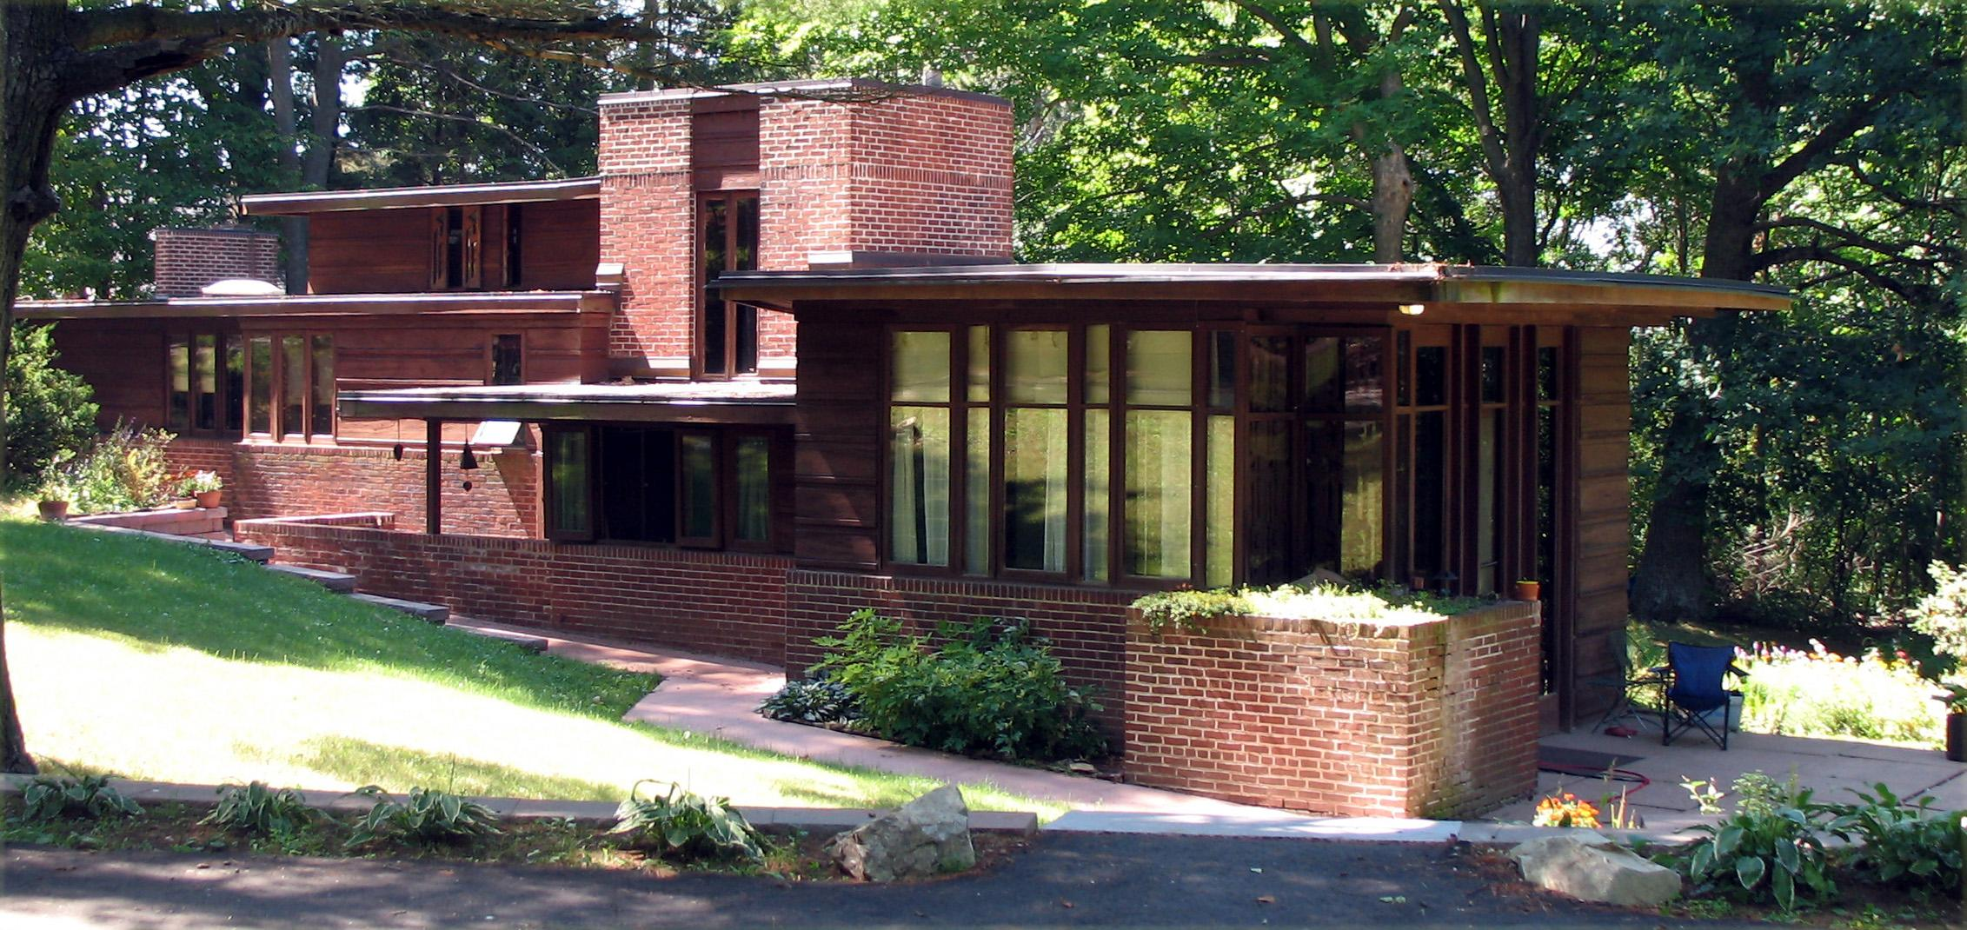
Great Design - Frank Lloyd Wright

Slide 9
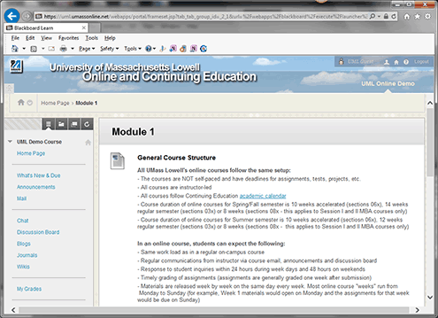
Online Courses

Slide 10
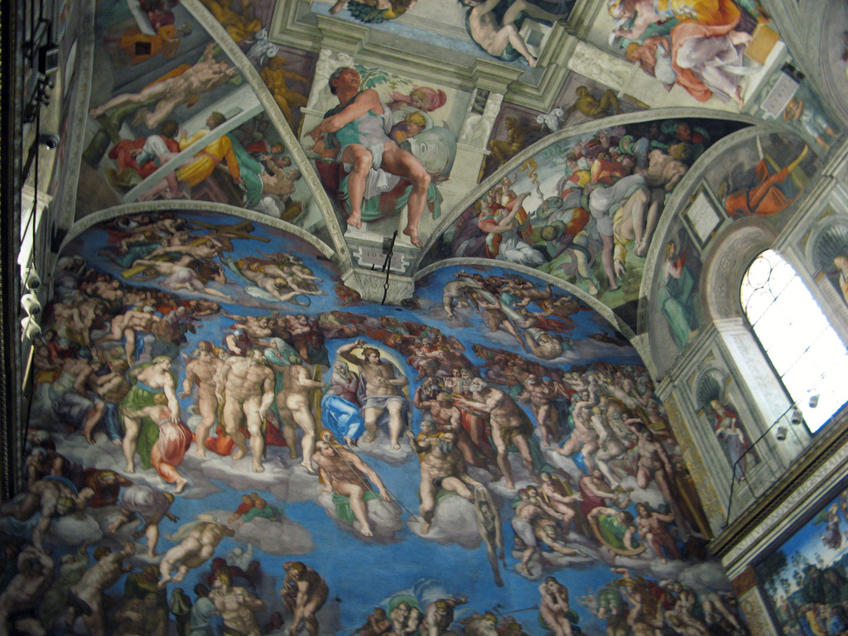
Great Design
-
Michelangelo

Slide 11
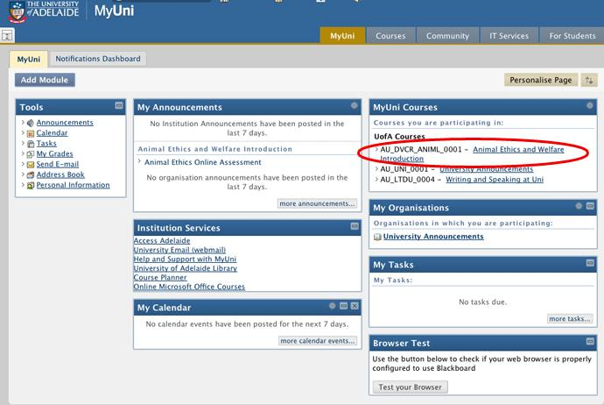
Online Courses

Slide 12
Let’s Play a Game!
Which design was created with aesthetic beauty in mind?

Slide 13
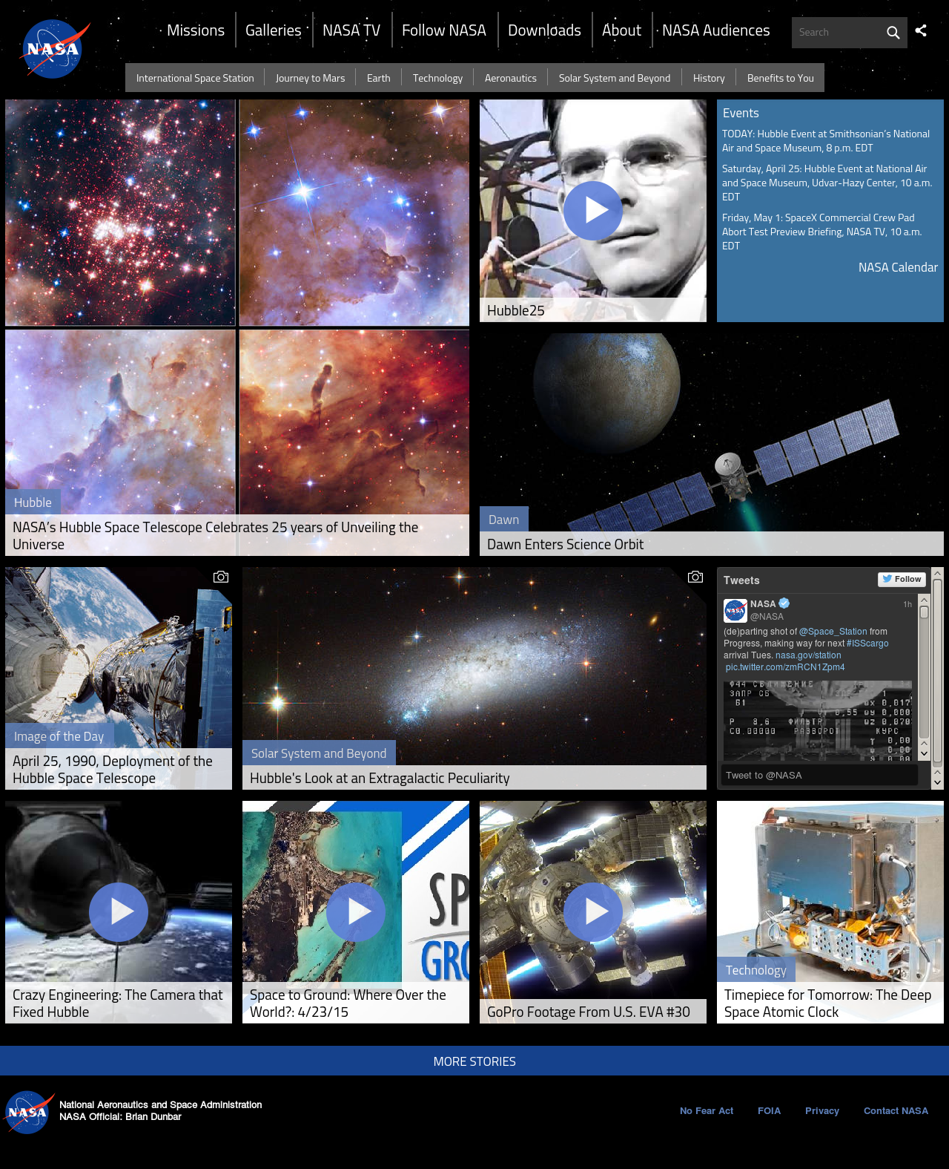
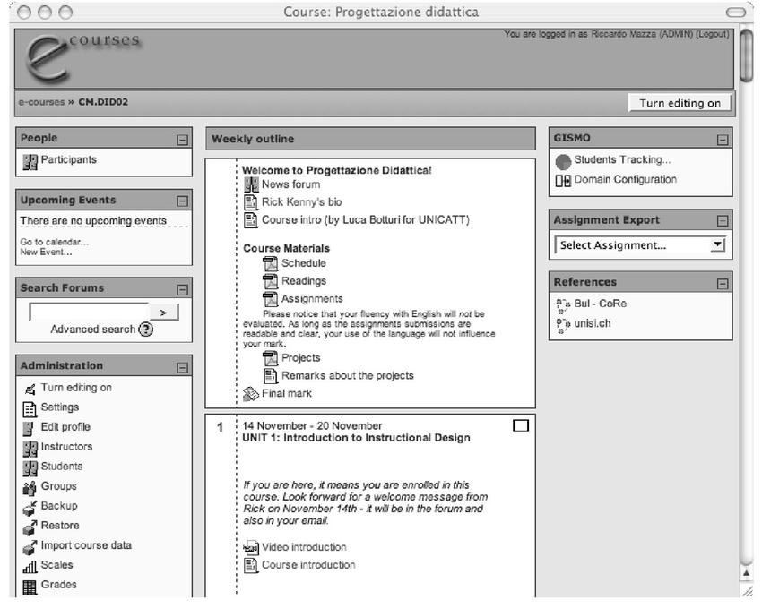

Slide 14
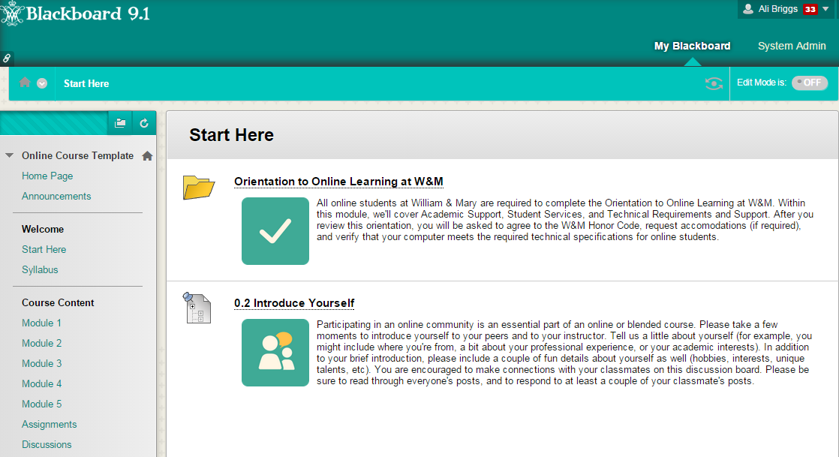

Slide 15
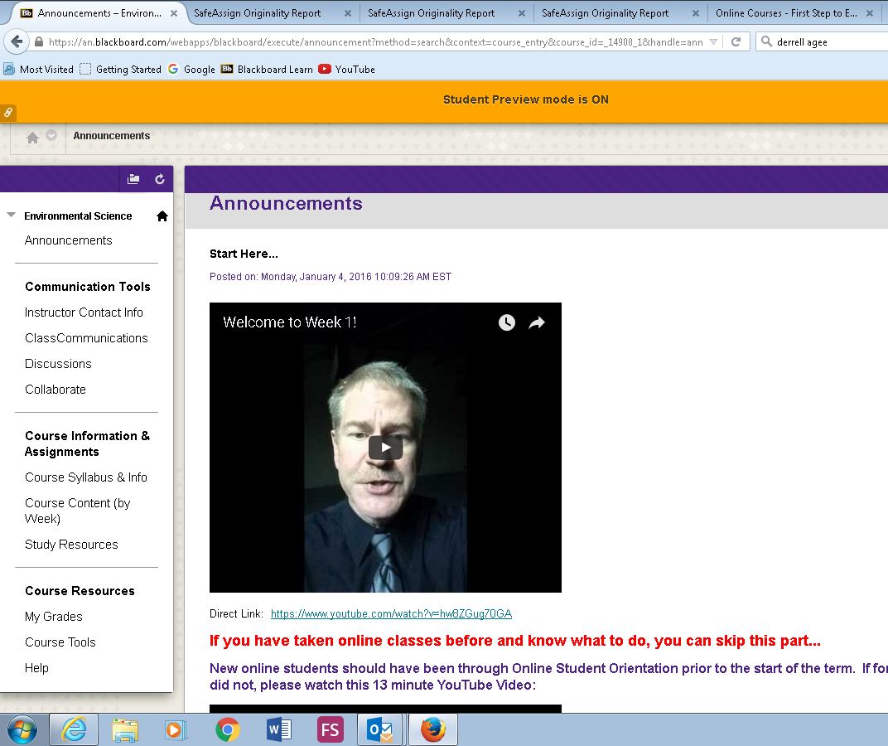
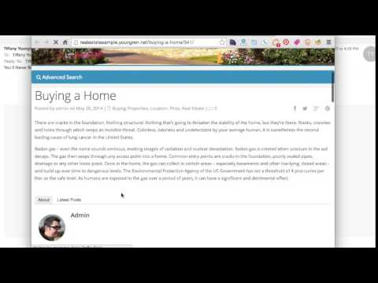

Slide 16
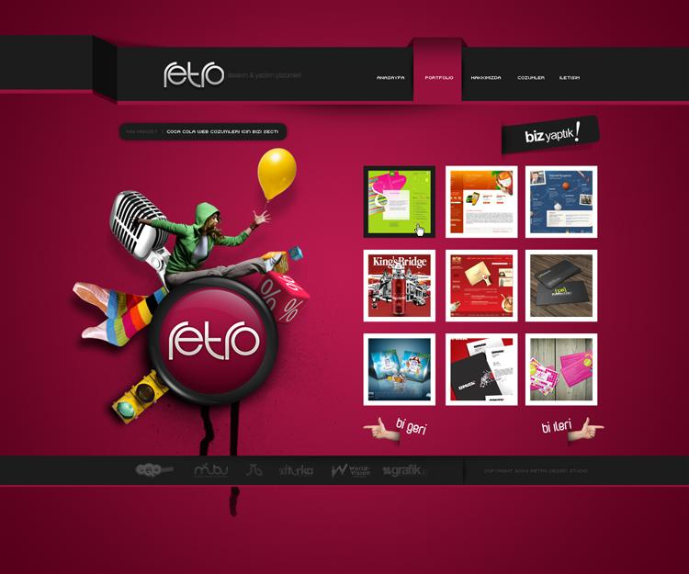
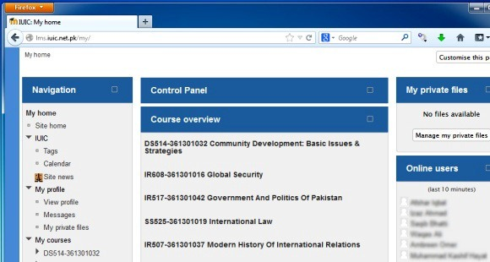

Slide 17
The Sexy Design of Social Media!
If designed right would students scroll through your course rather than their Twitter feed?
Hours of social scrolling!
Social Designers have a focus on the User's Experience.

Slide 18
Why does someone climb a mountain?
3

Slide 19
Similarities?
Being an Online Student VS Mountain Climbing

Slide 20
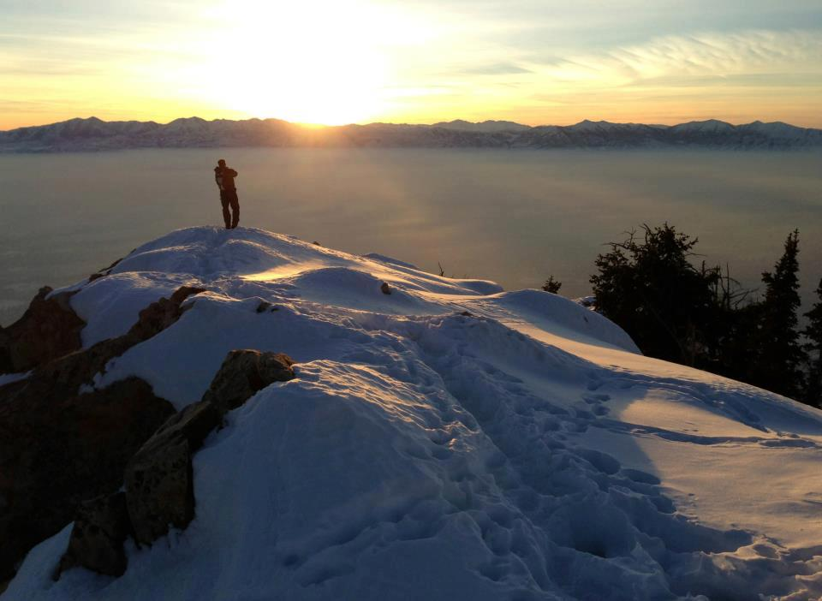

Slide 21
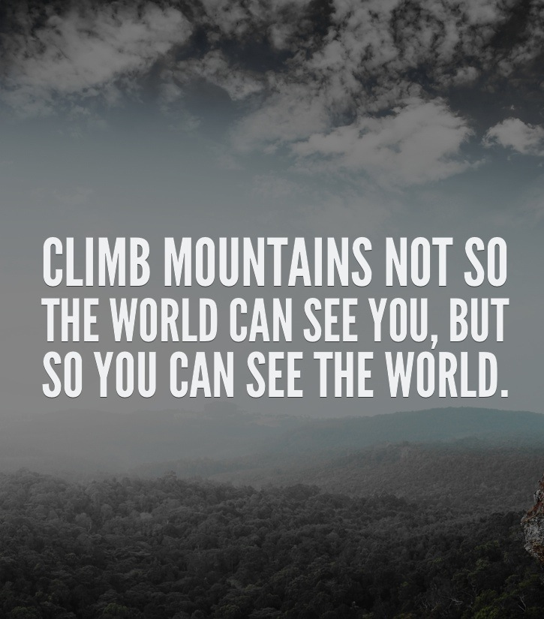

Slide 22
What are 5 easy steps to improving your course design?
4

Slide 23
Be Click Conscious
Step 1
Focus on having the least number of clicks so that you don’t lose the underachiever.

Slide 24
Example Images or Quotes
Step 2

Slide 25
Style Guide
Step 3
Having a school-wide style guide is essential, but if it is not available then create one for yourself.

Slide 26
The Teacher's Personality Should Come Through
Step 4
What is unique about you that your students could love?

Slide 27
Design Specific Practices
Step 5
Font
Colors
Contrast
Space

Slide 28
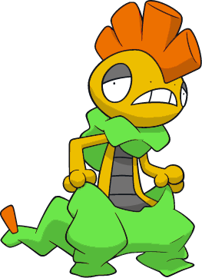
How do OER materials change the equation?
5

Slide 29
Open educational resources (OER) are freely accessible, openly licensed documents and media that are useful for teaching, learning, and assessing as well as for research purposes. It is the leading trend in distance education/open and distance learning domain as a consequence of the openness movement.
Reuse
Redistribute
Revise
Remix
Four R’s

Slide 30
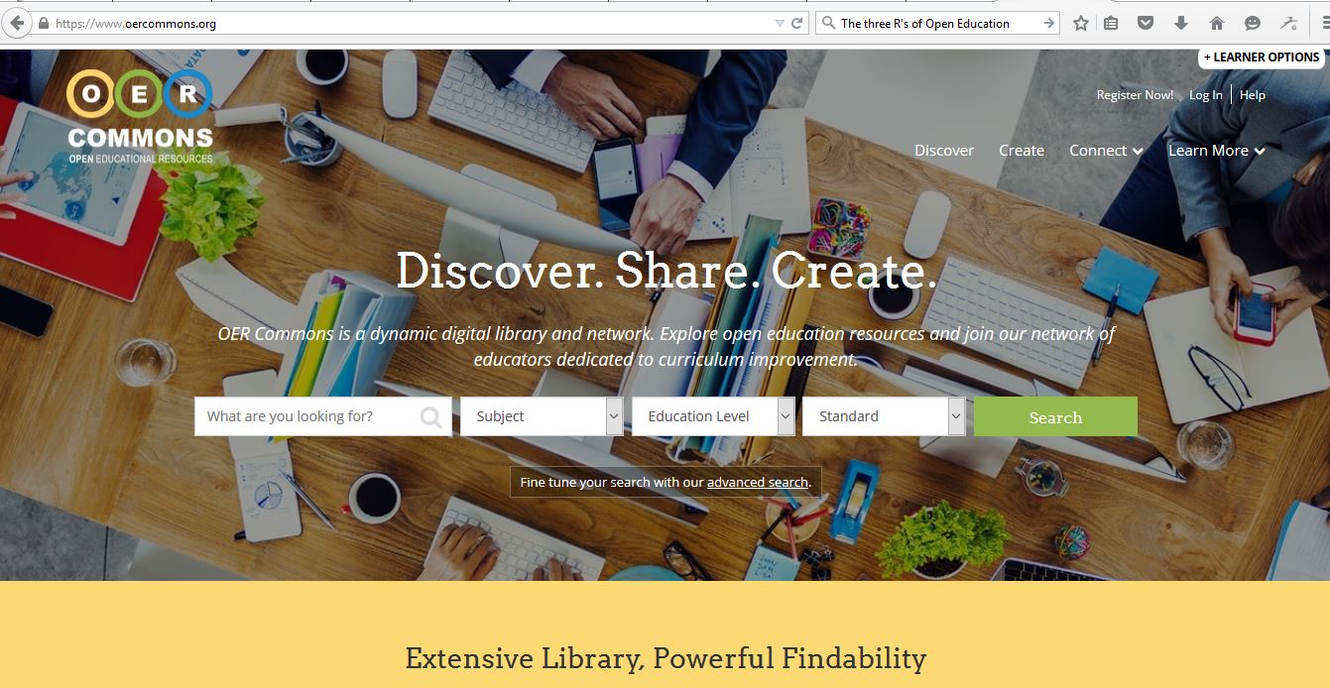

Slide 31
Combining Shared Knowledge!

Slide 32
Combining Abilities!
To capture the visual side to learning

Slide 33
THE PROCESS IS EASY
Use OER to free up planning time!
Use that extra time to dive deeply into your topic of interest and create INCREDIBLE resources about it!
Share resources and repeat!

Slide 34
Not a Visual Artist?
How could you solve this problem?

Slide 35
THANKS!
Any questions?
You can find me at
@mwiechmannTEACH / michael.wiechmann@gmail.com

Slide 36
CREDITS
Special thanks to all the people who made and released these awesome resources for free:
Presentation template by SlidesCarnival

Slide 37
PRESENTATION DESIGN
This presentation uses the following typographies and colors:
Titles: Oswald
Body copy: Source Sans Pro
You can download the fonts on this page:
https://www.google.com/fonts#UsePlace:use/Collection:Source+Sans+Pro:400,700|Oswald:400,700
Click on the “arrow button” that appears on the top right
Sky blue #00cef6 / Bright green #aff000 / Blue #3c78d8 / Dark blue #28324a
You don’t need to keep this slide in your presentation. It’s only here to serve you as a design guide if you need to create new slides or download the fonts to edit the presentation in PowerPoint®

