Slide 1
Six Pack to the Rescue:
3rd Party Integrations
Karen LaPlant, Hennepin Technical College
Dr. Sheri Hutchinson, North Hennepin Community College

Slide 2
Session Description
Want to get your classes ready to show off a marvelous six-pack? Exercise your healthy choice by joining us to hear how two faculty members have been successful with the implementation of this six-pack of 3rd party LMS Integrations. Improve your student engagement and success rates by one or more of the six following 3rd party tools to be presented: Zoom, Atomic Learning, Labryinth, Pearson, Cengage (Mindtap), and ReadSpeaker. We will demonstrate how we use these products in a variety of blended and online courses at both of our institutions with the result of engaging students with access to rich learning applications.

Slide 3
Agenda for the Healthy Six-Pack
LTI Integrations and Definitions
Web Conferencing with Zoom
Student Self-Help Videos with Atomic Learning
Publishers LTI: Labryinth, Pearson and Cengage Mindtap
Text to Speech with ReadSpeaker

Slide 4

LTI Overview
Get Healthy and integrate 3rd party and publisher content into a D2L Brightspace course or LMS
Engage students with access to rich learning applications through their familiar D2L Brightspace interface or other LMS
Improve student success and retention rates by reaching diverse student populations

Slide 5
What is LTI?
Principal concept of Learning Tools Interoperability (LTI) is to establish a standard way of integrating rich learning applications with platforms like learning management systems (LMS)
LTI enables tool consumers to connect and transfer information to tool providers
Tool providers consist of commercial tools vendors that write and host tools for eLearning
  Examples include wikis, simulations or publisher content

Slide 6
Who is Using LTI?
Many learning management systems, including the most widely used in education across the world, already support LTI
Growing list of application and content vendors
Systems and applications that have achieved official conformance are listed on the IMS website

Slide 7
What is LTI Certification?
A commitment by a supplier to the IMS community for ongoing support for achieving "plug and play" integration
It implies ongoing commitment to resolve problems, revise implementations and retest as need
LTI, as a standard from IMS Global Learning Consortium, allows users to access external learning tools from their courses without logging into the tool

Slide 8

Web Conferencing Advantages
Online Office Hours
Online Orientation
Help Sessions
Record and Review Later
Conduct Remote Classes
Easy to Use
Free ZOOM Demo License to Try-Out
Share screens quickly
No Downloads Required—Just a simple, fast plug-in

Slide 9
ZOOM
This LTI link may be shared to all courses. This allows instructors to use it, but does not automatically place the link within the course. For basic instructions on how to use the D2L integration, please refer to the MnSCU support page about ZOOM LTI Integration as of 3-14-2016:
https://d2l.custhelp.com/app/answers/detail/a_id/1674
Additional Support
Additional support resources for Zoom can be found at: https://support.zoom.us/ https://support.zoom.us.
https://d2l.custhelp.com/app/answers/detail/a_id/1674
https://d2l.custhelp.com/app/answers/detail/a_id/1674

Slide 10
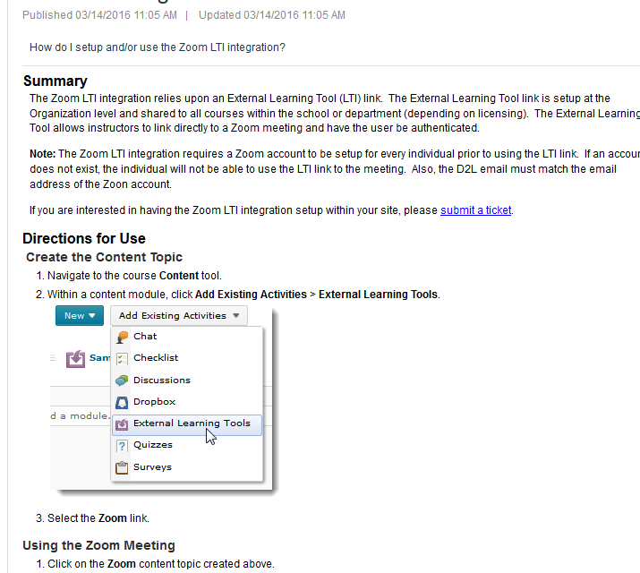
ZOOM

Slide 11
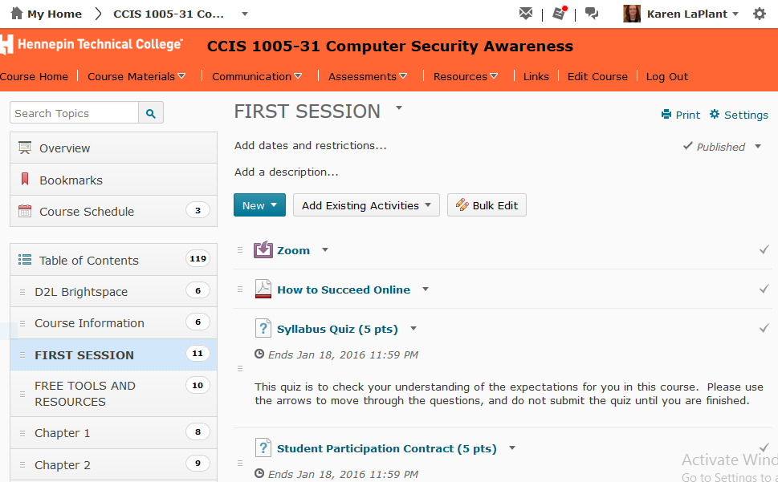
ZOOM Inside D2L

Slide 12
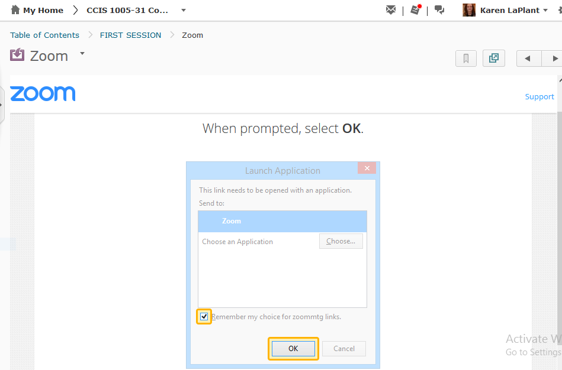
ZOOM

Slide 13
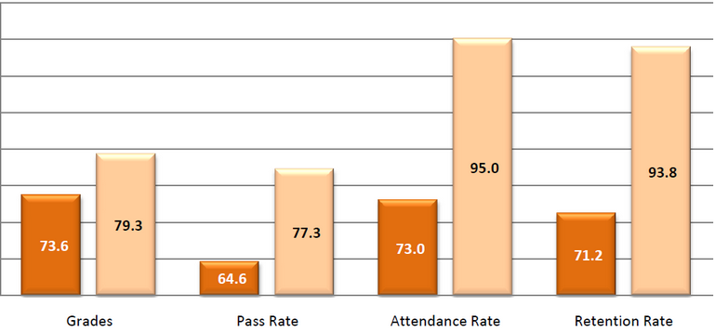

Improving Outcomes
What might this mean?
For the Classroom
  Increased Success (C or above)
  Increased Retention (stay in school)
  Better Grades
For the Student
  Self-efficacy
    Motivation
    Confidence
    Resourceful
Notes:
The outcomes I am referring to are not just the ones for the classroom, but the student ones that we can’t measure easily with a graph to show improvement.

Slide 14

Atomic Learning
    Develop Self-Efficacy Skills
    Via deep links that seamlessly open content directly into D2L-whether tutorials or assessments
    With a subscription to Atomic Learning students automatically open specific Technology Training video content that the instructor has chosen and progress can be tracked unlike external resources
    Self-Help Training and Self-Assessments

Slide 15
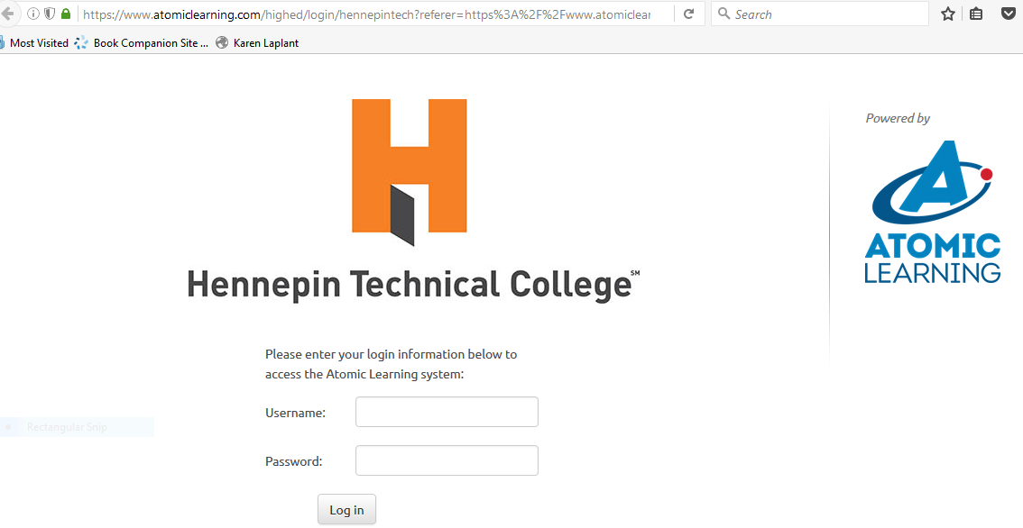
Atomic Learning Outside D2L

Slide 16
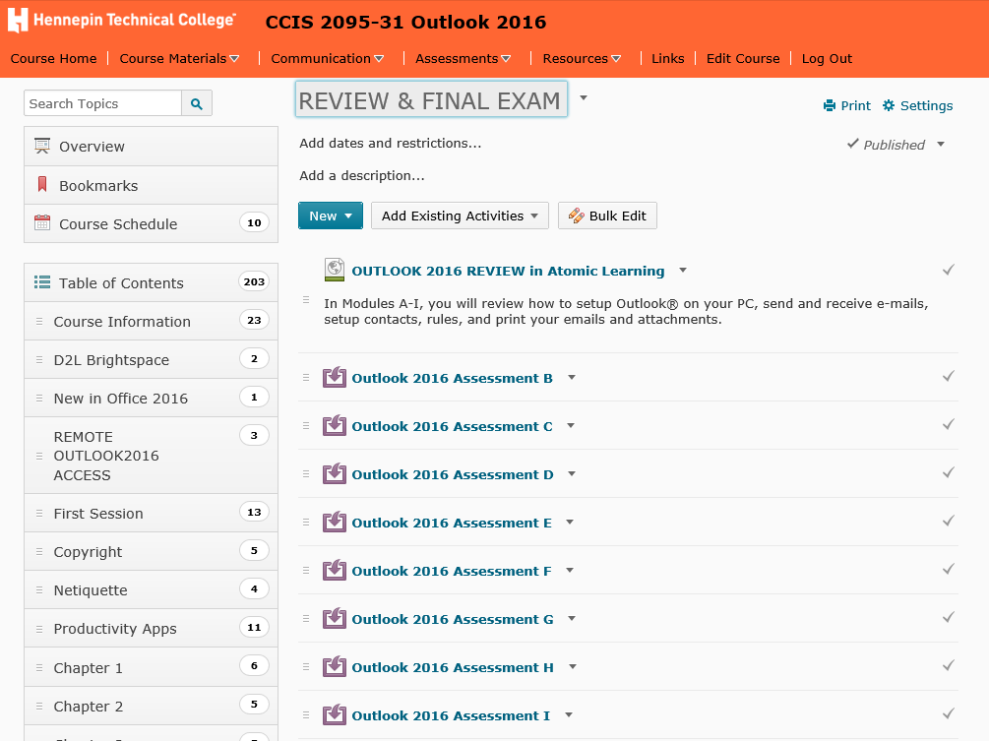
Atomic Learning Inside D2L

Slide 17
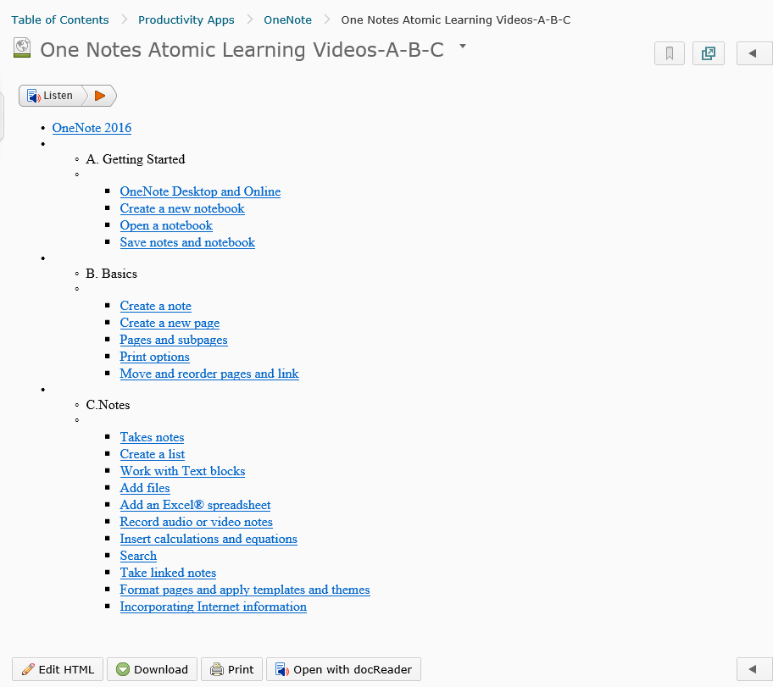
Embed Inside D2L

Slide 18
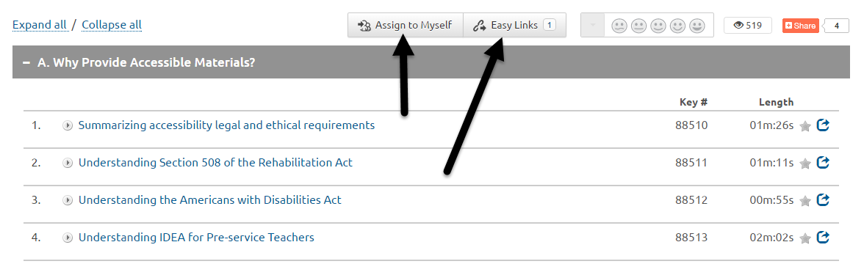
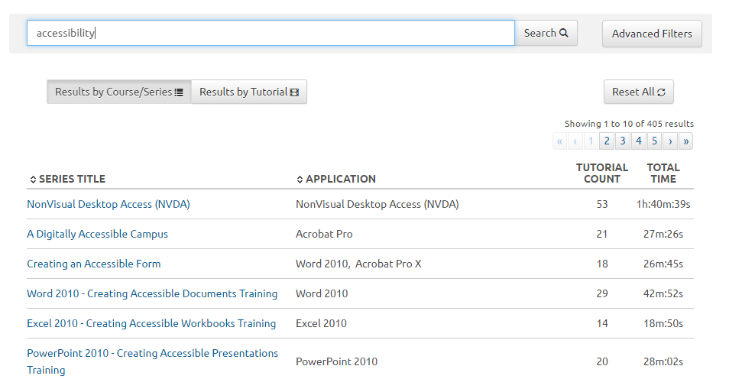
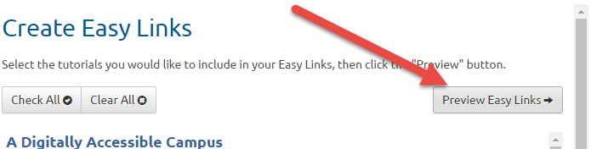
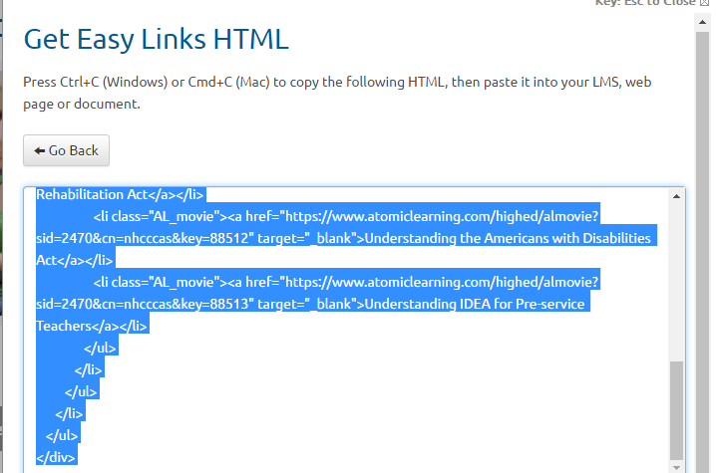
EMBED: Easy Links and Easy HTML

Slide 19
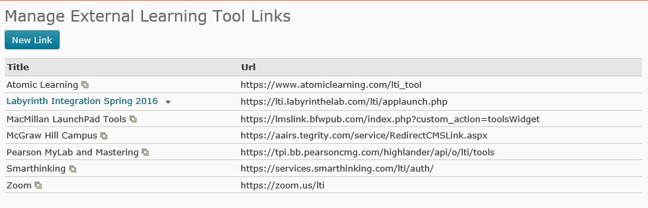
Inside D2L Brightspace: Atomic Learning
Notes:
Search Atomic Learning for things like Accessibility, Technical training, writing skills, career skills and much more. Use Easy Links or use HTML and embed

Slide 20
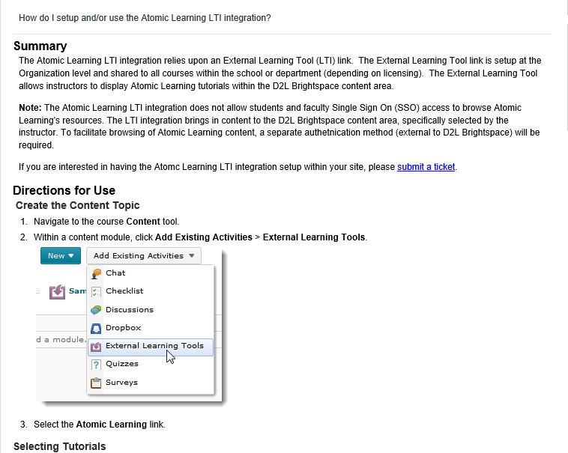
Atomic Learning LTI
Notes:
Search Atomic Learning for things like Accessibility, Technical training, writing skills, career skills and much more. Use Easy Links or use HTML and embed

Slide 21
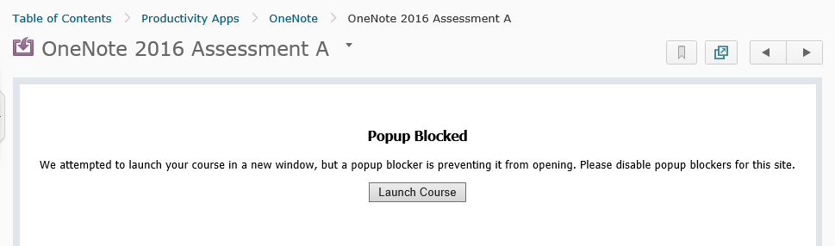
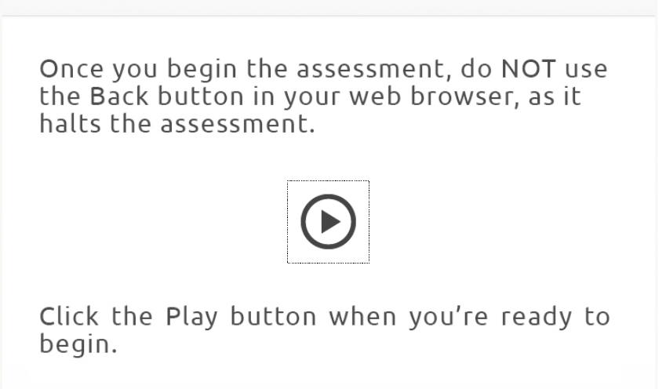
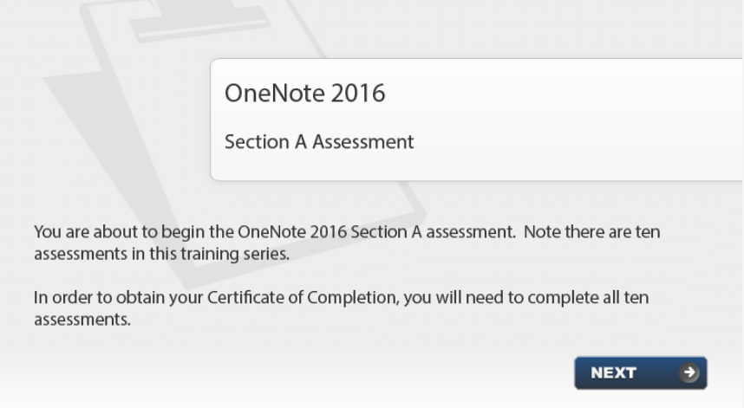
Atomic Learning LTI Inside D2L

Slide 22
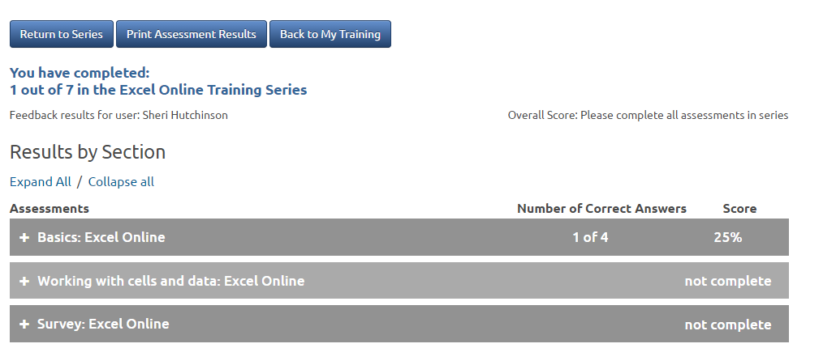
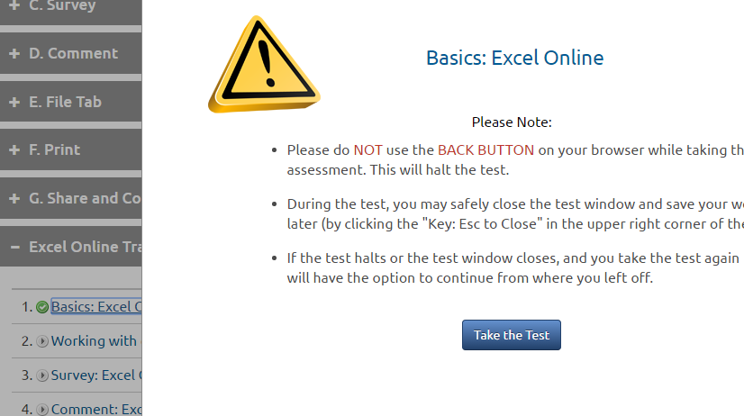
Atomic Learning Assessments

Slide 23
Advantages of Publishers
Without LTI:
  Student must log into eLab or any learning tool separate from their LMS to access resources and assessments
  Instructors must manually transfer scores via Excel or other methods to their LMS
Utilizing the LTI App, students can now access all course content:
  Including videos, assignments, and tests from links within their course in D2L

Slide 24
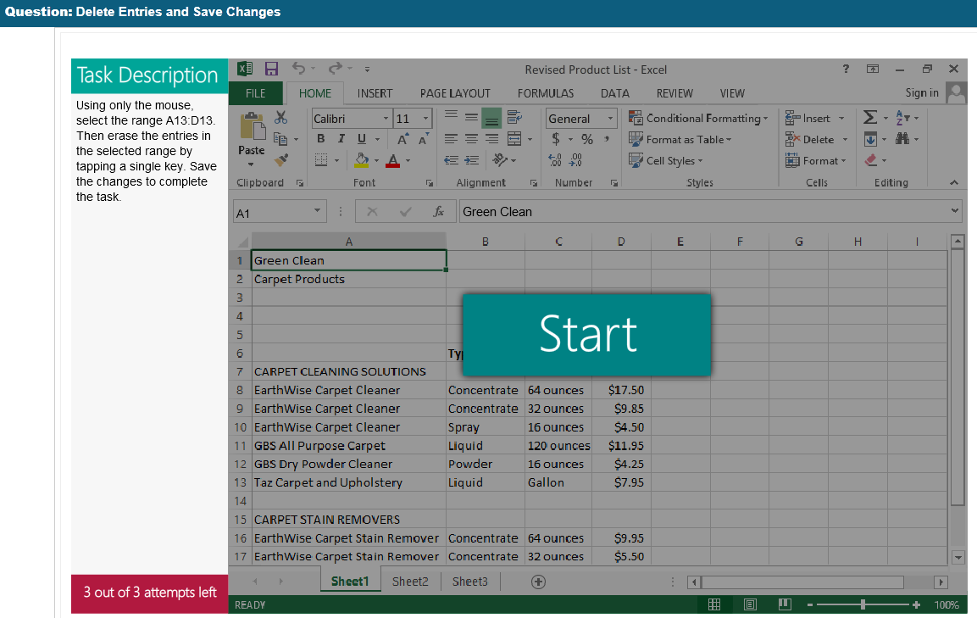
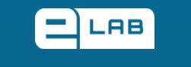

What does eLab Provide?
eLab is Labyrinth Learning’s platform for delivering learning resources
  Student data files
  PowerPoint presentations for each lesson
  Video tutorials that align with the learning materials
  Interactive training tutorials
  Expansive test bank of questions for automatic assessments
  Task-based flash simulations for assessments
  Automatically graded project-based assessments
Most of these resources cannot be uploaded into D2L directly

Slide 25
Labyrinth LTI 1.1
The Labyrinth integration with D2L is a Course Builder Remote Plugin. ‘Remote Plugin’ is D2L’s name for an integration point that may use LTI and/or Valence API and can display in different areas (Course Builder, Homepage Widget, or Insert Stuff).
Upon first use of an integration, Jon Werth generally give access only to the requesting instructor’s courses rather than school-wide, unless it is specifically for the entire school. Essentially, treating it as a pilot before granting larger access.

Slide 26
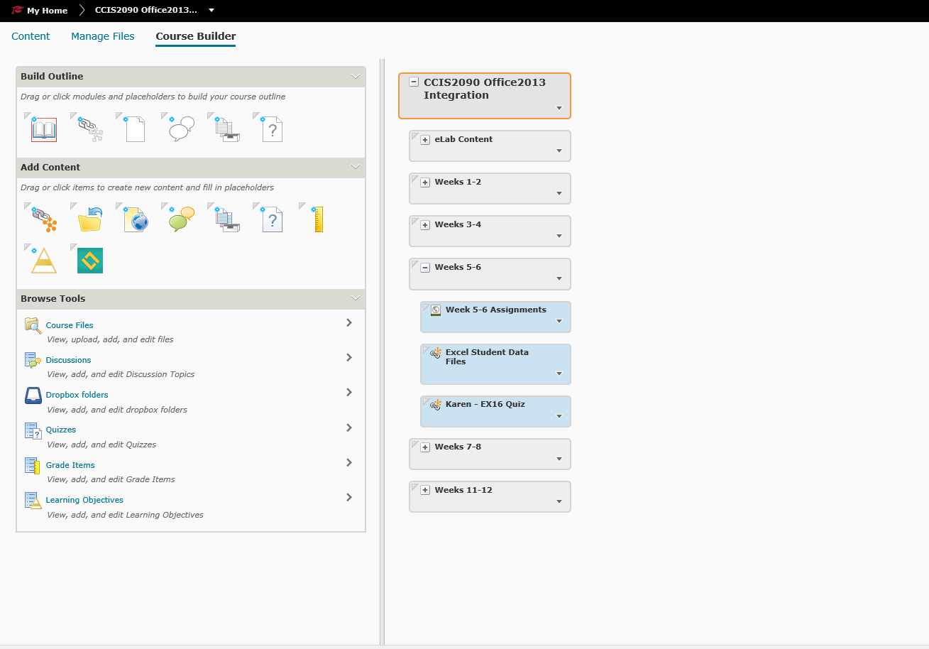
Labryinth LTI inside D2L

Slide 27
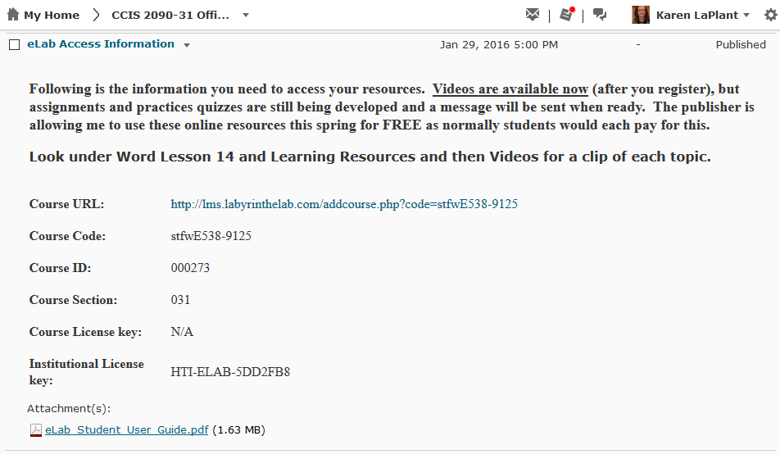
Labryrinth eLab in NEWS

Slide 28
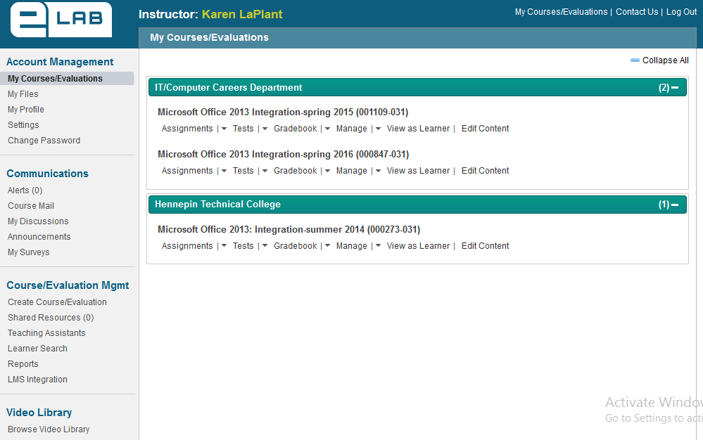
eLab Access through D2L

Slide 29
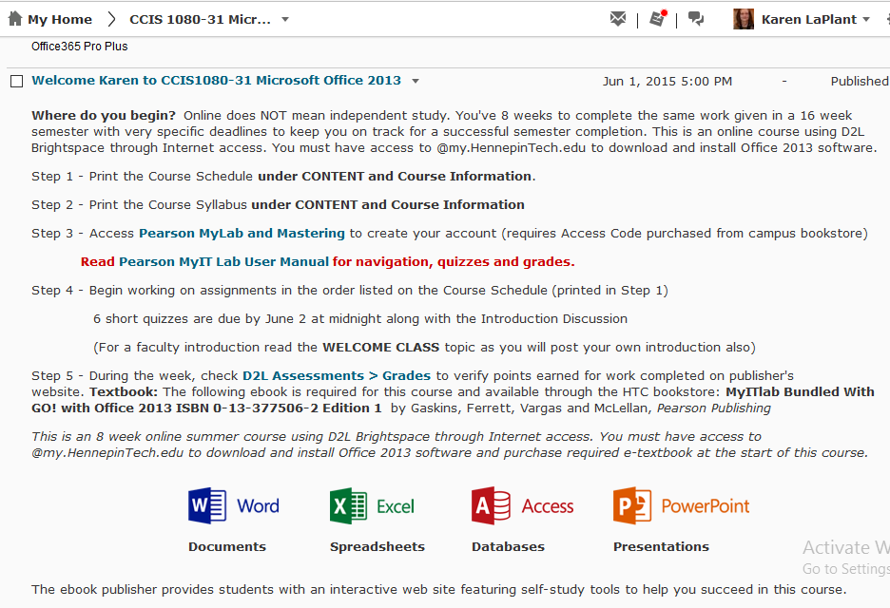
Pearson MyIT Lab

Slide 30
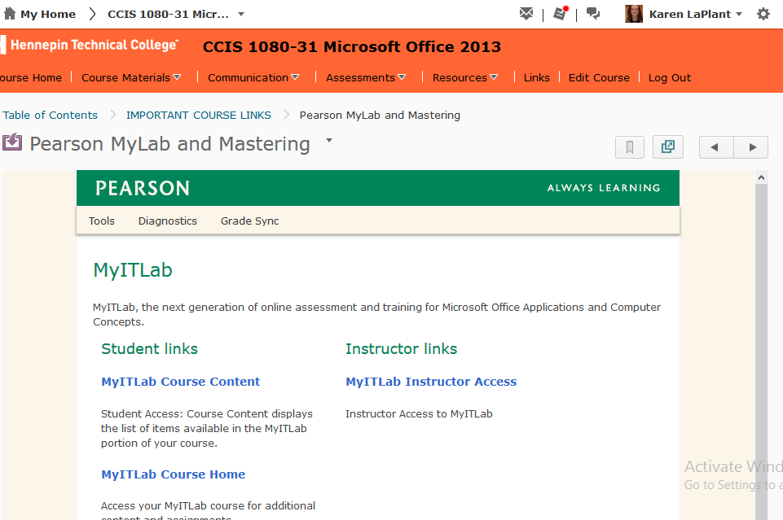
Pearson MyIT Lab

Slide 31
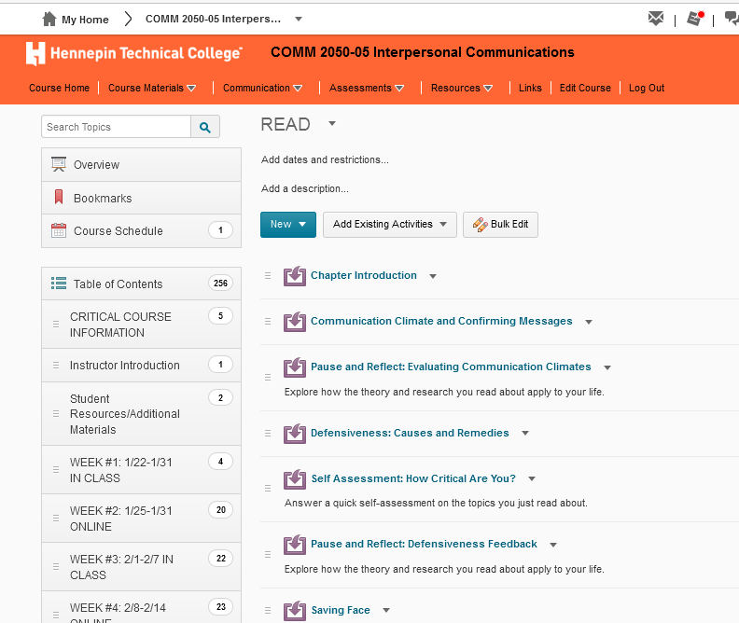
Cengage MindTap

Slide 32
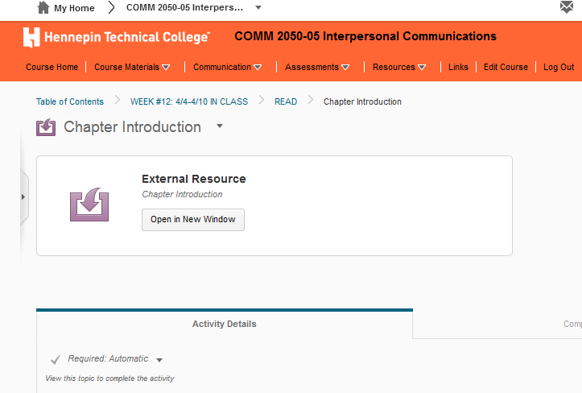
Cengage MindTap

Slide 33
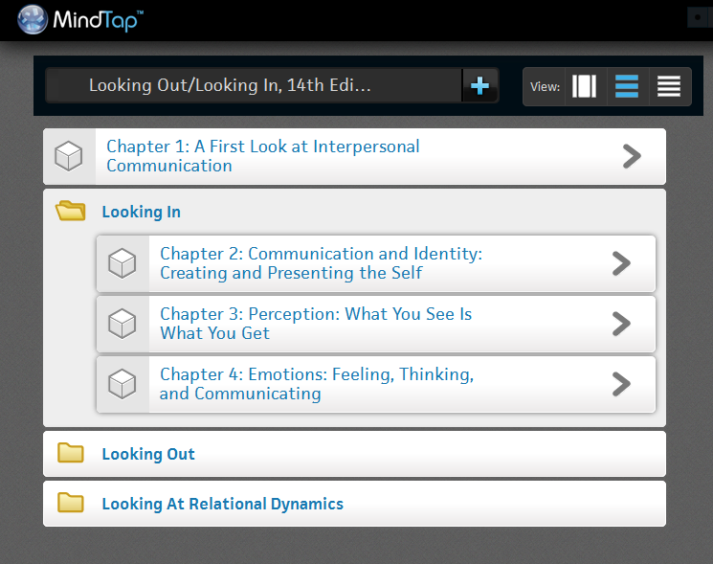
Cengage MindTap

Slide 34

eBook Capabilities
Interactive Capabilities
Bookmark
Highlight
Read Aloud
Notes
Video
Practice Quizzes

Slide 35
Benefits of Publishers LTI 1.1
LTI 1.1 app makes it easy for instructors to integrate into D2L
  Allows you to use publisher content that can’t be uploaded into D2L by seamlessly integrating eLab into D2L and tracking user progress in D2L
  Student can work within D2L familiar platform
  Student can access publisher content without logging in to another platform
  Allows instructor to manage their grades from within D2L without having to import from external platform
  Flexibility around where instructors can add the content for their course.
    For example, course is split into 16 weeks – you can put in access to the videos for that week – the information for what makes sense for your course organization and students.
    Add tests / assignments where you want it or need it by week or by lesson

Slide 36
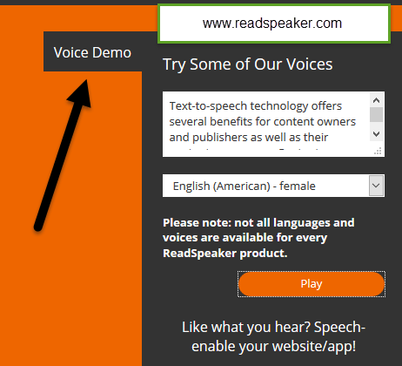

Human Voices with ReadSpeaker
Improve Student Outcomes
Mobile Friendly
Easy to Use
Cost Effective
High Quality Voices
Customizable

Slide 37
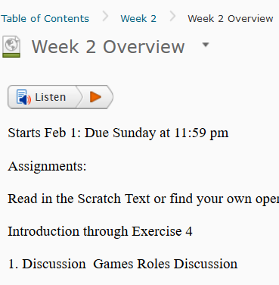

D2L Brightspace Reading
Notes:
LMS Brightspace HTML and PowerPoint Examples TextAid Web or LMS Reading Getting Started

Slide 38
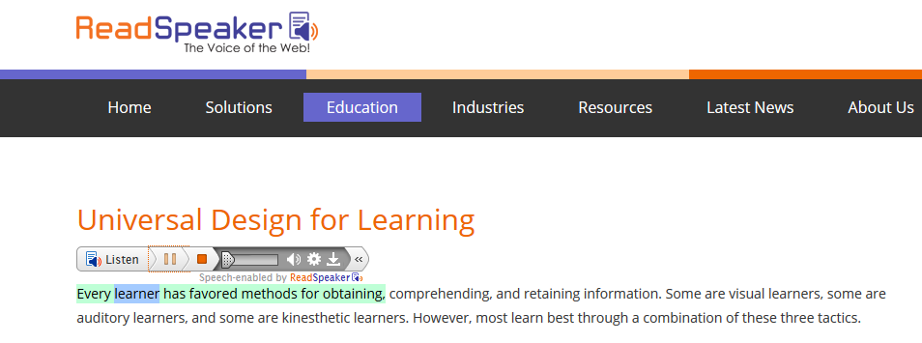


Text to Speech: ReadSpeaker LTI
Change Highlighting and text font colors
Speed up or Slow Down Reading
Increase text visibility

Slide 39
Who Benefits from Text to Speech
Low Illiteracy
Dyslexia
Low Vision or No Vision
Multi-taskers
Returning Adults
Mobile Users
Cognitive or other Disabilities
ELL-English Language Learners

Slide 40
LTI Benefit Summary
Single signon (students stay within course)
Gradebook Synch with Publishers
Straightforward integrations with third party tools, or tools you build in-house
Employs a standards based approach to allow for a more user friendly process
Compatible with a continually growing, large list of teaching and learning tools in the market

Slide 41

Questions & Answers ???
List of MnSCU 3rd party integrations within D2L Brightspace:
https://d2l.custhelp.com/app/answers/detail/a_id/1519/kw/lti%20list
https://connect.mnscu.edu/sites/d2lintegrations/SitePages/Home.aspx

Slide 42
Thank you for attending!
Karen LaPlant, Faculty
Hennepin Technical College karen.laplant@hennepintech.edu
Dr. Sheri Hutchinson, North Hennepin Community College sheri.hutchinson@nhcc.edu

