Slide 1
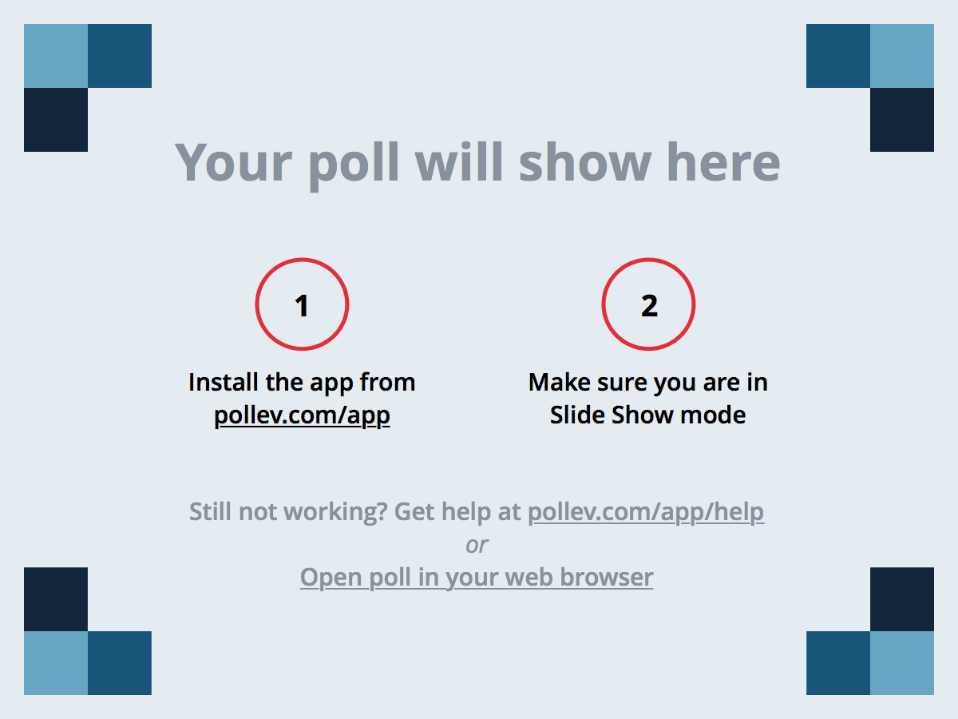
Notes:
Have you ever gamified a course?
https://www.polleverywhere.com/multiple_choice_polls/0bEUq4reIWvu6lB

Slide 2
Maximizing Brightspace Tools to Create a Gamified Online Learning Environment
Carrie Lewis Miller, PhD
Jeff Henline
Information & Technology Services

Slide 3
What is Gamification?
gam·i·fi·ca·tion
/ɡāmifəˈkāSHən/
Noun: the application of typical elements of game playing (e.g., point scoring, competition with others, rules of play) to other areas of activity, typically as an online marketing technique to encourage engagement with a product or service.
"gamification is exciting because it promises to make the hard stuff in life fun"

Slide 4
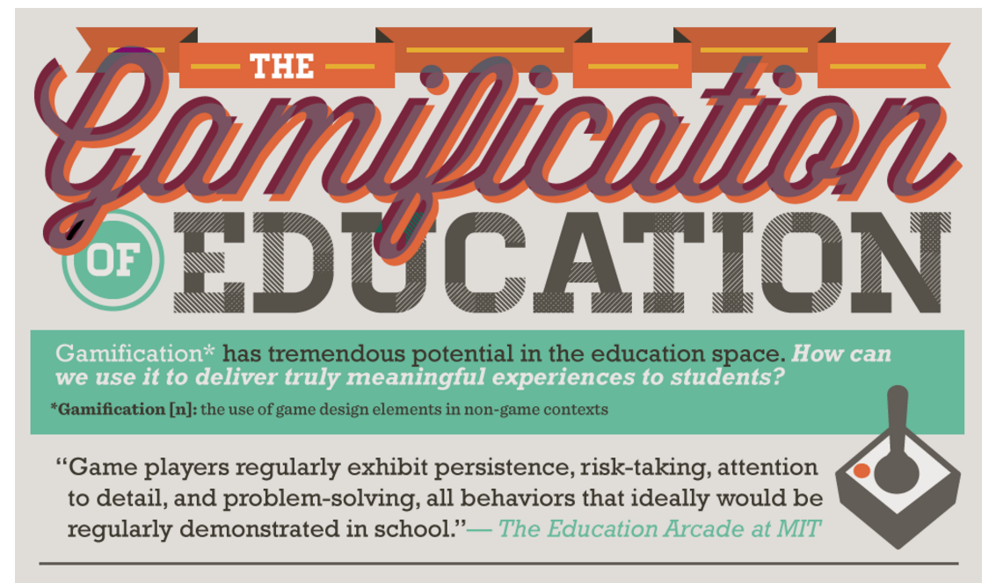
Why Would I Gamify?
https://www.knewton.com/infographics/gamification-education/

Slide 5
Notes:
Have you ever participated in a Gamified Learning Experience?
https://www.polleverywhere.com/multiple_choice_polls/qErj2h2Go7XO1m6

Slide 6
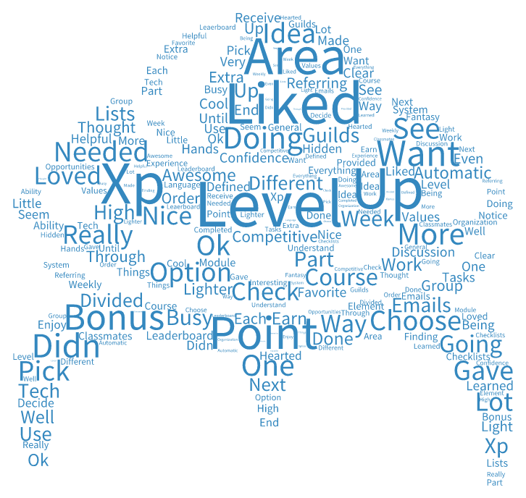
Why Would I Gamify?

Slide 7
What D2L Tools Can I Use?
Intelligent Agents
Checklists
Groups Tool
Widgets
Embeddable Videos
Grades
Modules
Badges and Awards

Slide 8
Primary Gamification Tools
Intelligent Agents
Release Conditions
Groups Tool
Modules
Badges and Awards (*was not available for my gamified course)

Slide 9
Secondary Gamification Tools
Checklists
Widgets
Embeddable Videos
Grades
Quizzes
Surveys

Slide 10
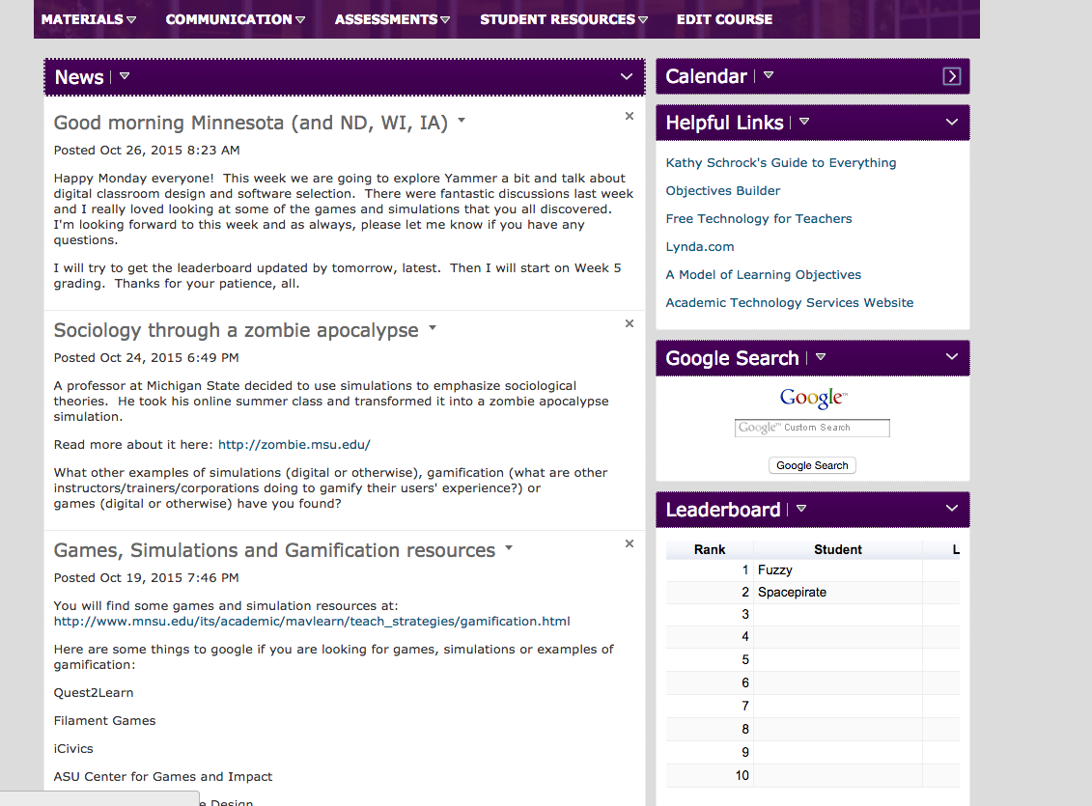
What Does a Gamified Course Look Like?

Slide 11
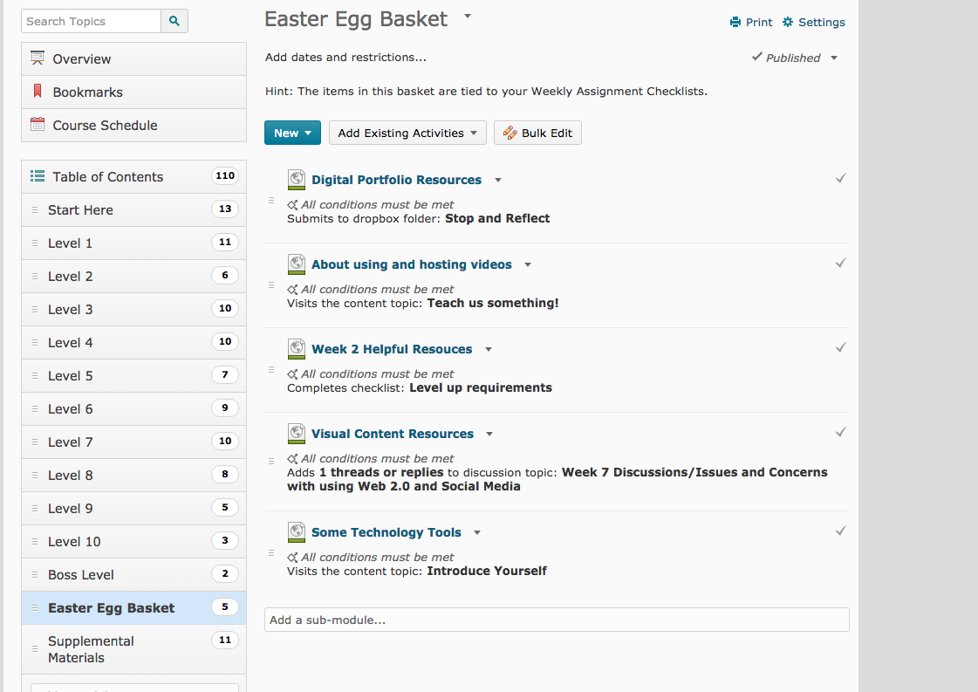
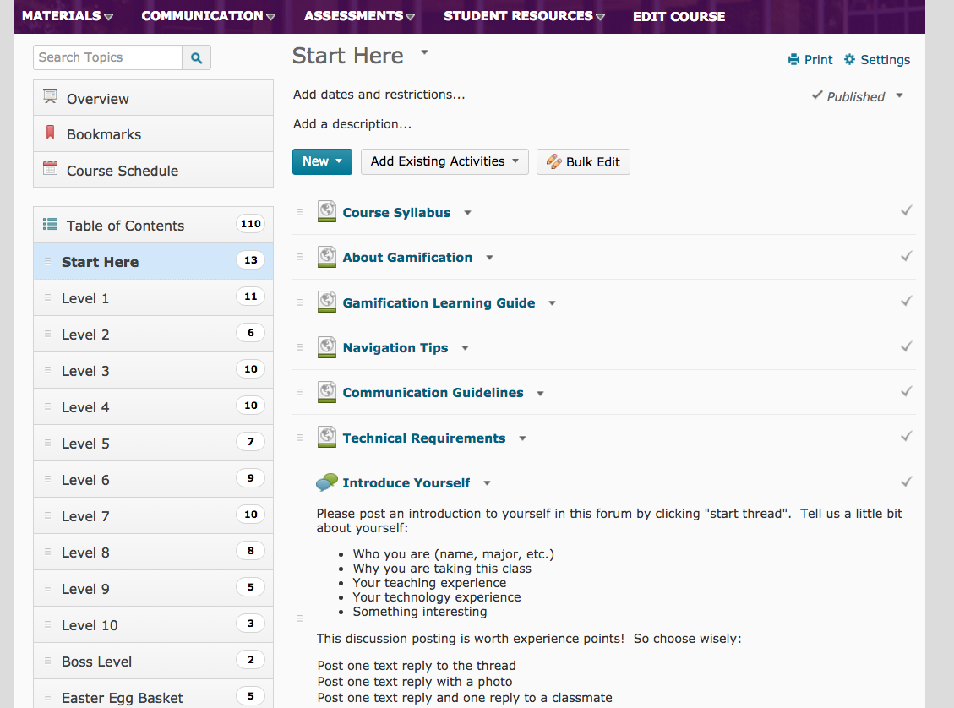
What Does a Gamified Course Look Like?

Slide 12
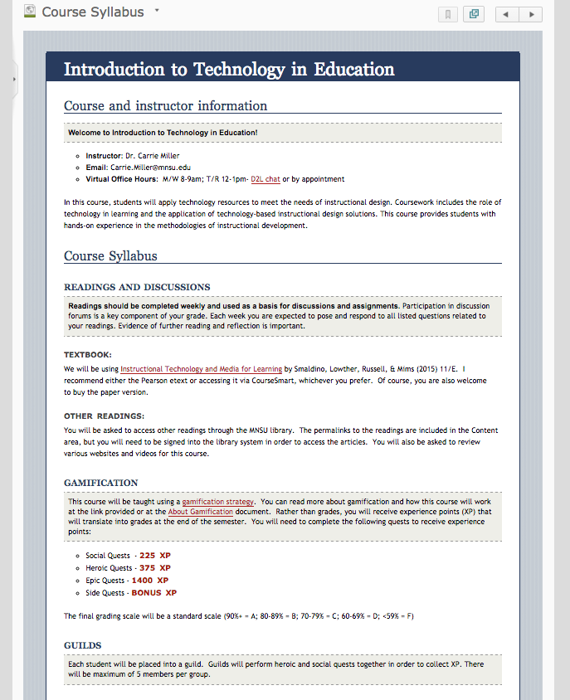
What Does a Gamified Course Look Like?

Slide 13
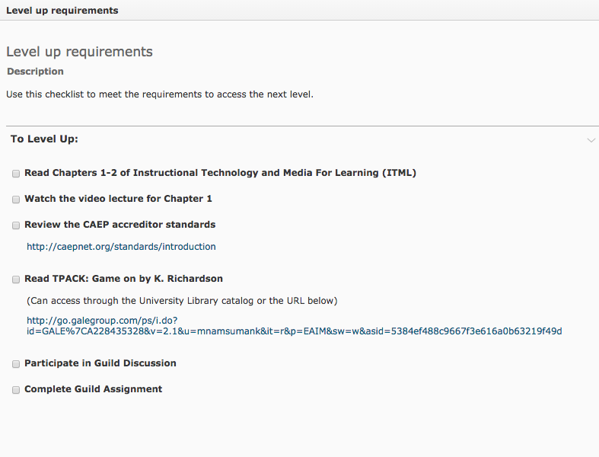
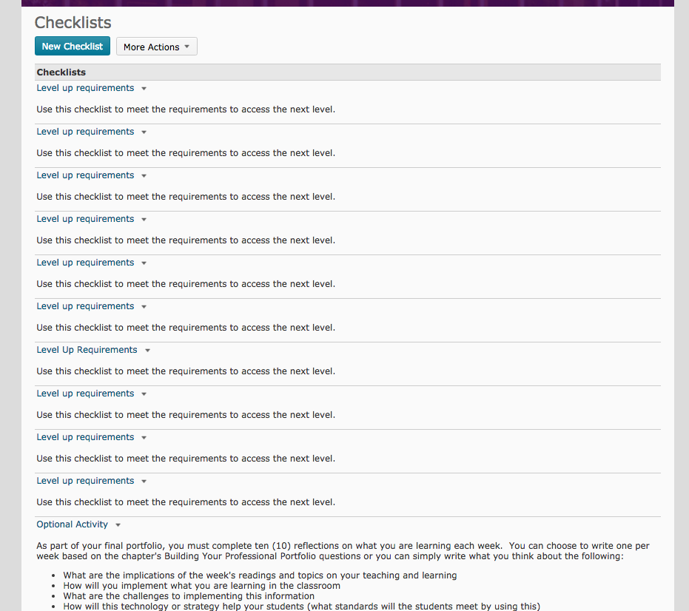
What Does a Gamified Course Look Like?

Slide 14
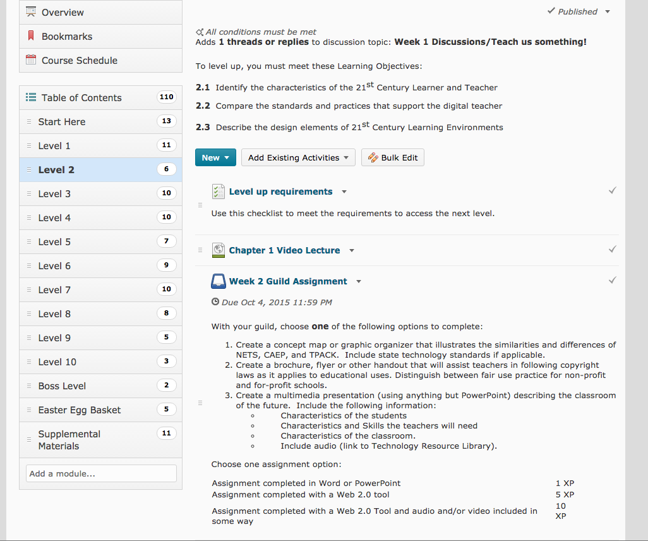
What Does a Gamified Course Look Like?

Slide 15
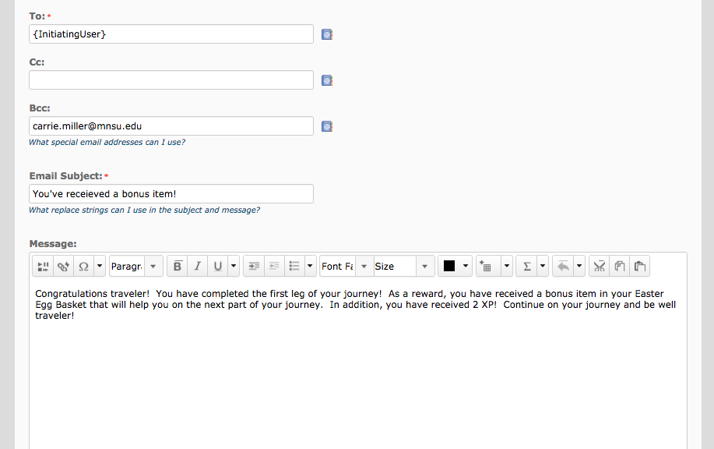
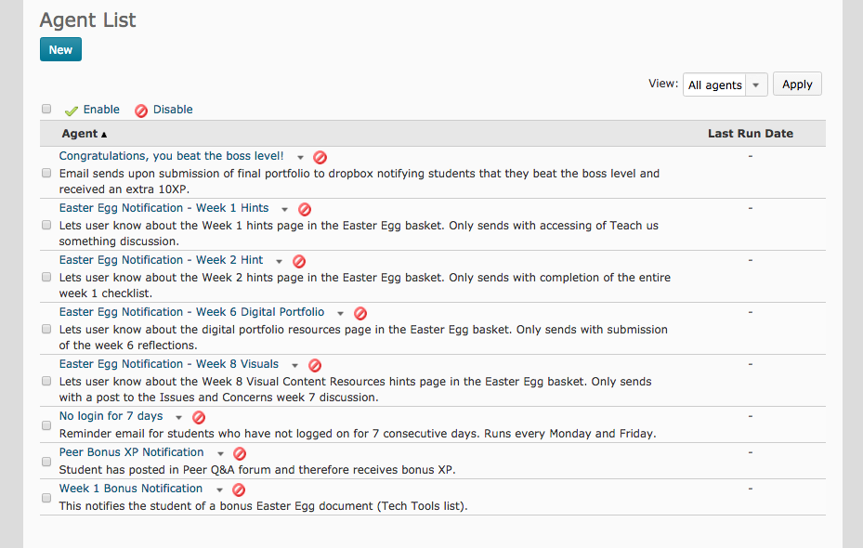
What Does a Gamified Course Look Like?

Slide 16
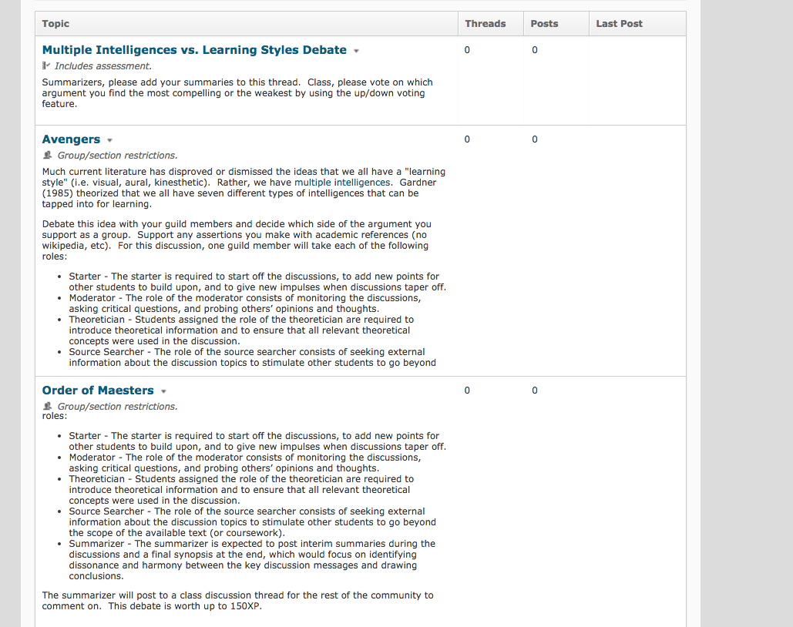
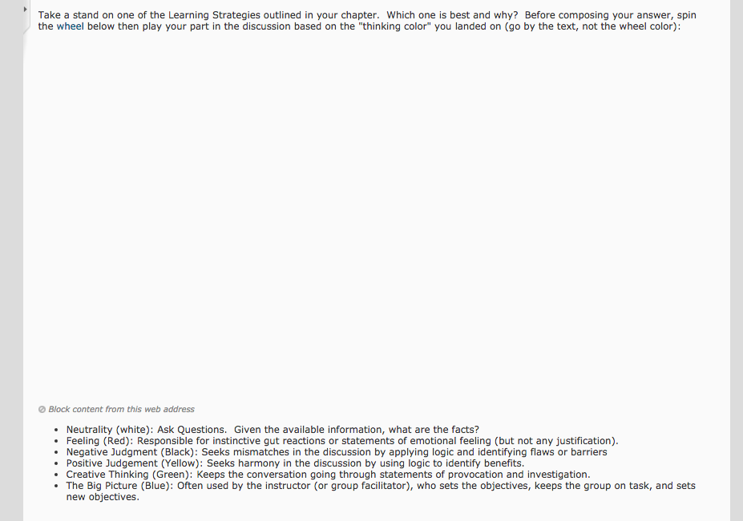
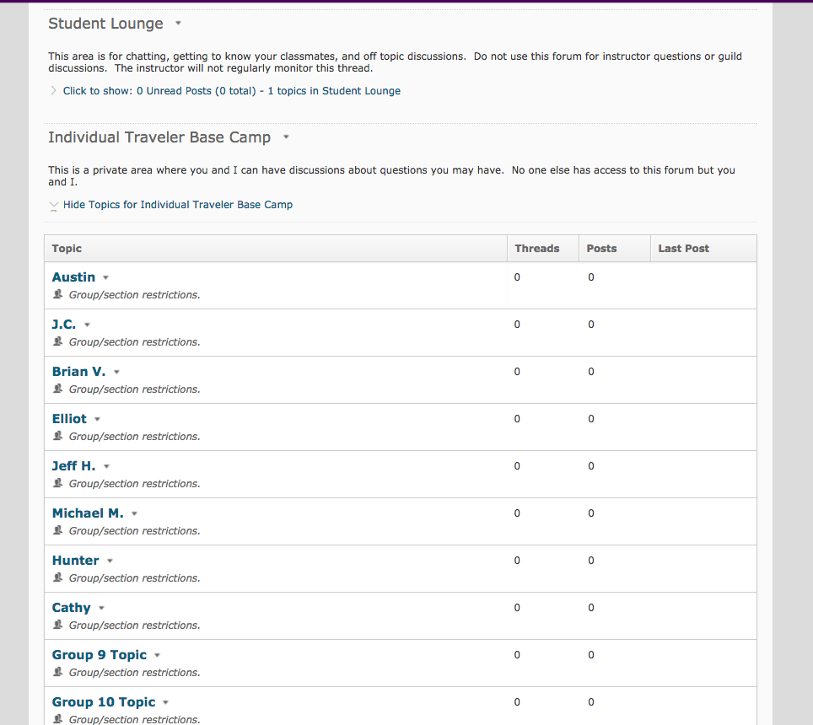
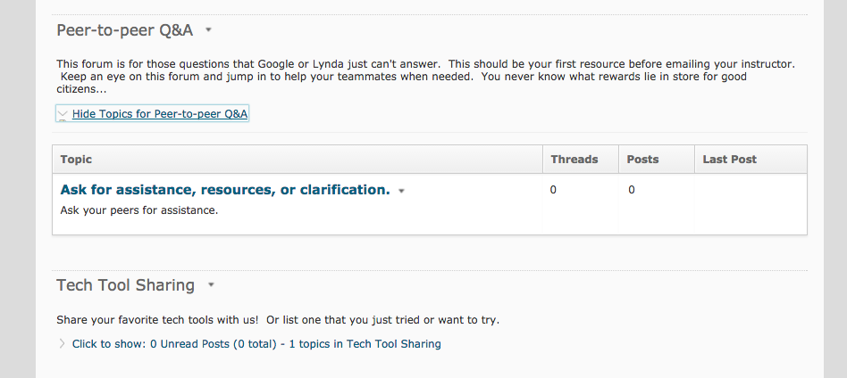
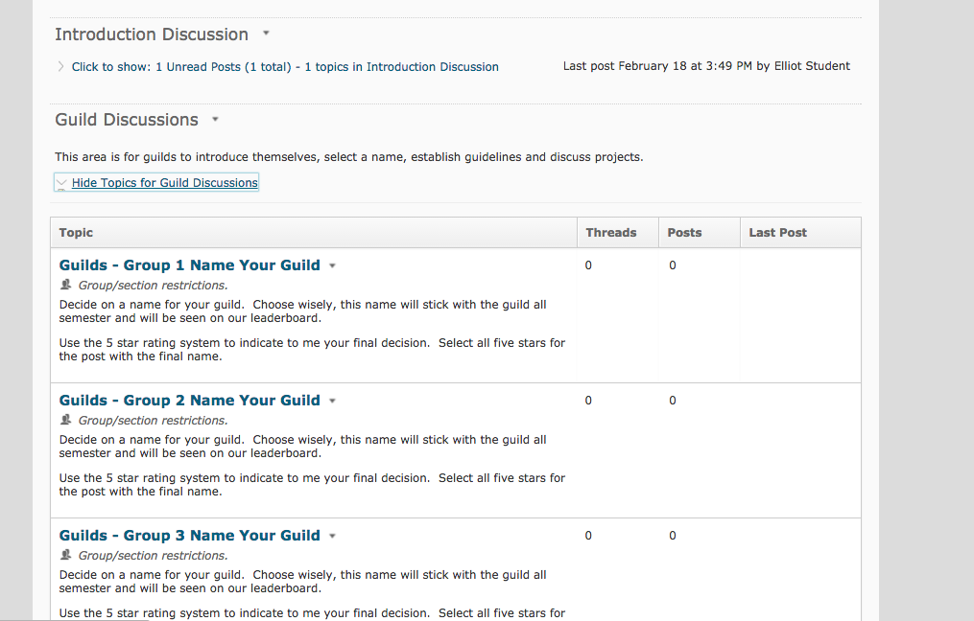
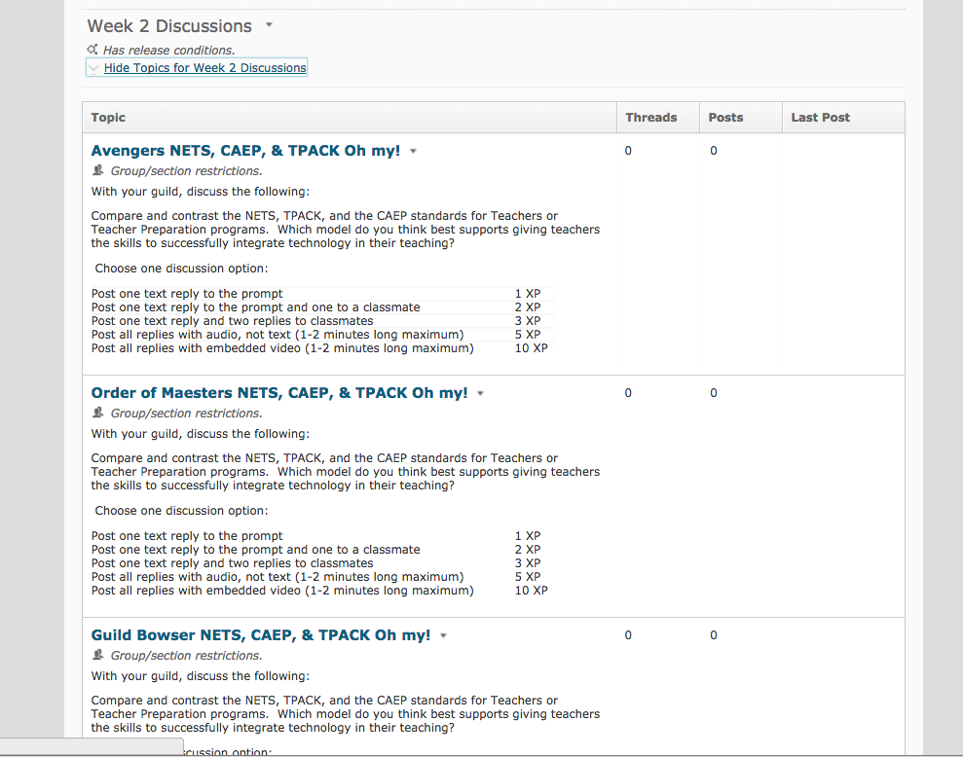
What Does a Gamified Course Look Like?

Slide 17
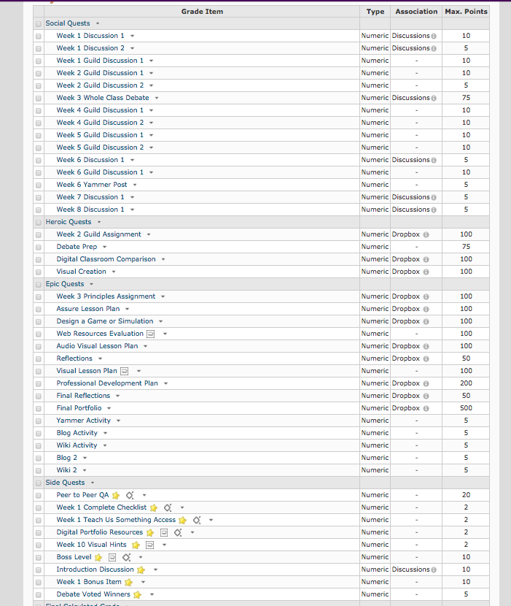
What Does a Gamified Course Look Like?

Slide 18
How Can I Gamify My Course?
Change the vocabulary
Create the context
Create a ranking structure
Use the tools at hand
Include personalization
Stay up to date
Create a support structure from the beginning
Differentiate Assignments
Issue Challenges
Declare a “Winner”

Slide 20
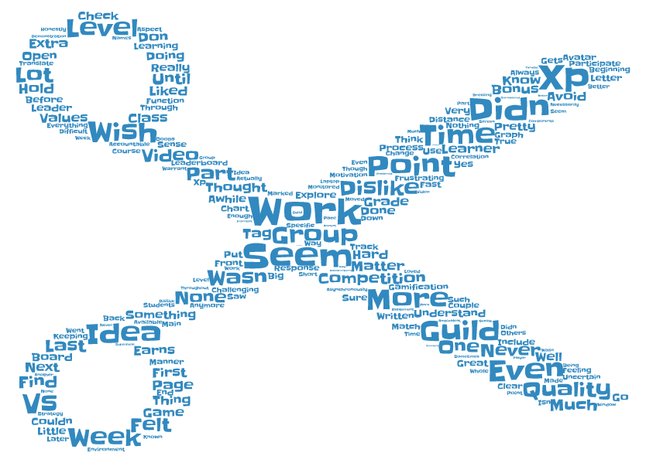
What Would You Have Done Differently?

Slide 21
What Would I Have Done Differently?
Created a context or story
Created a ranking structure
Differentiated assignments in a different way
Issued challenges continually throughout the course
Used more rubrics
Used less group work
Done more leaderboard research before the course started

Slide 22
What Other Resources Are Available?
http://link.mnsu.edu/gamification
Steps for Gamifying Your Course
Teaching Strategies: Gamification
Gamification instruction Planning Template
Reality is Broken by Jane McGonigal
The Gamification of Teaching and Learning by Karl Kapp

Slide 23
Thank You!
Carrie Lewis Miller, PhD
Instructional Designer
Carrie.Miller@mnsu.edu
507-389-1531
Jeff Henline
Enterprise Tool Coordinator
Jeffrey.Henline@mnsu.edu
507-389-2323

