Slide 1
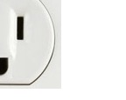
Data Analytics: Finding the Sustainable Sweet Spot
Greg Argo
Associate Library Director - Concordia University, St. Paul
MSIS – University of Texas at Austin
MBA – Concordia University, St. Paul

Slide 2
Learning outcomes
Knowing what is sustainable requires first knowing what is unsustainable.
Local control has drawbacks, but allows a deeper understanding of the data and more meaningful presentation of data relationships.
Presentation of data is only the first step; data analysis must lead to action in a true culture of assessment.

Slide 3
A culture of assessment exists in organizations where staff care to know what results they produce and how those results relate to customers’ expectations. (Lakos & Phipps, 2004, p. 352)
Clear expectations for assessment in the library
The library has an assessment plan
Leadership uses data systematically in decision-making
Shared understanding of the purpose of assessment in the library
Staff adequately supported in their assessment work
(Farkas, Hinchliffe, & Houk, 2015, p. 162)
5 factors assoc. w/ a “culture of assessment”
Notes:
Lakos, A. & Phipps, S. (2004). Creating a culture of assessment: A catalyst for organizational change. portal: Libraries and the Academy, 4(3) 346-361.
Farkas, M. G., Hinchliffe, L. J., & Houk, A. H. (2015). Bridges and barriers: Factors influencing a culture of assessment in academic libraries. College & Research Libraries, 76(2), 150-169.
A recent survey sent to 1,600 academic libraries found that these were the five library characteristics most often present in/correlated with a “Culture of Assessment.”

Slide 4
My experience
I assumed collection assessment responsibilities in 2010
We had no reliable historical usage data
We had no “assessment software” to perform analysis
We used Google Apps to build our own tool

Slide 5
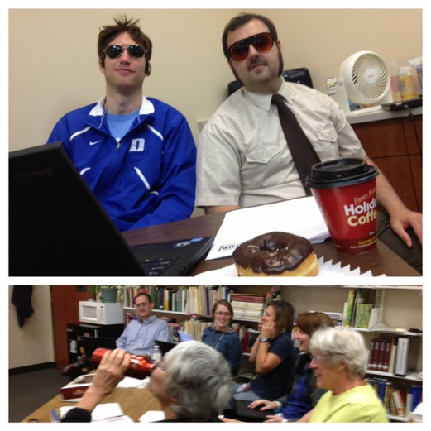
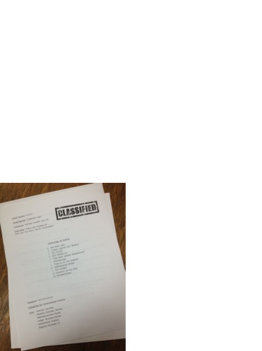
Hey, I thought you assumed responsibilities. What’s with this “we”?

Slide 6
Goals for Phase 1
Get good at the tools
Allow creativity to flow
Trust our instincts
Lay the foundation

Slide 7
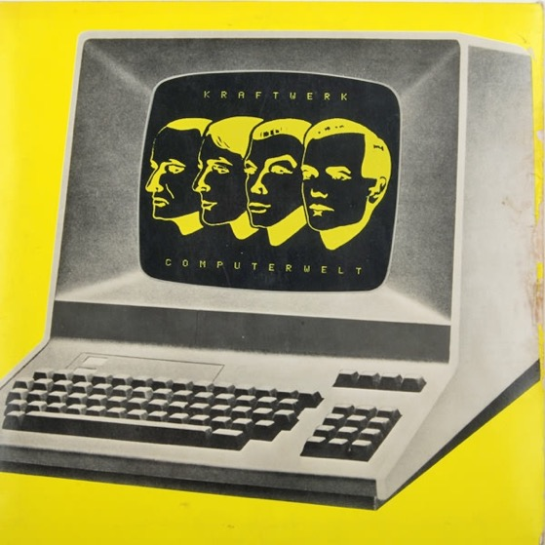
Routinize…repeat Routinize…repeat Routinize…repeat Routinize…repeat Routinize…repeat Routinize…repeat Routinize…repeat Routinize…repeat Routinize………….
^{Cost Info}
^{Admin Logins}
^{Admin Logins}
^{Usage Stats}
^{Cost Info}
^{Usage Stats}
^{Cost Info}
^{Admin Logins}
^{Chart Builder}
^{Usage Stats}
^{Chart Builder}
^{Chart Builder}

Slide 8
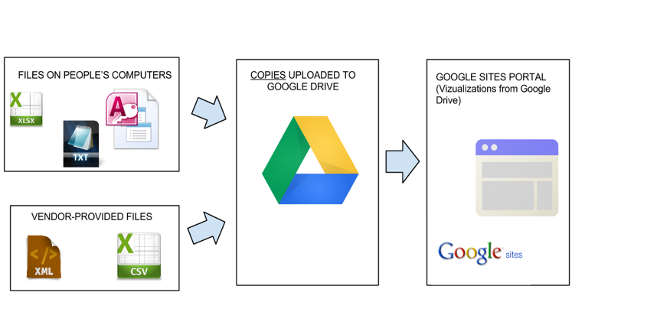
Systems used for data reporting
File
Origin
Data
gathering
Data
presentation
See example

Slide 9
Phase 1 Progress
Becoming one with systems
“Lay of the land”
Inspired staff with insights
Complex navigation
Too much information
Time consuming process

Slide 10
Phase 1: Develop baseline measures
If we are going scrutinize some database investments, where should we start?
$4 per use? $5 per use?

Slide 11
Phase 1: Develop action scripts
Anything over $5 triggers “On Probation” status
Ask for a price freeze
Create alerts 9/6/3 months out from next decision date
Check discoverability
Increase outreach efforts
Inventory of assignments/syllabi
Citation analysis of student papers
Investigate alternatives / Set up and run trials
Consolidate for better stewardship of funds

Slide 12
Phase 1: The blueprint
“Provide a clear blueprint for realizing business goals.”
- Barton & Court, 2012, p. 82
No resource should have a cost per download more than $5
Institution-wide cost per download under $1
50% firm book orders checked out after 2 years
Download per student greater than 75 per year
More than 2 years above $10 per download = cancellation
Clear expectations for assessment in the library
The library has an assessment plan.
Leadership uses data systematically in decision-making.
Notes:
Barton, D., & Court, D. (2012). Making advanced analytics work for you. Harvard Business Review, 90(10), 78-83.

Slide 13
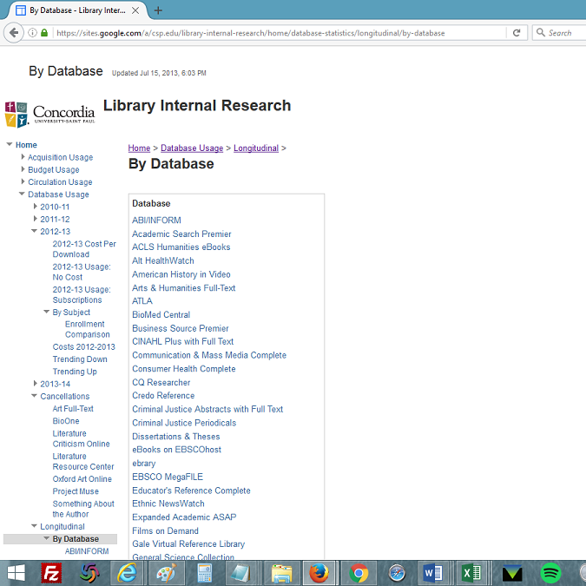
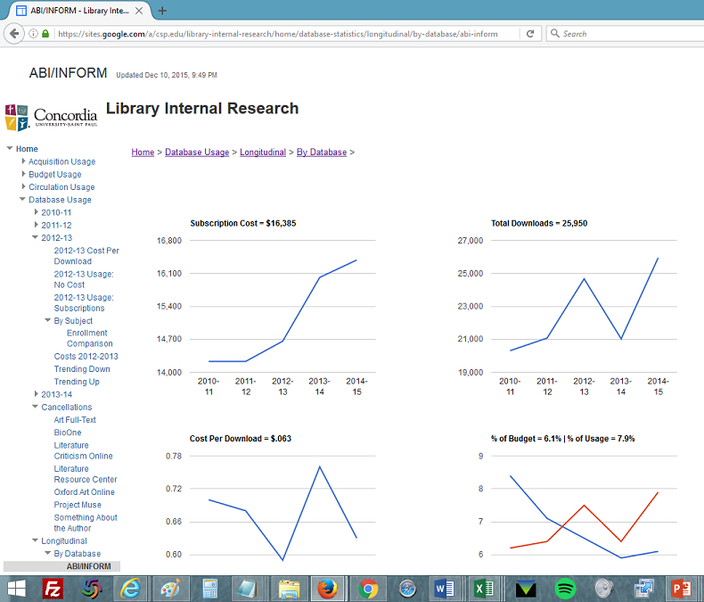
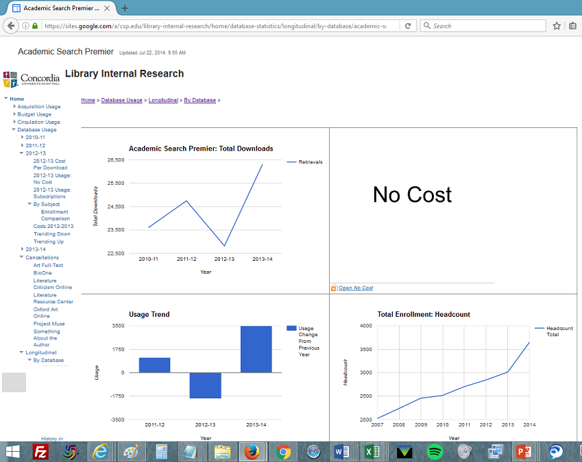
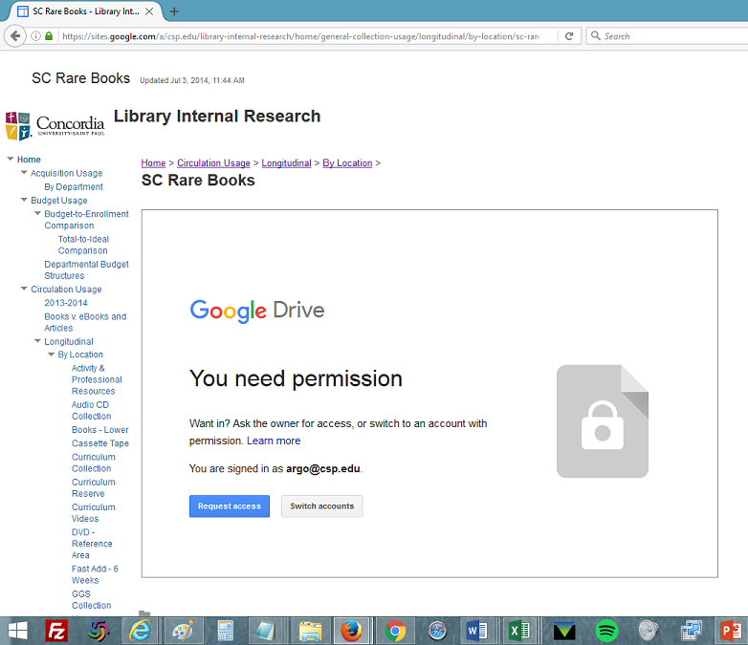
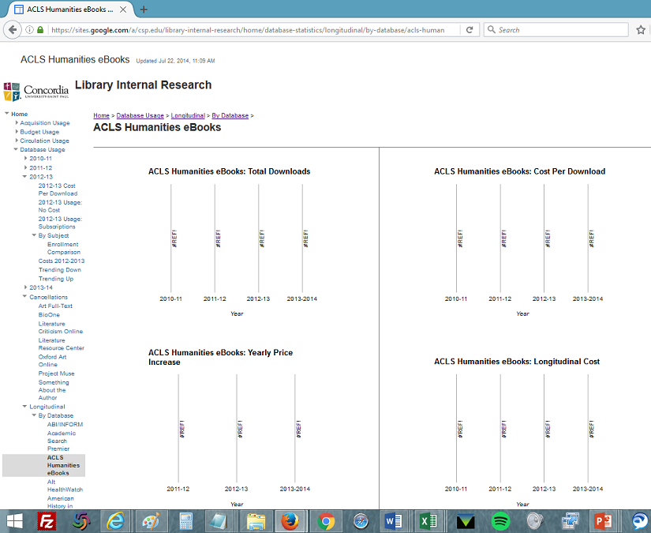
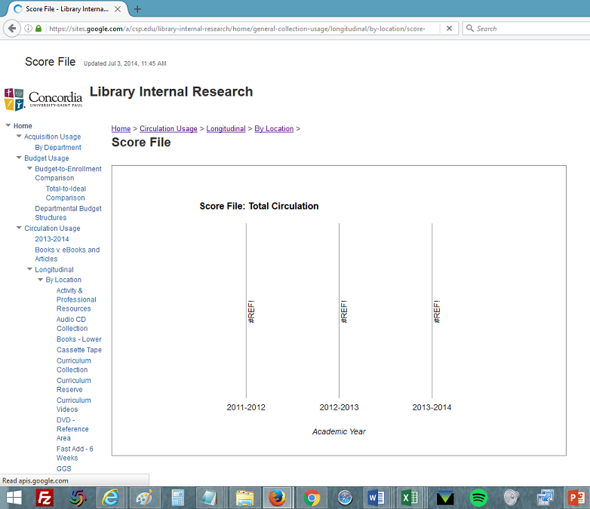
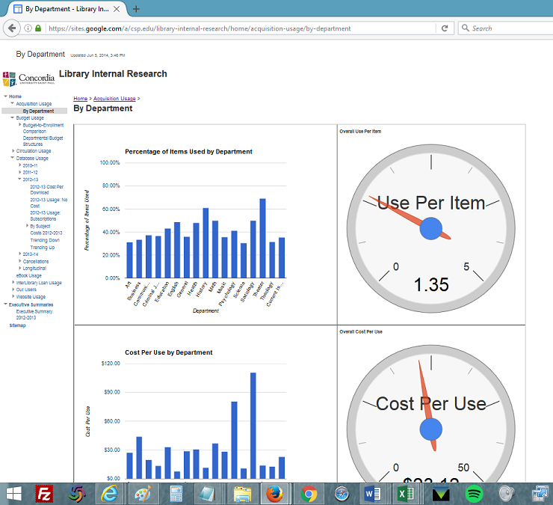
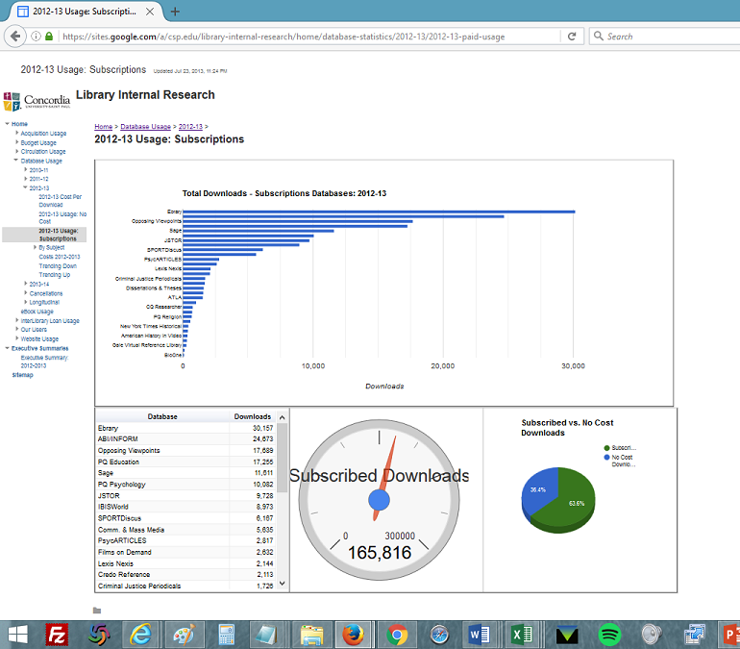
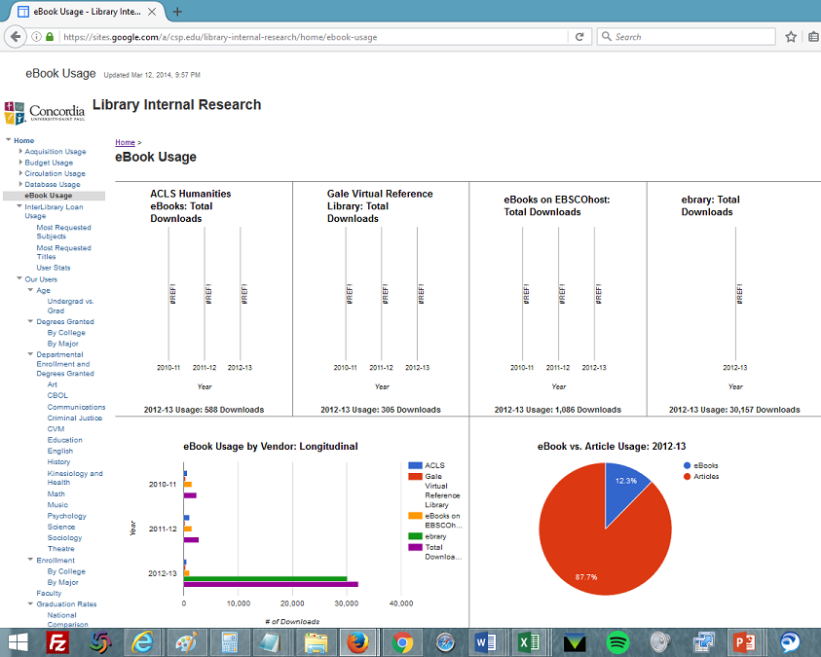
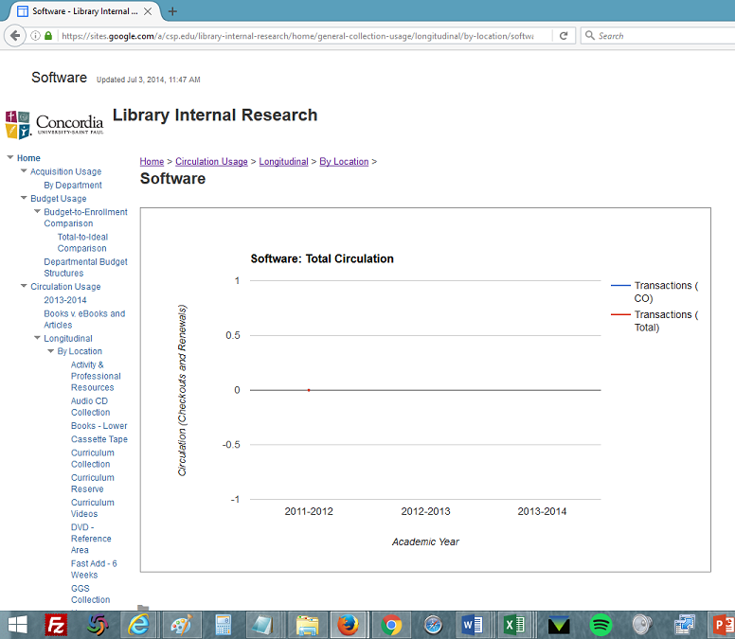
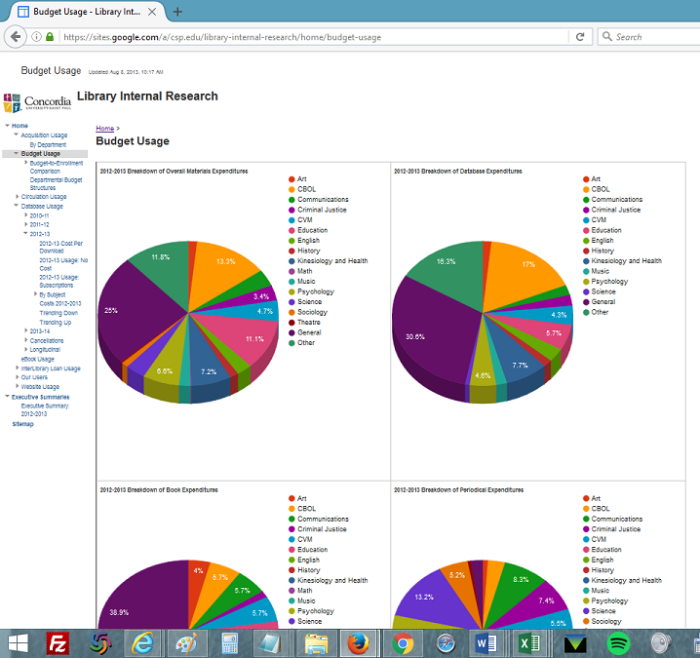
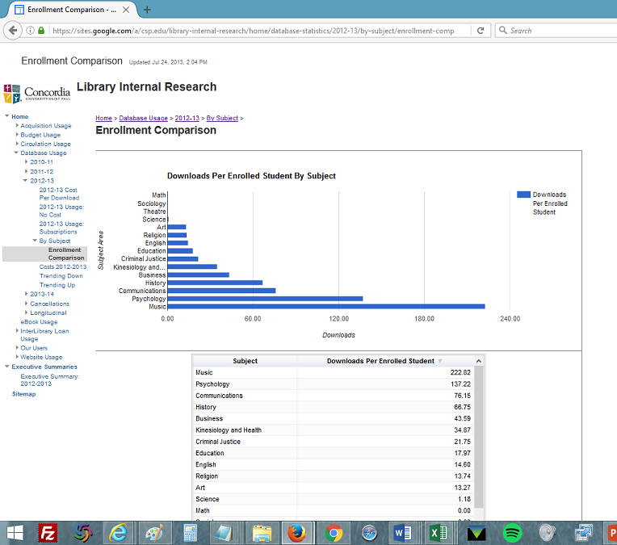
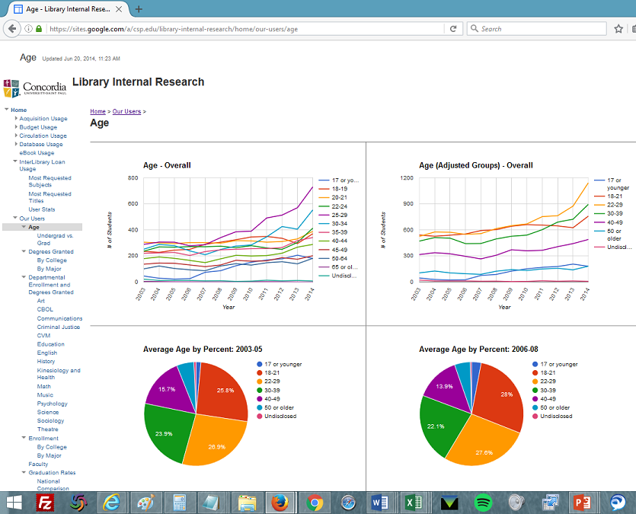
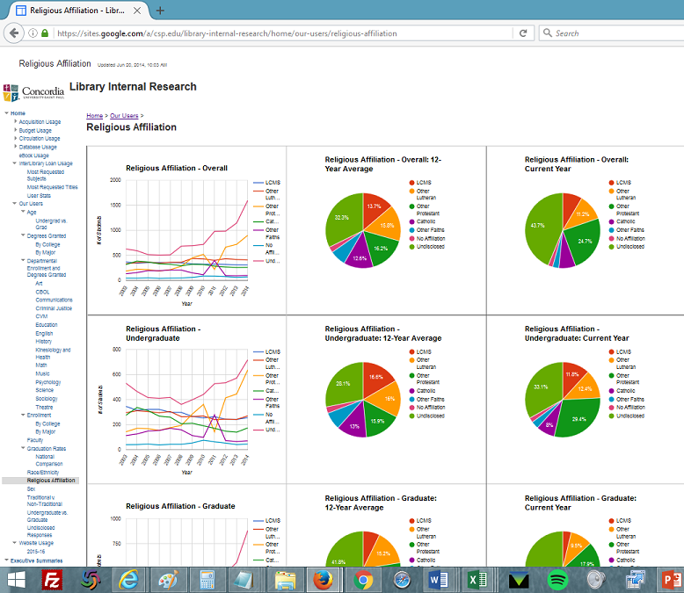
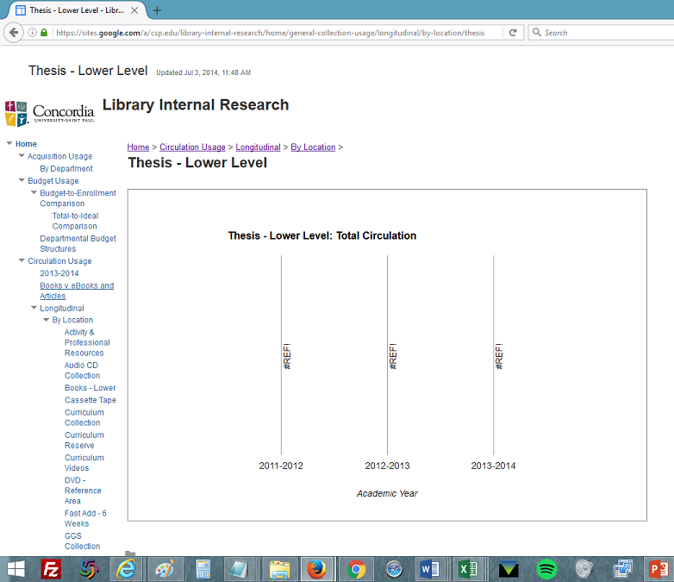
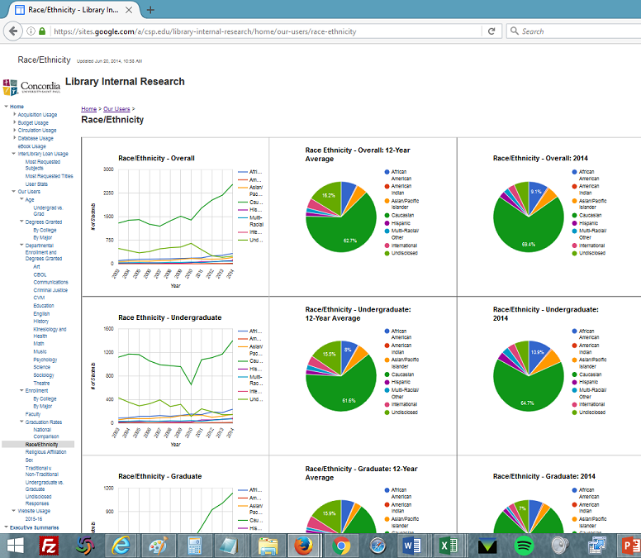
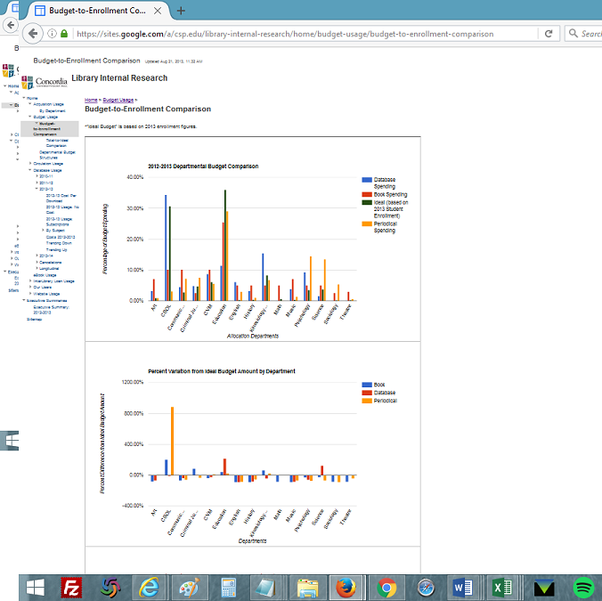
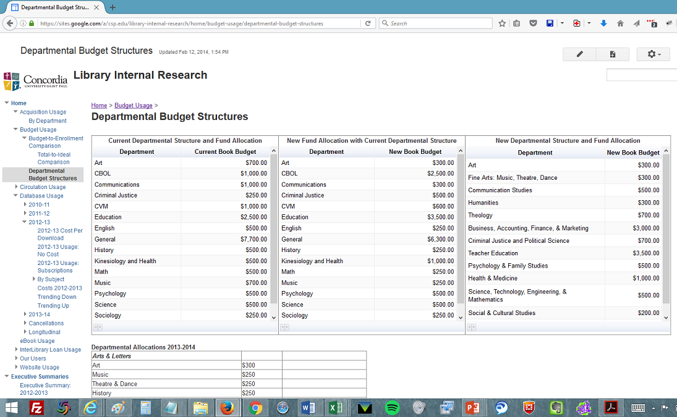
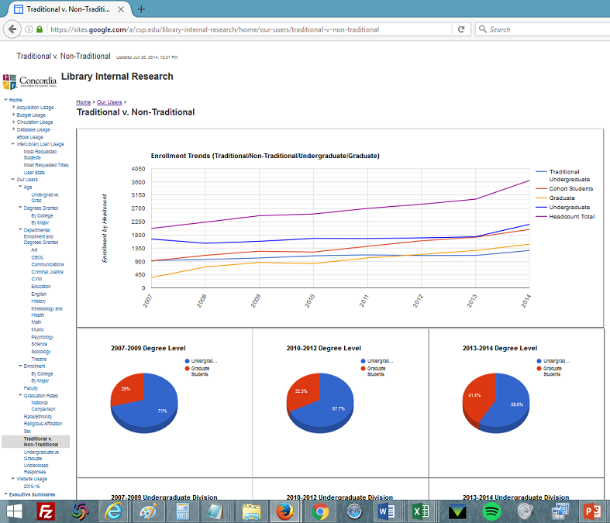
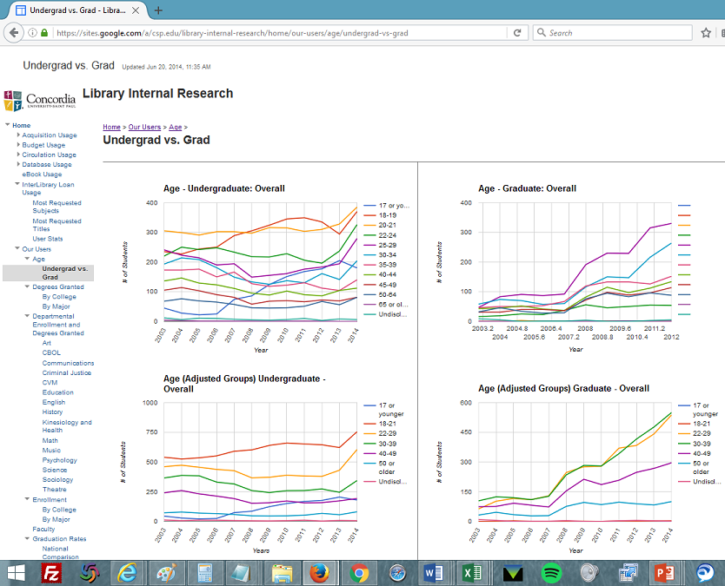
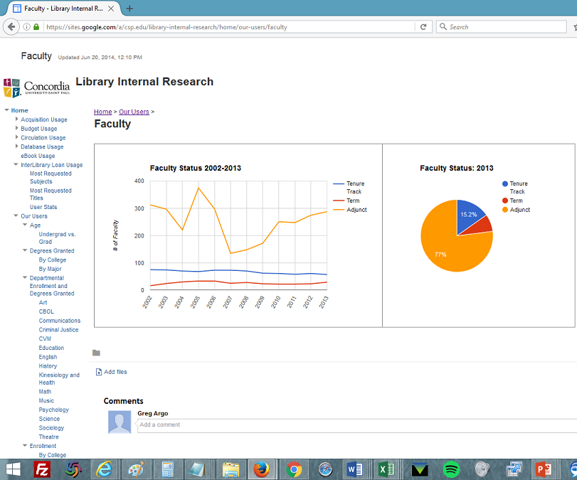
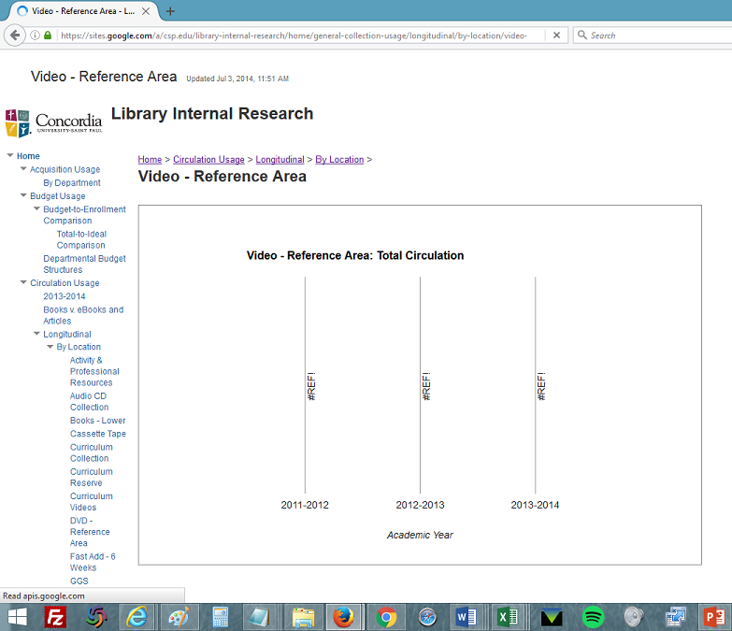
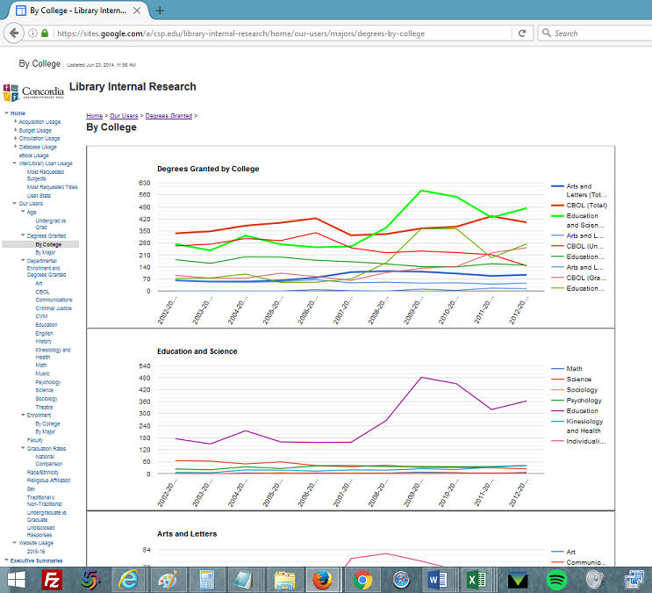
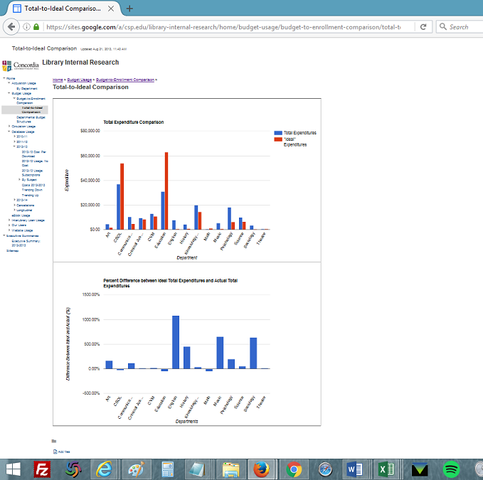
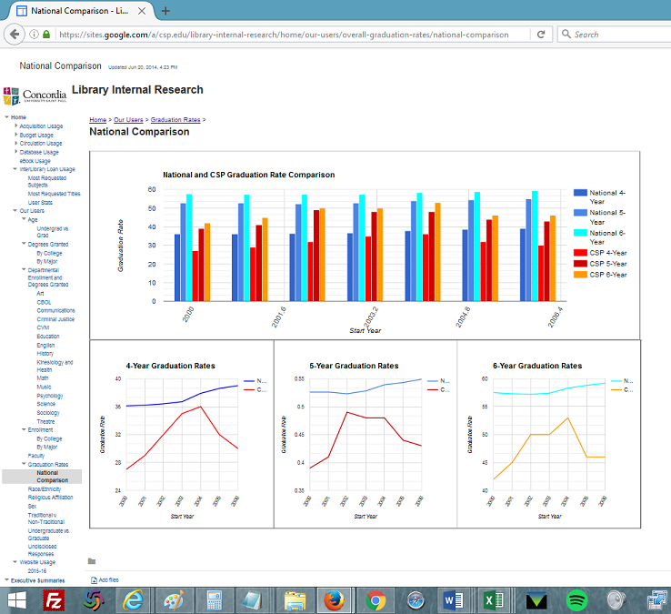
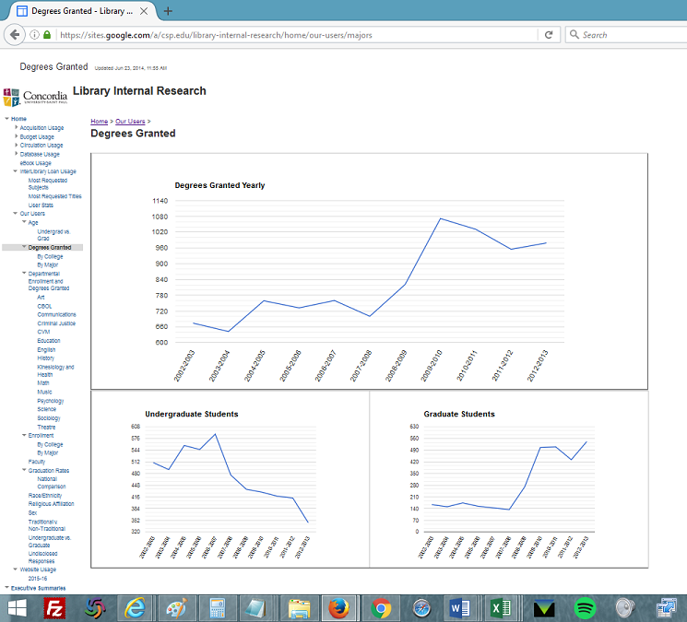
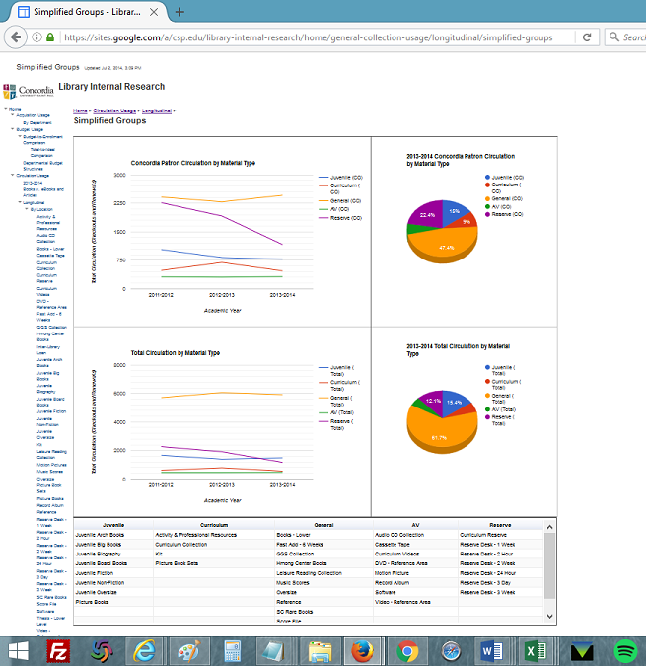
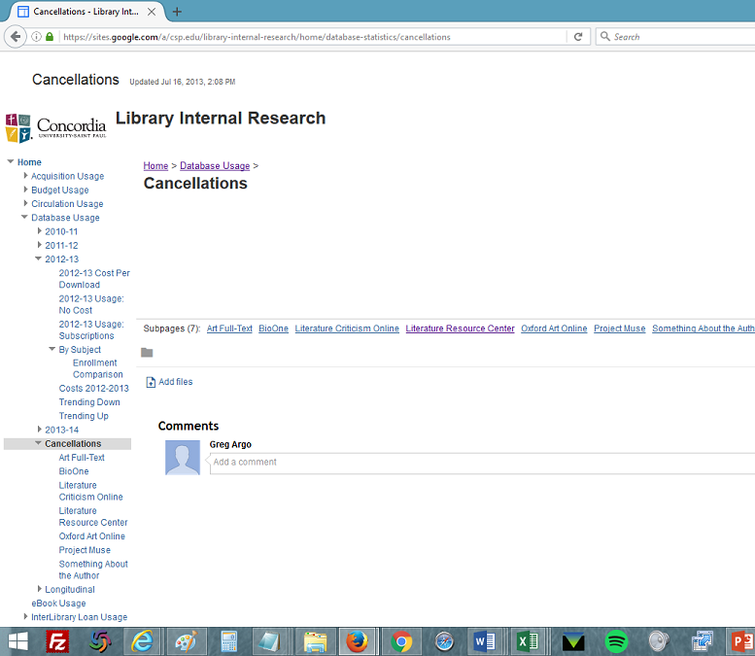
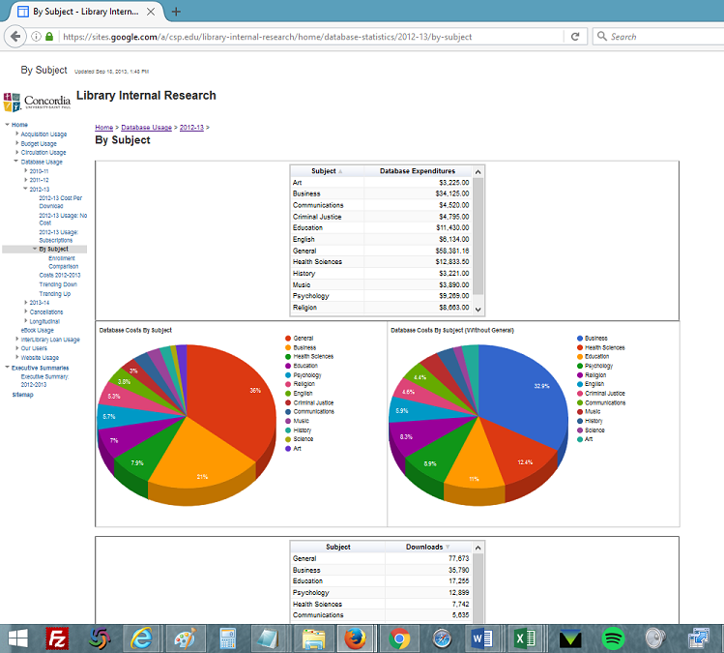
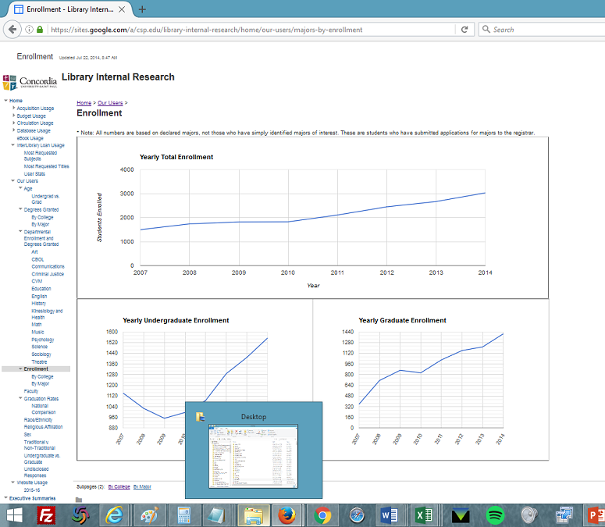
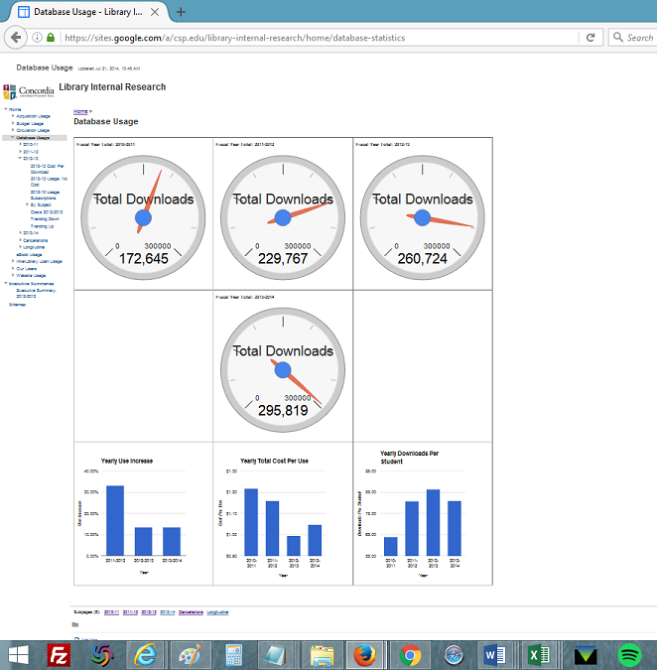
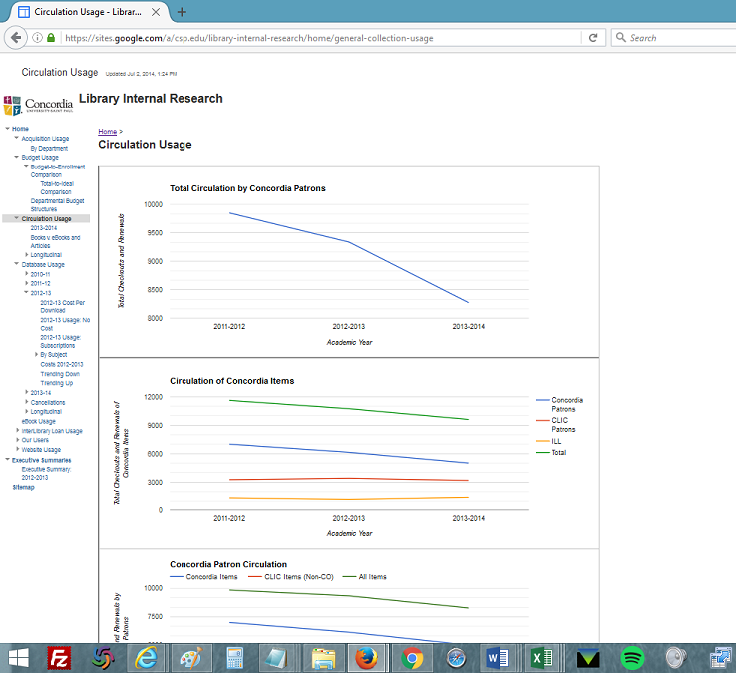
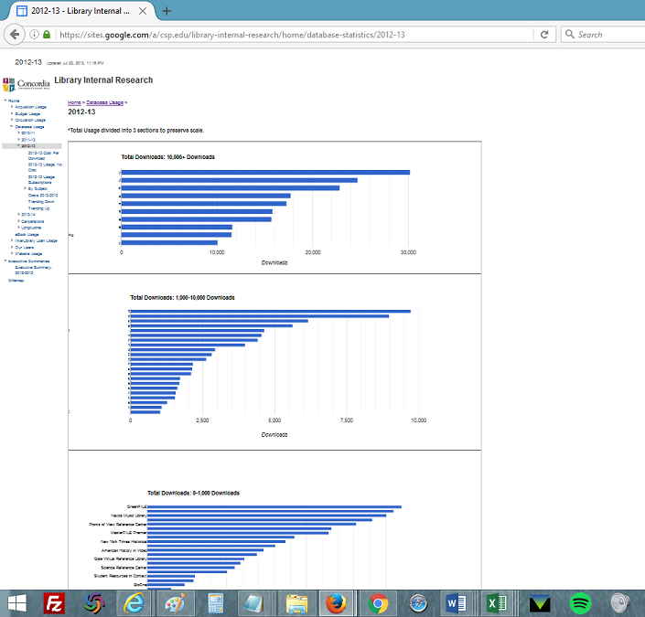
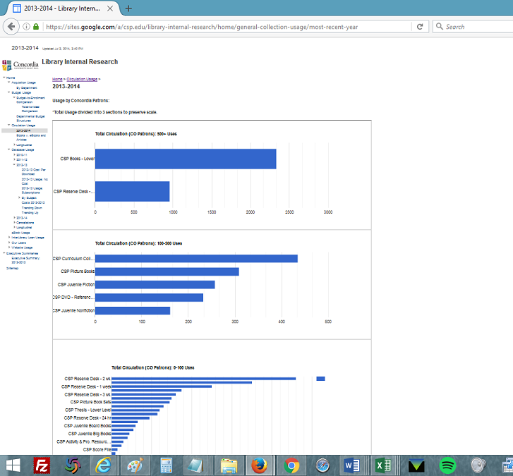
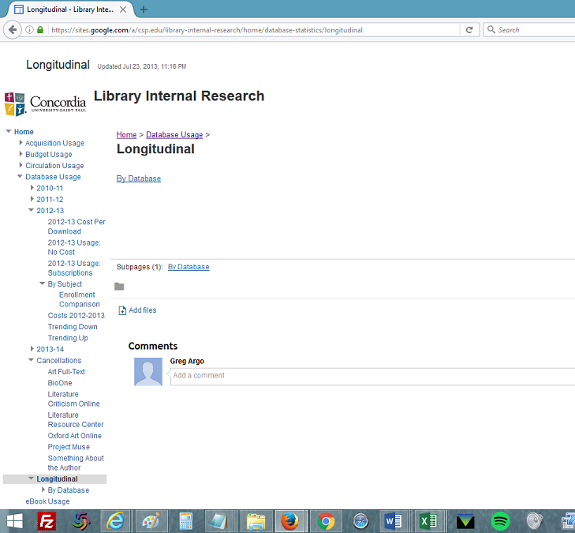
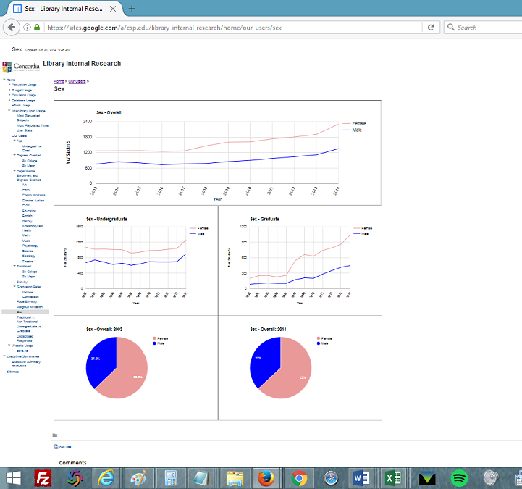
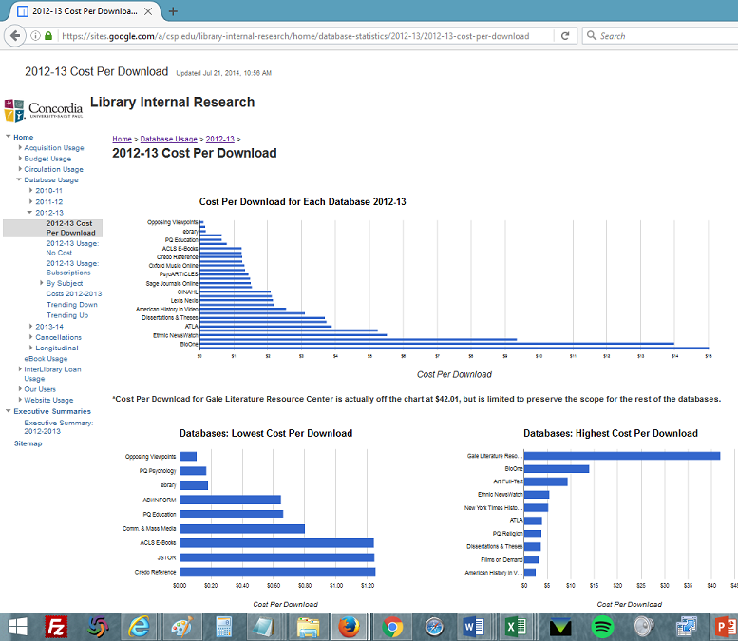
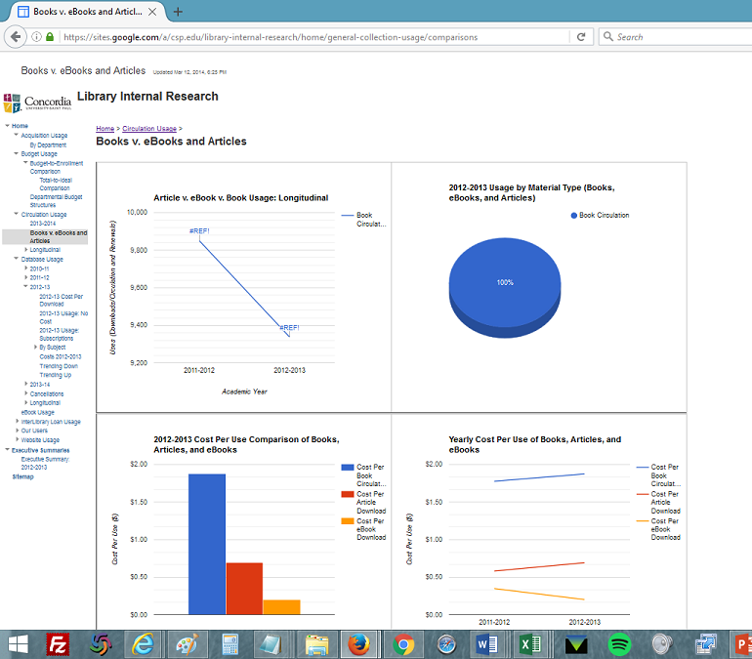
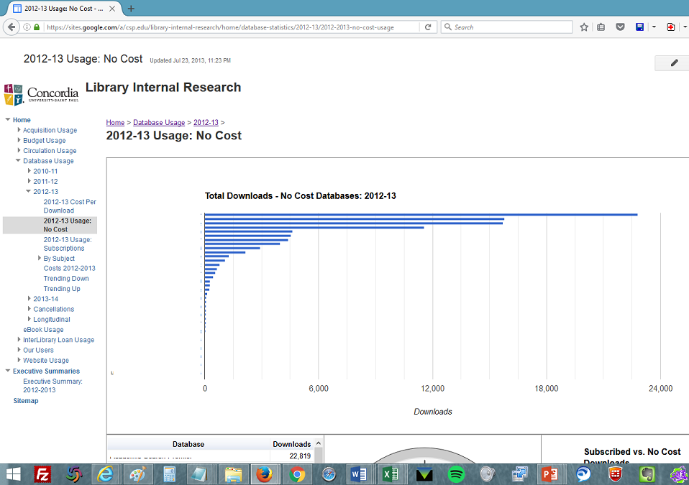
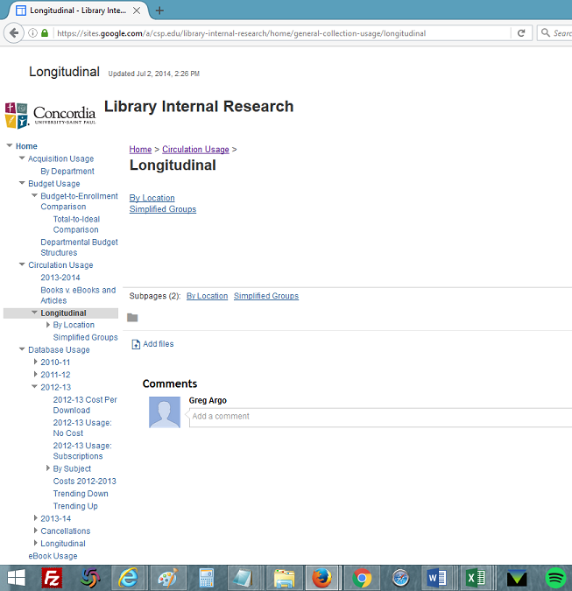
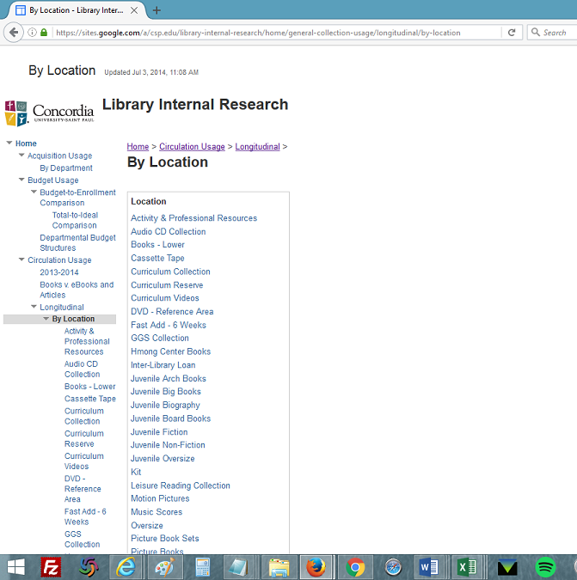
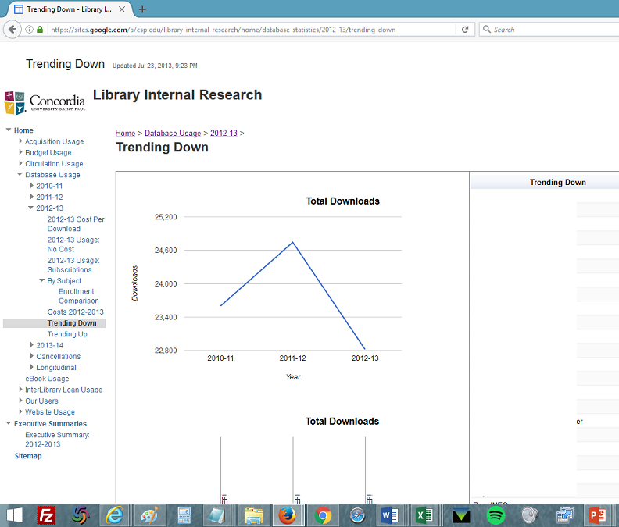
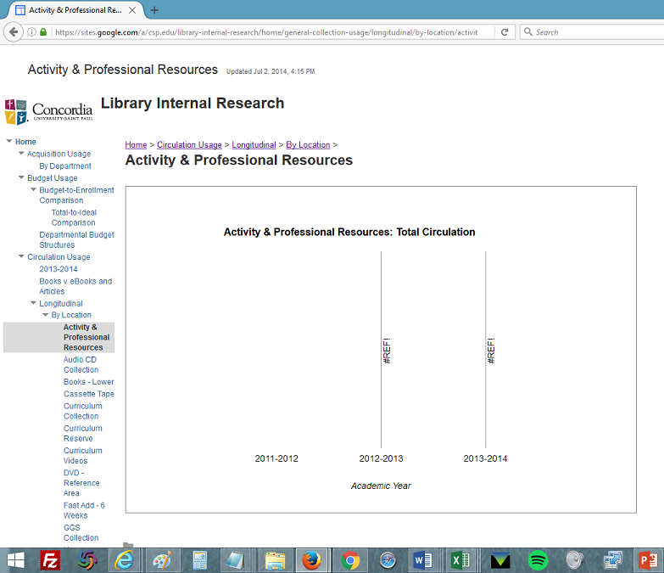
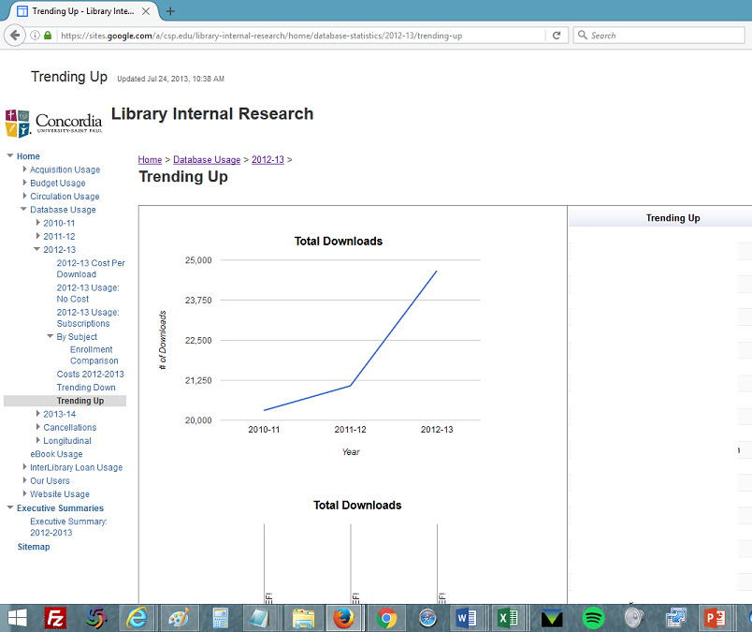
Too much-ness: 167 Web pages 472 charts 85 spreadsheets
Only 28% of the site’s pages!

Slide 14
Exposure to data
Handling data gives you confidence you know your data inside and out
Allows you to spot anomalies and recognize quality
See beyond silos
If using a standard (e.g., COUNTER), you become an expert on it

Slide 15
Overexposure to data
Navigation is difficult, even for the creator
Lack of uniformity makes sense-making difficult for audience
Lack of uniformity undermines drive for consistency for creators
Lack of uniformity creates silos in data structures
“Building and moving” requires much manual labor

Slide 16
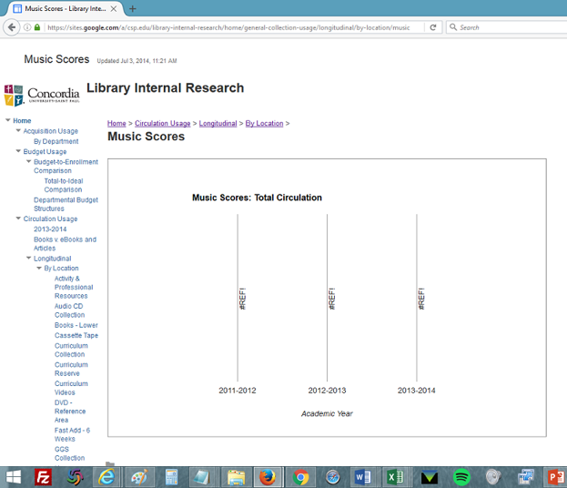
Technological degradation

Slide 17
Goals for Phase 2
Pare back to measures important for decision-making
Present data in a more user-friendly way, interactive way
Standards: Find consistency/repeatability in measures and presentation
Drive technology instead of following technology
Save time

Slide 18
Phase 2: Scripting
Allows for dynamic content on one page, e.g. filters and sorting
Transition from “building and moving” objects to make things
Frankenstein the code together using tutorials and trial and error
Minimize dependencies and special cases

Slide 19
Phase 2: Interactive and Scalable
Overall annual database analysis
Longitudinal by database
Script page

Slide 20
Challenges to sustainability: Proliferation of formats
Are we comparing apples to oranges?
Books vs eBooks vs Articles
COUNTER BR1 vs BR2
Can these be considered together?
We’re still comparing fruit

Slide 21
Challenges to sustainability: Temporal situations
How often to collect and analyze data?
How to analyze data when you have staggered renewal/cancellation periods throughout the year?
How long to let something underperform?

Slide 22
Challenges to sustainability: Technology
If we allow ourselves to be led by available technology, are we being strategic?
E.g., Analytics system which couldn’t handle multivolume works
Another vendor rep:” We need to make a mass market product.”

Slide 23
The main challenge to sustainability is choosing your scope (and sticking with it)
Companies should repeatedly ask, “What’s the least complex model that would improve your performance?”
(Barton & Court, 2012, p. 82)
Avoid technological degradation which causes painful changes in established workflows
Self-imposed limitations are necessary in era of overabundant data
Just because we can measure it doesn’t mean we should

Slide 24
Home-cooked vs. vendor-based systems
DIY vs. a system you pay for
Permanence vs. ephemerality
Native data (e.g., circulation, fund- and patron-related information)
Representation of student enrollment and demographic information
Sharing with non-library stakeholders
Is data trapped in ILS/LSP?
Home-cooked and local control encourages craftiness

Slide 25
Visual communication: Student body

Slide 26
Visual communication: Usage by format

Slide 27
Visual communication: Reference desk transactions in August 2015

Slide 28
Phase 2 database analysis: What is sustainable?
6 measures and one note field
Downloads
Cost
Cost Per Use
Percent of Total Budget
Percent of Total Usage
Trend
Notes
Longitudinal: https://goo.gl/ei6QxH
Annual Usage: https://goo.gl/fYVhar

Slide 29
Examples of things we quit doing
Creating pages for each no-cost database
Visualizations for all database usage together
Cost per download by subject
Downloads per enrolled student by subject
Separate pages for costs and usage trends

Slide 30
Phase 3
Bring on more library departments using the same data structure and same tool
Explore relationships between previously siloed data sets
Find ways to feed data back into frontline tools

Slide 31
Going forward
Knowing what is sustainable requires first knowing what is unsustainable.
Local control has drawbacks, but allows a deeper understanding of the data and more meaningful presentation of data relationships.
Presentation of data is only the first step; data analysis must lead to action in a true culture of assessment.

Slide 32
References
Barton, D., & Court, D. (2012). Making advanced analytics work for you. Harvard Business Review, 90(10), 78-83.
Davenport, T. H., & Patil, D. J. (2012). Data scientist: The sexiest job of the 21st century. Harvard Business Review, 90(10), 70-76.
Farkas, M. G., Hinchliffe, L. J., & Houk, A. H. (2015). Bridges and barriers: Factors influencing a culture of assessment in academic libraries. College & Research Libraries, 76(2), 150-169.
Lakos, A. & Phipps, S. (2004). Creating a culture of assessment: A catalyst for organizational change. portal: Libraries and the Academy, 4(3) 346-361.
*Images courtesy of Wikimedia Commons unless otherwise noted

