Slide 1
What does recent pedagogical research tell us about eLearning good practice?
Christina Petersen, PhD
Center for Educational Innovation
University of Minnesota

Slide 2
What is evidence-based pedagogy?
Research literature
Student needs
Personal experience
Adapted from Laurie Richlin

Slide 3
Use pedagogical research findings to:
Reflect on your current teaching practices
Provide support for your teaching approaches to students, colleagues, or administrators
Come up with new ideas for your teaching
Identify areas for personal SoTL research
Research literature
Student needs
Personal experience

Slide 4
What I won’t talk about

Slide 6
USDOE study 2010
Online learning – learning that takes place partially or entirely over the Internet
Contrast Online to F2F or Hybrid to F2F
Criteria for inclusion
Significant use of the Web for instruction (25%)
Objective learning measure as the outcome
Higher quality study design – controlled or quasi-experimental design

Slide 7
USDOE study 2010
1,318 articles
176 met all 3 criteria for inclusion
99 contrasted either online or hybrid to F2F
50 had enough data to extract an effect size

Slide 8
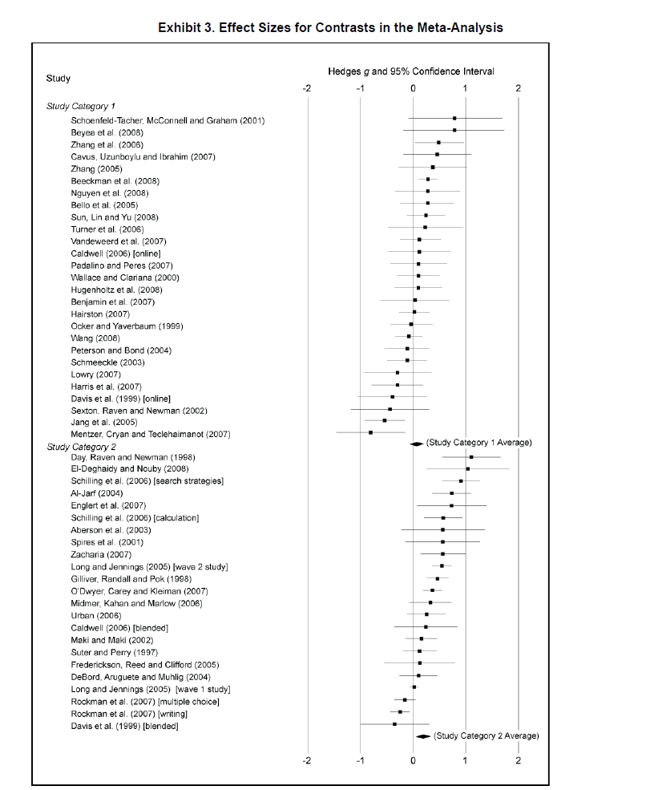
Classes with online learning on average produce stronger student learning outcomes than do classes with solely face-to-face instruction effect size of + 0.2

Slide 9
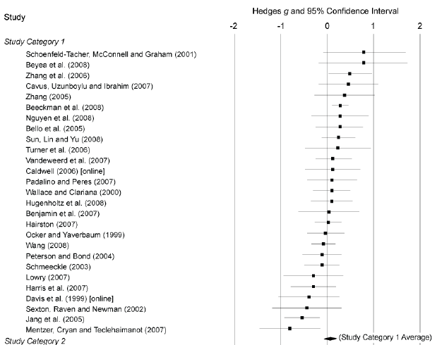
Classes taught completely online had a +0.05 effect size when compared to face-to-face classes

Slide 10
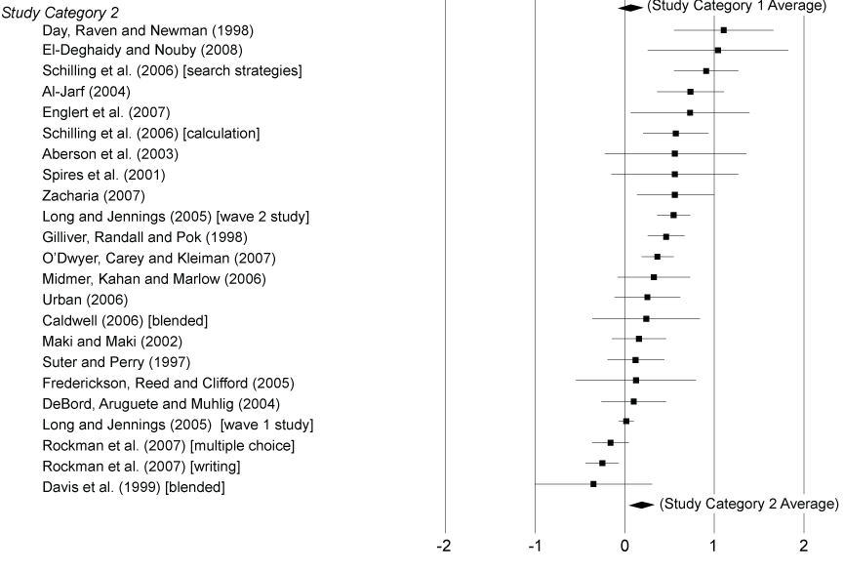
Classes taught partially online had a +0.35 effect size when compared to face-to-face classes

Slide 11
Authors’ conclusions
The findings…“should not be construed as demonstrating that online learning is superior as a medium. Rather it is the combination of elements in the treatment conditions, which are likely to include additional learning time and materials as well as additional opportunities for collaboration, that has proven effective.”

Slide 12
Authors’ recommendation
“These results do not support simply putting an existing course online, but….redesigning instruction to incorporate additional learning opportunities online.”

Slide 13
The study also looked at specific course activities that improved student outcomes
10 of 12 studies found that experimental manipulations that triggered student reflection offered advantages over online learning that did not provide a trigger for reflection.

Slide 14
Effectiveness of Fully Online Courses for College Students: Response to a Department of Education Meta-Analysis, Community College Research Center, S. S. Jaggars & T. Baily, 2010
Concerns about the population of students represented in the studies not representing community colleges

Slide 15
Study of Washington community colleges
Examining the Effectiveness of Online Learning Within a Community College System: An Instrumental Variable Approach, D. Xu & S. S. Jaggars, Community College Research Center, 2013

Slide 16
Study of Washington community colleges
 | Online | Face-to-face
Persistence rate | 91% | 94%
Final grade | 2.54 | 2.68
n = 21,989

Slide 17
Author conclusion
“…researchers need to empirically identify high-quality online courses, as well as strategies that contribute to stronger student learning and performance outcomes in an online learning environment.”

Slide 18
How Video Production Affects Student Engagement: An Empirical Study of MOOC Videos, P.J. Guo, J. Kim & R. Rubin, L@S 2014, 2014

Slide 19
Research question:
What are the factors that influence student engagement* with videos in MOOCs?
*Engagement
How long do students watch a video?
Do students attempt to answer post-video assessment problems?

Slide 20
Study design
Video data from 4 different MOOCs
n = 6.9 million
+
Interviews with 6 course designers
Recommendations for video production

Slide 21
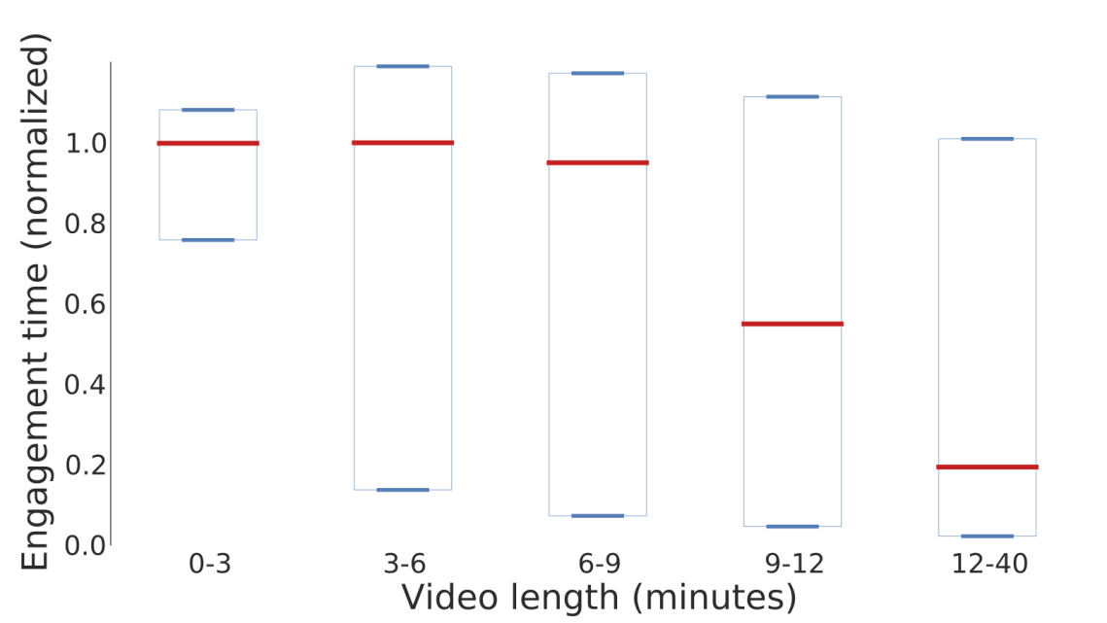
The optimal engagement time is 6 minutes or less
Normalized data
n = 6.9 X 10⁶

Slide 22
Other findings:
A close-up head shot is more engaging than speaking from a podium
Tablet drawing is more engaging than PowerPoint slides
Separate videos are more engaging than chopped-up lectures
Students engaged the most with fast-speaking instructors

Slide 23
Recommendations based on a summary of the results:
Segment videos into chunks shorter than 6 minutes
Display the instructor’s head at opportune times
It’s okay to film in an informal setting

Slide 24
Recommendations based on a summary of the results:
4. Introduce motion, visual flow, and extemporaneous speaking
5. Avoid pre-recorded classroom lectures
6. Coach for enthusiasm and not-too-slow speaking

Slide 25
How do online course design features influence student performance? S.S. Jaggars & D. Xu, Computers and Education (2016)

Slide 26
Study research question:
Among design features that have a significant impact on student course learning outcomes, what practices and techniques are typical of “higher quality” versus “lower-quality” online courses?

Slide 27
Study design
23 online courses at 2 community colleges
678 Students
Course organization
Learning objectives & assessments
Interpersonal interaction
Technology
Evaluate each category
Compare to final grades in the course

Slide 28
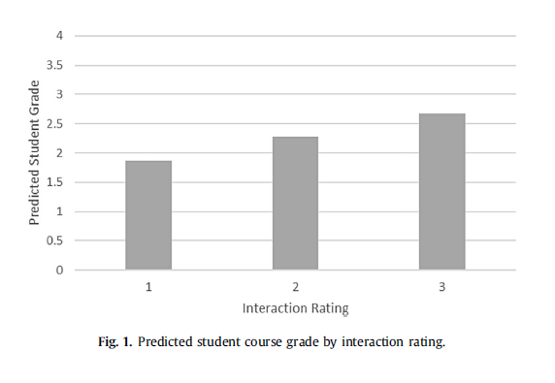
Higher interaction ratings (only) correlated with higher grades

Slide 29
Focus groups asked students for examples of “good” student-instructor interaction
Instructors:
Post frequently
Invite student questions through a variety of modalities
Respond to student questions in a timely manner
Solicit and incorporate student feedback
Cared about the course and the students’ performance

Slide 30
Authors’ conclusion
“Our results…lend support to creating more interactive opportunities within fully-online courses.”

Slide 31
The Impact of Findability on Student Motivation, Self-Efficacy, and Perceptions of Online Course Quality, B. Simunich, D.B. Robins & V. Kelly, The American Journal of Distance Education, (2015).

Slide 32
Research question:
How does course findability* correlate with student self-efficacy, motivation, and overall impression?
*Findability - the ease of locating instructions for getting started, the learning objectives, and the grading policy of the course

Slide 33
Study design
Control Course A | Control Course B
Low Findability Course A | Low Findability Course B
Course Type 1
Course Type 2
n = 81 students randomly assigned to one of the four groups

Slide 34
Students report lower levels of self-efficacy after interacting with low findability courses
Pretest self-efficacy score
Posttest self-efficacy score
Control Courses A & B | 23.3 ±2.6 | 23.6 ±2.6
Low Findability Courses A & B | 24.1 ±2.8 | 20.6 ±5.0
Self-efficacy scores range from 7 - 38

Slide 35
Students participating in high findability courses had better “experiences”
Experience question | Control Courses | Low Findability Courses
“Enjoyed the experience” | 3.8 ± 0.8 | 2.6 ± 1.1
“Would recommend course to friends” | 3.8 ± 1.0 | 2.5 ± 1.1
“Course instructor would be good” | 3.9 ± 0.9 | 2.8 ± 0.9

Slide 36
Authors’ Conclusion
“…this study lays the groundwork for demonstrating the importance of good navigation…”

Slide 37
Recommendations based on the results:
Create minimal guidelines for findability
Use chunking to group navigation items into logical categories
Use specific language (rather than file name)
Place links in logical locations
Don’t deeply bury content (3 click rule)
Use visual contrast among page elements

Slide 38
Summary

Slide 39
Design elearning courses that:
Don’t simply put an existing course online, but redesign instruction to incorporate online learning activities
Incorporate multiple opportunities for students to interact with the instructor and with other students
Introduce activities that require student reflection on the course material

Slide 40
Create engaging videos by:
Keeping the length to 6 minutes or less
Displaying the instructor’s head at opportune times; informal settings are OK
Introducing motion, visual flow, extemporaneous speaking, and instructor enthusiasm
Avoiding pre-recorded classroom lectures and speaking too slowly

Slide 41
Make courses findable by:
Grouping items into logical categories
Using specific language
Placing links in logical locations
Using visual contrast among page elements
Not deeply burying content

Slide 42
Research literature
Student needs
Personal experience

Slide 43
Articles & Reports Referenced
Evaluation of Evidence-Based Practices in Online Learning: A Meta-Analysis and Review of Online Learning Studies, U.S. Department of Education (2010).
Effectiveness of Fully Online courses for College Students: Response to a Department of Education Meta-Analysis, Jaggers, S.S. & Bailey, Community College Research Center (2010).
Examining the Effectiveness of Online Learning Within a Community College System: An Instrumental Variable Approach, Xu, D. & Jaggars, S.S., Community College Research Center (2013).
How do online course design features influence student performance? Jaggars, S.S. & Xu, D., Computers and Education, 95, 270-284 (2016).
How video production affects student engagement: an empirical study of MOOC videos, Guo, P.J., Kim, J., Rubin, R. L@s (2014).
Online Report Card: Tracking Online Education in the United States, Allen, I.E., Seaman, J., Poulin, R. & Straut, T.T. Babson Survey Research Group and Quahog Research Group (2016).
The impact of findability on student motivation, self-efficacy, and perceptions of online course quality, Simunich, Robins, & Kelly, The American Journal of Distance Education (2015).

