Slide 1
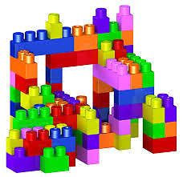
What’s Next for the LMS? From Walled Gardens to Open EcoSystems
Lesley Blicker, Director of LMS Learning and Next Generation Technology
Educational Innovations, MN STATE
Lesley.blicker@so.mnscu.edu

Slide 2
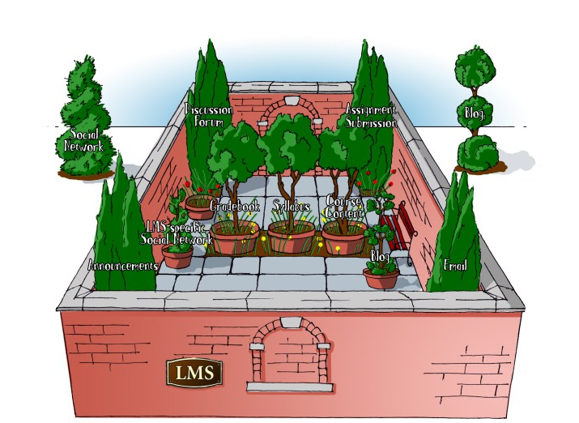
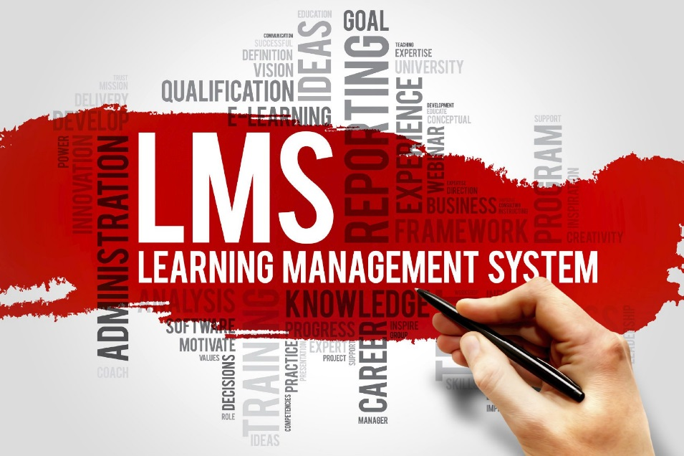
The Notion of Walled Gardens (LMS 1.0/2.0)
Notes:
Most of the current LMS systems were designed under the assumption that what happens in the course must stay in the course. As a result, within the LMS, the course is a private community—a walled garden.
This phrase has come to represent closed information technology systems or virtual spaces inaccessible to outsiders
Instructor and course-centric. One size fits-all architecture.

Slide 3
Michael Stephens Beyond the Walled Garden: Students in an Era of Participatory Culture
The garden is safe from outside influences and those inside can flourish if tended.
But the wall is also a barrier to outside participation. If students spend all of their time in a classroom or within the virtual walls of a closed learning management system (LMS), the potential benefits of accessing and experiencing their forthcoming professional environment will decrease.
There will always be a place for the classroom and the LMS, but balancing that environment with experience beyond the walled garden should be part of the learning process as well.
Source: Beyond the Walled Garden: LIS Students in an Era of Participatory Culture by Michael Stevens. SJSU Scholar Works, 2011.

Slide 4
Michael Feldstein on the LMS
Current LMS model likened to seats bolted to the floor and how the room is arranged.
Spaces we create for fostering learning matters and to the degree possible, technology platforms should get out of the way and avoid dictating choices.
Technology should enable choices that humans make, not the other way around.
Access privileges design particular ways of working together. Both protective and restrictive.
Faculty don’t come to the table with ideas of what could be, but fears of what they might lose, or checklists of feature enhancements to the basic same LMS properties
But while they still have walls, LMSs today do have “windows” via the IMS LTI standard.

Slide 5
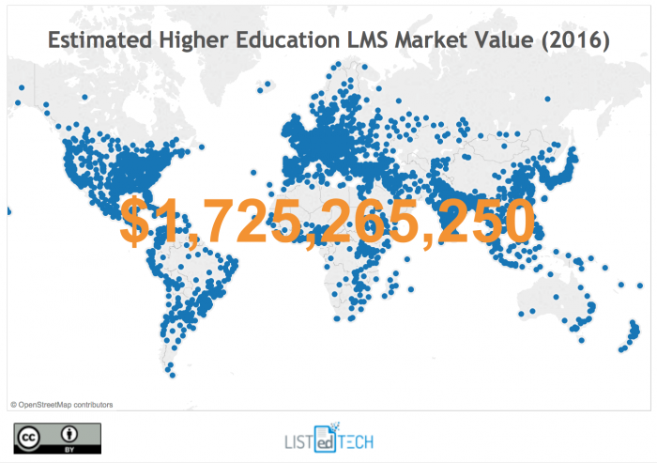
The LMS Business – Higher Ed
Notes:
ListEdTech It’s a 1.7 billion dollar business globally. 99% of institutions have an LMS. 85% of faculty use one. 83% of students use one.

Slide 6
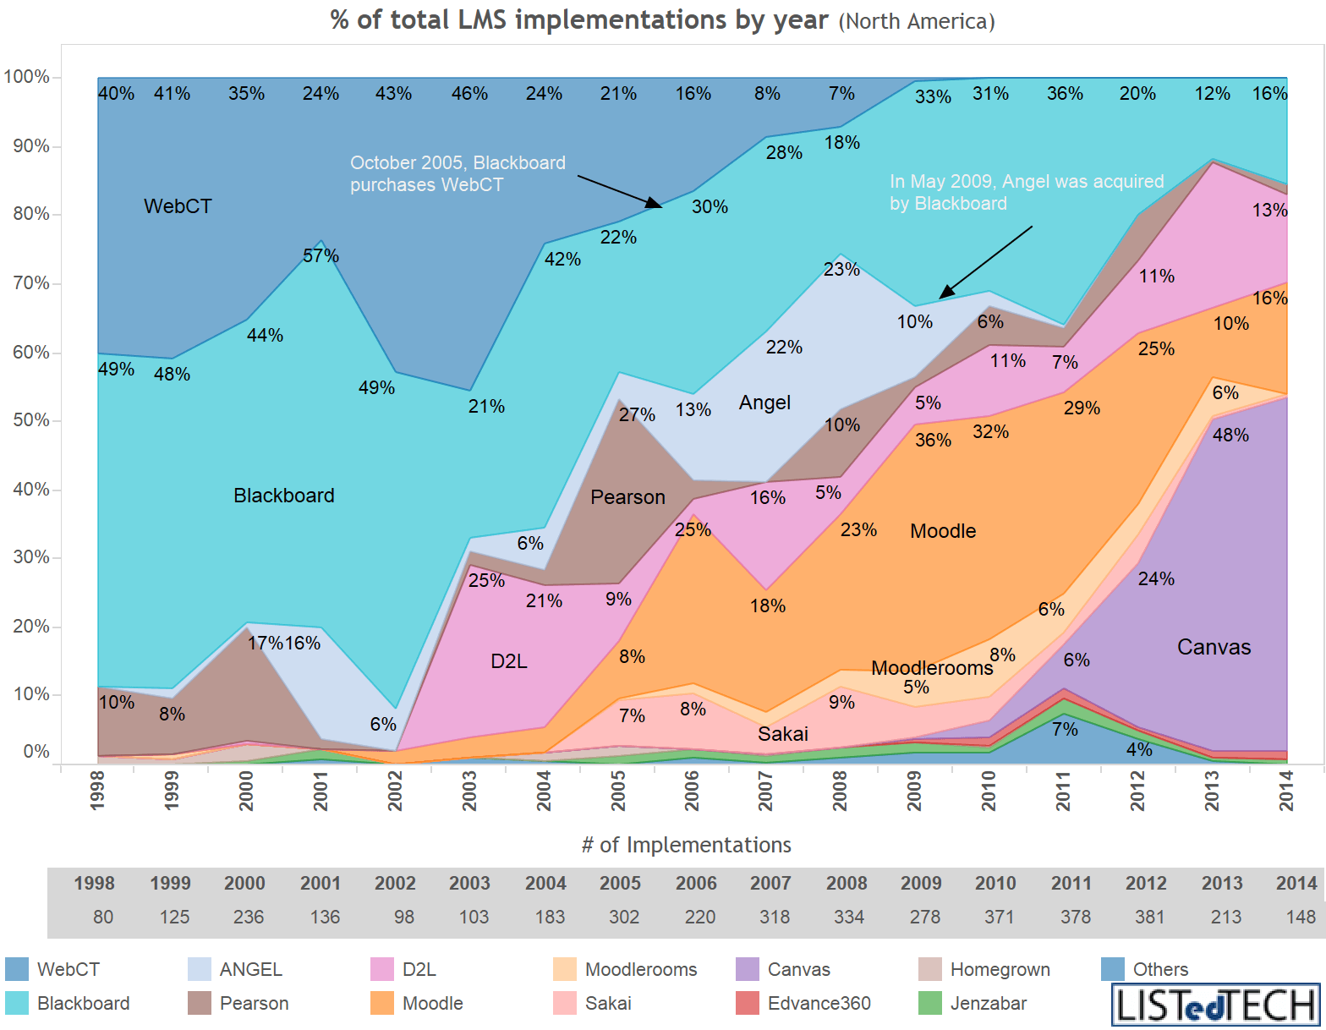
Current LMS Vendors – Higher Ed
Notes:
ListEdTech
Blackboard has dominated the higher ed market since data was first collected in 2002. But their overall market share is now declining. Canvas seems to be the new favorite for adoption.
Little variation in satisfaction ratings for different LMS vendors. Vendors are developing all functionality in the cloud.
Canvas – Speedgrader, can share your course with the world, EduApps Center

Slide 7
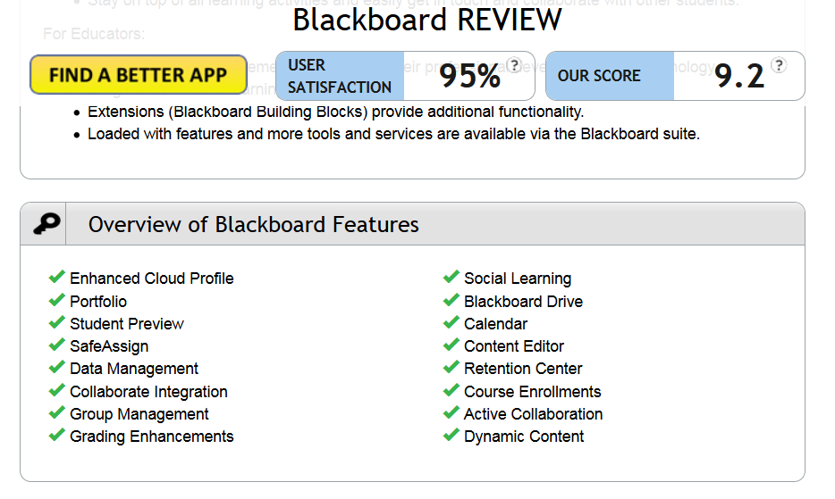

Slide 8
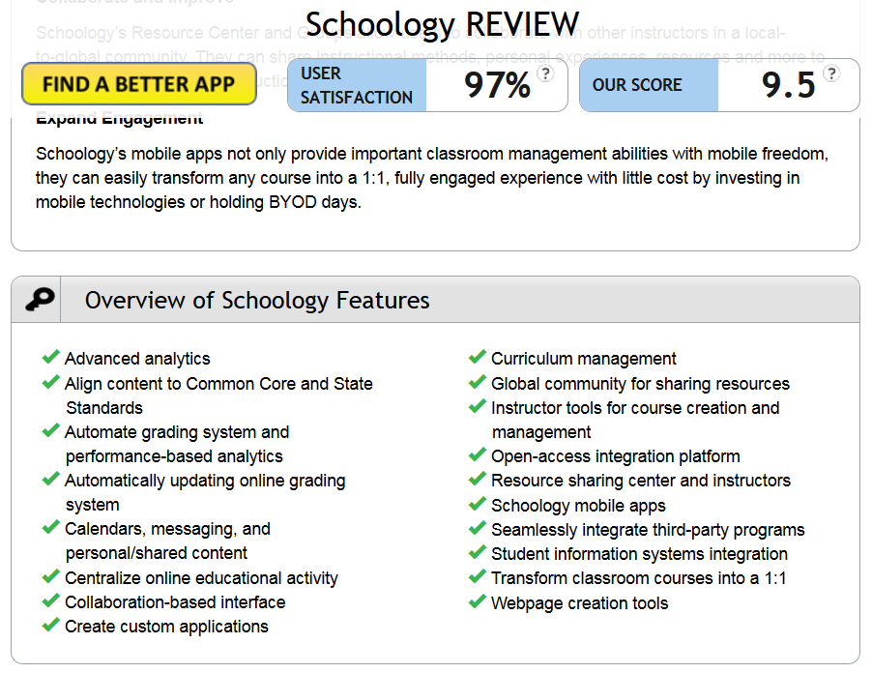

Slide 9
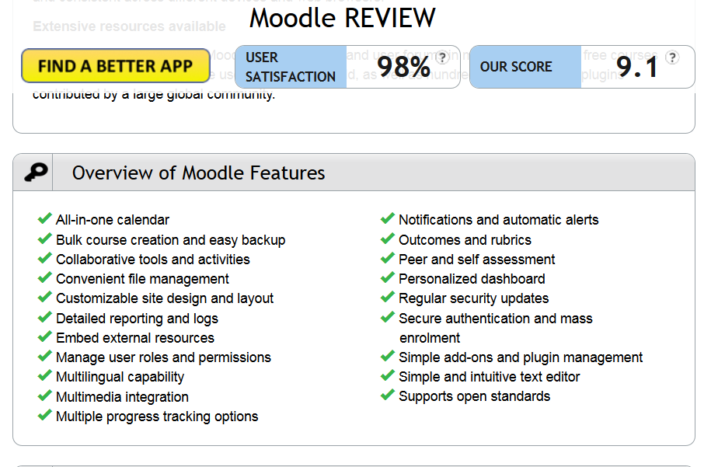

Slide 10
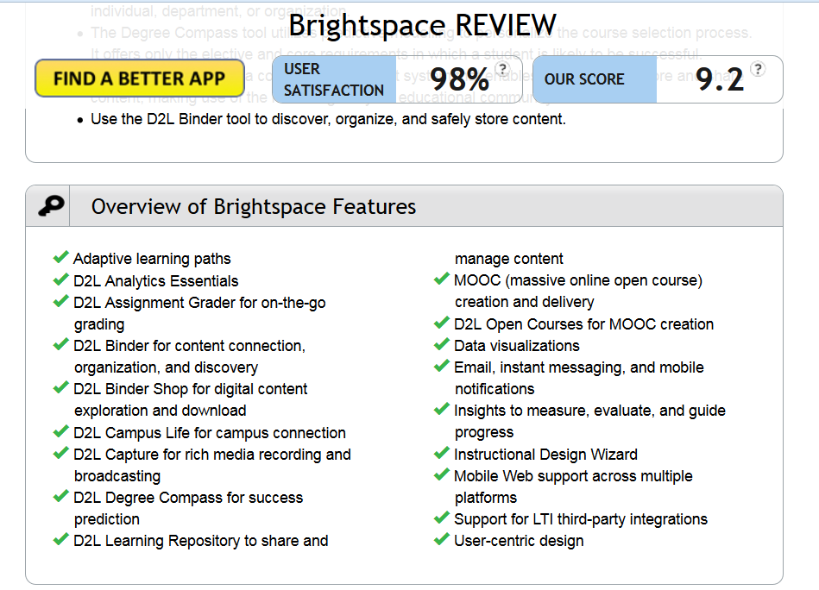

Slide 11
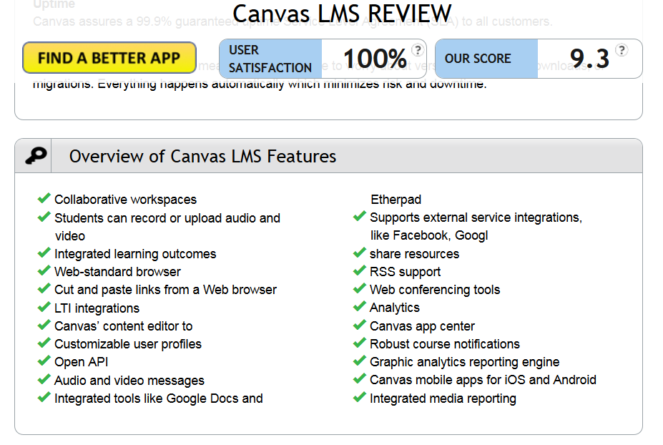

Slide 12
So What’s Next?
Notes:
Terms such as LMS 3.0 or LMS in a post-LMS world abound. Restlessness with the LMS is conspicuous. Despite the high percentages of LMS adoption, relatively few faculty use the more advanced features or use it consistently across programs.
What is clear is that it enables administration of a class, but less enables learning itself. What is Next Generation Learning? Needs to support this.
The notion of building from scratch is reaching obsolescence. We can’t expect new LMS products to appear in the near horizon that are fantastically different. And those that did build in a way that they said was vastly different? The legacy systems are re-architecting and they are nearly all caught up with each other.

Slide 13
Before We Look at the Next Generation Digital Learning Environment, First We Have to Ask: What is
What does it mean for students and for faculty?
Notes:
What does next generation look like?
Example:
Plug & play digital resources, learning tools, real-time analytics, competencies, mobile – responsive design, gamification and badging
Or project-based learning

Slide 14
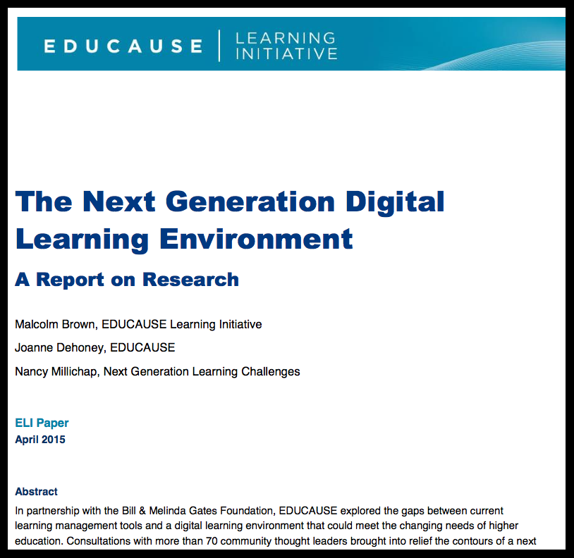
The Next Generation Digital Learning Environment (NGDLE)
Notes:
ELI Paper (Educause) in partnership with the Bill and Melinda Gates Foundation. Explored the gaps between current learning management tools and a digital learning environment that could meet the changing needs of higher education. Consultations with 70 thought leaders.
April 2015, Malcolm Brown, Joanne Dehoney, Nancy Millichap

Slide 15
Main Conclusion for the NGDLE - It’s More than an LMS
“An early conclusion from our research is that although the NGDLE might include a traditional LMS as a component, it will not itself be a single application, like the current LMS or other enterprise applications. Rather the NGDLE will be an ecosystem of sorts.”

Slide 16
EcoSystem
Componentry
Lego approach –interlocking pieces that work together
New architectures that support a digital confederation

Slide 17
The Five Core Functional Dimensions of the NGDLE
Interoperability and Integration
Personalization
Analytics, Advising, and Learning Assessment
Collaboration
Accessibility and Universal Design

Slide 18
1. Interoperability and Integration
Plug & play digital resources – components have to accept and exchange curricular content in common formats
Tools have to be easy enough to add
Unimpeded exchange of data (gradebook integration)
Understanding of interoperability standards (LTI, Caliper)
Notes:
Have to ensure that content can be exchanged, transferred and utilized.
Tools – ebook, publisher material, SoftChalk – might be separate quizzing tool, so want that smooth exchange of data in a secured manner.
Caliper – interoperability standard for Analytics. Sponsored in part by the Bill and Melinda Gates Foundation; group of developers led by D2L, Elsevier, Intellify Learning, Learning Objects, McGraw-Hill Education, Penn State University, and the University of Michigan

Slide 19
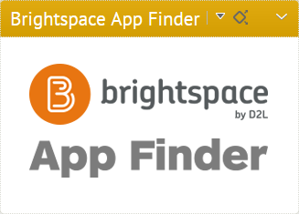
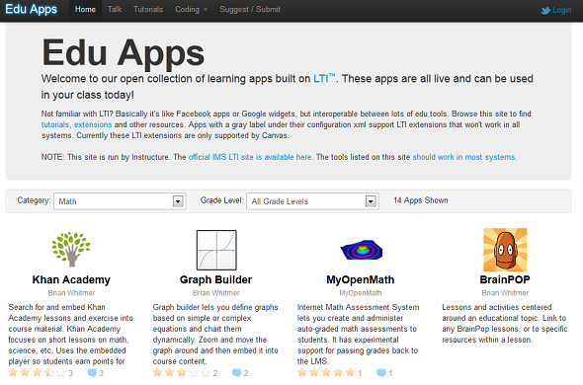
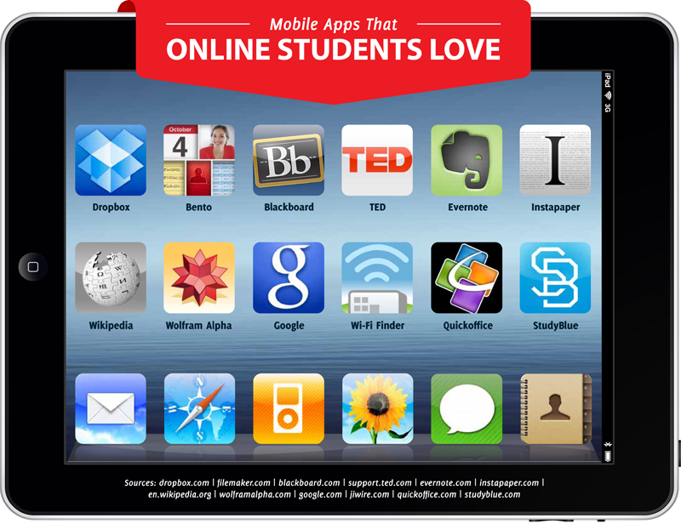

Slide 20
https://youtu.be/YJ7Yw8xBVIw?list=PLC0A574871BE1850A
IMG Global Consortium
Notes:
Add Caliper

Slide 21
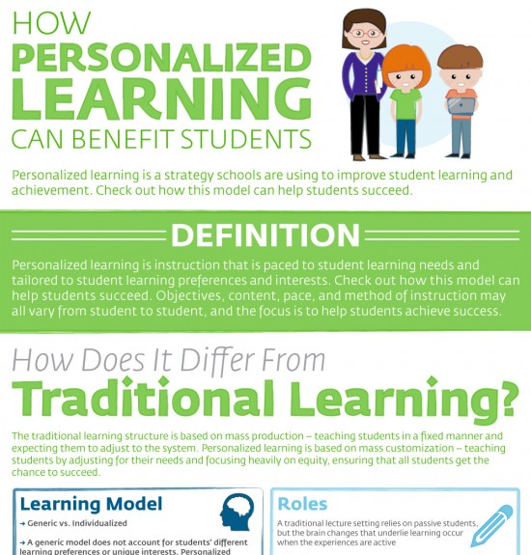
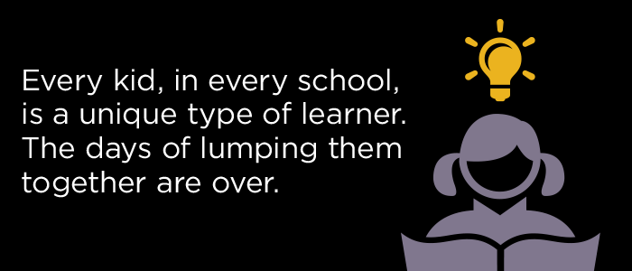
2. Personalized Learning
Personalized learning is intended to facilitate the academic success of each student by first determining the learning needs, interests, and aspirations of individual students, and then providing learning experiences that are customized—to a greater or lesser extent—for each student.
Notes:
Seen it more in the K-12 System
Learner profiles – learning styles, preferences
Competency-based progression
Individualized learning path
Flexible learning environments

Slide 22
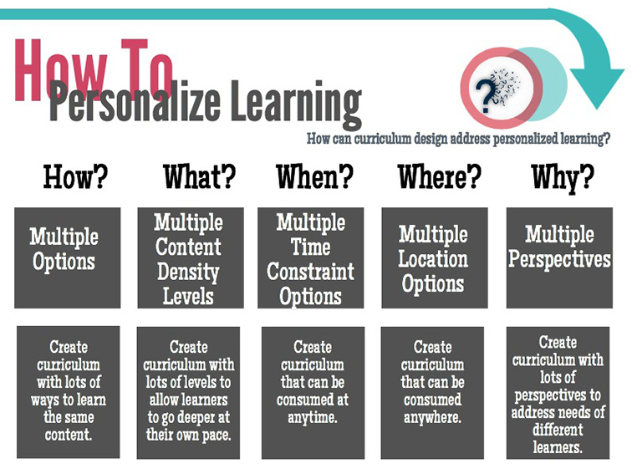
Personalization in the NGDLE
CBE - new architecture in LE to construct pathways to accomplish learning tasks and achieve learning goals
Adaptive Learning – automated system that provides learners with coaching an recommendations specific to the learner
Notes:
In its purest form, it means clear, customized, self-paced learning and degree pathways.
Instruction that is paced to student learning needs and tailored to student learning preferences and interests.

Slide 23
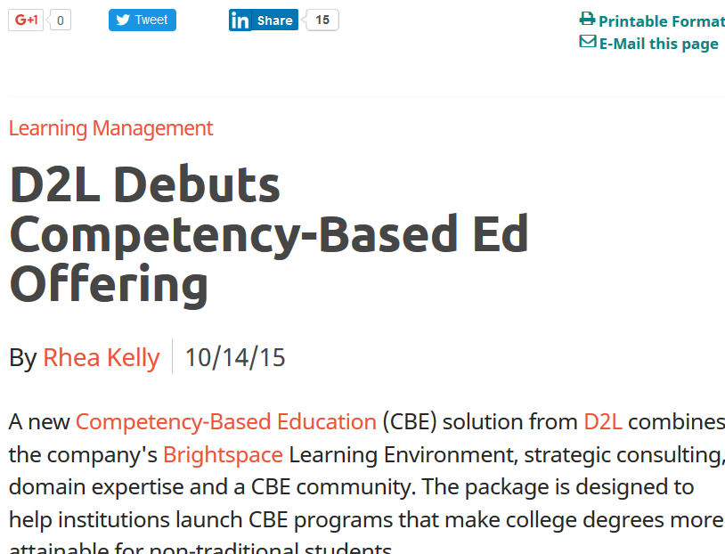
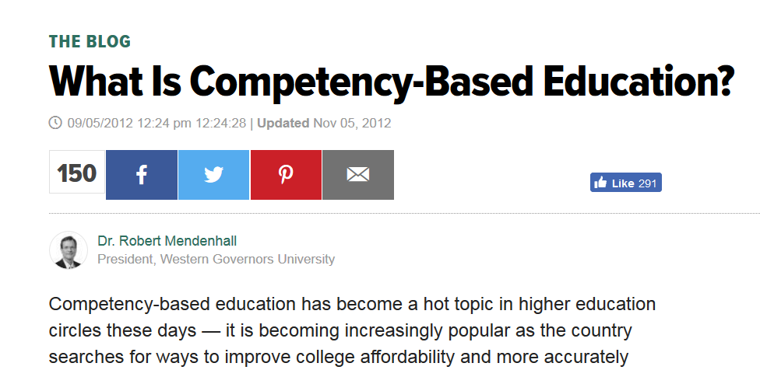
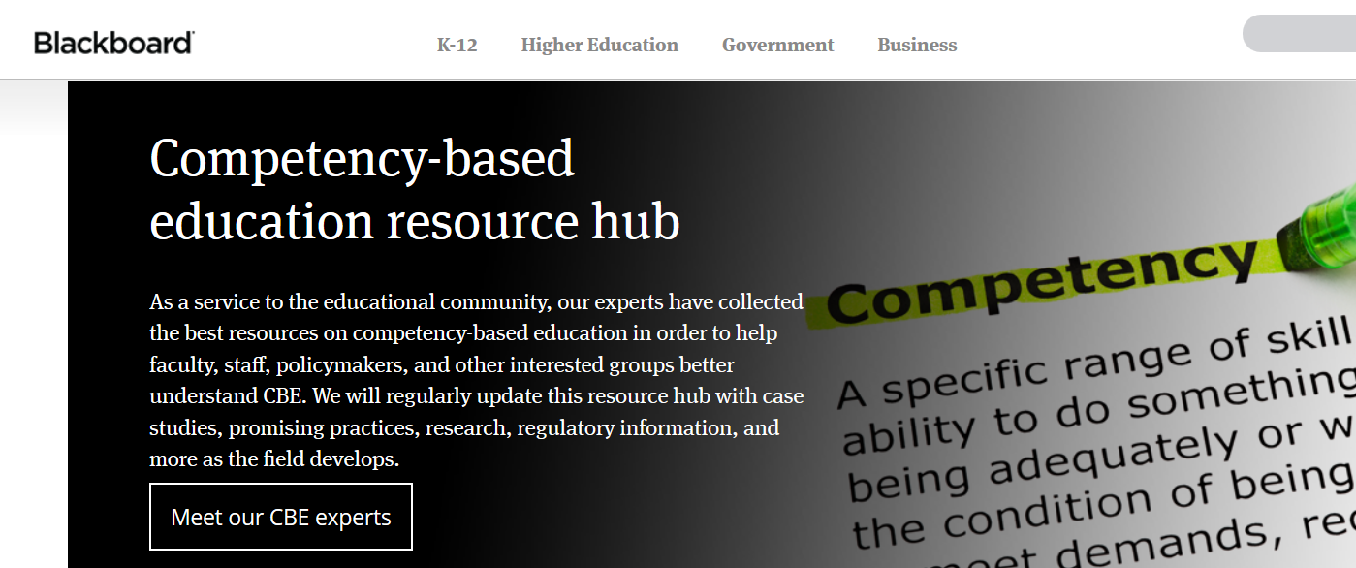
Competency-Based Learning in the LMS
Notes:
Very applicable to industry, Customized Training and Continuing Ed. Certificates or technical degrees
Competency-based learning refers to systems of instruction, assessment, grading, and academic reporting that are based on students demonstrating that they have learned the knowledge and skills they are expected to learn as they progress through their education
Not always related to time. While more traditional models can and often do measure competency, they are time-based — courses last about four months, and students may advance only after they have put in the seat time. This is true even if they could have completed the coursework and passed the final exam in half the time. So, while most colleges and universities hold time requirements constant and let learning vary, competency-based learning allows us to hold learning constant and let time vary.
Measure student learning rather than time.
Harness the power of technology for teaching and learning. Computer-mediated instruction gives us the ability to individualize learning for each student.
3. Fundamentally change the faculty role. Faculty members work with students, guiding learning, answering questions, leading discussions, and helping students synthesize and apply knowledge.
4. Define competencies and develop valid, reliable assessments. We define what students should know and be able to do, and they graduate when they have demonstrated their competency. This means that we have to define the competencies very clearly. Getting industry input is essential to make sure that we’ve identified relevant competencies. Once the competencies are established, we need experts in assessment to ensure that we’re measuring the right things.

Slide 24
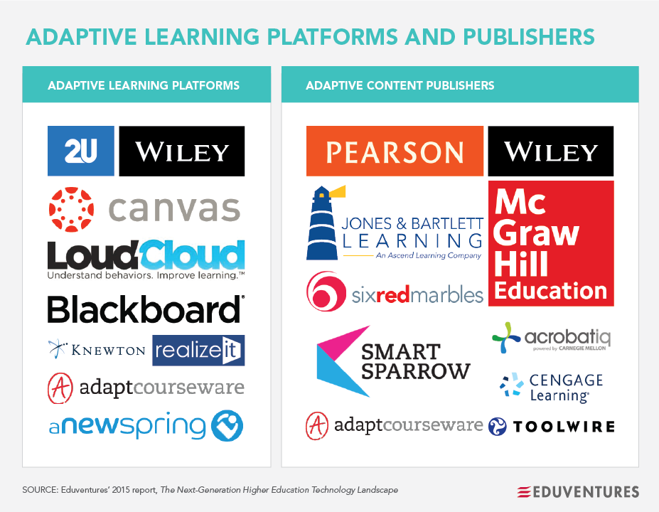
Adaptive Learning in the LMS
Notes:
LeaP – by Knowillage – but D2L’s product now
The study was done on an Introduction to Chemistry course at an unnamed Canadian university. Following ~130 students, the study looked at test scores. Study was not about the LMS – it was about the pedagogical usage of the adaptive engine that sits on top of the LMS. The study found evidence that Knowillage / LeaP allows students to have better test scores than students using just the main functionality within the LE.

Slide 25
3. Analytics, Advising, and Learning Assessment
Learning analytics
Integrated planning and advising systems (IPAS)
Assessment of learning: via CBE or learning outcomes measurement
Notes:
Learning analytics: measurement, collection, analysis and reporting of data about learners to optimize learning in the environment in which it occurs
Integrated planning and advising systems (IPAS) – Learning analytics can be seen as a poart of the larger IPAS suite of student success services.
Renewed emphasis on student progress and degree completion is driving higher education to take a fresh look at services that promote student success. Integrated planning and advising services (IPAS) are an approach to student success that promotes shared ownership for educational progress among students, faculty, and staff through holistic information and services that contribute to credential completion. EDUCAUSE is contributing to this effort with a comprehensive ECAR research project which will investigate IPAS benchmarking; data and systems integration; implementation; and assessment and evaluation.
Assessment of learning: CBE or outcomes – the key of the NGDLE is to weave together formative assessments, adaptive learning technology, and learning analytics. And if the course is organized around competencies, the LMS platforms have introduced support for Competency based approaches with tools. Many institutions now have CBE based programs. Moving away from a single-approach to learning.
Faculty, students, and administrators want to configure reporting dashboards to get the information they deem most essential to tracking progress.

Slide 26
IPAS Integrated planning and advising systems
Technologies for student success:
Education planning – identifying the degree and the best path to its achievement
Progress tracking (whether the learner is on course toward degree completion
Advising and counseling (offering mentoring and tutoring services)
Early alert system (initiating intervention strategies with at-risk students)
Notes:
IPAS services seek to realize a comprehensive vision of a technology-enabled and integrated digital environment that provides students, advisors, and faculty with the following capabilities:
Education planning – identifying the degree and the best path to its achievement
Progress tracking (whether the learner is on course toward degree completion
Advising and counseling (offering mentoring and tutoring services)
Early alert system (initiating intervention strategies with at-risk students)
Integrated planning and advising services (IPAS) are an approach to student success that promotes shared ownership for educational progress among students, faculty, and staff through holistic information and services that contribute to credential completion. EDUCAUSE is contributing to this effort with a comprehensive ECAR research project which will investigate IPAS benchmarking; data and systems integration; implementation; and assessment and evaluation.

Slide 27
4. Collaboration
NGDLE has to support collaboration at multiple levels
Make it easy to move between public and private spaces – go beyond a single course, if desired
Must be a design goal, not an afterthought
Notes:
LMSs in the first iterations support the walled garden: the course is a private community
Based on transmission model (instructor-posted materials) for faculty to post course documents, Except for discussion topics and group work,
Goal of the NGDLE – to move past the binary choice of either public or private. It should enable a learning community to make choices about which elements are public vs. private.
not much ability to collaborate. No shared creation or editing of documents. Students have to use tools outside of the LMS.
Newer technologies provide learners and instructors ways to collaboratively construct pathways to accomplish learning goals. Learners are not restricted to forming collaborations with just their peers in their course. They can organize inter-institutional collaborations, discover content, participate in MOOCs, to augment their learning. The breadth and depth of resources at the disposal of higher education is unprecedented. The NGDLE has to provide the architecture to support this kind of learning.

Slide 28
5. Accessibility and Universal Design
The NGDLE must support people with disabilities by adopting a universal design approach
UD is to be used by all people without any need for adaptation
All plug and play components should be filtered through the accessible lens
Notes:
So your school has video creation capability – but does the school have captioning in its toolset? Easy for the report to include it, but we know the massive cost associated with having all tools in the tool set.

Slide 29
The Conclusion
“Since no single application can deliver in all five domains, we recommend a “Lego” approach to realizing the NGDLE, where NGDLE-conforming components are built that allow individual and institutions the opportunity to construct learning environments tailored to their requirements and goals.”

Slide 30
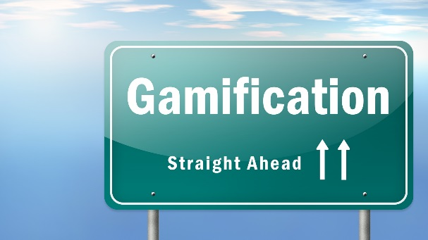
Other Ed Tech Themes not Specifically Addressed in the NDGLE Report
Gamification
Digital badging
Mobile functionality – it’s about the architecture

Slide 31
Moving Forward

Slide 32
Is the NGDLE Already Here?
Interoperability and Integration
Personalization
Analytics, Advising, and Learning Assessment
Collaboration
Accessibility and Universal Design
Notes:
Name elements of each that already exist or have been developed

Slide 33
MnSCU 2016 RFI
Competency Based Education (CBE) tools for alternative course delivery formats: All vendors have this capability, with varying levels of detail in the level of control
Differentiated Instruction – Adaptive Learning: All vendors have this capability, with varying levels of detail in the level of control
Student-centered features: Focus on tools that enable group work and collaboration. All products have a great many tools in this category. Each vendor has a unique approach, but all strive to engage students
Accessibility Standards and ADA Compliance: All vendors appear to have a high level of compliance, but there was no verification involved during RFI review and less confidence in third party tools with which they integrate
Release Management: Most have moved away from large annual version upgrades and have gone to more frequent releases (e.g., monthly, bi-monthly)

Slide 34
MnSCU 2016 RFI
Mobile Strategies: Strength of commitment to intentionally-designed mobile features for students and feature-parity with their core learning environment. Most are designing now for the responsive web, but variation in degree of completion
Cloud: All building to cloud with constraints for on-premise (self-hosted clients). Several don’t have a self-hosted option
Data and Reporting: All have some built-in analytics capabilities such as user progress, early alerts, but most are also building a suite of more robust functionality that can be purchased separately. These typically have predictive elements.
Interoperability Standards: All have commitment to interoperability standards and have growing partner relationships with 3rd party products.

Slide 35
My Take on the NGDLE for Higher Ed?
Domain | Present Already? | Coming? | Utilization
Interoperability and Integration | Yes | More of same, more apps, perhaps more standards to be developed | Extremely high
Personalization | Yes: Adaptive learning tools Technologies to support CBE Gamification Badging including integration with major badging platforms | Vendors will play catch-up; all LE vendors will have some sort of gamification and even add more gaming elements, plus badging | Modest to moderate use of CBE and adaptive learning tools except for programs with national standards Modest gamification in courses, too early to tell; may go the way of Second Life High utilization of badging for certain programs and for CE/CT or CPL *Not convinced personalization will take root in higher ed; tools will be there; but faculty time and interest issue

Slide 36
My Take on the NGDLE for Higher Ed? - continued
Domain | Present Already? | Coming? | Utilization
Analytics, Advising, and Learning Assessment | Elements of each: yes to analytics, some within LE, some as external products; historical data tools ready; predictive still being built. All have some form of competencies alignment structure; not sure of status of IPAS-readiness | More integration with student services; completion of predictive analytics tools for the LE | Very high (cost-dependent)
Collaboration | Not much; some LMS products more so than others | Yes – all will move to reduce or eliminate walls; will give option to make public, shared, or private | Early data shows little use of this function

Slide 37
My Take on the NGDLE for Higher Ed? - continued
Domain | Present Already? | Coming? | Utilization
Accessibility and UD | Core LE services – yes, high marks | Third party vendor ADA compliance – might be rating or certification | Focus on core LE compliance; uneven attention to third parties
Mobile Functionality/ Responsive Design | Mixed; most done through apps; most working on responsive design now | Responsive design fully developed More apps -“100,000” Ability to access full course and reply, post, edit – via any device | High

Slide 38
Next Gen LE Resource Articles
The Current Ecosystem of Learning Management Systems in Higher Education: Student, Faculty, and IT Perspectives. 2014 ECAR Report.
NMC Horizon Report: 2016 Higher Education Edition.
The Next Generation Digital Learning Environment. Malcolm Brown, Joanne Dehoney, and Nancy Millichap. 2015 ELI Report.
Six Trajectories for Digital Technology in Higher Education. Malcolm Brown. Educause June 22, 2015.
Dammit, the LMS. Michael Feldstein, e-Literate, November 10, 2014 post.
What’s Next for the LMS? Malcolm Brown, Joanne Dehoney, Nancy Millichap. Educuase June 22, 2015.

