Slide 1
Open Source Course (Learning) Management System (OSCMS): Providing Online Learning Experiences and Positive Alternatives to Addictive Internet Use
By
Agbo, Benjamin C. D. (PhD)
Onaga, Paul Okwudili

Slide 2
Objectives
At the end of this presentation, participants will be able to:
State the dangers inherent in the adolescents addiction to the Internet
Identify, at least, two open source that can be used for teaching/learning
Sign up on OpenEd Course Management System (OCMS)
Register students and/or learners in the OCMS
Sign subjects to different grade levels,
Organize activities in the OCMS, etc.

Slide 3
What is Addictive Use of the Internet?
Problematic Internet use, or addiction, is characterized by excessive or poorly controlled preoccupations, urges or behaviors regarding Internet use that lead to impairment or distress (Weinstein and Lejoyeux, 2010 p. 277)
Uncontrolled use of the internet that leads to significant psychosocial and functional impairments (Lie et all, 2011).
When negative outcomes are associated with repetitive, compulsive and uncontrolled use of online technology, they led to the term ‘internet addiction (Šmahel & Blinka, 2013)

Slide 4
Statistics
Associate with substance use, depression and aggression (Lie et all, 2011)
Present in about 4% of high school students in the United States (Lie et all, 2011).
3.7% of the sample were classified as potentially being addicted to the Internet (Kuss et al, 2013).
Associated with substance use disorder, attention-deficit hyperactivity disorder, depression, hostility, and social anxiety disorder (Ko, et al, 2012)

Slide 5
Overview of Prevalence Studies of Internet Addiction in Adolescents Study (Kuss et all, 2013)
Study | Aim | Sample and country | Design | Internet addiction measures | Prevalence
Kormas et al., (2011) | To assess the determinants and psychosocial implications associated with potential problematic Internet use (PIU) and PIU among adolescents | N = 866 randomly selected adolescents in Greece (mean age = 14.7 years) | Cross-sectional pen-and-paper questionnaire study | Young’s Internet Addiction Test (Young, 1999), scoring >50/100 indicates addiction | 1.5% with problematic Internet use
Kaltiala- Heino et al. (2004) | To assess the prevalence of features suggesting a harmful Internet use among 12–18 year-olds in Finland | N = 7,292 representative of adolescents in Finland (4 age groups, mean ages = 12.6, 14.6, 16.6 and 18.6 years) | Cross-sectional postal survey | Pathological gambling criteria (addicted when 4/7 criteria met) | 1.6% addicted
Liu et al. (2011) | To explore the prevalence and health correlates of problematic Internet use among high school students in the United States | N = 3,560 high school students in USA (age range = 14-18 years) | Cross-sectional pen-and-paper survey | Modified Minnesota Impulsive Disorder Inventory (Grant et al., 2005), endorsing craving, withdrawal, and abstinence attempts simultaneously indicates problematic Internet use | 4% with problematic Internet use
Cao et al. (2011) | To investigate the prevalence of problematic Internet use (PIU) and its relationships with psychosomatic symptoms and life satisfaction among adolescents in mainland China | N = 17,599 adolescents in China sampled via stratified cluster sampling in schools (mean age = 16.1 years) | School-based cross-sectional survey | Young’s Internet Addiction Test (Young, 1999), scoring >50/100 indicates addiction | 8.1% with problematic Internet use
Park et al. (2008) | To explore relations between risk and protective factors and Internet addiction among adolescents in South Korea | N = 903 middle and high school students in South Korea (60.5% middle school seniors, 39.5% high school students (12.4% freshmen, 27.1% juniors)) randomly selected from schools in Seoul | Cross-sectional pen-and-paper survey | Modified Young's Internet Addiction Scale (IAS) (1998a), scoring ≥70 indicates addiction | 10.7% addicted
Müller et al. (2012) | To explore Internet addiction prevalence in a clinical context in Germany | N = 81 child and adolescent psychiatric patients in Germany (mean age = 13.6 years) | Cross-sectional pen-and-paper questionnaire | Assessment of Internet and Computer Game Addiction Scale (Wölfling et al., 2010), scoring >7/15.5 indicates addiction | 11.3% addicted
Liberatore et al. (2011) | To study the prevalence of Internet addiction in adolescents receiving treatment for a diagnosed psychiatric illness | N = 71 adolescent outpatients in Puerto Rico, Latin America (age range = 13-17 years) | Cross-sectional pen-and-paper questionnaire | Internet Addiction Test (Young, 1998), scores ≥80/100 indicates addiction | 11.6% addicted
Source: Kuss, Van Rooij, Shorter, Griffiths, & van de Mheen, (2013), p. 3

Slide 6
Providing Positive Alternatives
If you cannot beat them, join them (?????????)
Challenge them (academically) using the same platform
Teachers – Flip your classroom instructions/activities
Be resourceful
Explore Open Source Software (e.g. OpenEd, Google Classroom etc.)
Parents – Get involved in the use of eLearning technology
Let them teach you (they know more than you can imagine)
Engage them constructively on academic related issues.
Use available Open Source you are familiar with to engage them

Slide 7
Providing Positive Alternatives Using Open Source
What is an Open Source?
Free software/course management system
No revenue
Public good
Free distribution
Examples
OpenEd - https://www.opened.com
Goggle Classroom - https://classroom.google.com/
Schoology - https://www.schoology.com/
Khan Academy - https://www.khanacademy.org/

Slide 8
CONDITIONS/TERMS ASSOCIATED WITH OPEN SOURCE
Free redistribution
Source code (for repair and modification)
Derived works (modification and distribution under the same license)
Integrity of the author’s Source Code
No discrimination against person/groups or field of endeavors
Distribution of License (the right must apply to all)
License must not be specific to a product or contaminate other software
(Perens,1999)

Slide 9
OpenEd: https://www.opened.com
OpenEd – Course (Learning) Management System or eLearning/Open Educational Resources
Founded in August 2012 by Adam Blum and Lisa Blum
Headquarter is at Los Gatos, California

Slide 10
Signing up for an OpenEd Account, (OpenEd, 2016)
Notes:
Open “https://www.opened.com” and click on “join for free” as shown above

Slide 11
More Information
Notes:
Scroll down on the home page for more information about OpenEd as shown above.

Slide 12
Creating Your Profile
Notes:
A click on “Join for Free” brings you profile page. Choose one from the options and click next to complete your profile.

Slide 13
Customizing Your Class
Notes:
You can customize your by selecting grade level, subject area, Textbook, suggested lesson plan, and class name. Use the dropdown menu in some cases.

Slide 14
Students’ Enrolment
Notes:
Students information could be entered one-by-one or uploaded if formatted in Excel file. Students should login with a class code that is generated automatically as soon as your class is created.

Slide 15
Resource Library
Notes:
The library showcases varieties of resources – assessments, homework, lesson plans, and other teaching aids you can assign to your class. Choose the resources that are appropriate for your students’ grade levels

Slide 16
Assignments and Lesson Plans

Slide 17
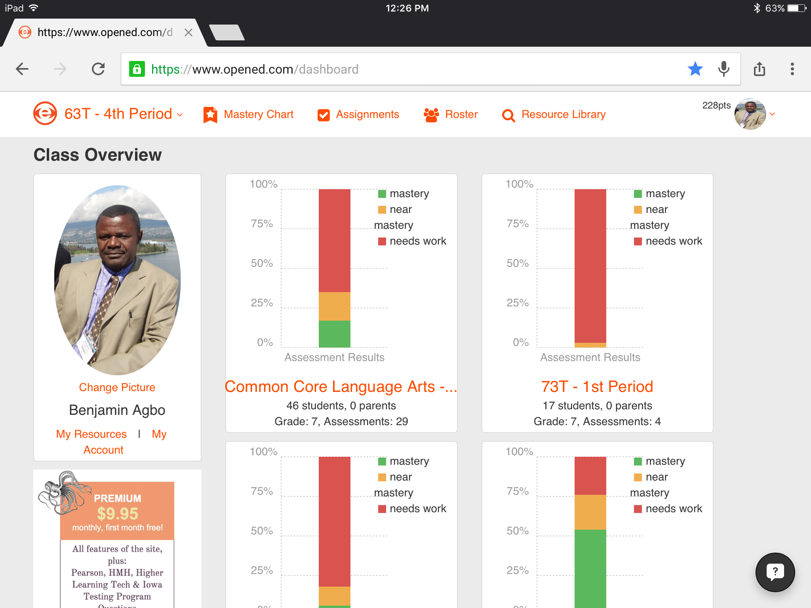
A Summary of Mastery Chart
Department of Organizational Lea, Policy, and Development
Notes:
The mastery chart is a summary of the class performance as a group.

Slide 18
COMMENTS, questions & answers (CQAs)
Notes:
18

Slide 19
Reference
Ko, C. H., Yen, J. Y., Yen, C. F., Chen, C. S., & Chen, C. C. (2012). The association between Internet addiction and psychiatric disorder: a review of the literature. European Psychiatry, 27(1), 1-8.
Kuss, D. J., Van Rooij, A. J., Shorter, G. W., Griffiths, M. D., & van de Mheen, D. (2013). Internet addiction in adolescents: Prevalence and risk factors. Computers in Human Behavior, 29(5), 1987-1996.
Li, W., O’Brien, J. E., Snyder, S. M., & Howard, M. O. (2015). Characteristics of internet addiction/pathological internet use in US University students: a qualitative-method investigation. PloS one, 10(2), e0117372.
Liu, T. C., Desai, R. A., Krishnan-Sarin, S., Cavallo, D. A., & Potenza, M. N. (2011). Problematic Internet use and health in adolescents: data from a high school survey in Connecticut. The Journal of clinical psychiatry, 72(6), 836-845.
OpenEd (2006). The leading standards aligned K-12 open educational resource library: An ACT Assessment Technologies Company. Retrieved on July 4th, 2016 from https://www.opened.com/?_=1467659147374.
Perens, B. (1999). The open source definition. Open sources: voices from the open source revolution, 1, 171-188.
Ryu, E. J., Choi, K. S., Seo, J. S., & Nam, B. W. (2004). The relationships of Internet addiction, depression, and suicidal ideation in adolescents. Taehan Kanho Hakhoe Chi, 34(1), 102-110.
Šmahel, D., & Blinka, L. (2012). Excessive internet use among European children. Children, risk and safety on the internet: Research and policy challenges in comparative perspective, 191-204.
Weinstein, A., & Lejoyeux, M. (2010). Internet addiction or excessive internet use. The American journal of drug and alcohol abuse, 36(5), 277-283.

Slide 20
Contacts for Suggestions
Agbo, Benjamin C.. D. (PhD)
Email: agbox003@umn.edu
Phone: +1 651 771 7632
Onaga, Paul O.
Email: equiptex2001@yahoo.com
Phone: +234 803 500 9454

