Slide 1
ConnectED Learning for 21st Century Educators

Slide 2
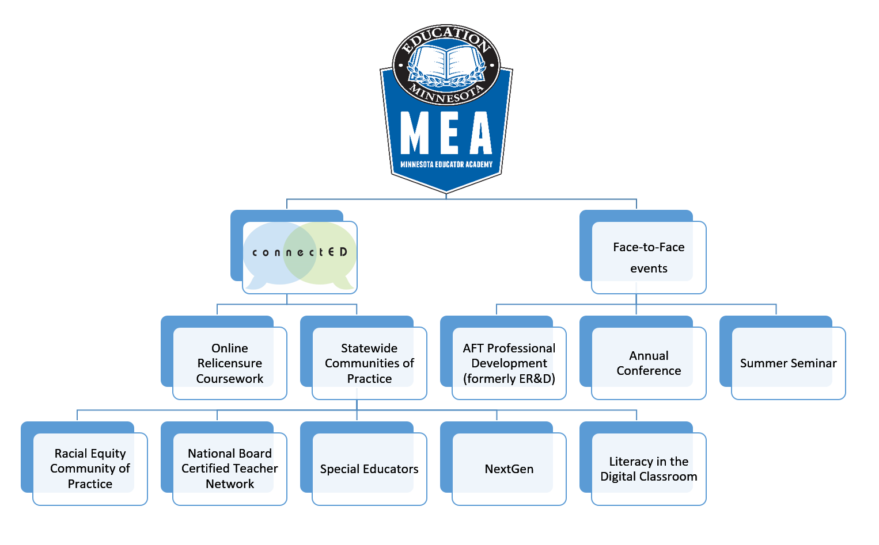

Slide 3
Unpacking the Present
Culture of constant change
Communication overload
Social media influence
Consumption vs. Production
Standards shift
Is it time for a new conversation?
Or… time for a new KIND of conversation?

Slide 4
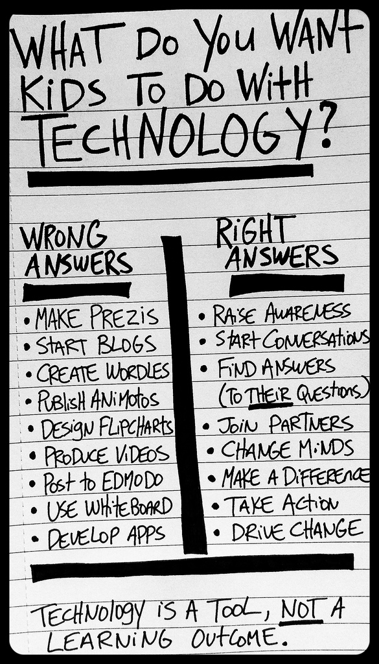
Creativity and Innovation
Critical Thinking and Problem Solving
Communication and Collaboration
Notes:
Teachers need to develop these skills just as much as students… Are you developing yours?
Change STUDENT to LEARNER to include teachers

Slide 5
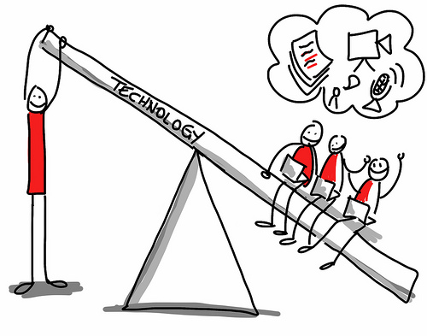
What do we want educators to do with technology?

Slide 6
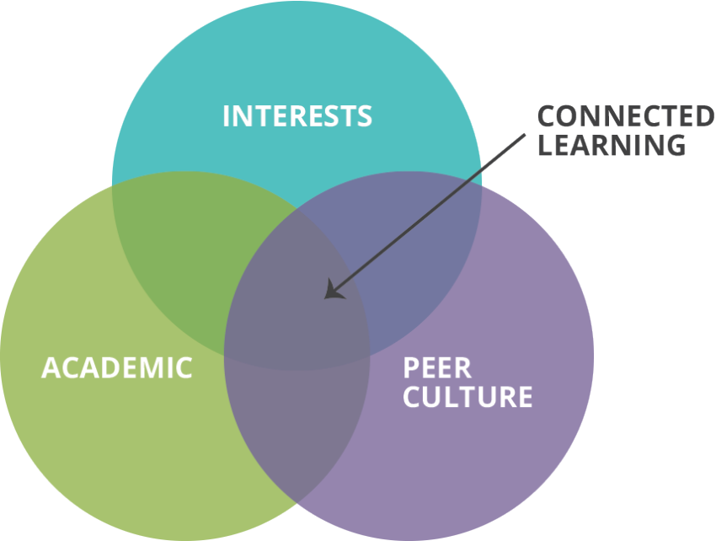
What is Connected Learning?
“How can we use the capacity of these network resources, these social connections, to bring people together, who want to learn together?”
-Mimi Ito
Digital Media and Learning Research Hub
Notes:
https://www.youtube.com/watch?v=zFdzz26g-EE

Slide 7
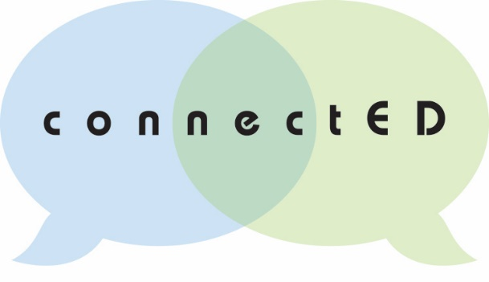
Why Connected Learning for Educators?
Supports principles of andragogy
Design principles reflect 21st century learning practices to model, so teachers can transfer learning to their classrooms
Equitable participation and empowered learner voice is a foundation of this model

Slide 8
Connected Learning Principles

Slide 9
Benefits
Network flexibility: multiple goals, multiple audiences
Models equitable, learner focused professional development and effective use of technology
This project serves as a statewide “lab” for innovative professional development

Slide 10
Habits of Mind: What are YOUR strengths as an educator?
Persisting
Managing impulsivity
Listening with understanding and empathy
Thinking flexibly
Metacognition
Striving for accuracy and precision
Questioning and problem posing
Applying past knowledge to novel situations
Thinking and communicating with clarity and precision
Gathering data through all the senses
Creating, imagining, and innovating
Responding with wonderment and awe
Taking responsible risks
Finding humor
Thinking independently
Remaining open to continuous learning

Slide 11
The Reflective Process
Awareness
Employment
Evaluation
Application
Commitment
Notes:
Curriculum 21 pages 218-219

Slide 12
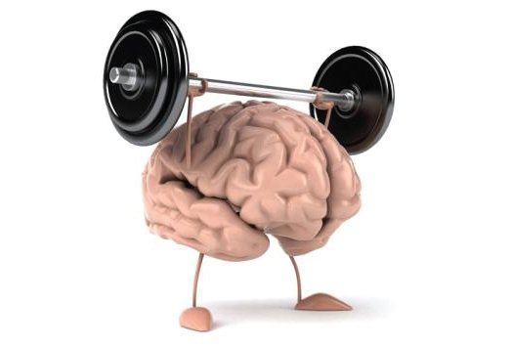
Mind Shifts
Knowing how to behave when answers are not readily apparent
Constructing meaning
Self Assessment
Knowing the right answers
Transmitting meaning
External evaluation

Slide 13
Inquiry Teams
Focusing
Organizing
Strategizing
Enhancing Learning
Connecting
Leading Change
Notes:
Ideally…

Slide 14
Notes:
What are our findings thus far?

Slide 15
What now?
Login:
MyNEA360.org
Join our statewide groups:
MEA ConnectED Home
Racial Equity Community of Practice
Literacy in the Digital Classroom
Minnesota NBCT Network
Teacher Support: Induction and Mentoring
MEA FIRE
Jen Kohan
jen.kohan@edmn.org
Notes:
Moderator Q&A

Slide 16
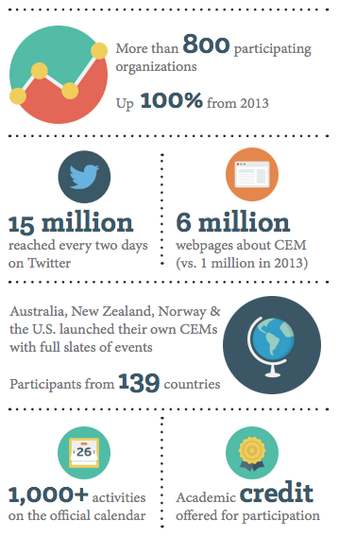
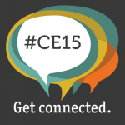
October is Connected Educator Month…

Slide 17
Global Competency and Connected Learning

Slide 18
How media and digital literacy in the classroom can help:
We can easily differentiate for multiple skill and interest levels by providing for choice
We can remix the voices of our students to reflect this vide variety of interests
We can provide an alternative to the “hidden curriculum” by allowing for self-directed inquiry
We can help all students to reshape their self-images through media “texts” that reflect them as individuals
Notes:
Examples:
Michael T., Andrew, and Zuri

Slide 19
Key Concept: CHOICE
Allow learners to make clear and distinct choices about topic study
Set clear expectations and guidelines
Provide extended time for learners to uncover views that are not immediately present
Allow learners to modify or abandon projects that are not going well

Slide 20
Formative Assessments: Practice Makes Perfect
Provide low stakes, low risk assessments
Use a wide variety of media tools
Address common themes or skills while offering topic choice
Model digital communication regularly
Encourage “word of mouth” recommendations
Learner generated media projects allow multiple opportunities for revision

Slide 21
Social Networks and Crowdsourcing
TOPICS
RESOURCES
Twitter
Facebook
Tumblr
Instagram
Pinterest
Yelp
Craigslist
Skype
Evernote
Hootsuite
Digital footprints and digital identities
Tone and messaging
Authentic audiences
Using social networks and crowdsourcing to your advantage
Encourage co-expertise

Slide 22
Learner Generated Media
Digital Storytelling
Narratives
Documentaries
Poetry and Spoken Word
Remixed Media and Mashups
Public Service Announcements
Websites
Blogs
Student Journalism: digital newspapers and yearbooks

