Slide 1
GPS LifePlan 2.0 Launch Party—Create the Life You Want: Goals + Plans = Success

Slide 2
Randy LaFoy, Minnesota State Colleges & Universities GPS LifePlan
Stephen Kelly, Century College & QUES LLC.

Slide 3
Agenda
Background about GPS
Who uses it
How being used
Phase II
Feedback and questions
(Leave your phones on)
Notes:
Randy

Slide 5
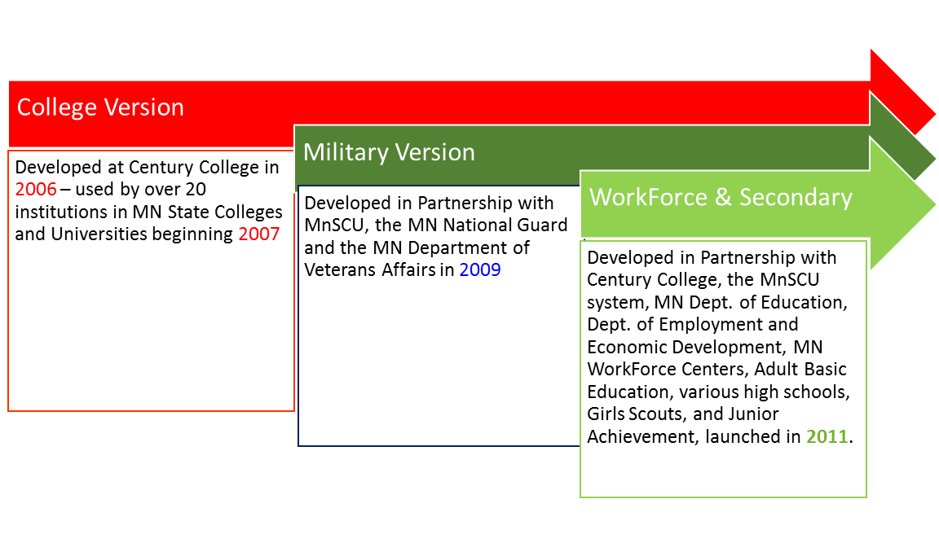
Brief History
Using the funds provided by a Robin Hood Grant, GPS launches a beta mobile and device friendly site in 2015.
MNSCU funds GPS LifePlan to finish beta work. Soft launch July – Hard launch August 2016
Notes:
Jenn

Slide 6
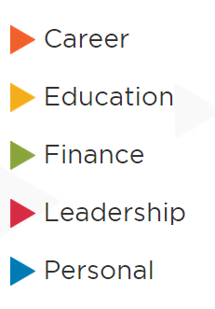
What will you find in GPS LifePlan?
Self Assess, Career & Training Exploration, Find a Job, Set Goals
Plan Education, Academic Skills & Strategies, Set Goals
Budget, Finance Education, Credit & Debt, Save, Set Goals
School & Community Involvement, Leadership Skills, Set Goals
Wellness, Relationships, Community Resources, Set Goals
Notes:
The holistic nature of the program includes resources for students to help with many of these areas. By learning more about resources, developing goals, identifying obstacles, and developing plans to adjust as needed, students can feel like they have more control of their college experience. The advisor/counselor communication provides the support and encouragement needed to continue. (2 minutes)
From: https://www.ccsse.org/center/resources/docs/publications/SENSE_2008_National_Report.pdf

Slide 7
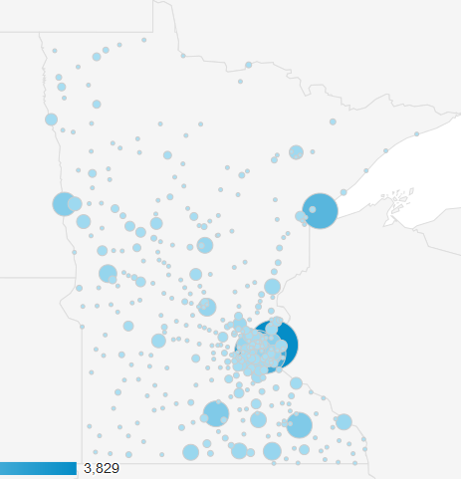
10 years ago, and now the entire state uses it – colleges and high schools.
Notes:
Randy

Slide 8
Mobile Technology is Everywhere
Notes:
Randy: Mobile technology is everywhere now in a student’s life! (20 seconds) – How much are you using the mobile phone to get on the internet?

Slide 9
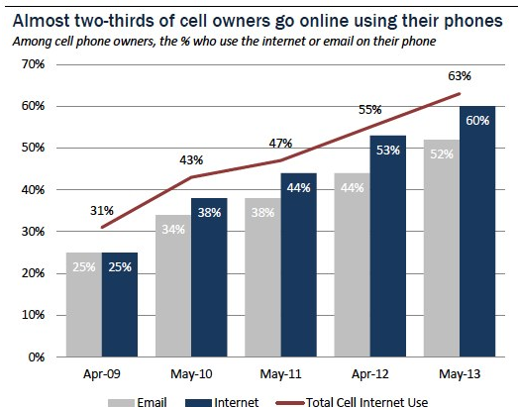
Notes:
Randy: Think about how much you use your phone now versus the past 5 years to access the internet. The trend continues to rise with over 2/3 of cell owners using their phones to go online. (30 seconds)
From: http://www.pewinternet.org/fact-sheets/mobile-technology-fact-sheet/

Slide 10
Mobile ACCESS IS VITAL
Users living in households with annual income less than $30,000 mostly use their phone to go online.
Cell-internet users age 18 – 29 who mostly use their cell phones to go online.
50%
45%
African-Americans who are cell-mostly internet users.
Hispanics who are cell-mostly internet users.
43%
60%
From: www.pewinternet.org/fact-sheets/mobile-technology-fact-sheet/
Notes:
Randy: The trend is that more and more young people are using cell phones as their primary way to go online! Which includes an increasing percent of low income and people of color. Mobile access is vital! (1 minute)
[From: www.pewinternet.org/fact-sheets/mobile-technology-fact-sheet/]

Slide 11
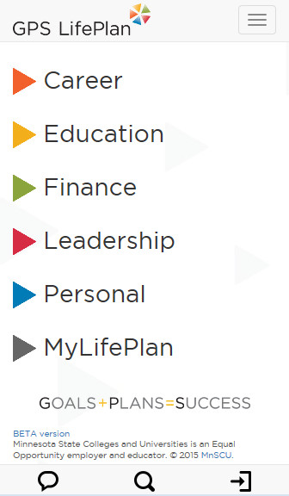
mygpslifeplan.org
Notes:
Jenn

Slide 12
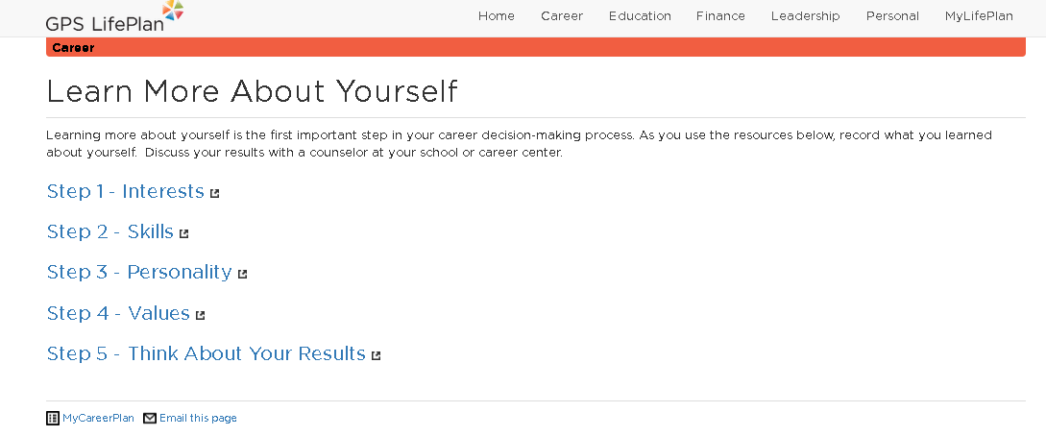
General Resources to Help – 100’s of links to .gov, .edu or .org sites
FAQ of all o
f the assessments - #4776
Notes:
Jenn

Slide 13
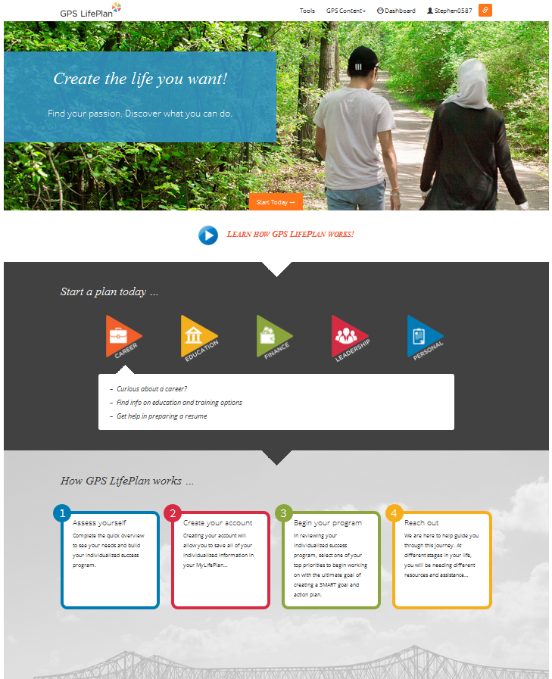

Slide 14
Navigation
2. Assessments to help determine student priorities.
3. STORE STUFF automatically.
4. New look and feel – scaling and tiling – device/mobile friendly.
5. Tools you can refer to – original content.
5. Breadcrumbs – no getting lost.
6. Accordion features making it easy to see what is available.
7. Online help and chat.

Slide 15
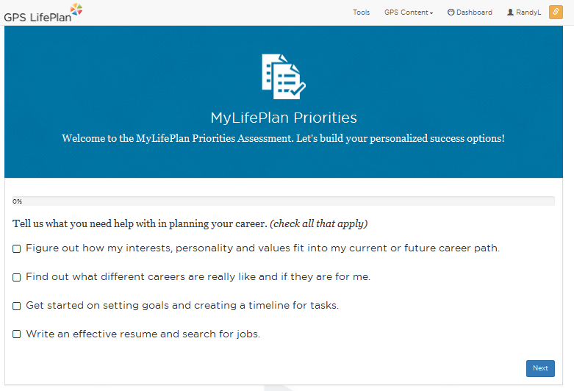
It all starts here – with an priorities assessment

Slide 16
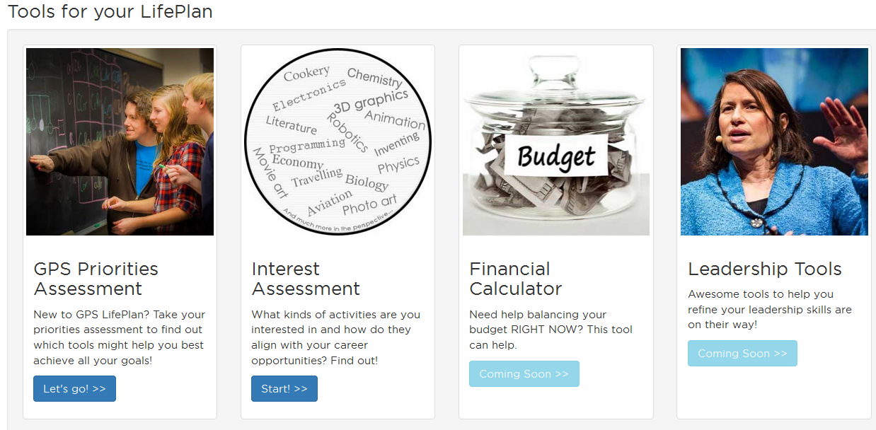

Slide 17
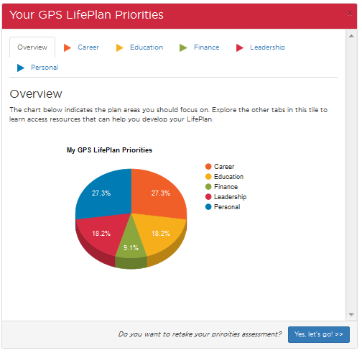
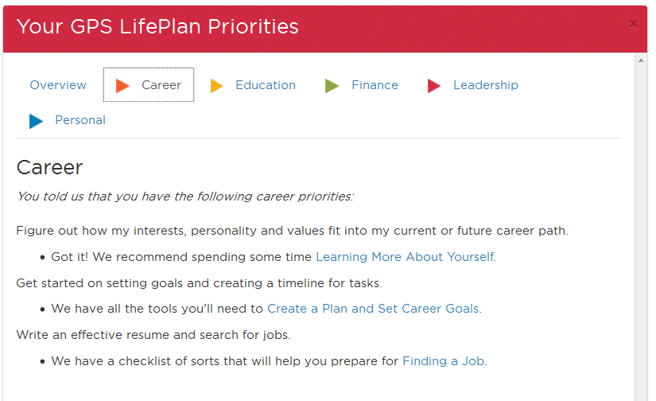
It goes here –with useful resources at your fingertips. That are stored.

Slide 18
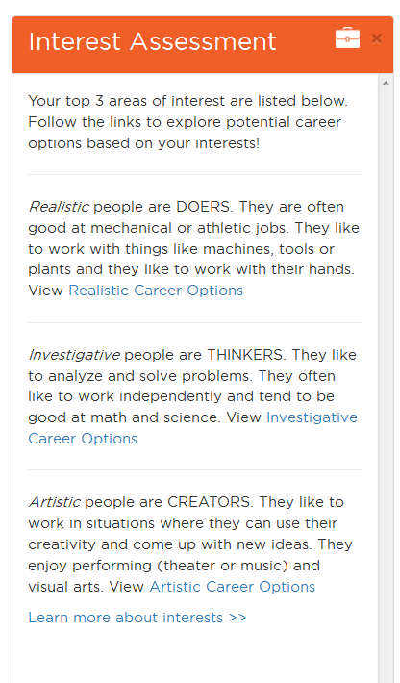

Slide 19
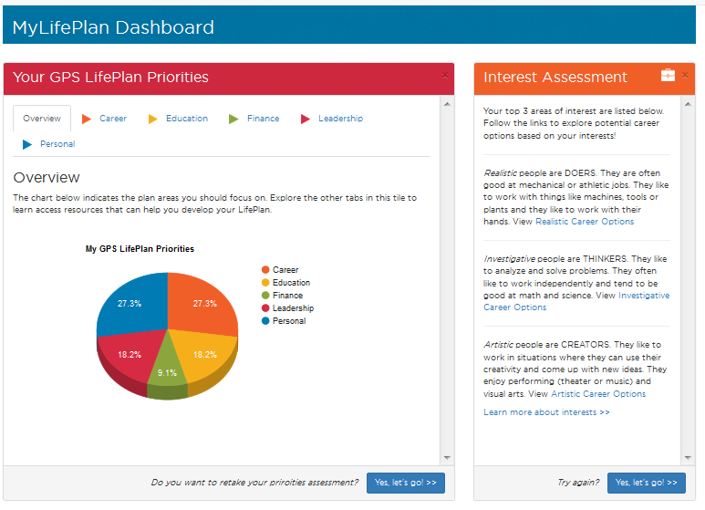

Slide 20
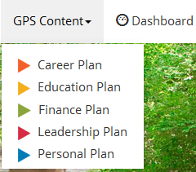

Slide 21
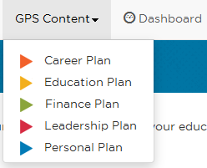
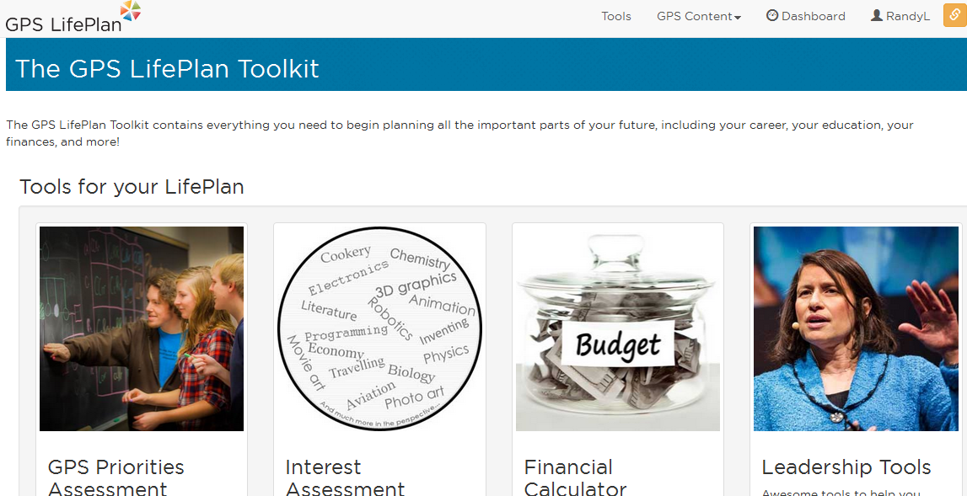

Slide 22
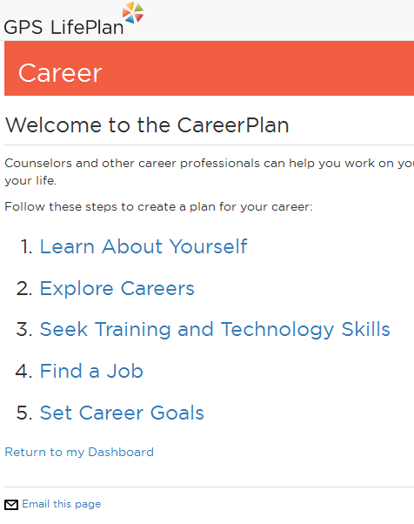

Slide 24
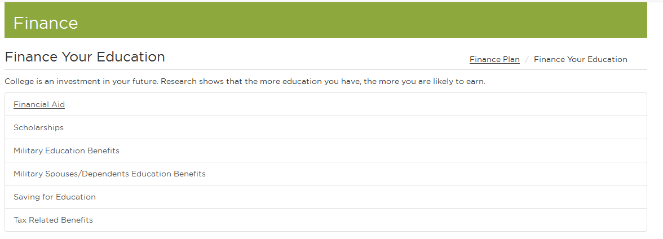
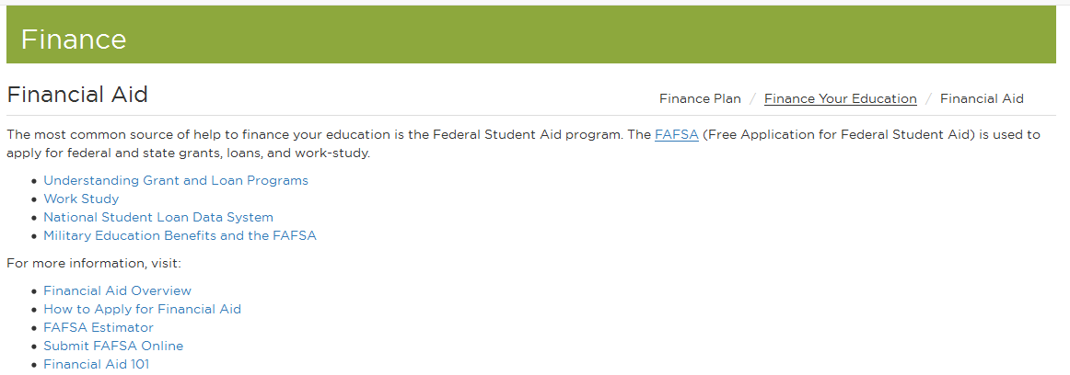

Slide 25
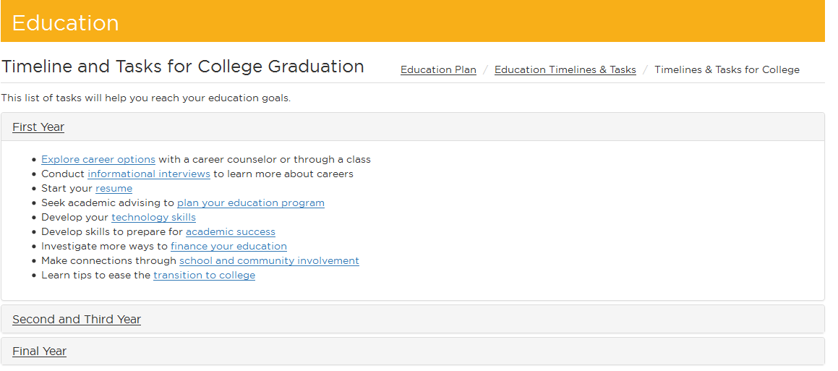

Slide 26
Each page has a unique ID associated with it – makes it easy to set up an assignment or link for a class or resource.

Slide 27
The Footer.

Slide 28
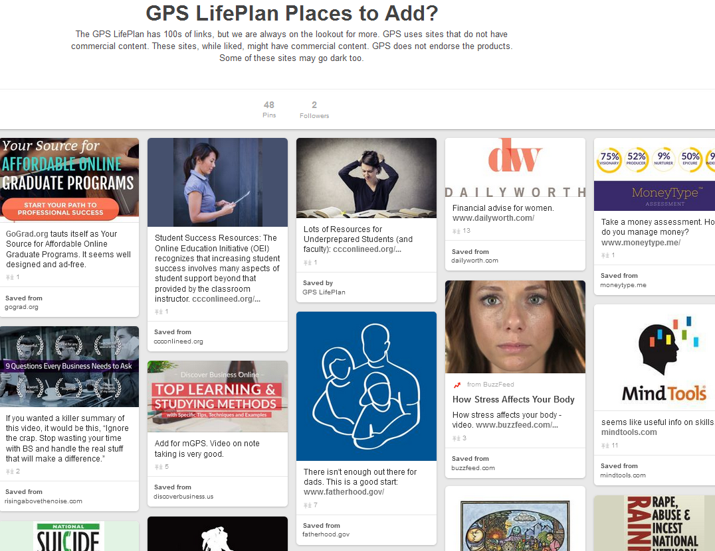
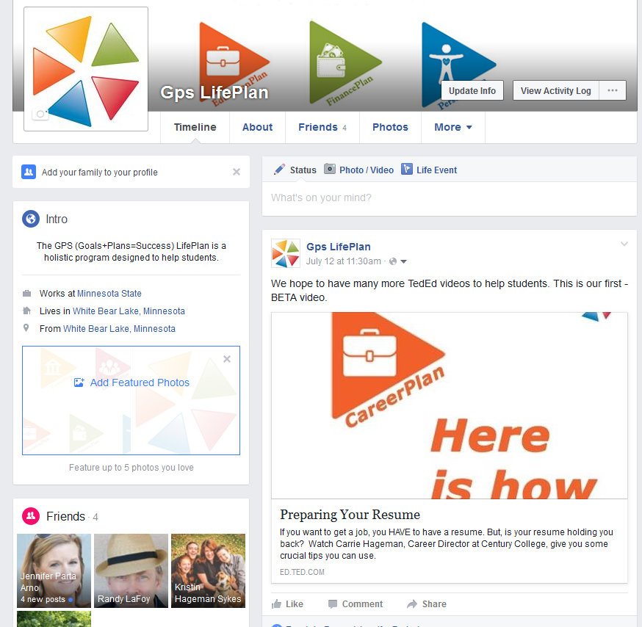
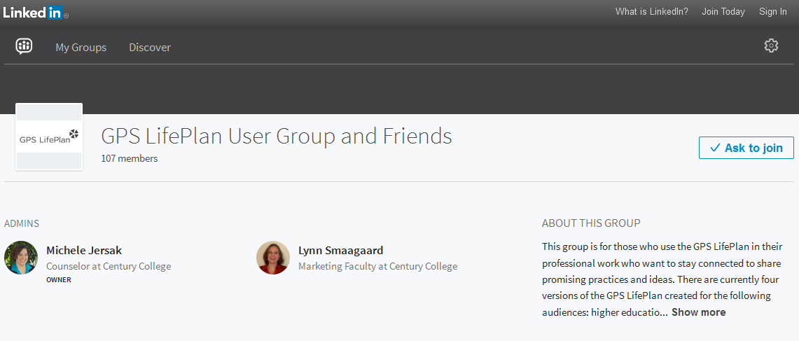
Social Media

Slide 29
Let’s get online and explore
https://mygpslifeplan.custhelp.com/
As you explore, we’d like feedback on:
Assessment
Signing in
Navigation
Typos
Enhancements
Future tools you could provide/work with us on
Fun and Games that are flash-free (apps?)

Slide 30
Thank you for attending.
Randy LaFoy, Minnesota State Colleges & Universities GPS LifePlan
Stephen Kelly, Century College & QUES LLC.

