Slide 1
Do-It-Yourself RECORDING STUDIO
Notes:
Dan

Slide 2
Dan Hoisington Associate Director of AV & Classroom Technologies Lisa Burke Director of Instructional Innovation- Opus College of Business Glori Hinck Instructional Designer/Technologist- Opus College of Business
Notes:
All

Slide 3
OBJECTIVES
Recognize the barriers to faculty created video content for online and blended courses.
Identify the space and equipment needs for a recording studio tailored to the needs of your institution.
Describe how such a studio can be used to meet the needs of faculty.
Notes:
Glori

Slide 4
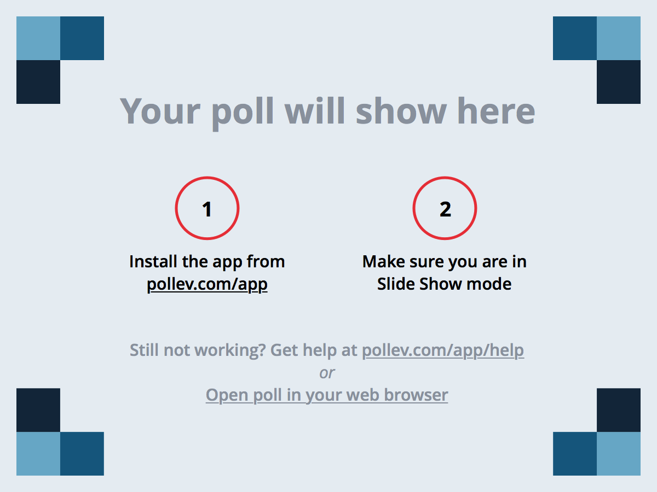
Notes:
Glori
Poll Title: What is your background? https://www.polleverywhere.com/multiple_choice_polls/nAHBySbY8XAo2CV

Slide 5
POLL
Notes:
What is your background?
https://www.polleverywhere.com/multiple_choice_polls/nAHBySbY8XAo2CV

Slide 6
Notes:
Glori
Poll Title: Why did you choose this presentation? https://www.polleverywhere.com/free_text_polls/IxFrloRBolw5KYq

Slide 7
POLL
Notes:
Poll Title: Why did you choose this presentation? https://www.polleverywhere.com/free_text_polls/IxFrloRBolw5KYq

Slide 8
Why was a studio needed?
Notes:
Lisa
Recognize the barriers to faculty created video content for online and blended courses.

Slide 9
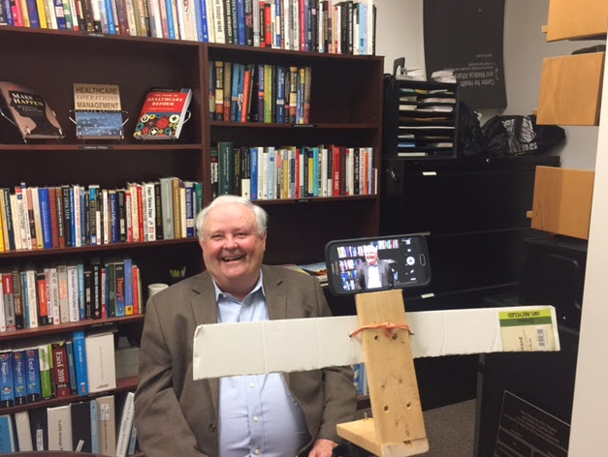
Notes:
This is how one of our faculty, Dan McLaughlin, rigged up his smartphone in order to be able to record a video from his office. He also cleverly printed out his script in 24 pt font and taped it to the cross bar.

Slide 10
Rationale for creating a studio
Increasing number of blended and online programs and courses = increased need for recorded lectures and presentations
Campus TV studio in St. Paul, most of our faculty work and teach on Minneapolis campus
Audio/video recorded in offices resulted in variable levels of quality
Adjunct instructors lacked access and facilities to easily record or edit files
Wanted something like Penn State’s One Button Studio – self-service and easy to use
Notes:
We have two blended graduate programs as well as a blended track in our PT MBA, plus instructors flipping courses
Distance between campuses is ~6 miles, but travel time can be lengthy, wanted a drop in facility
Wanted to enable improved quality, support needs of adjuncts
From their web site: What is the One Button Studio?
The One Button Studio is a simplified video recording setup that can be used without any previous video production experience. The design of the studio allows you to create high-quality and polished video projects without having to know anything about lights and cameras. You only need to bring your flash drive with you and push a single button.

Slide 11
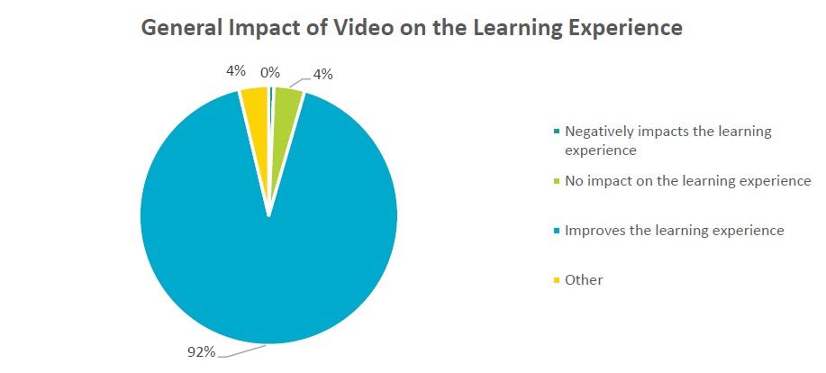
And more importantly…video works!
From “The State of Video in Education 2016: A Kaltura Report”
Notes:
Lisa
We have a health care

Slide 12
And more importantly…video works!
From “The State of Video in Education 2016: A Kaltura Report”
Notes:
Lisa
We have a health care

Slide 13
Initial Plan
Notes:
Dan
2. Identify the space and equipment needs for a recording studio tailored to the needs of your institution.

Slide 14
Overview of Options

Slide 15
POLL

Slide 16
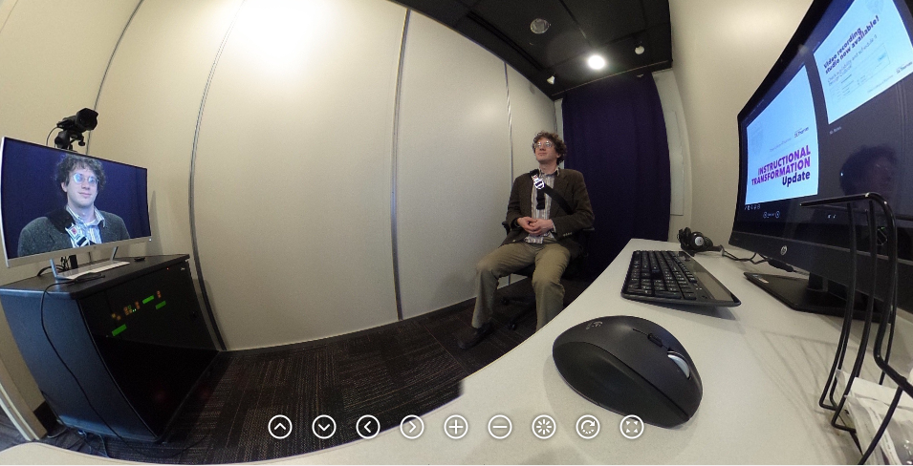
RECORDING STUDIO 360

Slide 17
Video Recording Studio
Digital Recorder (Extron SMP 351)
Sound Proofing
Lights
Backdrop
Touch all in one
Confidence monitor
Furniture on wheels
Notes:
Usb
Dual record
Wheels
Quiet place
Screen capture
Editing software
Whiteboard

Slide 18
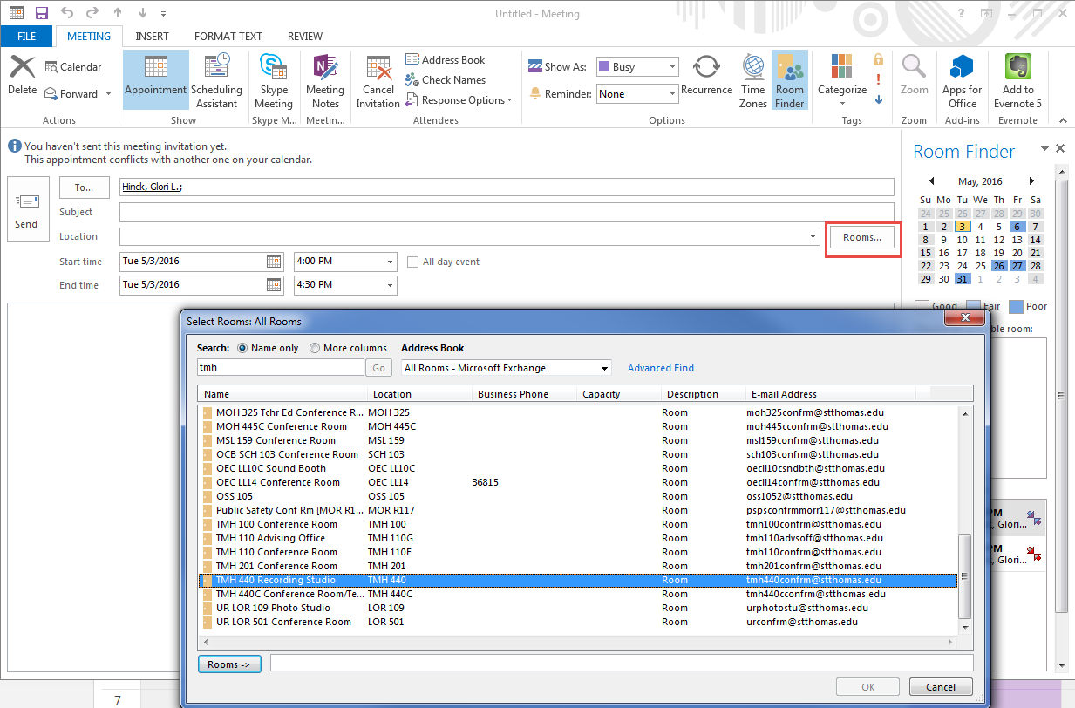
Reserve Through Outlook

Slide 19
Iterations
Notes:
Dan

Slide 20
Backdrop Evolution
Started with a whiteboard and purple curtain to cover whiteboard when not in use
Now have set of Studio Pro Photo and Video Studio Background Panels
System includes light stand with clip and 5” x 6’ 5” muslin backdrops
Easy to swap out color to complement attire of person in studio
Includes a chroma key (“green screen”) for special effects
Notes:
Lisa
We have a health care

Slide 21
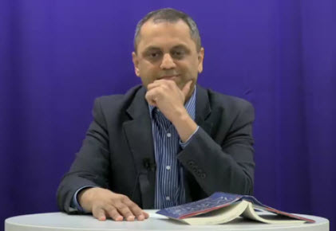
Original Backdrop

Slide 22
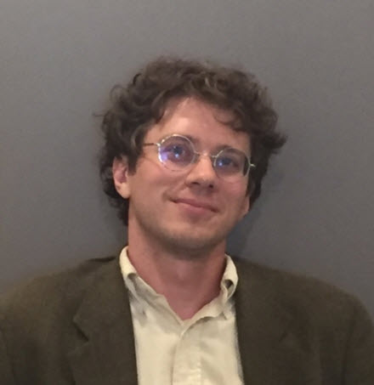
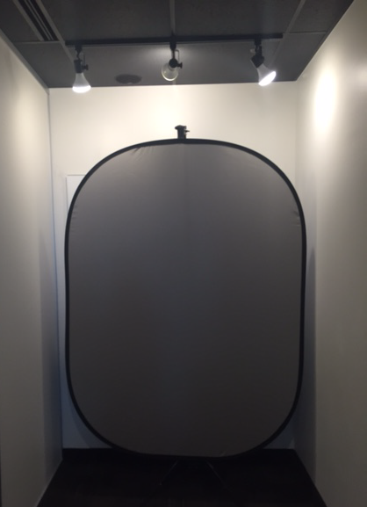
New Backdrop
Notes:
Lisa
We have a health care

Slide 23
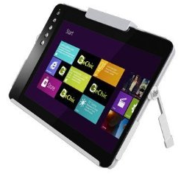
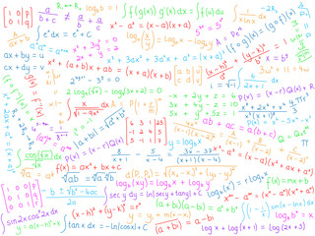
Drawing/Formulas
Notes:
This is one of our newest revisions. This tablet connects to the computer and will be loaded with a scientific notation app for those faculty who draw formulas. Their work will then be captured on the main computer for screen recording.

Slide 24
Remote

Slide 25
Use Cases
Notes:
Glori
Let’s talk a little bit about how this studio supported our faculty

Slide 26
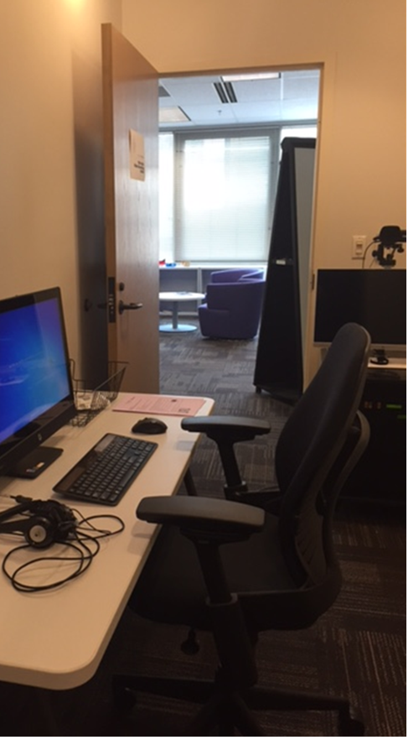
Meeting the Needs of Faculty
Central location
Staff nearby
Multi-purpose
Self-service
Tools
Screen recorder
Camtasia
Notes:
We really wanted to meet the needs of the faculty with this studio. The location was located near faculty offices and directly in the office of instructional transformation with easy access to staff
Multi-purpose. User could have a quiet space to do a screen capture or video; they could then save their video to the cloud as well as to a zip drive, and they could take the ideo and go or give it to staff for further processing
Self-service, Mostly
The computer is loaded with a tool set that includes the ilos screen recorder, Camtasia, and Premier and has internet for access to Office 365 and any cloud tools.

Slide 27
Notes:
This video demonstrates how a faculty member used the the studio to translate an in-class activity to an online exercise.

Slide 28
Notes:
Video was edited and embedded in an Articulate Storyline lesson

Slide 29
Notes:
This video was created by a faculty member who was asked to give a guest lecture.

Slide 30
Practice Job Interviews
Notes:
One unanticipated use of the room was for recording practice student job interviews. The interview was conducted and recorded in the studio and captured on a zip drive. The student then brough the video to the conference room next door where the program director reviewed it with them and provided suggestions.

Slide 31
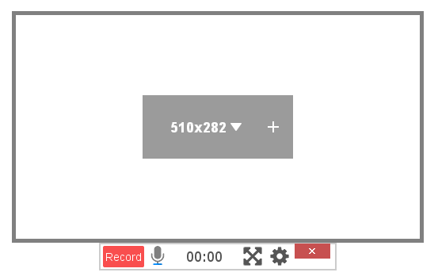
Screen Recording

Slide 32
Notes:
This has been a constant iterative process to produce the highest quality videos possible. This slide illustrates some of what we have learned. First, reconsider the side-by-side presentation. Next, review the slides of the presenter ahead of time for readability. Last, but certainly not least, clean up the background before recording. In this particular instance, our backdrop curtain fell down and in our hurry, we didn’t realize how cluttered the background was. We are still experimenting with settings to address clarity vs. streaming.

Slide 33
Expansion
Online Special Education Program
STELAR

Slide 34
TL;DR
You can find the right complexity and cost for your institution
Keep working at it (iterate!)

