Slide 1
Building Social Presence and Collaboration Online
Kim Ballard, PhD
Kimi Johnson, PhD
University of Minnesota
Notes:
Kim

Slide 2
Agenda
2 Courses; 3 Projects
CMGT 4550: Construction History
MUS 1013: History of Rock to 1970
Notes:
Kim

Slide 3
Engagement is...
Skill Set
Challenge
Positive Affect
Sustained Behavior
Positive Product
Motivation
Self-Efficacy
Notes:
Kim
When a student is engaged they have a
positive affect
sustained behavior to complete the task
produce a positive product
Complex construct
Effort, Involvement, Investment
Ultimate engagement = Flow where skill set is adequate to meet the challenge. In the zone

Slide 4
Engagement is...
Skill Set
Challenge
Positive Affect
Sustained Behavior
Positive Product
Motivation
Self-Efficacy
Notes:
Kim
Supporting players in engagement
Skill set
Challenging enough
Motivated
Believes they can successfully accomplish the task at hand.
Complex construct
Effort, Involvement, Investment
Deep attention to the learning task
Activation of cognitive processes
rehearsal
organization
visual imagery
use of metacognitive skills where am I in this task, what do I need to do to complete it successfully?
Ultimate engagement = Flow where skill set is adequate to meet the challenge. In the zone

Slide 5
Building Engagement
Build community with interaction
Provide adequate support structures
Give feedback early and often
Notes:
Kim
build relationships
Student to instructor
Student to student
What do students need to successfully complete the task?
Do they need help with special skills--such as technology

Slide 6
Building Social Presence
Notes:
Kim

Slide 7
Collaborative Assignment Tools
Notes:
Kim

Slide 8
Benefits of Collaborative Projects
Builds 21st Century Skills
Breaks monotony of memorization, quizzes, papers, and exams
Provides Relevance - Individual choice in projects
Synthesis, application, and presentation of concepts
Variety and just plain fun!
Notes:
Kim
21st Century Skills
Learning Skills
Critical Thinking
Creative Thinking
Collaborating
Communicating
Literacy Skills
Information Literacy
Media Literacy
Technology Literacy
Life Skills
Flexibility
Initiative
Social Skills
Productivity
Leadership
21st Century Skills

Slide 9
Construction History
Fully online, 7 weeks/2 credits
Primarily adult learners
Many students already in the industry
Lower tech threshold
Guest lecturer
Needed collaborative projects to supplement content delivery
Moodle Site

Slide 10
Assignments
Tiki Toki
Group Assignment
Blog
Individual Posts - 1st Week
Group Posts
CHSA Conference Post - Individual
Notes:
Kim
For the first week, you will post individually and comment on two of the other posts. In the subsequent weeks blog posts are a group assignment. Over the semester, each group will be assigned one module to summarize/analyze and post their summary to the course Blog. The group is expected to meet and post by Thursday evening, and the class will discuss the posts in the blog comments each week. For more information please read the Blog Assignments document.
Tiki Toki
Construction History Society of America Conference

Slide 11
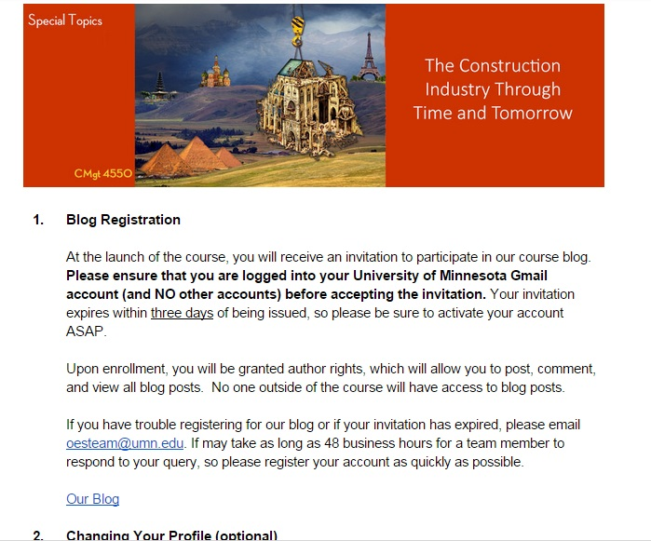
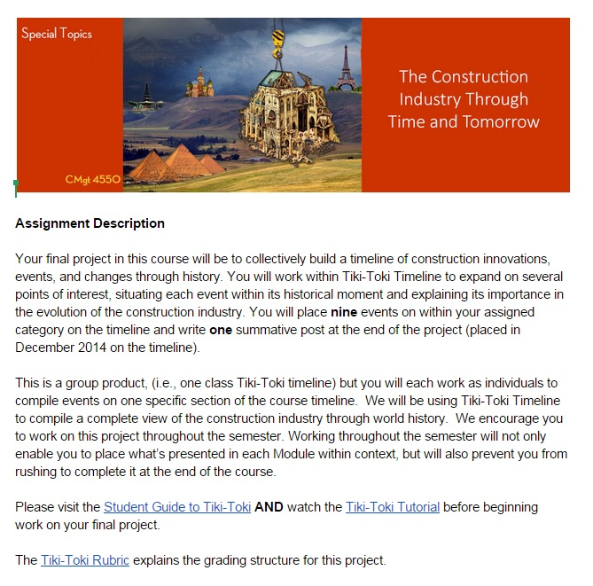
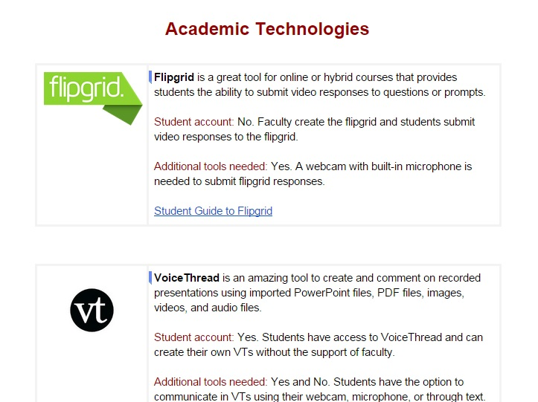
Tech Support Materials
Notes:
Kim

Slide 12
Third Party Tools In Practice
Notes:
Kimi
What works for Tiki Toki
What was complicated
Take away

Slide 13
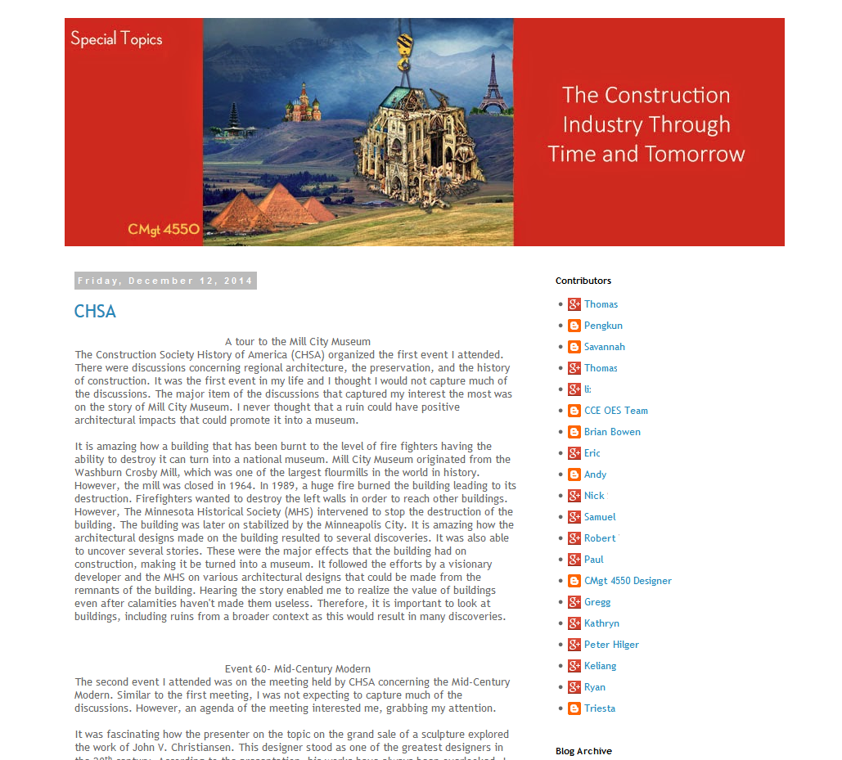
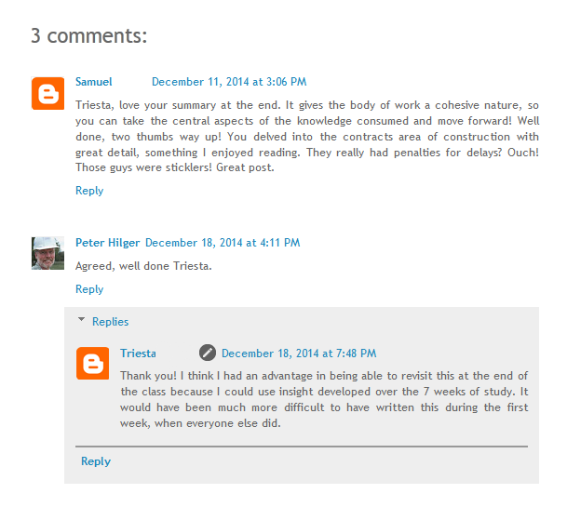
Notes:
Kimi

Slide 14
Student Feedback
I get the blog idea, but I the obsession with "technology" is a poor substitute for community building.
I am a returning student with great thirst to learn. I spent hard earned money, too.The way that this is set up requires much ‘risk’ on my part. I almost dropped it because I was not sure that I would be able to work in groups and on required “technology”.
Notes:
Kimchi

Slide 15
Student Feedback
There were lots of instructions, probably too many for the short duration of the course. Most of us missed the instructions for applying the framework to the timeline entries.
Perhaps a hands on workshop explaining the technology features of the class would be helpful.
Thank you for your help with learning the technologies for this course! Once I got the hang of Tiki-Toki, I thought the project was a fun way to cap our learning for the class.
Notes:
Kimchi

Slide 16
Instructor Feedback
I was a bit skeptical about the Tiki-Toki but admit it was a great idea. I think the TT course assignment could be improved [with adjustments to make this a more substantive project].
[...R]evisit the blogging assignments. Getting them to comment on each module seemed to enlist them to précis the content – not much of a challenge there.
Recommends regular check-ins to provide tech help.
Notes:
Kimchi

Slide 17
Effectiveness
Timeline project was a success; needs slight alteration
Blog concept was successful; needs alteration
Blogger is not the right technology
Recommend the blog uses Moodle native tools
One new, third-party technology seems sufficient for a course
Notes:
Kimchi

Slide 18
Lessons Learned (Takeaway)
Adult Learners have a different perception of technology and its presence in the online classroom.
Third party tools and technologies that fall outside of the telecommuting category can be intimidating.
High threshold for use was off-putting.
Notes:
Kimchi

Slide 19
Historical Origins of Rock Music to 1970
14 weeks, Fully online, undergraduate learners (core requirement elective)
Students are more tech savvy
No lecture; content delivered through text, study notes, and YouTube playlist
Before revision, course had no collaborative component
Moodle Site
Notes:
Kimi

Slide 20
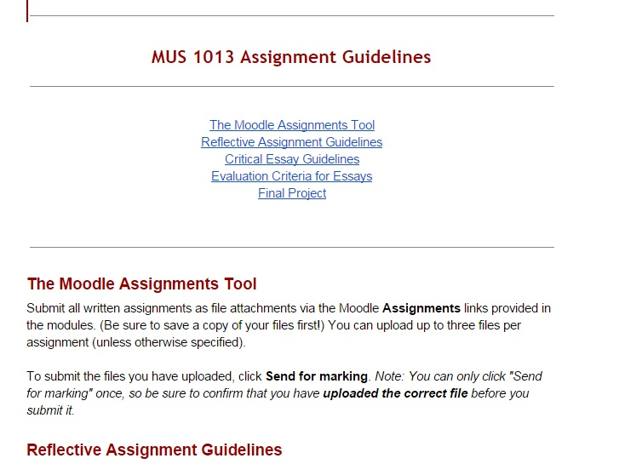
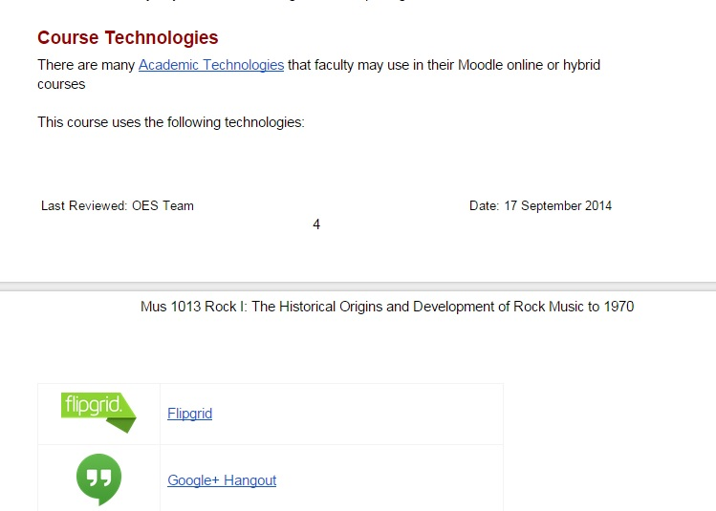
Tech Support Materials
Notes:
Kimi

Slide 21
YouTube Project in Practice
Notes:
Kimi

Slide 22
Student Feedback
Little individual accountability
21st Century Skills don’t translate
Doesn’t seem content driven
Notes:
Kimi
Very little accountability on project submission
Some of the skills don’t make sense in the scope of the class
Project is fun, but doesn’t seem content driven in early stages
Very little accountability on project submission
Some of the skills don’t make sense in the scope of the class
Project is fun, but doesn’t seem content driven in early stages

Slide 23
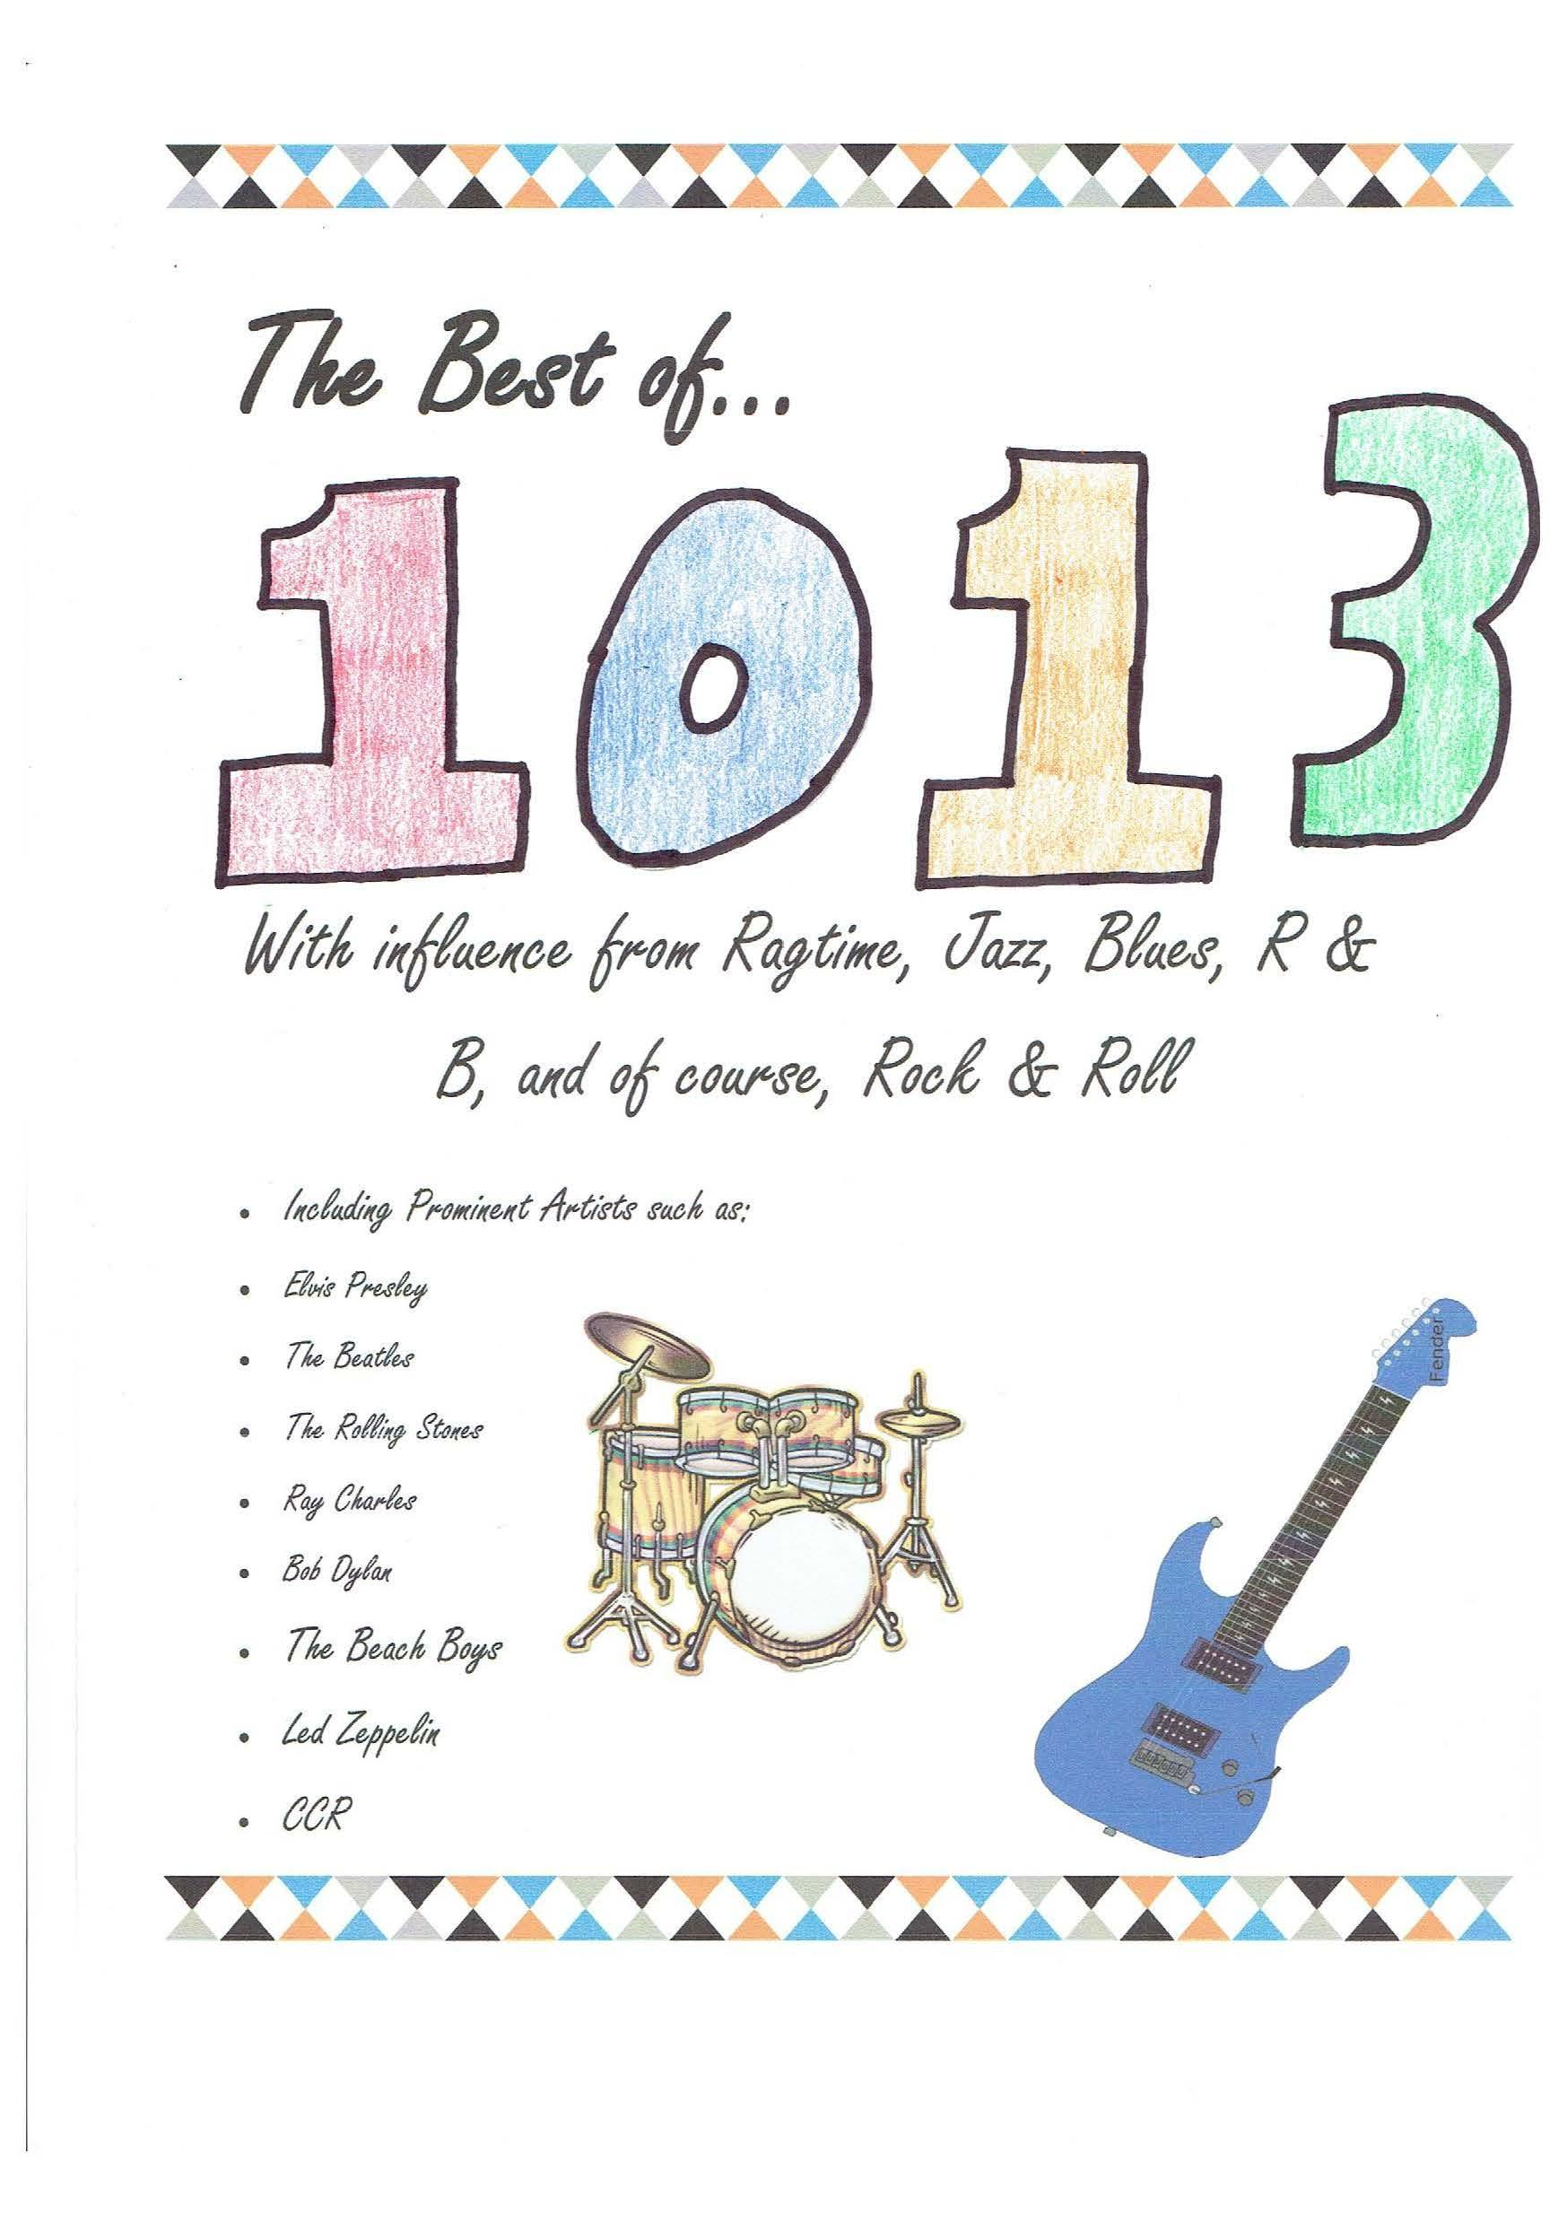
Instructor Feedback
Difficult to grade
Collaboration not effective in practice
Difference in tech skill levels
Initial work not content driven
Tech creates extra work for instructor

Slide 24
Lessons Learned (Takeaway)
Project will be revised to:
Contain 2 parts, not 5
Be an individual assignment
Solicit class feedback on finished product
Use Moodle Tools
Allow for more instructor feedback
Focus on developing one 21st century skill
Expand reflection component
Notes:
Kimi

Slide 25
Final Takeaways
DO Experiment!
DO Create solid prompts
DO Provide assignment justifications
DO Make projects substantive
DO Design for your audience
DON’T Over-technologize
DON’T Be afraid to revise!
http://z.umn.edu/buildingsocialpresence
Notes:
Kimi

