Slide 1
MN eLearning Summit
Active Learning: An essential element for student engagement in online course design and delivery

Slide 2
Introductions
Arshia Khan Ph.D
Brooke Palkie Ed.D
Ona Egbue Ph. D

Slide 3
Objectives/Outcomes
Student engagement in online course design
How Mobile learning can improve student engagement?
Active learning that can be applied to online/hybrid or face-to-face classes

Slide 4
Participant Participation
Poll Everywhere
*Ona – will please add brief instructions for the audience?

Slide 5
Course Design
Main Elements:
First view of online course
Identifying Deliverables / Resources
Navigation
Instructional Material
Discussions
Assessments

Slide 6
Course design
Use of templates
Best practices

Slide 7
Development of Community
Start with a warm welcome
Clear expectations
Design a welcome page for each unit
Provide audio options
Incorporate applications/activities (even if not graded) for each unit
Provide multiple types of assessment options
Consistency with intuitive navigation
Provide both virtual (synchronous) and offline (asynchronous) activities
Make sure to have enough instructor involvement

Slide 8
Discussion
Types:
General questions/logistics (not graded)
Subject matter (graded)
Groups
Role playing
Debates
Virtual rooms (Synchronous learning)
Online Office hours

Slide 9
Assessment
Alternative Options:
Polls
Rubrics
Debates

Slide 10
Use of Rubrics
Are you truly articulating the assignment expectations?
How to best use a Rubric:
Guide students in performance
Teaching students that learning is their responsibility
Provide both the scoring sheet and all definitions
Highlight self reflection
Teach students to use the rubrics to self reflect on assignments before submission
Take away the guessing game
Lends to equality in grading and standardized expectations
Clearly delineate point values
Utilize rubrics to identify student strengths and support any weaknesses
Enhance the visual representations to students with individualized feedback within the rubric

Slide 11
Use of Bloom’s Taxonomy
Understanding the levels of Bloom’s
Identify how/where content is introduced
Do you know the content you want woven throughout the curriculum?
Identify how it is leveled throughout the curriculum
Does it meet the necessary level where intended?
Provide examples of levels to faculty
Make it a group

Slide 12
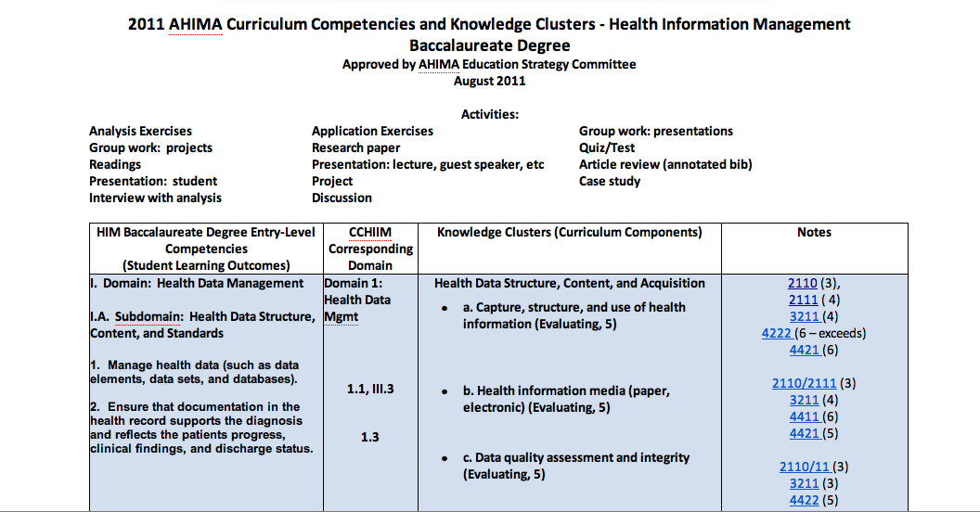
Use of Google Docs

Slide 13
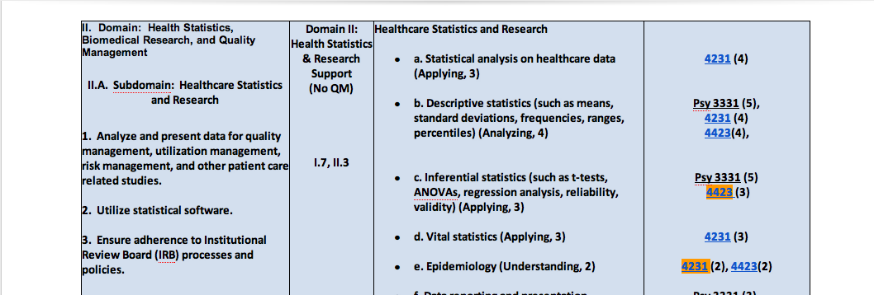
Linking of Google Docs

Slide 14
Instructional Materials
Tools:
Videos
Annotated powerpoints
Podcasts
Mobile device accessibility

Slide 15
eLearning Tools
Cooperative Learning / Research
Demonstrations
Audacity
Blogs/Wikis
Group Pages
Adobe Connect
Instructor Feedback
Jing
Camtasia
You Tube
ePortfolios
Turnit-in
Instructor Feedback
Jing

Slide 16
Time Management
Faculty
Course Design
Delivery
Students
Expectations
Time commitment
Independent

Slide 17
Frustrations
Faculty
time
resources
advisement
Questions/clarifications
Student
Lack physical proximity
Community/Belonging
Awareness of expectations

Slide 18
Collaborations
What can they lead to?
Technology
Cross Discipline Collaborations
Creation of a Community atmosphere

Slide 19
Academic / Industry Partnerships
Important for the college/university:
Recruitment
Research/scholarship
Importance for faculty:
Strengthen the skills of faculty
Keeps faculty current
Informs curriculum development
Research/Scholarship
Important for students:
Obtain real hands on experience
Jobs!

Slide 20
How to collaborate
Where to start?
Find something that is mutually beneficial
Training
Grants
Other needs…
Organizing the partnership
Need a champion from the college and a champion from the industry partner
Be creative!

Slide 21
Questions

Slide 22
Resources
American Productivity and Quality Center, Assessing Learning Outcomes. Consortium Benchmarking Study, Best–in-Class Report (Houston: American Productivity and Quality Center, 1998), 9-10. 43 institutions participated in the study.
Association of American Colleges and Universities. Taking Responsibility for the Quality of the Baccalaureate Degree. (Washington, D.C.: Association of American Colleges and Universities 2004) chapter 3.
http://assessment.uconn.edu/docs/resources/AAHE_Principles_of_Good_Practice.pdf

Slide 23
Resources
Bloom, B. S. (1969). Taxonomy of educational objectives: The classification of educational goals : Handbook I, Cognitive domain. New York: McKay.
Bloom, B. S., et al. (1994). Excerpts from the "Taxonomy of educational objectives, the classification of educational goals, handbook I: Cognitive domain." In L. W. Anderson & L. A.

Slide 24
Resources
Gronlund, N. E. (1991). How to write and use instructional objectives, Fourth Ed. New York: Macmillan Publishing Co.
https://www.qualitymatters.org/rubric
Newell, William H. Educating for a Complex World: Integrative Learning and Interdisciplinary Studies. Association of American Colleges & Universities
https://www.aacu.org/publications-research/periodicals/educating-complex-world-integrative-learning-and-interdisciplinary

Slide 25
Resources
Fink, L. Dee. (2015) Designing Instruction for Significant Learning. National Education Association http://www.nea.org/home/34960.htm
Poll, Kathleen, Widen, Jeanne, and Sherrie Weller. (2014) Six Instructional Best Practices for Online Engagement and Retention Best_Practices_for_Online_Engagement_and_Retention_Poll_Widen_Weller_2.pdf

Slide 26
Resources
Person (2014) http://www.pearsoned.com/news/pearson-releases-report-on-best-practices-for-implementing-successful-online-programs-at-higher-education-institutions/

