Slide 1
State Authorization for Distance Education, Minnesota Update
Todd Digby
Minnesota State Colleges & Universities
Sandra Ecklein
University of Minnesota

Slide 2
What is the Issue?
States and territories regulate higher education within their borders, with varying requirements for out-of-state institutions that want to do business in the state.
Cross-state online education offered by colleges and universities is expanding dramatically.
Each institution separately pursues needed approvals (state authorization) in each state and territory where it enrolls students.
Consequently, thousands of institutions are required to contact and work through as many as 54 states and territories, and, sometimes, with multiple regulatory agencies in those states.
That process is inefficient, costly, and not effective in supporting access to high quality distance education throughout the country.

Slide 3
Current status of State Authorization
2010 language was set aside by the courts. This only affected federal DOE’s ability to enforce.
State regulators became more aware and have continued and increased their enforcement of out of state education providers.
Institutions are still required to be authorized in all states that they have students residing in. Individual state rules apply.
Federal DOE entered into negotiated rule making to reintroduce 2010 language.

Slide 4
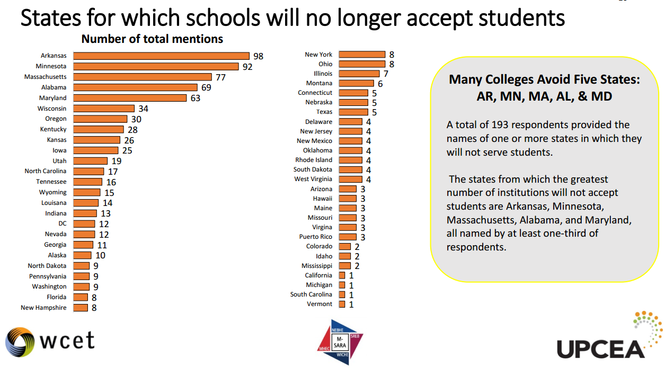

Slide 5
Goals of SARA
SARA establishes a state-level reciprocity process that will support the nation in its efforts to increase the educational attainment of its people by making state authorization:
more efficient, effective, and uniform in regard to necessary and reasonable standards of practice that could span states;
more effective in dealing with quality and integrity issues that have arisen in some online/distance education offerings; and
less costly for states and institutions and, thereby, the students they serve.

Slide 6
Participation in SARA
$2,000/year for institutions with fewer than 2,500 FTE students
$4,000/year for institutions between 2,500-9,999 FTE students
$6,000/year for institutions with 10,000 or more FTE students

Slide 7
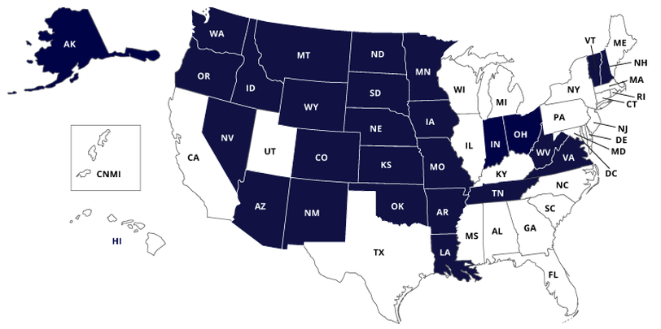
Current SARA Status
27 States are members of SARA (July 2015)

Slide 8
Other States - SARA Status
Enabling legislation passed but have yet to apply to Regional Compact.
Alabama (SREB)
Hawaii (WICHE)
Illinois (MHEC)
Maine (NEBHE)
Maryland (SREB)
Michigan (MHEC)
Mississippi (SREB)
Rhode Island (NEBHE)
Texas (SREB)
Utah (WICHE)
Legislation introduced but not yet passed.
California (WICHE)
Connecticut (NEBHE)
New York
Pennsylvania

Slide 9
SARA Institutional Participation in MN
32 MN institutions are members of SARA (July 2015)
Adler Graduate School
Alexandria Technical College
Bemidji State University
Bethel University
Capella University
Concordia University, St. Paul
Crown College
Hamline University
Hazelden Graduate School of Addiction Studies
Hibbing Community College
Lake Superior College
Luther Seminary
Martin Luther College
Mesabi Range College
Metropolitan State University
Normandale Community College
North Hennepin Community College
Northland Community and Technical College
Northwest Technical College
Oak Hills Christian College
Rasmussen College
Riverland Community College
St. Catherine University
St. Cloud Technical and Community College
University of Minnesota Crookston
University of Minnesota Duluth
University of Minnesota Morris
University of Minnesota Rochester
University of Minnesota Twin Cities
University of St. Thomas
Walden University
William Mitchell College of Law

Slide 10
SARA for Minnesota
MHEC- SARA http://www.mhec.org/sara
http://www.nc-sara.org/content/sara-state-status
MnSCU State Authorization page
http://asa.mnscu.edu/educationalinnovation/stateauthorization/index.html

Slide 11
Contacts
Todd Digby Minnesota State Colleges & Universities todd.digby@so.mnscu.edu
Sandra Ecklein eLearning Analyst
University of Minnesota
eckle001@umn.edu

