Slide 1
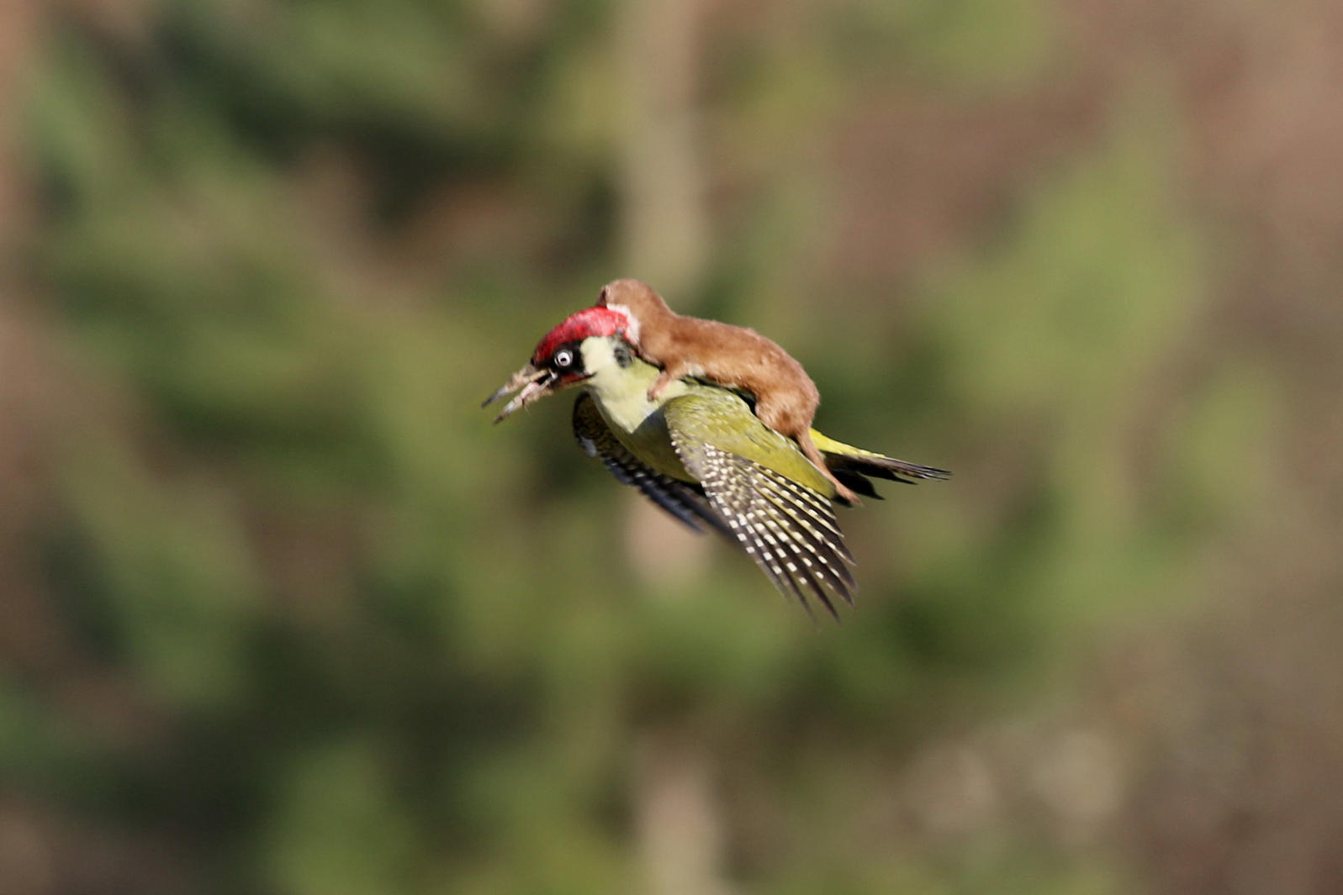
Flying Weasels and Snoring Hummingbirds: Techniques to Discover & Critically Read Quality Images
Greta Bahnemann Jennifer Hootman
Digitization, Cataloging & Metadata Education Reference Outreach & Instruction
bahne002@umn.edu hootm001@umn.edu
Credit: Photo by Martin Le-May
http://www.audubon.org/news/the-weasel-could

Slide 2
Credit: Video by forrestertr7
https://www.audubon.org/news/can-hummingbirds-snore
Can hummingbirds snore?

Slide 3
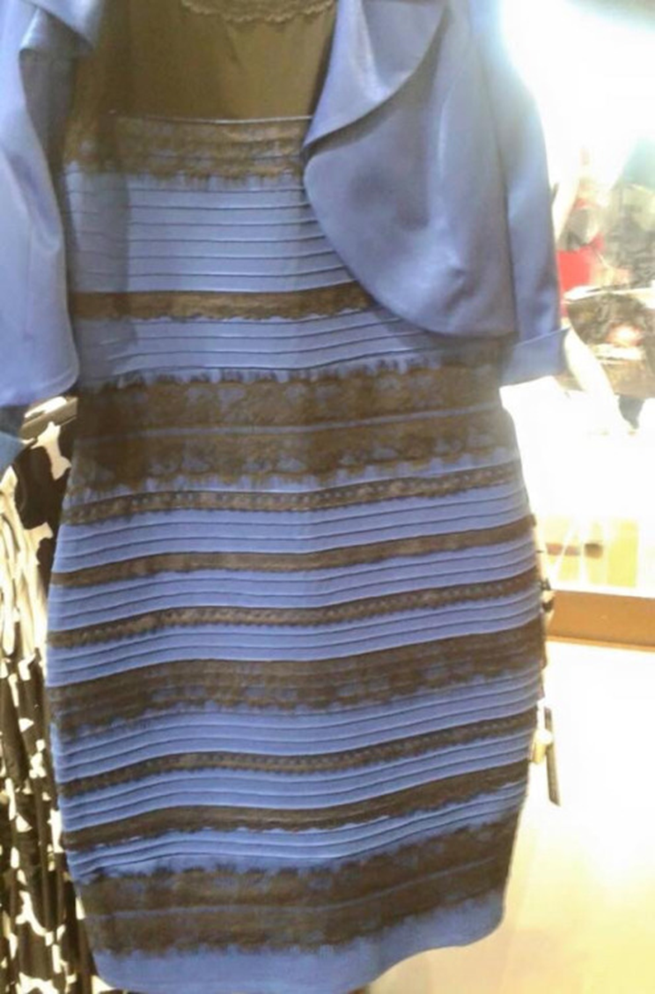
Is this dress blue and black or white and gold?
Credit: https://www.psychologytoday.com/blog/logical-take/201502/the-blueblack-whitegold-dress-controversy-no-one-is-right

Slide 4
How do we know what we know?
How do we understand what we see?
Is there a way to “read” the internet?
Make sense of it?
Apply context?
To be better judges of
multi-media content?

Slide 5
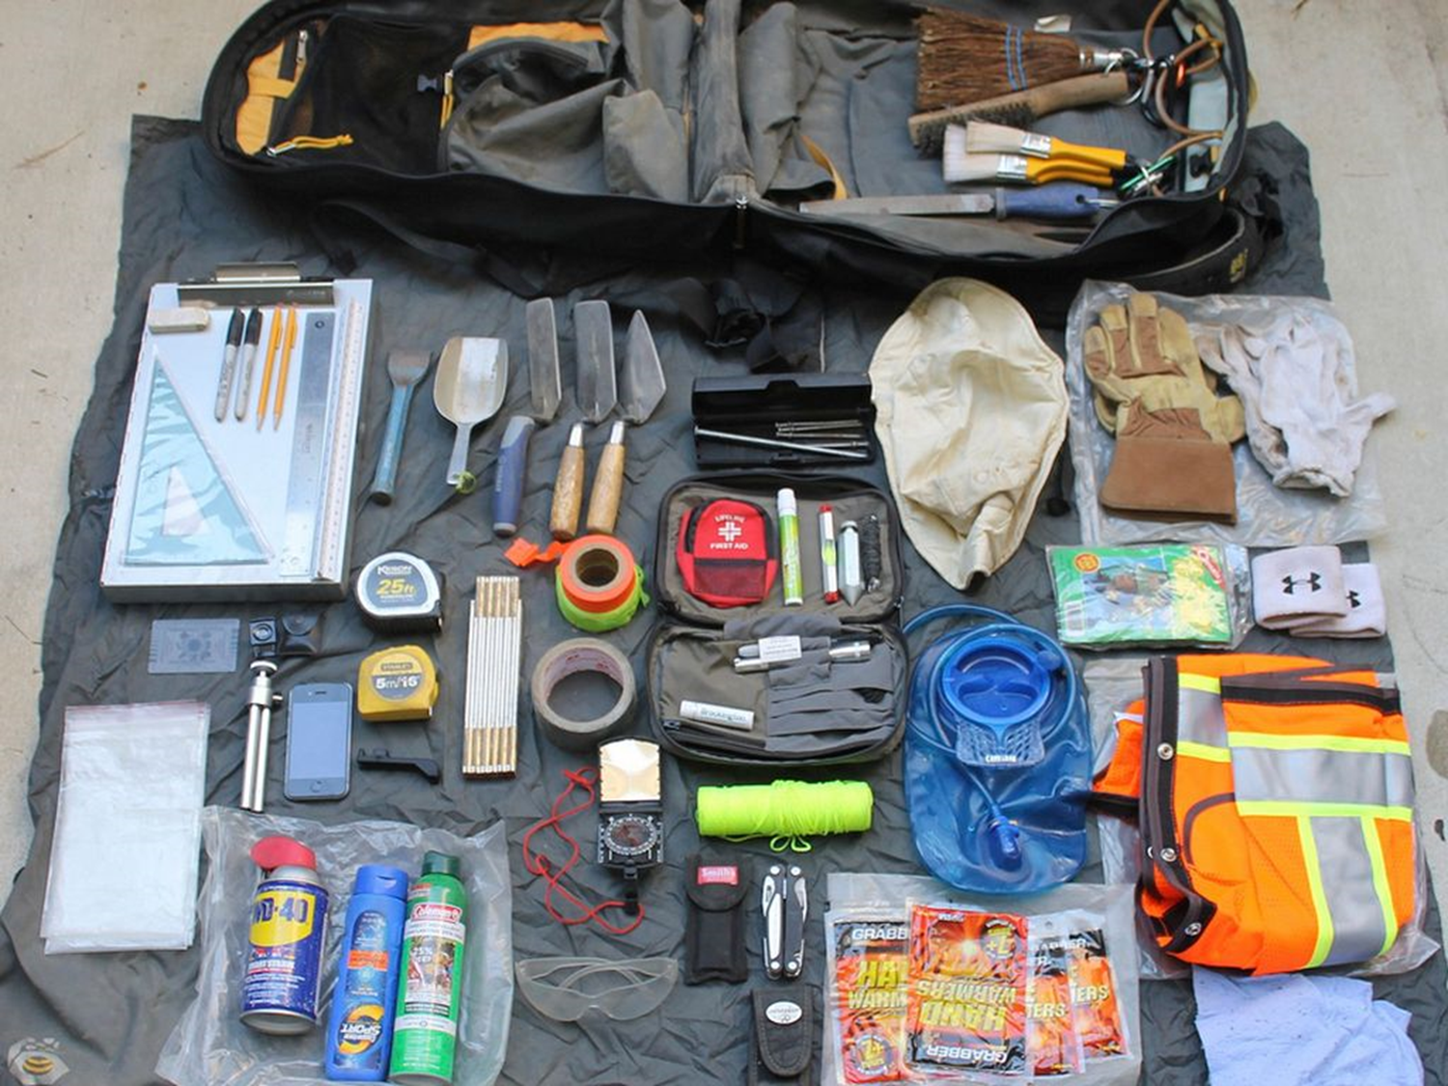
Tools for Finding Quality Images
Created with Haiku Deck
Photo by TerryBrock - Creative Commons Attribution-NonCommercial License https://www.flickr.com/photos/33147452@N05
Notes:
Today’s Presentation:
Overview of Finding quality images and content
Leveraging Google
ELM
Resources/Tools for analyzing primary sources
Vetting Digital content
Vetted content = MDL/DPLA

Slide 6
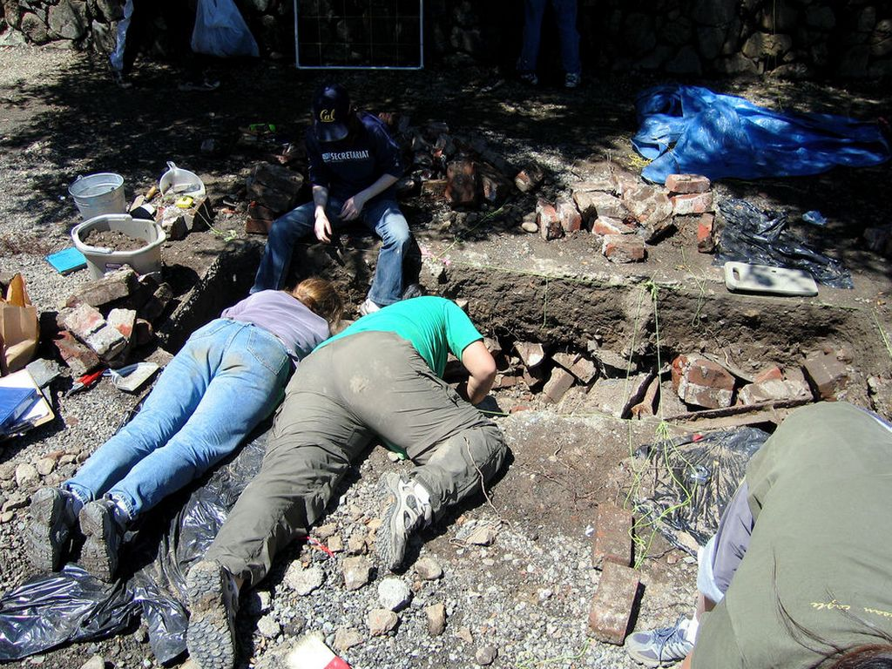
Discovering Digital Content: Search Tips
Domain Specific
inurl:gov
inurl:edu
inurl:org
Site Specific
site:umn.edu
site:lib.umn.edu
site:mnhs.org
site:loc.gov
Examples
abraham lincoln inurl:gov digital collection
world war I inurl:edu digital library
Photo by peterme - Creative Commons Attribution-ShareAlike License https://www.flickr.com/photos/35468145500@N01
Created with Haiku Deck

Slide 7
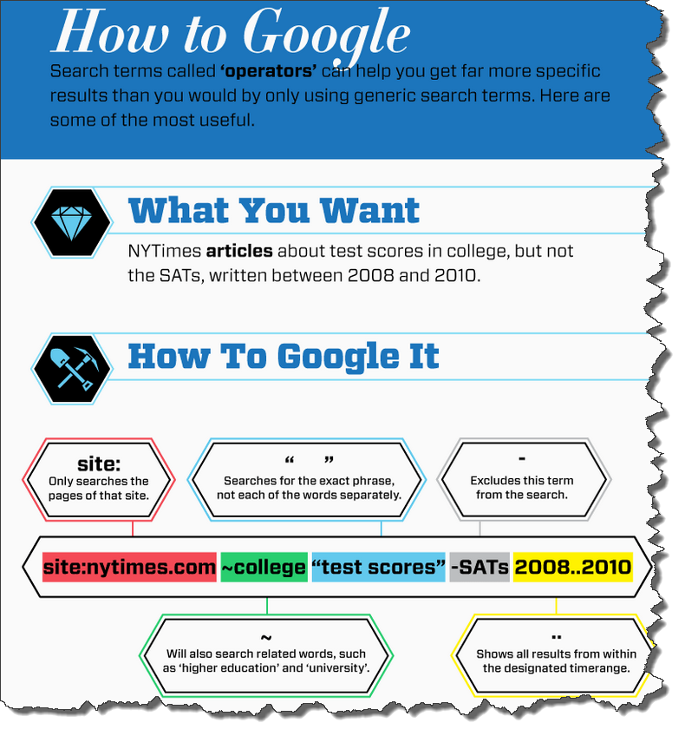
Example
site:org "digital collections" "civil war"
-lincoln 1860..1865
To learn more power searching tips check out Hack College's infographic, Get More Out of Google: Tips & Tricks for Students Conducting Online Research
http://www.hackcollege.com/blog/2011/11/23/infographic-get-more-out-of-google.html

Slide 8
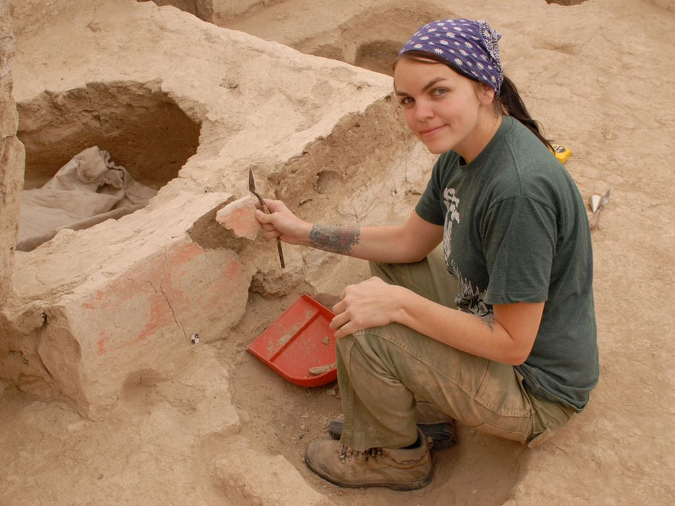
Discovering Quality Images in
Britannica Library
Research In Context
Student Resources In Context
Explora (Kids, Teens, Library)
CAMIO
Consumer Health Complete
Kids InfoBits
Photo by Dr._Colleen_Morgan - Creative Commons Attribution License https://www.flickr.com/photos/56323217@N00
Created with Haiku Deck

Slide 9
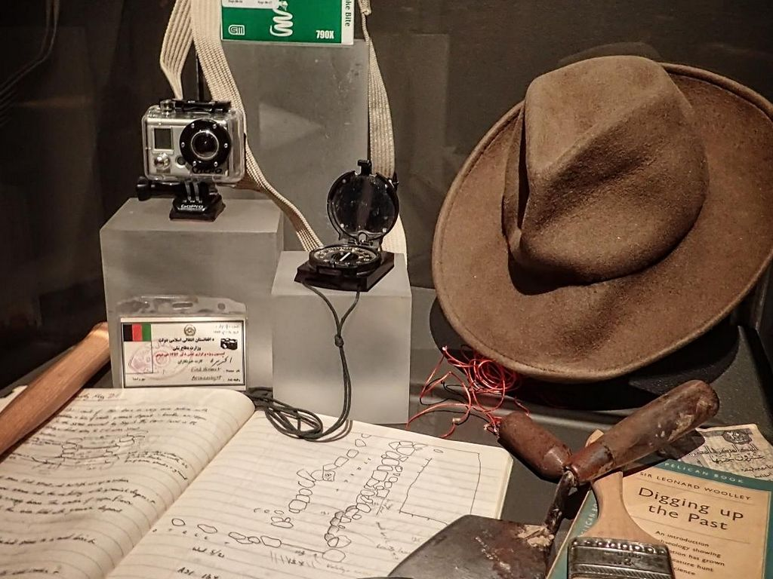
Resources for Analyzing Primary Sources
History Matters
Making Sense of Evidence
z.umn.edu/histmatters
National Endowment for the Humanities
Tools for Analyzing Primary Sources and Close Reading
z.umn.edu/nehprimary
Library of Congress
Using Primary Sources
z.umn.edu/locprimary
National Archives
Docs Teach
docsteach.org
Created with Haiku Deck
Photo by mharrsch - Creative Commons Attribution-NonCommercial-ShareAlike License https://www.flickr.com/photos/44124324682@N01

Slide 10
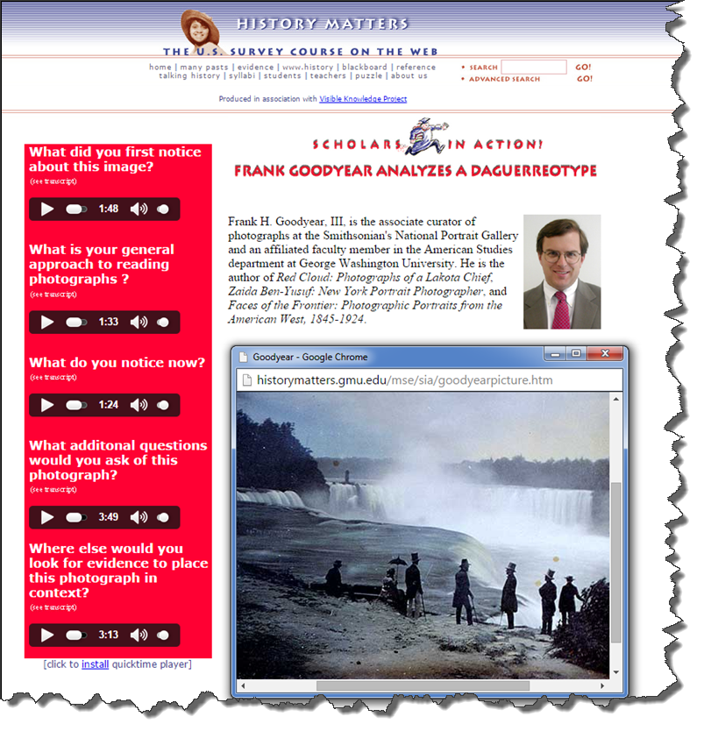

Slide 11
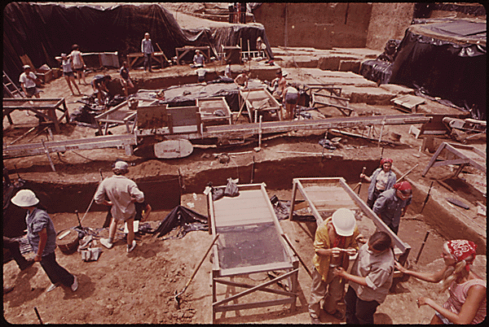
Criteria for Vetting Digital Content
Trusted Source
Searchable and Discoverable
Persistent
Citation Ready
Evidence of Good Metadata
Reliable Funding Source
Retention of Original Context

Slide 12
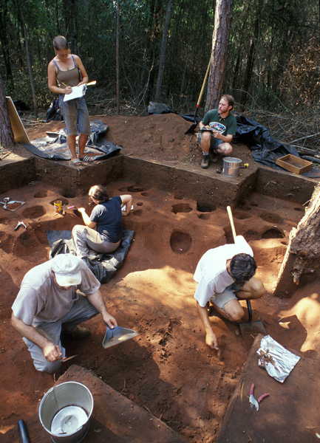
Does the content came from a Trusted Source?
Museums - Historical Societies
Libraries - Archives
Colleges - Universities
vs.
Google images
Personal websites
Pinterest
Wikipedia

Slide 13
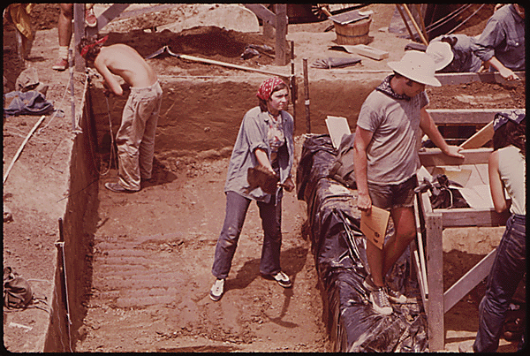
Is the content Searchable and Discoverable?
Searchable
Search / Advanced Search
AND
Discoverable/Browse-able via OTHER access points
Dates (date spans or ranges)
Formats (photographs oral histories, etc.
Subject matter (Native Americans, the CCC in Minnesota, Jane Adams, etc. )
Named collections (Ray Segar Map Collection)
Is the content Searchable and Discoverable?
Searchable
Search / Advanced Search
AND
Discoverable/Browse-able via OTHER access points
Dates (date spans or ranges)
Formats (photographs oral histories, etc.
Subject matter (Native Americans, the CCC in Minnesota, Jane Adams, etc. )
Named collections (Ray Segar Map Collection)

Slide 14
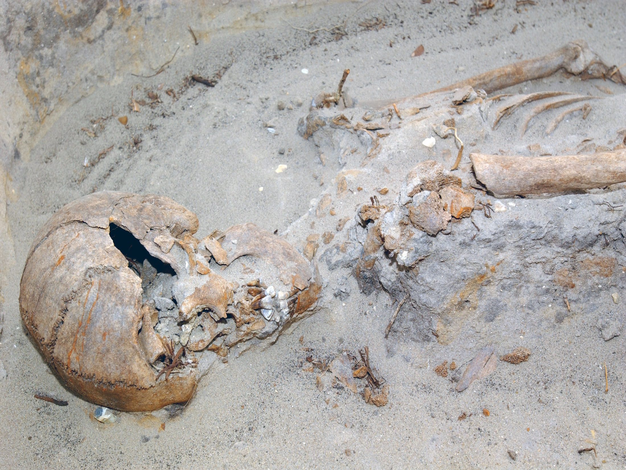
Is the content Persistent?
Will the resource be there tomorrow?
Will it be there next week?
Will it be there next year?

Slide 15
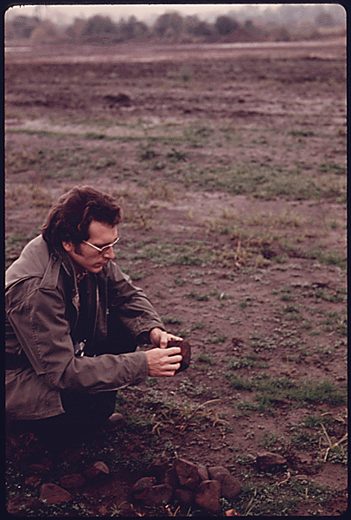
Is the content Citation Ready?
Can you easily tell the source?
Can you credit the source?
Is the content Citation Ready?
Can you easily tell the source?
Can you credit the source?

Slide 16
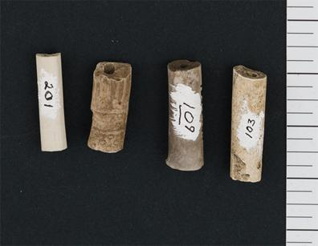
Is there evidence of Good Metadata?
Is there Descriptive Information associated with the content?
Who?
What?
When
Where?
Is there Administrative Information associated with the content?
Who owns the content?
Contact information?
Rights Statements included?

Slide 17
Does the content have a reliable funding source?
Is the project funded by a trusted institution or a government agencies?
Is the project sponsored by an individual or created as part of class project?
Notes:
Project funded by trusted institutions, government agencies, etc. have a longer shelf life than projects sponsored by an individual

Slide 18
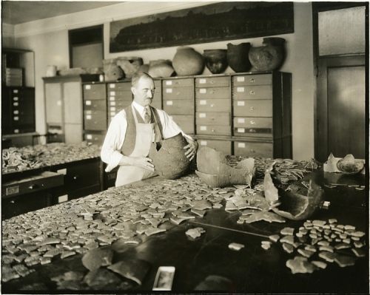
Does the content show Retention of Original Context?
Can you easily understand how a single item or page relates to the larger whole?
Can you easily understand how a single item or page relates to the larger whole?
Notes:
How many times have you done a google search and retrieved page 4 out of a document - you don’t know what document or book it came from, date, title, etc.

Slide 19
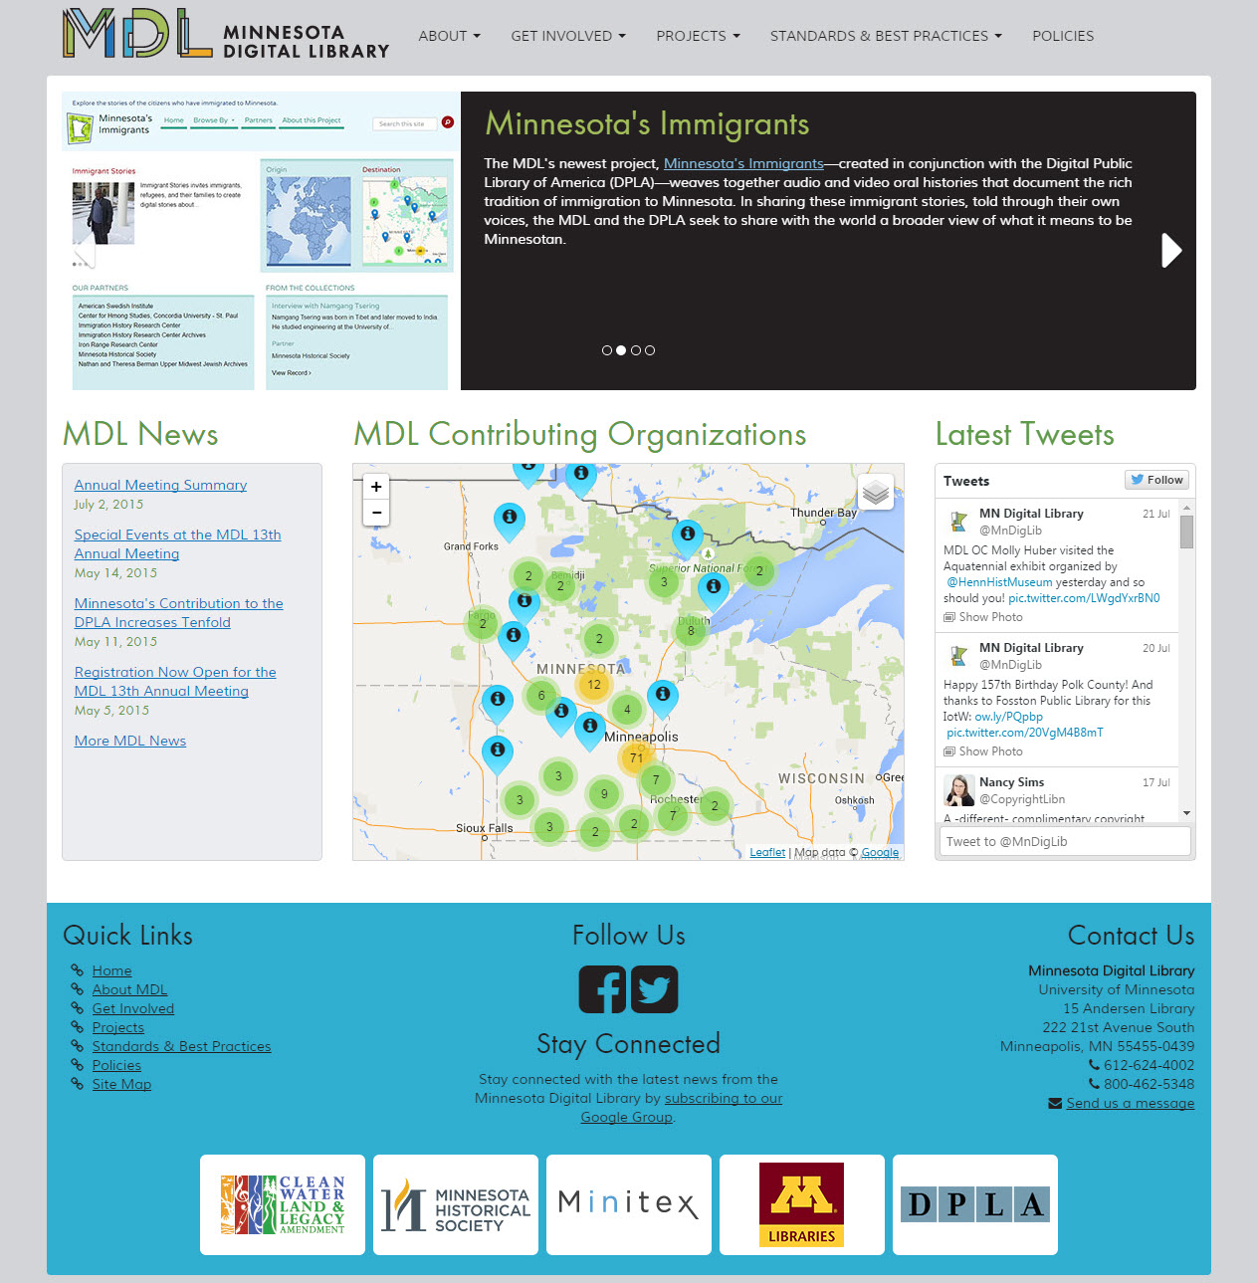
http://reflections.mndigital.org
Notes:
Greta

Slide 20
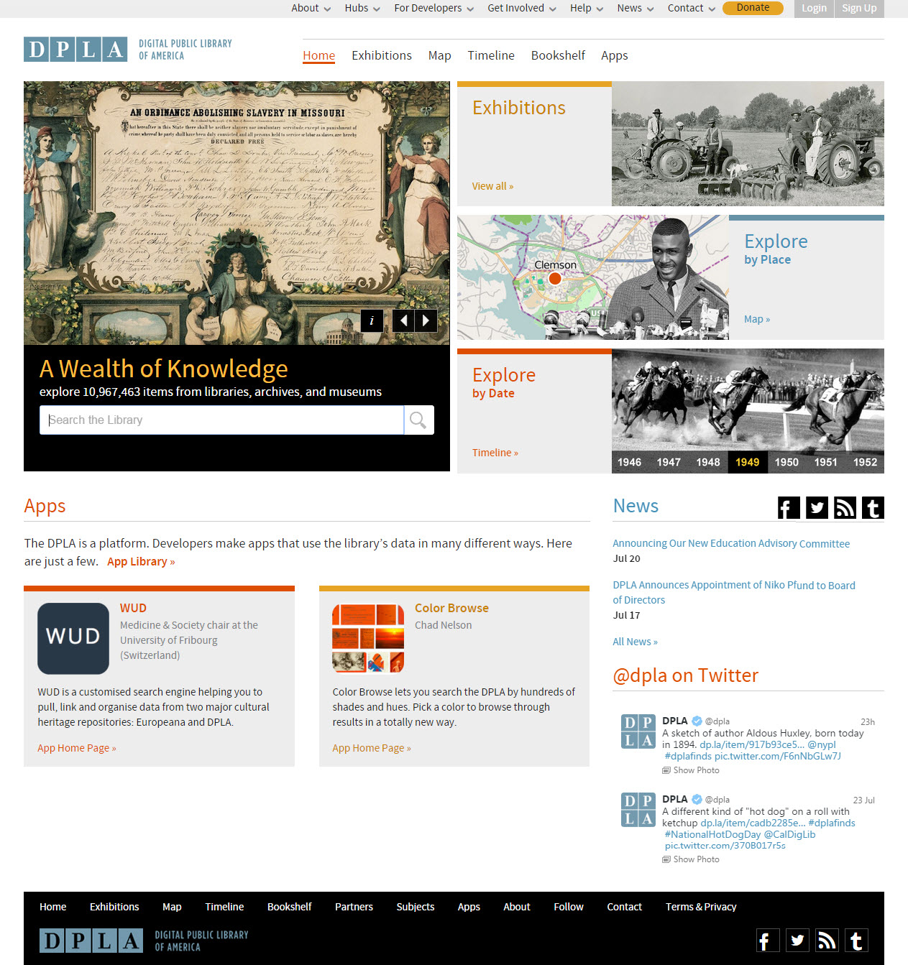
dp.la
Notes:
Dp.la

Slide 21
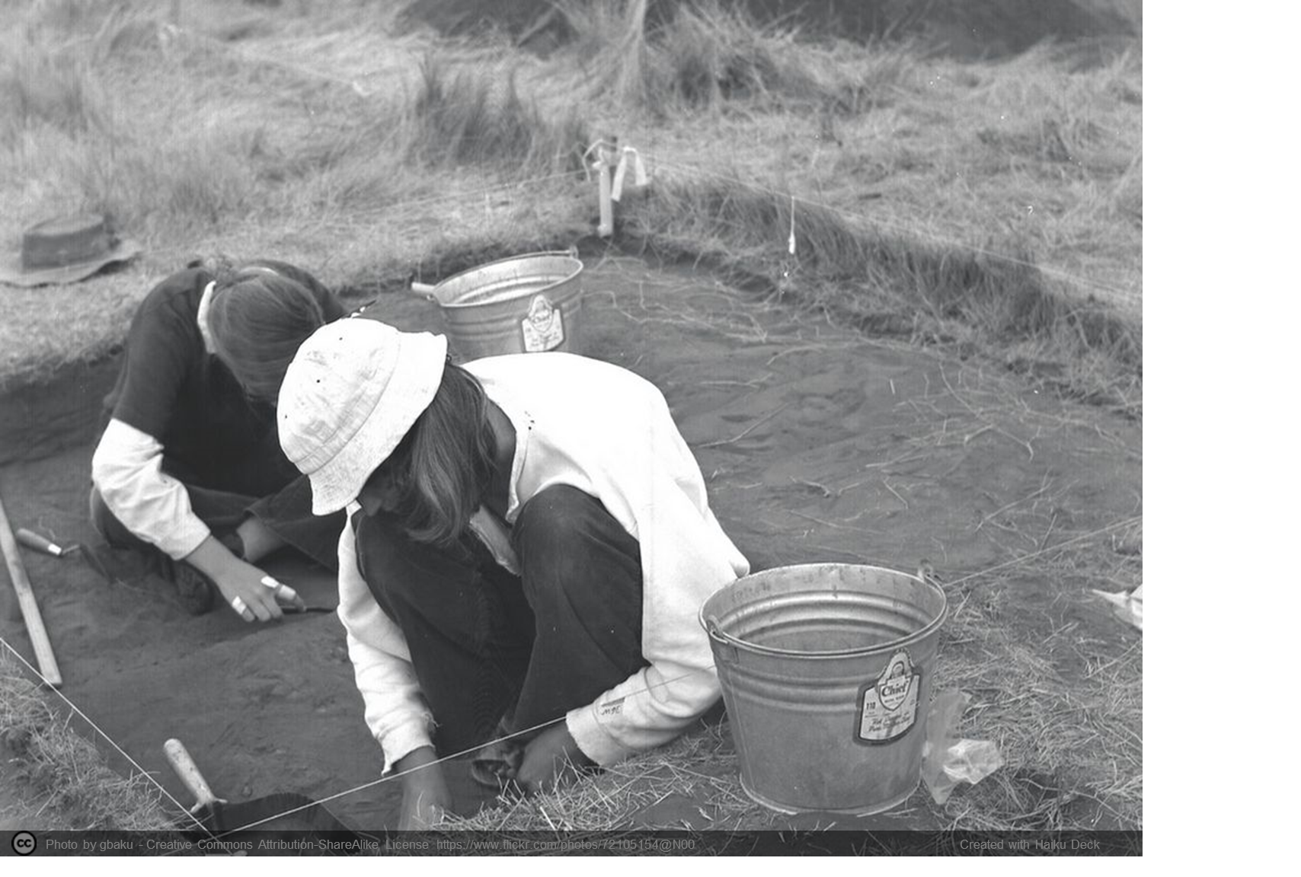
Greta Bahnemann
Metadata Librarian
Minnesota Digital Library
bahne002@umn.edu
612-625-6497
Jennifer Hootman
Reference Outreach & Instruction Librarian
hootm001@umn.edu
612-624-2924

