Slide 1
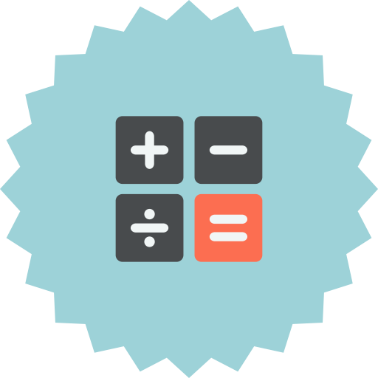
Needs of a Math Course
Helping Teachers Translate
Classroom Techniques into
Digital Environments
Designing a Course
When designing a course, in particular when that course already exists in a face-to-face version, the framework can be used to find solutions that fill the needs of an instructional environment.
Assessing a Course
When presented with an already created course this framework can be used to determine which of the learners' needs been attended to.
Assessing a Tool
When presented with a new or novel use of a tool this framework can be used to determine what needs the tool meets.
Disclaimer:
These examples are not exhaustive and are from the perspective of traditional college math courses.
The framework is intended to guide thinking about your course and should be adapted to your available tools and environment.
Need | In the classroom | Online | Tools | Issues and Challenges
Student Engagement / Social Presence | In Natura | Recorded Introductions Forums | Flipgrid VoiceThread
Orientation to the Course | In Situ | Recorded Tour | Screen Capture (many good options)
Assess Learner Readiness / Clarify Prerequisite Knowledge | Anticipatory Set | Pre-Test Remediating Resources | Learning Management System Publisher resources YouTube playlists | Depending on the course, a great deal of attention could be put toward this goal.
Introduction to New Concept / Modeling of Concept | On board | Recorded Presentation | Screen Capture YouTube playlists
Exploration of Concept / Practice Sets | Seatwork Homework | Mastery-based applications | WebAssign MyMathLab Maple TA, Mathematica PRO
Collaboration / Discourse Learning | Recitation Study Groups | Forums Web Conferencing | Learning Management System Google Hangout | Forums are a difficult and often ill-fitting solution.
Questions and Answers | Office hours Recitation | Forums Web Conferencing | Learning Management System Google Hangout | In practice most students prefer email over forums.
Formative Assessment | In-Class Guided Work Recitation | Synchronous Sessions | Adobe Connect WebEx
 |  | Expert Systems Mastery-based Applications | WebAssign Mymathlab Maple TA, Mathematica PRO
Summative Assessment / Grading | Paper Exams Pen on Paper | Machine graded Annotated PDF | Learning Management System Adobe Reader | Proctoring Mark-up instrument: Wacom or Tablet PC
Connections / Synthesis | Group problems Application problems | Group problems Application problems | Learning Management System | A weak or missing component in most mathematics courses.

