Slide 1
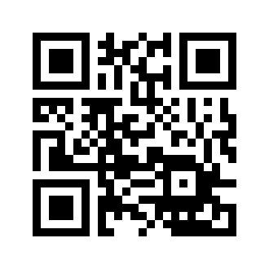
The journey towards successfully flipping the classroom: a community of practice approach
http://tinyurl.com/qefc46k
MINNESOTA ELEARNING SUMMIT
July 29th 2015
Minnesota Technical College
Elizabeth Hill
Mitra Emad
Helen Mongan-Rallis

Slide 2
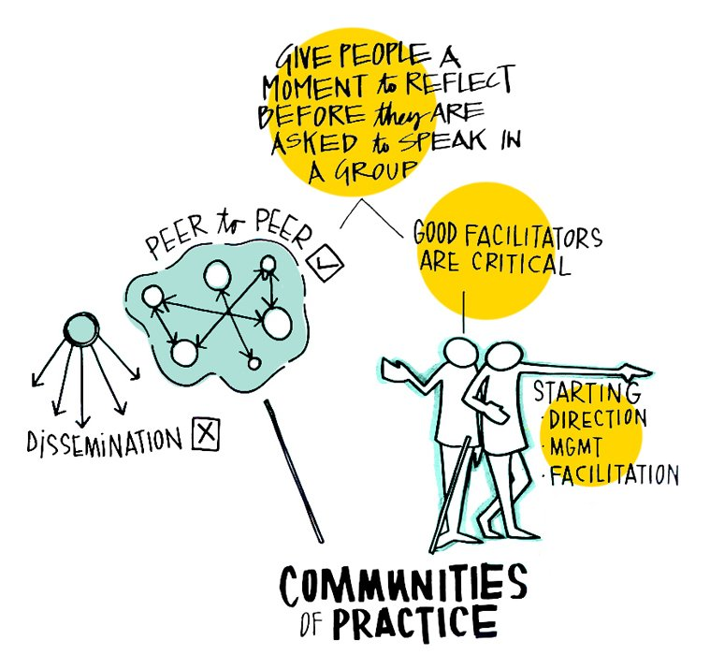
A Community of Practice Approach
A faculty-facilitated Communities of Practice (CoP) helped 27 instructors learn how to flip their classroom.
CoP are groups of people who share a concern or a passion for something they do and learn how to do it better as they interact regularly.
The CoP concept was first proposed by cognitive anthropologists Jean Lave and Etienne Wenger in 1991.
The adjacent image was created at the Global Health Knowledge Management
Share Fair: Challenges and Opportunities by the Value Web

Slide 3
Specific to the Flipped Classroom CoP
What went well
Having a larger cross-collegiate group to introduce the concept and methods of flipping
Hearing perceptions from instructors and their students’ views
Instructor shared resources
What it led to
Skills to participate in CoP for flipped curriculum at college level within SCSE
Collaborative research on team based learning with others from CoP
What we’d change
27 too big for meaningful conversations among full room of participants.
Didn’t use flipped model within sessions.
Said participants could miss twice.
Lack of deliverable
Without deliverable, professional development is usually the first to go when time constraints emerge.

Slide 4
Model of “Why” - COP Outcome
Defined three main components of a successful flip
Post-Class Follow-up
Y
In-Class
Activities
Pre-Class
Preparation

Slide 5
Faculty Feedback
Identifying Problems
Students expected traditional lecture-based teaching
Students didn’t do the work
Students didn’t know how to study
What Worked Well
setting expectations clearly and early
repetition
explain consequences & reasoning
active and collaborative assignments
quizzes at beginning of or before class
student-created study guides for exams
teacher can have one-on-one or small group interactions with students
What it Led To
building a sense of community
care, responsibility, commitment
willingness to still lecture or spontaneously explain, as well as
willingness to let students do the work
opportunities for students to give input into what they learn (objectives, topics)
ownership of learning

Slide 6
Lessons from faculty feedback
Initially, flipping can be a lot more work
Also very different work
Importance of learning with others - collaborative community of practitioners (faculty need this as much as students do)
Reflective practice:
How to create a Flexible environment?
What kind of Learning culture do you want in your classroom?
Creating highly Intentional content
Choosing the role of Professional educator vs. professor

Slide 7
Student Feedback
What they liked:
Self-directed & paced learning: Time to think, review videos, understand before class
Active learning: activities designed to challenge, apply, engage, deeper learning
Collaboration: learning from peers, varied perspectives
Receiving feedback & help in class (from peers & instructor)
Greater connection to instructor
What they didn’t like:
Missed structure, familiarity of lecture
More demanding & more work: having to take greater responsibility for learning, be more self-disciplined

Slide 8
Lessons from student feedback
Take time to talk with students about flipped approach, address their concerns:
ask how they learn, why we have class
how to use time out of class, how to prepare, what to expect, time involved
benefits and challenges
Make both out & in-class experiences meaningful & purposeful to students (need for structure)
Maximize in-class time for active engagement: interaction & problem solving among students as well as feedback, guidance from instructor

Slide 9
Connect the circle - Answer, “Why?”
Providing precise direction
How to use resources
The goal for today is…
Purposeful
Connecting in/out of class assignment & activities
Pacing
Managing short attention spans
Student abilities
Not “in addition to” but rather an “in place of”
Post Class Follow-up
Y
In Class
Activities
Pre-Class
Preparation

Slide 10
Discussion
Your experiences & thoughts on:
Feedback or concerns from your perspective?
How can pre-college experiences prepare students for college?
What can college instructors do to help students transition from high school?

Slide 11
Useful resources & references
Bishop, J. L. & Verleger, M.A. (2015). The flipped classroom: A survey of the research. 120th ASEE Annual Conference & Exposition, June 23-26. Paper ID #6219
Bergmann, J. (2014). Flipped-learning toolkit: Let’s talk tech. Edutopia.
Brame, C., (2013). Flipping the classroom. Vanderbilt University, Center for Teaching.
Center for Teaching & Learning: The University of Texas at Austin (n.d). Quick Start Guide: Flipped Classroom.
Flipped Learning Network: A professional learning community for educators using flipped learning.
Maarek, J.I., & Kay, B. (2015). Assessment of performance and student feedback in the flipped classroom. 122nd ASEE Annual Conference & Exposition, Seattle, WA. June 14-17. Paper ID #12179.
McCallum, S., Schultz, J., Sellke, K., & Spartz, J. (2015). An examination of the flipped classroom approach on college student academic involvement. International Journal of Teaching and Learning in Higher Education, 2015, 27 (2), 42-55.
Talbert, R. (2015). Three critical conversations started and sustained by flipped learning. Faculty Focus, March 2nd, 2015.

