Slide 1
Quality Feedback in the eLearning Classroom
To prepare for our session, please do the following if you have an iOS device; Download:
ClassKick

Slide 2
Hattie Asks…
In education,
what gets you the most
bang for your buck?

Slide 3
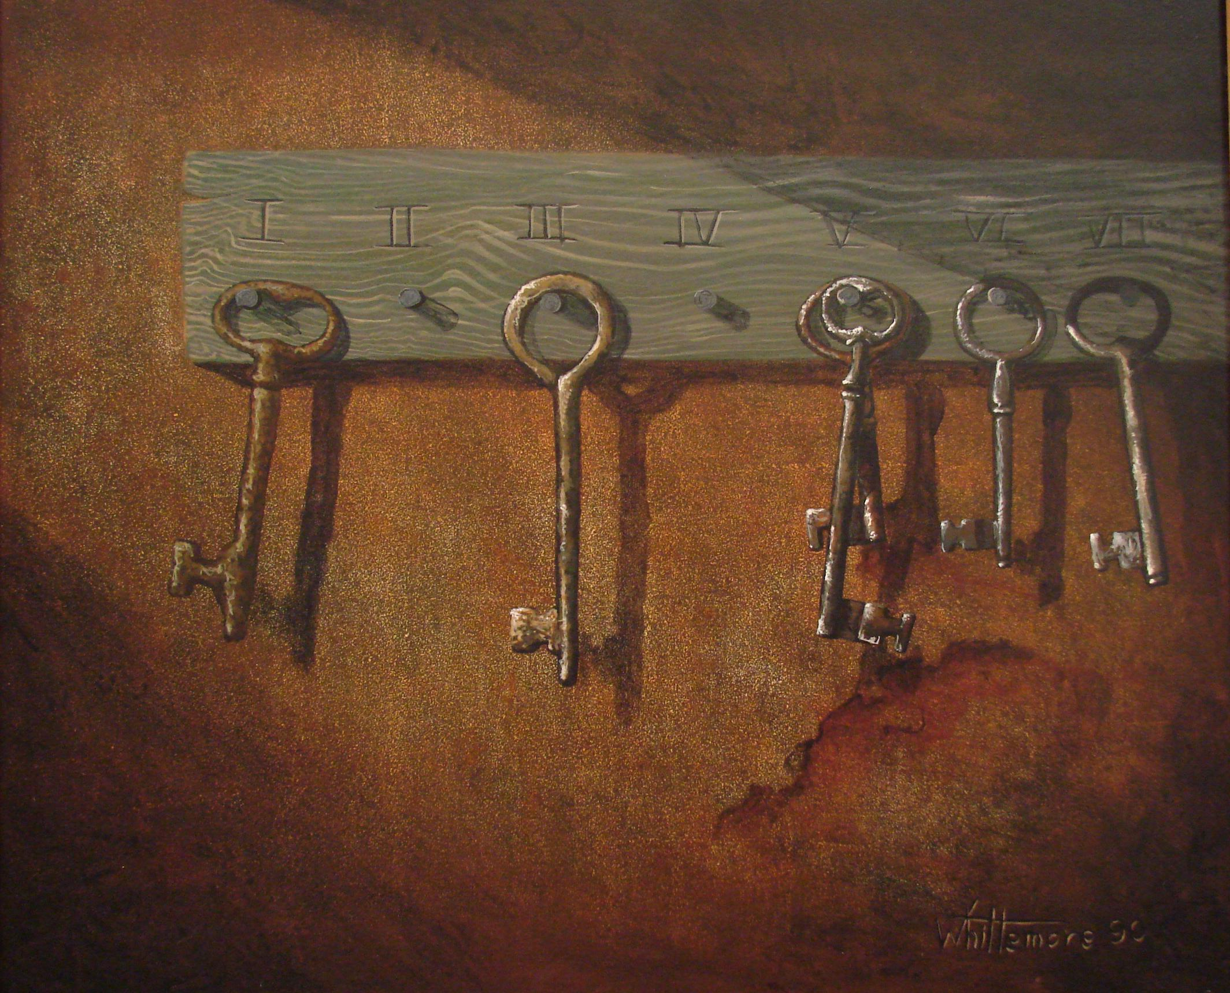
Grant Wiggins – Seven Keys to Effective Feedback
Goal-Referenced
Tangible and Transparent
Actionable
User-Friendly
Timely
Ongoing
Consistent

Slide 4
Goal-Referenced
Screencasting your feedback
QuickTime (Mac) or Screencast-o-Matic

Slide 5
Tangible and Transparent
Using ThingLink
Annotate exemplars
Student self reported grading
“The feedback students give teachers can be more powerful than the feedback teachers give students.” - Hattie
Check out an example:
bit.ly/thinglink123

Slide 6
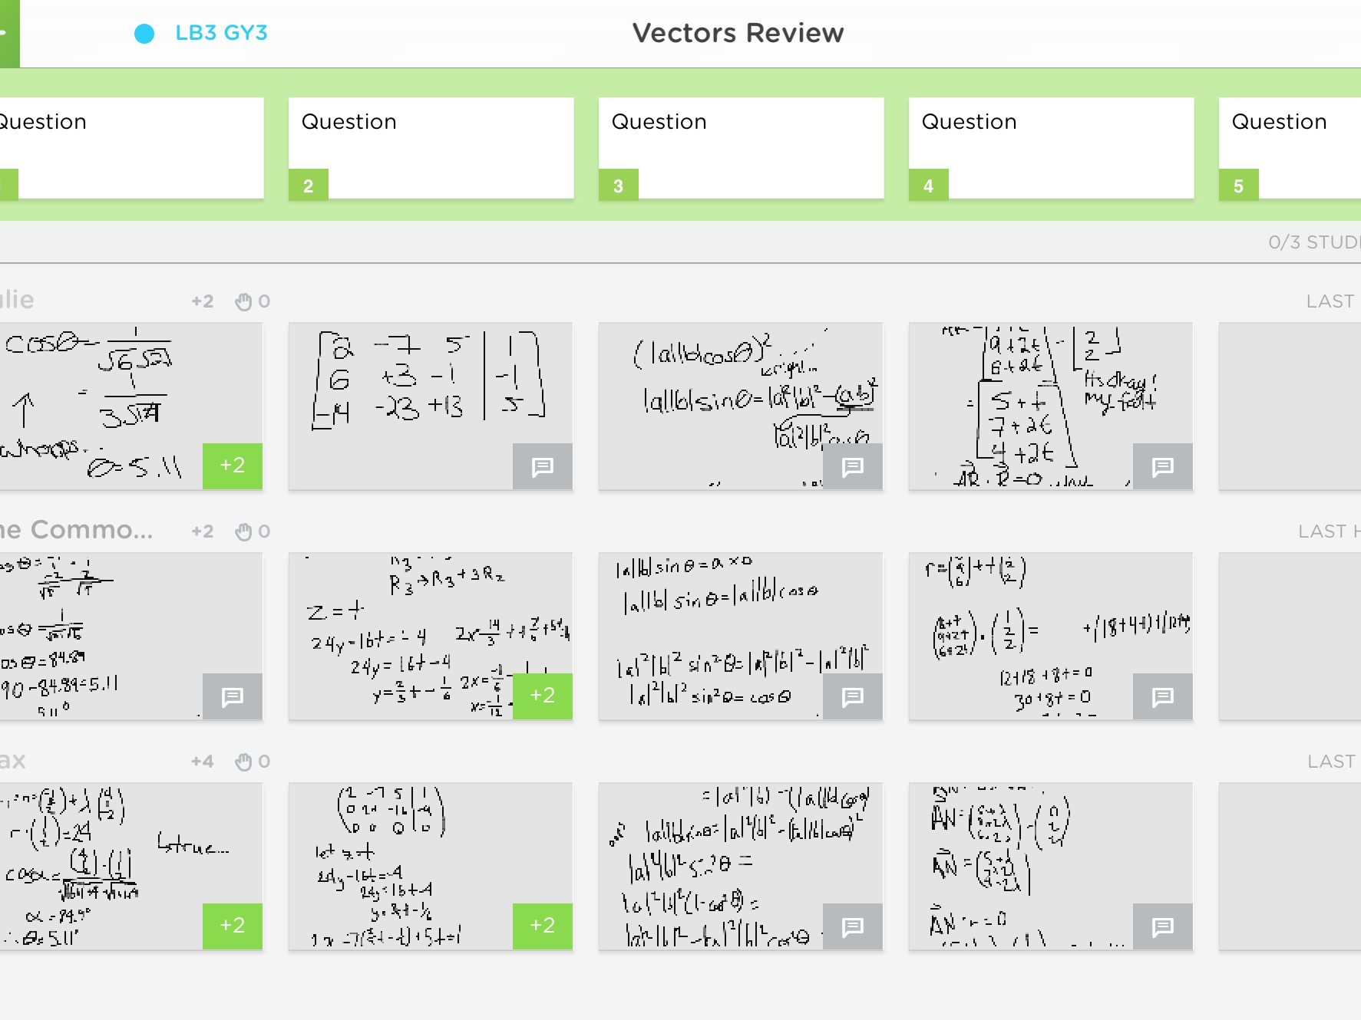
Actionable & User-Friendly
Classkick App
Class Code =
Y2WGN2

Slide 7
Timely & Ongoing
Hattie encourages teachers to “start by seeking feedback about their impact”
Socrative, Kahoot, Geddit, etc.
Screencasts on how to use each are linked to the word

Slide 8
Zaption
Embed elements within videos from a variety of sources (or your own videos)
Analytics collected
Try one: bit.ly/boyband1

Slide 9
Questions?
Please feel free to contact me!
Elizabeth Nelsen
ms.nelsen@gmail.com twitter.com/elizeducation elizeducation.blogspot.com google.com/+ElizabethNelsenEdu

Slide 10
Picture Credits
https://sweetsymbiosisdotcom.files.wordpress.com/2013/01/tree_of_knowledge.png
http://www.jobinuk.info/wp-content/uploads/2015/01/feedback.png
http://midwestbasementtech.com/wp-content/uploads/2014/05/basement-waterproofing1.jpg
http://gamertherapist.com/blog/wp-content/uploads/2013/09/lightbulb.jpg
http://www.mesacc.edu/sites/default/files/pages/section/students/service-learning/images/america-reads-key1.jpg
http://wykobet.com/wp-content/uploads/2014/10/dad.jpg
http://rjacquez.com/wp-content/uploads/2012/08/multiscreen-mLearning.jpeg
http://cohort21.com/rutheichholtz/wp-content/blogs.dir/51/files/2014/12/image-2.jpg
http://www.museinthevalley.com/wp-content/uploads/2013/11/helping.jpg
http://oceanbreezerecovery.org/wp-content/uploads/2013/04/Circle-of-Support.jpg
http://www.kazyoung.com/wp-content/uploads/2014/07/Challenge.jpg
http://www.wellnesstoday.com/sites/default/files/article/challenge.jpg
http://cdn.trendhunterstatic.com/thumbs/transparent-acrylic-paperweight.jpeg
http://www.desktopwallpaperhd.net/view/wallpaper-nature-clear-sky-blue-water-219058.html
https://www.flickr.com/photos/kjarrett/15048547040
http://thenextweb.com/wp-content/blogs.dir/1/files/2012/12/96522934.jpg

