Slide 1
Understanding the Resistance of the Faculties to the eLearning Technologies and the Use of Negotiations as a Coping Strategy.
PRESENTED BY
AGBO, BENJAMIN C. D. (PhD)
July, 30th, 2015
Department of Organizational Leadership, Policy, and Development
Notes:
1

Slide 2
Objectives
At the end of the presentation, participants will be able to, among other things:
Discuss reasons why faculties resist embracing eLearning technologies;
Explain “Resistance Models” and its application to understanding resistance to eLearning technologies;
Discuss the use of “Relational Negotiation” and application of emotions when negotiating the use of eLearning technologies with faculties; and
Faculties’ coping stages.
Department of Organizational Leadership, Policy, and Development
Notes:
2

Slide 3
Understanding the Concepts: “Resistance to eLearning Technologies”
Resistance to eLearning Technologies is the refusal to accept or comply with the use of eLearning Technologies; the attempt to prevent something by action or argument.
OR
Resistance is the action of opposing the use of eLearning Technologies that you disapprove or disagree with.
eLearning Technologies are the technologies that enhance the faculty’s ability to teach effectively, and students’ ability to learn with sustained interest and retain knowledge. They include, Course Management System (CMS), Flipping of Classroom, Internet, PowerPoint, Words, etc.
Department of Organizational Leadership, Policy, and Development
Notes:
3

Slide 4
“Do not bother me with all that complex technologies; let me do my job the best way I know how”.
After all, your so called technologies are ‘disconnecting people from nature, their community, and one another’ (Ross, 2000)
Department of Organizational Leadership, Policy, and Development

Slide 5
Resistance Behaviors
Actions or behaviors intended to prevent the implementation or use of eLearning Technologies or to prevent curriculum designers from achieving stated objectives
Markus (1983, p. 433) in Lapointe & Rivard (2005) - definition modified
Department of Organizational Leadership, Policy, and Development
Notes:
5

Slide 6
Why do Faculties Resist eLearning Technologies? Guy, 2014; Perera, 2011; Haymes, 2008; Lapointe & Rivard, 2005
Resistance to change
Technology generally brings change; people and society resist change, probably because of uncertainty.
Too comfortable with old approaches that work.
Feeling Threatened and Loss of Power
Actors will resist change if they believe it might cause them to lose power.
Department of Organizational Leadership, Policy, and Development
Notes:
6

Slide 7
Why do Faculties Resist eLearning Technologies? Guy, 2014; Perera, 2011; Haymes, 2008; Lapointe & Rivard, 2005
Inexperience, ignorance, and fear of feeling Stupid
Complicated and Stressful
Prior Negative Experience Using Similar Technology
Department of Organizational Leadership, Policy, and Development
Notes:
7

Slide 8
Conceptualizing Resistance Thamos & Hardy (2011)
Demonizing Resistance to Change
- There is assumption that resistance constitutes a problem. misunderstanding the change; a lack of tolerance for change; and cynicism towards change
Celebrating Resistance
- Resistance can lead to a better change
Resistance is actually healthy; it makes you check your assumptions and it forces you to clarify what you are doing (Lee, u.d.)
Resistance can neither be good or bad (Lapointe & Rivard, 2005)
Department of Organizational Leadership, Policy, and Development
Notes:
8

Slide 9
Resistance Model Lapointe & Rivard, 2005
Apathy
inaction, distance, and lack of interest that manifest in delay tactics, excuses, withdrawal, and persistence of former behavior
Passive Resistance,
Defiant or insubordinate (refusal) behavior resulting from both fear and stress stemming from the intrusion of the technology into the previous stable world of the faculties.
Active Resistance
Voicing out individually and later, jointly; protest – resistance becomes significant.
Aggressive Resistance
Rebelling; Revenge; punishment; ultimatum; resignation
Department of Organizational Leadership, Policy, and Development
Notes:
9

Slide 10
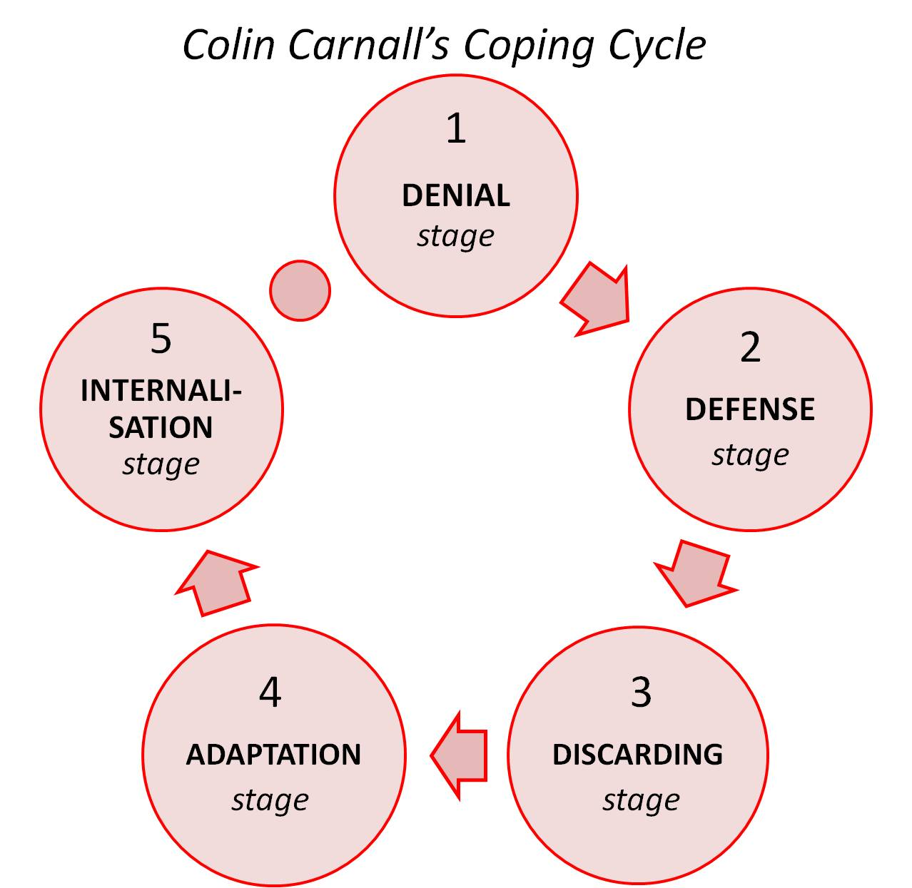
Faculties' Coping Stages White (2009)
Coping Stages
Denial: Faculties’ initial response is the denial for the need for a change. Comfortable with the current situation.
Defense: Faculties forcing the new reality into the old model, thereby allowing the continuation in the comfort zone
Discarding: Faculties discard and abandon the old ways of doing things and either commit to new work methods
Adaptation: Faculties adapt to the new realities of their situation; expend significant levels of energy on finding ways of making eLearning Technologies work
Internalization: Faculties adopted and adapted eLearning Technologies and made them their own.
Department of Organizational Leadership, Policy, and Development
Notes:
10

Slide 11
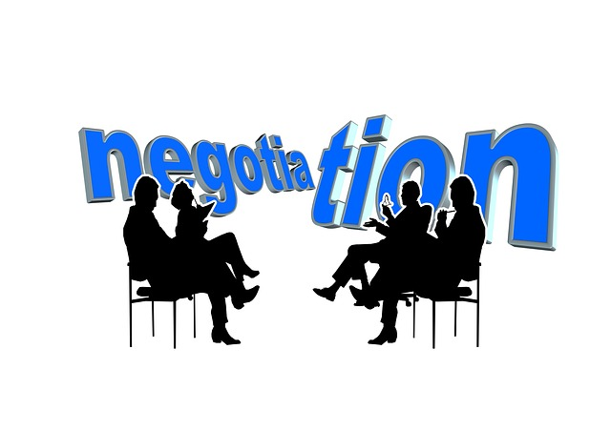
Negotiations as a Coping Strategy
Department of Organizational Leadership, Policy, and Development
Notes:
11

Slide 12
Negotiation (discussion intended to produce an agreement) Ingerson, DeTienne, and Liljenquist, 2015
Instrumental Negotiation
Relational Negotiation
Selfish motives
What is in it for me (or us)?
Individual wishes take precedence over the wishes of others
Individual values, independence, and self-reliance take over all else in making decision
Embedded in a system relationships, motivated to understand and advance the welfare of others.
Communal orientation
Asking and questioning behavior
Focuses on fair outcomes
The basic reality of the world is relationship
Department of Organizational Leadership, Policy, and Development

Slide 13
Differentiating Features of Instrumental versus Relational Approaches to Negotiation
Instrumental Negotiation Relational Negotiation
Relationality | Weak relationality: Relationships matter because I never know when I’ll see someone again | Strong relationality: Relationships are important part of our human experience
Orientation/Focus | Exchange orientation: Focus is on self. I care what I get out of the negotiation. | Communal orientation: Focus is on the other and the shared experience. I care about the welfare of the other. Increased perspective taking.
Behaviors | Telling/Selling: Ask questions in order to push own agenda, to solve the problem at hand, and come to an agreement. | Listening: Ask questions not just because it will equip me with information to solve the problem, but because I want to understand the interest and constraints of my counterpart.
Outcomes | More likely to evaluate the final agreement to make sure I have captured as much of the value as possible. Concern for self-interest. | More likely to evaluate the final agreement to ensure equity. Concern for justice.
Ingerson, DeTienne, and Liljenquist (2015, p. 38)
Department of Organizational Leadership, Policy, and Development
Notes:
13

Slide 14
Negotiation and Emotions Olekalns and Druckman, 2014
Emotional expressions that influence the course of negotiation.
Negative Emotions
Anger – elicits lager concessions, and effective with time constraints.
Disappointment – expressed disappointment triggers guilt, and guilt encourages high level of cooperation.
Positive Emotion
Positive emotions increase the possibility of reaching an agreement and willingness of interacting in future.
Happiness suppressed at winning attracts positive reactions and indicates a desire to protect a counterpart’s feelings.
Department of Organizational Leadership, Policy, and Development
Notes:
14

Slide 15
When to use Anger
Positive when conflicts concern faculty/student’s INTEREST
Positive when disputes concern VALUE
Department of Organizational Leadership, Policy, and Development
Notes:
15

Slide 16
Other Things to Note
Faculties priorities, preferences, skills/knowledge relating to eLTech.
Emotions facilitate social bonding.
Expression of positive emotions build trust.
Strategically expressed anger reduces trust and elicit higher demands, while authentic anger increases perceived toughness and elicit lower anger.
Low power negotiator process information in greater details and are more responsive to emotional displays.
(Are the faculties low or higher negotiators?)
Department of Organizational Leadership, Policy, and Development
Notes:
16

Slide 17
Summary
When dealing with faculties and their resistance to eLearning Technologies, you should:
Know and understand their abilities.
Be aware of each faculty’s (if possible) level or stage of resistance.
Negotiate with them with an open mind.
Apply your emotions strategically during discussion.
Be willing to provide assistance when needed.
They are as worried as you are.
Department of Organizational Leadership, Policy, and Development
Notes:
17

Slide 18
COMMENTS
Department of Organizational Leadership, Policy, and Development
Notes:
18

Slide 19
Reference
Guy, M. (2013). How do you overcome faculty resistance to technology? Retrieved on 19th December, 2014 from http://elearningtransforms.com/how-do-you-overcome-faculty-resistance-to-technology/
Haymes, T. (2008). The three-E strategy for overcoming resistance to technological change. Educause Quarterly, (4), 67-69.
Ingerson, M., DeTienne, K. B., & Liljenquist, K. A. (2015). Beyond instrumentalism: A relational approach to negotiation. Negotiation Journal, January, 31-46.
Lapointe, L, & Rivard, S. (2005). A multilevel model of resistance to information technology implementation. MIS Quarterly, 29(3), 461-491.
Olekalns, M & Druckman, D. (2014). With feeling: How emotions shape negotiation. Negotiation Journal, October, 455-477.
Perera, N. C. (2011). Addressing resistance to use technology by faculty members through professional development initiatives from different cultural lenses. Retrieved on 21st December, 2014 from http://nishancperera.com/2011/11/30/addressing-resistance-to-use-technology-by-faculty-members-through-professional-development-initiatives-from-different-cultural-lenses/
White, A. (2009). The paradox of performance from comfort zone to performance management: Understanding development and performance. Performance Management Solutions. .Retrieved on July 15th, 2015 from http://web.archive.org/web/20091014211340/www.pm-solutions.com/ComfortZone_Performance.html
Department of Organizational Leadership, Policy, and Development

Slide 20
Department of Organizational Leadership, Policy, and Development
Notes:
20

Slide 21
Department of Organizational Leadership, Policy, and Development
Notes:
21

