Slide 1
The value of assessing outcomes of teaching methodologies to guide instructional design Margaret V. Root Kustritz, DVM, PhD, DACT Professor and Assistant Dean of Education, College of Veterinary Medicine

Slide 2
Instructional design includes determination of appropriate teaching methodologies.
http://www.slideshare.net/BillJerome/integrating-user-experience-and-instructional-design/

Slide 3
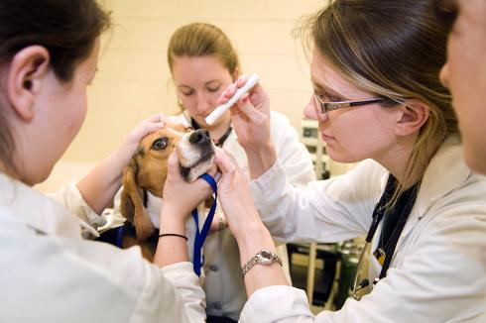
This includes determining how best to present the content, how to get students to work with the content appropriately, and how to assess their understanding or skills.
http://collegeof2020.com/
http://www.vt.edu/spotlight/achievement/2011-10-10-vetschool/licensing-exam.html
http://oupeltglobalblog.com/2015/01/29/getting-english-language-students-to-practice-outside-of-class/

Slide 4
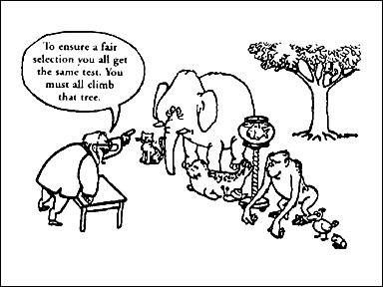
This also includes consideration of learning styles.
https://www.pinterest.com/erinnaas/school-counselor-multiple-intelligences/

Slide 5
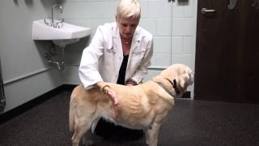
Presentation options include lecture, video, readings and podcasts.
http://www.nsf.gov/discoveries/disc_summ.jsp?cntn_id=133670&org=EHR
https://www.youtube.com/watch?v=S2xX5_QuxdM

Slide 6
Student assignments and assessments may be completed individually or in groups and include homework problems, essays, creation of artifacts (real or virtual), discussion forums, and examinations.
http://www.noozhawk.com/article/tutoring_helps_stem_students_prepare_for_transfer_20131107

Slide 7
Choice of teaching methodology should be driven by learning objectives.
http://www.articulate.com/rapid-elearning/heres-an-easy-way-to-create-learning-objectives/

Slide 8
Choice of teaching methodology often is driven by more pragmatic concerns.
https://inspiringedchat.wordpress.com/

Slide 9
Lecture capture at the College of Veterinary Medicine changed my understanding of how students use video for their learning.

Slide 10
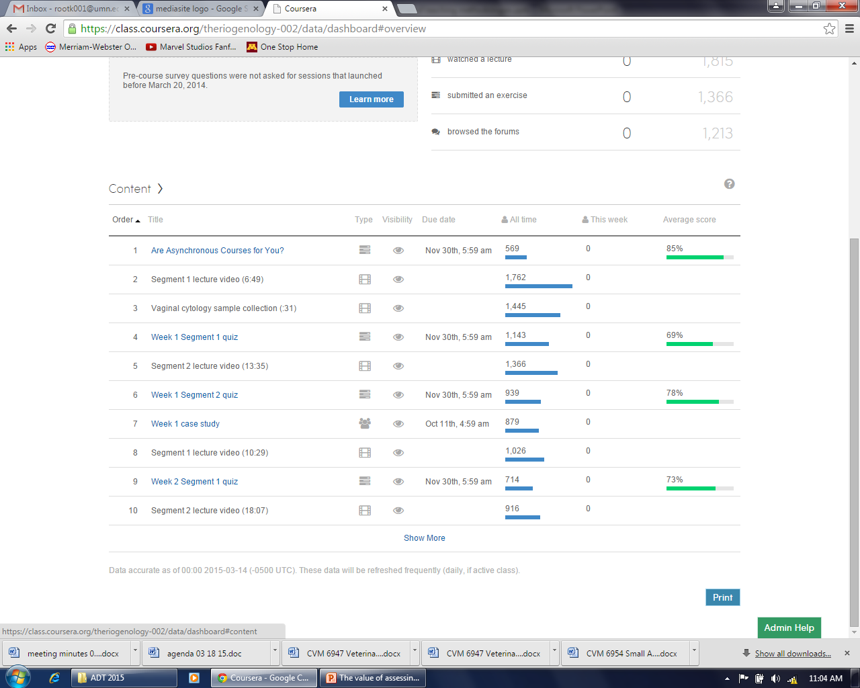
Tracking of student use of video is available within the lecture capture software and in on-line systems, may be available as part of that platform.

Slide 11
Podcasts were first provided at student request and are used by students very differently than they use video.
http://fitness.mercola.com/sites/fitness/archive/2010/09/09/does-music-make-you-exercise-harder.aspx

Slide 12
Information about use of podcasts was not readily available in the classroom management system so information was collected by student survey; in general, about 19% of students listen to podcasts in a given class.
http://www.rezxmag.com/surveyresults/

Slide 13
Facebook, Twitter, Instagram and other social media outlets have been described as possible educational tools.

Slide 14
Facebook has over 1 billion members across the world, with 75% of people born after 1980 having a Facebook profile and with half of its users accessing it at least once daily.

Slide 15
First-year veterinary students enrolled in a clinical communications course were given the opportunity to participate in an education Facebook group as an optional learning activity.
http://www.howtomakez.com/2015/01/post-in-multiple-facebook-groups.html

Slide 16
The instructor made 14 Facebook posts over one month, tracked student responses, and surveyed all students in the course at the end of the semester.
“What are your favorite non-verbal communications in movies, and why?”
“Here’s the URL for a video about handling upset clients that say unexpected things. What do you think about their recommendations? – http://www.youtube.com/watch_v=g5RknemM8Hw”

Slide 17
Of the 99 students enrolled in the course, 51 asked to join the Facebook group; 64% of those students completed the final survey and 92% of students from the non-Facebook group completed the survey.
Root Kustritz MV. Use of Facebook as a teaching tool in a veterinary communications course. J Vet Med Educ 2013;40:327.

Slide 18
Students in the Facebook group were more likely then their classmates to consciously practice communication skills outside of the academic setting.
“I consciously practiced communication skills we had talked about in class in other venues (home, work, etc.). 1 = strongly disagree to 5 = strongly agree

Slide 19
Students in the Facebook group were infinitely more likely to read posts than to respond to posts, citing desire to remain anonymous, unwillingness to look foolish, reading posts at a time not conducive to response, seeing their thoughts reflected in other posts, and lack of time as rationale.
- Read at least half of the postings = 72.7%
- Responded to none of the postings = 63.6%

Slide 20
Metrics available on Facebook did not make clear the amount of time students spent accessing the posted materials; student survey was necessary to help the instructor learn the extent of use and value to the students.
http://www.rezxmag.com/surveyresults/

Slide 21
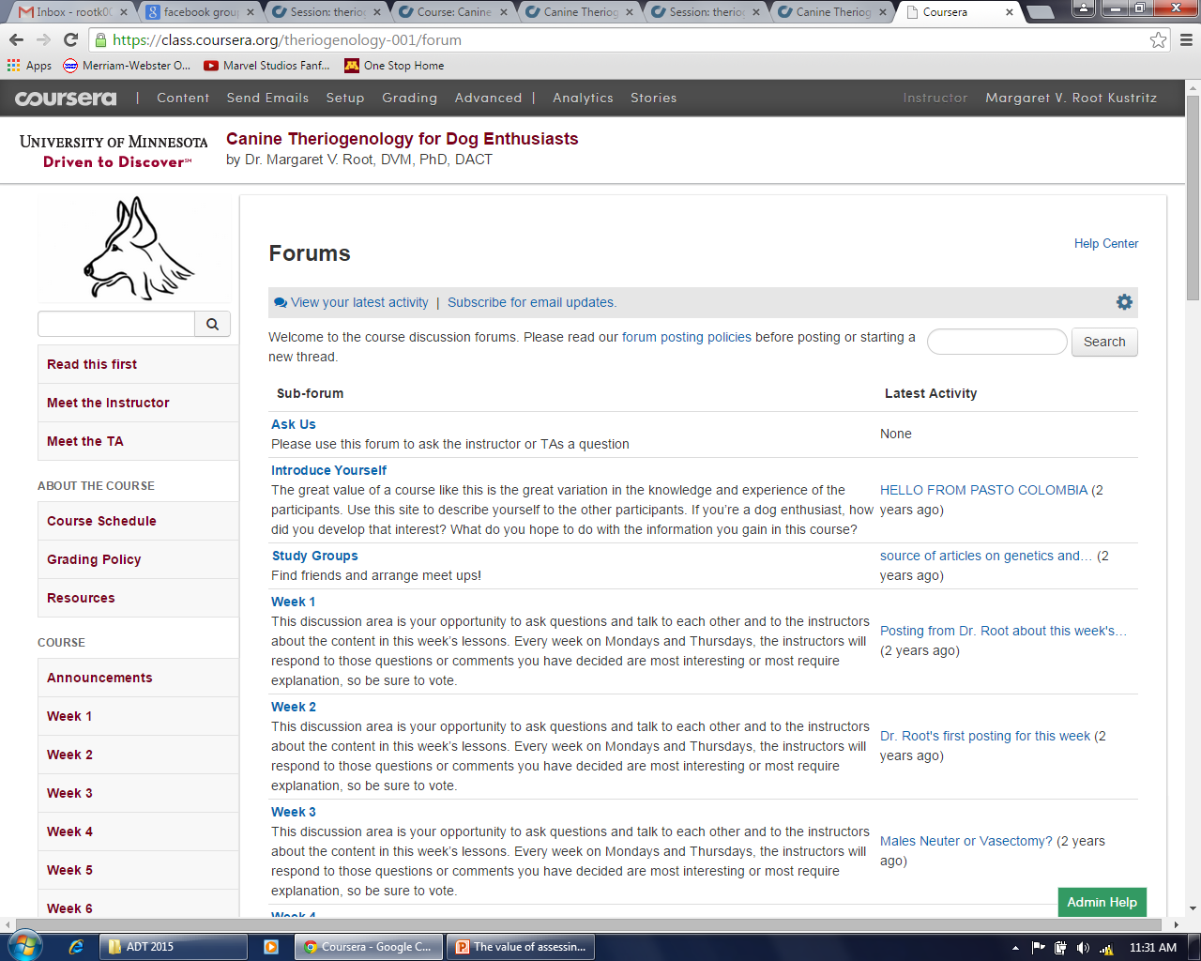
Discussion forums are commonly used in on-line coursework to promote student articulation of their understanding, and peer teaching.

Slide 22
First-year veterinary students in one class were encouraged to discuss and then individually submitted ethics cases, while students in the next year’s class were required to use a specific website for submission and critique of each other’s assignments.
Root Kustritz MV, Copes L. Use of a civil discourse web site for ethics training. J Vet Med Educ 2013;40:45.

Slide 23
Students significantly preferred not being required to discuss and critique each other’s work but students that did that work were better able to demonstrate achievement of specific learning objectives in the course.
* = percentage agreeing or strongly agreeing – “I enjoyed completing the ethics cases”
** = percentage correctly completing assessment

Slide 24
A large, mixed group of participants including veterinarians, veterinary students, and lay people took a massive open on-line course about canine reproduction (MOOC).

Slide 25
Participants were not required to participate in discussion forums, which were intended to reinforce their learning.
Root Kustritz MV. Canine theriogenology for dog enthusiasts: Teaching methodology and outcomes in a massive open online course (MOOC). J Vet Med Educ 2014;41:9.

Slide 26
Again, participants were infinitely more likely to view posts than to make posts themselves, either as unique posts or responses.
WEEK | NO. POSTS | NO. VIEWS
1 | 1,403 | 18,225
2 | 938 | 9,517
3 | 468 | 6,547
4 | 442 | 5,073
5 | 244 | 3,526
6 | 833 | 7,442

Slide 27
It is not clear to me, as an instructor, how to determine the value of reading posts and not responding for a given student.
http://act.mtv.com/posts/4-college-board-approved-tips-for-the-college-app-essay/

Slide 28
Research evaluating efficacy of MOOCs defines several types of learners, including completers, auditors, and samplers.
http://revgalblogpals.org/2013/10/07/a-cornucopia-of-new-members/

Slide 29
How can instructors best determine the value of auditing or sampling, or is such determination necessary in all cases?
http://www.nataliewitcher.com/?p=1783

Slide 30
Advanced students studying for theriogenology boards showed the same type of auditing behavior and again cited unwillingness to appear foolish and lack of time as rationale.

Slide 31
Practice: By the end of this course, students will be able to argue their point of view about a contentious issue in veterinary medicine, citing the primary literature.
- What is the best teaching methodology and how will you determine if students are using it as you expect?

Slide 32
Practice: By the end of this course, students will be able to demonstrate basic communication skills including open-ended questioning, expression of empathy, building rapport with clients, and recognizing non-verbal signals.
- What is the best teaching methodology and how will you determine if students are using it as expected?

Slide 33
Practice: By the end of this course, students will be able to formulate vaccine and parasite control protocols by species including cost to owner / producer.
- What is the best teaching methodology and how will you determine if students are using it as expected?

Slide 34
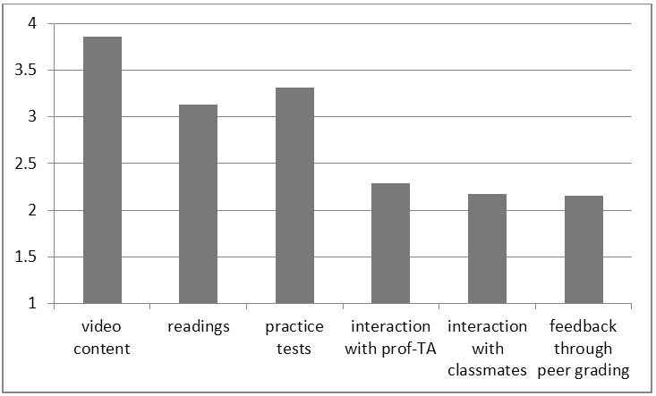
Students at the veterinary school highly value face-to-face instruction; participants in on-line coursework highly value video content, reading, and quizzes.

Slide 35
Take-home lessons for me:
Students use video and use it in ways I hadn’t expected.
Students listen to podcasts to learn or reinforce learning.
Students learn from facilitated discussion but I may have to force them to participate by making it a course requirement.

Slide 36
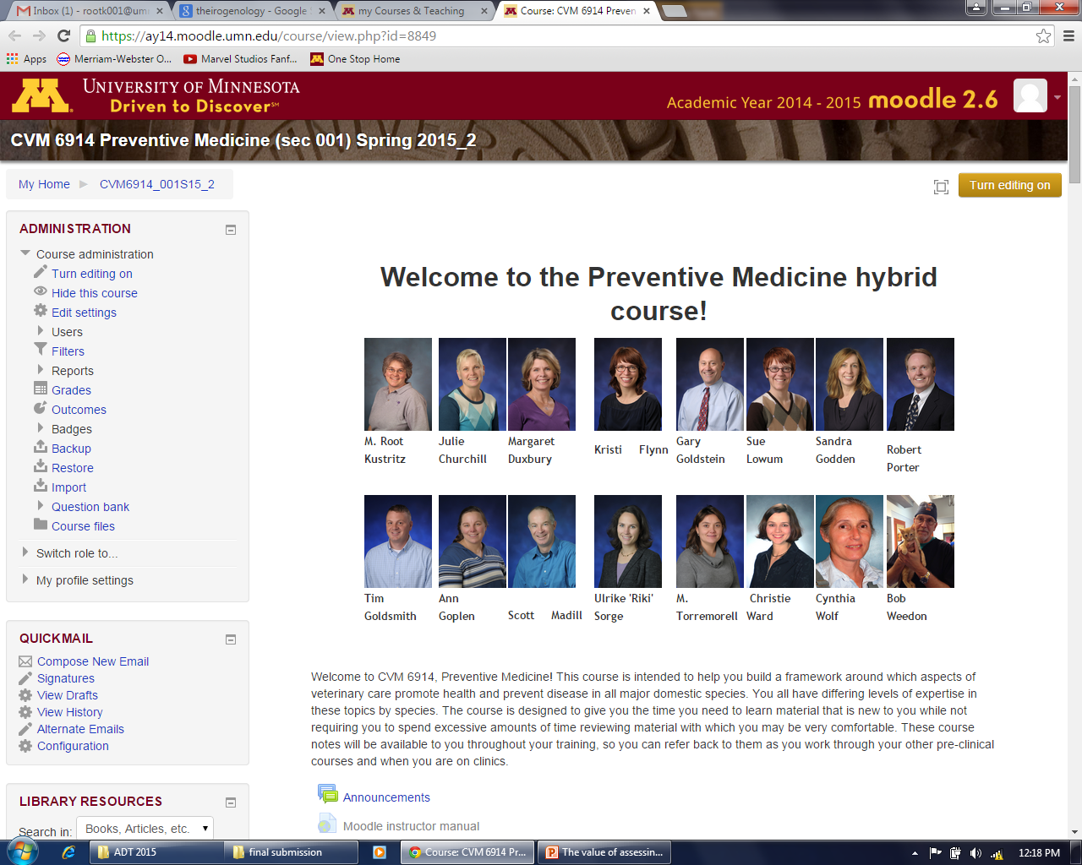
In spring of 2014, I coordinated a new course in our curriculum, Preventive Medicine, with 3 face-to-face components and 6 on-line modules with posted notes and on-line quizzes.

Slide 37
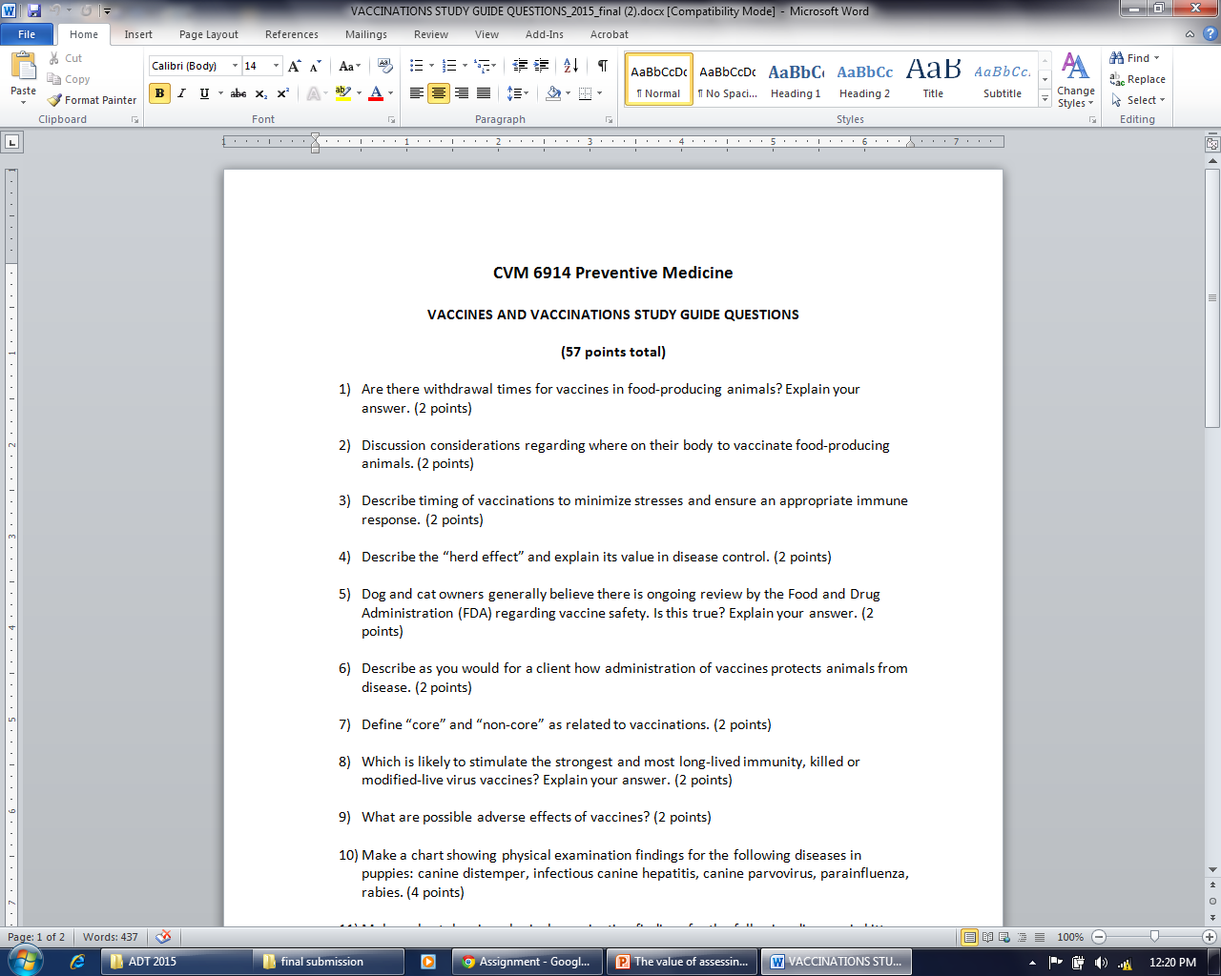
In fall of 2014, I added study guides for the on-line modules to ensure students weren’t sampling too extensively.

Slide 38
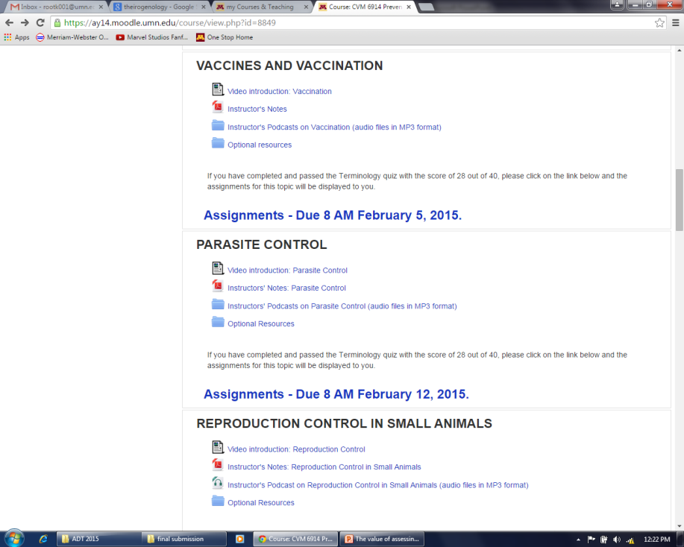
In spring of 2015, I added short video introductions, podcasts of all course notes, and for one section, a facilitated discussion of critiques of selected manuscripts from the primary literature.

Slide 39
What should be my plan to assess what are the most valuable components of the course, as I look ahead to 2016?

Slide 40
Students always ask for more (notes, PowerPoints, podcasts, lecture capture, last year’s examinations, recommendations for texts / websites) – at what point have we stopped facilitated their learning and are just catering to unreasonable demands and overloading them with information?

Slide 41
Peggy Root Kustritz
4-7290
rootk001@umn.edu

