Slide 1
Walking the Walk
August 2023
Educational Development and Technology
Minnesota State system office
Modeling Tech-Forward, Culturally-Responsive Practices in Faculty Training
Melissa Williams, PhD
Instructional Designer

Slide 2
Outcomes: What will you be able to do after this session?
Employ frameworks and practices that model culturally-responsive teaching in DEI faculty training.
Identify potential uses of technologies to maximize efficiency and scalability in DEI training implementation.
Choose strategies for shifting current DEI training practices, from passive and instructor-centered, to active and learner-centered.
Notes:
Ed

Slide 3
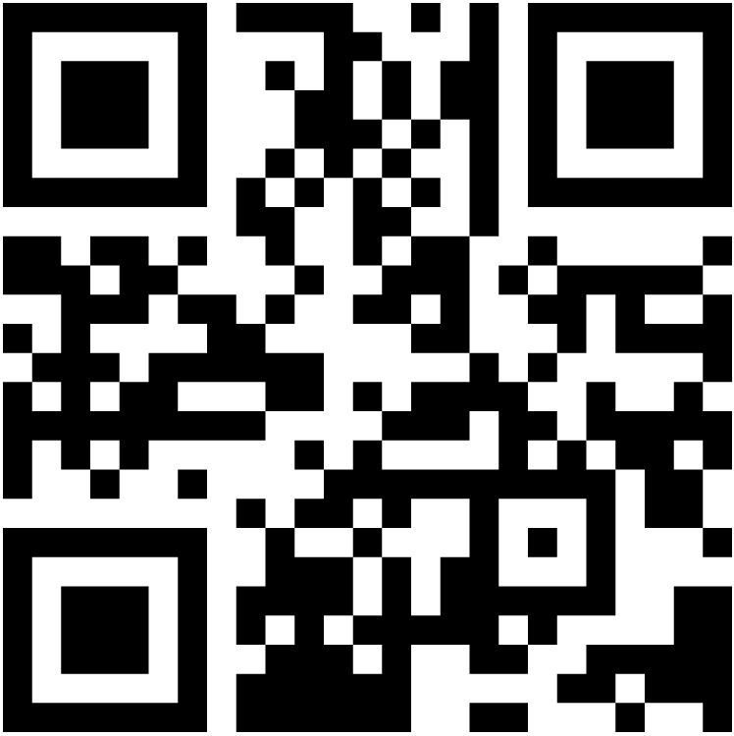
Agenda: What will we do today?
Faculty DEI Challenges: yours and theirs (your input)
Our story
Our outcomes thus far
What interests you? (your input)
Tech-forward modeling
Questions and examples (per your input)
Access Mentimeter surveys and resources at https://www.menti.com/, or use the above QR code to access on your phone, then type in code 8737 0066.
Notes:
Melissa

Slide 4
DEI training for faculty: challenges for trainers
Access Mentimeter surveys and resources at https://www.menti.com/, or use the above QR code to access on your phone, then type in code 8737 0066.
Notes:
Melissa

Slide 5
DEI training challenges for faculty
Work harder, teach better
You’re failing your students!
MANDATORY
We know more about your job than you do
Just, you know, sprinkle magic fairy dust
Do as I say, not as I do
Equity concepts + data = training
Frustration by Gan Khoon Lay is licensed under CC BY 3.0 via the Noun Project

Slide 6
Addressing challenges, empowering educators
Learning Community + Coaching
Linear, Granular, Practical
Modeling Equity Practices
Evidence-Based
Access a preview of the FLC structure by scanning the QR code on this slide or going to Faculty Learning Communities for Culturally Responsive Teaching (https://minnstate.pressbooks.pub/crtflc/)

Slide 7
Equity Rubric & Action Plans: JUST ONE THING
Be Intrusive
Digital Literacy Survey & Supports
Pre-semester outreach & onboarding
Be Relational
“Bumper” videos
“Student” (rather than “office”) hours
Be Culturally Relevant and Affirming
Proactive microaggressions activity
Student cultures story theater projects
Be Community Focused
Be Race Conscious
Diverse community service learning projects
Intelligent Agents for connection & retention
Creative, collaborative exam reviews
Diverse chemists exploratory assignment
Student-guided community agreements
“Math in your daily life” learning activities
History gamification projects
Accessible course materials
Partnering with diverse local businesses for class projects
Dimensions of the Hartnell College Equity Rubric for Teaching & Learning (licensed under CC BY-NC-SA 4.0), informed by research findings presented by Frank Harris and Luke Wood from the Center for Organizational Responsibility and Advancement (CORA).
Notes:
Ed

Slide 8
Action Plan Implementation Rates
First three cohorts (Sp22, Su22, Fa22)
37% response rate
N=65
I need the structure and timeline to keep myself working through the material and reflecting with others.
Notes:
Ed

Slide 9
The FLC Prepared Me to Successfully Implement My Selected Equity Practice:
This course was designed meticulously, and the instructors modeled equity in their approach.
Notes:
Melissa

Slide 10
Pre- and Post-FLC Self Evaluation (through Spring 2023)
Participants self-evaluated their use equitable teaching principles, based on the UW-Green Bay Equity-Minded Worksheet for Instructors of Online Courses.
[I]f a participant engages with the resources provided in the FLC, [they] will have a much better understanding of equity and inclusion and ideas of ways to make their own course more equitable.
Notes:
Melissa

Slide 11
Equity in the Classroom and on Campus: Did Participating in the FLC Increase Your Ability to do the Following?
Notes:
Ed

Slide 12
What Interests You?
Add questions and observations to the Mentimeter question throughout the session. We’ll return to your input at the end. Reminder of our session’s outcomes (icon by each outcome will be repeated on later slides to indicate alignment):
Modeling culturally-responsive teaching
Efficient, scalable technology use
Active, learner-centered training

Slide 13
Modeling for Equity
Equitable Learning Environments
Relationships
Sustainability
Collaboration
Rigor
Relevance
Technology Use

Slide 14
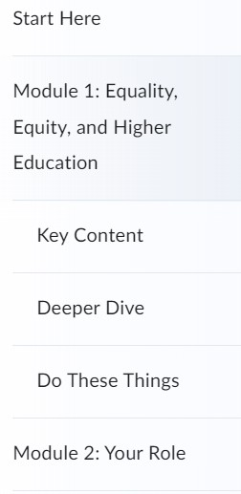
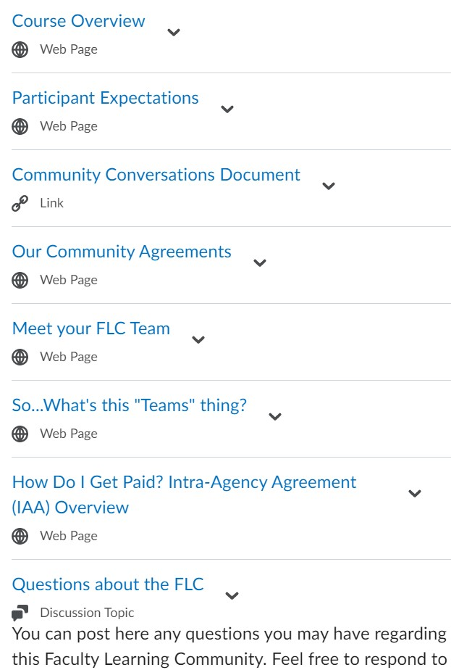
Technology Use
Lead with the need
Leverage the familiar
Onboard thoughtfully
Structured flexibility
Automate
Plan for mistakes
Notes:
Lead with the need
Never, ever use a tech tool just because it’s cool and you want to try it out.
Identify the goal, then choose a tool to do it.
Seek the minimum number of tools to do what you seek to do.
Leverage the familiar
Choose. Supported. TOOLS!
Draw on prior learning
Account for varying user practices when designing
Reduce cognitive load
Show (don’t tell) what your supported tools can do
Thoughtful onboarding
Provide detailed instructions for using every tool
Practice together
Be kind, patient, flexible with tool use
Get out of the way!
Peer-to-peer priority, accountability
Interactive, personalized
Choice, not chores
Automate, back it up
Find every automation option (autoenroll, preset announcements, notifications for you, etc.)
Intelligent Agents (nudges, data gathering)
Assume someone will break something (back up all your materials)

Slide 15
Relationships
Proactive community-building
Confidentiality
Room to err, grow
Collegial, not competitive
Technology-supported examples:
Non-topical greetings to start live meetings
Shared Community Conversations document
Private Teamsite channel
Proactive resources on intent versus impact, how to be an ally
Notes:
Melissa w/ Ed input

Slide 16
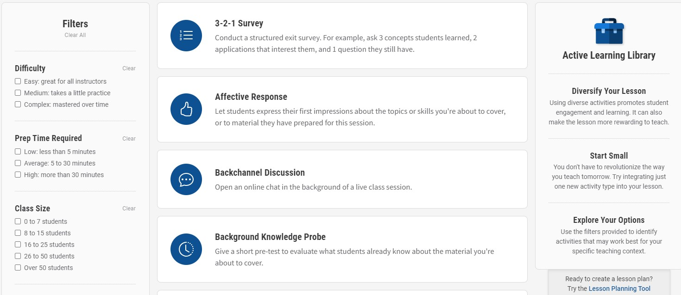
Relevance
Personalized
Discipline-informed
Campus-aware
Technology-supported examples:
Applying Equity Matrix (AEMy)
Active Learning Library
Notes:
Melissa w/ Ed input

Slide 17
Rigor
Evidence-based
UDL (“multiple means”)
Culturally responsive
Scaffolded
Competence, not compliance
Technology-supported examples:
Inclusive Teaching: Evidence-Based Teaching Guides
Action Plan form
Zaretta Hammond, Using Neuroscience to Help Students
Notes:
Melissa w/ Ed input

Slide 18
Collaboration
“Learning Community” best practices
Open Pedagogy approach
Structured peer feedback
No wheels reinvented here!
Group reflection
Technology-supported examples:
Action Plan Feedback form
Action Plan Examples and Artifacts
Open Educational Resources (OER) Guide
Notes:
Melissa w/ Ed input
“Learning Community” best practices
Based on Larson & Witman “Train the Trainer” lit review around LC best practices
Keep group around 15
Maintain a pattern
Prioritize community creation, development
Use “flipped” model, with live discussion assuming pre-work
Open Pedagogy approach
Collaborative development
Emphasis on practical deliverable that has value beyond in individual—a “renewable” assignment)
Structured peer feedback
Criterion-based, guided peer feedback
Accountability via live discussion follow-up
No wheels reinvented here!
Heavy emphasis on OER
Multiple examples from peers, both former and current FLC participants
Reflection
Synchronous and asynchronous opportunities to reflect, learn from each other’s insights

Slide 19
Sustainability
“Just one thing” in systemic context
Evaluation built in
Continuous improvement expected
Sharing with colleagues, campuses, beyond
Technology-supported examples:
Hartnell College Equity Rubrics
Making Connections Presentation
Jake Cohen, The Pedagogical Value of Failure
Notes:
Melissa w/ Ed input

Slide 20
FLC scope as of Summer 2023
Participation
256 unique faculty participants
11 returning participants
Sharing
System, regional, and national presentations (6 between March and June 2023)
Offered as Open Educational Resource (OER) via Pressbooks
Sustainability
Faculty co-facilitators onboarded to increase scalability
All 33 Minnesota State campuses represented
Adapted for campus-level DEI programs
Documentation for replicability (LMS build, facilitator guide, etc.) in progress
Pending EDUCAUSE Review article
Funding extended through FY2025
Developing staff version of FLC

Slide 21
Questions and examples

