Slide 1
Minnesota History for All!
Jessica McMahon
bit.ly/MNH4A
Notes:
Hello and welcome to the Minnesota Historical Society. How many of you have been here before?

Slide 2
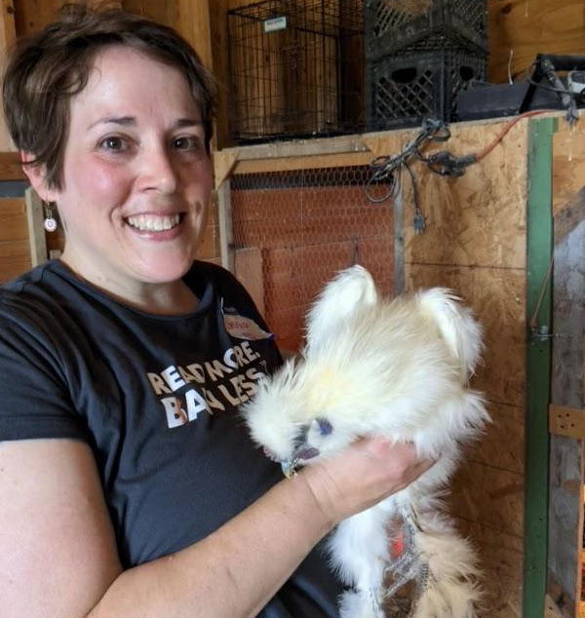
Jessica McMahon
Digital Learning Specialist
Teacher Education and Curriculum Development
Former Latin teacher & Technology Integration Specialist

Slide 3
Classroom Ready Resources
Ready to Go Activities
Forest, Fields and the Falls
Videos
Teaching with Curated Collections
bit.ly/MNH4A

Slide 4
Inquiry of the Upper Midwest
Culturally Relevant Pedagogy
Primary Source Set
Using Primary Sources
bit.ly/MNH4A

Slide 5
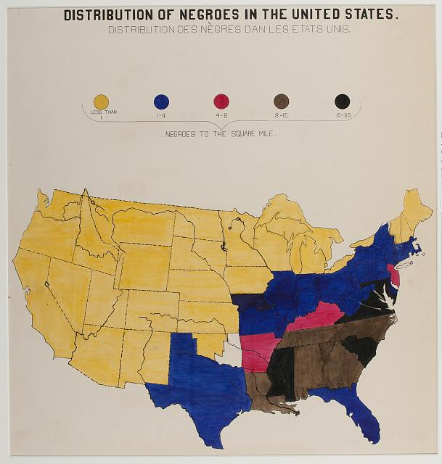
See, Think, Wonder Activity

Slide 6
Spotlights
Map
This day in MN History
MNopedia
bit.ly/MNH4A

Slide 7
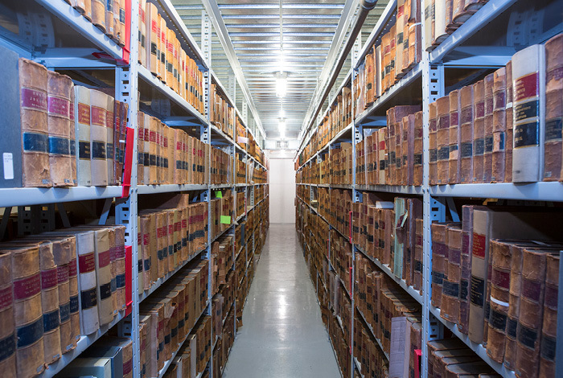
Collections Online
bit.ly/MNH4A

Slide 8
Library Resources
Research Guides
Finding Aids
Newspaper Hub
Minnesota History Magazine Archive
Notes:
Orrin Smith
Locust 1876

Slide 9
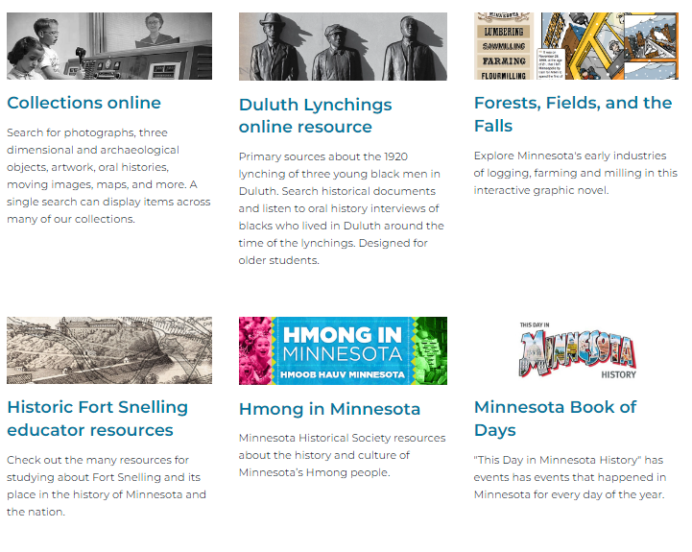
Online Resources
bit.ly/MNH4A
Notes:
FFtF
Duluth Lynching
US Dakota War

Slide 10
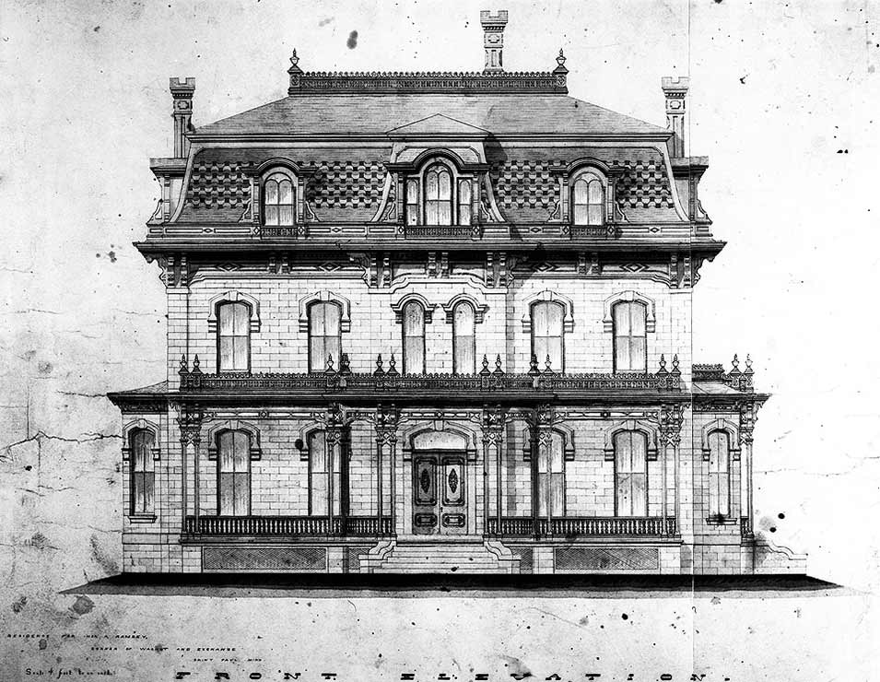
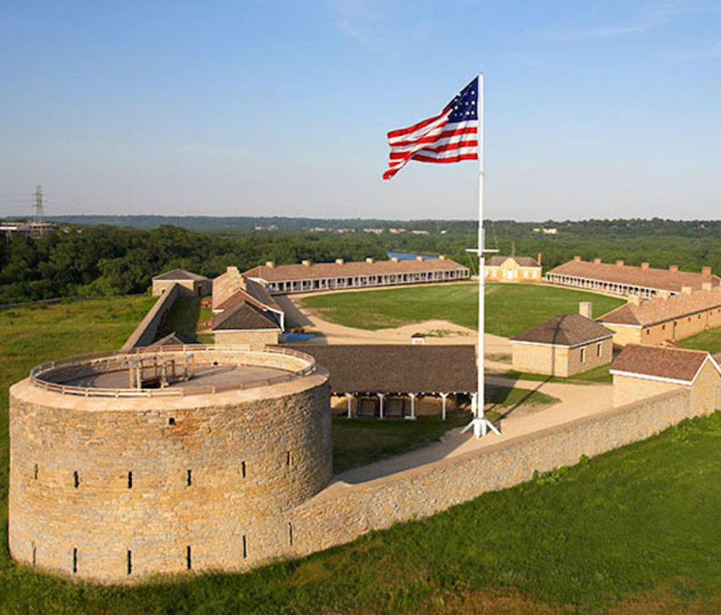
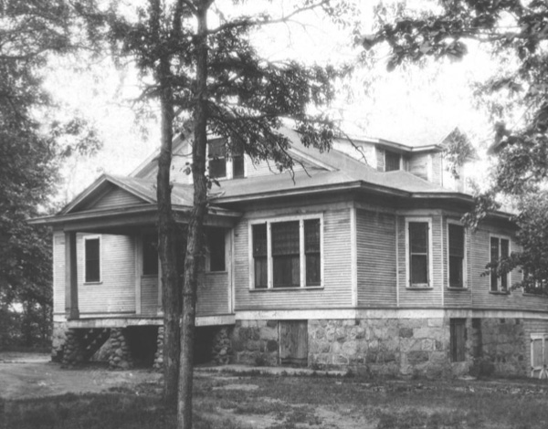
Alexander Ramsey House
Historic Fort Snelling
Charles Lindbergh House and Museum
Virtual Field Trips

Slide 11
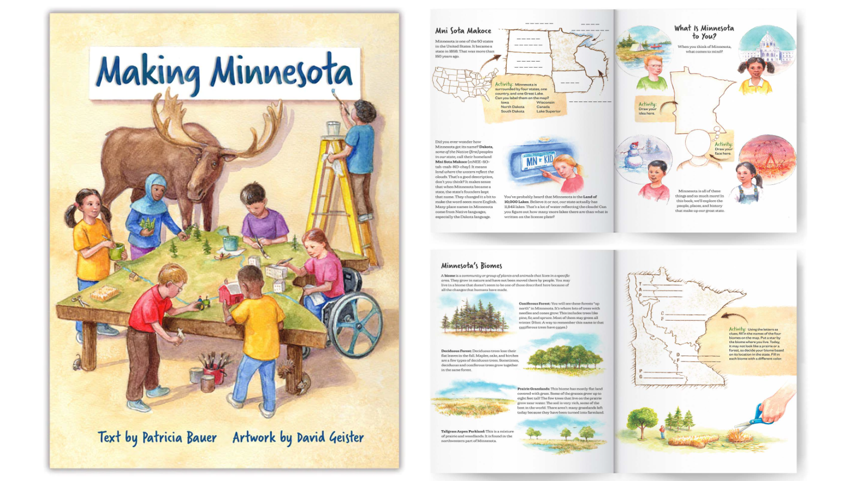
Making Minnesota
bit.ly/MNH4A

Slide 12
HistoryEdMNHS
@HistoryEdMNHS
Historyeducationmnhs
Education Newsletter
Stay in Touch!
jessica.mcmahon@mnhs.org
bit.ly/MNH4A

