Slide 2
9:30–10:30 a.m. Keynote The Promise and Possibility of Human-Centered Learning Environments Dr. Bernard Bull, President, Goddard College
Over the past century, much of the modern educational system has been built on values such as standardization, efficiency, quantification, mechanization, and applied scientific knowledge. Each of these continues to play an important role in modern education and society, yet none are capable of drawing learners into meaning-rich, authentic, engaging, and transformative learning experiences. For that, we must learn from the best of ancient knowledge and modern research. With this in mind, Dr. Bull draws from his study of hundreds of learning organizations and environments to offer insight on what he calls "human-centered learning-experience design." This is an invitation to innovations in teaching and learning, built on traits like adventure, learner agency, compassion, experimentation, mastery, meaning, and wonder.

Slide 3
Human-Centered Learning Experience Design
Dr. Bernard Bull
@BernardBull

Slide 4
It starts with subtle physiological changes, unnoticed by most people.

Slide 5
Then we start to see impaired thinking & attention.

Slide 6
People find it difficult to complete otherwise easy tasks.

Slide 7
Poor judgement, fatigue, and difficulty managing emotions.

Slide 8
They fall asleep...or worse.

Slide 9
What happens when there is a lack of oxygen in the air?

Slide 10
What are the Traits of a Priority?
By definition, it is that which is regarded as more important.
It shapes the questions that we ask.
It shapes the culture.
It influences what we choose to define as quality.
It gets the majority of time, attention, and financial resources.

Slide 11
Industrial Age
Learning Priorities
Standardization & Uniformity
Mass production & Scale
Efficiency & Order
Quantification & Measurement
Centralized Power & Authoritarianism
Mechanization & Automation
Technology (applied scientific knowledge)

Slide 12
These are incapable of infusing “oxygen” into our learning contexts. They are disconnected from our most fundamental yearnings as humans and as learners.

Slide 13
Human-Centered
Learning Priorities
Adventure & Quests
Agency & Action
Compassion & Connectedness
Experimentation & Play
Mastery & Growth
Meaning & Purpose
Wonder & Mystery

Slide 14
ancient traditions & modern research about fundamental human yearnings

Slide 15
Adventure & Quests

Slide 16
“Questing refers to the pursuit of a long-term challenge or adventure with a series of intermediate steps.”
Clear Goal - Challenging - Choice - Milestones
– Chris Guillebeau

Slide 17
Are there calls to a quest in this course?

Slide 18
How does this course support the quests of the learners?

Slide 19
How can I use the language of quests and adventures in the course?

Slide 20
What would my course look like as a quest or embedded into one or more narratives?

Slide 21
Dr. Chris Haskell at Boise State University
& Rezzly
https://www.rezzly.com
The Moonshot Edu Show Interview with Barry Fishman on Gradecraft
& Gameful Learning
https://moonshotedu.com/index.php/tag/gameful-learning/

Slide 22
Agency & Action

Slide 24
Self-directed learning is any increase in knowledge, skill, accomplishment or personal development that an individual selects and brings about by his or her own efforts, using any method, in any circumstances, at any time.”
– Maurice Gibbons

Slide 25
What do I want them to learn?
How will I assess their learning?
How will I give them feedback along the way?
How will I help them learn it?

Slide 26
What do I want/need to learn?
How will I know when I’ve learned it?
How will I monitor my progress & get feedback?
How will I learn it?

Slide 27
5 Templates for Self-Directed Learning etale.org

Slide 28
Compassion &
Connectedness

Slide 29
How many authentic & meaningful connections do learners make with the professor, other learners, or other potential mentors?

Slide 30
The audio feedback experiment.
Why these results?

Slide 31
We humanized feedback & grading, shifting the focus toward mentoring & coaching.

Slide 32
Meaning & Purpose

Slide 33
Why do college students fall asleep in class?

Slide 34
“Ever more people today have the means to live, but no meaning to live for.”
Victor Frankl

Slide 35
How can I help learners discover a personally compelling reason for learning this?

Slide 36
Linger on the “So what?”

Slide 37
Wonder & Mystery

Slide 38
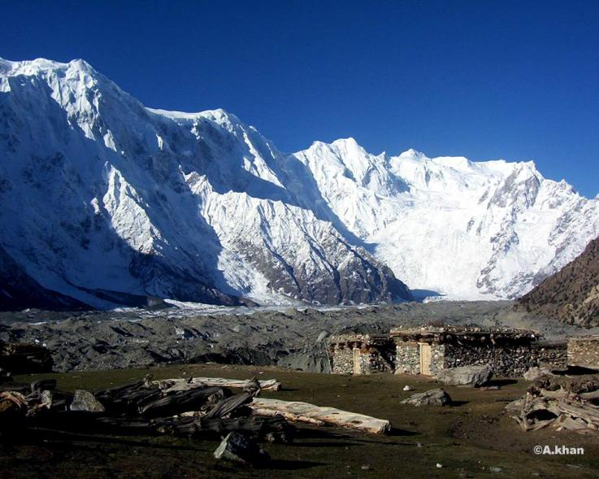
Where are the unsolved mysteries in this subject?
What has never been done?
What has been done, and it is awe-inspiring?

Slide 39
College Students Try to Help Police with 2013 Cold Case of Mother Slain in Taylor

Slide 40
What is Wonder-Full or Awe-Inspiring?
Wonder as a noun leads to wonder as a verb.

Slide 41
Increased generosity.

Slide 42
Increased humility.

Slide 43
Increased humility.

Slide 44
Shared “awe” increases openness & acceptance.

Slide 45
Vivid long-term memories.

Slide 46
The Human-Centered Design Course Makeover
Where is the sense of adventure?
How is this part of a personal quest for each learner?
How is agency nurtured & empowered?
Where are the meaningful connections with other people?
Where is there opportunity for experimentation & play?
How do students see evidence of personal progress/growth?
How will each student discover meaning & purpose in this course?
How is wonder and/or mystery experienced in this course?

Slide 47
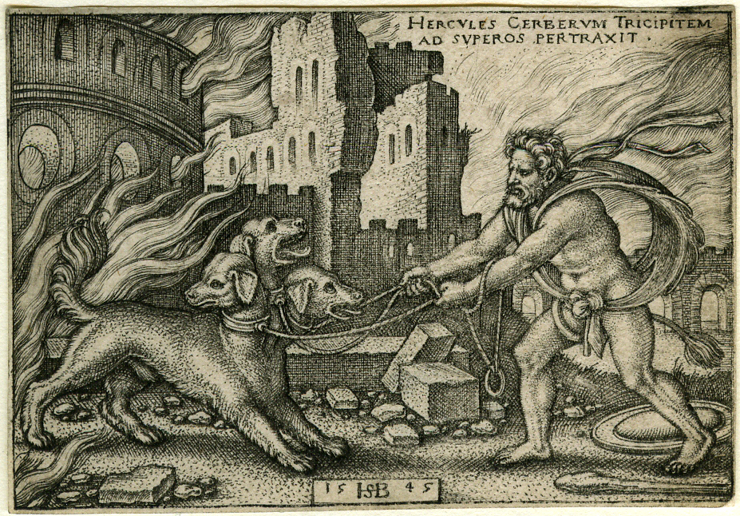

Slide 48
Human-Centered Learning Experience Design
Dr. Bernard Bull
@BernardBull

