Slide 1
Establishing a Collegiate Office of Online Learning
Minnesota Summit on Learning & Technology // August 1, 2019 // St. Paul, MN
Minnesota Summit on Learning and Technology // August 1, 2019
Notes:
SPEAKER / WELCOME: Mark
Intro- CASE STUDY, lessons learned that you may or may not need in your own structure

Slide 2
Provide CVM eLearning Faculty Resource Center
Support fulfillment of grant deliverables
Help faculty navigate university resources
Empower faculty to be innovative
Reach new audiences
Align with UMN strategic learning initiatives
THE NEED
Notes:
SPEAKER: Tom

Slide 3
The CVM faculty
The Audiences
Research appointment
Clinical appointment
Education appointment
Extension appointment
Practicing Veterinarians
Farm Personnel
Non-US Veterinarians
Graduate Students
DVM/MPH Students
Notes:
SPEAKER: Tom

Slide 4
THE PROCESS
Notes:
SPEAKER: MK

Slide 5
External funding
Departmental
Collegiate
University Level
THE FUNDING
Notes:
SPEAKER: MK

Slide 6
FACULTY LEADERSHIP:
Dr. Tom Molitor
Department Chair, Professor - Veterinary Population Medicine
Dr. Mark Rutherford
Associate Dean for Graduate Studies
Dr. Andrés Perez
Director, Center for Animal Health & Food Safety
Dr. Jennifer van de Ligt
Director, Integrated Food Systems Leadership Program
Associate Professor, College of Veterinary Medicine
Associate Director, Food Protection and Defense Institute
COOL CONSULTANTS:
Dr. Debra Freedman
Education Manager
Dr. Mary Katherine O’Brien
Researcher for Education & Outreach
Kelly Vallandingham
Education Specialist
+STUDENT TALENT:
Hannah Bakke (DVM)
Pa Gar Vang (College of Design)
THE TEAM
Notes:
SPEAKER: MK

Slide 7
THE PARTNERS
Notes:
SPEAKER:MK

Slide 8
THE STRATEGIES
Notes:
MK - tee this up for the team

Slide 9
STRATEGY 1: Funding, Focus and Partnerships
Encourage faculty to write grants that have educational component
(e.g. 1. Federal-USDA-NRI, 2. Foundation-ARCUS, 3. Internal CVM educational)
Develop core focus group--meet regularly, seminars
Make it a priority for resources, “campaign, beg, borrow, DO NOT STEAL”
Department -redirect people
Collegiate --compact
Central ---”novel audiences”
CVM and VPM have a history of developing partnership to fulfill educational mission
Notes:
SPEAKER: Tom

Slide 10
STRATEGY 2: Managing and Resourcing a Team
Share resources and expertises
Centralize project inputs to manage workflow
Communicate!
With faculty leads
Between project managers
Opportunities for all faculty
“THE BELL COW”
Notes:
SPEAKER: Mark

Slide 11
STRATEGY 3: Project Management
Working with not against
Deadlines can be fluid
Being flexible and forgiving but knowing when to step in
Self-awareness
Notes:
SPEAK: Deb

Slide 12
STRATEGY 4: Setting up for and assessing “success”
Create a go-to education design toolkit to guide conversations (and progress)
Raise awareness of *continuous* assessment and evaluation components
Understand your audience and what they want to hear
Notes:
SPEAKER: MK

Slide 13
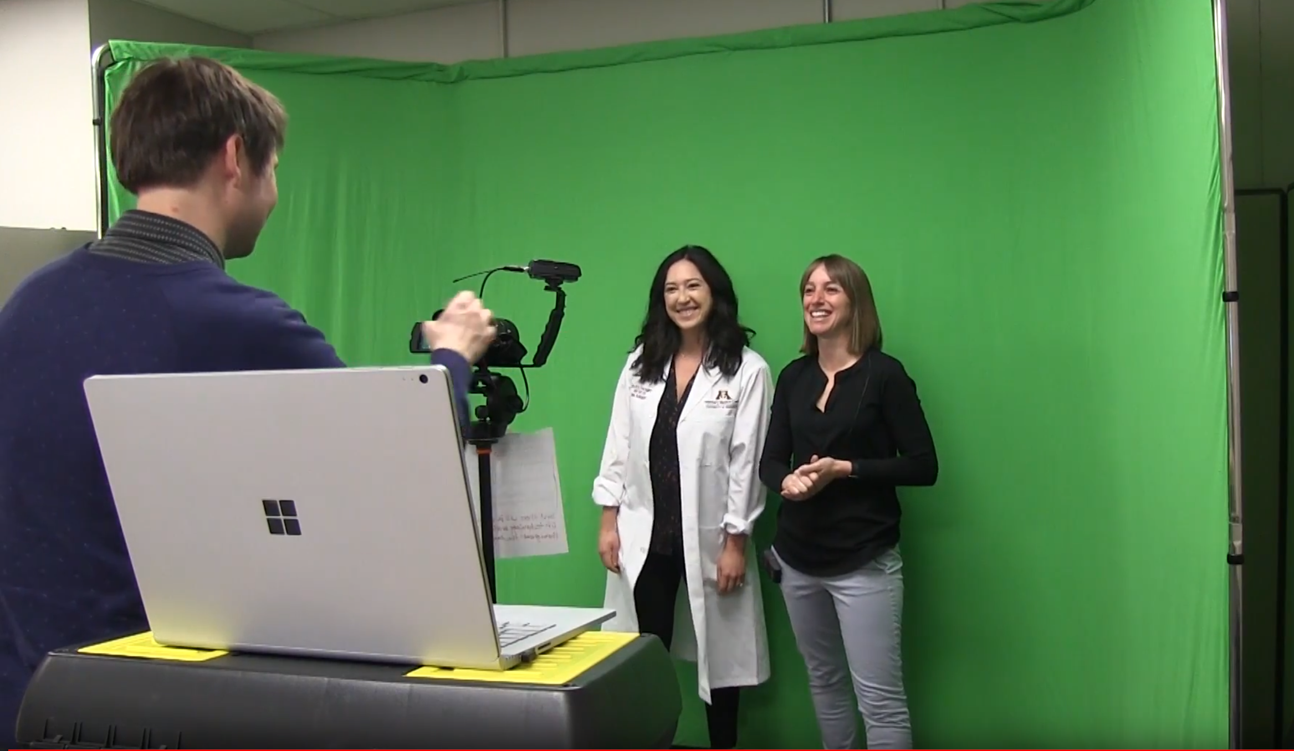
STRATEGY 5: Technology on a shoestring budget
Check UMarket regularly Inexpensive equipment Student help
Free or Inexpensive Online tools WeVideo H5P WordArt Canva Elevator Manifold
Notes:
SPEAKER: Kelly
The U renegotiates software deals often. Snagit and Adobe products good examples
Greens Screen, teleprompter that works with ipad
Students with work study across colleges - School of Design, Computer Science, Animal Science and Journalism (video journalists)
Tools - So many options - need a photo editor, a video editor, an ebook publisher (if you do not want free by Pressbooks and Redhat still not a contract and you want to do enhanced with embedded code and videos), also an infographic creator and wordart for wordclouds.

Slide 14
Sustainability of funding / staffing from partner units
Volume, flow of work now that interest is piqued, Prioritizing projects
Assessing market potential
Culture of Assessment-the program, the course, the people
Quality assurance
Developing a financial model
Educating faculty / clients on available technologies
THE CHALLENGES
Notes:
SPEAKER: Mark

Slide 15
Green Screen Outtakes

Slide 16
THE PROJECTS
Notes:
SPEAKERS: Deb, MK, Kelly

Slide 17
THANK YOU!
Questions?
cvmonline@umn.edu
Notes:
SPEAKER: Tom -- wrap up, pass off to questions

