Slide 1
Alternative Credentials

Slide 2
Session Objectives
understanding basic terminology,
the five-step process to launch an initiative
four university examples of different types of credentials
highs and lows of what we have learned through MSUM's badging initiative
How to make a more educated decision on joining this movement

Slide 3
SHARE WHAT YOU KNOW
Why are you interested in alternative credentials and badging?
What would you like to know?

Slide 4
Terminology
Micro credentialing: Recognition achieved through demonstrating mastery of a defined skill or competency, including industry-recognized competencies.
A badge is a visual representation of an achievement or skill acquisition—more granular than a formal degree but helps to make incremental learning more visible and engaging.
Digital badges: electronic badge that is portable and shareable. Recognizes a particular experience. Signify accomplishments i.e. completion of a project or mastery of a skill
Backpack: a repository where earners can collect digital badges from a variety of issuers

Slide 5
Terminology
Issuer: The group or organization that has created the micro-credential and validates the educator's competence in the defined skill or set of skills.
Earner: The educator or professional submitting evidence for the micro-credential.

Slide 6
Verify a new hire has the skills necessary to do their job
Documentation of skills and abilities employee can use for future career advancement
You can share your badges on services like LinkedIn to show your job skills
Secure valuable marketing impressions every time someone shares their badge on a social media site
Link real time labor market data to the badge

Slide 7
Example Badges
MSUM CSIS 104 Badge
Winona State: Digital Literacy Badge
IBM Digital Badges Count Toward College Degrees
Google: IT Badge
Lynda.com
Madison College Sales Badges and Health Care Soft Skills
MIT (EDX) Micro-Masters
Coursera Badging (private)

Slide 8
Different Types of Badges
External or Internal
Non-Credit (Continuing Studies) or Credit Badges
Classroom Badges
Co-curricular badges

Slide 9
Theoretically- The Five Step Process
Create Alternative Credentialing Cross Functional Campus Team
Decide why to badge: What problem is badging going to solve or what opportunity is it going to create?
Alignment: Align the right badge for the right audience.
Badging platform: Select software vendor for badging platform
Create an example Curriculum Map for Badge and supporting evidence of learning achieved (ex. Later)
Marketing
Design graphic (s) for badges
Create alternative credentials landing page
Develop campus communication plan
Train students , faculty, and administrators on alternative credentials
Create badging operations team for ongoing process and work.

Slide 10
Different Micro-Credentialing Models
Colorado State University
Not for credit but supports their mission of lifelong learning
Wichita State University
Multipurpose for multiple learning audiences
University Of Maryland
Prepares recent graduates for employment
Montgomery County Community College:
Micro credential Day for High School Seniors
Elizabeth Forward Elementary School
Badging for kindergarten students
Chicago’s City of Learning
Stave off summer learning loss
Notes:
Colorado State University: https://www.online.colostate.edu/badges/
Certified Gardener Program
Communication for Science and Engineering Professionals
Creative Organizational Innovation
Crucial Business Management Skills for the 21st Century
Developmental Disabilities Training Series
Foundations of 3D Printing
Goodwill Industries of Denver's Essential Soft Skills for Employment Program
Introducing Feminist Frameworks
Land Stewardship
LinkedIn: Building a Robust LinkedIn Profile
Living Mindfully
NALP Professional Landscape Technician Training
Spanish for Animal Health and Care
Wichita State University : https://badges.wichita.edu/badgecatalog-original
High School Students
Behavioral Sciences
Business
Creative
Education
Engineering
General Workforce Skills
Healthcare
Graduate
Undergraduate
University Of Maryland: https://www.usmd.edu/cai/usm-digital-badging-initiative
Collaborator
Communicator
Critical Thinker
Globalist
Interculturalist
Leader
Problem Solver
Professional
Montgomery County Community College: Micro-credential day for high school seniors (PA)
Microsoft Word
Microsoft Excel
Introduction to Cybersecurity
OSHA
Nurse Aide fundamentals
Massage Therapy fundamentals
Culinary Arts fundamentals
Basic work skills
Elizabeth Forward Elementary School (PA)
Students could earn 68 different, physical badges they could place on a binder ring that is hung in the room
The badges were also on an online app (FreshGrade)
https://vimeo.com/207131473
https://www.edsurge.com/news/2017-06-21-micro-credentials-for-micro-students-kindergarteners-swap-grades-for-badges
Chicago’s City of Learning
Has expanded to DC, LA, Pittsburg, Dallas
Very successful
Partnership across organizations across the entire city
Business
Secondary education
Non-Profits
Municipal services
https://bostonbeyond.org/wp-content/uploads/2016/06/Digital_Badging_Paper_NMEF.pdf
Examples of micro-credentialing in secondary education:
NZ automotive micro-credential
sophomore through seniors
For those who complete it, it leads to an apprenticeship.
http://transporttalk.co.nz/news/automotive-micro-credentials-secondary-students

Slide 11
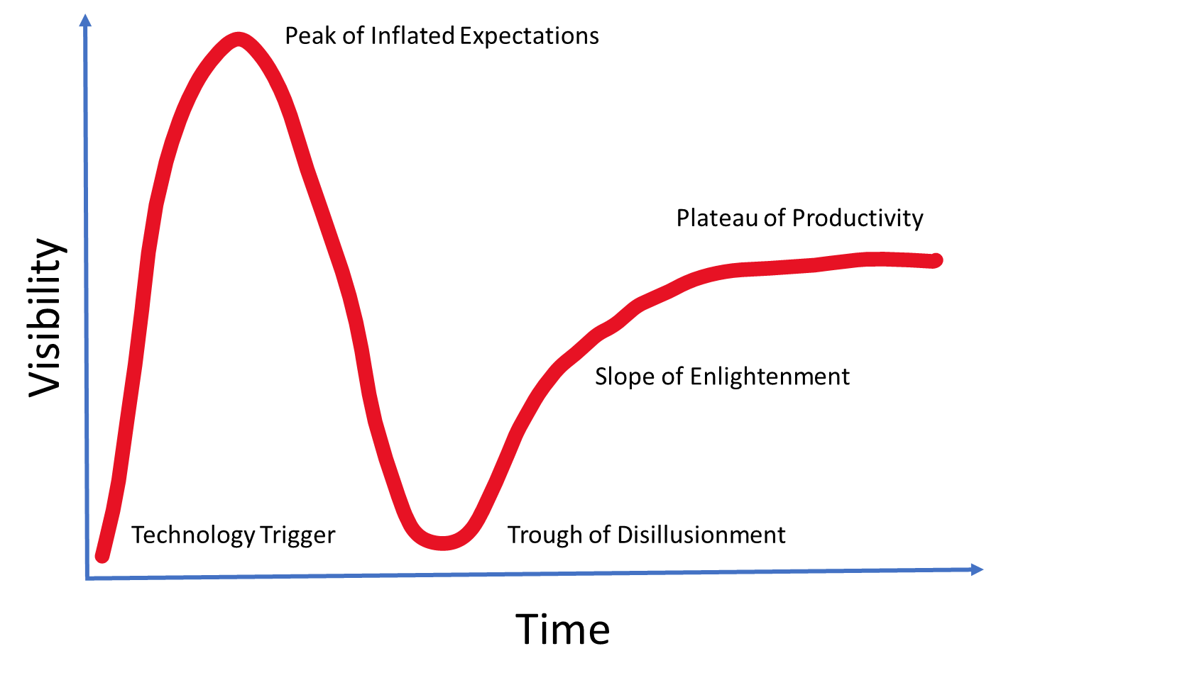
Where are we in the timeline?

Slide 12
Obstacles & Constraints
External validation
Credit or non-credit
Are you killing your own degrees if you offer badges?
Student affairs example
Where does it live? Who owns?
Resourcing the badging initiative , who will administer the badge
Consensus on overall purpose of the badge
Governance

Slide 13
Questions?

