Slide 1
Are We Doing Enough for Faculty who are Teaching Online?
Roundtable facilitated by:
Elizabeth A. Harsma

Slide 2
Intro
Notes:
InsideHigherEd.com article (2019, February 13) by Doug Lederman gave an overview of results from a survey of public college provosts. The survey in partnership with the American Association of State Colleges and Universities, by Learning Hours reported that many forms of training and support for those who teach online is lacking, even as institutions' expectations for online learning capacity and quality grow. The Learning House offered recommendations based on the findings. They include:
mandatory or incentivized training for instructors who have not taught online.
a regular feedback cycle for continuous professional development.
a regular feedback cycle for instructor evaluation, including peer feedback.
a uniform learning experience for standard components of an online course.

Slide 3
Not enough?
“they [higher ed public institutions] are often not training faculty members in advance or giving them the support they might need to be effective and to continue to develop their skills” (Lederman, 2019)

Slide 4
Recommendations
Mandatory or incentivized training for instructors who have not taught online.
Regular feedback cycle for continuous professional development.
Regular feedback cycle for instructor evaluation, including peer feedback.
Uniform learning experience for standard components of an online course.

Slide 5
Roundtable outcomes
Evaluate recommendations for faculty professional development in online teaching in higher education.
Assess the necessity of institutional culture change to the implementation of the proposed recommendations.
Apply best practices in professional/human development to hypothesize about or share programming models and practices of these recommendations.

Slide 6
Group Process
Divide into Groups of 5-7 people
Establish Roles: Member, Monitor, Scribe, Reporter
Member: Participate in the discussion, share your thoughts, use the Poll Everywhere individually
Monitor: Keep on track of time, assures everyone shares if they wish, follows group process
Scribe: Take notes, shares on Poll Everywhere for the group
Reporter: Speaker summarizes group finds and reports to the whole room after each round
Notes:
Divide into Groups of 5-7 people
Establish Roles
Monitor-Keep on track of time, assures everyone shares if they wish, follows group process
Scribe-Backchannel
Reporter-Speaker
Step 1: Think Allow individuals to take notes, think about questions briefly. Use Poll Everywhere individually, if desired (2-3 minutes)
Step 2: Individual Share Each person shares for one minute their thoughts, no one else talks or responds. Monitor keeps track of time, and assures everyone shares who wishes to. (5-7 minutes)
Step 3: Open discussion. Now everyone can ask individuals questions, offer examples, offer confirmation or offer a counter story, ask for clarification. Scribe takes notes and shares group feedback notes on Poll Everywhere. Reporter prepares to share summary with the group. (5-7 minutes)
Step 4: Report Back to the entire room
Group reporter shared back to the entire round table the commonalities and innovations. A group scribe adds those comments to the Poll Everywhere. (2-3 minutes per a group)

Slide 7
Group Process for each round
Step 1: Think Allow individuals to take notes, think about questions briefly. Use Poll Everywhere individually, if desired (2-3 minutes)
Step 2: Share Each person shares for one minute their thoughts, no one else talks or responds. Monitor keeps track of time, and assures everyone shares who wishes to. (5-7 minutes)
Step 3: Discuss. Now everyone can ask individuals questions, offer examples, offer confirmation or offer a counter story, ask for clarification. Scribe takes notes and shares group feedback notes on Poll Everywhere. Reporter prepares to share summary with the group. (5-7 minutes)
Step 4: Report. Group reporter shared back to the entire round table the commonalities and innovations. A group scribe adds those comments to the Poll Everywhere. (2-3 minutes per a group)
Notes:
Divide into Groups of 5-7 people
Establish Roles
Monitor-Keep on track of time, assures everyone shares if they wish, follows group process
Scribe-Backchannel
Reporter-Speaker
Step 1: Think Allow individuals to take notes, think about questions briefly. Use Poll Everywhere individually, if desired (2-3 minutes)
Step 2: Individual Share Each person shares for one minute their thoughts, no one else talks or responds. Monitor keeps track of time, and assures everyone shares who wishes to. (5-7 minutes)
Step 3: Open discussion. Now everyone can ask individuals questions, offer examples, offer confirmation or offer a counter story, ask for clarification. Scribe takes notes and shares group feedback notes on Poll Everywhere. Reporter prepares to share summary with the group. (5-7 minutes)
Step 4: Report Back to the entire room
Group reporter shared back to the entire round table the commonalities and innovations. A group scribe adds those comments to the Poll Everywhere. (2-3 minutes per a group)

Slide 8
Tech set-up

Slide 9
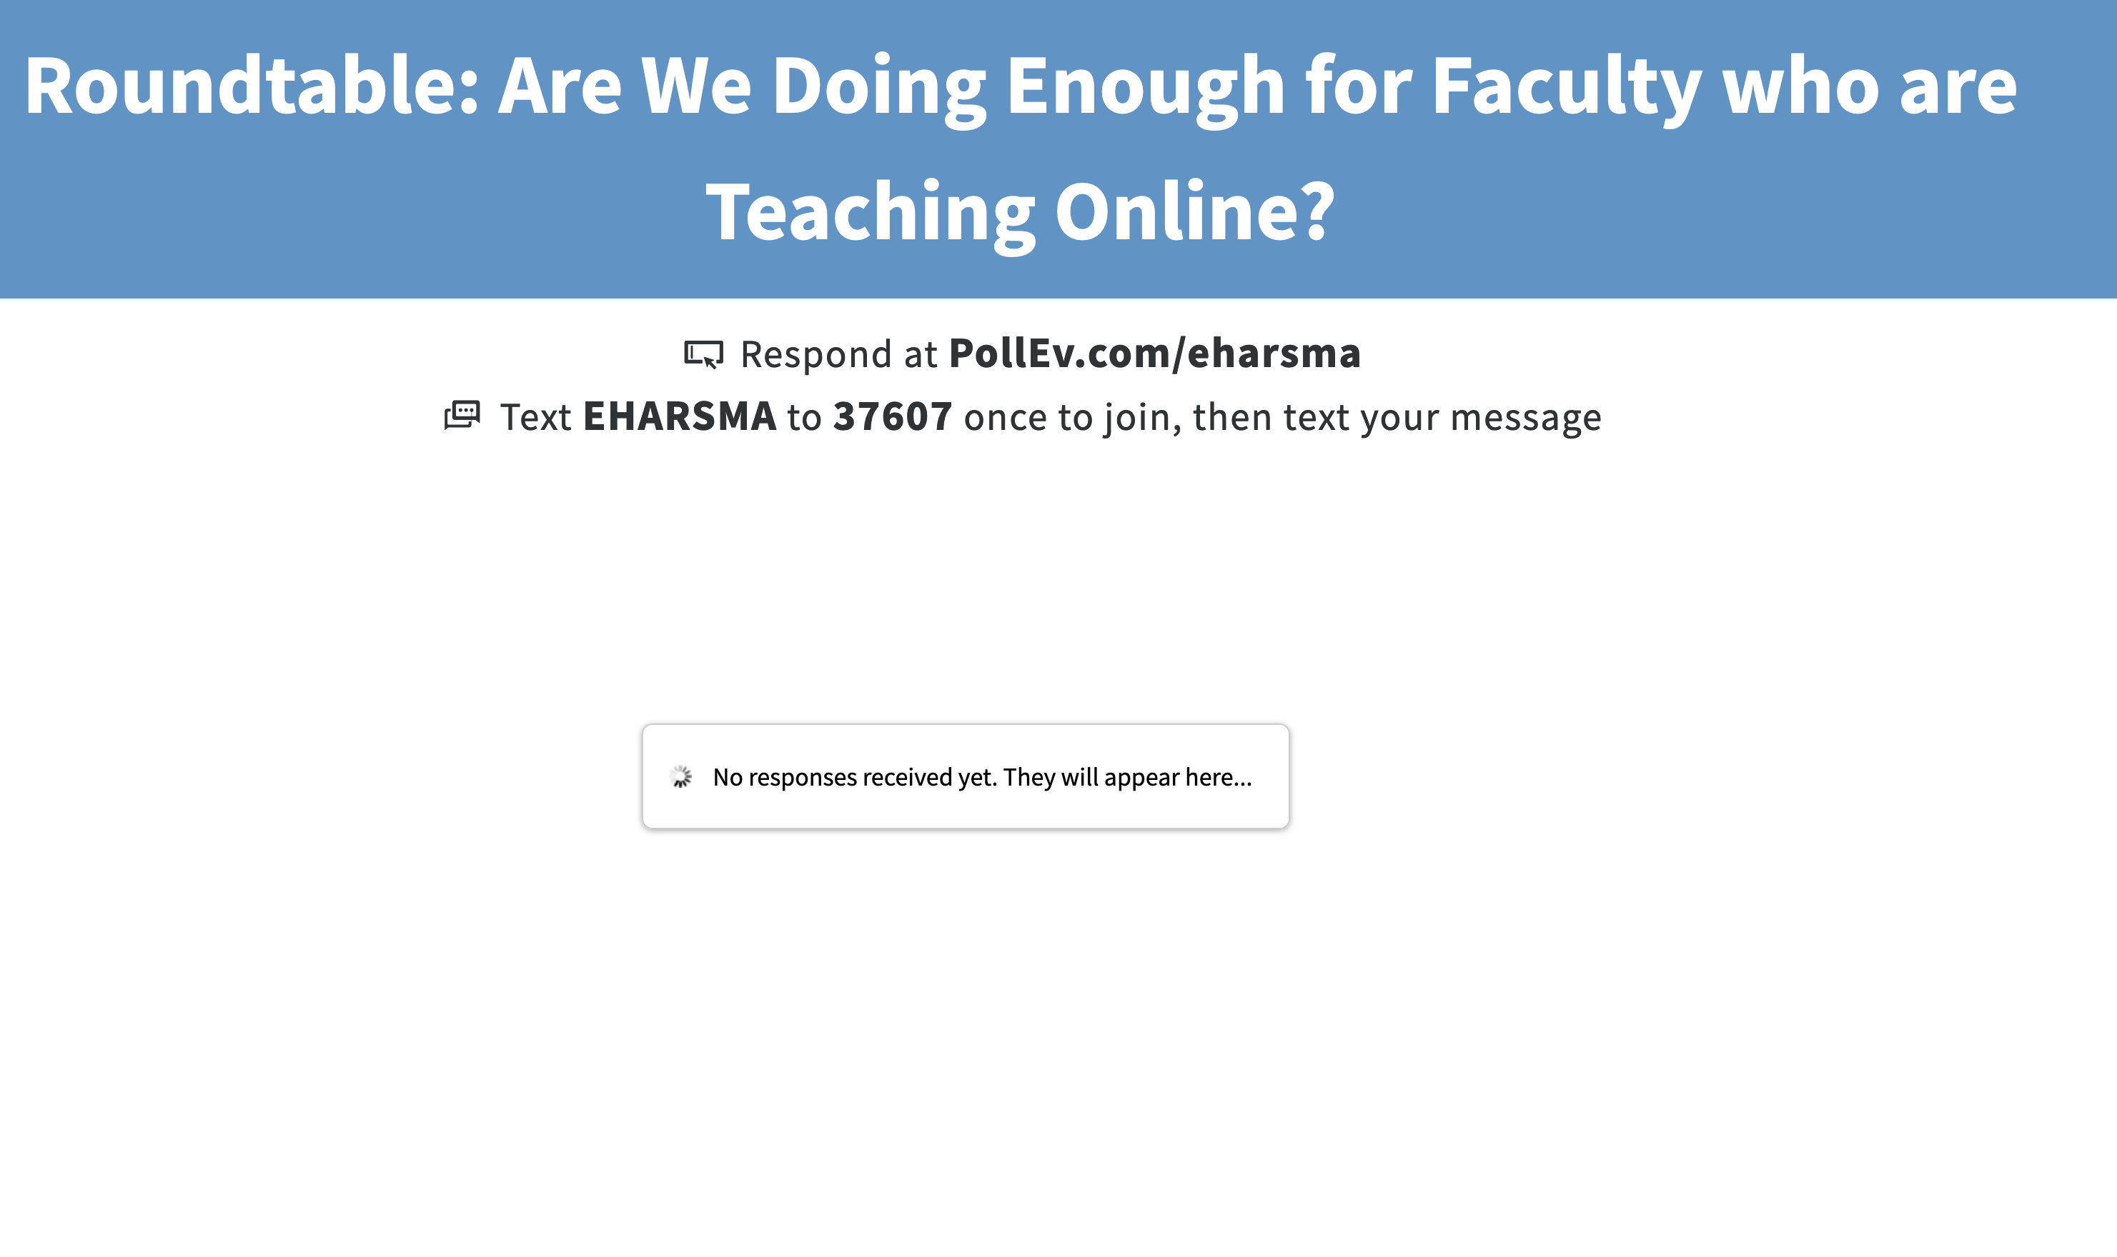
Tech test
In PollEverywhere share:
What type of institution do you work at?
K-12, 2-year college, university
What is your role there?
Student, Faculty/Teacher, Teacher Trainer, Professional Development Provider/Coordinator, Instructional Designer, Support Staff, etc…
Have you taught or taken online courses?

Slide 10
Round 1: Evaluate
What are you doing currently for faculty development in (online) teaching and learning?
Are the Learning House recommendations appropriate for public higher education institutions?
What should be taken out? What is missing?

Slide 11
Round 2: Assess
How do you/your institution motivate and incentivize pro dev?
How do you/your institution build a culture of pro dev/innovation?
Is an institutional culture change needed for these recommendations to be implemented in a meaningful way?
If so, what are the components and process of that culture change?

Slide 12
Round 3: Apply
What’s on the horizon for faculty development for you/your institution?
What are you doing to plan for it?
What could these recommendations look like in public higher education institutions?
What are the best practices for establishing and maintaining sustainable practice of these recommendations?

Slide 13
References
Lederman, D. (2019, February 13). Too Little Help for Professors Teaching Online. Retrieved March 7, 2019, from https://www.insidehighered.com/digital-learning/article/2019/02/13/assessing-faculty-role-online-learning-public-comprehensive
Magda, A.J. (2019). Online learning at public universities: Recruiting, orienting, and supporting online faculty. Learning House. Louisville, KY. Retrieved from https://www.learninghouse.com/knowledge-center/research-reports/online-learning-at-public-universities/

